Slide 1
Antianginal Drugs
Learning outcomes
Recognize variables contributing to a balanced myocardial supply versus demand
Expand on the drugs used to alleviate acute anginal attacks versus those meant for prophylaxis & improvement of survival
Detail the pharmacology of nitrates, other vasodilators, and other drugs used as antianginal therapy

Slide 2
Calcium channel blockers
Classification
Selectivity
Dihydropyridines:-
Nifedipine , Nicardipine, Amlodepine
Nifedipine ,
Vascular smooth muscle
Verapamil
Cardiomyocytes
Phenylalkylamines:-
Verapamil
Diltiazem
Intermediate
Benzthiazepines:-
Diltiazem

Slide 3
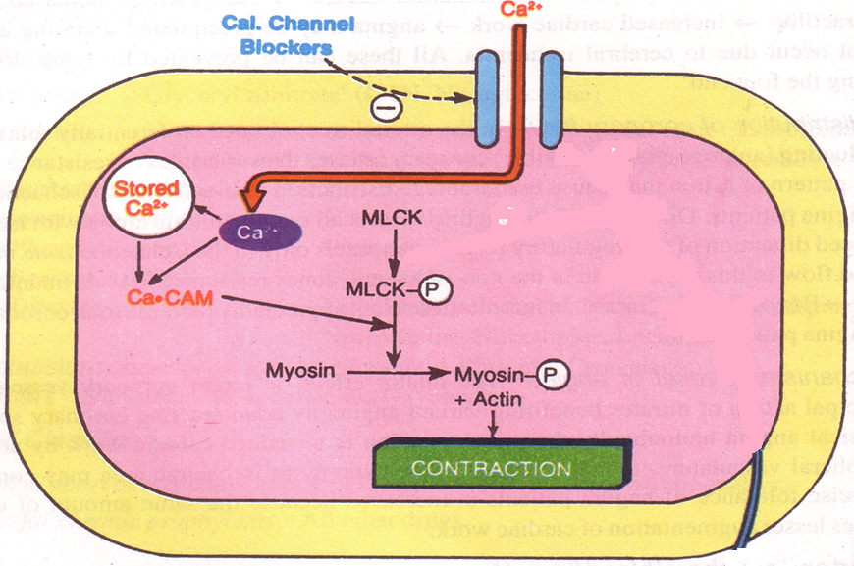
Mechanism of Action
Binding of calcium channel blockers [CCBs] to the L-type Ca channels  their frequency of opening
in response to depolarization
entry of Ca   Ca release from internal stores  No Stimulus-Contraction Coupling  RELAXATION

Slide 4
Antianginal Action
◉ Cardiomyocyte Contraction  cardiac work through their –ve inotropic & chronotropic action (verapamil & diltiazem)  myocardial oxygen demand
VSMC Contraction   After load  cardiac work  myocardial oxygen demand
Coronary dilatation  myocardial oxygen supply

Slide 5
Therapeutic Uses
 Attacks prevented (> 60%) / sometimes variably aborted
IN VARIANT ANGINA
Short acting dihydropyridine should be avoided ??
Can be combined to β-AR blockers???
IN UNSTABLE ANGINA;
Seldom added in refractory cases
Can be combined with nitrates???
IN STABLE ANGINA;
Dihydropyridenes useful antianginal if with CHF??
Regular prophylaxis

Slide 6
Beta Adrenoceptor Blockers
Examples Atenolol, Bisoprolol, Metoprolol (β₁ – Selective)
Antianginal Mechanism

Slide 7
Beta Adrenoceptor Blockers
Indications in angina
In stable angina
Regular prophylaxis, selective are preferred?
First choice for chronic use?
Can be combined with nitrates?
Can be combined with dihydropyridine CCB?
Verapamil?
In variant angina
Contraindicated?

Slide 8
Beta Adrenoceptor Blockers
Indications in angina
In Unstable angina
Halts progression to MI, improve survival
In Myocardial infarction
Reduce infarct size
Reduce morbidity & mortality
→reduce O2 demand
→reduce arrhythmias

Slide 9
Beta Adrenoceptor Blockers
β- blockers should be withdrawn gradually?
Given to diabetics with ischemic heart disease?

Slide 10
Minicase
Which antianginal drug is the best choice for the case of Helmi? And Why?

Slide 11
Minicase
If Helmi does not respond to monotherapy, what other drug should be added to his regimen?

Slide 12
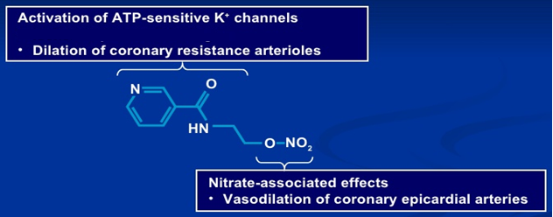
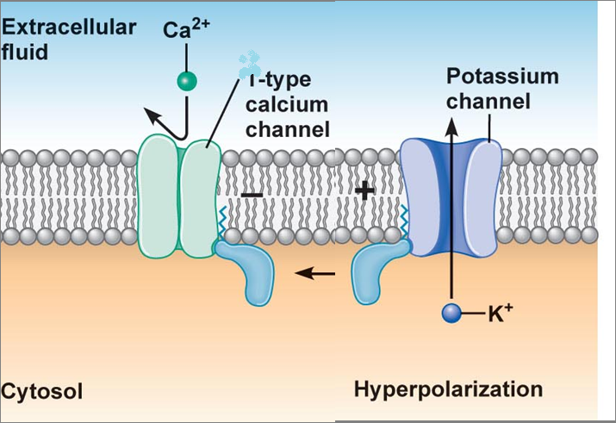
Potassium channel openners
Nicorandil
Mechanism
It has dual mechanism of action;
Opens K_{ATP} channels
(> arteriolar dilator)
2. NO donor as it has a nitrate moiety (> venular dilator)
L

Slide 13
Pharmacodynamic Effects
As K channel openner
As nitric oxide donor
On vascular smooth muscles opening of K channels hyperpolarization  vasodilatation
NO  cGMP/PKG  vasodilatation
On cardiomyocytes opening of K channels repolarization  cardiac work

Slide 14
Indications
Prophylactic 2nd line therapy in stable angina & refractory variant angina
ADRs
Flushing, headache,
Hypotension, palpitation, weakness
Mouth & peri-anal ulcers, nausea and vomiting.

Slide 15
Think-pair-share
A 55 - year - old woman complained to her physician of palpitations, flushing of the face, and vertigo. The woman, suffering from diabetes mellitus, was giving herself three daily doses of insulin. She had been recently diagnosed with exertional angina for which nitrate therapy was started with transdermal nitroglycerin and oral isosorbide mononitrate.
After 3 weeks of therapy, her anginal attacks were less frequent but not completely prevented. Which
would be an appropriate next therapeutic step for this patient?

Slide 16
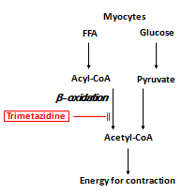
Metabolically Acting Agents
e.g. Trimetazidine
O2 requirement of glucose pathway is lower than FFA pathway
During ischemia, oxidized FFA levels rise, blunting the glucose pathway
Reduces O2 demand without altering hemodynamics

Slide 17
Trimetazidine
Indications
Used as an add on therapy
ADRs
GIT disturbances
Contraindications
Hypersensitivity reaction
Pregnancy & lactation

Slide 18
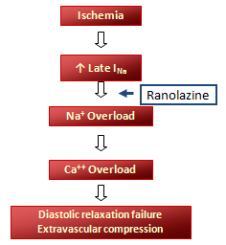
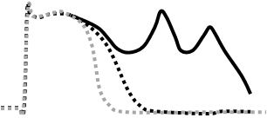
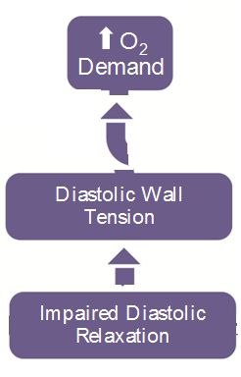
Ranolazine
Inhibits the late sodium current which increases during ischemia
It prolongs the QT interval so contraindicated with; Class Ia & III antiarrhthmics
Toxicity develops due to interaction with CYT 450 inhibitors as; diltiazem, verapamil, ketoconazole, macrolide antibiotics, grapefruit juice
ADRs:- dizziness & constipation
Used in chronic angina concomitantly with other drugs

Slide 19
Minicase
Which antihyperlipidemic drug should be prescribed to Helmi?

Slide 20
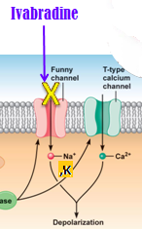
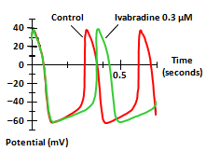
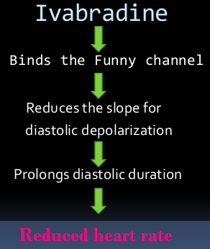
Ivabradine
Ivabradine Selectively blocks I_{f}
Ivabradine reduces slope of depolarization, slowing HR, reducing myocardila work & O2 demand
Used in treatment of chronic stable angina in patients with normal sinus rhythm who cannot take ß-blockers
Used in combination with beta blockers in people with heart failure with LVEF lower than 35 percent inadequately controlled by beta blockers alone and whose heart rate exceeds 70/min
ADR:- luminous phenomena
I_{f} current is an inward Na+/K+ current that activates pacemaker cells of the SA node

Slide 21
Agents that improve prognosis
-Aspirin / other
antiplatelet agents
-ACE inhibitors
-Statins
-β -blockers
Halt progression
Prevent acute insult
Improve survival

Slide 22
Memory matrix
In the following table indicate increase, decrease or no effect with signs ↑, ↓, ─ respectively
Drug/Class | HR | BP | Wall Tension | Contract-ility | O₂ Supply
Beta-blockers
CCBs Verap/Dilt Dihydropyridines
Nitrates
Ranolazine

