Slide 1
Cardiovascular Pharmacology
Antiarrhythmic drugs
Drugs in heart failure
Antihypertensive drugs
Antianginal drugs
Antihyperlipidemic drugs

Slide 2
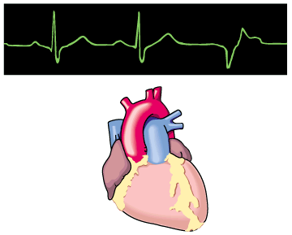
Antiarrhythmic Drugs
Prof. Abdulrahman Almotrefi
Dr. Aliah Alshanwani

Slide 3
Learning objectives
By the end of this lecture, students should be able to:
Understand definition of arrhythmias and their
different types
- describe different classes of Antiarrhythmic drugs and their mechanism of action
understand their pharmacological actions, clinical
uses, adverse effects & their interactions with
other drugs.

Slide 4
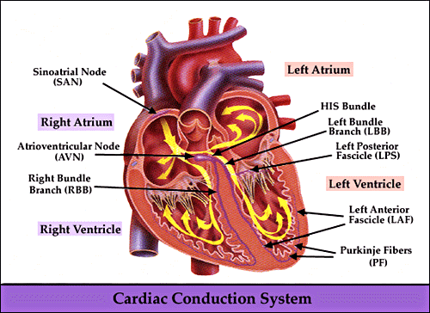

Slide 5
CARDIAC CONDUCTION SYSTEM
- S.A. node
- Inter-nodal pathways
- A.V. node
- Bundle of His and branches
- Purkinje fibers

Slide 6
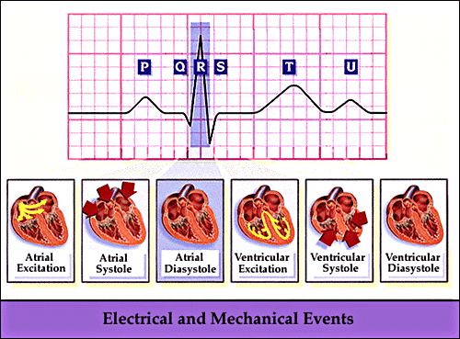
Electrocardiogram (ECG)

Slide 7
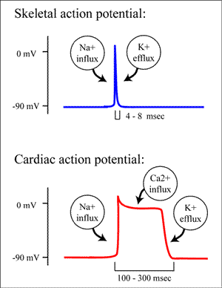
CARDIAC ACTION POTENTIAL

Slide 8
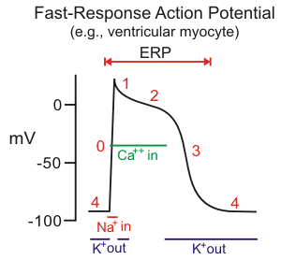

Slide 9
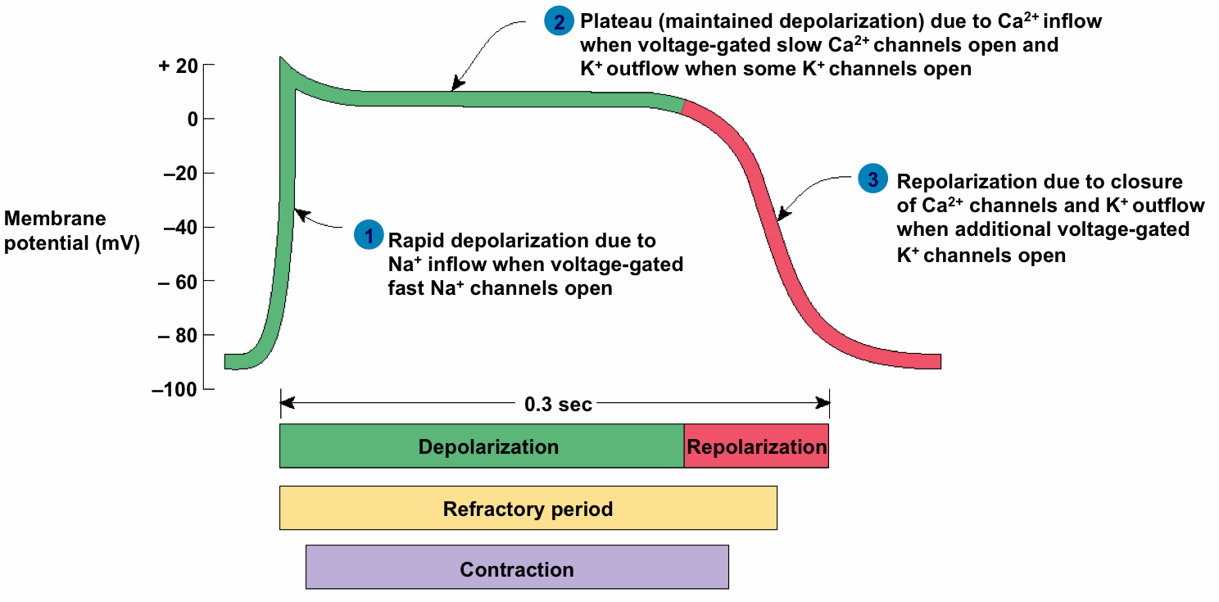
CARDIAC ACTION POTENTIAL
Non-pacemaker (ventricular muscle)

Slide 10
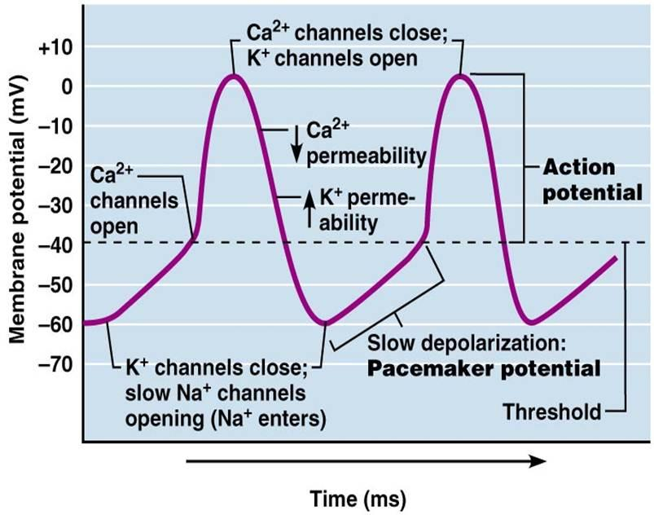
CARDIAC ACTION POTENTIAL
Pacemaker (SA node)

Slide 11
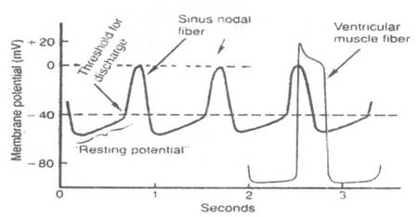
Difference between pacemaker and non-pacemaker action potential

Slide 12
WHAT IS ARRHYTHMIA?
An abnormality in the :
■ rate ............... high= tachycardia
low = bradycardia

Slide 13
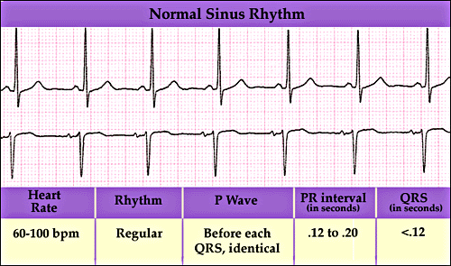

Slide 14
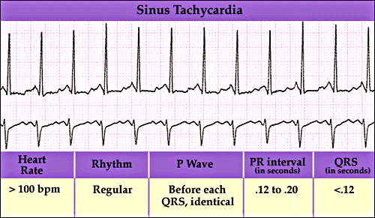

Slide 15
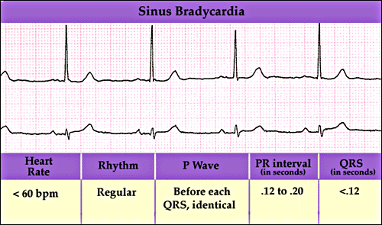

Slide 16
WHAT IS ARRHYTHMIA?
An abnormality in the :
■ rate ............... high= tachycardia
low = bradycardia
■ regularity ..... Extrasystoles
(PAC, PVC)

Slide 17
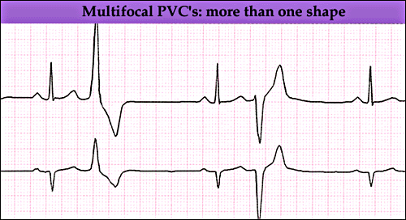

Slide 18
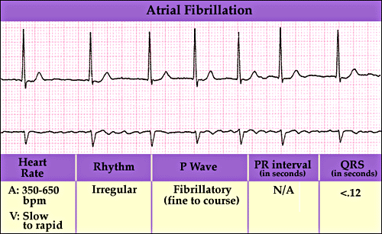

Slide 19
WHAT IS ARRHYTHMIA?
An abnormality in the :
■ rate ............... high= tachycardia
low = bradycardia
■ regularity ..... extrasystoles
■ site of origin ... ectopic pacemakers
■ or disturbance in conduction

Slide 20
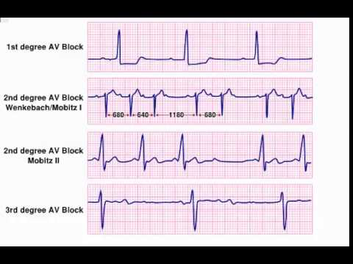
Disturbances in conduction

Slide 21
Therapeutic use of antiarrhythmic drugs
The ultimate goal of therapy
⬇
Restore normal rhythm & conduction
⬇ ⬇
Maintenance of Prevention of more
normal rhythm serious arrhythmias

Slide 22
How antiarrhythmic drugs produce these effects?
Slow conduction velocity
Altering the excitability of cardiac cells by prolonging the effective refractory period (ERP)
Suppressing ectopic pacemaker activity by inhibiting phase 4 slow depolarization

Slide 23
CLASSIFICATION
OF
ANTIARRHYTHMIC DRUGS

Slide 24
Vaughn Williams classification
CLASS I
Na+ channel blockers
(membrane stabilizing drugs)
CLASS II:
β- adrenoceptor blockers
CLASS III:
Drugs that prolong action potential duration
CLASS IV:
Calcium channel blockers.

Slide 25
CLASS I
Drugs that block the influx of Na ions through Na channels
⬇
1- decrease the rate of rise of
rapid depolarization (Phase O)
2- decrease phase 4 slow
depolarization
(suppress pacemaker activity)
(membrane stabilizing effect)

Slide 26
CLASS I
Sub classified according to their effect on action potential duration :
- Ia : prolong action potential duration
- Ib : shorten action potential duration
- Ic : no effect on action potential duration

Slide 27
CLASS I a
Ia : prolong action potential duration
e.g.
Quinidine
Procainamide

Slide 28
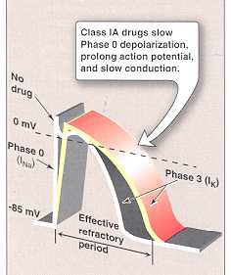

Slide 29
CLASS I a
QUINIDINE
Other pharmacological actions :
1- Anticholinergic effect:
⬇
Increase conduction through the A.V. node
(risk of ventricular tachycardia)
2- α-adrenergic blocking effect:
⬇
may cause vasodilatation & reflex sinus tachycardia
(seen more after I.V. dose)
3- ECG changes:
- prolongs P-R and Q-T interval
- widens QRS complex

Slide 30
CLASS I a
QUINIDINE
Therapeutic uses:
- atrial flutter & fibrillation
maintaining sinus rhythm after cardioversion

Slide 31
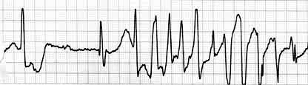
CLASS Ia
QUINIDINE
Adverse effects :
quinidine syncope: episodes of fainting
due to torsades de pointes (twisting of the spikes)
developing at therapeutic plasma levels

Slide 32
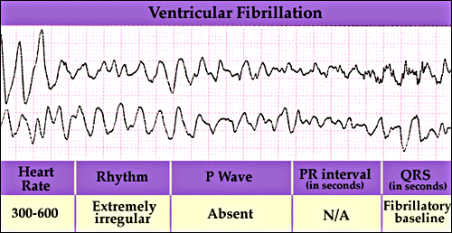
Torsades de pointes
- may terminate spontaneously or lead to
⬇
fatal ventricular fibrillation

Slide 33
CLASS I a
QUINIDINE
Adverse effects :
Anticholinergic adverse effects:
Dry mouth
Blurred vision
Urinary retention
constipation
Hypotension
- due to depressing contractility & vasodilatation
GIVEN ORALLY (Rarely given I.V.)

Slide 34
CLASS I a
PROCAINAMIDE
Similar to quinidine except :
1- less toxic on the heart...
can be given I.V.
2- more effective in ventricular than in
atrial arrhythmias
3 – Less anticholinergic or α-blocking actions

Slide 35
CLASS I a
PROCAINAMIDE
Adverse effects:
- In long term therapy it causes reversible
lupus erythematosus-like syndrome
- Hypotension
- Torsades de pointes (at toxic dose)
- Hallucination & psychosis

Slide 36
CLASS I b
Shorten action potential duration
e.g.
Lidocaine
Mexiletine

Slide 38
CLASS Ib
LIDOCAINE
Therapeutic uses :
treatment of emergency ventricular arrhythmias
e.g. :
1 - during surgery
2 - following acute myocardial infarction
- NOT effective in atrial arrhythmias
- NOT effective orally (3% bioavailability)
Only given I.V. bolus or slow infusion
t_{1/2} = 2 hours

Slide 39
CLASS Ib
LIDOCAINE
Adverse effects:
hypotension
similar to other local anesthetics,
causes CNS adverse effects such as:
- paresthesia
- tremor
- dysarthria (slurred speech)
- tinnitus
- confusion
- convulsions

Slide 40
CLASS Ib
MEXILETINE
- EFFECTIVE ORALLY
Therapeutic uses :
1- ventricular arrhythmia
2- digitalis-induced arrhythmias
t_{1/2} = 10 hours
ADVERSE EFFECTS :
1- nausea, vomiting
2- tremor, drowsiness, diplopia
3- arrhythmias & hypotension

Slide 41
CLASS Ic
have no effect on action potential duration
e.g.
Flecainide

Slide 42
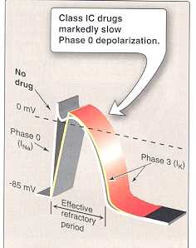

Slide 43
CLASS Ic
FLECAINIDE
Therapeutic uses :
supraventricular arrhythmias
- Wolff-Parkinson-White syndrome
- very effective in ventricular arrhythmias, but
very high risk of proarrhythmia
- should be reserved for resistant arrhythmias

Slide 44
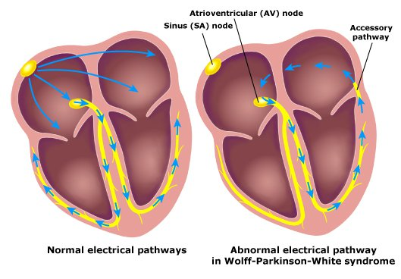
Wolff-Parkinson-White syndrome
Pre-excitation of the ventricles due to an accessory pathway known as the Bundle of Kent.

Slide 45
CLASS Ic
FLECAINIDE
Adverse effects:
1- proarrhythmia
2- CNS :
dizziness, tremor, blurred vision,
abnormal taste sensations, paraesthesia
3- heart failure due to -ve inotropic effect

Slide 46
CLASS II DRUGS
β- ADRENOCEPTOR BLOCKERS
pharmacological actions :
block β₁- receptors in the heart
⬇
reduce the sympathetic effect on the heart
⬇
1 - decrease automaticity of S.A. node &
ectopic pacemakers
2 - prolong RP (slow conduction) of the A.V node

Slide 47
CLASS II DRUGS
β- ADRENOCEPTOR BLOCKERS
Therapeutic uses :
1- atrial arrhythmias associated with emotion:
e.g. : - after exercise
- thyrotoxicosis
2- WPW
3- digitalis-induced arrhythmias.

Slide 48
CLASS II DRUGS β- ADRENOCEPTOR BLOCKERS
Therapeutic uses :
Esmolol :
- very short acting (half-life = 9 min.)
- given I.V. for rapid control of ventricular rate in
patients with atrial flutter or fibrillation
Propranolol, Atenolol, Metoprolol :
- used in patients who had myocardial infarction to
reduce incidence of sudden death due to ventricular
arrhythmias

Slide 49
CLASS III DRUGS
Prolong the action potential duration & RP
Prolong phase 3 repolarization

Slide 50
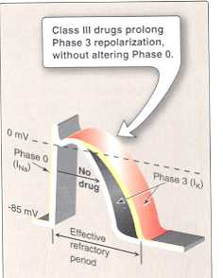

Slide 51
CLASS III DRUGS
AMIODARONE
pharmacological actions :
- prolongs action potential duration & therefore
prolongs RP (Main effect)
- additional class Ia, II & IV effects
- vasodilating effects
(due to its α- & β-adrenoceptor blocking effects
& its calcium channel blocking effects)

Slide 52
CLASS III DRUGS
AMIODARONE
Therapeutic uses :
1- main use : serious resistant ventricular arrhythmias
2- maintenance of sinus rhythm after cardioversion
3- resistant supraventricular arrhythmias (e.g. WPW)

Slide 53
CLASS III DRUGS
AMIODARONE
Adverse effects:
- exacerbation of ventricular arrhythmias (high dose)
- bradycardia & heart failure
- pulmonary fibrosis
- hyper- or hypothyroidism
- photodermatitis & skin deposits (patients should avoid exposure to the sun).

Slide 54
CLASS III DRUGS
AMIODARONE
Adverse effects:
- Neurological:
e.g. tremors & peripheral neuropathy
- nausea, vomiting & constipation
- corneal micro deposits
- hepatocellular necrosis

Slide 55
CLASS III DRUGS
AMIODARONE
Pharmacokinetics:
- extremely long t_{1/2} = 13 - 103 DAYS
- metabolized by CYP3A4 and CYP2C8 to its major
active metabolite: N-desethylamiodarone
- eliminated primarily by hepatic metabolism
- cross placenta & appear in breast milk

Slide 56
CLASS III DRUGS
AMIODARONE
Drug Interactions:
1 - Co-administration of amiodarone with drugs
that prolong the QT interval increases the risk
of Torsades de Pointes
e.g. :
macrolide antibiotics (Clarithromycin, Erythromycin)
azole antifungals (Ketoconazole)

Slide 57
CLASS III DRUGS
AMIODARONE
Drug Interactions:
2- Drugs (or substances) that inhibit CYP3A4 & CYP2C8 enzymes cause increase in serum concentration of amiodarone
e.g. : Loratadine, Ritonavir, Trazodone
Cimetidine, Grapefruit juice
3- Drugs that induce these enzymes
Cause decrease in serum concentration of amiodarone
e.g. : Rifampin

Slide 58
PURE CLASS III
Ibutilide
Given by rapid I.V. infusion
Used for the acute conversion of atrial flutter or fibrillation to normal sinus rhythm
Causes QT interval prolongation
(may cause torsades de pointes).

Slide 59
Class 1V
Calcium channel blockers
Verapamil, Diltiazem
main site of action is A.V.N & S.A.N
cause:
- slowing of conduction
- prolongation of ERP

Slide 60
Class 1V
Calcium channel blockers
Therapeutic uses :
1- atrial arrhythmias
2- re-entry supraventricular arrhythmias
e.g. WPW
3- NOT effective in ventricular arrhythmias.

Slide 61
ADENOSINE
Mechanism of action :
inhibits c.AMP by binding to adenosine A1 receptors
causing the following actions:
1 - opening of potassium channels
(hyperpolarization)
2 - decreasing conduction velocity mainly at AV node
(negative dromotropic effect)
3- inhibiting phase 4 pacemaker action potential at SA node
(negative chronotropic effect)

Slide 62
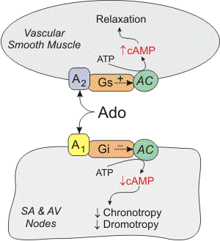

Slide 63
ADENOSINE
Therapeutic uses :
■ drug of choice for acute management of
paroxysmal supraventricular tachycardia
■ preferred over verapamil
(safer & does not depress contractility)
half-life = less than 10 sec

Slide 64
ADENOSINE
Adverse effects:
■ flushing in about 20% of patients
■ shortness of breath & chest burning in 10%
of patients (due to bronchospasm)
■ brief AV block (contraindicated in heart block)

Slide 65
New Antiarrhythmic Drugs
Dronedarone
a noniodinated congener of amiodarone
has antiarrhythmic properties belonging to all four classes
Used for maintenance of sinus rhythm following cardioversion in patients with atrial fibrillation

Slide 66
New Antiarrhythmic Drugs
Dronedarone
WARNINGS
should not be used in patients with severe (class IV) heart failure. Risk of death may be increased in these patients
should not be used in patients with permanent atrial fibrillation. Risk of death & stroke, may be increased in these patients.

Slide 67
BRADYARRHYTHMIAS
ATROPINE
■ used in sinus bradycardia after myocardial
infarction & in heart block
■ in emergency heart block isoprenaline may
be combined with atropine (caution)

Slide 68
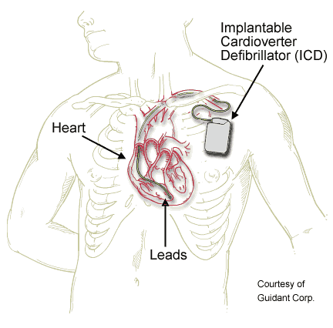
NONPHARMACOLOGIC THERAPY
OF ARRHYTHMIAS
Implantable Cardiac Defibrillator (ICD)
- can automatically detect & treat fatal
arrhythmias such as ventricular fibrillation

Slide 69

Thank you

