Slide 1
HEART SOUNDS By Dr. Ola Mawlana

Slide 2
Objectives
To understand why the different heart sounds are produced.
To know the sites at which heart sounds are best recorded.
To recognize the value of phonocardiography.

Slide 3
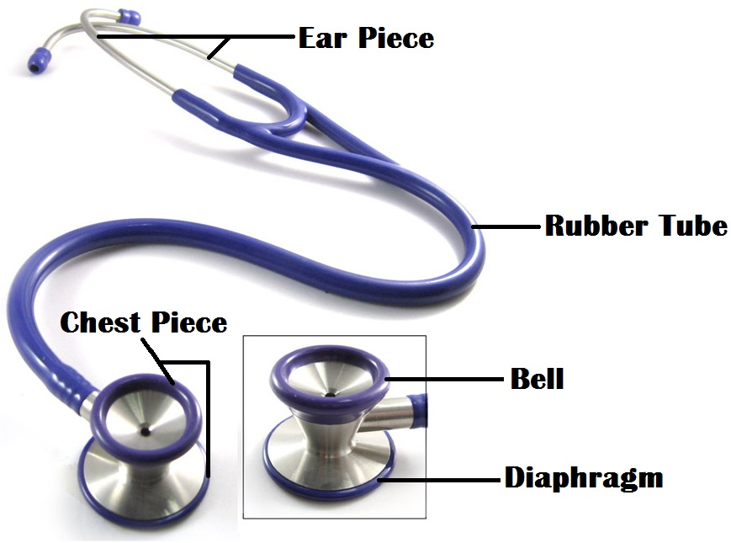
Auscultation Method
The stethoscope

Slide 4
The position of the patient
The heart should be auscultated when the patient is in the following positions:
Supine.
Left lateral.
Sitting.

Slide 5
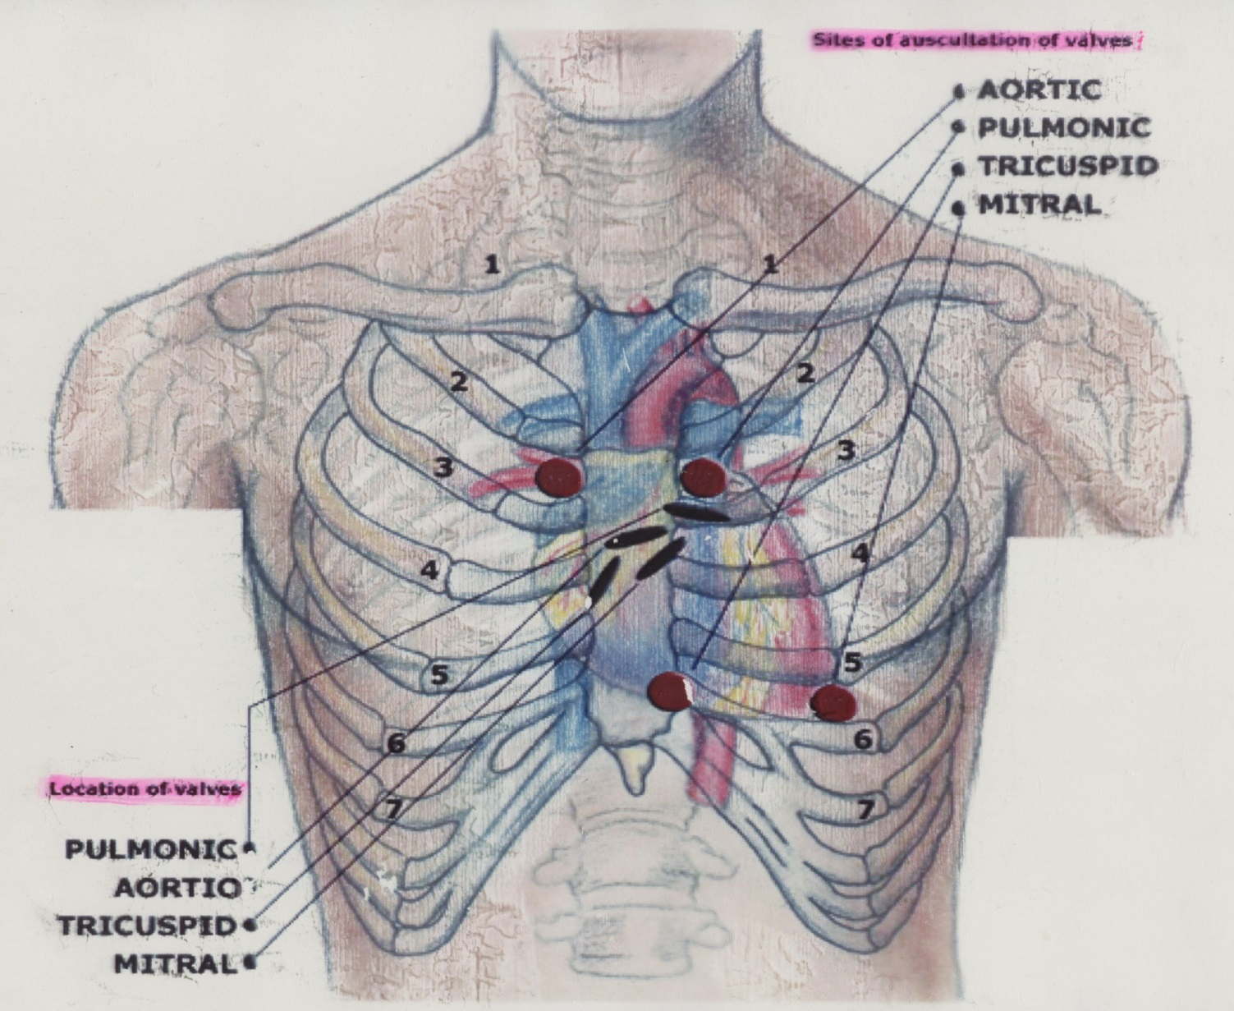
Areas of auscultation

Slide 6
Areas of auscultation

Slide 7
The mitral area (apex): This is found in the left 5th intercostal space, approximately 1 cm medial to the mid-clavicular line.
The tricuspid area: This is found just to the left of the lower border of the sternum.
The pulmonary area: This is found in the left 2nd intercostal space at the sternal border.
The aortic area: This is found in the right 2nd intercostal space at the sternal border.

Slide 8
Phonocardiography
Phonocardiography is the sensitive technique, by which a recording can be made of all four heart sounds by placing a transducer on specific areas of auscultation.

Slide 9
First heart sound (S1)
It is always normal. It sounds as “lub”. It is also called S₁.
It is usually prolonged, but dull in nature.
It is caused by the closure of AV valves.
It is best heard when auscultated at mitral and tricuspid areas.
It occurs at the beginning of ventricular systole in relation to cardiac cycle.
It occurs just after QRS complex if we relate it to ECG
Frequency: 50-60 Htz
Time: 0.15 sec

Slide 10
Second heart sound (S2)
It is always normal. It sounds as “dub”. It is also called S₂.
It is usually short and sharp in nature.
It is caused by the closure of semi-lunar valves.
It is best heard when auscultated at aortic and pulmonary areas.
It occurs at the beginning of ventricular diastole in relation to cardiac cycle.
It occurs just after T wave if we relate it to ECG.
Frequency:80-90 Htz
Time: 0.11 sec

Slide 11
Third heart sound (S3)
It may be heard normally in children, thin adults, and pregnant women or after exercise. It is also called S₃.
It is caused by the striking of the blood to the wall of ventricles during rapid filling phase of ventricular diastole.
It occurs in the early diastole in relation to cardiac cycle (beginning of the middle third of diastole)
Frequency: 20-30 Htz
Time: 0.1 sec

Slide 12
Fourth heart sound (S4)
It may be heard normally in older people. It is also called S₄.
It is caused by the forceful contraction of atria.
It occurs just before the first heart sound during late diastole in relation to cardiac cycle.
Frequency: < 20 Htz

Slide 13
Heart sounds using Phonocardiography

Slide 14
The Events of the Cardiac Cycle

Slide 15
Relationship of heart sound with ECG

Slide 16
Splitting of second heart sound A₂-P₂
Physiologic splitting of the 2nd heart sound occurs during deep inspiration when the A2 component splits from the P2 component by more than 0.2 seconds.
It is auscultated as “dub, dub” over the aortic or pulmonary areas

Slide 17
Heart Murmurs
Murmurs are abnormal sounds produced due to abnormal flow of blood through abnormal heart valves e.g. stenosis or regurgitation.

Slide 18
Function of papillary muscle & Chordae tendineae

Slide 19
Thank you

