Slide 1
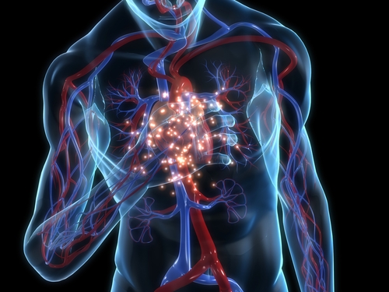
MAJOR BODY
VEINS
Khaleel Alyahya, PhD, MEd
King Saud University
School of Medicine
@khaleelya

Slide 2
OBJECTIVES
At the end of the lecture, the student should be able to:
Define veins and understand the general principle of venous system.
Describe the superior & inferior Vena Cava.
formation and their tributaries
List major veins and their tributaries in;
head & neck
thorax & abdomen
upper & lower limbs
Describe the Portal Vein.
formation & tributaries.
Describe the Portocaval Anastomosis.
formation, sites and importance

Slide 3
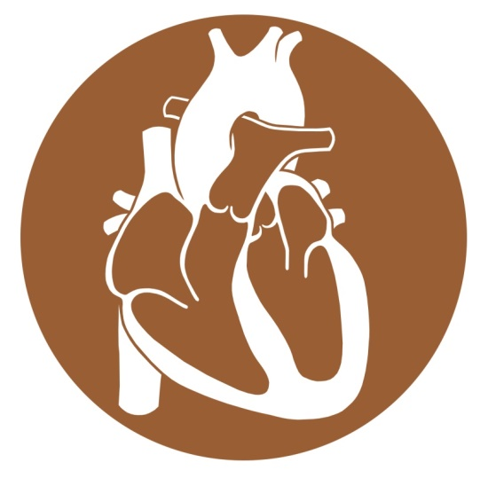
VEINS
Veins are blood vessels that bring blood back to the heart.
All veins carry deoxygenated blood
with the exception of the pulmonary veins and umbilical veins
There are two types of veins:
Superficial veins: close to the surface of the body
NO corresponding arteries
Deep veins: found deeper in the body
With corresponding arteries
Veins of the systemic circulation:
Superior and inferior vena cava with their tributaries
Veins of the portal circulation:
Portal vein

Slide 4
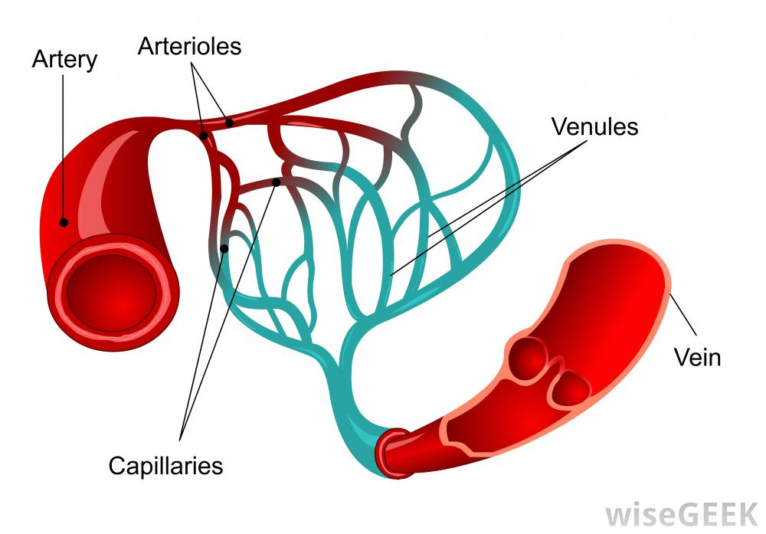
arteries Vs. VEINS

Slide 5
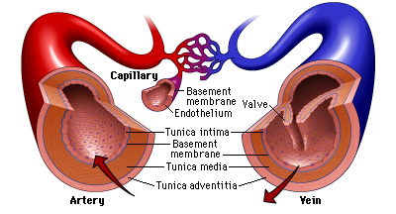
histology
The arteries and veins have three layers, but the middle layer is thicker in the arteries than it is in the veins:
Tunica Intima (the thinnest layer): a single layer of simple squamous endothelial cells.
Tunica Media (the thickest layer in arteries): is made up of smooth muscle cells and elastic tissue.
Tunica Adventitia: (the thickest layer in veins) entirely made of connective tissue.
Capillaries consist of little more than a layer of endothelium and occasional connective tissue.

Slide 6
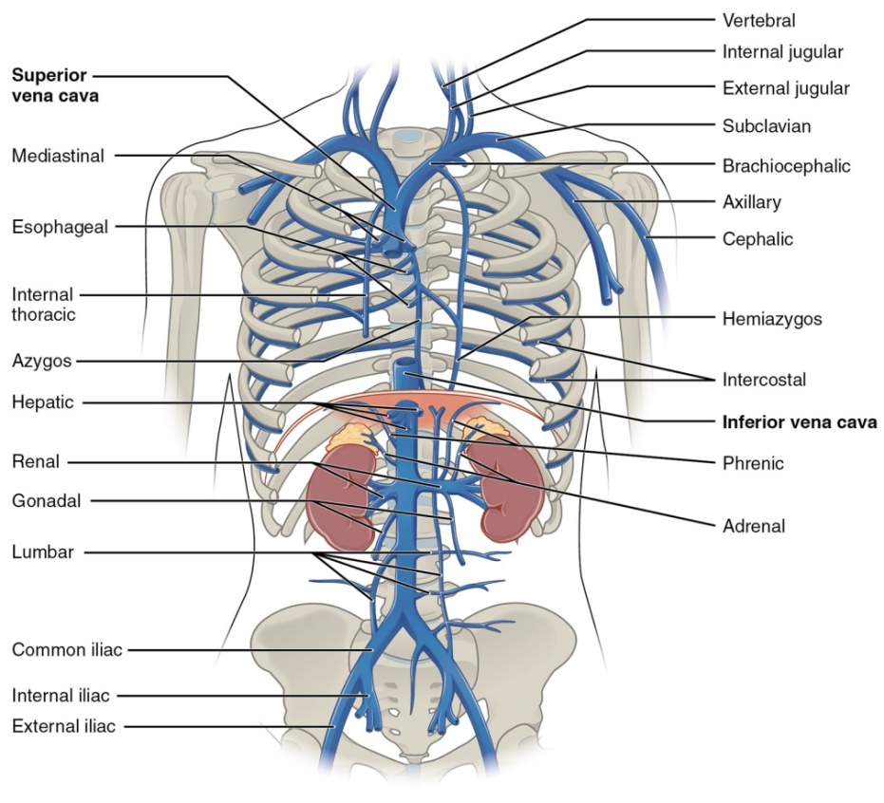
VENA CAVAE
They are two large veins that return deoxygenated blood from the body into the heart.
There are the superior vena cava and the inferior vena cava.
Both empty into the right atrium.
They are located slightly off-center toward the right side of the body.
The superior vena cava is above the heart, and formed by the union of the left and right brachiocephalic veins, which drain blood from the head and the upper limbs.
The inferior vena cava travels up alongside the abdominal aorta with blood from the lower part of the body.
It is the largest vein in the human body.

Slide 7
HEAD & NECK

Slide 8
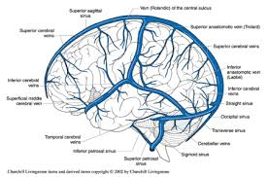
VEINS OF BRAIN (FYI)
The brain is drained by a system of veins that empty into the dural sinuses.
The sinuses empty into the right and left internal jugular veins.
Two divisions of veins:
Superficial Veins
Deep Veins

Slide 9
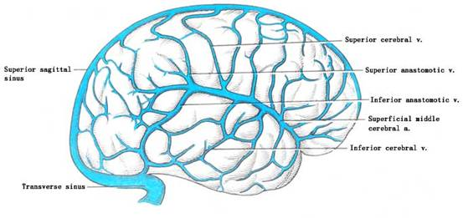
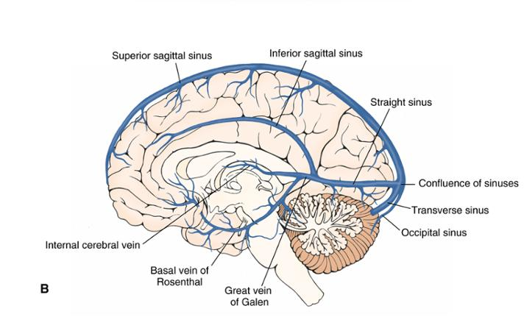
Cortical Veins (FYI)
Superficial Cerebral Veins
Lie on the brain surface
They are three superficial cortical veins:
Superior cerebral veins
Inferior cerebral veins
Superficial middle cerebral vein
Deep Cerebral Veins
They drain the internal structures;
There are three deep veins:
The great cerebral vein of Galen
The basal vein of Rosenthal
The internal cerebral vein
Both superficial and deep cortical veins drain into cortical sinuses.

Slide 10
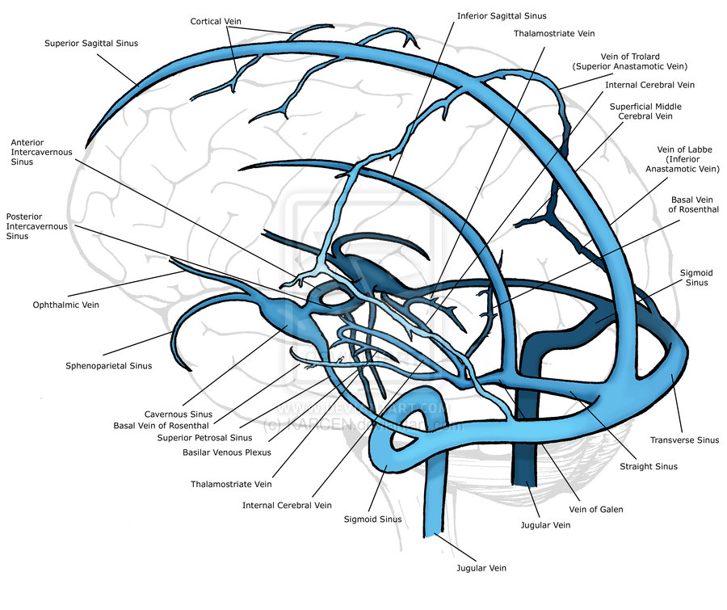
DEEP CEREBRAL VEINS (FYI)
They drain the internal structures;
There are three deep veins:
The great cerebral vein of Galen
The basal vein of Rosenthal
The internal cerebral vein

Slide 11
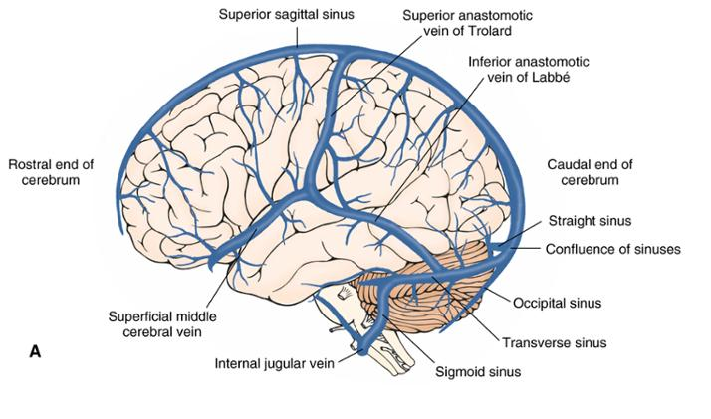
Cerebral Sinuses (FYI)
The Superior Sagittal Sinus
Lies along the superior border of the falx cerebri and empties into the confluence of sinuses.
The Inferior Sagittal Sinus
Lies in the inferior border of the falx cerebri.
The great cerebral vein of Galen joins the inferior sagittal sinus to form the straight sinus.
The Transverse Sinuses
Originate on each side of the confluence of sinuses.
Each transverse sinus travels laterally, and curves downward to form the sigmoid sinus that empties into the internal jugular vein on the same side.

Slide 12
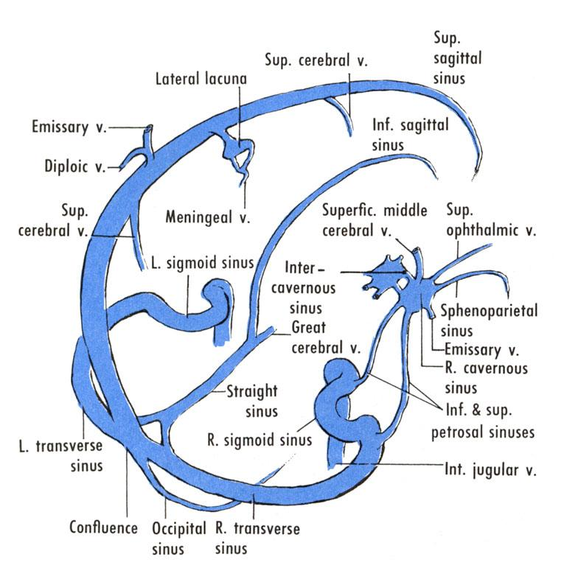
Cerebral Sinuses (FYI)
The Confluence of Sinuses
At the confluence of sinuses, the superior sagittal, straight, transverse, and occipital sinuses join.
The Cavernous Sinuses
Located on each side of the sphenoid bone.
Ophthalmic and superficial middle cerebral veins drain into these sinuses.
The Sphenoparietal Sinuses
Located below the sphenoid bone and drain into the cavernous sinus.
The Sigmoid Sinuses
Receive blood from the transverse sinuses and travels inferiorly along the parietal bone, temporal bone and occipital bone, to empty into the internal jugular veins

Slide 13
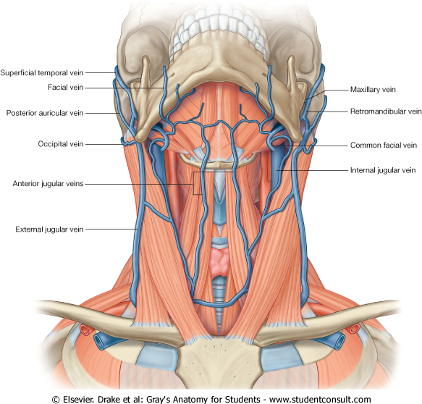
Veins of Neck
TWO DIVISIONS:
Superficial Veins
External Jugular veins
Anterior jugular veins
Deep Veins
Internal Jugulars veins

Slide 14
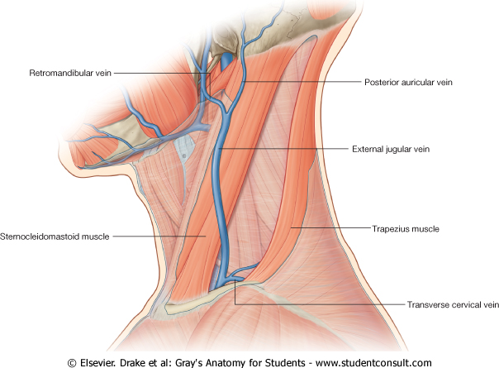
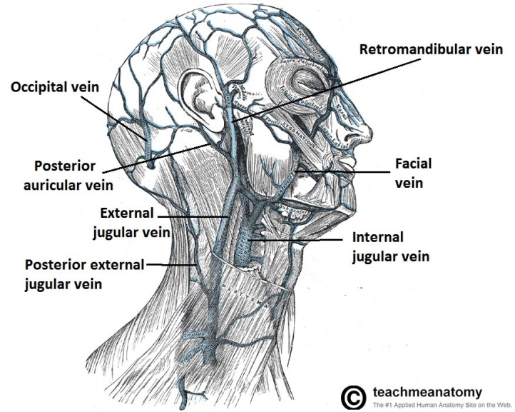
Superficial Veins of Neck
External Jugular Veins:
Lies superficial to the sternomastoid muscle
Formed by the union of posterior auricular vein and retromandibular vein.
It passes down the neck and it is the only tributary of the subclavian vein.
It drains blood from:
Outside of the skull
Deep parts of the face.

Slide 15
Superficial Veins of Neck
Anterior jugular veins:
It begins in the upper part of the neck by the union of the submental veins.
It descends close to the median line of the neck, medial to the sternomastoid muscle.
At the lower part of the neck, it passes laterally beneath that muscle to drain into the external jugular vein.
Just above the sternum the two anterior jugular veins communicate by a transverse vein to form the jugular arch.

Slide 16
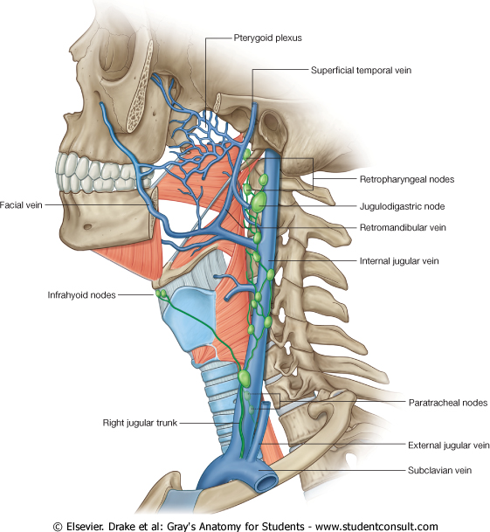
Deep Veins of Neck
Internal Jugulars vein:
Drains blood from the head, brain, face & neck.
It descends in the neck along with the internal and common carotid arteries and vagus nerve, within the Carotid Sheath.
Joins the subclavian vein to form the brachiocephalic vein.
Tributaries:
Superior thyroid
Middle thyroid
Lingual
Facial
Occipital
Pharyngeal
Dural venous sinuses
These veins drain blood from anterior face, trachea, thyroid, esophagus, larynx, and muscles of the neck.

Slide 17
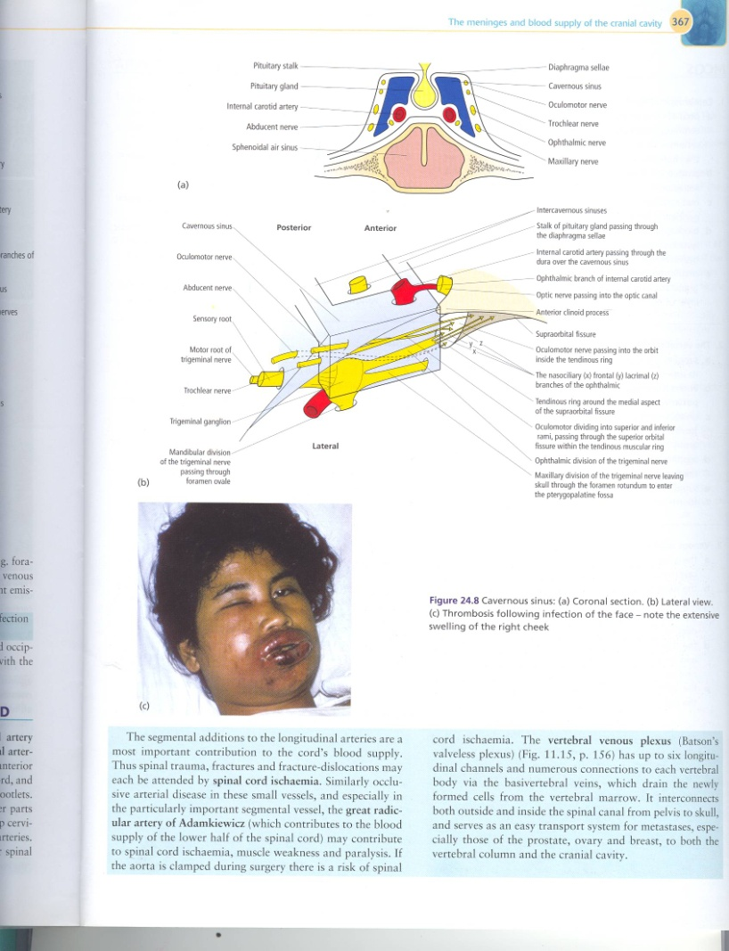
VENOUS DISORDER
INFARCTION
Refers to tissue death (necrosis) that is caused by a local lack of oxygen due to obstruction of the tissue's blood supply
SINUS THROMBOSIS
SSS thrombosis
Superior Sagittal Sinus
Can complicates ear infection
Cavernous Sinus thrombosis
As a complication of infection in the dangerous area of the face
Obstruction of venous drainage of the brain leads to Cerebral swelling (edema) and raised Intracranial Pressure.

Slide 18
Upper limbs

Slide 19
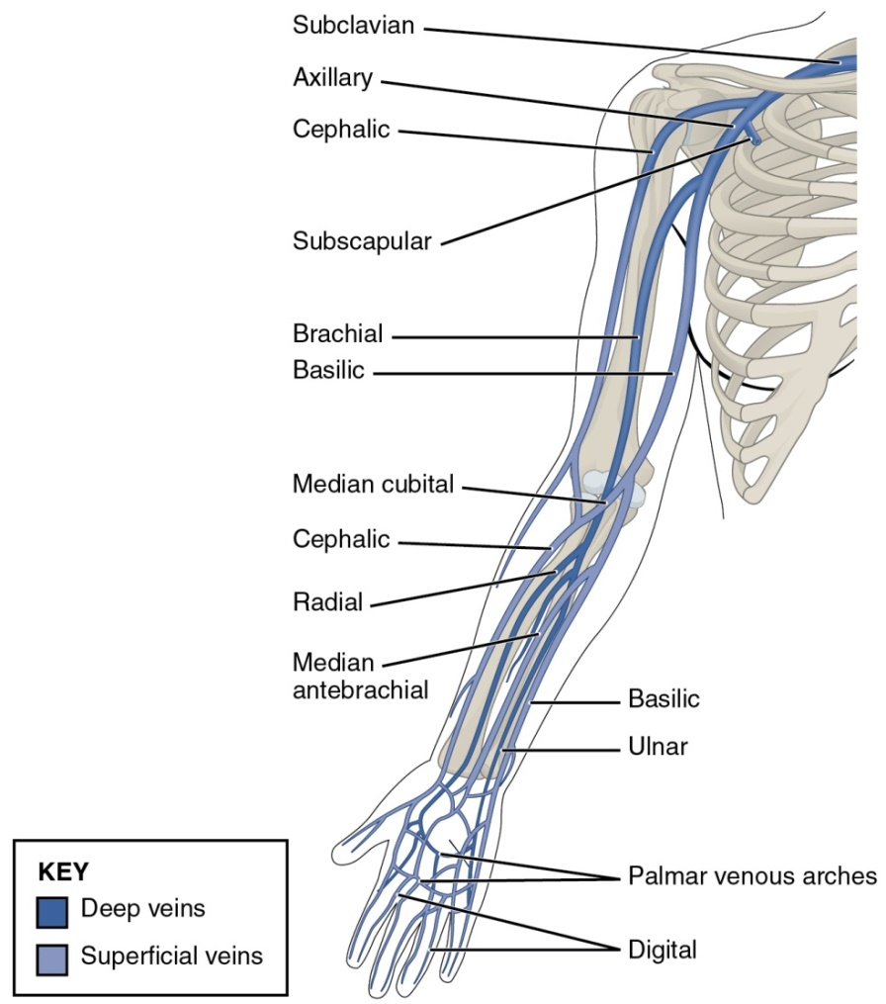
Veins of hands
The hand is drained by network of superficial and deep veins.
In the palm, these veins form arches and they are associated with the superficial and deep palmar arterial arches.
This network unites to give rise to two extensive superficial veins, the cephalic and basilic veins.
On the lateral side of the carpus, the dorsal venous network is prolonged proximally as the cephalic vein, while the basilica vein arises from the medial side..

Slide 20
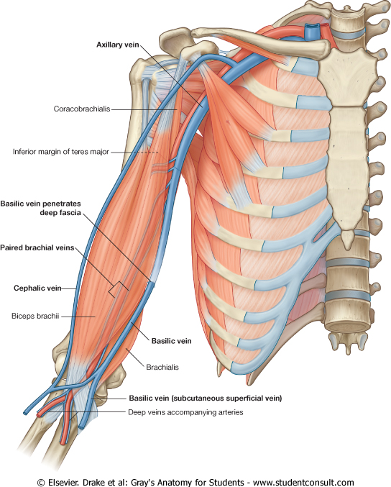
Superficial veins
The major superficial veins of the upper limb are the cephalic and basilic veins.
At the elbow, the cephalic and basilic veins are connected by the median cubital vein.

Slide 21
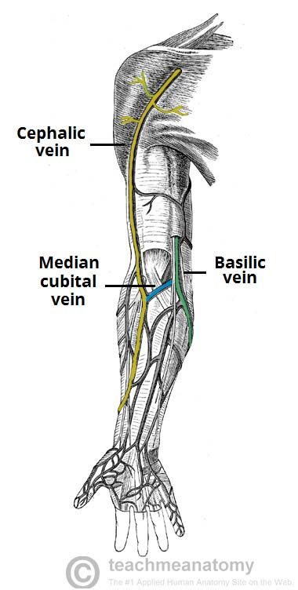
Basilic vein
Originates from the dorsal venous network of the hand.
It ascends the medial aspect of the upper limb.
At the border of the teres major, the vein moves deep into the arm.
It then combines with the brachial veins to form the axillary vein.

Slide 22
Cephalic vein
Arises from the dorsal venous network of the hand.
It ascends the antero-lateral aspect of the upper limb, passing anteriorly at the elbow.
At the shoulder, the cephalic vein travels between the deltoid and pectoralis major muscles to enters the axilla region via the clavipectoral triangle.
Within the axilla, the cephalic vein terminates by joining the axillary vein.

Slide 23
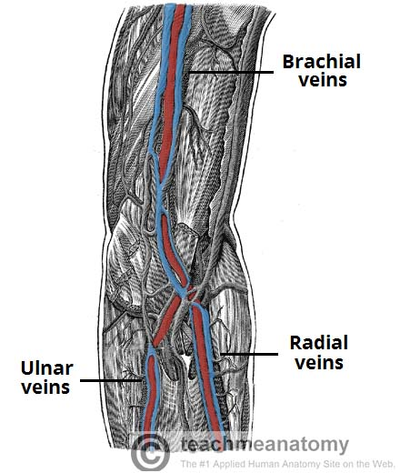
Deep veins
The deep veins of the upper limb are situated underneath the deep fascia.
They are usually paired veins that accompany one artery.
vena comitantes
The brachial veins are the largest in size, and are situated either side of the brachial artery.
Ulnar and radial veins are vena comitantes of ulnar and radial arteries.
The pulsations of the brachial artery assists the venous return.
Perforating veins run between the deep and superficial veins of the upper limb, connecting the two systems together.

Slide 24
Axillary vein
Formed by the union of basilic vein and the brachial veins (venae comitantes) of the brachial artery.

Slide 25
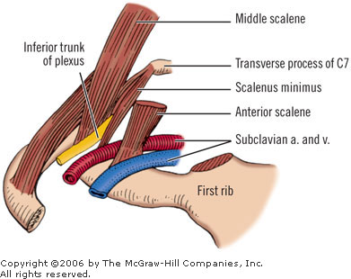
Subclavian vein
Each subclavian vein is a continuation of the axillary vein and runs from the outer border of the first rib to the medial border of anterior scalene muscle.
It then joins with the internal jugular vein to form the brachiocephalic vein.
The subclavian vein follows the subclavian artery.
The right and left brachiocephalic veins form superior vena cava that enters right atrium. anterior to the middle scalene).

Slide 26
SUPERIOR VENA CAVA

Slide 27
Superior Vena Cava
Formed by the union of the right and left brachiocephalic veins.
Brachiocephalic veins are formed by the union of internal jugular and subclavian veins.
Drains venous blood from:
Head, neck, thoracic wall & upper limbs
It Passes downward and enter the right atrium.
Receives azygos vein on the posterior aspect just before it enters the heart.

Slide 28
Additional Veins in Thoracic
The azygos vein drains into the superior vena cava.
The hemiazygos vein drains into left brachiocephalic trunk.
Internal thoracic vein drain into brachiocephalic vein.

Slide 29
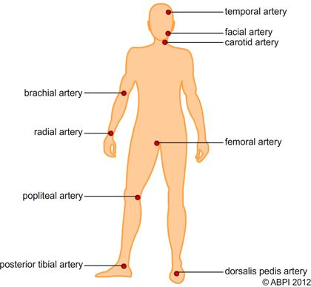
PULSE POINTS IN UPPER LIMB
AXILLARY PULSE
Located inferiorly of the lateral wall of the axilla.
BRACHIAL PULSE
Located on the inside of the upper arm near the elbow, frequently used in place of carotid pulse in infants (brachial artery).
ULNAR PULSE
Located on the medial of the wrist (ulnar artery).
RADIAL PULSE
Located on the lateral of the wrist (radial artery). It can also be found in the anatomical snuff box.

Slide 30
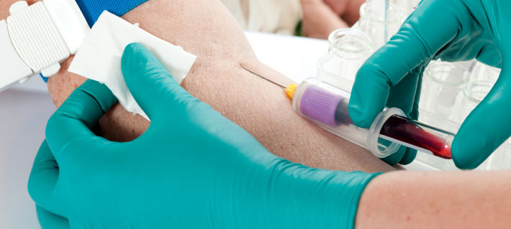
Clinical significance
VENEPUNCTURE
The practice of obtaining intravenous access. This can be for intravenous therapy or obtaining a blood sample.
The main vein used in venipuncture is the median cubital vein.
It is a superficial vein that is situated anteriorly at the cubital fossa region.
It is commonly used due to its accessible and superficial position.

Slide 31
Abdomen

Slide 32
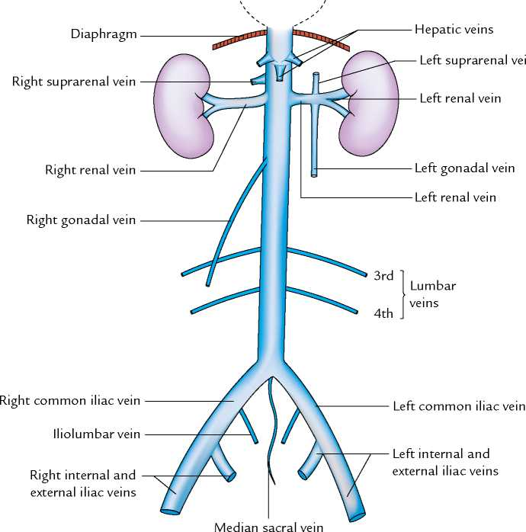
TRIBUTARIES OF INFERIOR VENA CAVA
Two common iliac veins
Median Sacral Vein
Four lumbar veins
Right gonadal vein
the left vein drains into the left renal vein
Paired renal veins
Right suprarenal vein
the left vein drains into the left renal vein
Hepatic veins
Paired inferior phrenic vein

Slide 33
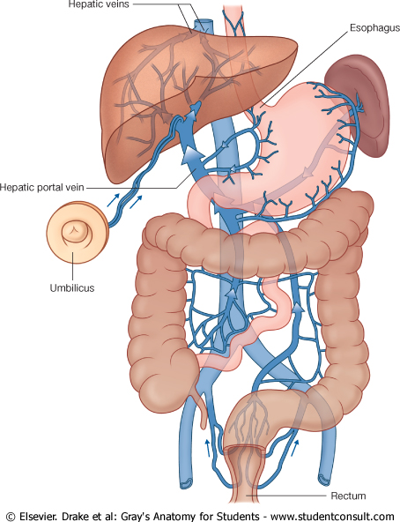
PORTAL CIRCULATION
A portal venous system is a series of veins or venules that directly connect two capillary beds.
Examples of such systems include the hepatic portal vein and hypophseal portal system.

Slide 34
HEPATIC PORTAL VEIN
Drains blood from the gastrointestinal tract and spleen
It is formed by the union of the superior mesenteric and splenic veins.
Immediately before reaching the liver, the portal vein divides into right and left that enter the liver.
Tributaries: Gastric and cystic veins

Slide 35
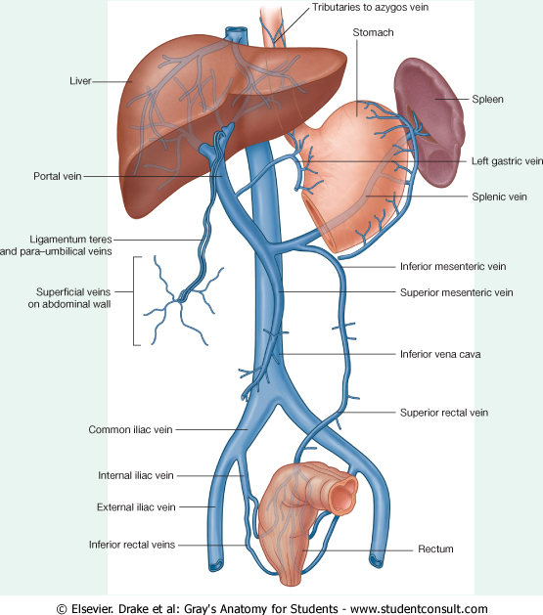
PORTOCAVAL ANASTOMOSIS
A portacaval anastomosis (also known as portal systemic anastomosis) is a specific type of anastomosis that occurs between the veins of portal circulation and those of systemic circulation.
The anastomotic channels become dilated (varicosed) in case of portal hypertension.

Slide 36
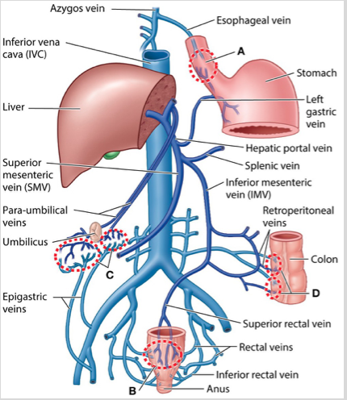
SITES OF PORTOCAVAL ANASTOMOSIS
Lower end of esophagus: left gastric vein & azygos vein
Lower part of rectum: (Hemorrhoids) superior and middle rectal veins & inferior rectal vein
Para umbilical region: (Caput Medusae) Para umbilical veins & superficial epigastric vein
Retroperitoneal: Veins draining colon & veins of the posterior abdominal wall
Bare area of liver: There is some anastomosis between portal venous channels in the liver and azygous system of veins above the diaphragm. across the bare area of liver.

Slide 37
LOWER limbs

Slide 38
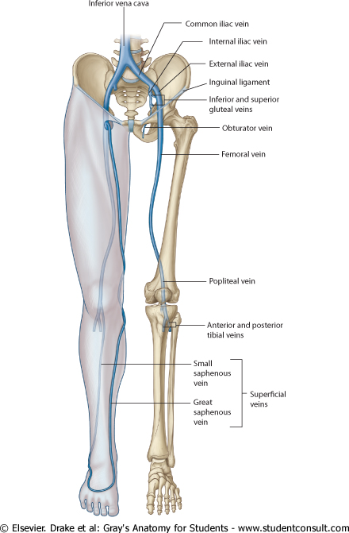
Superficial veins
Form a network in the subcutaneous tissue
Pattern is variable
They are the tributaries of the:
Great (long) saphenous vein
Small (short) saphenous vein

Slide 39
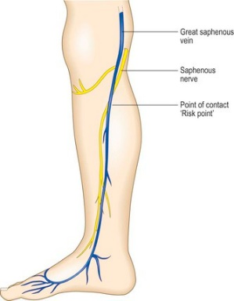
GREAT SAPHENOUS VEIN
The longest vein
Begins from the medial end of the dorsal venous arch of the foot.
Passes upward in front of the medial malleolus with the saphenous nerve.
Then it ascends in accompany with the saphenous nerve in the superficial fascia over the medial side of the leg.
Ascends obliquely upwards, and lies behind the medial border of the patella.
Passes behind the knee and curves forward around the medial side of the thigh.
Hooks through the lower part of the saphenous opening in the deep fascia to joins the femoral vein about 4 cm below and lateral to the pubic tubercle.

Slide 40
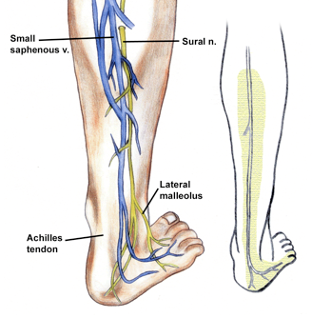
SMALL SAPHENOUS VEIN
Arises from the lateral end of the dorsal venous arch.
Ascends behind the lateral malleolus in company with the sural nerve.
Follows the lateral border of the tendocalcaneus and then runs up to the middle of the back of the leg.
Pierces the deep fascia in the lower part of the popliteal fossa
Drains into the popliteal vein
Has numerous valves along its course.
Anastomosis with great saphenous vein.

Slide 41
DEEP veins
Including:
Anterior and posterior tibial veins
Popliteal vein
Femoral vein

Slide 42
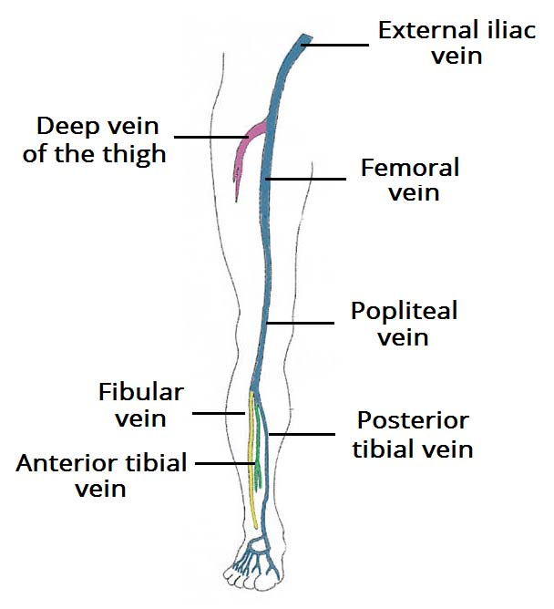
Veins of foot and leg
The main venous structure of the foot is the dorsal venous arch, which mostly drains into the superficial veins.
Some veins from the arch penetrate deep into the leg, forming the anterior tibial vein.
The plantar aspect of the foot, medial and lateral plantar veins arise. These veins combine to form the posterior tibial and fibular veins.
The posterior tibial vein accompanies the posterior tibial artery, entering the leg posteriorly to the medial malleolus.
On the posterior surface of the knee, the anterior tibial, posterior tibial and fibular veins unite to form the popliteal vein.

Slide 43
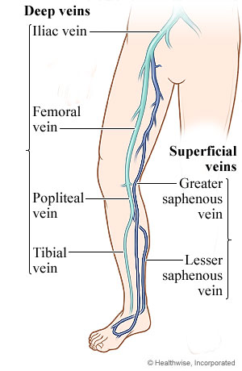
Popliteal vein
Comprise the venae comitantes, which accompany popliteal artery.
Formed by the unite of anterior, posterior tibial and fibluar veins.
Popliteal vein then continues as the femoral vein.
Receive blood from superficial veins through perforating veins.

Slide 44
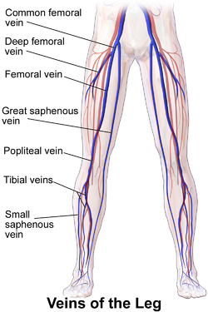
Femoral veins
The femoral vein is a blood vessel that accompanies the femoral artery in the femoral sheath.
It is a continuation of the popliteal vein.
Ends at the inferior margin of the inguinal ligament, where it becomes the external iliac vein.
External iliac join internal iliac to form common iliac veins.
Both right and left common iliac veins form inferior vena cava that drains the entire low part of the body.
Inferior vena cava drains into right atrium.

Slide 45
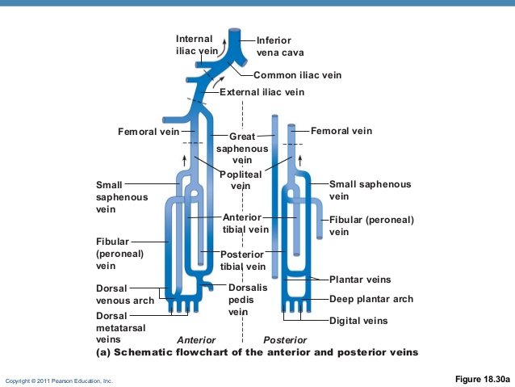

Slide 46
PULSE POINTS IN LOWER LIMB
FEMORAL PULSE
Located in the inner thigh, at the mid-inguinal point, halfway between the pubic symphysis and anterior superior iliac spine (femoral artery).
POPLITEAL PULSE
Located above the knee in the popliteal fossa. The patient bends the knee at approximately 124°, and the physician holds it in both hands to find the popliteal artery in the pit behind the knee (Popliteal artery).).
DORSALIS PEDIS PULSE
Located on top of the foot, immediately lateral to the extensor of hallucis longus (dorsalis pedis artery).

Slide 47
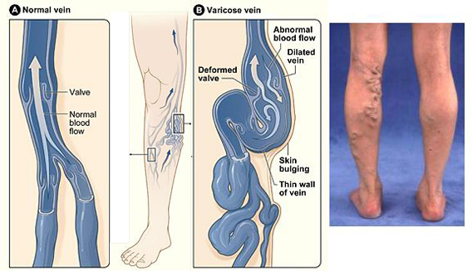
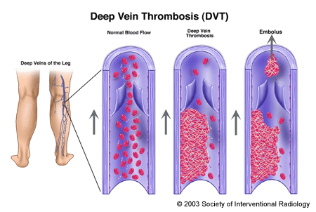
Clinical significance
VARICOSE VEINS
If the valves in the perforating veins become incompetent, the direction of blood flow is reversed and the veins become varicosed.
Most common in posterior & medial parts of the lower limb, particularly in old people.
DEEP VEIN THROMBOSIS (DVT)
Occurs when a blood clot (thrombus) forms in one or more of the deep veins in your body, usually in your legs. Deep vein thrombosis can cause leg pain or swelling, but may occur without any symptoms.
Deep vein thrombosis is a serious condition because blood clots in your veins can break loose, travel through your bloodstream and lodge in your lungs, blocking blood flow (pulmonary embolism).

Slide 48
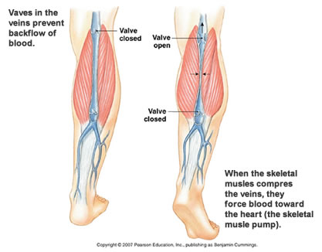
MECHANISM OF VENOUS RETURN FROM LOWER LIMB
Much of the saphenous blood passes from superficial to deep veins through the perforating veins
The blood is pumped upwards in the deep veins by the contraction of the calf muscles (calf pump).
This action of calf pump is assisted by the tight sleeve of deep fascia surrounding these muscles.

Slide 49
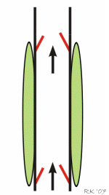
FACTORS AIMING BLOOD RETURN
Muscle Contraction.
Rhythmical contraction of limb muscles as occurs during normal locomotory activity (walking, running, swimming) promotes venous return by the muscle pump mechanism.
Respiratory Pump
During respiratory inspiration, the venous return increases because of a decrease in right atrial pressure.
Decreased Venous Compliance
Sympathetic activation of veins decreases venous compliance, increases central venous pressure and promotes venous return.
Gravity
The effects of gravity on venous return seem paradoxical because when a person stands up hydrostatic forces cause the right atrial pressure to decrease and the venous pressure in the dependent limbs to increase.

Slide 50
QUESTIONS!
Any

