Slide 1

Drug Therapy
of
Heart Failure
Prof. Abdulrahman Almotrefi
1

Slide 2
Learning objectives
By the end of this lecture, students should be able to:
Describe the different classes of drugs used for treatment of acute & chronic heart failure and their mechanism of action
Understand their pharmacological effects, clinical uses, adverse effects and their interactions with other drugs

Slide 3





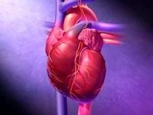
HEART FAILURE
Inability of the heart to maintain an adequate cardiac
output to meet the metabolic demands of the body.

Slide 4



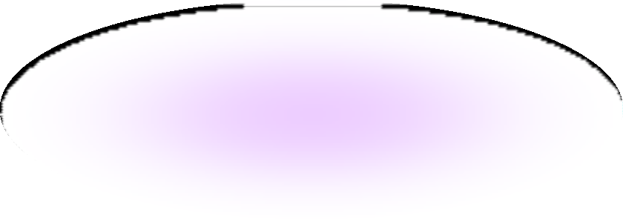
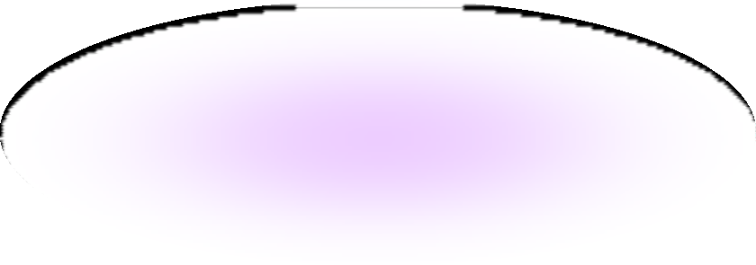
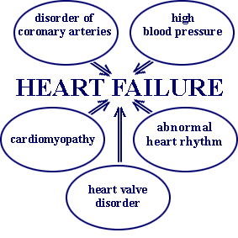
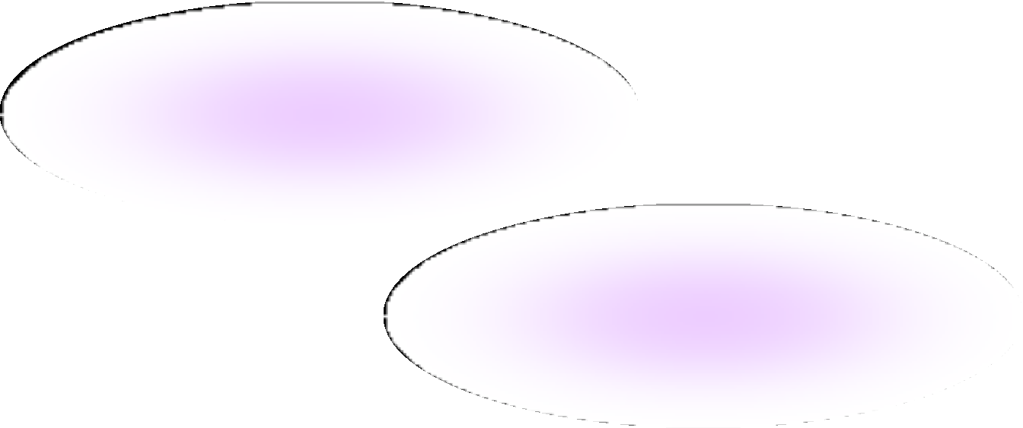
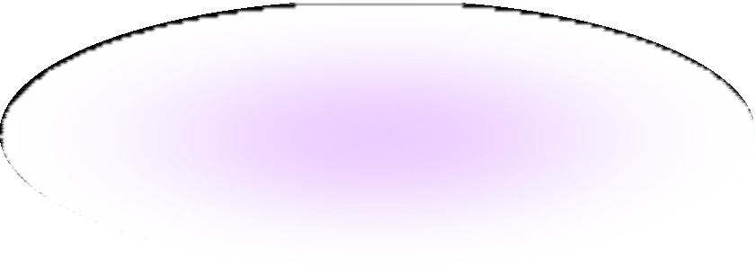
CAUSES OF HEART FAILURE

Slide 5

- Tachycardia
Decreased exercise tolerance (rapid fatigue)
Dyspnea ( pulmonary congestion )
Peripheral edema
Cardiomegaly
5

Slide 6
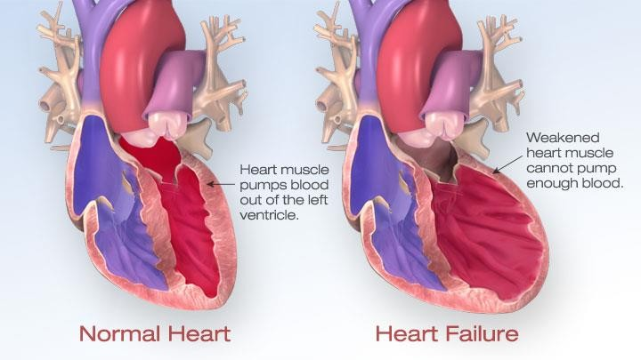
5

Slide 7
Pathophysiology of CHF
↓ Force of contraction
Low C.O.
↓ Carotid sinus firing
Activate renin-angiotensin-
Aldosterone system
Activate sympathetic system
↑ Sympathetic discharge
Remodeling
Salt & Water Retention
Volume expansion
Vasoconstriction
↑ Force of Cardiac .cont.
Venous VC Arterial VC
↑ HR
↑ Preload
↑ Preload
↑ Afterload

Slide 8




1- Preload
Afterload
Cardiac contractility

Slide 9
I- Drugs that decrease preload:
- Diuretics
- Aldosterone antagonists
- Venodilators
II- Drugs that decrease afterload:
1 - Arteriodilators

Slide 10
III- Drugs that decrease both preload & afterload:
( Combined arteriolo- & venodilators )
1- Angiotensin converting enzyme (ACE) inhibitors 2- Angiotensin receptor antagonists
α₁-adrenoceptor antagonists
Direct vasodilators

Slide 11




IV- Drugs that increase contractility:
Cardiac glycosides (digitalis)
β- adrenoceptor agonists
Phosphodiesterase inhibitors

Slide 12
I- Drugs that decrease preload 1-Diuretics:
Mechanism of action in heart failure :
reduce salt and water retention
⬇
decrease ventricular preload and venous pressure
⬇
reduction of cardiac size
⬇
Improvement of cardiac performance

Slide 13
I- Drugs that decrease preload
Diuretics:
Chlorothiazide
  first-line agent in heart failure therapy
  used in volume overload ( pulmonary and/ or
peripheral edema )
- used in mild congestive heart failure

Slide 14
I- Drugs that decrease preload 1-Diuretics:
Furosemide
- a potent diuretic
used for immediate reduction of pulmonary congestion & severe edema associated with :
  acute heart failure
  moderate & severe chronic failure

Slide 15
I- Drugs that decrease preload
2-Aldosterone antagonists:
Spironolactone
nonselective antagonist of aldosterone receptor
a potassium sparing diuretic
improves survival in advanced heart failure

Slide 16
I- Drugs that decrease preload
2-Aldosterone antagonists:
Eplerenone
a new selective aldosterone receptor antagonist ( does not inhibit other hormones such as
estrogens & androgens)
indicated to improve survival of stable patients
with congestive heart failure

Slide 17
I- Drugs that decrease preload
Venodilators:
Nitroglycerine Isosorbide dinitrate
  used I.V. for severe heart failure when the main symptom is dyspnea due to pulmonary congestion
  dilates venous blood vessels and reduce
preload

Slide 18
II- Drugs that decrease afterload
1- Arteriodilators:
Hydralazine
- used when the main symptom is rapid
fatigue due to low cardiac output
- reduce peripheral vascular resistance

Slide 19
III- Drugs that decrease both
preload & afterload
1-Angiotensin converting enzyme (ACE) inhibitors:
- considered as first-line drugs for
chronic heart failure along with diuretics
- first-line drugs for hypertension therapy
19

Slide 20



























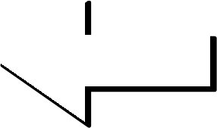










Angiotensin converting enzyme inhibitors
MECHANISM OF ACTION
VASOCONSTRICTION
ALDOSTERONE VASOPRESSIN
SYMPATHETIC
Angiotensinogen
RENIN
Angiotensin I
VASODILATATION
BRADYKININ
A.C.E.
Inhibitor
Breackdown
ANGIOTENSIN II

Slide 21
ACE Inhibitors
Pharmacological actions:
- Decrease peripheral resistance ( Afterload )
- Decrease Venous return ( Preload)
- Decrease sympathetic activity
4- Inhibit cardiac and vascular remodeling associated with chronic heart failure
⬇
Decrease in mortality rate

Slide 22
ACE Inhibitors
Pharmacokinetics:
Captopril, Enalapril and Ramipril
- rapidly absorbed from GIT after oral administration.
food reduce their bioavailability
Enalapril , Ramipril
prodrugs, converted to their active metabolites in liver
have long half-life & given once daily

Slide 23
ACE Inhibitors
Adverse effects:
acute renal failure, especially in patients with renal artery stenosis
hyperkalemia, especially in patients with
renal insufficiency or diabetes
severe hypotension in hypovolemic patients (due to diuretics, salt restriction or gastrointestinal fluid loss)

Slide 24
ACE Inhibitors
Adverse effects:
dry cough sometimes with wheezing
angioneurotic edema ( swelling in the nose , throat, tongue, larynx)
dysgeusia ( reversible loss or altered taste)

Slide 25
ACE Inhibitors
Contraindications:
during the second and third trimesters of pregnancy
( due to the risk of : fetal hypotension renal failure & malformations )
renal artery stenosis

Slide 26
III- Drugs that decrease both preload & afterload
2- Angiotensin receptor blockers (ARBs) :
Losartan, Valsartan , Irbesartan
Mechanism of action:
block AT₁ receptors
decrease action of angiotensin II

Slide 27
III- Drugs that decrease both preload & afterload
α-ADRENOCEPTOR BLOCKERS :
Prazosin
  blocks α- receptors in arterioles and venules
  decrease both afterload & preload

Slide 28
III- Drugs that decrease both
preload & afterload
Direct acting vasodilators:
Sodium nitroprusside
  given I.V. for acute or severe heart failure
  acts immediately and effects lasts for 1-5 min.

Slide 29

IV- Drugs that increase contractility
1- Cardiac glycosides ( digitalis) :
Digoxin
-increases the force of myocardial contraction
( +ve inotropic effect )
Mechanism of action :
- Inhibit Na⁺ / K⁺ ATPase enzyme ( the sodium pump )

Slide 30
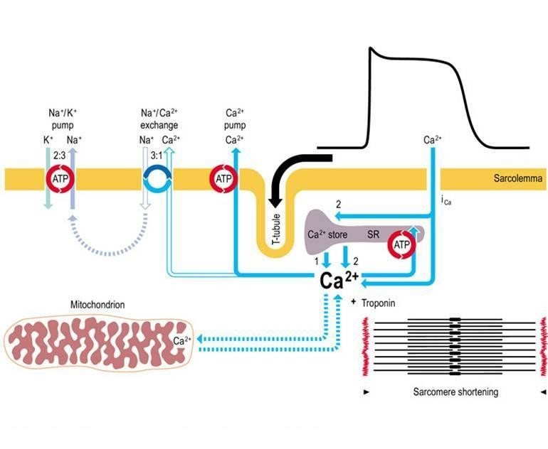
MECHANISM OF ACTION OF DIGOXIN

Slide 31
IV- Drugs that increase contractility
1- Cardiac glycosides ( digitalis) :
Digoxin
Therapeutic uses:
Congestive heart failure
has narrow therapeutic index

Slide 32
1- Cardiac glycosides ( digitalis) :
Digoxin
IV- Drugs that increase contractility
Adverse effects (Cardiac):
digitalis-induced arrhythmias
  extrasystoles
  coupled beats (Bigeminal rhythm)
  ventricular tachycardia or fibrillation
  cardiac arrest

Slide 33
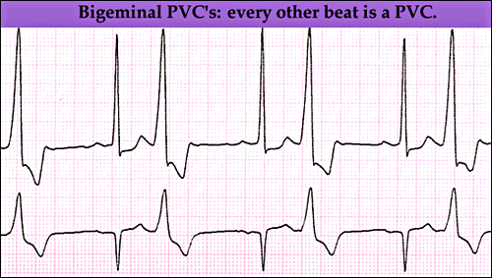

Slide 34
IV- Drugs that increase contractility
1- Cardiac glycosides ( digitalis) :
Digoxin
Adverse effects (non-cardiac) : GIT :
anorexia ,nausea, vomiting, diarrhea CNS:
headache, visual disturbances, drowsiness

Slide 35
IV- Drugs that increase contractility
1- Cardiac glycosides ( digitalis) :
Digoxin
Factors that increase its toxicity:
Renal diseases
Hypokalemia
Hypomagnesemia
Hypercalemia

Slide 36
IV- Drugs that increase contractility
Dobutamine
Selective β₁ agonist
Uses : Treatment of acute heart failure in
cardiogenic shock

Slide 37


IV- Drugs that increase contractility 3- phosphodiesterase -III inhibitors:
Milrinone
Mechanism of action:
- Inhibits phosphodiesterase -III ( cardiac & B. Vessels)
which inhibits cAMP degradation (↑ cAMP )
⬇
Increase cardiac
Contractility
⬇
dilatation of arteries & veins
(reduction of preload & afterload )

Slide 38
IV- Drugs that increase contractility 3- phosphodiesterase -III inhibitors :
Milrinone
Therapeutic uses:
- used only intravenously for management of
acute heart failure
- not safe or effective in the longer ( > 48 hours)
treatment of patients with heart failure

Slide 39
IV- Drugs that increase contractility 3- phosphodiesterase -III inhibitors :
Milrinone
Adverse effects:
Hypotension and chest pain (angina?)
Chemical interaction:
furosemide should not be administered in I.V. lines containing milrinone due to formation of a precipitate
- Enoximone & Vesnarinone
new drugs in clinical trials

Slide 40
The use of β-adrenoceptor blockers
in heart failure
- The elevated adrenergic activity in chronic heart failure patients cause structural remodeling of the heart (cardiac dilatation & hypertrophy)
β-blockers:
- reduce the progression of chronic heart failure
- not used in acute heart failure

Slide 41
The use of β-adrenoceptor blockers
in heart failure
Mechanism of action of β-blockers in HF:
attenuate cardiac remodeling
slow heart rate, which allows the left ventricle to fill more completely
decrease renin release
⬇
reduce mortality & morbidity of patients with HF

Slide 42
The use of β-adrenoceptor blockers in heart failure
- Second generation:
cardioselective ( β₁-receptors )
e.g. Bisoprolol, Metoprolol
- Third generation:
have vasodilator actions ( α- blocking effect)
e.g. Carvedilol , Nebivolol

Slide 43
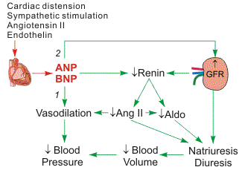
New drugs for heart failure
Natriuretic Peptides:
Nesiritide
  BNP is secreted by the ventricules in response to stretch
  elevated BNP is associated with advanced heart failure ( compensatory mechanism in HF )

Slide 44
Natriuretic Peptides
Nesiritide
a purified preparation of human BNP, manufactured
by recombinant DNA technology
↑ cyclic-GMP in vascular smooth muscle, leading to
smooth muscle relaxation & reduction
of preload and afterload
indicated for the treatment of patients with acute decompensated heart failure (ADHF) who have dyspnea at rest or with minimal activity

Slide 45
New drugs for heart failure
2- Calcium sensitisers:
Levosimendan
mechanism of action:
Calcium sensitization
(improves cardiac contractility without increasing oxygen consumption)
potassium-ATP channel opening
(cause vasodilation, improving blood flow to vital organs)
These effects reduce the risk of worsening CHF or death
compared with dobutamine

Slide 46


Management of chronic heart failure
Reduce work load of the heart
  Limit patient activity
  Reduce weight
  Control hypertension
Restrict sodium
Stop smoking

Slide 47

NYHA Class | Symptoms
I | Cardiac disease, but no symptoms and no limitation in ordinary physical activity, e.g. no shortness of breath when walking, climbing stairs etc.
II | Mild symptoms (mild shortness of breath and/or angina), slight limitation during ordinary activity.
III | Marked limitation in activity due to symptoms, even during less-than-ordinary activity, e.g. walking short distances (20–100 m).Comfortable only at rest.
IV | Severe limitations. Experiences symptoms even while at rest. Mostly bedbound patients.
47

Slide 48

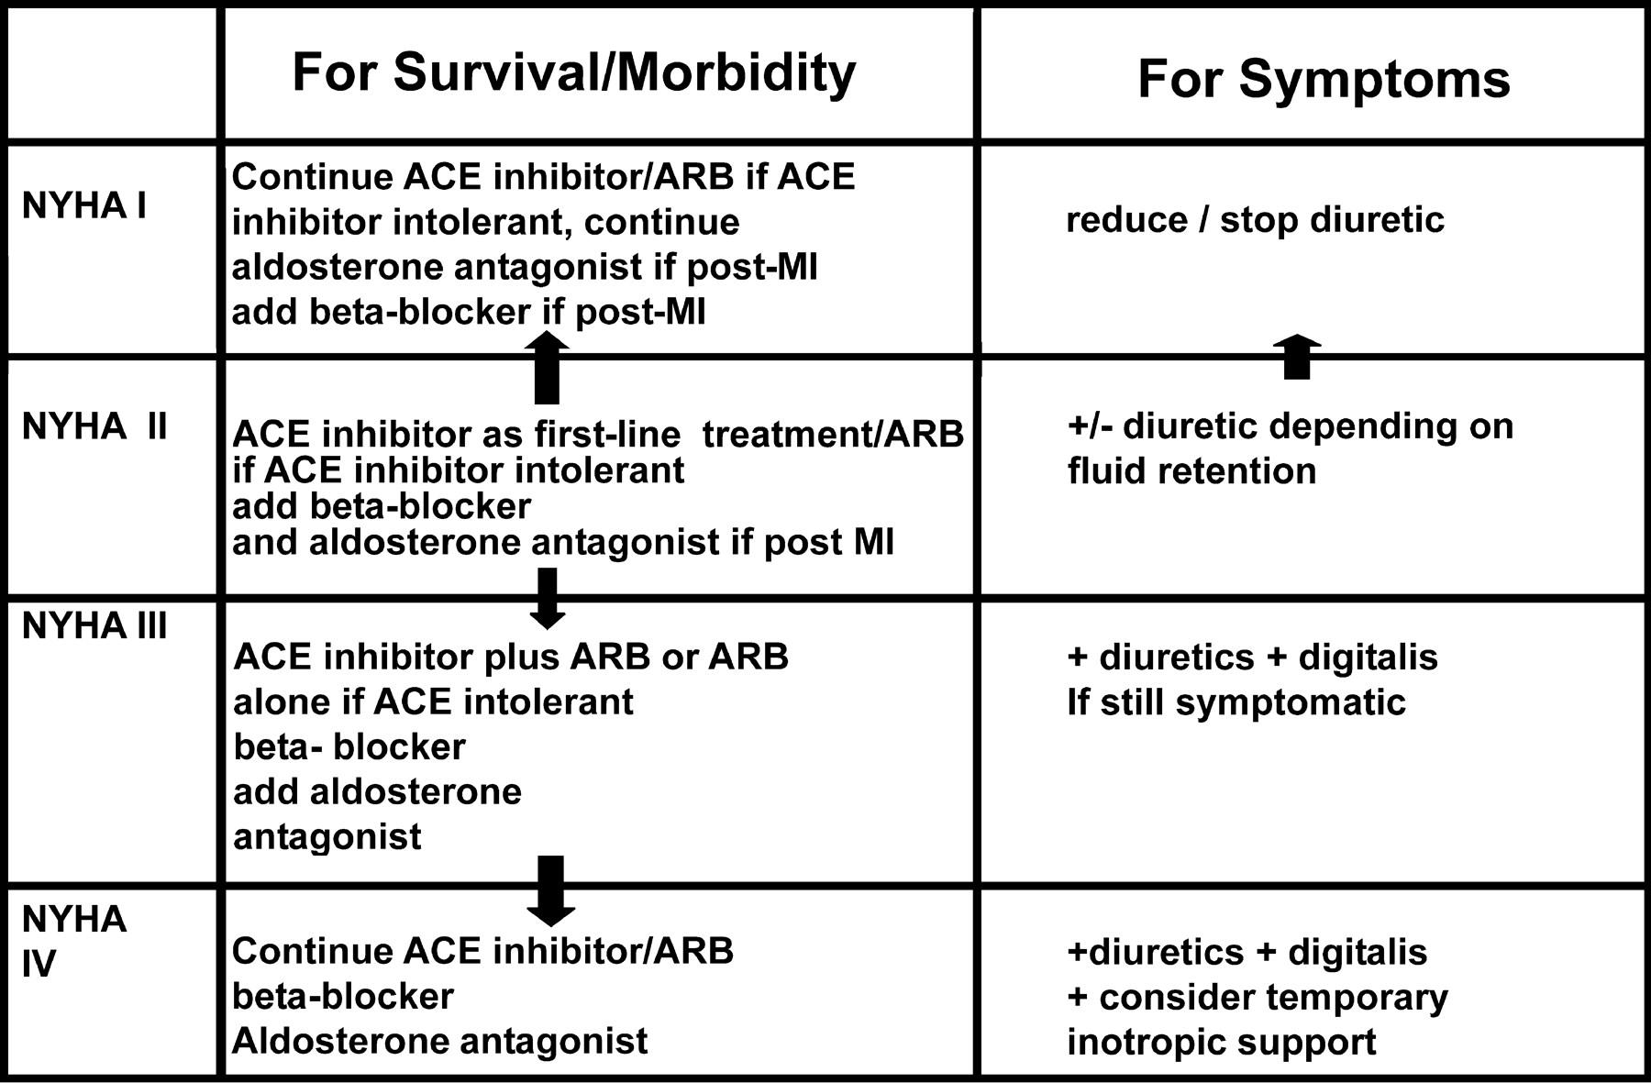
Management of chronic heart failure
48

Slide 49
Congestive Heart Failure in Black patients
Hydralazine/isosorbide dinitrate fixed dose combination
FDA approved to add to standard therapy for
black Americans with congestive heart failure
( due to poor response to ACE inhibitors )
should be considered for patients intolerant to ACE inhibitors & ARBs due to
renal dysfunction
49

Slide 50
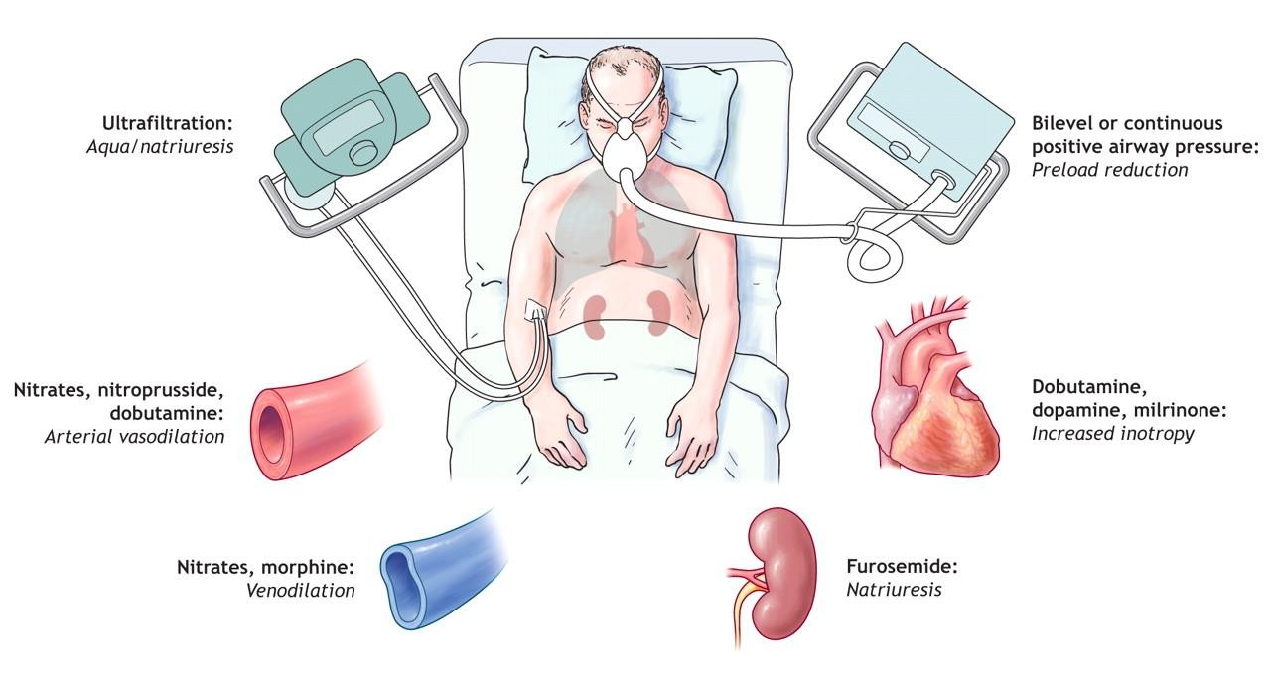
Management of acute heart failure
50

Slide 51

Thank you

