Slide 1



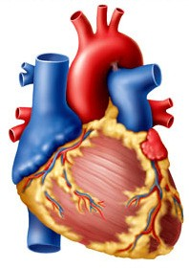
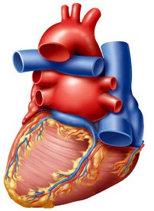

CARDIOVASCULAR SYSTEM
CARDIAC CYCLE
Dr Syed Shahid Habib
Professor & Consultant Clinical Neurophysiology Dept. of Physiology
College of Medicine & KKUH King Saud University
PROF. HABIB 2018

Slide 2
OBJECTIVES
At the end of the lecture you should be able to …..
Enumerate the phases of cardiac cycle
Explain the effect of heart rate on duration of systole and diastole
Recognize the pressure, electrical, sound and volume changes during cardiac cycle
Correlate different phases of cardiac cycle with various changes in events.
Compare and contrast left and right ventricular pressures and volumes during the normal cardiac cycle.
Describe atrial pressure waves & their relationship to cardiac cycle
Describe the use of the pressure-volume loop in describing the phases of the cardiac cycle
SOURCE GUYTON 13TH ED. CHAPTER9: PAGE:113-119
PROF. HABIB 2018

Slide 3
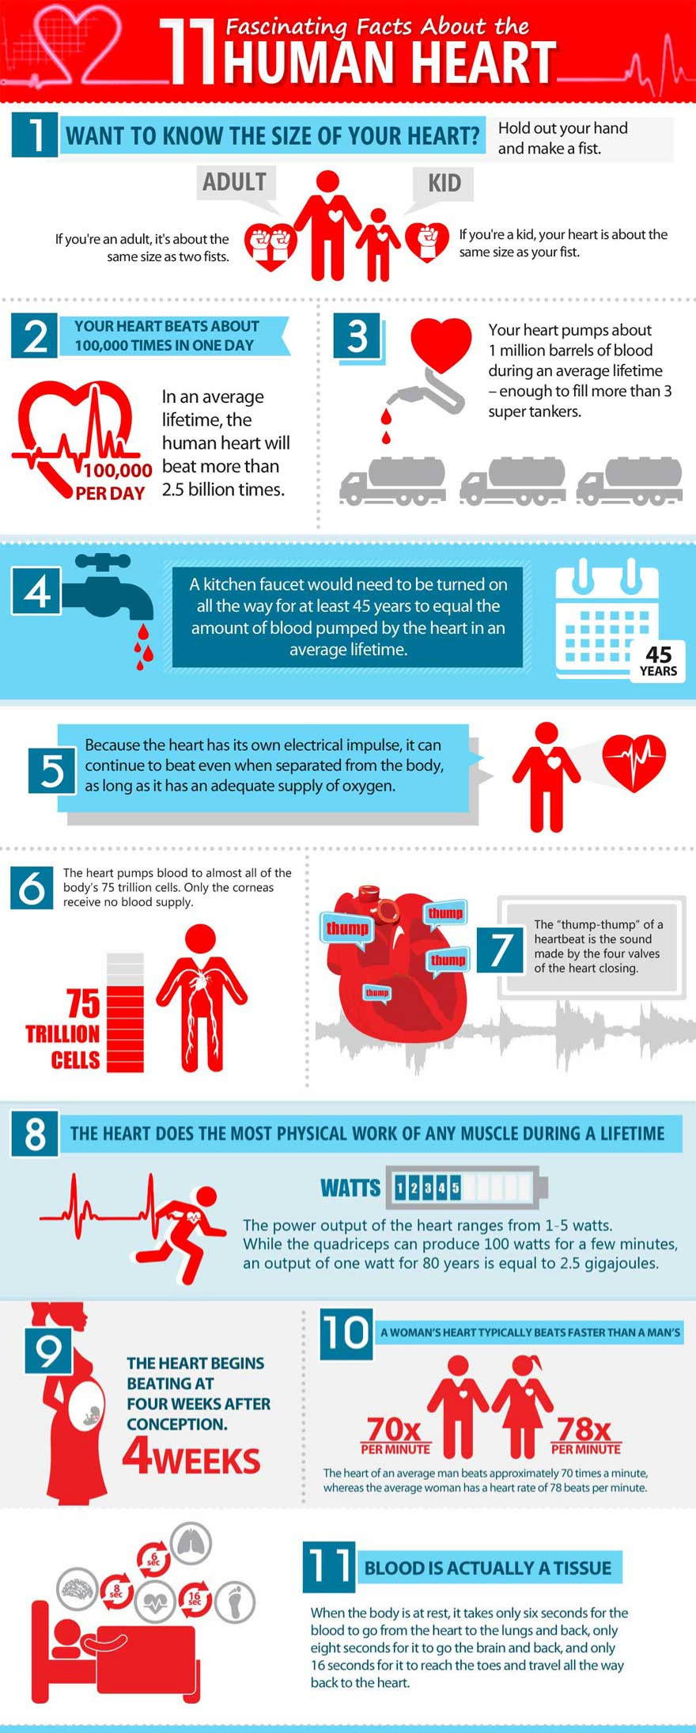
FACTS ABOUT OUR HEART
Size of a fist and weighing about 250 grams
In lifetime beats 2,500 million times and pumps 110 million gallons of blood.
Every day, your heart creates enough energy to drive a truck for 20 miles (32 km).
In a lifetime, that is equivalent to driving to the moon and back
Our heart has its own electrical impulse, it can continue to beat even when separated from the body, as long as it has an adequate supply of oxygen

Slide 4

CARDIAC CYCLE
Definition: Cardiac Cycle is the time duration comprising all the events from beginning of one heart contraction to the beginning of next heart contraction.
At heart rate of 75 beats per minute duration of one Cardiac cycle is 0.8 second.
What are the Events?

Slide 5
EVENTS OF CARDIAC CYCLE
Mechanical changes:
Phases of cardiac cycle
Heart sounds
Pressure changes during cardiac cycle
Volume changes during cardiac cycle Electrical Changes
Electrocardiogram (ECG)

Slide 6
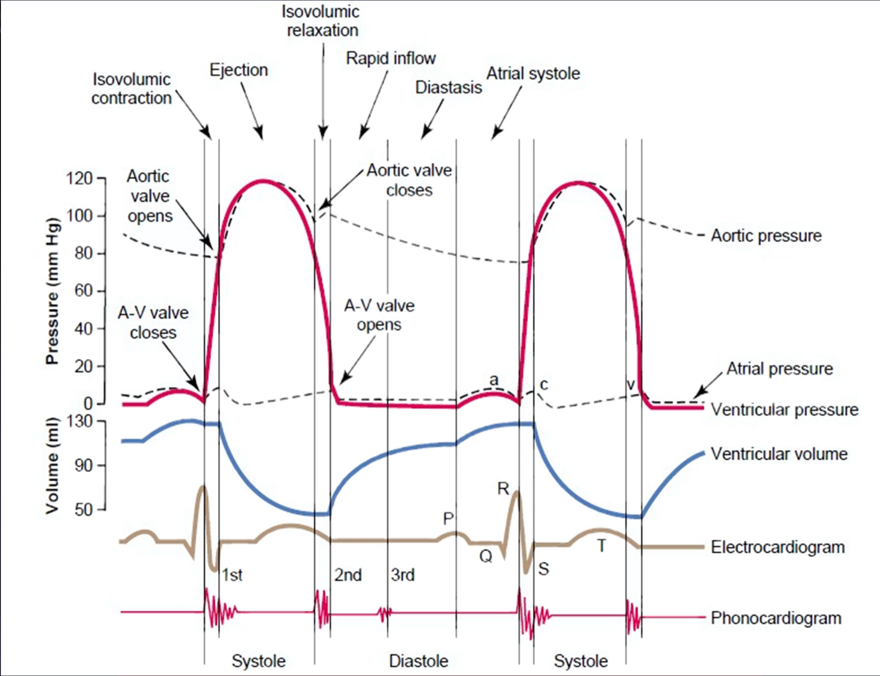
The Events of the Cardiac Cycle
PROF. HABIB 2018

Slide 7

PHASES OF CARDIAC CYCLE
Atrial Events
Atrial systole: 0.1 second
Atrial diastole : 0.7 seconds
Ventricular Events
Ventricular systole : 0.3 seconds
Ventricular diastole : 0.5 seconds
CARDIAC CYCLE
0.8 SECONDS

Slide 8


ATRIAL DIASTOLE
0.7 SECONDS
ATRIAL SYSTOLE
0.1 SEC
VENTRICULAR SYSTOLE
0.3 SECONDS
VENTRICULAR DIASTOLE
0.5 SECONDS
CARDIAC CYCLE
0.8 SECONDS

Slide 9
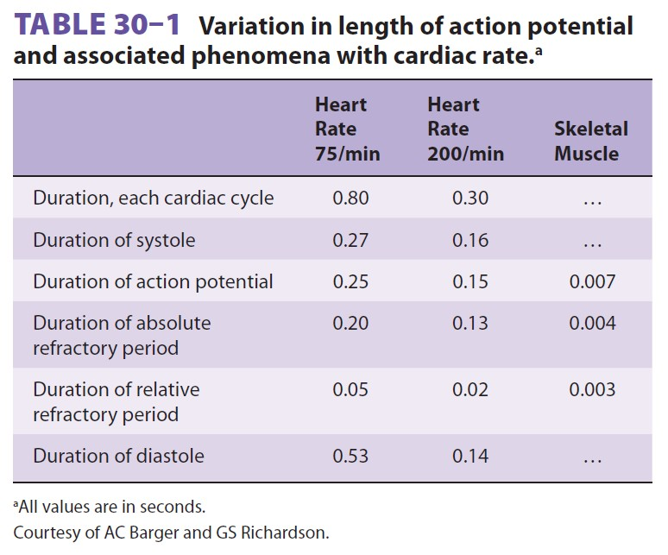

Slide 10
VENTRICULAR EVENTS
Ventricular systole 1.Isovolumetric contraction 2.Ejection phase
  Rapid ejection
  Slow ejection
Ventricular Diastole
Isovolumetric relaxation phase
Filling phase
  Rapid filling
  Slow filling (Continued filling)
  Last rapid filling (Atrial Systole)

Slide 11
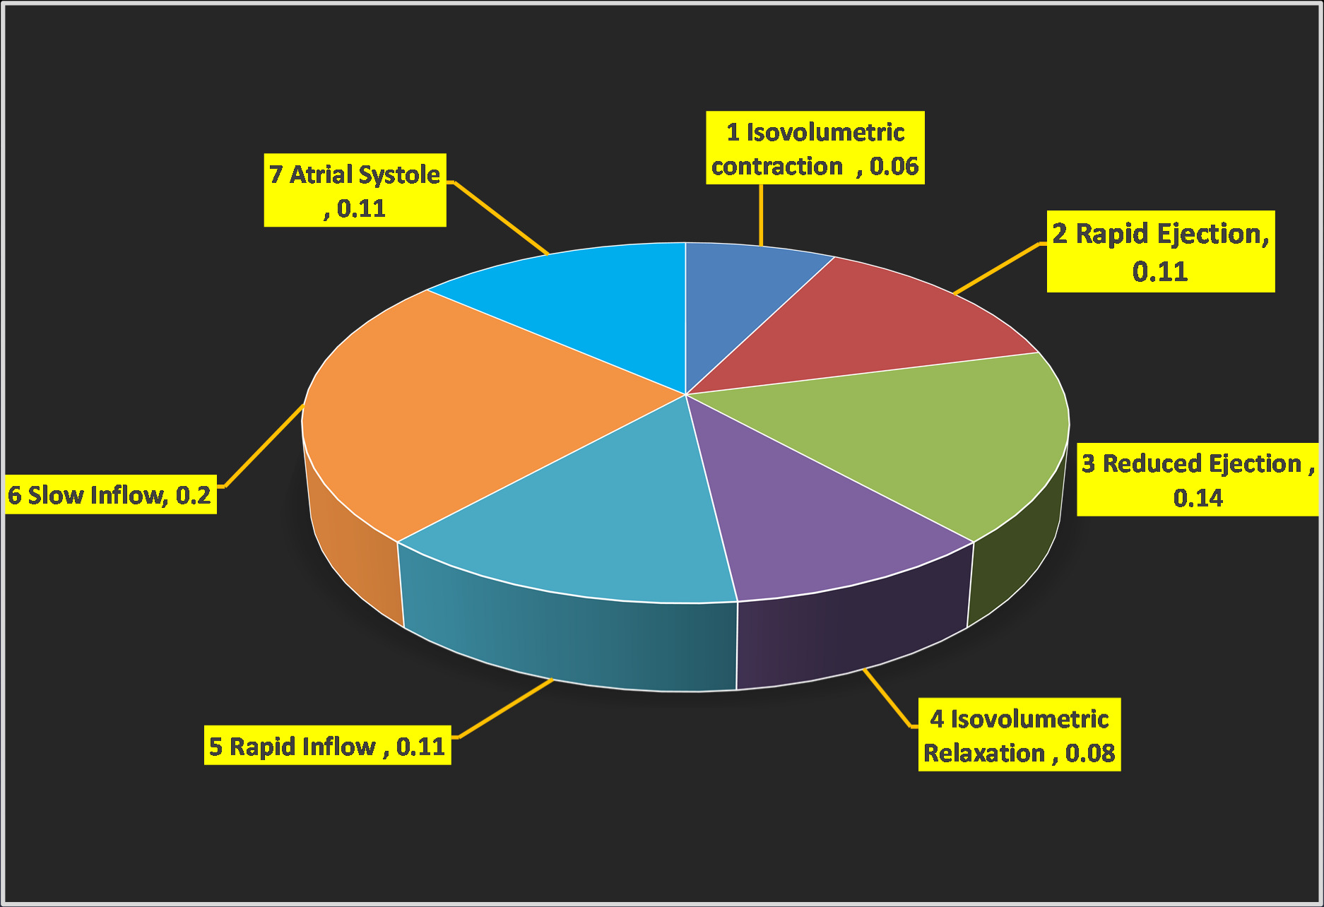
PHASES OF CARDIAC CYCLE

Slide 12
VENTRICULAR SYSTOLE 0.31 sec (Peak of R wave of QRS complex to the end of T wave)
ISO-VOLUMETRIC CONTRACTION | 0.06 sec
MAXIMUM EJECTION (2/3, 70%) | 0.11 sec
REDUCED EJECTION (1/3, 30%) | 0.14 sec
VENTRICULAR DIASTOLE 0.52 sec (End of T wave to the peak of R wave of QRS complex)
ISO-VOLUMETRIC RELAXATION | 0.06 sec
RAPID INFLOW | 0.11 sec
SLOW INFLOW / DIASTASIS | 0.2 sec
ATRIAL SYSTOLE (after P wave) | 0.11 sec
7 Phases of CARDIAC CYCLE | 0.8 sec
Importance of the long ventricular diastole? This is important for:
PROF. HABIB 2018
Coronary blood flow & Ventricular filling

Slide 13
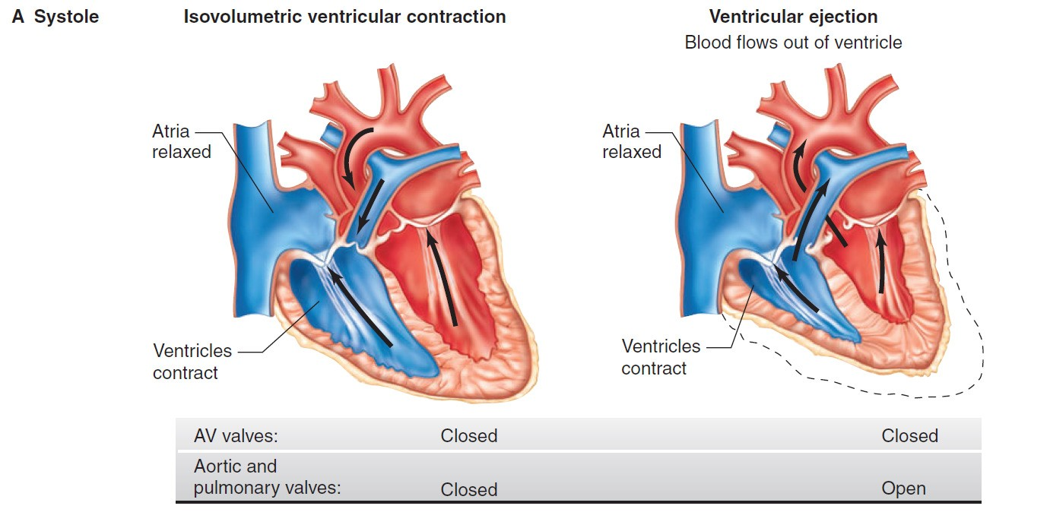

Slide 14
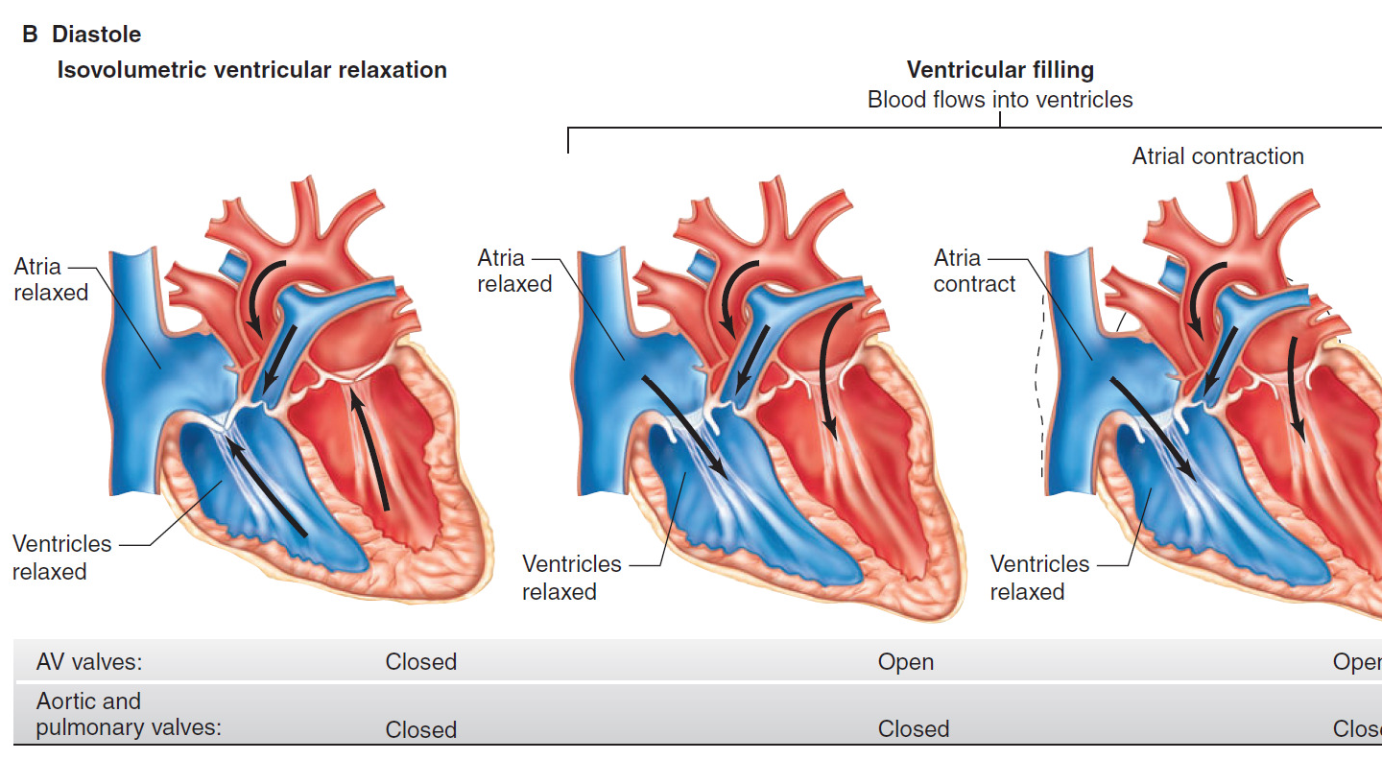

Slide 15
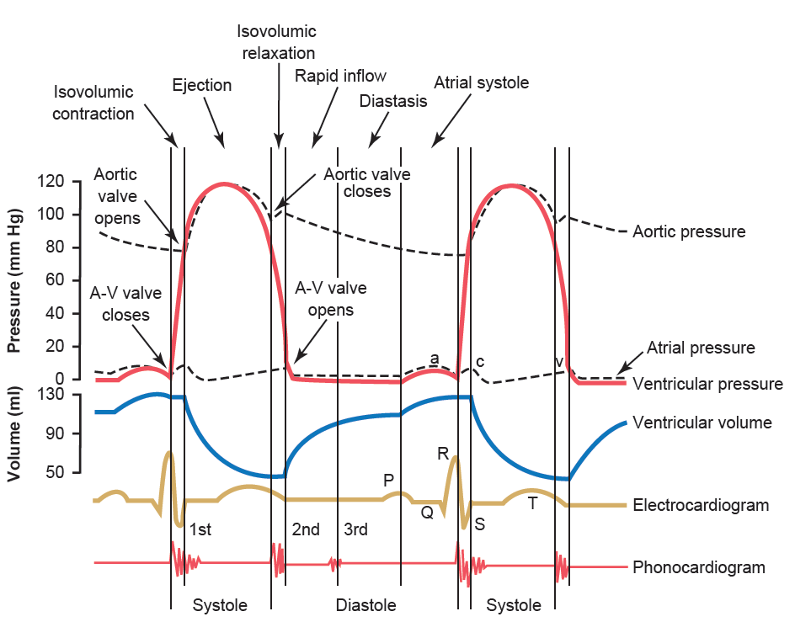
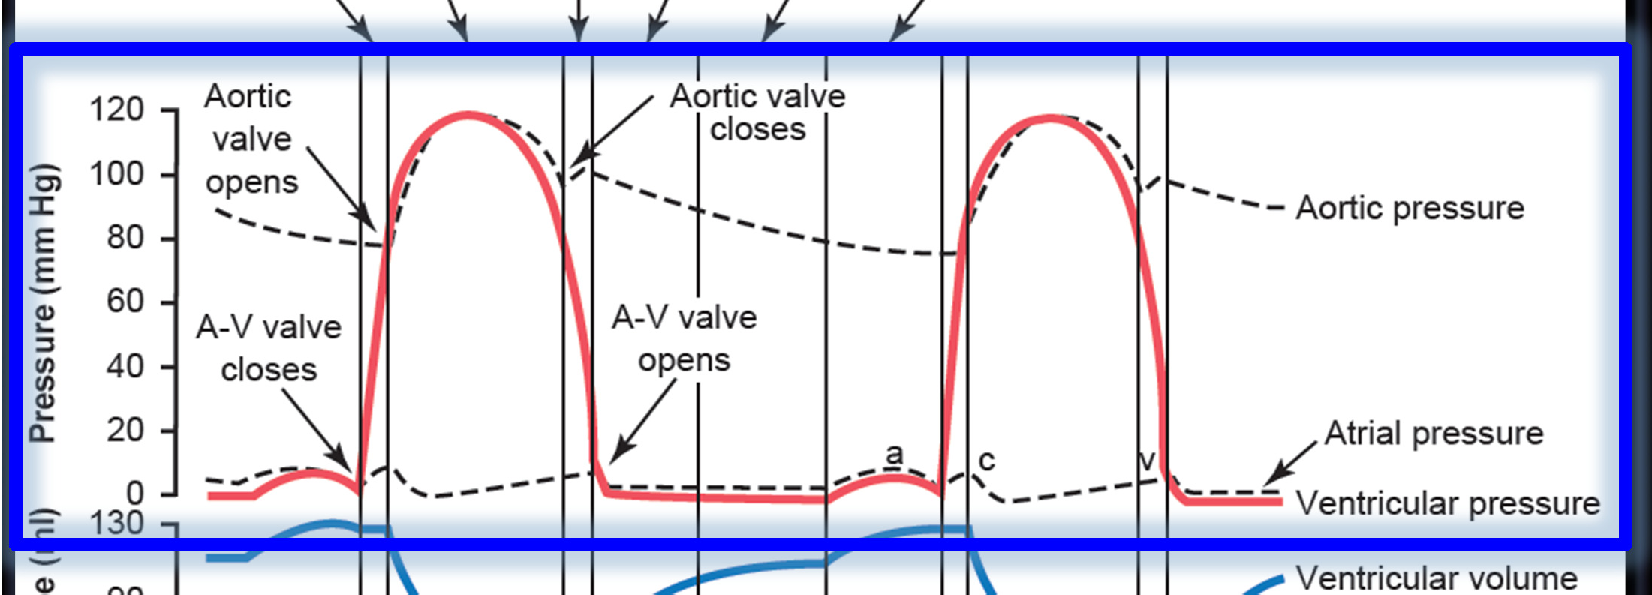
PRESSURE CHANGES

Slide 16
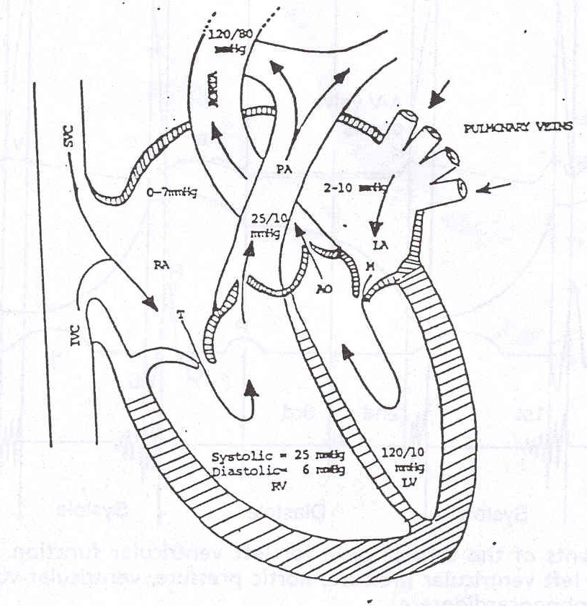
VARIOUS PRESSURE VALUES
CHAMBERS | NORMAL RANGE (mm of Hg)
Right Atrium | 2 – 8
Right Ventricle ( systolic) (diastolic) | 15 – 25 2 -8
Pulmonary Artery (systolic) (diastolic) | 15 – 25 8 - 15
Left Atrium | 2-10
Left Ventricle (systolic) (diastolic) | 100 – 120 2 – 10
PROF. HABIB 2018

Slide 17
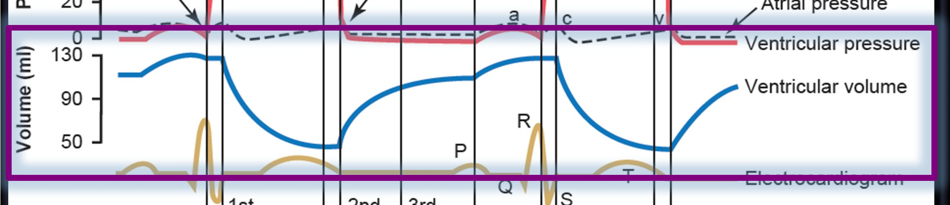
VOLUME CHANGES

Slide 18
End Diastolic Volume: Volume of blood in each ventricle at the end of diastole.
It is about 110 – 120 ml.
End Systolic Volume: Volume of blood in each ventricle at the end of Systole. It is about 40 to 50 ml
Stroke Volume: It is a volume of blood pumped out by each ventricle per beat. It is about 70 ml.
Stroke volume (SV) = EDV – ESV

Slide 19
EJECTION FRACTION (EF) is the percentage of ventricular end diastolic volume (EDV) which is ejected with each stroke.
SV or (EDV – ESV)
EF =
X 100
EDV
75
X 100 = 62.5%
120
Normal ejection fraction is about 60 – 65 %.
Ejection fraction is good index of ventricular function.

Slide 20
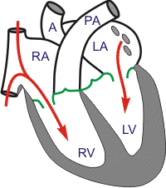
ATRIAL SYSTOLE
Atrial Depolarization
⧫
Atrial contraction
⧫
Atrial pressures rise
⧫
Blood flows across AV valves
ATRIA = PRIMER PUMPS .
Ventricular filling :
80% - direct flow from SVC & IVC
20% - atrial contraction.

Slide 21
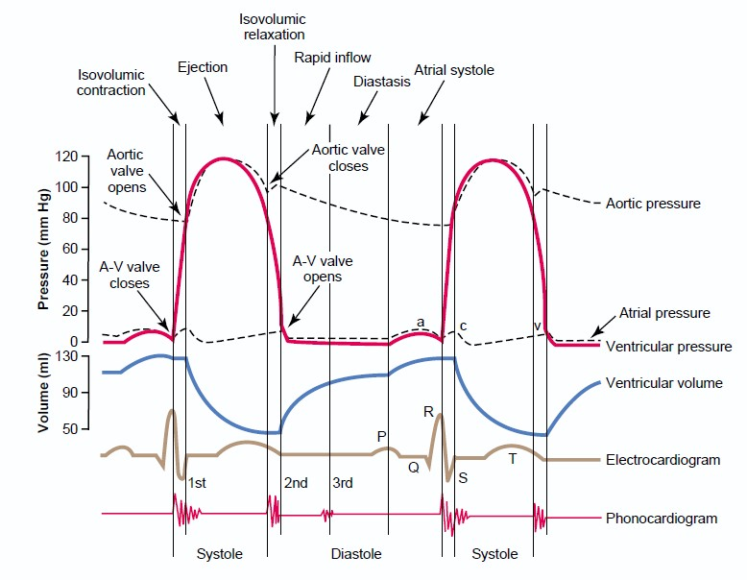

Slide 22
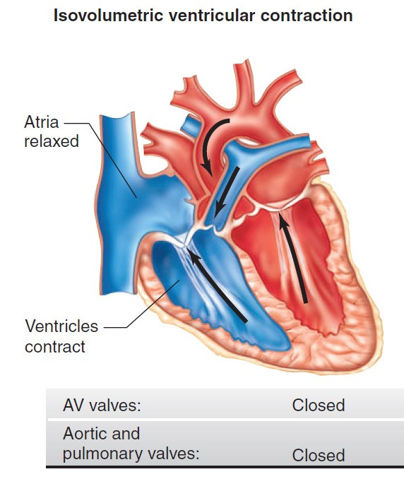
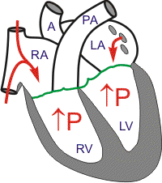
ISOVOLUMETRIC CONTRACTION
Increase in ventricular pressure > atrial pressure → AV valves close
After 0.02s, semilunar valves open
Period between AV valve closure and semilunar valve opening → heart prepares for contraction without shortening→ occurs without emptying
Tension develops without change in muscle length

Slide 23
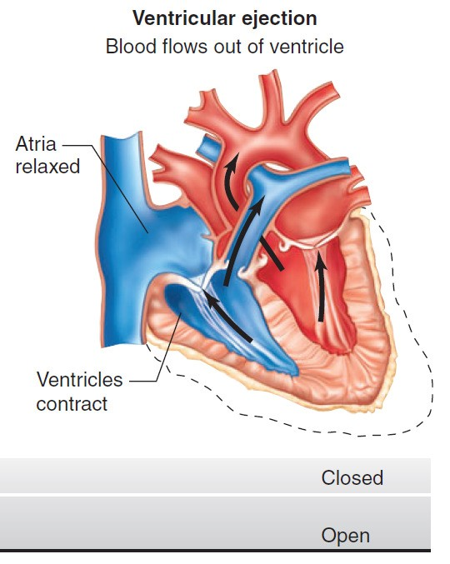
EJECTION
When LV pres > 80 mm Hg RV pres > 8 mm Hg,
The semilunar valves open.
Rapid Ejection – 70% emptying in first 1/3 duration
Slow Ejection – 30% in last 2/3 time
The pressure in the ventricle keeps decreasing until it becomes lower than that of the great vessels

Slide 24
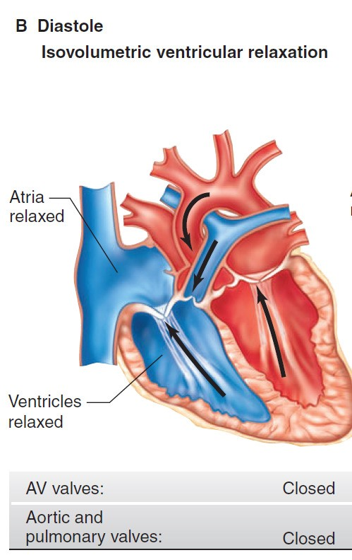
ISOVOULUMETRIC RELAXATION
When ventricle pressure < arterial pressure→ backﬂow of blood → forces semilunar valves to close.
For 0.03-0.06 s, ventricle relaxes despite no change in its volume
AV and Semilunar valves are closed
Meanwhile, atria fill up and atrial pressure gradually rises
Pressures in ventricle keep falling till it is < atrial pressure

Slide 25
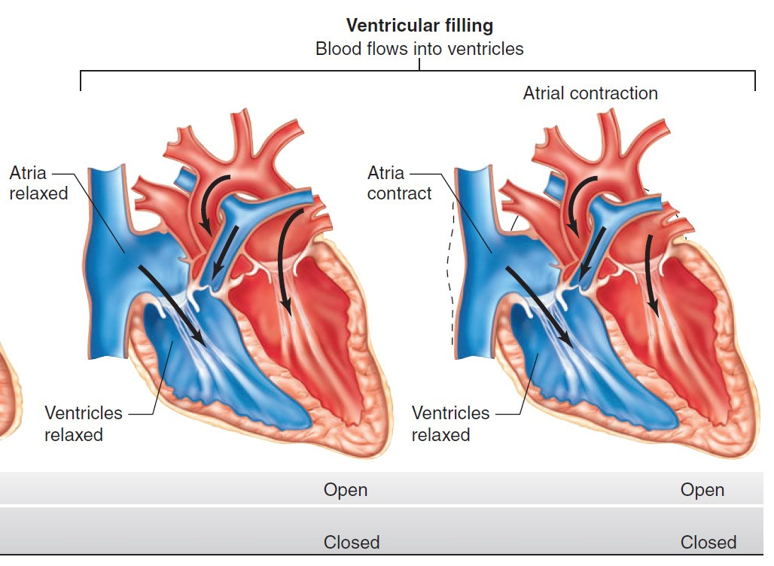
VENTRICULAR FILLING
Begins with the opening of AV valves
Rapid filling – first 1/3 of diastole (60-70% blood)
Reduced filling (Diastasis) – middle 1/3 of diastole
Atrial contraction – last 1/3 of diastole (27-30% blood)
As the atrial pressures fall, the AV valves close and left ventricular volume is now maximum → EDV (120 ml in LV)

Slide 26
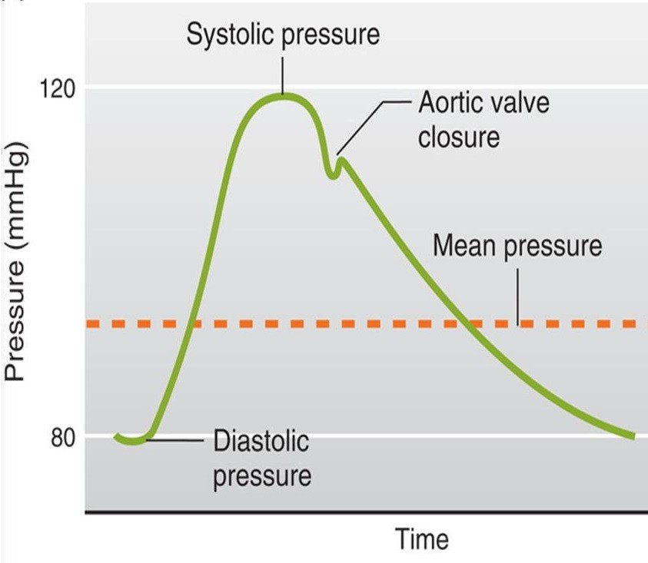
Aortic Pressure Curve
Ascending or anacrotic limb:
❑ This coincides with the ‘rapid ejection phase’
❑ The amount of blood enters aorta > leaves
❑ Aortic pressure ↑ up to 120 mmHg
Descending or catacrotic limb: (Has 4 stages)
Pulmonary artery pressure changes are similar to the aortic pressure changes but with difference in magnitude. Normal pulmonary artery pressure during the cardiac cycle ≈ 25-30/4-12 mmHg

Slide 27
Descending / catacrotic limb - 4 STAGES
↓ Aortic pressure:
❑ This coincides with the ‘reduced ejection phase’
❑ The amount of blood enters aorta < leaves
Dicrotic notch (incisura): Due to closure of aortic valve
❑ There is sudden drop in aortic pressure
❑ This notch is seen in the aortic pressure curve at end of ventricular systole
Dicrotic wave:
Due to elastic recoil of the aorta
❑ Slight ↑ in aortic pressure
Slow ↓ aortic press: up to 80 mmHg Due to continued flow of blood from
aorta → systemic circulation

Slide 28
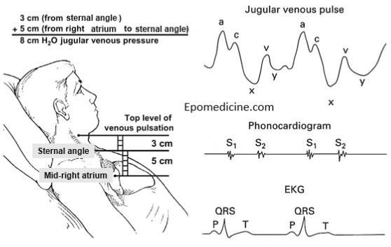
Atrial pressure changes during the cardiac cycle THE JUGULAR VENOUS PULSE (JVP)

Slide 29
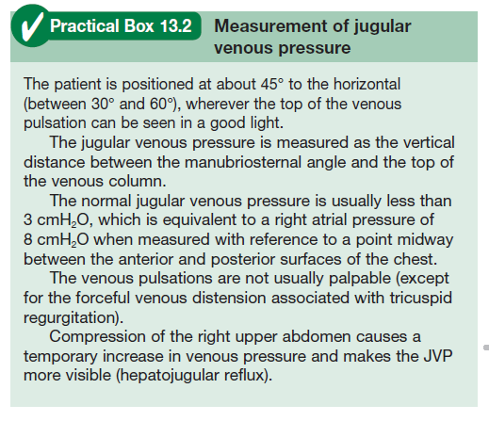
OF. HABIB 2018

Slide 30
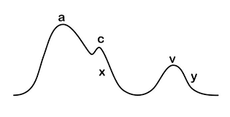
Atrial pressure changes during the cardiac cycle
The 3 wave (a, c, & v) are equal to ONE cardiac cycle = 0.8 sec
3 upward waves:
❑ a, c, & v waves
❑ 2 components in each wave: +ve (↑ pr), -ve (↓ pr)
2 downward deflection (waves):
❑ x & y waves

Slide 31
Atrial pressure waves
❑ ‘a’ wave: Atrial systole: ↑ atrial pressure during atrial contraction
❑ ‘c’ wave: Ventricular systole
❑ +ve as a result of bulging of AV valve into the atria during ‘isovolumetric contraction phase’
❑ -ve as a result of pulling of the atrial muscle & AV cusps down during ‘rapid ejection phase’, resulting in ↓ atrial pressure
❑ ‘v’ wave: Atrial diastole or ↑ venous return (VR)
❑ +ve: atrial pressure ↑ gradually due to continuous VR
❑ -ve as a result of ↓ atrial pressure during ‘rapid filling phase’
❑ ‘x’ descent:
❑ Downward displacement of AV valves during ‘reduced ejection phase’
❑ ‘y’ descent:
❑ ↓ atrial pressure during ‘reduced filling phase’

Slide 32
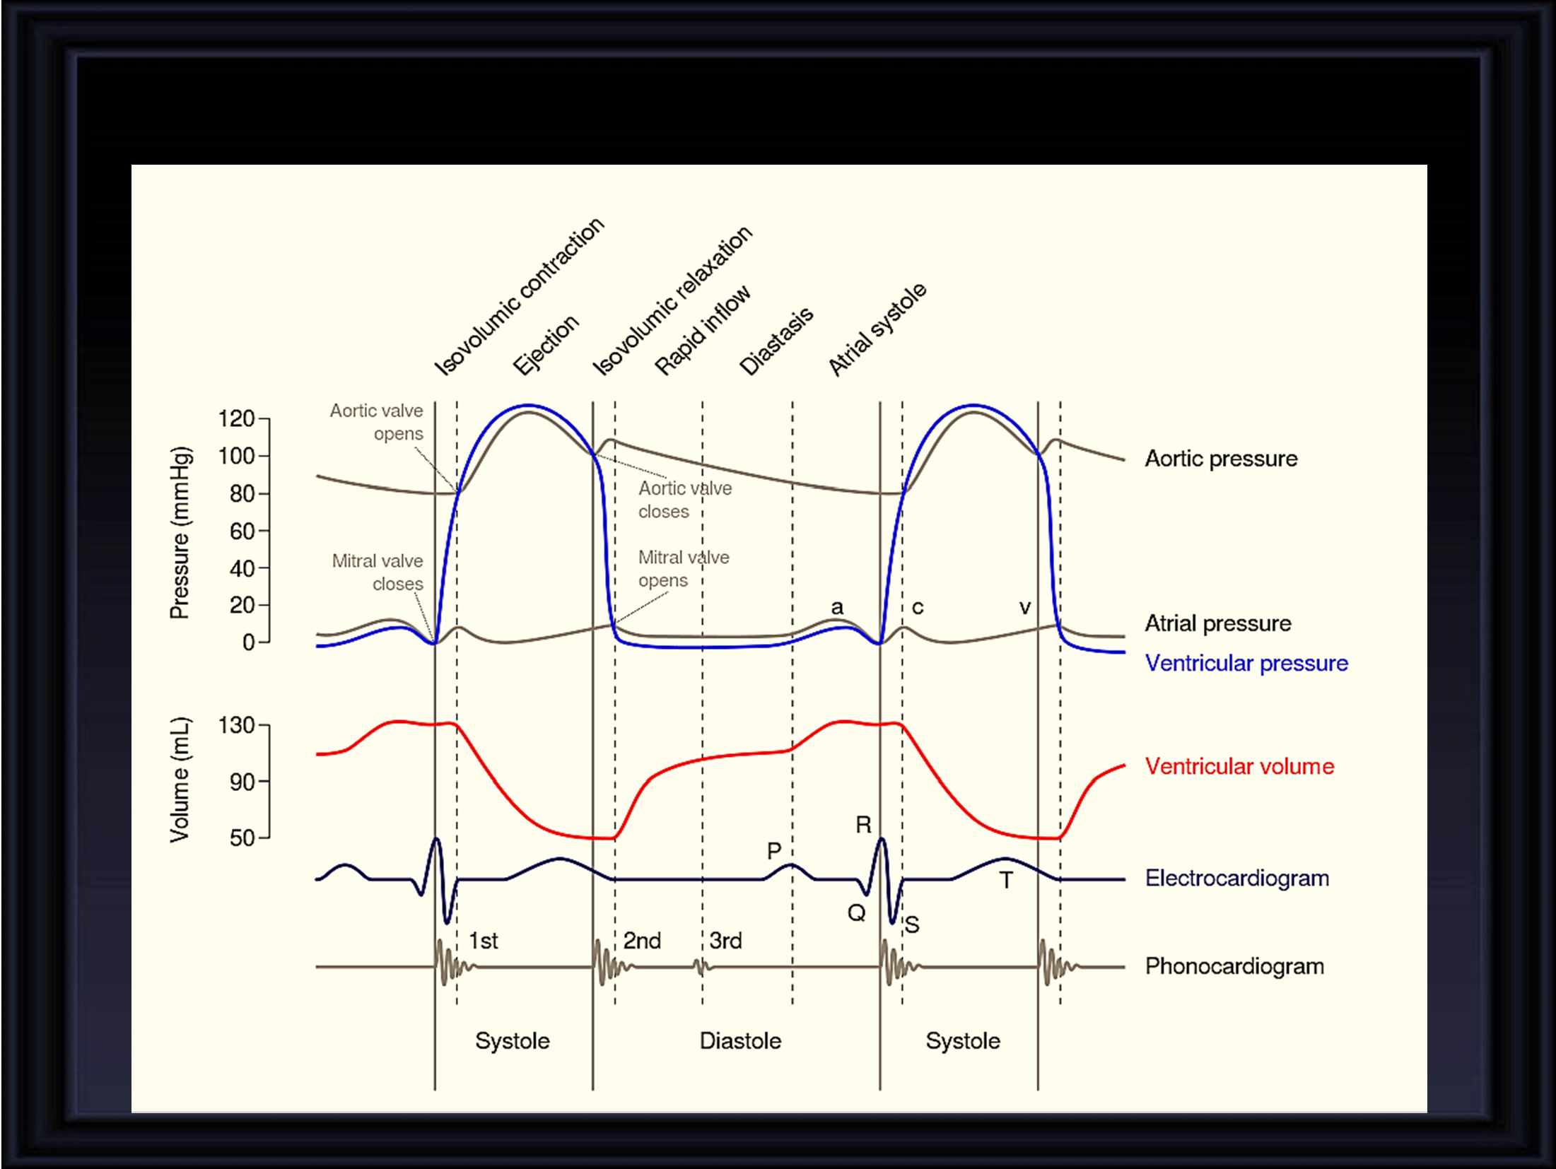
CORRELATING EVENTS TOGETHER
26

Slide 33
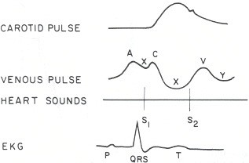
ATRIAL SYSTOLE
JVP – ‘a’ wave
ECG – P wave precedes the atrial systole. PR interval – depolarization proceeds to the AVN. The brief pause allows complete ventricular filling
Heart sounds - S ₄ – pathological. Vibration of the ventricular wall during atrial contraction. Heard in ‘stiff’ ventricle like in hypertrophy and in elderly. Also heard in massive pulmonary embolism, cor pulmonale, TR

Slide 34
ISOVOLUMETRIC CONTRACTION
Volume does not change All valves are closed
JVP – ‘c’ wave → due to the bulging of the Tricuspid valve into RA secondary to increased pressure in the ventricle.
ECG – End of QRS complex
Heart Sounds – S₁ : closure of the AV valves.

Slide 35
EJECTION
Rapid Slow
JVP – no waves
ECG – T wave
Heart sounds – none
Aortic pressure - Rapid rise in the pressure = 120 mm Hg. Even at the end of systole pressure in the aorta is maintained at 90 mm Hg because of the elastic recoil

Slide 36
ISOVOLUMETRIC RELAXATION
Volume does not change All valves are closed
JVP: ‘v’ wave – due to venous return to the atria from SVC and IVC
ECG: End of T wave
Heart sounds: S₂ : closure of the semilunar valves coincides with this phase.
Aortic pressure curve: INCISURA - when the aortic valve closes. Caused by a short period of backflow before the valve closes followed by sudden cessation of the backflow when the valve closes.

Slide 37
VENTRICULAR FILLING
Rapid filling
Reduced filling
Atrial contraction
JVP – ‘y’ descent in first 2/3 & ‘a’ wave in last 1/3
ECG – P wave before atrial systole
Heart sounds - S₃ - Pathological in adults. Seen in dilated congestive heart failure, MI, MR, severe hypertension. Normal in children.

Slide 38
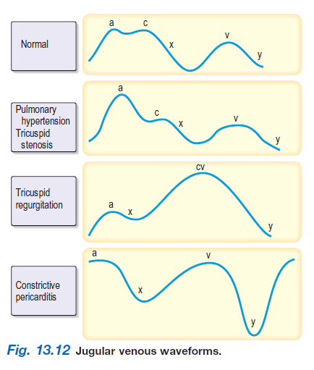

Slide 39
ABNORMALITIES OF “a” WAVE
Elevated a wave
Tricuspid stenosis
Decreased ventricular compliance (ventricular failure, pulmonic valve stenosis, or pulmonary hypertension)
Cannon a wave
Atrial-ventricular asynchrony (atria contract against a closed tricuspid valve)
complete heart block, following premature ventricular contraction, during ventricular tachycardia, with ventricular pacemaker
Absent a wave
Atrial fibrillation or atrial standstill Atrial flutter

Slide 40
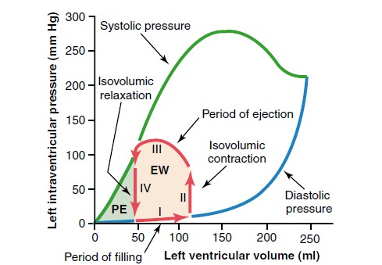
“Volume-Pressure Diagram” During the Cardiac Cycle; Cardiac Work Output.

Slide 41
BASIC MYOCARDIAL MUSCLE MECHANICS:
Both ventricular systole & diastole can be divided into early & late phases.
Systole:
Early systole = ‘Isovolumetric Contraction’.
Late systole = Isotonic Contraction ‘EjectionPhase’.
Diastole:
Early diastole = ‘IsovolumetricRelaxation’.
Late diastole = Isotonic Relaxation ‘Filling Phase’.

Slide 42
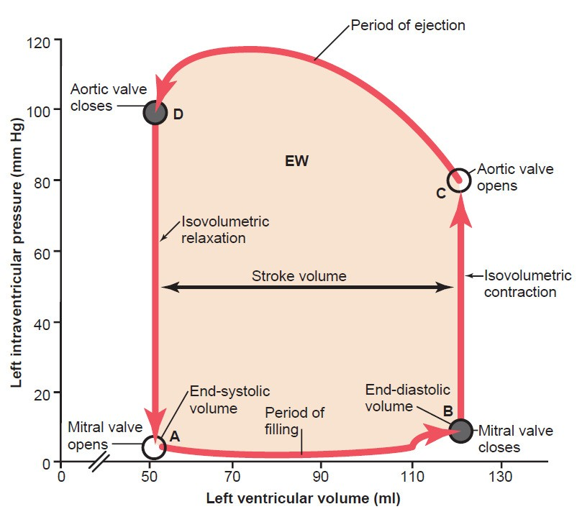
VENTRICULAR PRESSURE - VOLUME LOOP
Plots LV pressure against LV volume through one complete cardiaccycle
Systole: divided into
Early systole Late systole
Diastole: divided into Early diastole Late diastole
→ LateDiastole
(Filling phase)

Slide 43




VENTRICULAR PRESSURE - VOLUME LOOP
End of Systole
Contractility Area = Work Compliance
Systolic BP
Diastolic BP
Beginning of Systole
ESV
EDV
SV = EDV - ESV

Slide 44
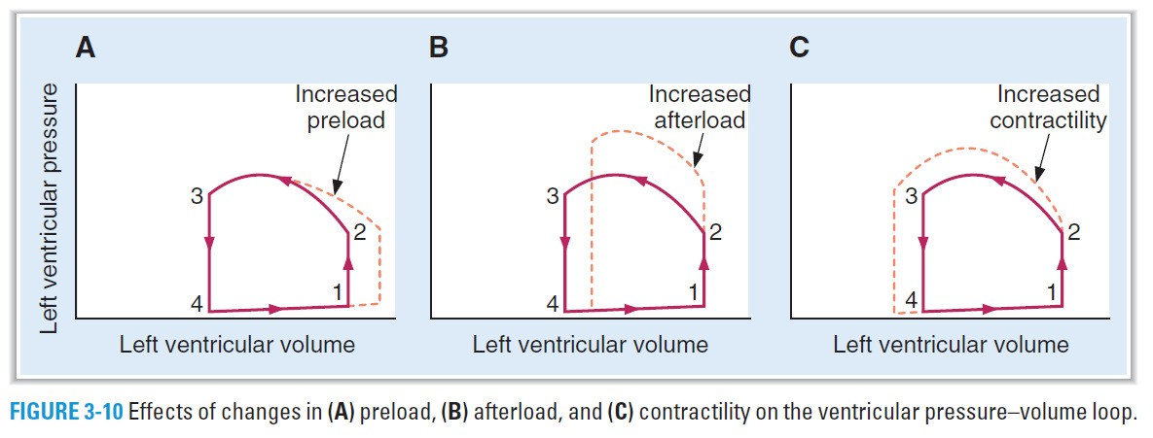
a. Increased preload: n refers to an increase in end-diastolic volume and is the result of increased venous return.
causes an increase in stroke volume based on the Frank–Starling relationship….reflected in increased width of the pressure–volume loop.
b. Increased afterload refers to an increase in aortic pressure.
n The ventricle must eject blood against a higher pressure, resulting in a decrease in stroke volume….is reflected in decreased width of the pressure–volume loop.
The decrease in stroke volume results in an increase in end-systolic volume.

Slide 45
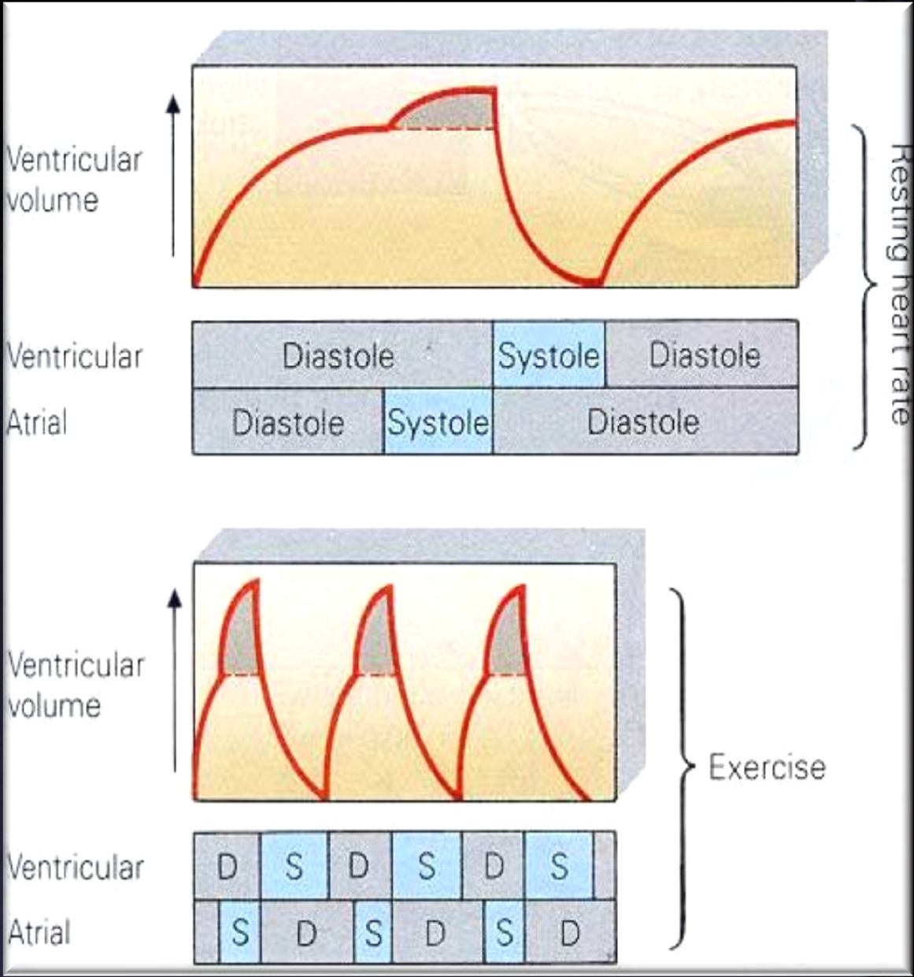
EFFECT OF ATRIAL CONTRACTION ON VENTRICLE FILLING
❑ At rest, atrial contraction adds little extra blood to the ventricles.
❑ When the heart rate is high, ventricle filling time is reduced.
❑ During exercise, atrial contraction adds a MORE amount of blood to the ventricles.

Slide 46
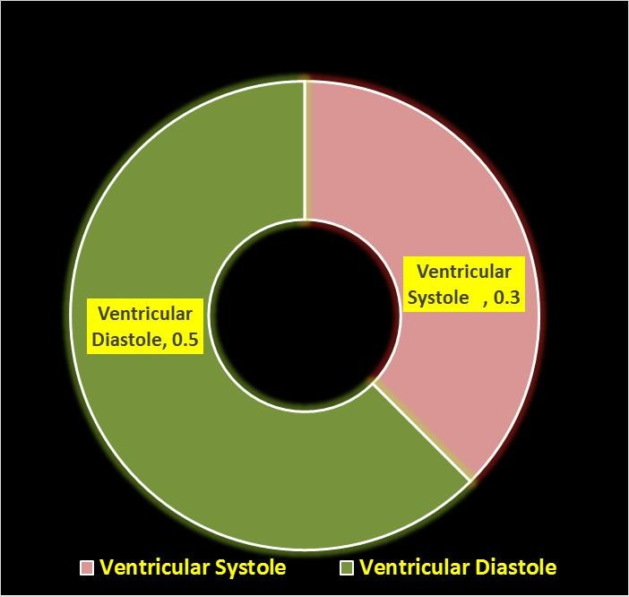
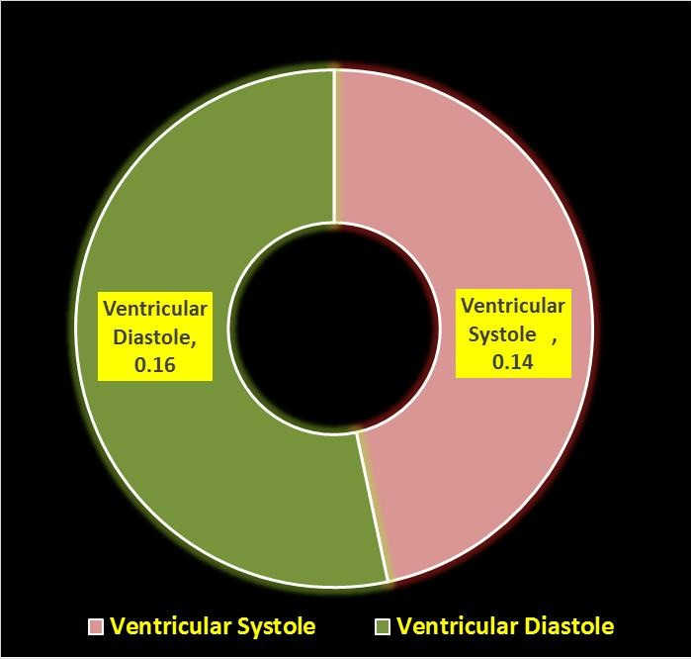


Hear Rate & Cardiac Cycle
At Rest
After Exercise

Slide 47
Hear Rate & Cardiac Cycle
Higher the rate lesser is duration of Cardiac cycle.
However, the duration of systole is much more fixed than that of diastole.
When the heart rate is increased, diastole is shortened to a much greater degree. For example, at a heart rate of 65 beats/min, the duration of diastole is 0.62 s, whereas at a heart rate of 200 beats/min, it is only 0.14 s.
Physiologic and clinical implications of shortened diastole: The heart muscle rests during diastole. Coronary blood flows to the subendocardial portions of the left ventricle only during diastole. Furthermore, most of the ventricular filling occurs in diastole.
Up to about 180/min, filling is adequate as long as there is enough venous return,
and cardiac output per minute is increased by an increase in rate. However, at very high heart rates, filling may be compromised to such a degree that cardiac output per minute falls.

Slide 48

THANKS

