Slide 1
Anatomy of large blood vessels – arteries
Lecture 2
Please check our Editing File
{وَمَنْ يَتَوَكَّلْ عَلَى اللَّهِ فَهُوَ حَسْبُهُ}
هذا العمل لا يغني عن المصدر الأساسي للمذاكرة

Slide 2
Objectives
Define the word ‘artery’ and understand the general principles of the arterial system
Define arterial anastomosis and describe its significance
Define end arteries and give examples
Describe the aorta and its divisions and list the branches from each part
List major arteries and their distribution in the head & neck, thorax, abdomen, and upper & lower extremities
List main pulse points

Slide 3
Arteries:
Arteries carry blood from the heart to the body
All arteries carry oxygenated blood, except the pulmonary artery which carries deoxygenated blood to the lungs
General Principles of Arteries:
The flow of blood depends on the pumping action of the heart
Arteries have elastic walls with no valves
Branches of arteries normally anastomose with one another freely, providing backup routes for blood to flow if one artery is blocked e.g. arteries of of limbs
Arteries whose terminal branches do not anastomose with branches of adjacent arteries are called “end arteries”, and have two types:
Anatomic (true) end artery: no anastomosis exists (e.g. artery of retina)
Functional end artery: Anastomosis exists but isn’t capable of supplying enough blood (in case of block) (e.g. renal artery, splenic artery)

Slide 4
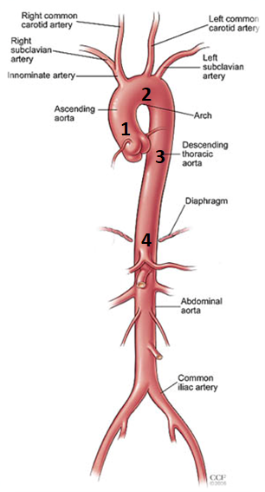
Aorta
The largest and longest artery in the body
Carries oxygenated blood to all parts of the body.
Is divided into 4 parts:
Ascending aorta
Arch of aorta
Descending thoracic aorta
Abdominal aorta

Slide 5
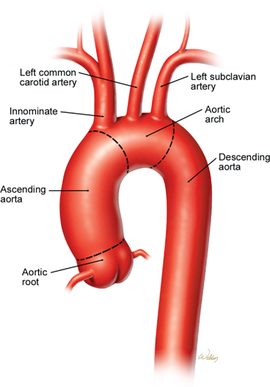
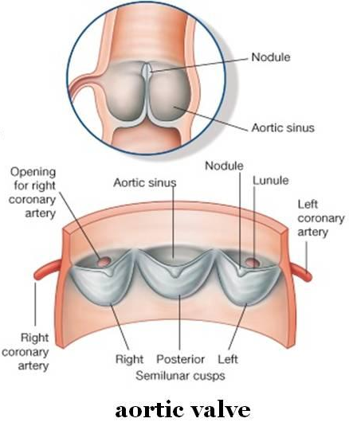
Ascending Aorta
Originates from left Ventricle.
Continues as the arch of Aorta (at the level of T4)
Has three dilatations at its base, called aortic sinuses
Branches (arise from sinuses & supply heart):
Right Coronary Artery
Left Coronary Artery
2
1

Slide 6
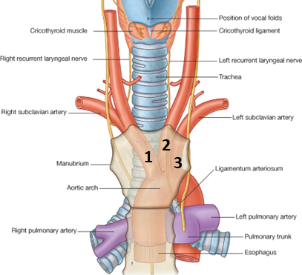
Arch of Aorta
Continuation of the ascending aorta
Leads to descending Aorta
Located behind the lower part of manubrium sterni and on the left side of Trachea
Branches:
Brachiocephalic Trunk
Left Common Carotid Artery
Left Subclavian Artery
The right common carotid and right subclavian are branches of the Brachiocephalic trunk

Slide 7
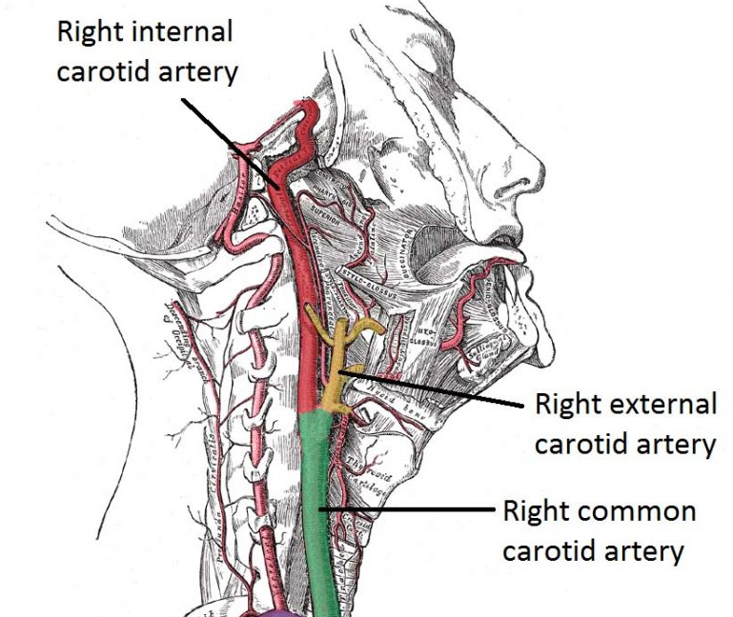
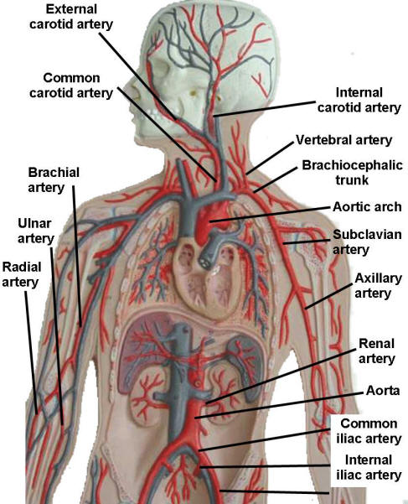
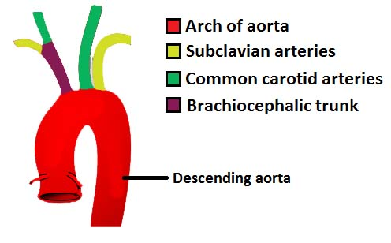

Slide 8
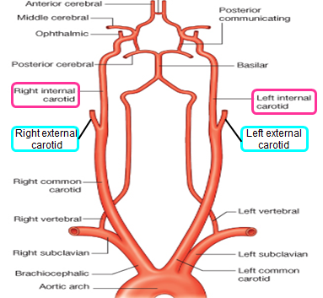
Common carotid artery
Origin:
➢ LEFT from aortic arch.
➢ RIGHT from brachiocephalic trunk.
• Each common carotid divides into two branches:
➢ Internal carotid
➢ External carotid
(At the level of the disc between C3 & C4)
Notes:
Enters cranial cavity, no branches in neck

Slide 9
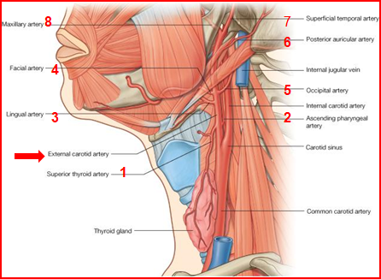
External carotid artery
It divides behind neck of mandible into: 1. Superficial temporal 2. Maxillary arteries It supplies: Scalp: Superficial temporal, occipital, & posterior auricular arteries Face: Facial artery Maxilla & mandible: Maxillary artery Tongue: Lingual artery Pharynx: ascending pharyngeal artery Thyroid gland: Superior thyroid artery

Slide 10
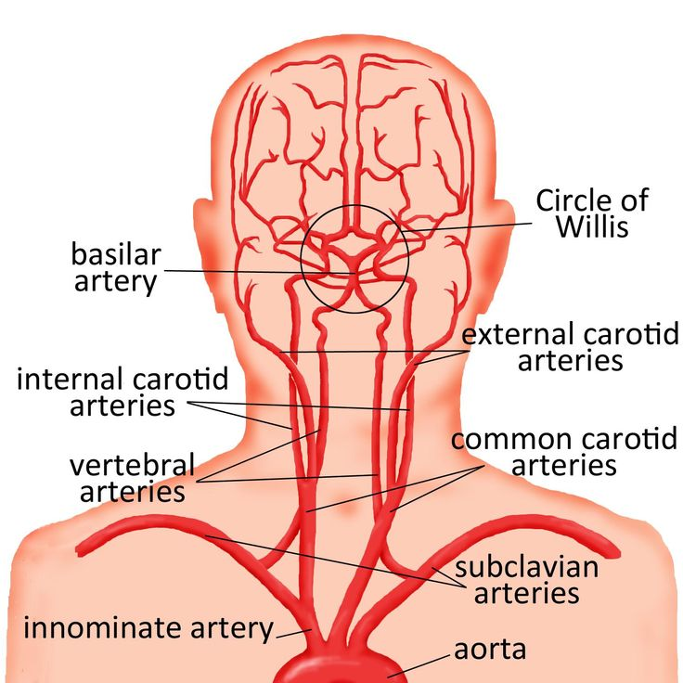
Internal carotid artery
O Has NO branches in the neck.
O Enters the cranial cavity, joins the basilar artery (formed by the union of two vertebral arteries) and forms ‘arterial circle of Willis’*so important* to supply brain.
O In addition, it supplies
•Nose
•Scalp
• Eye

Slide 11
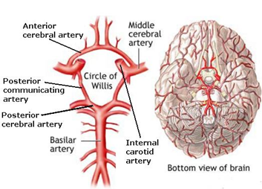
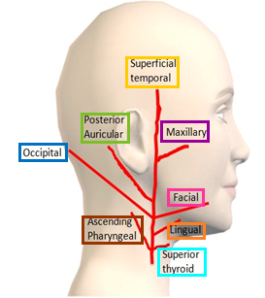
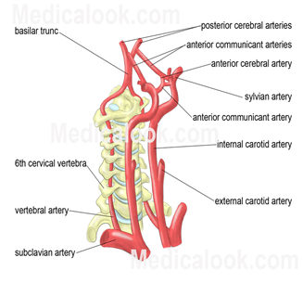
External carotid artery *mnemonics*
Internal carotid artery
Some American Ladies Found Our Pyramids So Magnificent
Some: Superior temporal artery
American: Ascending pharyngeal artery
Ladies: Lingual artery
Found: Facial artery
Our: Occipital artery
Pyramids: Posterior auricular artery
So: Superior thyroid
Magnificent: Maxillary *436 anatomy team*

Slide 12
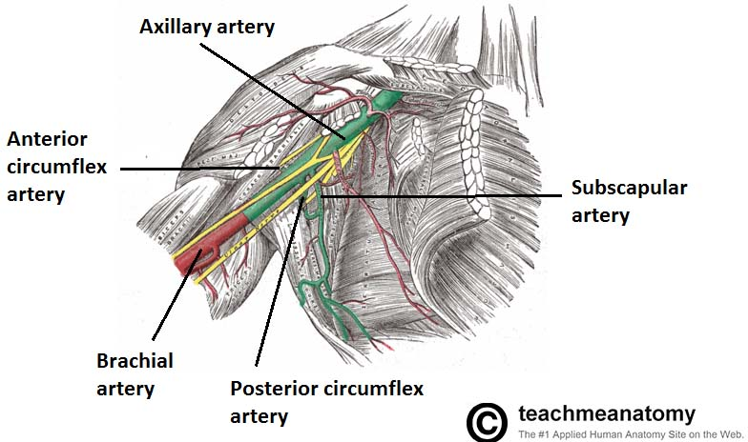
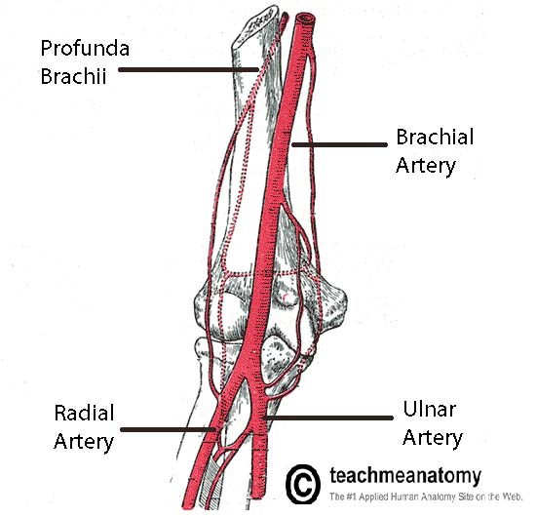
Subclavian artery
Arteries of upper limb
-Origin:
LEFT: from arch of aorta
RIGHT: from brachiocephalic trunk
- It continues, at lateral border of first rib, as axillary artery (artery of upper limb)
- Main branches:
•Vertebral artery: supplies brain & spinal cord
•Internal thoracic artery: supplies thoracic wall

Slide 13
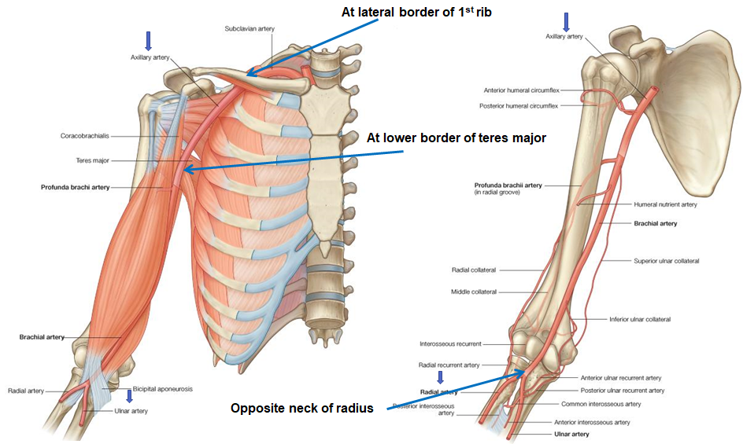
Arteries of upper limb
Recall the arteries of the upper limb:
o At the lateral border of the first rib the subclavian artery continues as the axillary artery.
o The axillary artery ends at the lower border of teres major and becomes the brachial artery.
o The brachial artery bifurcates into radial and ulnar arteries opposite the neck of radius.
*436 anatomy team*

Slide 14
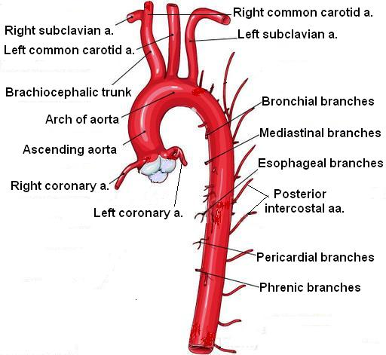
Descending thoracic aorta
It is the continuation of aortic arch
At the level of the 12th thoracic vertebra, it passes through the diaphragm and continues as the abdominal aorta
Branches of descending thoracic aorta:
1- Pericardial
2- Esophageal
3- Bronchial
4- Posterior intercostal
Supplies all structures in the thorax except the heart

Slide 15
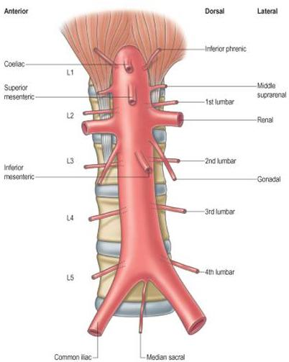
Abdominal aorta
It enters the abdomen through the aortic opening of diaphragm.
At the level of lower border of L4, it divides into two common Iliac arteries.
Branches: divided into two groups:
A-Single branches
B-Paired branches

Slide 16
Main branches of abdominal aorta
SINGLE BRANCHES :SUPPLYING GASTROINTESTINAL TRACT
1- coeliac artery
2-superior mesenteric artery
3-inferior mesenteric artery
4-median sacral
1
1
2
2
3
3
4
PAIRED BRANCHES
1-inferior phrenic arteries
2-middle suprarenal arteries
3-renal arteries
4-gonadal arteries
In addition to that for lumbar paired arteries
Notes:
Anyone interested might add the relationship with gut supply and target organ of branched arteries moreover to why the name of “middle suprarenal artery” came to be so.

Slide 17
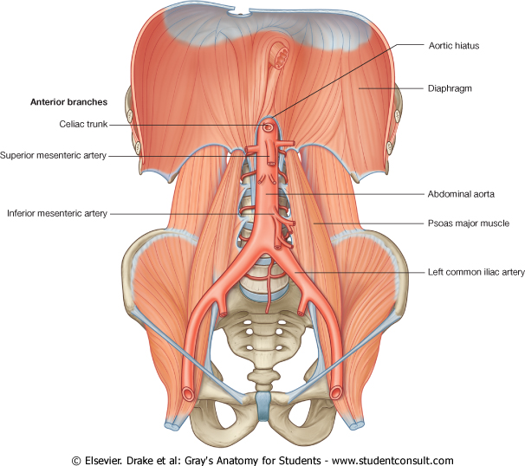
Branches of common iliac artery
A-EXTERNAL ILIAC ARTERY:
continues (beneath midpoint of inguinal ligament) as femoral artery the main supply for lower limb
B-INTERNAL ILIAC ARTERY:
supplies pelvis
External iliac artery
Femoral artery
Internal iliac artery

Slide 18
Arteries of lower limb
Femoral Artery
1-Is the main arterial supply to lower limb
2- Is the continuation of external iliac artery behind the midpoint of the inguinal ligament
3- Passes through adductor hiatus and continues as:
Popliteal Artery
1- Deeply placed in the popliteal fossa.
2- Divides, at lower end of popliteal fossa into:
1-Anterior Tibial Artery
2-Posterior Tibial Artery

Slide 19
Arteries of lower limb
Femoral Artery
1-Is the main arterial supply to lower limb
2- Is the continuation of external iliac artery behind the midpoint of the inguinal ligament
3- Passes through adductor hiatus and continues as:
Popliteal Artery
1- Deeply placed in the popliteal fossa.
2- Divides, at lower end of popliteal fossa into:
1-Anterior Tibial Artery
2-Posterior Tibial Artery

Slide 20
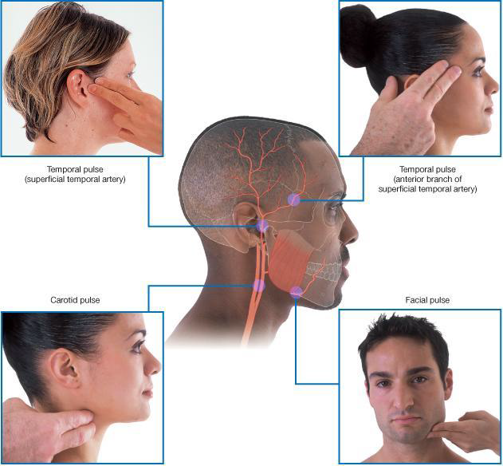
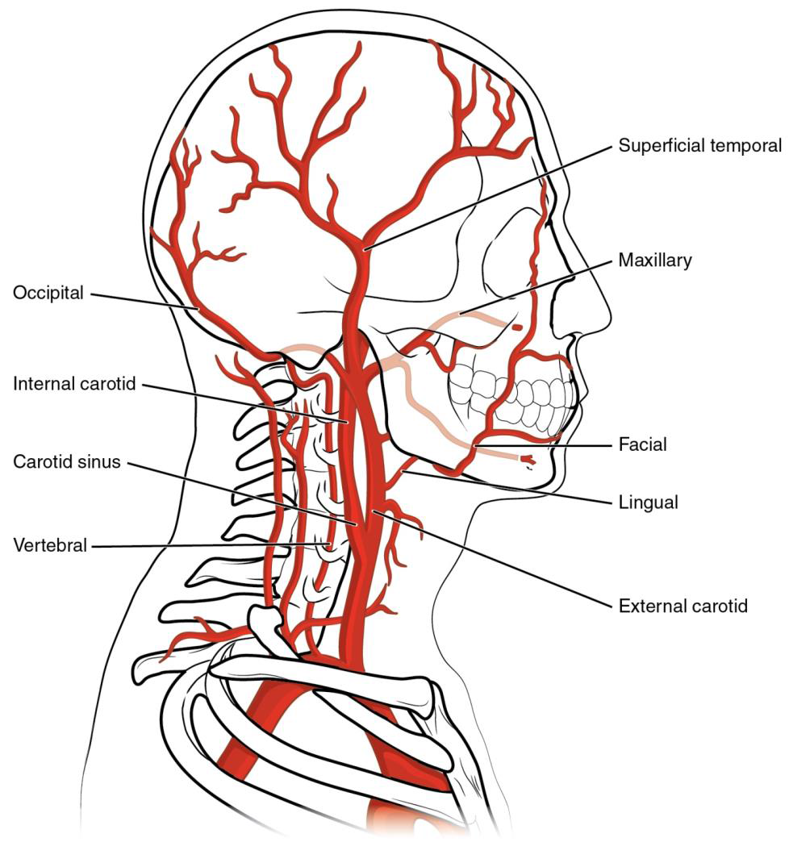
Pulse points in head & neck
Temporal pulse: (superficial temporal artery).
Temporal pulse
(anterior branch of superficial temporal artery )
Carotid pulse
Facial pulse

Slide 21
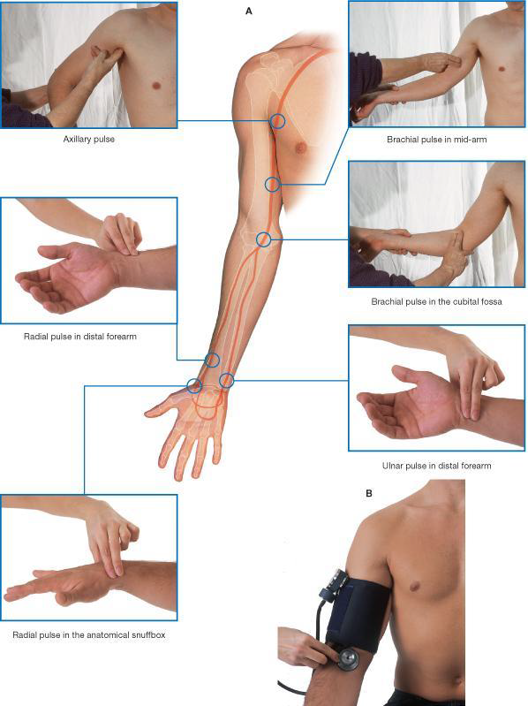
Pulse points in upper limb
Axillary pulse
Brachial pulse im mid-arm
Brachial pulse in the cubital fossa
Radial pulse in distal forearm
Ulnar pulse in distal forearm
Radial pulse in the anatomical snuffbox

Slide 22
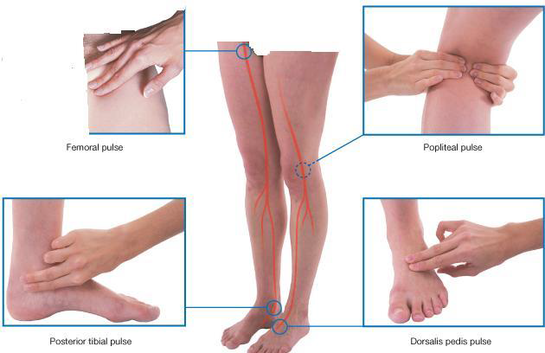
Pulse points in lower limb
Femorapulse
Popliteal pulse
Posterior tibial pulse
Dorsalis pedis pulse

Slide 23
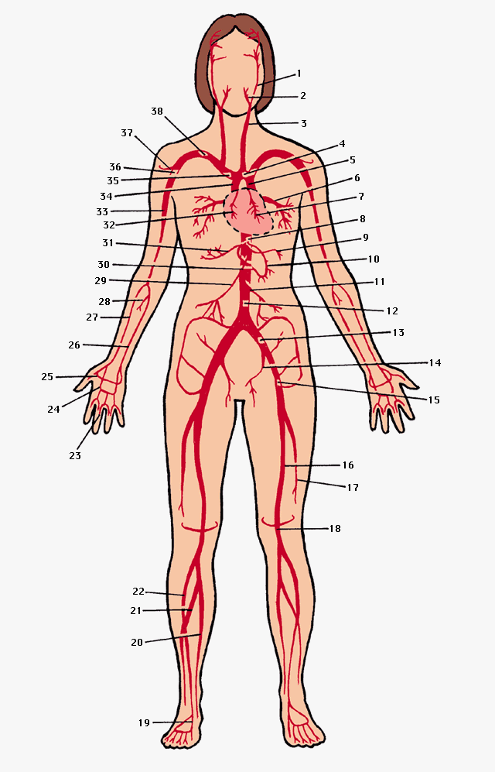
Summary
Principal arteries of the human body
1 internal carotid artery | 11 inferior mesenteric artery | 21 peroneal artery | 31 hepatic artery
2 external carotid artery | 12 abdominal aorta | 22 anterior tibial artery | 32 right coronary artery
3 common carotid artery | 13 common iliac artery | 23 digital artery | 33 brachial artery
4 arch of the aorta | 14 internal iliac artery | 24 superficial palmar arch | 34 ascending aorta
5 descending aorta | 15 external iliac artery | 25 deep palmar arch | 35 brachiocephalic artery
6 pulmonary vein | 16 femoral artery | 26 ulnar artery, | 36 axillary artery
7 left coronary artery | 17 profunda femoris artery | 27 radial artery | 37 anterior circumflex humeral artery
8 celiac artery | 18 popliteal artery | 28 common interosseous artery | 38 subclavian artery
9 splenic artery | 19 dorsalis pedis | 29 superior mesenteric artery | 31 hepatic artery
10 left gastric artery | 20 posterior tibial artery | 30 right gastric artery | 32 right coronary artery

Slide 24
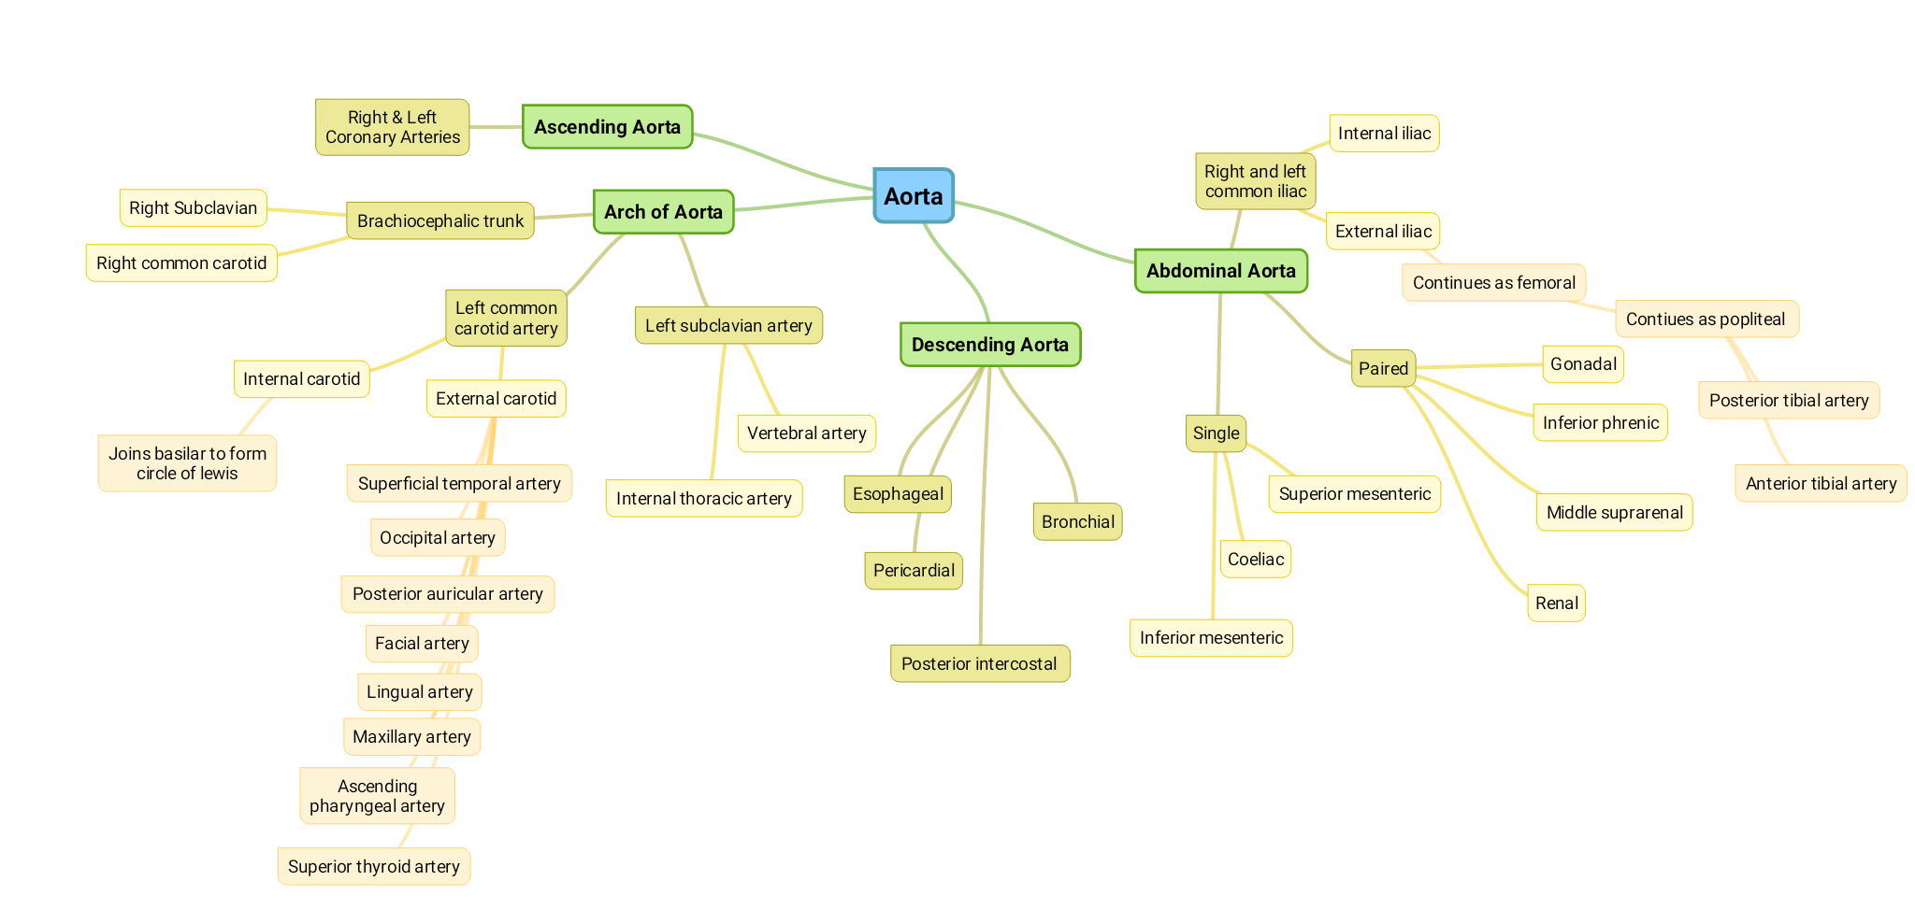
Summary
From 436

Slide 25
MCQs
(1) Which of the following arteries doesn’t carry oxygenated blood?
A) Brachial Artery B) Femoral Artery
C) Internal Carotid Artery D) Pulmonary Artery
(2) Which of the following is an example of a true end artery?
A) Retinal Artery B) Splenic Artery
C) Renal Artery D) Radial Artery (3) Which of the following gives the coronary arteries? A) Ascending Aorta B) Arch of Aorta C) Descending Aorta D) Abdominal Aorta
(4) Which of the following is a branch of the arch of aorta?
A) Right Common Carotid Artery
B) Right Subclavian Artery
C) Brachiocephalic Trunk
D) External Carotid Artery
(5) When the internal carotid artery Enters the cranial cavity and joins the basilar artery it forms which one of these?
A) Superficial temporal artery B) Arterial circle of Willis
C) Occipital artery D) Ophthalmic Artery

Slide 26
MCQs
(6) Which of the following arteries is an upper limb artery?
A) Posterior auricular artery B) Basilar artery
C) Lingual artery D) Axillary artery
(7) Which of the following is NOT a branch of descending thoracic aorta?
A) Pericardial B) Esophageal
C) Anterior intercostal D) Bronchial (8) Internal iliac artery supplies which of the following? A) Abdomen B) Gluteal region C) Pelvic D) Thigh
(9) What is the main arterial supply to the lower limb?
A) arterial supply to lower limb B) anterior tibial artery
C) ulnar artery D) Femoral Artery
(10) Which one of the following is a pulsation on the upper limb?
A) Femoral pulse B) Axillary pulse
C) Carotid pulse D) Dorsalis pedis pulse

Slide 27
Answers
(1) D (6) D (2) A (7) C (3) A (8) C (4) C (9) D (5) B (10) B

Slide 28
Team Members
‏Team leader: Faisal Fahad Alsaif Abdulaziz Al dukhayel Abdulelah Aldossari ‏Abdulrahman Alduhayyim ‏Hamdan Aldossari ‏Fahad Alfaiz ‏Zeyad Al-khenaizan ‏Abdullah Almeaither Abduljabbar Al-yamane Abdulmajeed Alwardi ‏Abdulaziz Al-drgam Ali Alammari ‏Saleh Almoaiqel ‏Majed Aljohani
‏Team leader: Rawan Mohammad Alharbi Abeer Alabduljabbar
Afnan Almustafa
Ahad Algrain
Albandari Alshaye
AlFhadah alsaleem
Ghaida Alsanad
Lojain Azizalrahman
Majd AlBarrak
Maha barakah
Nouf Alotaibi
Rinad Alghoraiby
Wejdan Albadrani

