Slide 1
Anatomy of the arterial supply and venous drainage of the heart
Lecture 4
Please check our Editing File
{وَمَنْ يَتَوَكَّلْ عَلَى اللَّهِ فَهُوَ حَسْبُهُ}
هذا العمل لا يغني عن المصدر الأساسي للمذاكرة

Slide 2
Objectives
The arterial supply of the cardiac muscle regarding (origin, course, distribution and branches).
The coronary anastomosis.
The arterial supply to the conducting system of the heart.
The venous drainage of the heart regarding (origin, tributaries and termination).

Slide 3
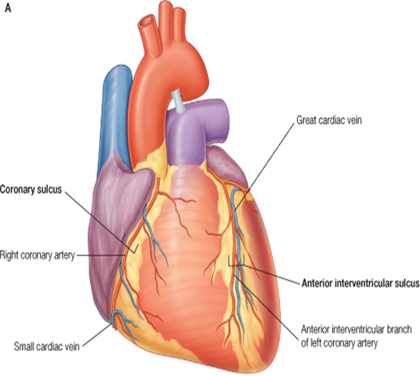
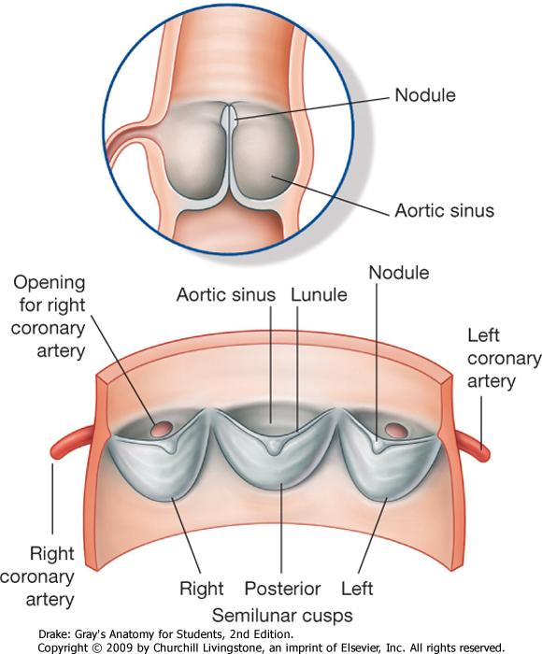
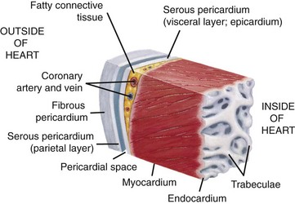
Arterial Supply
The arterial supply of the heart is provided by
Left coronary artery
Right coronary artery
Left coronary artery
they are distributed over the cardiac surface, within the subepicardium (below epicardial) connective tissue
Extra
Origin of coronary arteries
They arise from the initial part of the Ascending Aorta (Aortic Sinuses), immediately above the aortic valve.
aortic sinuses: three dilatations at the base ascending aorta

Slide 4
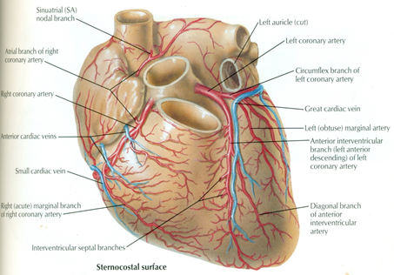
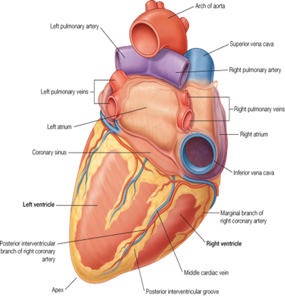
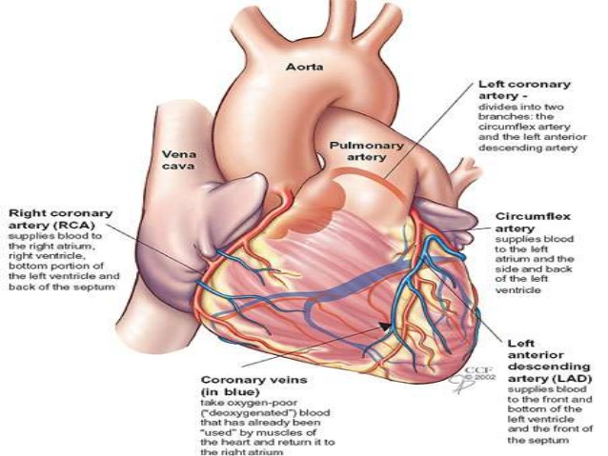
Right Coronary Artery “smaller branch”
Arises from the anterior aortic sinus of the ascending aorta.
Descends in the right atrioventricular groove between the Right Auricle and the Pulmonary trunk.
At the inferior border of the heart it continues posteriorly to anastomose with the left coronary
Runs forward between the Pulmonary trunk and Right Auricle.
At the inferior border of the heart it is continuous posteriorly a long the atrioventricular groove to anastomose with the left coronary artery (in the posterior interventricular groove
Right coronary artery (RCA) supplies: - Right atrium: - Right ventricle - part of Left Atrium , - Left ventricle - Atrioventricular septum - Most of conducting system
Extra
right auricle
/trunk

Slide 5
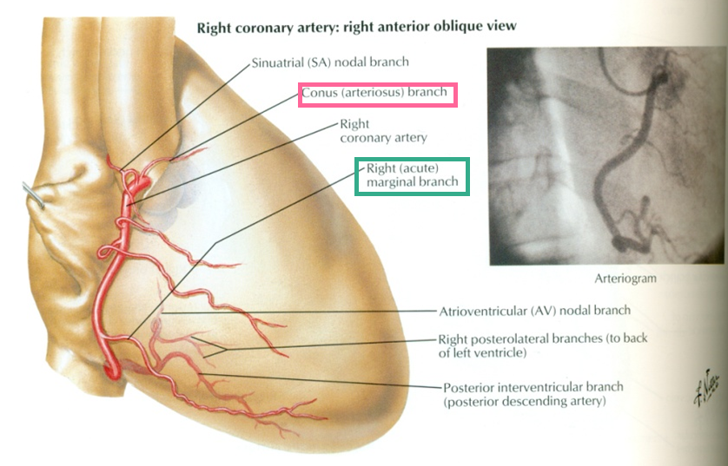
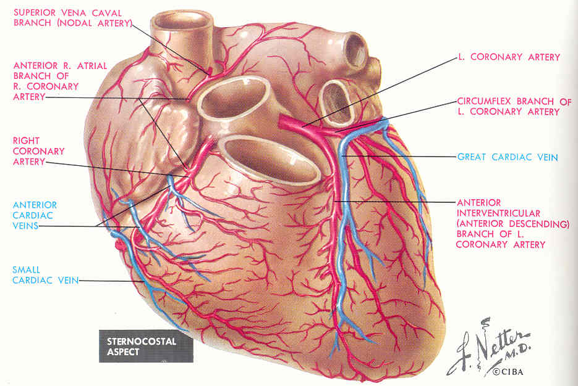
Branches (Right Coronary Artery)
Right Conus: to the infundibulum and upper part of anterior wall of the right ventricle.
Anterior ventricular branches (2-3 branches): Supply anterior surface of the right ventricle.
Marginal artery: The largest branch, runs along the lower (inferior) margin of the sternocostal surface toward the apex. It is accompanied by the Small Cardiac vein.
Posterior ventricular branches (2 branches): Supply the diaphragmatic surface of the right ventricle
Right conus

Slide 6
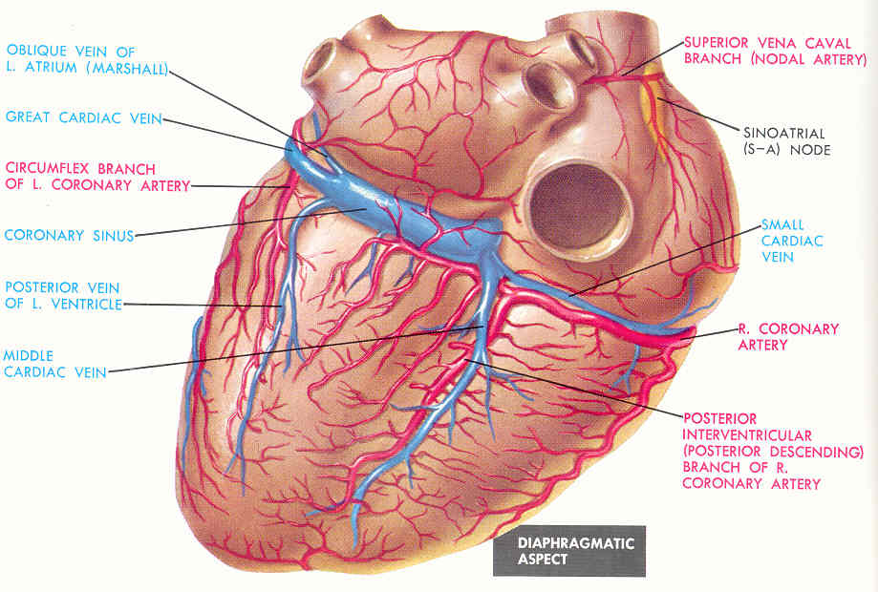
Branches (Right Coronary Artery)
Atrial branches: Supply anterior and lateral surfaces of the right atrium, one branch supplies posterior surface of both atria.
Artery of the Sinoatrial Node (SAN): Supplies the SAN and both atria In 35% it arises from the left coronary.
Posterior Interventricular artery (accompanied by Middle Cardiac vein): Runs toward the apex Lies in the posterior interventricular groove, it supplies: - Diaphragmic surface of the Right and Left Ventricles. - Septal branch to the AVN - Posterior part of the IVC (except its Apex) - The Right and Left Ventricles, including their inferior wall. - Posterior part of ventricular septum, not the Apical part (except Apex)

Slide 7
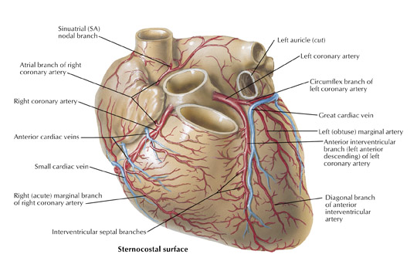
Left Coronary Artery
The Larger of the two coronaries.
Arises from the left posterior aortic sinus of the ascending aorta.
Descends: 1. (passing forward) Between the pulmonary (artery) trunk and the left auricle. 2. (Enter) the IV (interventricular) groove to the apex of the heart.
Divides into two terminal branches: Anterior Interventricular artery & Circumflex arteries.
*Q from Dr.Sanaa Which of the aortic sinuses doesn’t give rise to any of coronary arteries ?
Right posterior aortic sinus “because the RCA arises from the anterior aortic since & LCA arises from the left posterior aortic sinus”
Pulmonary artery/trunk

Slide 8
Branches (Left Coronary Artery)
Anterior Interventricular Descends in the anterior interventricular groove to the apex of the heart (accompanied by the Great cardiac vein in most individuals it passes around the apex to anastomose with terminal branches of the right coronary , in 1\3 it ends at the apex. It supplies the 1. right and left ventricles 2. anterior part of ventricular septum . It gives: - Left conus artery for pulmonary conus. - Anterior ventricular and Posterior ventricular ; Supply left ventricle - Atrial branches ; Supply greater part of left atrium - Left diagonal artery one of the ventricular branches or may arises from trunk of the left coronary.

Slide 9
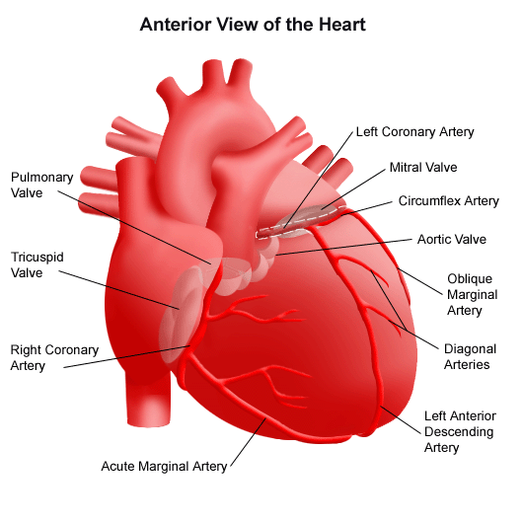
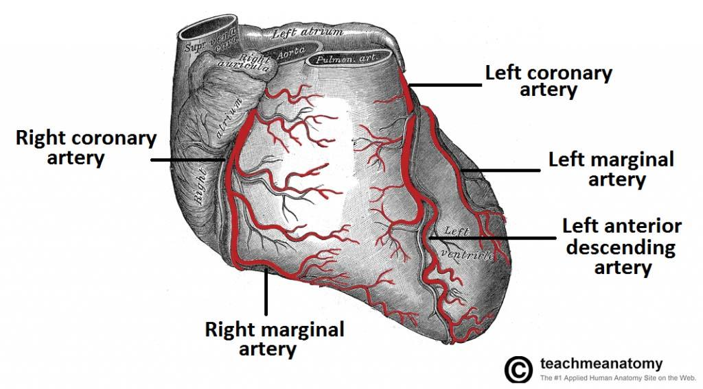
Branches (Left Coronary Artery)
Circumflex Artery Winds around the left margin of the heart in the atrioventricular groove. It give: 1. Left Marginal artery 2. Anterior & posterior ventricular branches to the left ventricle 3. Atrial branches to the left atrium
Left Marginal artery Supplies the left margin of the left ventricle down to the apex

Slide 10
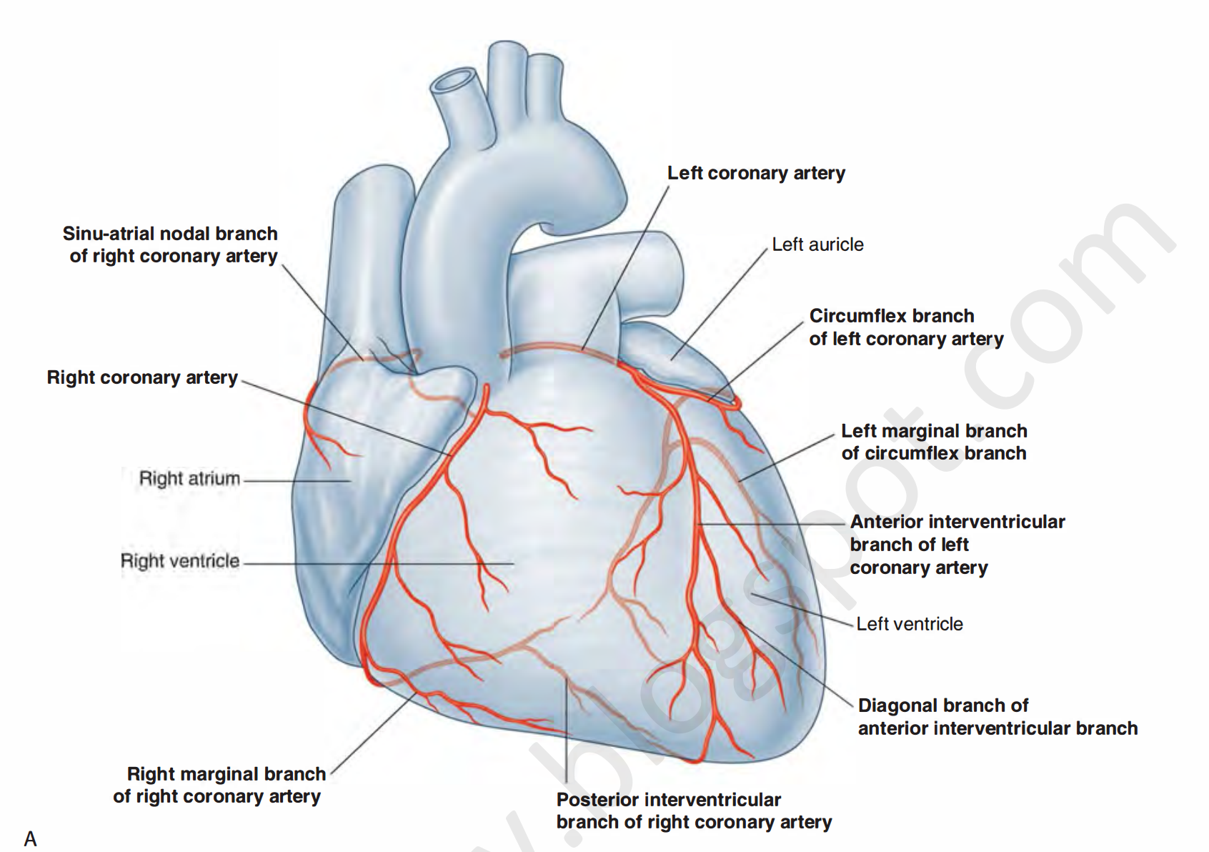
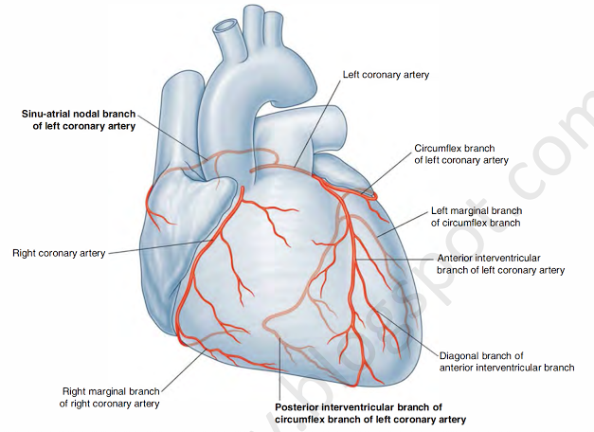
Variations of the Coronary Arteries
Right Dominance: | Left Dominance:
In (90 %) of population, the Posterior Interventricular artery is a branch of the Right Coronary. | In the rest (10%), the Posterior Interventricular artery arises from the Circumflex branch of the Left Coronary Artery.

Slide 11
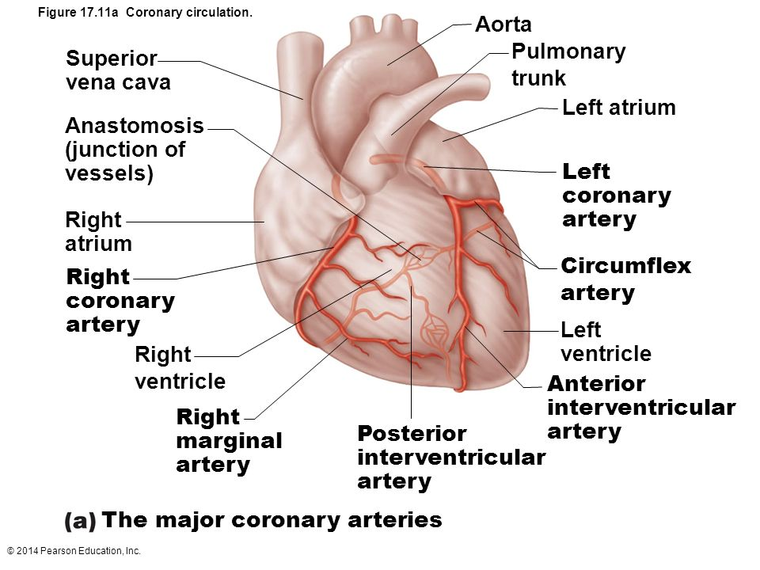
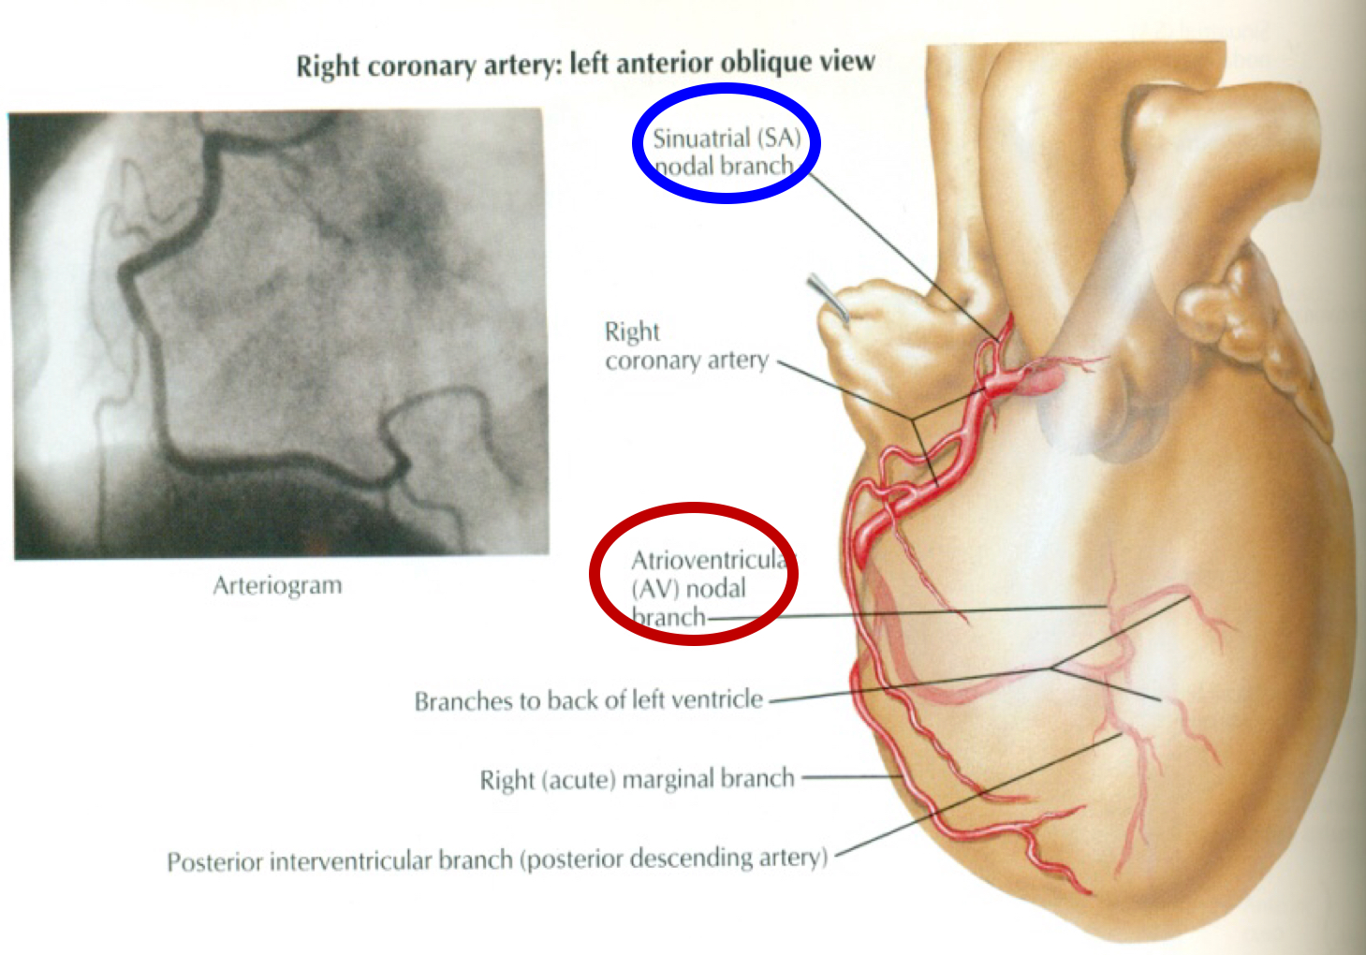
Coronary Anastomoses
Arterial Supply of Conducting System
In MOST of people, the terminal branches of the right and left coronaries exist anastomose in the posterior part of the IV (interventricular).
However this anastomoses is not large enough to provide adequate blood supply in case of coronary occlusion (Functional End arteries).
SAN, AVN & AVB are usually supplied by Right coronary.
Right Bundle Branch (RBB) of (AVB) is supplied by Left coronary.
LBB of (AVB) is supplied by both Right and Left coronaries.

Slide 12
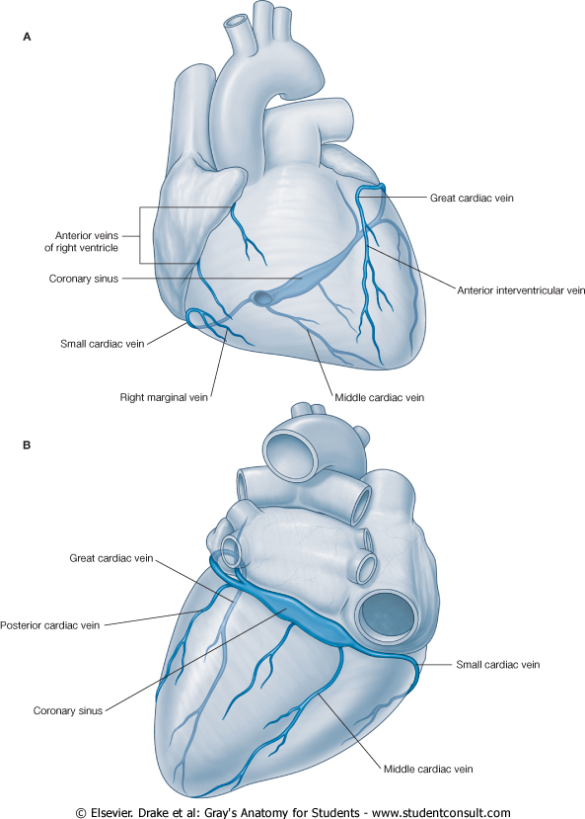
Venous Drainage
Blood of the heart is drained into the right atrium either directly or through the coronary sinus. “Coronary sinus”
Drains most of the Venous Blood of the heart.
It lies in the Posterior part of the AV groove.
Origin : It is the direct continuation of the Great Cardiac Vein.
Tributaries:
(3) Cardiac Veins:
Great
Middle
Small
Oblique vein of left atrium (vein of Marshall).
Termination: It empties into Right Atrium.
Its opening is inferior & to the left of the IVC opening.
It is guarded by a valve.

Slide 13
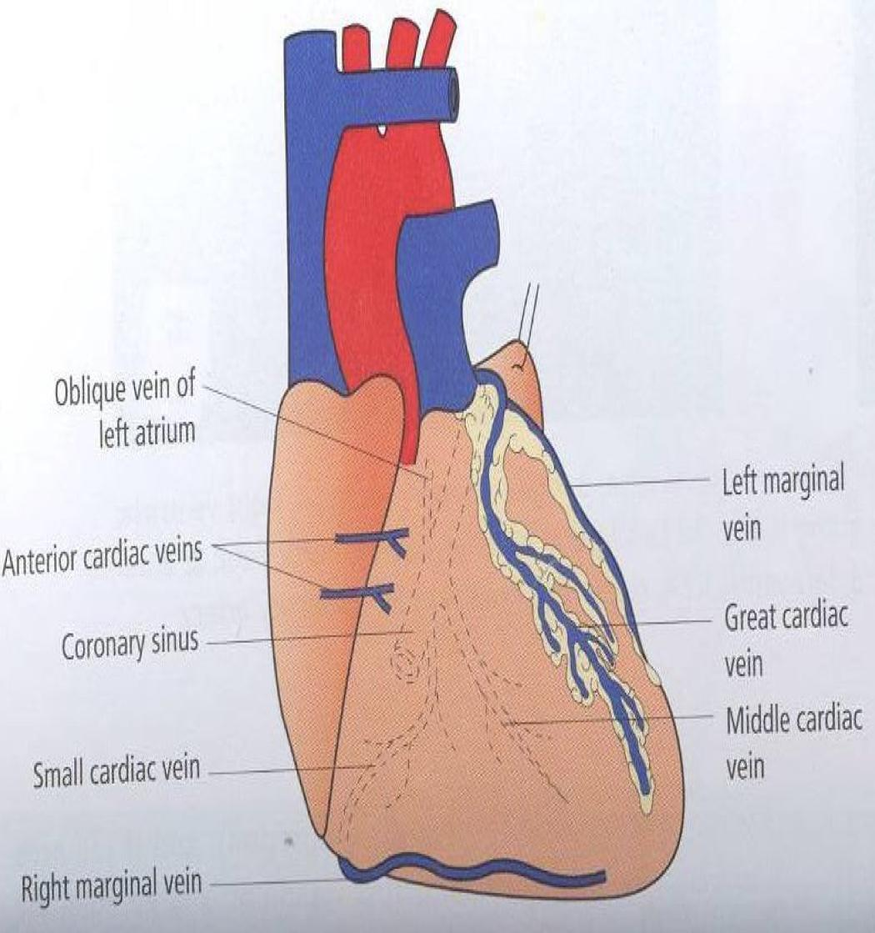
Venous Drainage Outside coronary sinus “directly into right atrium”
Anterior cardiac veins:
Open directly into the Right Atrium.
Venae Cordis minime (small cardiac veins):
Open into the heart chambers.

Slide 14
MCQs
(1)Which of the following arises from the anterior aortic sinus?
A)Right coronary artery B)Circumflex artery
C)Anterior Interventricular D)Left coronary artery
(2)Posterior ventricular branches of Right coronary artery supply:
A)Anterior surface of the right ventricle B)Diaphragmatic surface of the right ventricle
C)The whole right ventricle
(3)LBB of (AVB) is supplied by: A)Right coronary artery B)Left coronary artery C)Both D)none
(4)Which of the following lies in the Posterior part of the AV groove?
A)Right coronary artery B)Coronary sinus
C)Left coronary artery D)Marginal artery
(5)Which of the following veins is draining out of coronary sinus?
A)Small cardiac veins B)Posterior cardiac veins
C)Large cardiac veins D)Inferior cardiac veins

Slide 15
MCQs
(6)________ lies between the pulmonary trunk and the left auricle?
A)Right coronary artery B)Circumflex artery
C)Anterior Interventricular D)Left coronary artery
(7)Which of the following is not a branch of left coronary artery?
A)Circumflex artery
B)Posterior ventricular
C)Anterior Interventricular (8)Left Marginal artery supplies? A)Left margin of the left ventricle
B)The whole left ventricle
C)Inferior margin of the left ventricle
(9)SAN, AVN & AVB are usually supplied by ?
A)Right coronary artery B)Circumflex artery
C)Left coronary artery D)A+C
(10)___________accompanied by Middle Cardiac vein?
A)Posterior Interventricular artery B)Circumflex artery
C)Anterior Interventricular artery D)Marginal artery

Slide 16
Answers
(1)A (6)D (2)B (7)B (3)C (8)A (4)B (9)A (5)A (10)A

Slide 17
Team Members
‏Team leader: Faisal Fahad Alsaif Abdulaziz Al dukhayel Abdulelah Aldossari ‏Abdulrahman Alduhayyim ‏Hamdan Aldossari ‏Fahad Alfaiz ‏Zeyad Al-khenaizan ‏Abdullah Almeaither Abduljabbar Al-yamane Abdulmajeed Alwardi ‏Abdulaziz Al-drgam Ali Alammari ‏Saleh Almoaiqel ‏Majed Aljohani
‏Team leader: Rawan Mohammad Alharbi Abeer Alabduljabbar
Afnan Almustafa
Ahad Algrain
Albandari Alshaye
AlFhadah alsaleem
Ghaida Alsanad
Lojain Azizalrahman
Majd AlBarrak
Maha barakah
Nouf Alotaibi
Rinad Alghoraiby
Wejdan Albadrani

