Slide 1
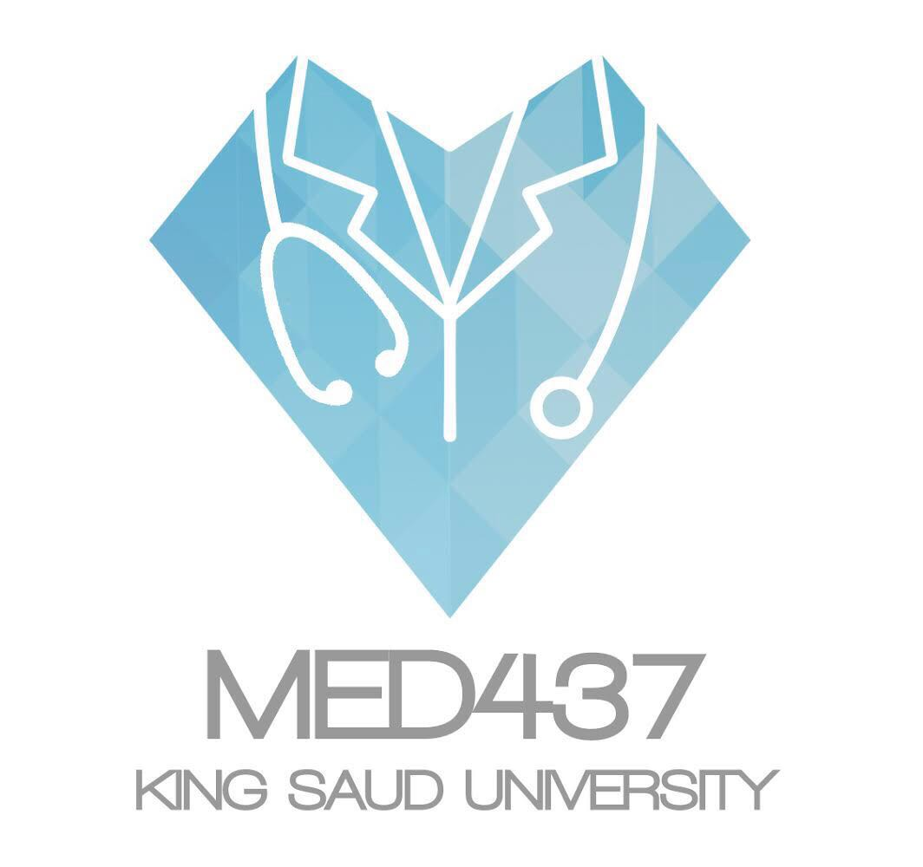
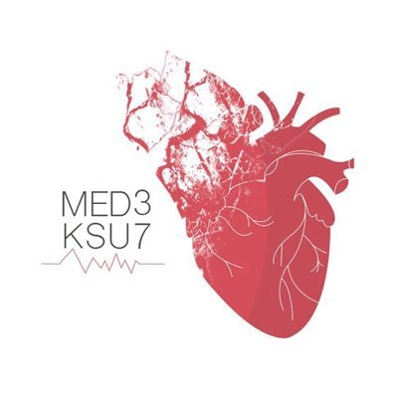
DEVELPOMENT OF HEART
Dr’s slides
Important
Extra explanation

Slide 2
OBJECTIVES
Describe the site, formation, union, and division of the of the heart tube.
Describe the formation and fate of the sinus venosus.
Describe the formation of the interatrial and the interventricular septae.
Describe the formation of the two atria and the two ventricles.
Describe the partitioning of the truncus arteriosus and formation of the aorta and pulmonary trunk.
List the most common cardiac anomalies.

Slide 3
REVIEW OF THE 3 LAYERS OF ORIGIN
Mesoderm divided into :
Paraxial Mesoderm
Intermediate medsoderm
Lateral mesoderm
Notochord:
stimulates neural tube formation (where CNS will be formed )
Somatic mesoderm
Lateral mesoderm contains intraembryonic coelem into :
Somatic Mesoderm
Splanchic Mesoderm : formation of heart
Splanchnic mesoderm

Slide 4
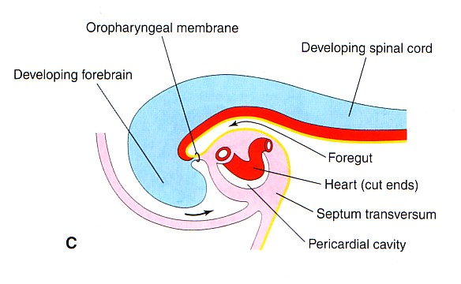
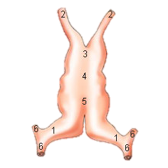
Formation of the heart tube
The cvs (heart) is the first functional major organ to develop, It begins to beat at 22 to 23 days. (from fertilization) لما تروح الحامل تسوي الالتراساوند أول شيء ينسمع هو دقات قلب الجنين
It develops from splanchnic mesoderm
the origin of the heart in the wall of the yolk sac (cardiogenic area)
Anatomical description (picture A) :
-cranial to the developing mouth and nervous system .
-ventral to the developing pericardial sac.
-The heart primordium is first evident at 18 days (as an angioplastic cords which soon canalize to form the 2 heart tubes).
After completion of the head fold, the developing heart tubes change their position and become lie in the ventral aspect of the embryo and dorsal to the developing pericardial sac.(picture C)
- After lateral folding of the embryo, the 2 heart tubes approach each other and fuse in a craniocaudal direction to form a single endocardial heart tube within the pericardial sac.
Angioplastic : giving rise of blood vessel
Lateral folding

Slide 5
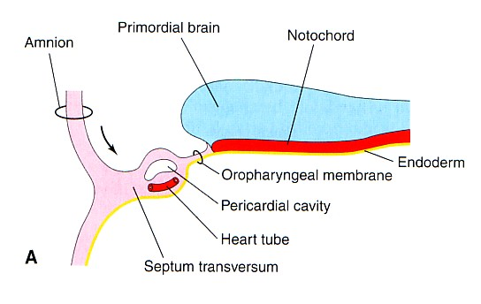
Extra explanation “team 436”:
Notochord: this line is the axis of the embryo, it divide the body into right and left sides, each side has: 1- endoderm, 2- mesoderm ( intraembryonic mesoderm ), 3- ectoderm
The mesoderm is divided into somatic(from paraxial), intermediate and lateral
Within lateral mesoderm appears a cavity divide it into 1- somatic mesoderm (nearer to the ectoderm ), 2- splanchnic mesoderm (nearer to the endoderm).
In this phase the embryo is flat, has a cranial end (فوق ) and caudal end (تحت ). We can see the developing brain and cranial to it the the developing mouth. يعني على مستوى أعلى منه بس كلهم في خط مستقيم واحد More cranial to the developing mouth will appear two tubes made of splanchnic mesoderm. This area is called cardiogenic area. Behind the the tubes will appear the pericardial cavity This all appear in the 18th day of pregnancy. | The embryo’s developing head will fold (head fold), The heart tubes will change: 1- canalization of the tubes after they were close. 2- they will be ventral to the developing brain and mouth, and dorsal to the pericardial cavity.
بإختصار : أول عضو يتطور القلب . يجي من splanchnic mesoderm
أول مرحلة: يكون القلب فوق الفم و النيرف (أقرب للرأس) ويكون القلب فنترال أمام) البريكارديال ساك( ثم يبدأ الانطواء. .بعد18 يوم القلب نقدر نشوفه بعد اتمام طوية الرأس المرحلة 2، التيوب حق القلب تصير أمامية بنسبة للامبريو. وتكون خلفية بالنسبة للبردي كارديال ساك . بعدين طوي جانبي للامبريو الانبوبين يلتحمان ويكونون
single endocardial heart tube . يبدأ النبض في اليوم 22-23

Slide 6
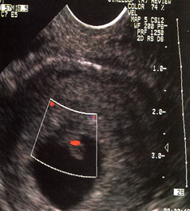
blood flow and fate of heart
Blood flow begins during the beginning of the fourth week (22-23) days after fertilization and start beating and can be visualized by Ultrasound Doppler.
- The heart tube (vertical) grows faster than the pericardial sac, so it shows 5 alternate dilations separated by constrictions(تضيقات).
These are :
Sinus Venosus )Two tubes because as we mentioned it is the last part to get fused(
Truncus Arteriosus.
Bulbus Cordis.
Common Ventricle.
Common Atrium.
The endocardial heart tube has 2 ends:
1. Venous end : Sinus Venosus.
2. Arterial end : Truncus arteriosus

Slide 7
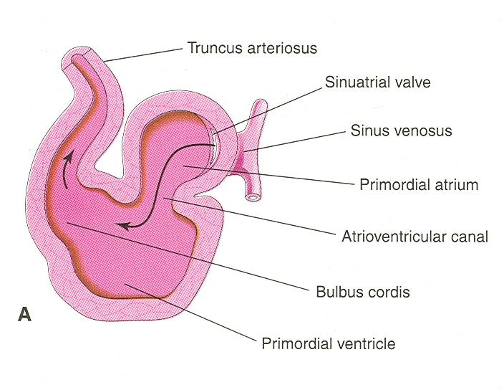
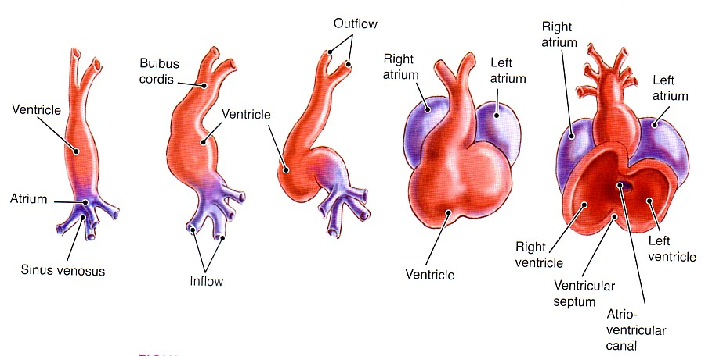
U shaped heart tube
- Bulbus cordis and ventricle grow faster than the other chambers.
So the heart bends upon itself (القلب ينحني على نفسه),forming what is called:
The U-shaped heart tube or Bulboventricular loop.
S shaped heart tube
As the heart keeps developing , it bends upon itself forming what is called S shaped heart tube .
the atrium and sinus venosus become dorsal to the truncus arteriosus, bulbus cordis, and ventricle.
By this stage the sinus venosus opens in the dorsal wall of the atrium and has developed 2 lateral expansions (ends) called the 2 horns ( right and left horns) and a body.

Slide 8
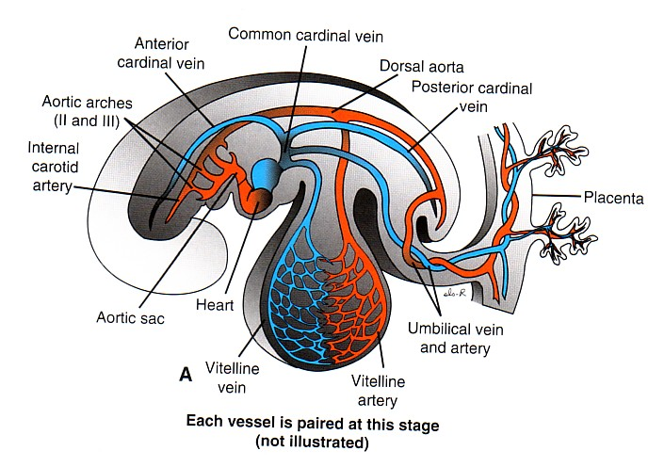
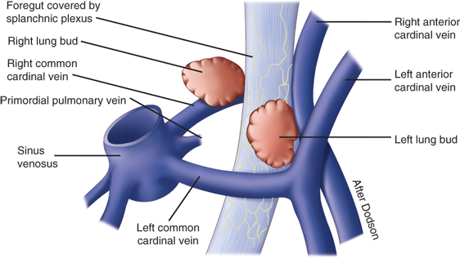
Veins associated with heart development
Each horn of the sinus venosus (opens in the dorsal wall of the atrium) receives 3 main veins :
1- Common Cardinal vein from the fetal body
it’s fuse of posterior& Anterior cardinal vein
2- Vitelline from the yolk sac.
3- Umbilical from the placenta.
Sinus )
2ends
2horn (left and right ) each one has three veins. )
(هو عبارة عن جيب عنده
تمثل
Each vessel is paired at this stage
*Common Cardinal vein and Vitelline carry venous blood (deoxygenated) while Umbilical carries oxygenated blood.
and they all open in sinus venosus so it has mixed blood.

Slide 9
Fate of sinus venosus
- The right horn of the sinus venosus forms the smooth posterior wall of the right atrium.
-The left horn and the body of the sinus venosus atrophy and form the coronary sinus , will open directly to the right atrium
-The left common cardinal vein forms the oblique vein of the left atrium in the coronary sinus.
*All veins will degrade except Umbilical vein will form al ligament , and the left common cardinal vein which is the only vein that remains as a vein.

Slide 10
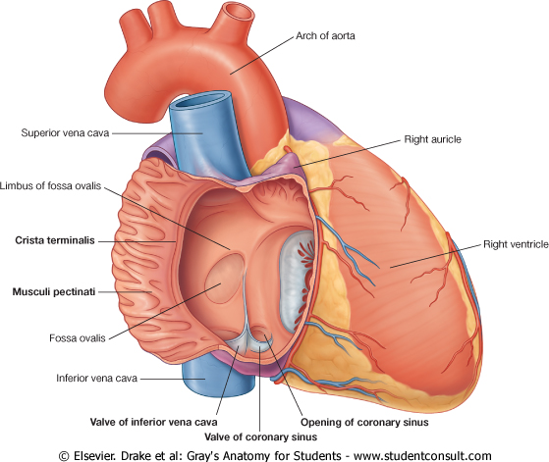
Right atrium
- The right horn of the sinus venosus forms the smooth posterior part of the right atrium.
- Rough (Trabeculated) anterior part (musculi pectinati) of the right atrium is derived from the primordial common atrium.
- These two parts are demarcated by the crista terminalis internally and sulcus terminalis externally.
Left atrium
-Rough Trabeculated part:
derived from the common primordial atrium.
-The smooth part:
derived from the absorbed part of the Pulmonary Veins*.
Pulmonary veins :
Was a single vein
When entered left atrium divided into 2 veins and then became 4 when embedded deep inside heart , giving smooth part

Slide 11
Partitioning of primordial heart
Partitioning of heart :-
1- Atrioventricular canal.
2- Common atrium.
3- Common ventricle.
4- Bulbus cordis
5- Truncus Arteriosus.
- It begins by the middle of 4thweek completed by the end of 5th week.
*أي مشكلة تصيب الأم في هذي الفترة ممكن تأثر على الجنين و تخليه يُولد أما ب ventricle واحد أوatrium واحد.

Slide 12
Endocardial Cushions
- They appear around the middle of the 4th week as Mesenchymal Proliferation* They participate in formation of:
1- A.V canals and valves.
2- Atrial septa.
3- Membranous part of Ventricular septum.
4- Aortic and Pulmonary channels (Spiral septum).
مجموعة خلايا تساعد بشكل كبير في تكون القلب وتكوين ال septae أيضا صمامات القلب

Slide 13
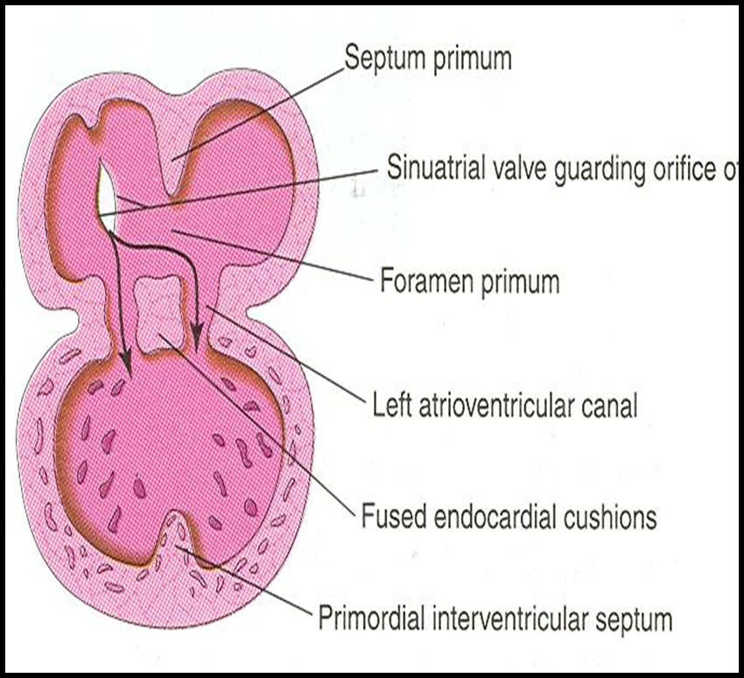
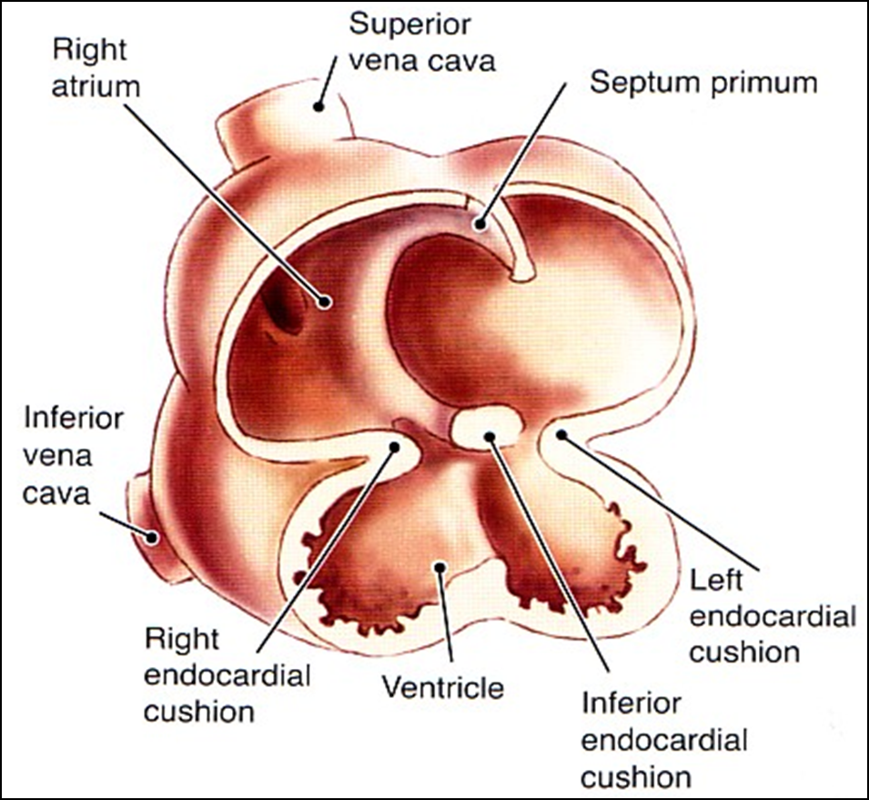
Partitioning of atrioventricular canal
Two dorsal Endocardial Cushions are formed on walls of the AV canal.
The AV endocardial cushions approach each other and fuse together to form the septum intermedium.
Dividing the AV canal into right & left canals.
These canals partially separate the primordial atrium and primordial ventricle.
Partitioning of common atrium
Septum Primum :
A sickle- shaped septum grows from the roof of the common atrium towards the fusing endocardial cushions (septum intermedium).from above downward
So it divides the common atrium into right & left halves.

Slide 14
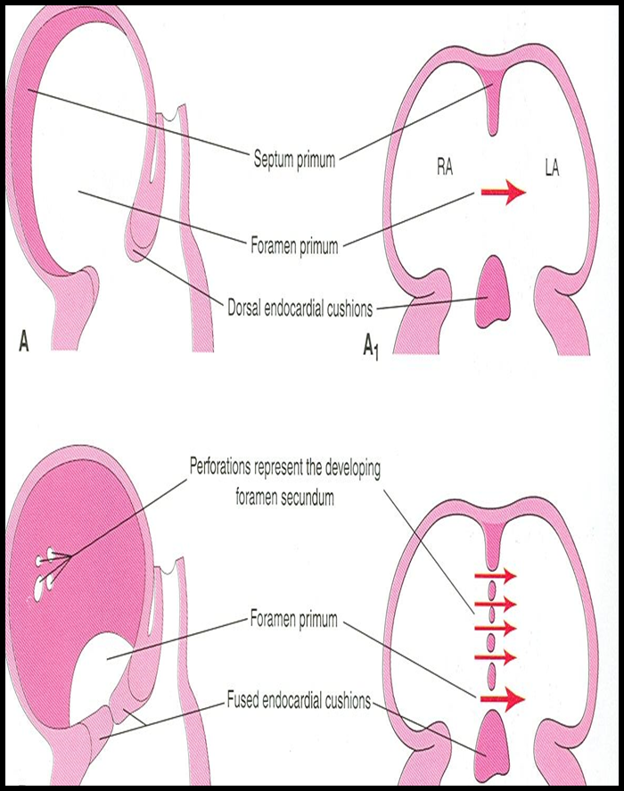
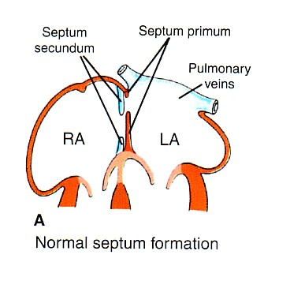
Ostium primum
At first the two ends of the septum primum reach to the growing subendocardial (endocardial)cushions before its central part.
now the septum primum bounds a foramen called ostium (opening) primum.
It serves as a shunt, enabling the oxygenated blood to pass from right atrium to left atrium.
The ostium primum become smaller and disappears as the septum primum fuses completely with subendocardial cushions (septum intermedium) to form the interatrial septum (AV septum).
Septum secondum
The upper part of septum primum that is attached to the roof of the common atrium shows gradual resorption forming an opening called ostium secundum.
Another septum descends on the right side of the septum primum called septum secundum.
It forms an incomplete partition between the two atria.
Consequently a valvular oval foramen forms(foramen ovale).

Slide 15
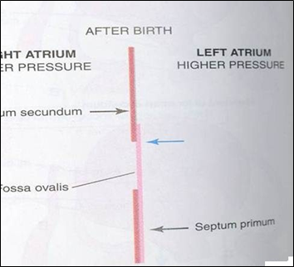
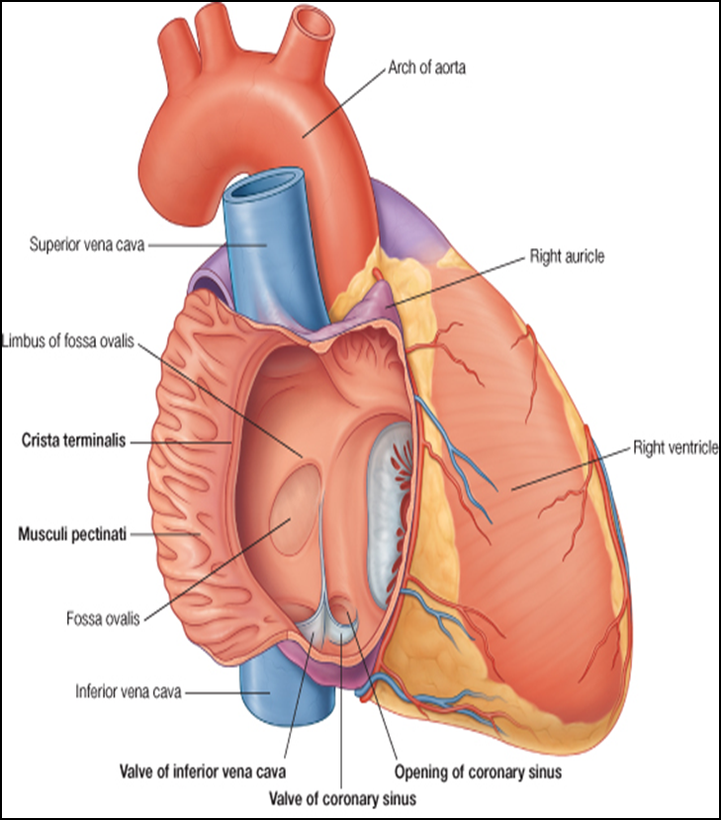
Fate of foramen ovale
At birth when the lungs inflated and pulmonary circulation begins the pressure in the left atrium increases and exceeds that of the right atrium.
The valve of the foramen ovale is pressed against the septum secumdum and obliterates the foramen ovale , So the two septae oppose each other.
Its site is represented by the Fossa Ovalis.
The septum primum forms the floor of the fossa ovalis
The septum secondum forms the margin of the fossa ovalis which is called the limbus ovalis or annulus ovalis.

Slide 16
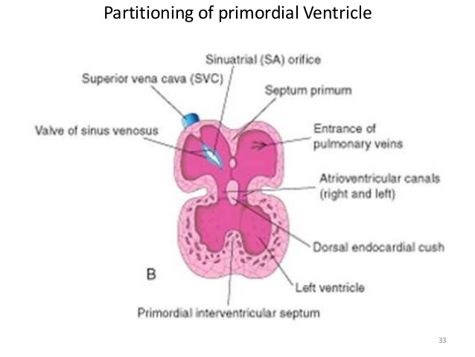
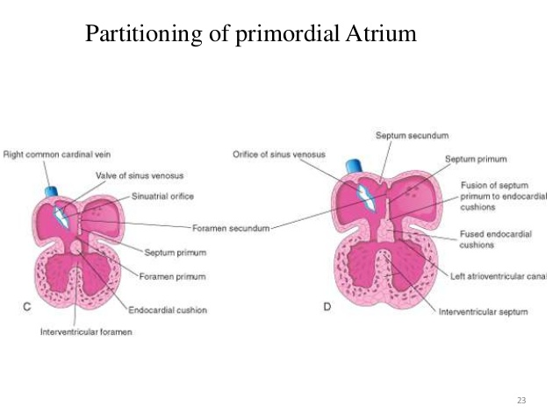
Partitioning of Primordial Ventricle
It is a Muscular part of the interventricular septum.
Division of the primordial ventricle is first indicated by a median muscular ridge, the primordial interventricular septum.
It is a thick crescentic fold which has a concave (left ventricle)upper free edge. (right ventricle is convex )
This septum bounds a temporary connection between the two ventricles called (IVF) interventricular foramen.

Slide 17
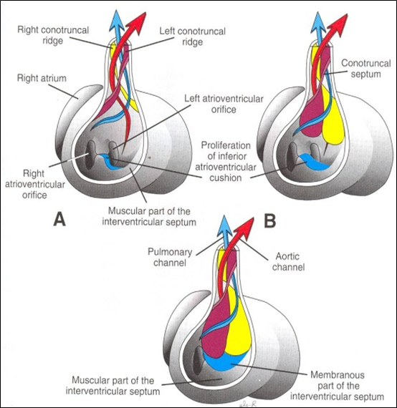
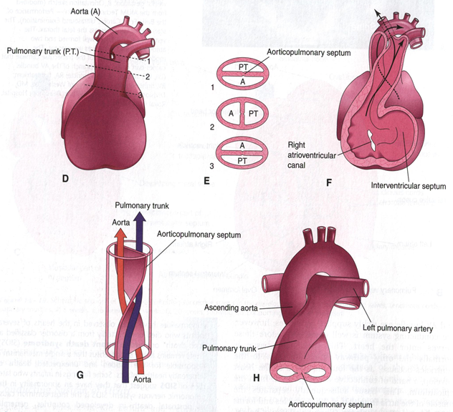
Interventricular Septum
The membranous part of the IV septum is derived from:
1- the right side of the endocardial cushion.
2- Aorticopulmonary septum.
3Thick muscular part of the IV septum.
Its benefit to close the space between ventricles
Spiral Aorticopulmonary Septum
- A spiral septum develops in the Truncus arteriosus dividing it into aorta and pulmonary trunk.
Now the pulmonary artery joins the right ventricle while the aorta joins the left ventricle.

Slide 18
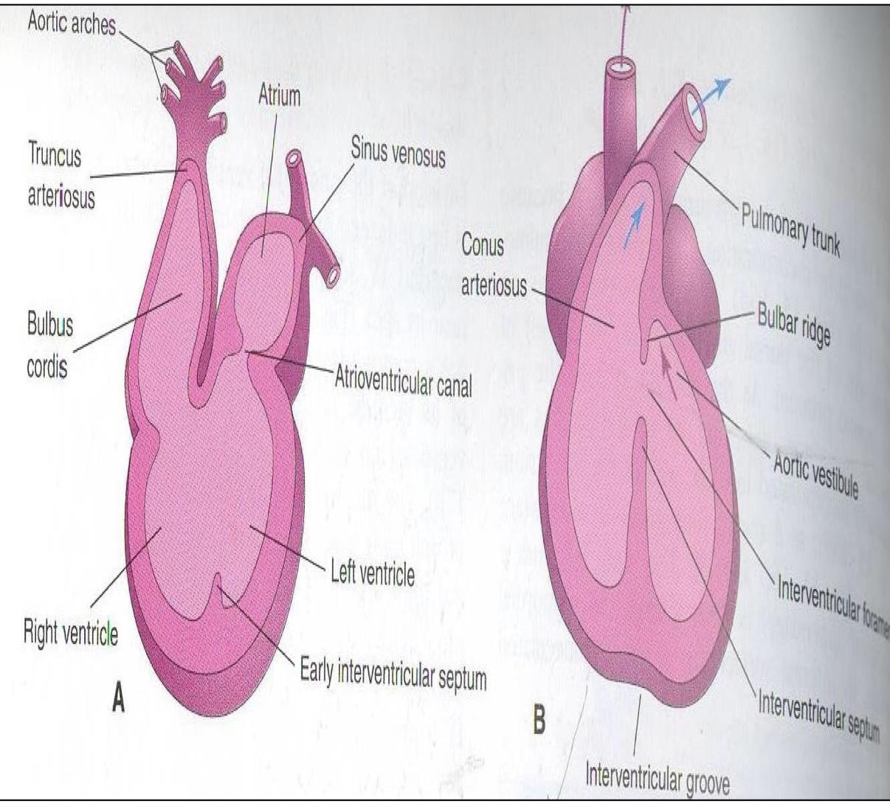
Bulbus Cordis
•The bulbus cordis forms the smooth upper part of the two ventricles.
In Right Ventricle:
Conus Arteriosus or (Infundibulum): which leads to the pulmonary trunk.
In Left ventricle:
Aortic Vestibule: leading to ascending aorta.

Slide 19
Partition of Truncus Arteriosus
In the 5th week, proliferation of mesenchymal cells (Endocardial Cushions) appear in the wall of the truncus arteriosus ,they form a Spiral Septum:
It divides the Lower part of the TA into Right &Left parts
It divides the Middle part of TA into Anterior & Posterior parts.
It divides the Upper part of the TA into Left & Right parts.
This explains the origin of pulmonary trunk from Right ventricle & ascending aorta from Left ventricle & their position to each other.

Slide 20
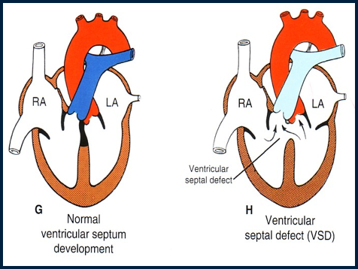
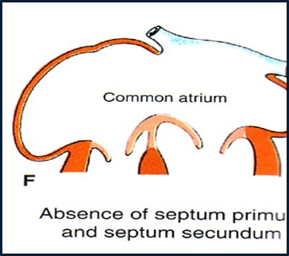
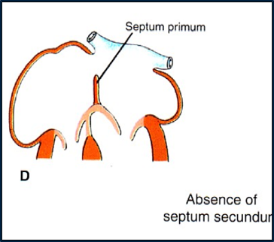
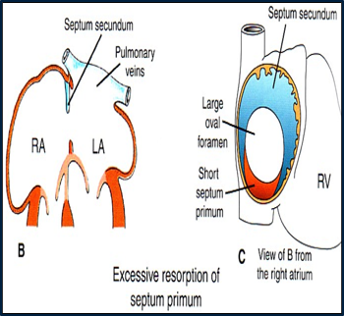
MAJOR CARDIAC ANOMALIES
Roger’s disease:
Absence of the membranous part of interventricular septum (presistent IV formen)
(There is a space between 2 ventricles , so it leads to mix of Venus and arterial blood )
Usually accompanied by other cardiac defects.
Absence of septum primum and septum secundum, leads to common atrium.
Absence of Septum Secundum
-Large(Patent) foramen ovale (فتحة تكون أكبر من اللازم) -Excessive resorption of septum primum

Slide 21
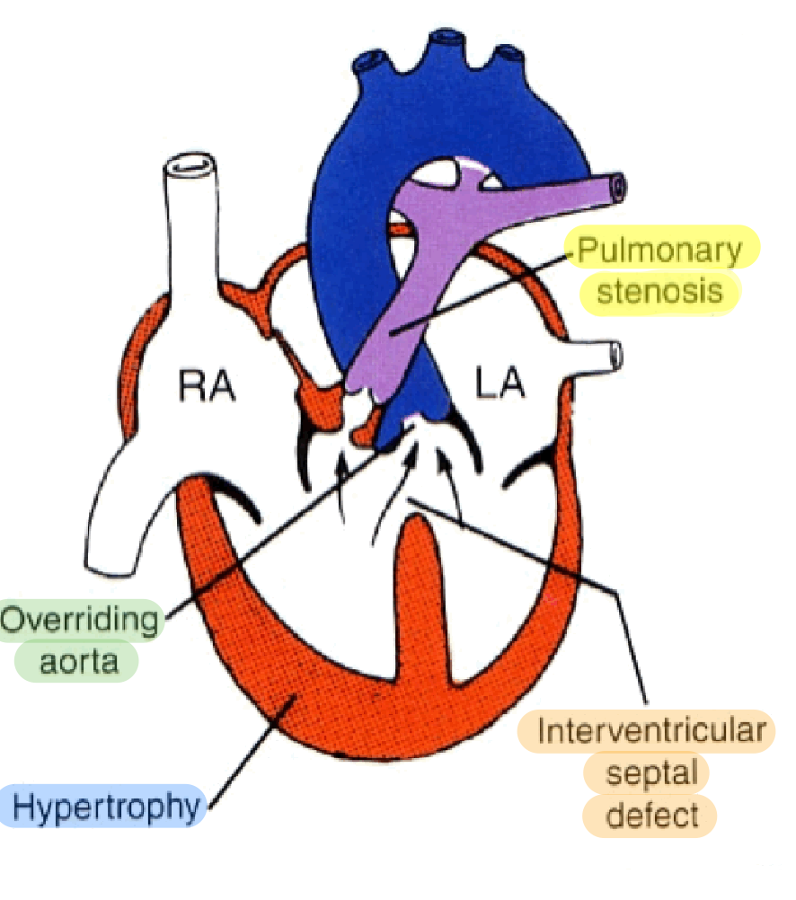
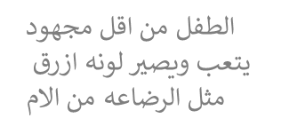
1-TETRALOGY OF FALLOT
Includeds four heart malformations present together:
1-Ventricular Septal Defect (VSD) (Absence of the membranous part )
2-Pulmonary stenosis (narrowing of pulmonary valves , so the aorta will be larger than pulmonary)
3- Right ventricular hypertrophy
4-overriding of aorta (blood enters the aorta from both ventricles).
Blue baby

Slide 22
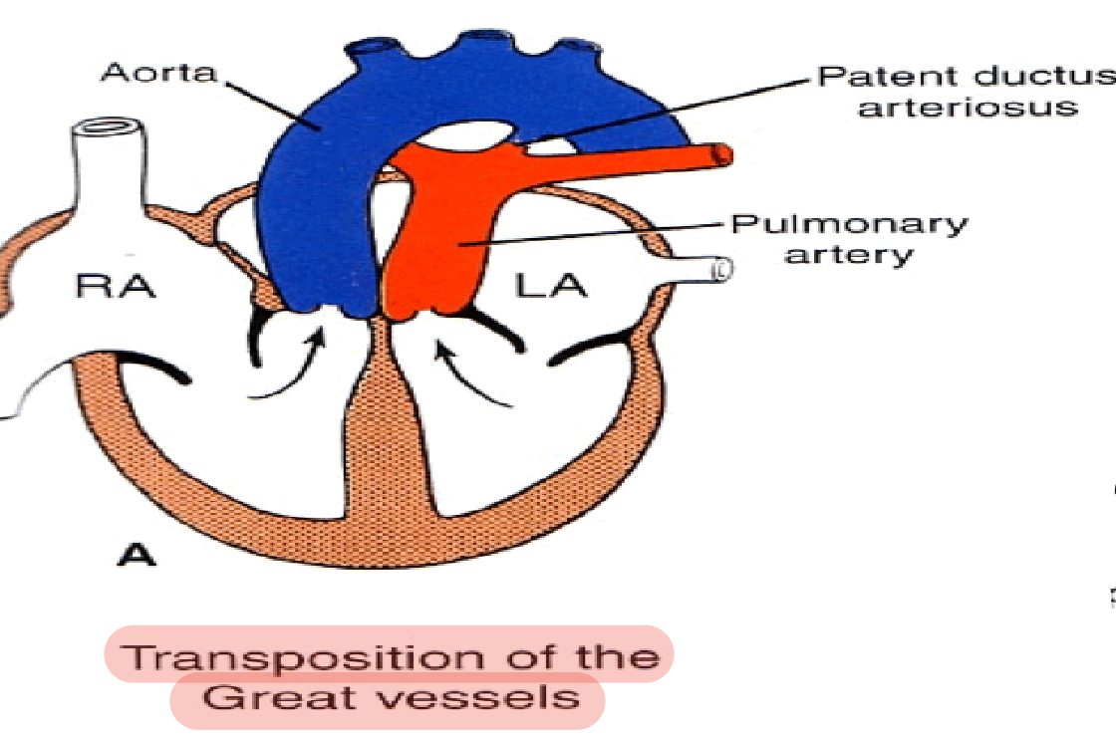
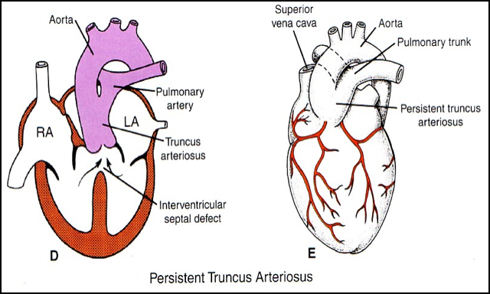
2- Transposition of great arteries(TGA)
3- Persistent truncus arteriosus
TGA is due to abnormal rotation or malformation of the aorticopulmonary septum,so the right ventricl joins the aorta, while the left ventricle joins the pulmonary artery.
One of the most common cause of cyanotic heart disease in the newborn. (blue baby).
Often associated with ASD(atrial septal defect) or VSD(ventricular septal defect).
It is due to failure of the development of the aorticopulmonary (spiral) septum.
It is usually accompanied with Ventricular septal defect (VSD). It forms a single arterial trunk arising from the heart and supplies the systemic ,pulmonary and coronary circulations
-ماتكونت عندي أساسا سبايرال سبتمز
بيطلع فيسلز واحد فقط (أرتري)
و البلود سيركيوليشن رح تجي من هذا الفيسل الواحد
That has mixed blood, so it is ( very Difficult to treat)

Slide 23
Summary :
Anomalies | description
Atrial septal defects (ASD) | 1)Excessive resorption of septum primum 2)Patent foramen ovale 3) Absence of septum secundum 4) Absence of septum primum and septum secundum lead to common atrium
VENTRICULAR SEPTAL DEFECT (VSD) | -Roger’s disease . -Absence of the membranous part of interventricular septum.
TETRALOGY OF FALLOT | 1.Pulmonary stenosis. 2.Right ventricular hypertrophy. 3.VSD (absent of membrane IV septum) 4.Overriding of the aorta
(TGA) OR TRANSPOSITION OF GREAT ARTERIES | -TGA is due to abnormal rotation or malformation of the aorticopulmonary septum. -It is one of the most common cause of cyanotic heart disease
Persistent Truncus Arteriosus | due to failure of the development of the aorticopulmonary (spiral) septum
Heart primordium
Day 18
Blood flows and heart beating
Day 22-23
Partitioning of heart
Mid 4th week to 5
Endocardial cushion
Mid 4th week
Partitioning of truncus arteriosus
5th week

Slide 24
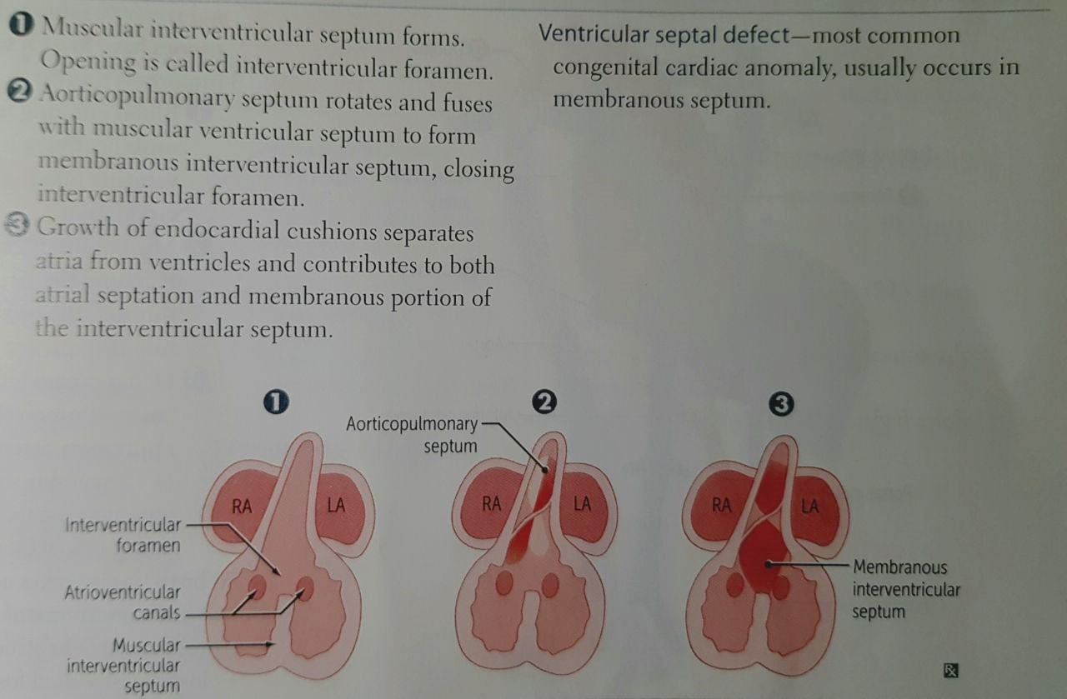
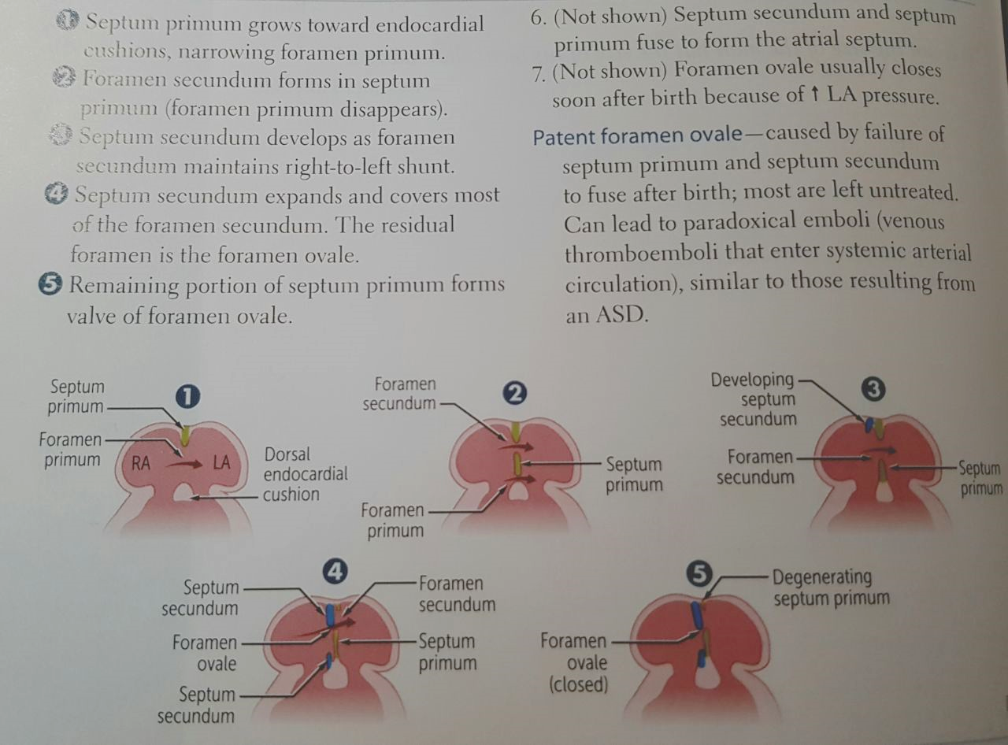
Summuary of events in partitioning of atria and ventricles

Slide 25
Quiz and Videos :
1- which mesodermal layer give rise to endocardial heart tubes :
A- Paraxial mesoderm B- Somatic Mesoderm C- Intermediate Mesoderm D- Splanchnic Mesoderm
2- the embryo cardinal venous vessels which drain into the sinus venosus are :
A- anterior cardinal veins B-posterior cardinal veins C-common cardinal veins D- superior cardinal veins
3 -which part of the primitive heart tube gives rise to the pulmonary artery and aorta :
A-bulbus cordis B- trancus arteriosus C- primitive ventricle D- sinus venosus
4- what cardiac malformation causes the aorta to arise from right ventricle and the pulmonary trunk to arise from left ventricle:
A-transposition of the great vessels B- persistent truncus arteriosus C- ventricular septal defect D- atrial septal defect
5- which heart chamber does the right horn of the sinus venosus contribute to during development of the heart :
A- left atrium B- left ventricle C- right ventricle D- right atrium
1-D
2-C
3-C
4-A
5-D
https://www.youtube.com/watch?v=5DIUk9IXUaI (Explanation)
https://www.youtube.com/watch?v=YxPp67XluQA (pneumonics )

Slide 26
القادة
محمد ثامر الزهراني – آلاء الصويغ
الأعضاء
مها النهدي وائل مبيريك
سارة البليهد عمر سعد اليابس
ميعاد النفيع
عهد القرين
contact us on: embryology437@gmail.com
Wish all the best :)

