Slide 3
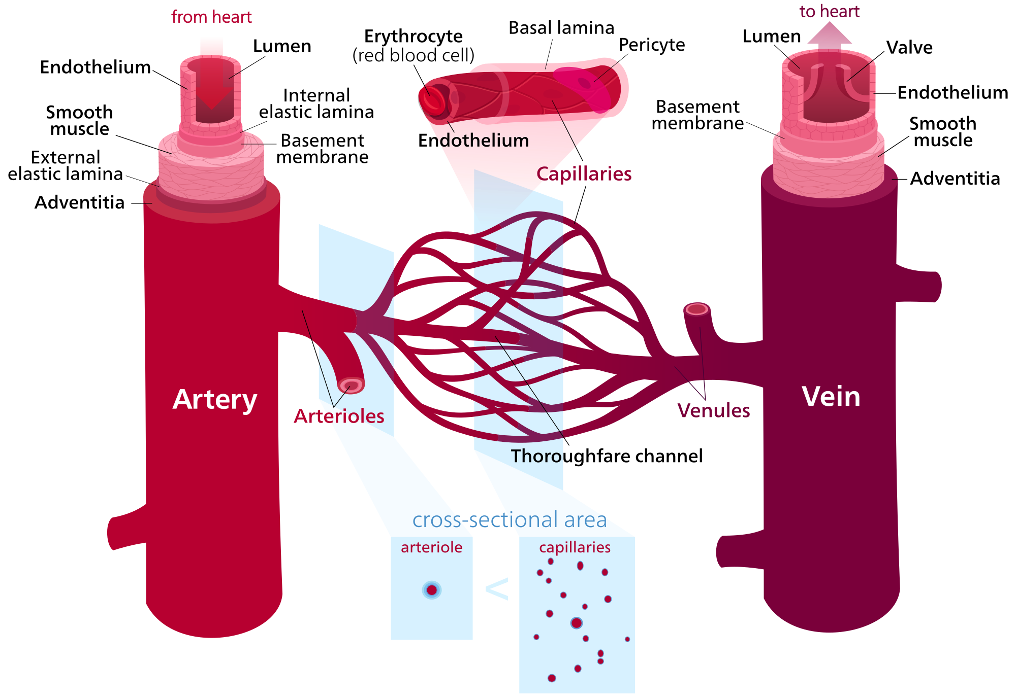
EXTRA:

Slide 4
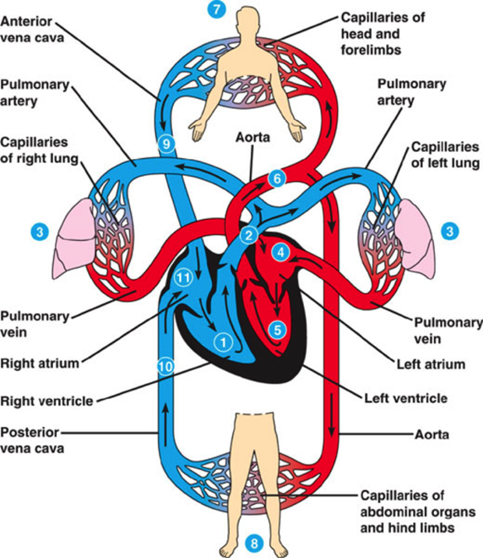
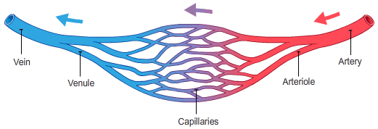
Blood vessels
Arteries
Blood Capillaries
Veins
Elastic arteries
Medium-sized arteries
(Muscular “distributing”)
Arterioles
Venules
Small veins
Medium-sized veins
Large veins

Slide 5
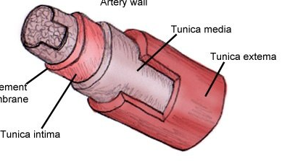
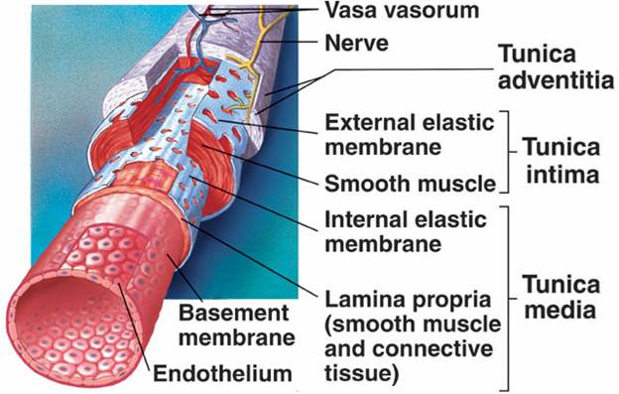
Major structure of blood vessels:
Tunica intima (Interna)
innermost layer
Tunica adventitia (Externa)
Outermost layer “mainly connective tissue”
Intermediate layer “Thickest layer”
Tunica media
Composed of:
1- Endothelial cells: SSE=Simple squamous epithelium
Composed of:
1- Smooth muscles “mainly” 2- Elastic fibers
3- Type I collagen 4- Type III collagen (reticular fibers)
*NB: Large muscular arteries have external elastic lamina separation the tunica media from the tunica adventitia.
Composed of connective tissue containing Vasa vasorum:
They are small arterioles in tunica adventitia and the outer part of tunica media.
They are more prevalent in the walls of veins than arteries (because venous blood contains less oxygen and nutrients than arterial blood)
“Remember SSE lining all circularity system”
2- Subendothelial layer: loose C.T.
3- Internal elastic lamina: fenestrated elastic sheet “rich”
“Tunica = layer”

Slide 6
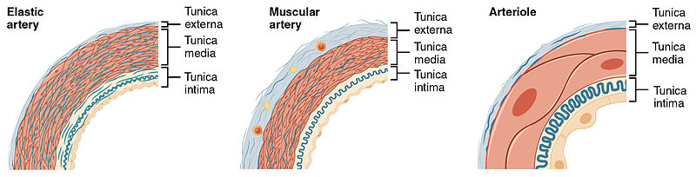
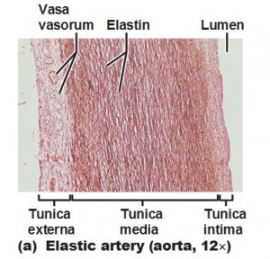
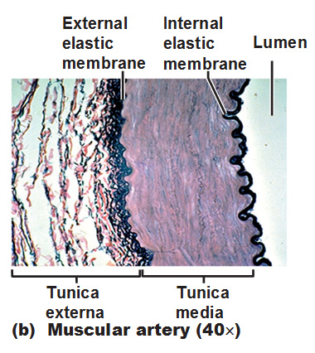

 | Elastic arteries “Large artery” | Muscular arteries “Medium-sized artery”
 | Aorta, common carotid artery, subclavian artery, common iliac artery, pulmonary Trunk. | Brachial, ulnar, renal.
 | Endothelium Subendothelial C.T. Internal elastic lamina: not prominent “not clear” & indistinct | Endothelium. Subendothelial C.T. layer. Internal elastic lamina: Is prominent & displays an undulating surface.
 | It consists of: A. Fenestrated elastic membranes: sheets & lamellae “main component of T.M.” B. In between, there are: 1- Elastic fibers “predominant (main) component = 90%" 2- Collagen fibers (type I collagen) 3- Reticular fibers (type III collagen) 4- Smooth muscle cells | (Thicker than T. Adventitia or similar in thickness). Components: A. Smooth muscle cell (SMCs) “predominant component" B. In between, there are: 1- Elastic fibers 2- Collagen fibers (type I collagen) 3- Reticular fibers (type III collagen) C. External elastic lamina: may be identifiable.
 | Much thinner than T.M. It is composed of loose connective tissue Contains vasa vasorum → send branches to the outer part of T.M. | Loose connective tissue
EX.
T. Intima (Interna)
T. Media
T. Adventitia (Externa)
Pic.

Slide 7
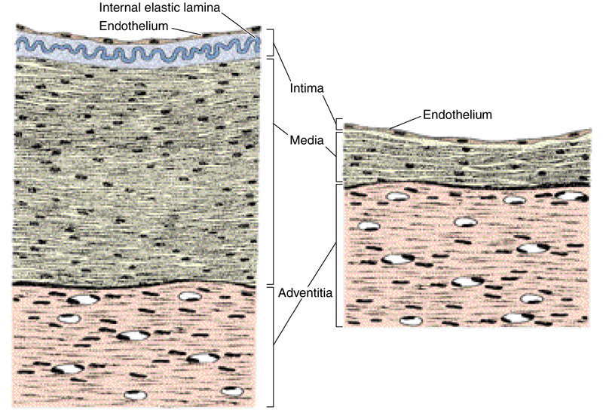
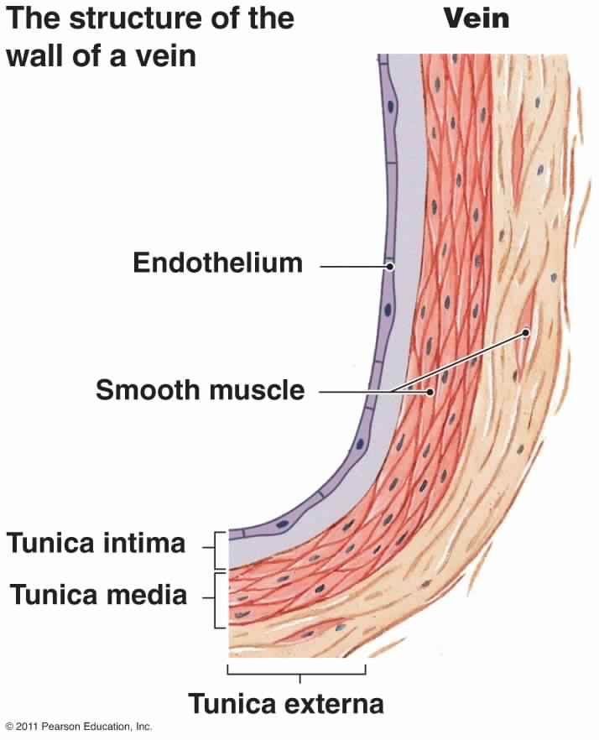
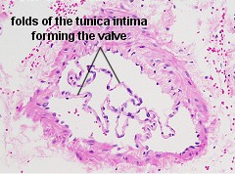
 | Medium-sized vein
 | Thickness of the wall: thinner than the accompanying artery
 | usually forms valves no internal elastic lamina
 | Thinner than T. Adventitia. It consists of: 1- Fewer SMCs 2- Types I & III Collagen fibers
 | thicker than T. Media
Medium-sized artery & vein
T. Intima (Interna)
T. Media
Valves of the vein
Valve of a vein is composed of 2 leaflets.
Each leaflet has a thin fold of the T. Intima.
Components:
  Endothelium
  Core of Connective tissue
T. Adventitia (Externa)

Slide 8
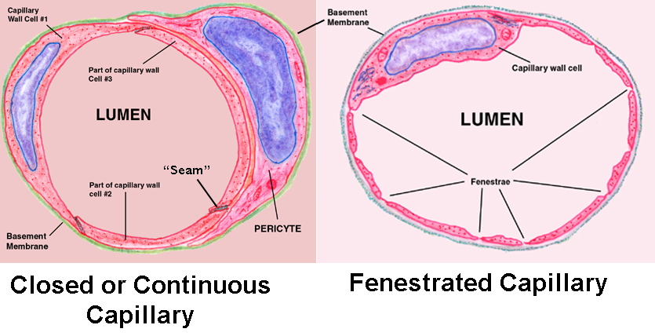
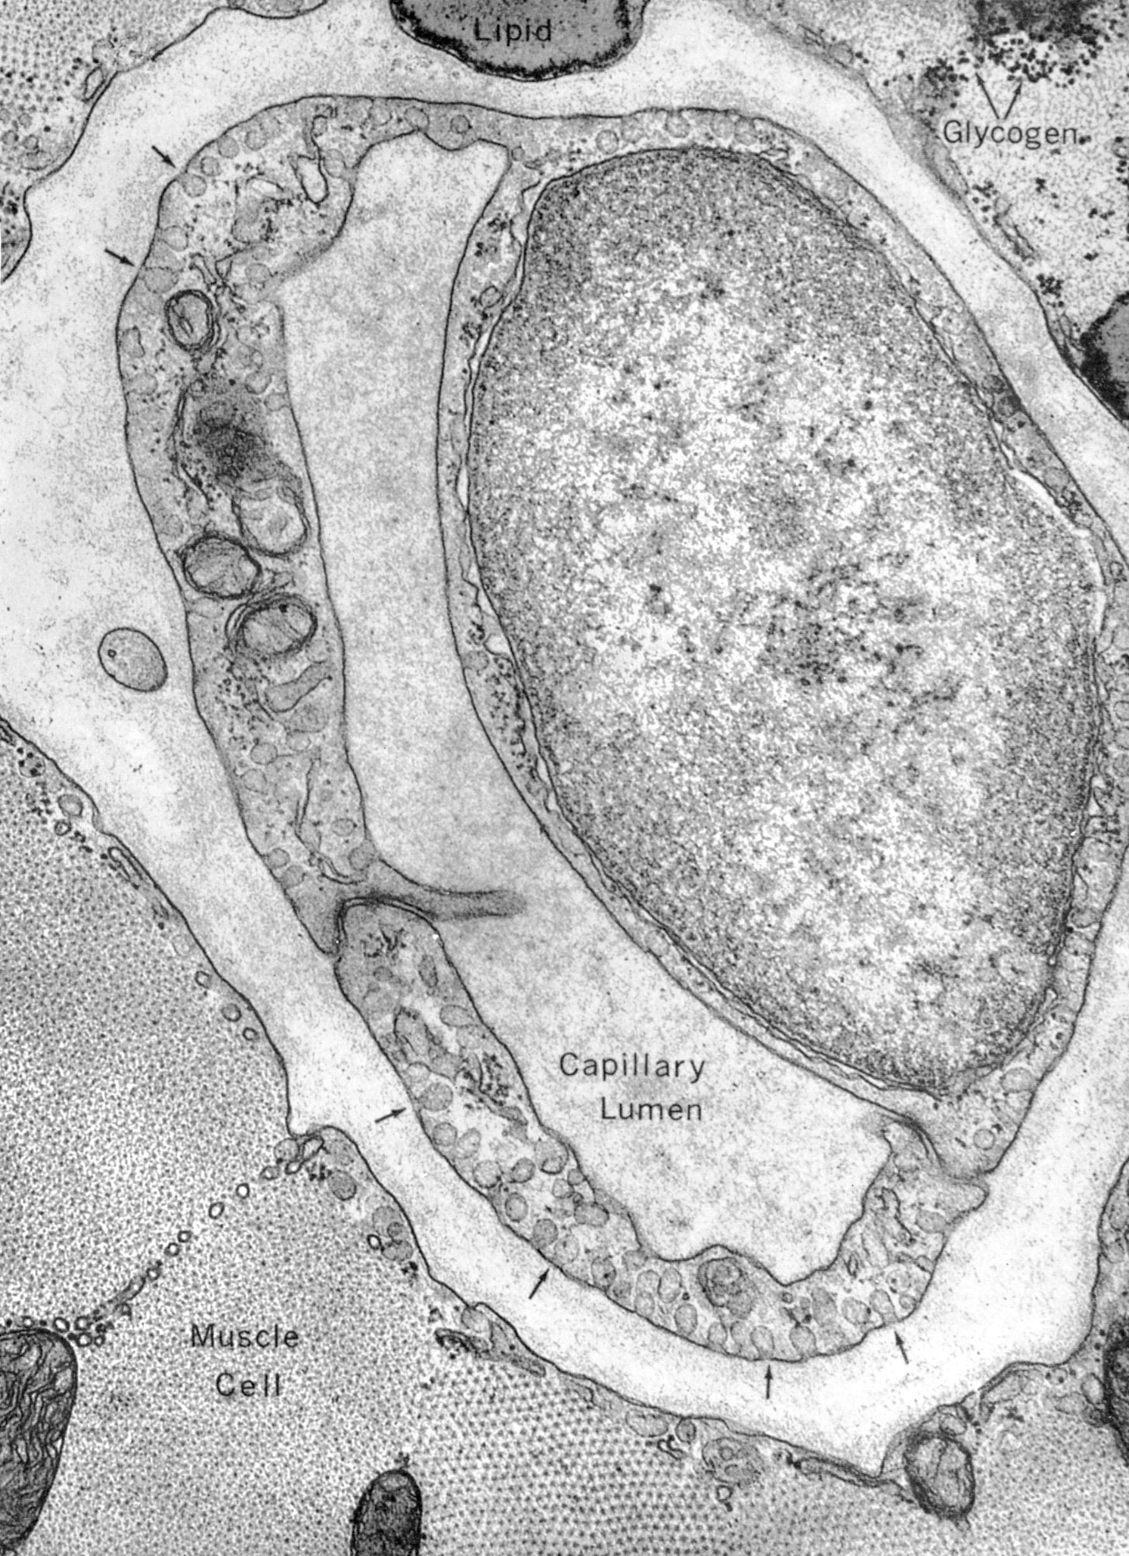
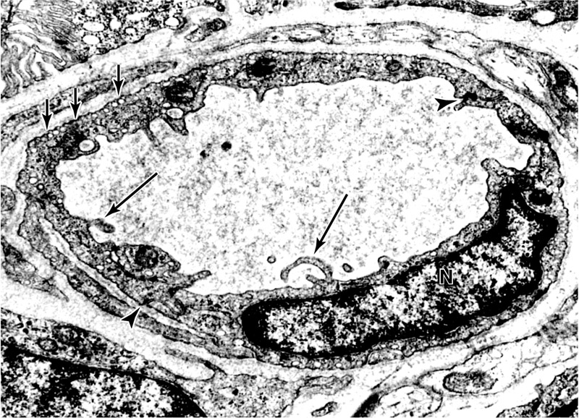
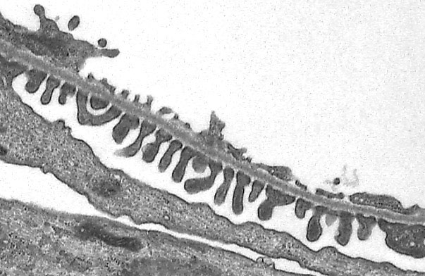
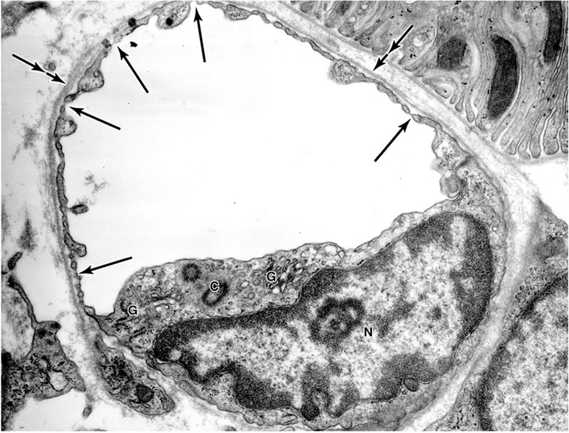
Blood capillary
Diameter: usually 8-10 µm
Microscopic structure:
  Single layer of squamous endothelial cells.
  Basal lamina: surrounds the external surface of the endothelial cells.
  Pericytes: “act as stem cell for endothelium cells & for smooth muscle in blood vessel”
    Have processes
    Share the basal lamina of the endothelial cells
Types:
(1) Continuous blood capillaries
(2) Fenestrated blood capillaries
(2A) With diaphragm
(2B) Without diaphragm
*Diaphragm allow the substance to pass in one direction
(3) Sinusoidal blood capillaries
(1)
(2A)
(2A)

Slide 9
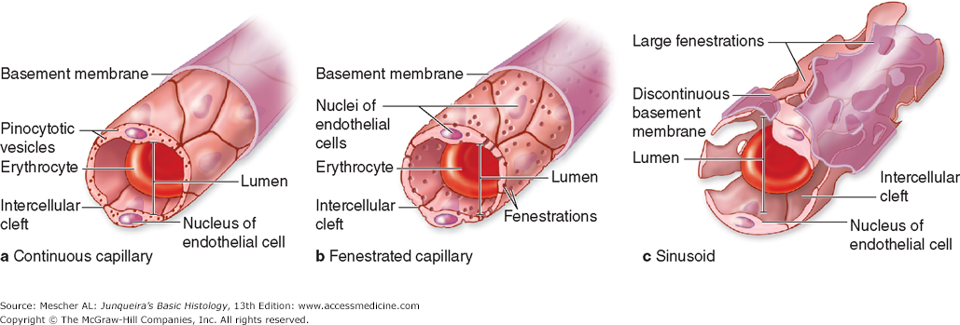
 | Continuous blood capillaries | Fenestrated blood capillaries | Sinusoidal blood capillaries
 | In muscles, nervous tissue, C.T. | (with diaphragm): In intestine, pancreas and endocrine glands (without diaphragm): In renal glomerulus (only one structure) | Red bone marrow, liver, spleen and certain endocrine glands *Diameter: irregular (30-40 µm).
 | No pores or fenestrae in their walls | (with diaphragm): The walls of their endothelial cells have pores (fenestrae). These pores are covered by diaphragm. (without diaphragm): The walls of their endothelial cells have pores (fenestrae). These pores are NOT covered By diaphragm. | Their endothelial cells have “large” fenestrae without diaphragms. They possess discontinuous endothelial cells. They possess discontinuous basal lamina. Macrophages may be located in or along the outside of the endothelial wall.
Distribution
Microscopic structure
Pic.

