Slide 1
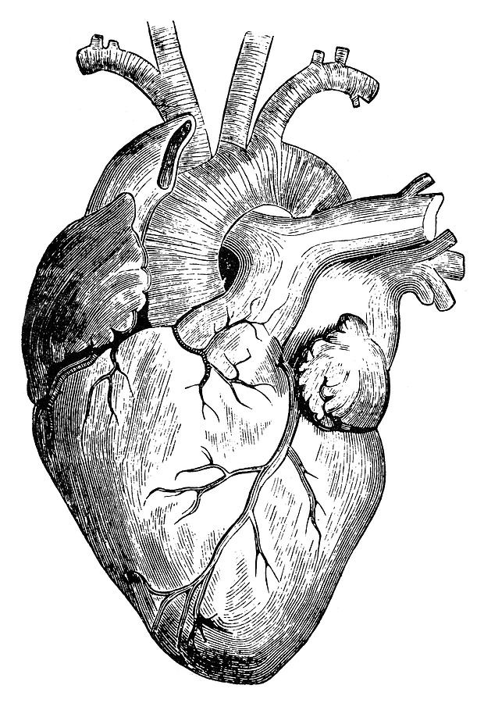
Pathology
teamwork
Lecture (1) :
Rheumatic fever, endocarditis and heart valves
Editing File
Color Index :-
VERY IMPORTANT
Extra explanation
Examples
Diseases names: Underlined
Definitions
* Who you are tomorrow begins with what you do today ..

Slide 2
\
Understand the clinicopathological features of rheumatic heart disease which is a major cause of acquired mitral and aortic valve diseases in the Kingdom of Saudi Arabia.
Know the pathological causes and pathophysiological consequences of stenosis and incompetence of all the cardiac valves but particularly the mitral and aortic valves.
Understand the pathology of infective endocarditis so as to be able to identify patients at risk and when appropriate ensure prophylactic treatment is given.
Objectives :

Slide 3
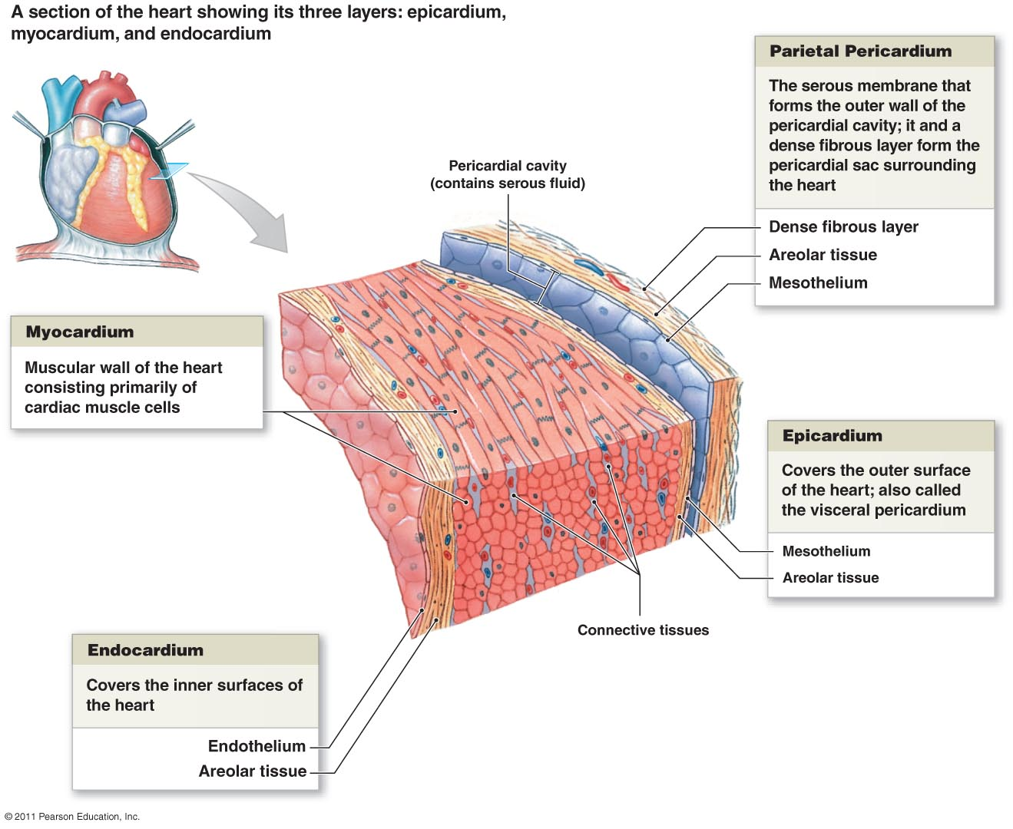
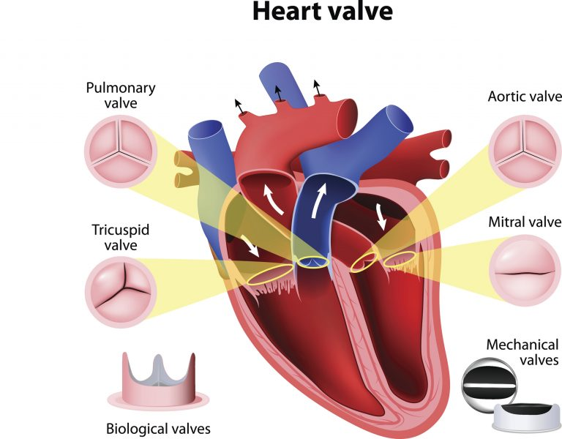
introduction
The heart is composed of 3 layers; the epicardium, myocardium and the endocardium.
and it contains two groups of valves; the atrioventricular valves and the semilunar valves:
AV valves: tricuspid and mitral.
Semilunar valves: aortic and pulmonary.
Valvular Heart Disease
Valvular disease results in regurgitation/insufficiency/incompetence or stenosis, or both.
Stenosis is the failure of a valve to open completely, obstructing forward flow.
Regurgitation is the failure of a valve to close completely, allowing backflow of blood.
Any abnormal blood flow through a diseased valve produces an abnormal sound called a murmur.
Causes:
Most common cause of aquired valvular heart disease is post inflammatory scarring.
May be congenital.
Can occur even with prosthetic heart valves.
Secondary to thrombus formation or infectious endocarditis.

Slide 4
Rheumatic fever
Rheumatic fever is an acute, immunologically mediated, multisystem inflammatory disease that occurs after group A beta-hemolytic streptococcal infection, (pharyngitis, tonsillitis).
Inflammation is mainly seen in the heart, joints, skin, and central nervous system.
Occurs in only 3% of patients with group A streptococcal recurrent pharyngitis.
It mainly occurs in children, 5 to 15 years of age.
Rheumatic Heart Disease (RHD) is the cardiac manifestation of rheumatic fever, which mainly affects the valves. It is the only cause of acquired mitral stenosis.
Pathogenesis:
Manifestations of rheumatic fever are not caused by the bacteria. It is a hypersensitivity reaction, mainly mediated by antibodies directed against certain group A streptococcal antigens; which also cross react with host antigens.
In particular, antibodies against M proteins (a virulence factor produced by GAS) bind to proteins in the myocardium and cardiac valves and then cause injury by:
Activation of complement.
Cytokine-mediated inflammation by CD4+ T cells.
These proteins found in the body resemble similar structures to M proteins (molecular mimicry), and that explains why this immune response occurs.
Manifestations and symptoms take 2-3 weeks (in girls slides from 10 days to 6 weeks) to appear, because this immune response takes time to develop.
antibodies against M protein
activation of complement and T cells
Inflammation occurs
cross reaction with host proteins
2-3 weeks till symptoms appear

Slide 5
Morphology:
In acute rheumatic fever:
The myocardial inflammatory lesions are called Aschoff bodies; which are the hallmark lesions for rheumatic fever.
Aschoff body is a focus of collagen necrosis, collections of lymphocytes (T cells), plasma cells, and plump activated macrophages/histiocytes called Anitschkow/caterpillar cells.
These bodies can be found in all three layers of the heart, including valves. Rheumatic fever causes pancarditis (inflammation of all layers of the heart) when:
Pericardium contains a fibrinous exudate.
Myocardium contains many Aschoff bodies, which could cause sudden death.
Endocardium inflammation leads to valvular damage, which results in fibrin deposition along the lines of valvular leaflets called vegetations.
Lesions found in the posterior wall of the left atrium are called MacCallum Plaques.
In chronic rheumatic heart disease:
It takes years to develop, and it is characterized by subsequent scarring (fibrosis). Aschoff bodies are replaced by fibrous scar, that’s why they are rarely seen in chronic RHD.
Valve leaflets become thickened and fused, chordea tendineae are tightened, fused and shortened.
* Changes in chordea tendineae result in regurgitation.
* Fibrosis along with calcification in these leaflets creates stenosis, which is known as ‘fish-mouth’ deformity.
* RHD occurs in valvular areas with great blood flow, mitral valve is the most affected. Sometimes combined with aortic valve.
Tricuspid valve is less involved,
and the pulmonary valve is almost never involved.

Slide 6
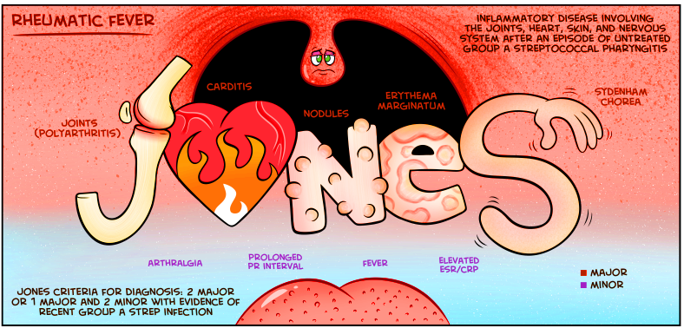
Diagnosis:
Serum antibodies to one or more streptococcal antigens (virulence factors) are elevated. Those are anti-streptolysin O, anti-DNAse, and anti-hyaluronidase.
(culture is usually negative) we know that the symptoms of the disease will appear after 1 or 2 weeks from infection with group A streptococcus, by that time the causative agent will be gone. The only thing we have is the antibodies that produced during infection and caused the manifestations.
Diagnosis is based on serologic evidence, along with Jones’ Criteria; which are clinical features divided into major and minor. See the mnemonics below in the picture
Major:
Pancarditis, includes murmurs, pericardial friction rubs, weak heart sounds, tachycardia and arrhythmias cardiomegaly, pericarditis, and congestive heart failure
Migratory polyarthritis, affects one joint after another-fleeting arthritis-and large joints.
Subcutaneous nodules, usually found at bony promineces.
Erythema Marginatum.
Sydenham chorea, involved in the CNS, characterized by involuntary movements and grimaces.
Minor:
Fever.
High ESR and CRP.
Prolongation of PR interval in ECG.
Arthralgia, which is pain in the joints not caused by inflammation.
Previous history of rheumatic fever.
For diagnosis, you need two major, or one major + two minor clinical features.

Slide 7
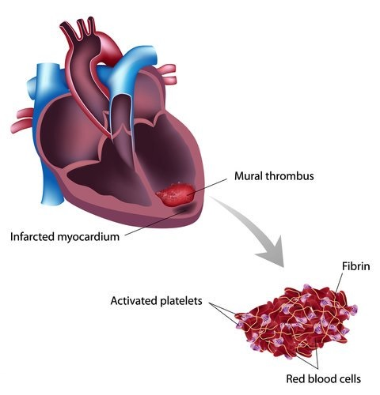
Complications:
Prognosis is highly variable. Surgical replacement of diseased valves is available.
Summary:
Infective endocarditis, the scarred valves of rheumatic heart disease provide an attractive environment for bacteria to grow.
Mural thrombi form in cardiac chambers. They give rise to thromboemboli, which can produce infarcts in various organs.
Congestive heart failure.
Adhesive pericarditis.
Atrial fibrillation, due to mitral stenosis.
*A beautiful mind map by Mr. Rakan. All rights reserved.

Slide 8
Infective endocarditis
Definition: infection of the cardiac valves or surface of the endocardium, often with destruction, resulting in the formation of friable vegetations; composed of adherent mass of thrombotic debris and micro-organisms.
Infective endocarditis is a particularly difficult infection to eradicate; because of the avascular nature of the heart valves. So the antibiotics will not reach there
Infective endocarditis (IE) is divided into:
Acute IE:
Is caused by highly virulent organisms (staphylococcus aureus).
Attacks normal/healthy valves.
Destructive, progresses rapidly.
Has little local host reaction.
Prognosis: very bad, it could lead to death even with antibiotics and surgery.
Tricuspid valve is more involved.
Subacute IE:
It is caused by low virulence organisms (a-hemolytic streptococci viridans).
Attacks previously abnormal valves, especially scarred or deformed ones.
Progresses slowly.
It induces a local inflammatory reaction.
Prognosis: depends to some extent on the offending organism and the stage at which the infection is treated, most patients recover after antibiotic therapy.

Slide 9
Risk Factors:
In acute IE, it mostly occurs due to intravenous drug abuse. Tricuspid valve is affected in most cases.
In subacute IE, the mitral valve is mostly affected, and frequently combined with the aortic valve. It occurs due to:
Rheumatic heart disease, mitral valve prolapse, and bicuspid aortic valve.
Cardiac anomalies, such as atrial septal defect.
People with (Prosthatic valves), especially if they undergo surgery.
IV Drug abusers.
Immunocompromised patients, like diabetics, pregnant.
Children an underlying cardiac lesions, the main cause is congenital heart diseases.
Adults usually there is no predisposing cardiac lesions. The main causes are mitral prolapse and congenital heart diseases.
Transient bacteremia from any procedure.
The elderly due to degeneration of heart valve
Note that:-
Mitral valves are the most common sites of IE followed by aortic valve.
In IV drug users, the right side valves like the tricuspid are more commonly involved.
Vegetations may be single or multiple, involving one or more valve(s).
Diagnosis and Clinical features:
Most consistent sign of IE is fever. However, fever may be absent in subacute IE and they might only have fatigue and weight loss. In acute disease, they might have chills and weakness along with fever. Splenomegaly may occur at late stages.
Diagnosis is confirmed by positive blood cultures, you might need more than one culture because organisms or strongly attached to the bulky vegetations.
Complications:
When these vegetations fragment, they may produce abscesses. These emboli when they get lodged somewhere in the body; they produce septic infarcts. Renal failure may occur due to glomerular trapping of antigen-antibody complexes, and pulmonary emboli may occur too. Arrhythmias may be present.
Vegetations can detach and form septic thrombi, go to brain, cause abscess or go to kidney or spleen

Slide 10
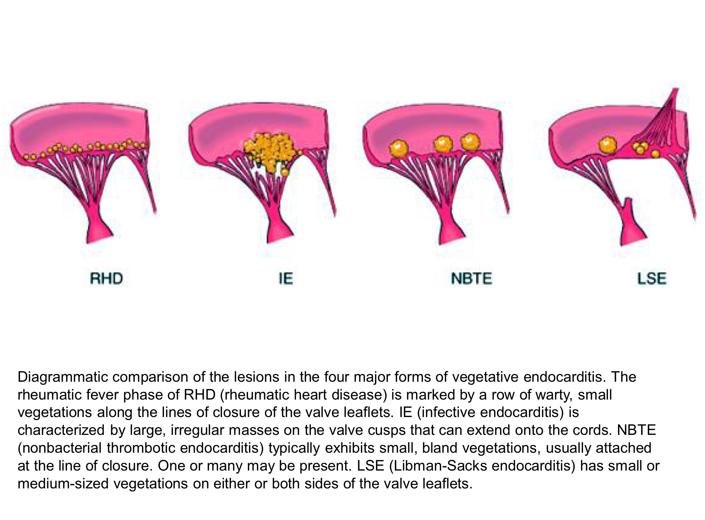
Other types of NON-infective endocarditis: (very important in MCQs)
Libman-Sacks endocarditis: Less common, non-infective, associated with elevated levels of circulating immune complexes. Seen in patients with systemic lupus erythematosus (SLE).
Endocarditis of carcinoid syndrome: Secretory products of carcinoid syndrome, especially serotonin (5-hydroxytryptamine) and histamine can cause endocarditis. The endocardial plaques are seen in the right side of the heart.
Nonbacterial thrombotic endocarditis (NBTE) (marantic endocarditis): It is associated with terminally ill people, such as metastatic cancer. Characterized by sterile vegetations (small masses of fibrin, platelets, and other blood components) on the leaflets of the cardiac valves. There is no infective organism, it is aseptic. In contrast with IE, lesions of NBTE are nondestructive.
DIFFIRENT VALVULAR DISEASES
Mitral Valve Prolapse:
Myxomatous degeneration of the mitral valve, also called floppy mitral valve.
There is myxoid/mucoid degeneration of the valve which causes ballooning of mitral valves (floppy cusp), results in stretching of the mitral valve, producing a parachute deformity of the cusp with prolapse of the cusp into the atrium during systole. These changes produce a characteristics systolic murmur.
Pathogenesis is unknown.
Unlike rheumatic fever, chordae tendineae here are elongated.
Most patients are asymptomatic.
Seen in young women.
Can be component of Marfan syndrome.
Patients are predisposed to infective endocarditis. which type of infective endocarditis? Subacute because it is already damaged

Slide 11
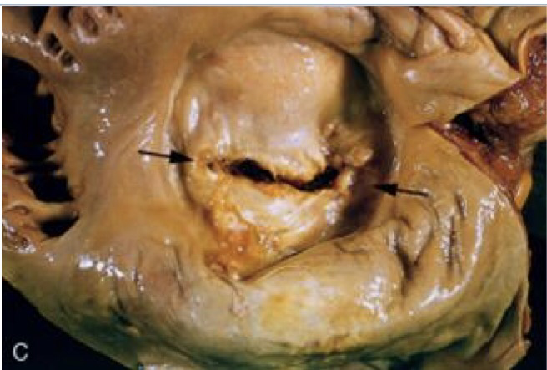
Mitral Stenosis:
Mitral Regurgitation:
Is usually due to rheumatic heart disease .
Can be due also to mitral valve prolapse, infective endocarditis,papillary muscle injury in myocardial infarction.
Leads to left ventricle hypertrophy and dilataion.
Aortic Stenosis:
Commonly caused by calcification and is called as calcific aortic stenosis.
It is associated with age and ‘Wear and tear’ mechanism.
Aortic Regurgitation:
Can be caused by aortic aneurysm, RHD, IE and syphilitic aortitis (rare).
Bicuspid Aortic Valve:
It occurs when there is deformity in the aortic valve, it has two cusps instead of three. Characterized by adhesions and fibrosis.
Tricuspid valve:
Rarely involved in rheumatic heart disease, when involved it is along with the mitral and aortic valves (not alone).
Pulmonary valve:
Can be affected in congenital malformations like tetralogy of fallot.
Stenosis is more common than regurgitation. Mitral stenosis is most commonly due to rheumatic heart disease.
In mitral stenosis (picture):
Leaflets are thickened, fibrotic and fused leading to fish-mouth/button hole deformity (stenosed valve looks like fish's-mouth or button hole Increased pressure, dilatation and hypertrophy of left atrium. Secondary deposition of Ca++ Pulmonary hypertension and lungs are firm and heavy(chronic passive congestion).
Right heart may be affected later (right ventricular-hypertrophy).
Right side of the heart:

Slide 12
Summary of Infective Endocarditis:
Endocarditis | Acute | Subacute
Causative organism | Staphylococcus aureus | Streptococcus viridans or streptococcus bovis
Common valves | Healthy valves, mostly Tricuspid valves | Abnormal valves. Mitral valves followed by aortic valves
Risk factors | Drug addiction | 1- Congenital heart disease 2- Persistent foramen ovale 3- Rheumatic valve disease 4- Drug addicts 5- Artificial valves 6- Septicemia (rare)
Investigations | 1- ECG 2- X-ray 3- Echocardiography 4- ESR (very high) 5- Anti-streptolysin O
Prognosis | Very bad could lead to death | Most patients recover after appropriate antibiotic therapy
Complications | 1- glomerulonephritis 2- septic emboli
*A beautiful comparison by Mr. Tareq. All rights reserved.

Slide 13
questions
Q1) Aschoff bodies are usually found in large numbers within?
A) Epicardium
B) Subendothelial epicardium
C) Myocardium
D) Pericardium
Q2) In case of Rheumatic Fever the immune system would develop antibodies against?
A) Exotoxin
B) Lipopolysaccharides
C) Capsule
D) M protein
Q3) The diagnosis of acute rheumatic fever is made based on?
A) Serological evidence of previous streptococcal infection
B) Jones Criteria
C) Both A&B
D) None of the above
Q4) The most common organism of subacute endocarditis?
A) streptococcus viridians
B) streptococcus pnuemoniae
C) Staph aureus
D) streptococcus pyogens
Q5) In diagnosis of acute rheumatic fever the Jones criteria can be helpful. Which of the following is NOT considered as a major criteria?
A) Erythema marginatum
B) Carditis
C) Polyarthritis
D) Fever

Slide 14
Q6) In case of rheumatic fever, which of these gets irreversibly damaged (fibrosis) ?
A- Pericardium
B- Myocardium
C- Valves
D- Chordae tendineae
E- C&D
Q7) which valve is least likely to be affected in rheumatic fever ?
A- Bicuspid valve
B- Aortic valve
C- Tricuspid valve
D- Pulmonary valve
Q8) Patient with cancer came to the hospital complaining about his heart and you suspect endocarditis, the laboratory findings have shown a non-bacterial thrombi, which type of endocarditis the patient most likely has ?
A– Marantic endocarditis
B– Libman sacks endocarditis
C– Carcinoid syndrome endocarditis
D– A&B
Q9) The cause of aortic valve stenosis is ?
A– Dystrophic calcification
B– Inflammation
C– Hemodynamics
Q10) Complications of Chronic rheumatic fever include;
A– Bacterial infective endocarditis
B – Mural thrombi
C– Congestive heart failure
D– All of the above
Answers:
C
D
C
A
D
E
D
A
A
D

Slide 15
case
A 7 year old girl is brought to the clinic because she has a rash and joint pains that bother her. Her past medical history is unremarkable other then a sore throat that resolved on its own about 2 weeks ago. Last week the patient noticed pain in her knees. This pain resolved after a few days, however now she complains of pain in her wrists and ankles. The patient has also developed a pink rash on her back. Her temperate is 101.2°F, pulse is 87/min, and respirations are 18/min. A physical exam reveals both pain and stiffness in the wrists and ankles. A fait, erythematous rash with sharp borders is present on her trunk and proximal lines. The rest of her exam is non-contributory. Lab results are collected and are as follows:
Leukocytes: 7,500/µL
Haemoglobin: 12.9 g/dL
platelets: 220,000/µL
CRP: 38 mg/dL **
ESR: 40 m/hr **
1) What diagnosis could explain this presentation?
2) What type of hypersensitivity reaction?
3) Bacterial virulence factor responsible:
4) Name one complication:
Answers:
Acute rheumatic fever
Type II hypersensitivity reaction
M protein
Atrial fibrillation

Slide 16
Females:
-Leader : فاطمة بالشرف
الغريبي ريناد
منيرة المسعد
شوق القحطاني
رزان الزهراني
الرحيمي بتول
فاطمة الديحان
الجوهرة الشنيفي
نورة القاضي
غادة الحيدري
مها العمري
غرام الجليدان
آلاء الصويغ
ال فهدة السليم
شيرين حمادي
رناد الفرم
نورة الحربي
ميعاد النفيعي
Males:
-Leader :منصور العبرة
خالد العقيلي
عبدالجبار اليماني
بندر الجماز
محمد المحيميد
راكان الغنيم
سليمان الزميع
طارق العلوان
أحمد الصبي
أنس السيف
تركي آل بنهار
خالد المطيري
سعد الفوزان
سعود الأحمري
سيف المشاري
عبدالعزيز العبدالكريم
عبدالله العبيدان
عبدالله السرجاني
فهد الفايز
محمد الأصقه
محمد بن معيوف

Slide 17
Kindly contact us if you have any questions/comments and suggestions:
* EMAIL: pathology437@gmail.com
* TWITTER : @pathology437
GOOD LUCK ! ☺
*references:
- Robbins Basic Pathology
- Slides
Pathology
teamwork

