Slide 1
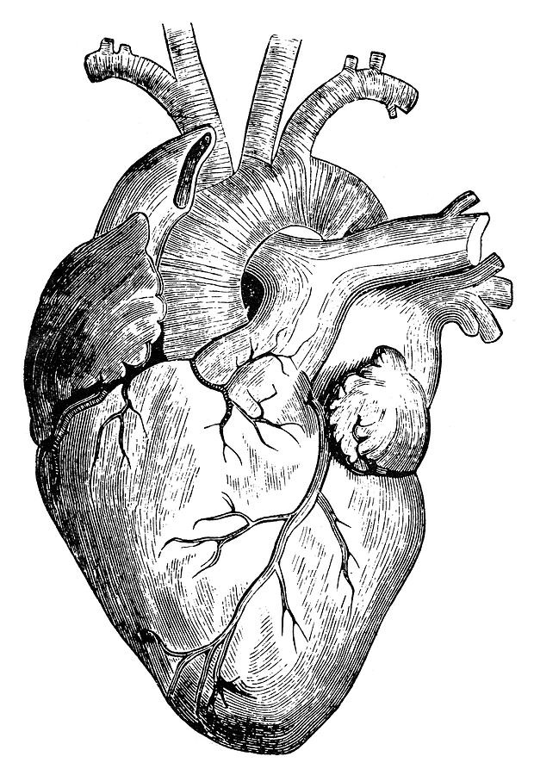
Pathology
teamwork
Lecture (2):
Atherosclerosis
Editing File
Color Index :-
VERY IMPORTANT
Extra explanation
Examples
Diseases names: Underlined
Definitions
*The expert in anything was once a beginner

Slide 2
\
Understand the pathogenesis and clinical consequences of atherosclerosis.
Be able to discuss pathology and complications of ischemic heart diseases with special emphasis on myocardial infarction. Next lecture
Know how lifestyle modifications can reduce the risk of ischemic heart diseases. Next lecture
Key principles to be discussed:
Risk factors of atherosclerosis.
Pathogenesis of the fibro lipid atherosclerotic plaque.
Clinical complications of atherosclerosis.
Commonest sites for the clinically significant coronary atherosclerosis.
Macroscopic and microscopic changes in myocardial infarction.
Biochemical markers of myocardial infarction.
Complications of myocardial infarction: immediate and late.
Objectives :

Slide 3
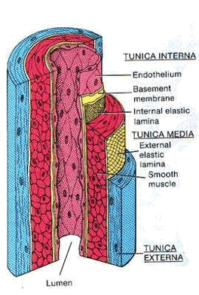
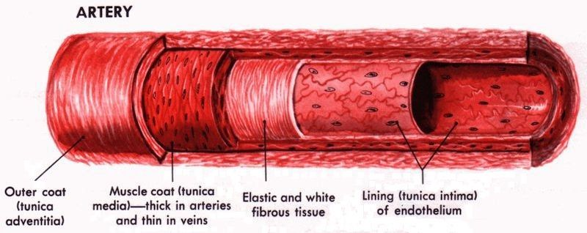
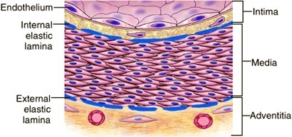
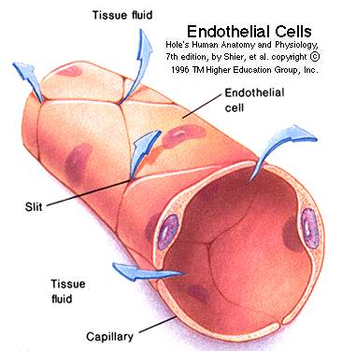
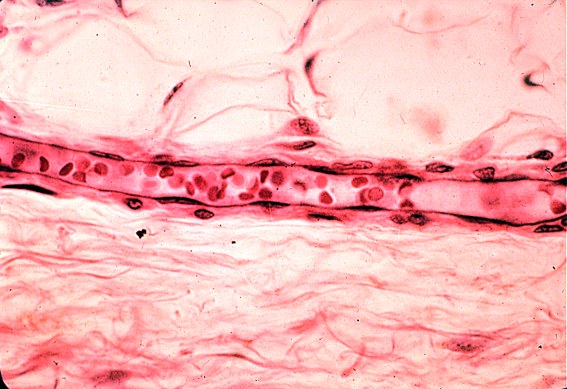
Introduction:Normal Blood Vessels
Large (elastic) arteries
aorta, common carotid, iliac
lots of elastic fibers
Medium (muscular) arteries
coronary, renal arteries
mostly smooth muscle cells
Small arteries/arterioles
all smooth muscle cells
blood pressure controlled here
Capillaries
diameter of RBC
thin walls, slow flow
great for exchanging oxygen, nutrients
Venules/veins
large diameter, thin walls
compressible, penetrable by tumor
Have valves
Lymphatics
drain excess interstitial fluid
pass through nodes
Artery
Endothelial Cells
The endothelium is a single cell thick lining of endothelial cells and it is the inner lining of the entire cardiovascular system (arteries, veins and capillaries) and the lymphatic system.
It is in direct contact with the blood/lymph and the cells circulating in it.
A normal structure and function of endothelium is essential for the maintenance of vessel wall homeostasis and normal circulatory function.

Slide 4
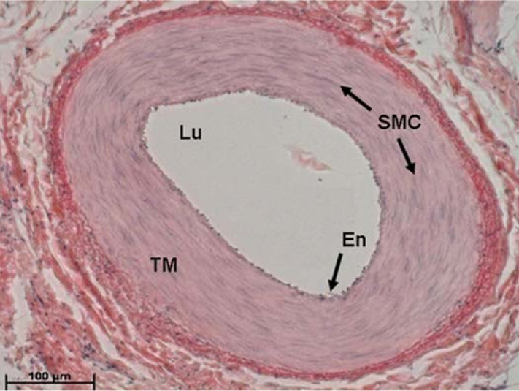
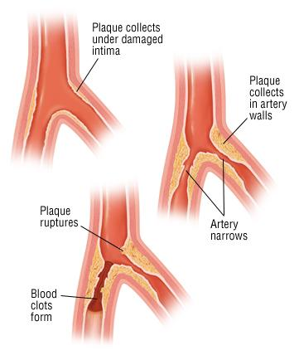
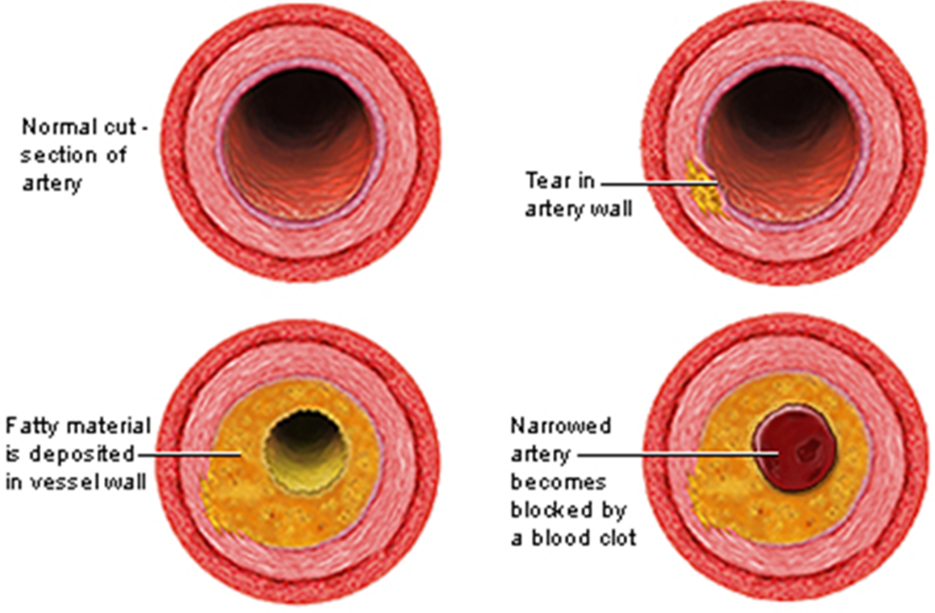
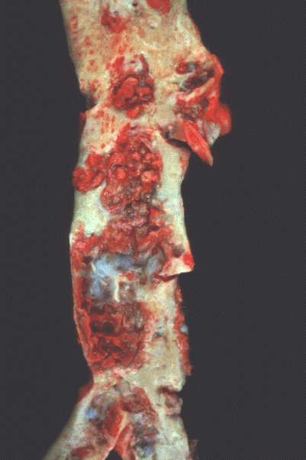
Smooth Muscle Cells (SMC)
SMCs are present in the media of blood vessels
SMCs are responsible for vasoconstriction and vasodilation of blood vessel.
Any vascular injury or dysfunction stimulates SMCs. On stimulation the SMCs:
1- Migrate from the media to the intima.
2- In the intima the SMCs lose the capacity to contract and gain the capacity to
divide. So they proliferate as intimal SMCs.
3- They synthesize collagen, elastin etc. and deposit extracellular matrix (ECM).
Atherosclerosis (AS)
Atherosclerosis is characterized by intimal lesions called atheromas (also known as atheromatous plaque or fibrofatty plaque), which protrude into and obstruct vascular lumens and weaken the underlying media.
The most commonly involved vessels are the abdominal aorta then coronary arteries, the popliteal arteries, the internal carotid arteries, and the vessels of the circle of Willis*.
Atheroma usually found in large arteries.
AS can cause serious complications like Coronary artery disease (angina & MI) and Carotid atherosclerotic disease (stroke).
2 things are happening at the same time: “lumen → narrower” “wall → weaker”
Gross Morphology of Atheroma/Atheromatous (AS) Plaque
The key processes in AS is intimal thickening and lipid accumulation.
AS plaques impinge on the lumen of the artery.
AS plaques vary in size.
AS plaques usually involve only a partial circumference of the arterial wall ("eccentric" lesions)-means not fully circular and are patchy and variable along the vessel length.
*Abdominal aorta is a big vessel and if it has a blockage it causes aneurysm “wall become so weak”
Coronary artery which supply Rt and Lt side of the heart
Popliteal arteries in the popliteal fossa behind the knee posteriorly
Internal carotid artery is a branch of common carotid artery go to the brain
Circle of Willis circle made by anastomoses of many blood vessels in the brain

Slide 5
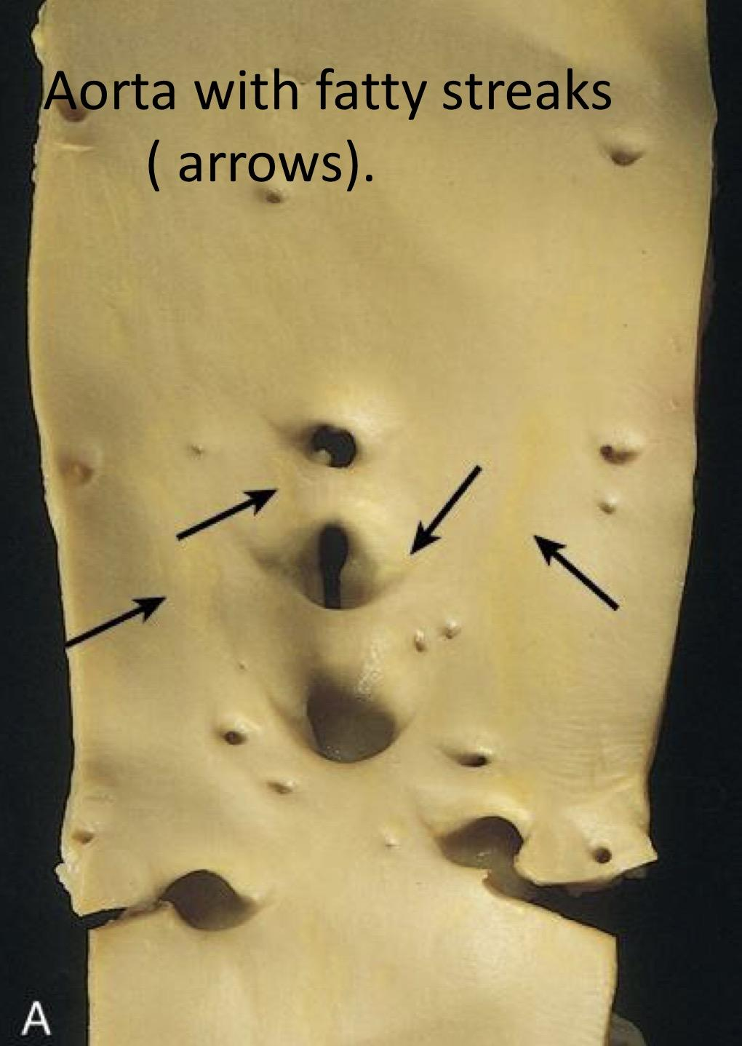
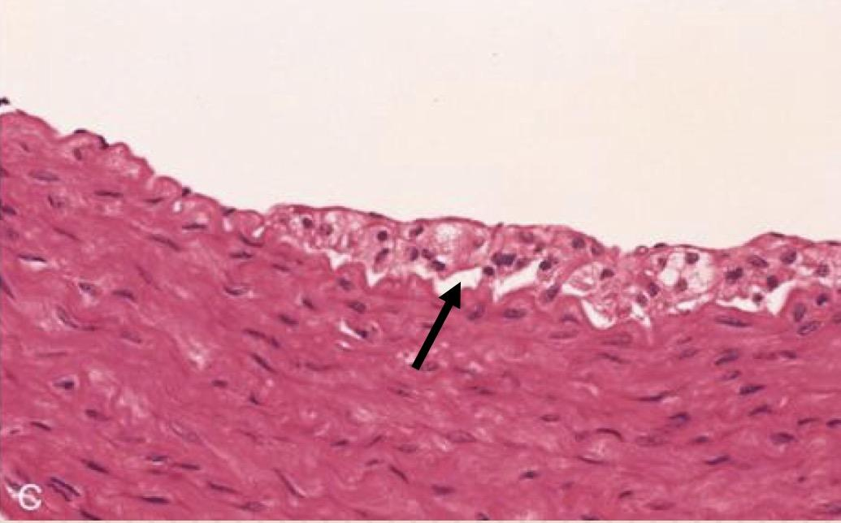
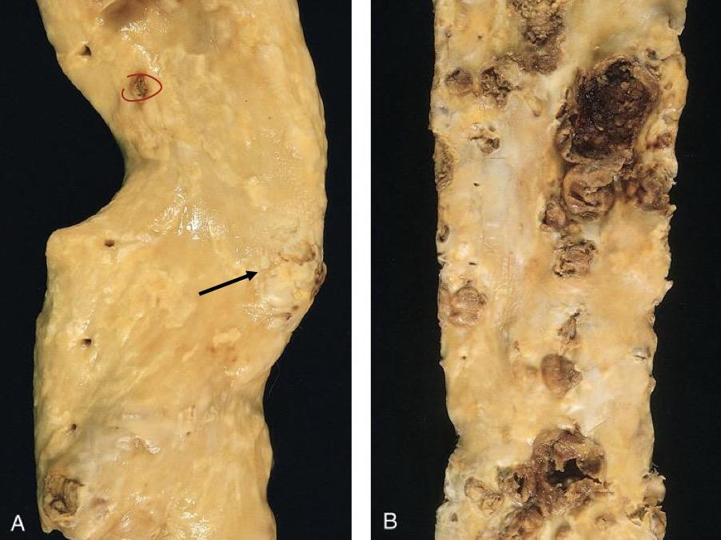
Atherosclerosis
Fatty streaks are the earliest lesion of atherosclerosis they are a collection of lipid and lipid laden foam cells in the intima.
They do not cause any disturbance in blood flow.
Fatty streaks begin as multiple yellow, flat spots less than 1 mm in diameter that coalesce into elongated streaks, 1 cm long or longer.look at pic1
The fatty streaks contain of:
1.T lymphocytes.
2.Extracellular lipid in smaller amounts.
3.lipid laden foam cells.
Every person by the age of 12 will develop fatty streaks which is the earliest lesion of atherosclerosis “the yellow lines in pic1” and if we see it under the microscope we will see a collection of lipid and lipid laden foam cells. Fatty streaks will cause no problem at all it’s only the place where the atherosclerosis start.
Pic1: Aorta with fatty streaks ( arrows).
Pic2: Photomicrograph of fatty streak in an experimental hypercholesterolemic rabbit, demonstrating intimal macrophage-derived foam cells ( arrow).
Fatty streaks = macrophages-derived foam cells.
Gross views of atherosclerosis in the aorta:
A.Mild atherosclerosis composed of fibrous plaques, one of which is denoted by the arrow.
B.Severe disease with diffuse and complicated lesions.
Very important
Pre clinical phase of atherosclerosis has no symptoms.
Pre clinical turns to clinical either by:
1- 70% obstruction of the lumen.
2- Occurrence of a complication.
Clinical phase is the symptomatic phase.

Slide 6
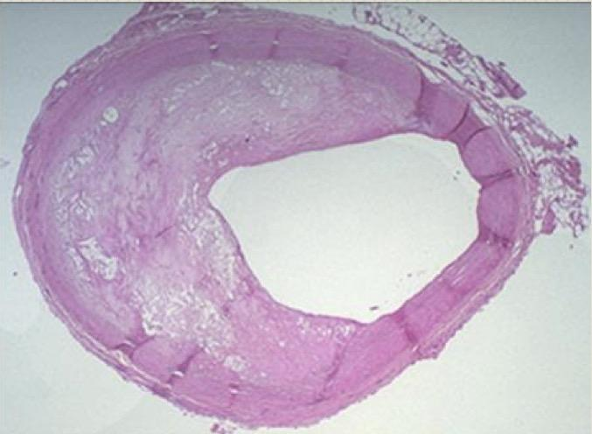
Microscopic morphology of atherosclerosis
A well established atheroma/ AS plaque consists of a raised focal lesion in the intima, with a soft, yellow, grumous/granular core of lipid (mainly cholesterol and cholesterol esters), covered by a firm, white fibrous cap.
Atherosclerotic plaques have three principal components:*
1- Cells: SMCs, macrophages, lymphocytes and foam cell.
2- Extracellular matrix: including collagen, elastic fibers, and proteoglycans.
3- Lipid: Typical atheromas contain relatively abundant lipid both intracellular and extracellular lipid.
Fibrous cap is composed of => SMCs, extracellular matrix “collagen, elastic fibers and proteoglycans” some macrophages and T lymphocytes.
Necrotic core contain => lipid deposits (primarily cholesterol and cholesterol esters), cholesterol clefts, debris from dead cells, foam cells, fibrin.
NOTE: Foam cells are large, lipid-laden macrophages derived from blood monocytes, but SMCs can also imbibe lipid to become foam cells.
* under the microscope we will see a raised focal lesion in the intema which is lipid core covered by fibrous cap. simply this focal is caused after a vascular injury there will be an inflammation and that's why you will see a lymphocytes and macrophages and also due to injury the SMCs will be stimulated and migrate from media to intima and there it will start to proliferate and produce an ECM which consist of collagen, elastic fibers, and proteoglycans and also in the blood there is circulating lipid like primarily cholesterol and cholesteryl esters which will deposits in thy cytoplasmof the cells and also on the outside and that's why you will see both intracellular and extracellular lipid also some of the macrophages will eat up these lipid and form what it’s called foam cells
superficial fibrous cab and below it there is necrotic core they all in the intima
Overall architecture demonstrating an eccentric lesion with a fibrous cap and a central lipid core with typical cholesterol clefts.
The lumen is moderately narrowed. There will be reduction in blood supply

Slide 7
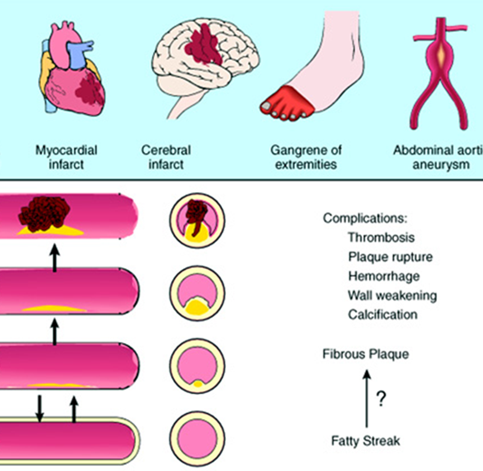
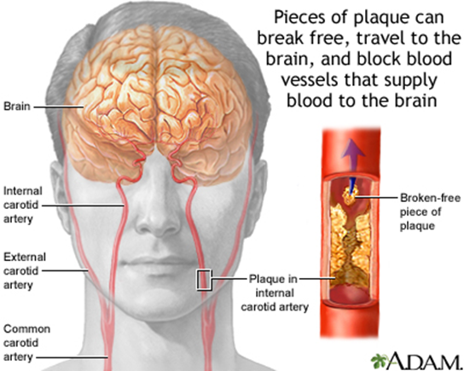
PATHOLOGICAL COMPLICATIONS
Plaque rupture/ ulceration/ erosion of the AS plaques induce thrombus formation OR the AS plaque may discharge debris into the bloodstream, producing microemboli composed of plaque lipid (cholesterol emboli or atheroemboli).
Hemorrhage into a plaque due to rupture of the overlying fibrous cap or the capillaries in the plaque. The hematoma may expand the plaque or induce plaque rupture
Superimposed thrombosis, which usually occurs on top of ruptured or ulcerated plaques. It is the most feared complication. The thrombus can lead to partial or complete occlusion of the lumen. The thrombus can also embolize.
Weakening of the blood vessel wall with aneurysmal dilation.Atheroma can induce atrophy of the underlying media, causing weakness, aneurysm and potential rupture.
Calcifications:Atheromas often undergo calcification.
Stroke/ cerebrovascular accident

Slide 8
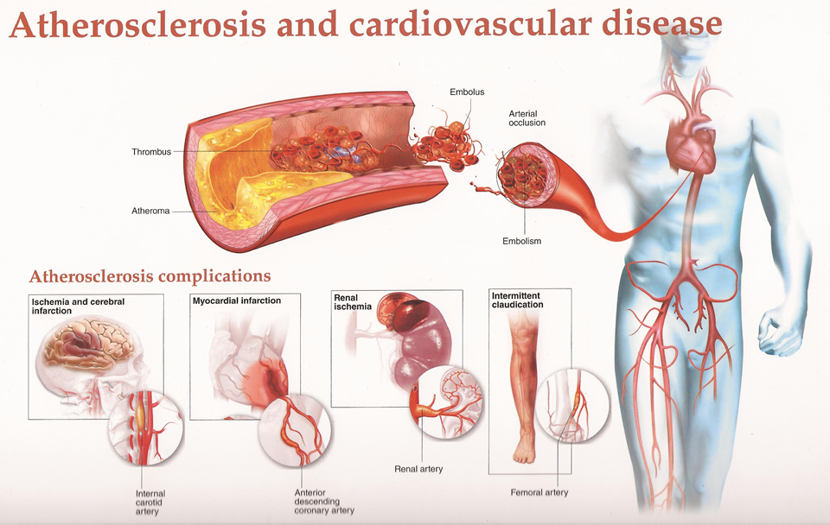
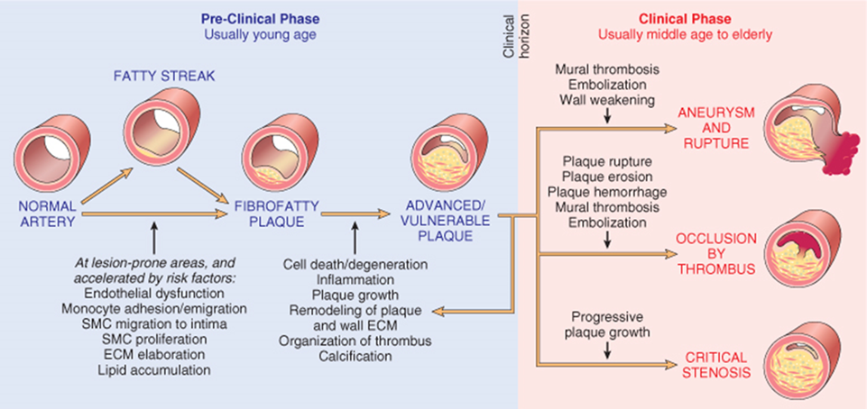
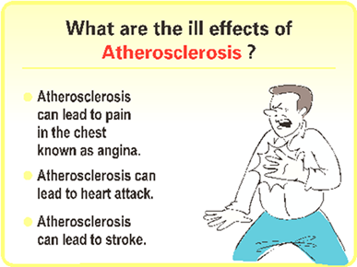
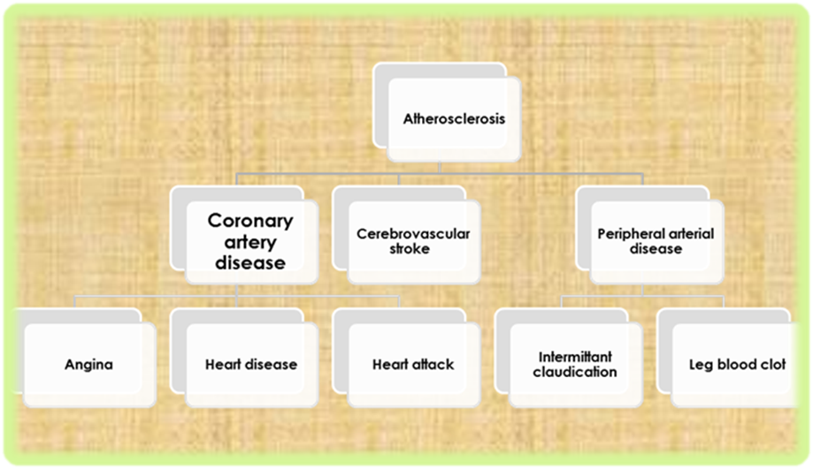
important picture
seen during first stage
partial obstruction

Slide 9
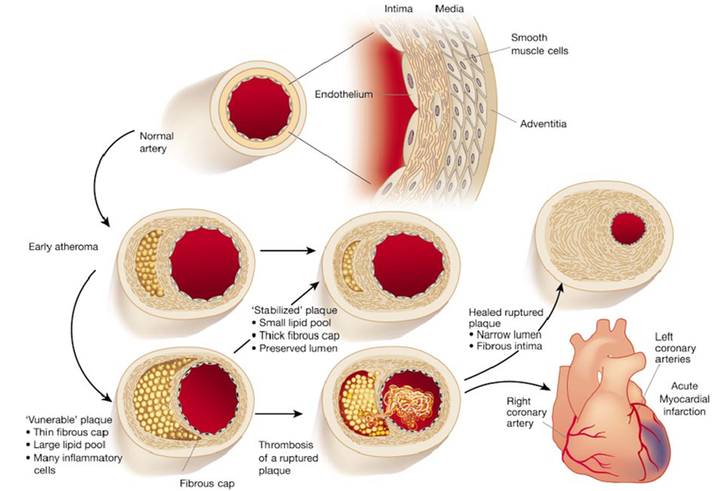
Risk factors
MAJOR RISK FACTORS
MINOR/ UNCERTAIN RISK FACTORS
NON-MODIFIABLE FACTORS: cannot be changed
1. Increasing age 2. Male gender 3. Family history 4. Genetic abnormalities
Obesity
Physical inactivity
Stress ("type A" personality)
Postmenopausal estrogen deficiency
High carbohydrate intake
Alcohol
Lipoprotein Lp(a)
Hardened (trans)unsaturated fat intake
Chlamydia pneumoniae
POTENTIALLY MODIFIABLE FACTORS: could be changed 1. Hyperlipidemia 2. Hypertension
3. Cigarette smoking
4. Diabetes

Slide 10
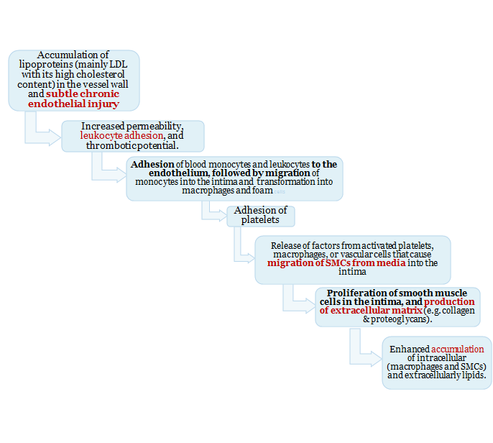
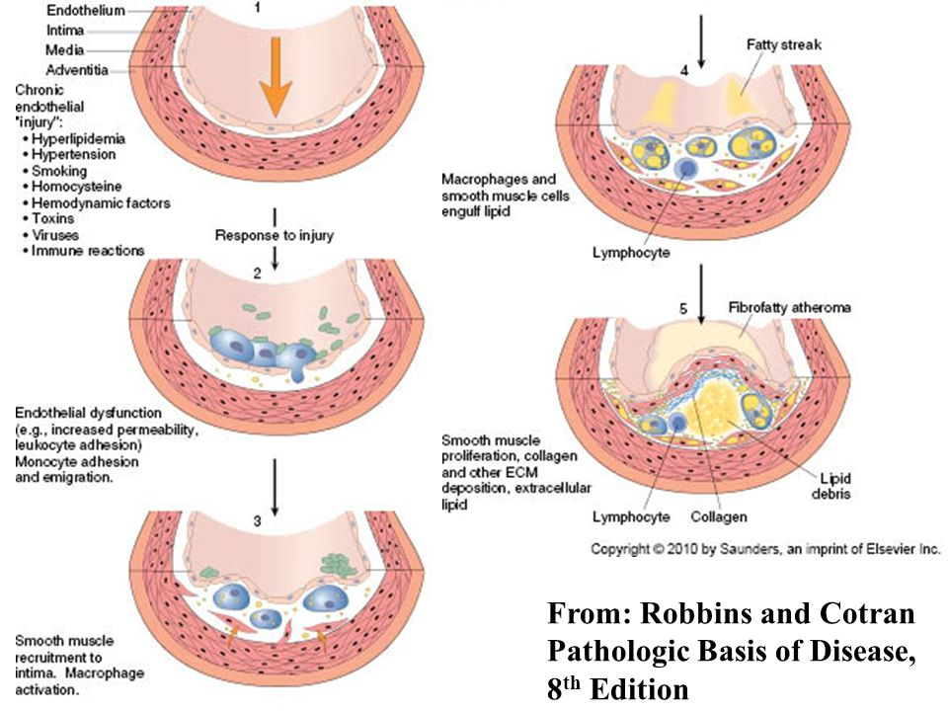
IMPORTANCE OF TYPES OF LIPOPROTEINS IN HYPERLIPIDEMIA
High blood levels of the following promotes AS and therefore heart disease:
• Low-density lipoproteins (LDLs): It is “bad cholesterol”.
• Very-low-density lipoproteins (VLDLs)
• Chylomicrons
High-density lipoproteins (HDLs): is known as “good cholesterol”. High levels of HDL protects against heart attack. Low levels of HDL also increase the risk of heart disease. HDLs help to reverse the effects of high cholesterol.
Treatment of any disease:
1- Stop etiology if 100% known.
2- Interact somewhere in the pathogenesis.
3- Stay away from risk factor.
PATHOGENESIS: the hypothesis is that AS is a response to injury
First step (most important) Endothelial injury
Endothelial injury dysfunction
Fatty streaks seen in the beginning

Slide 11
Angioplasty

Slide 12
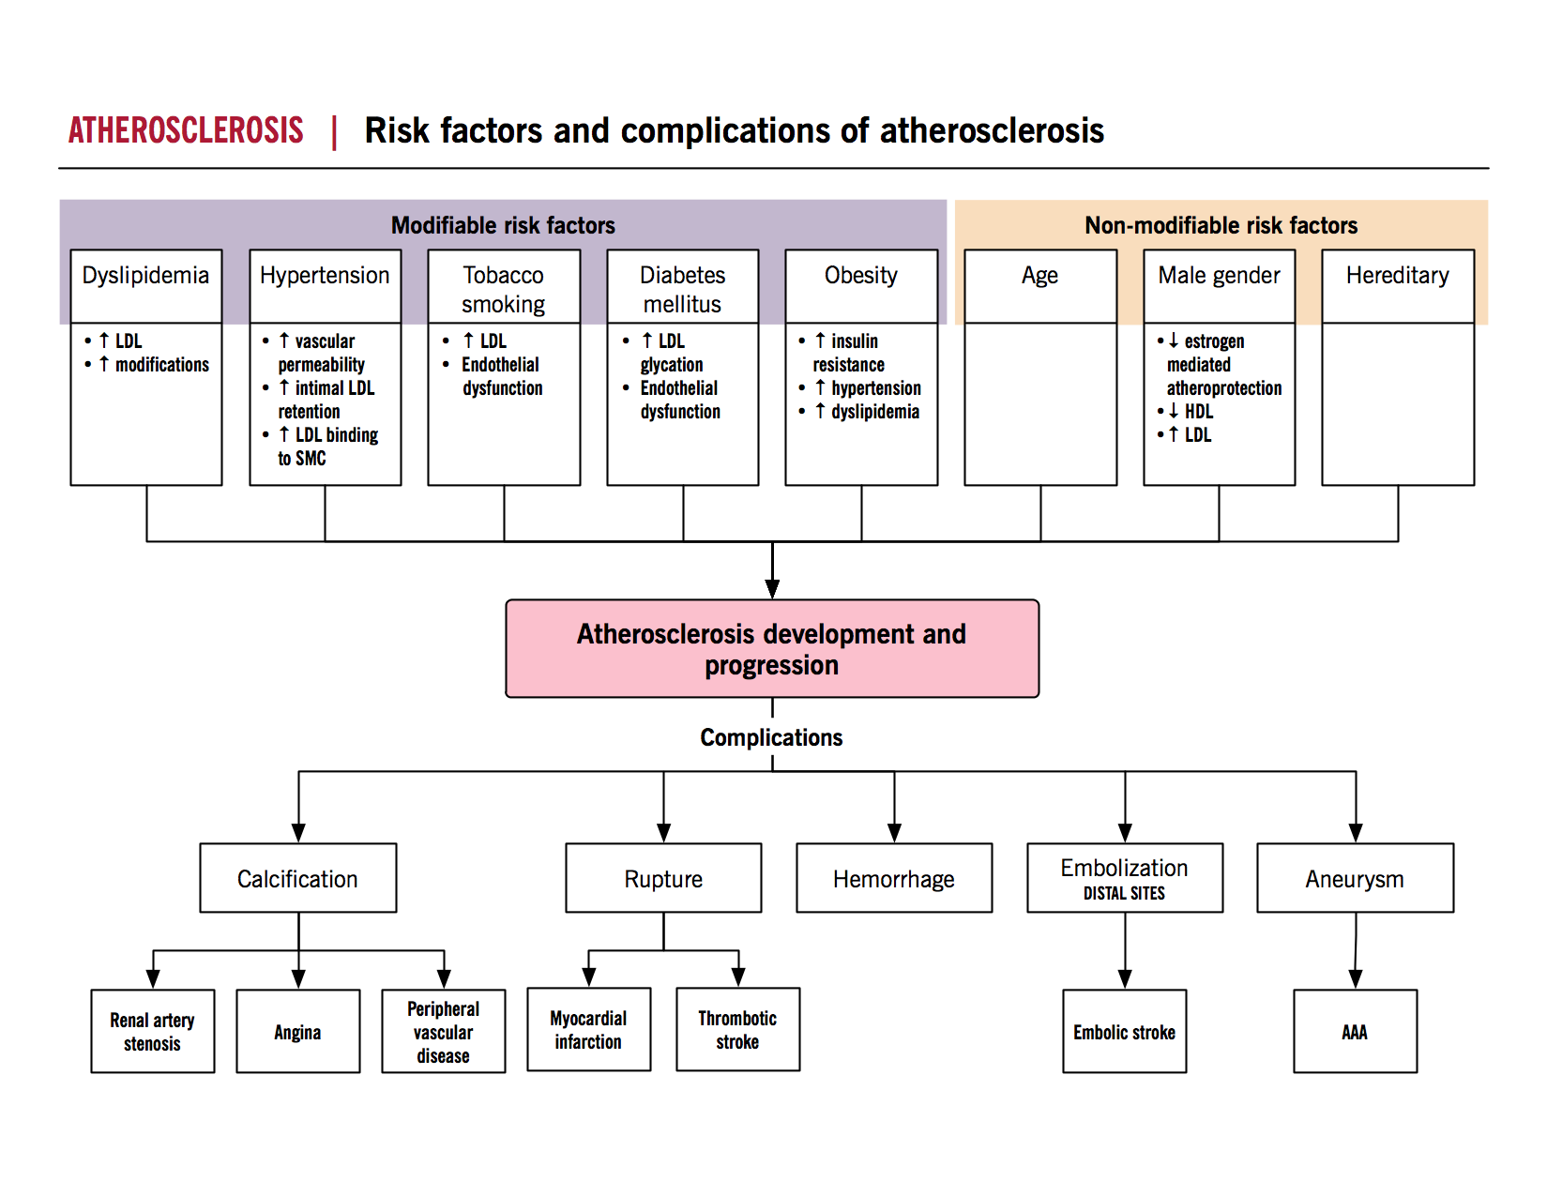
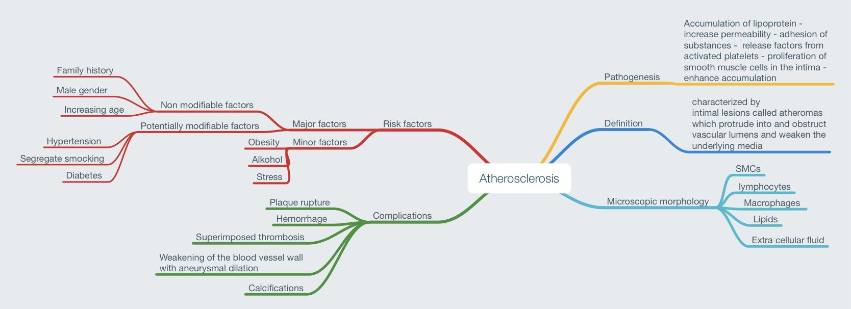
Summary

Slide 13
Questions:
1/ Which of the following is a major, Nonmodifiable Risk factors?
A- Hyperlipidemia
B- Cigarette smoking
C- Increasing age
D- diabetes
2/ Which one of the following is not a complication of atherosclerosis?
A- Myocardial infarction
B- Aortic aneurysms
C- Heart failure
D- Hemorrhage
3/ Which of the following is most likely to be the first visible gross evidence for the formation of an atheroma?
A- Thrombus
B- Fatty streak
C- Calcification
D- Hemorrhage
4/ Which of the following is a major, Potentially controllable Risk factors?
A- Male gender
B- Family history
C- Genetic abnormalities
D- Hypertension
5/ The excess deposition of lipid in the ……… of an artery in Atherosclerosis
A- Intima
B- Media
C- Adventitia

Slide 14
Cases:
6/ A 66-year-old woman has sudden paralysis of the left side of her body. She has been smoking a pack of cigarettes daily for the past 45 years. Vital signs: temp: 37.1 C. heart rate 80/minute, respiratory rate 16/minute, and BP 160/100 mm Hg. A cerebral angiogram reveals occlusion of a branch of her middle cerebral artery. Laboratory findings include a hemoglobin A1C of 9%. - Which of the following components of blood lipids is most important in contributing to her disease?
A- Chylomicrons
B- HDL cholesterol
C- Oxidized LDL
D- VLDL
7/ A 49-year-old woman with atherosclerosis came to the clinic. She complained of experiencing marked pain in her lower extremities on ambulation (moving) for more than 300 meters for the past 5 months. On physical examination, her lower extremities are cool and pale, without swelling or erythema. No dorsalis pedis or posterior tibial pulses are palpable. Her body mass index is 32 and she is a smoker. - Which type of atherosclerosis complication is most likely responsible for these symptoms?
A- MI
B- Peripheral vascular disease
C- Aortic aneurysms
D- Cerebral stroke
ANSWERS:
1- C
2-C
3-B
4-D
5- A
6-C
7- B

Slide 15
Females:
-Leader : فاطمة بالشرف
الغريبي ريناد
منيرة المسعد
شوق القحطاني
رزان الزهراني
الرحيمي بتول
فاطمة الديحان
الجوهرة الشنيفي
نورة القاضي
غادة الحيدري
مها العمري
غرام الجليدان
آلاء الصويغ
ال فهدة السليم
شيرين حمادي
رناد الفرم
نورة الحربي
ميعاد النفيعي
Males:
-Leader :منصور العبرة
خالد العقيلي
عبدالجبار اليماني
بندر الجماز
محمد المحيميد
راكان الغنيم
سليمان الزميع
طارق العلوان
أحمد الصبي
أنس السيف
تركي آل بنهار
خالد المطيري
سعد الفوزان
سعود الأحمري
سيف المشاري
عبدالعزيز العبدالكريم
عبدالله العبيدان
عبدالله السرجاني
فهد الفايز
محمد الأصقه
محمد بن معيوف

Slide 16
Kindly contact us if you have any questions/comments and suggestions:
* EMAIL: pathology437@gmail.com
* TWITTER : @pathology437
GOOD LUCK ! ☺
*references:
- Robbins Basic Pathology
- Slides
Pathology
teamwork

