Slide 1
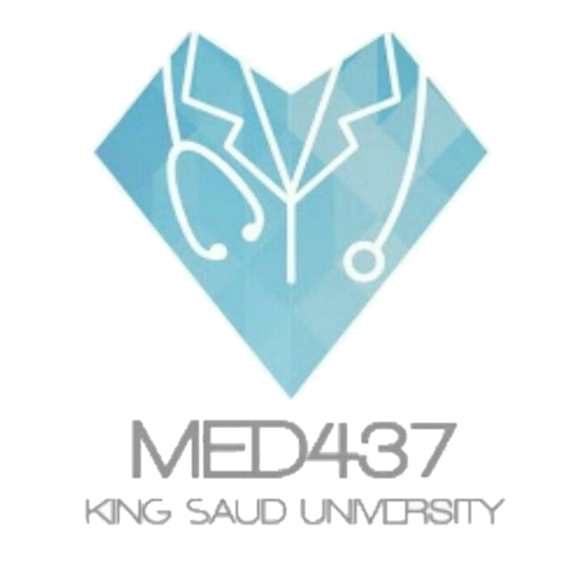
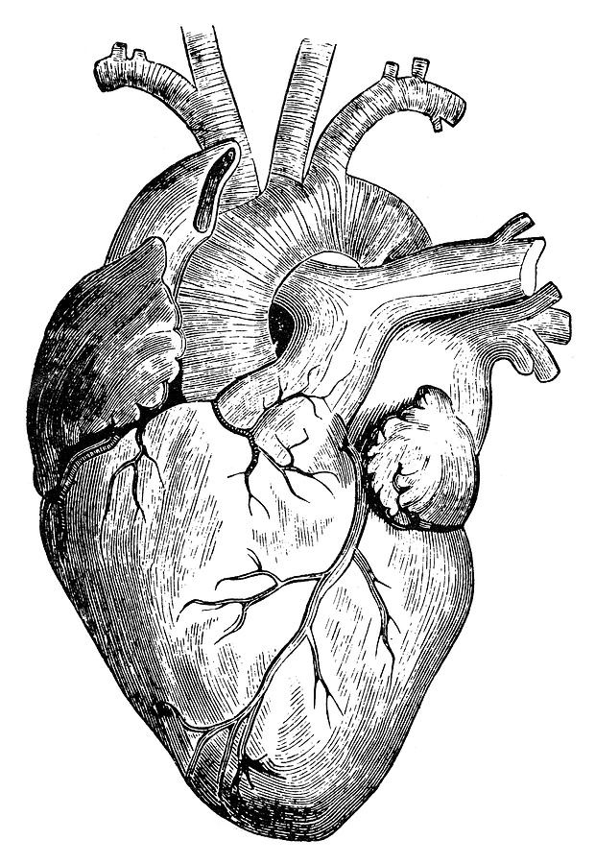
Pathology
teamwork
Lecture (5) :
Thromboembolism
Color Index :-
VERY IMPORTANT
Extra explanation
Examples
Diseases names: Underlined
Definitions
When you feel like quitting, think about why you started..

Slide 2
Understand the basic pathology of thrombogenesis and the risk factors for development of venous and arterial thrombosis.
Know the types of emboli and to be able to describe the causes and pathology for each one.
\
Objectives :

Slide 3
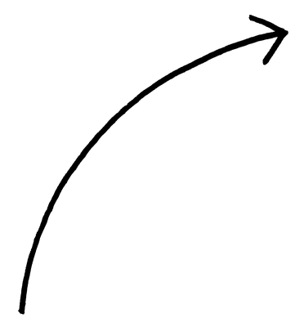
* Try to focus on the red text, all of it is important.
Thrombosis:
A thrombus is a solid mass of blood constituents which develops in artery or vein.
It is intravascular coagulation of blood and it often causes significant interruption to blood flow.
Pathogenesis:
Three primary influences called as Virchow triad predispose to thrombus formation:
Endothelial injury.
Stasis or turbulence of blood flow.
Blood Hyper-coagulability.
It results from interaction of platelets, damaged endothelial cells and the coagulation cascade. All 3 are components of the hemostatic process.
Thrombosis development & decomposition
Thrombotic factor
1. Platelets
2. Coagulation cascade
Formation of thrombin
Fibrinogen Fibrin
Anti-thrombotic
Antithrombin 3
Protein S
Protein C
Fibrinolysis
Generation of plasmin
Splits
If there is a deficiency the patient will develop thrombosis
Hyper-coagulable States:
Primary/Genetic (e.g. mutation in factor V gene or prothrombin gene, anti-thrombin III deficiency protein C or S deficiencies, or fibrinolysis defects). (thrombosis in early ages).
Secondary/acquired states they can be high risk or low risk
a) High risk for thrombosis:
Prolonged bed rest or immobilization
Myocardial infarction, Atrial fibrillation
Tissue damage (surgery, fracture, burns)
Cancer = (release of procoagulant tumor products)
Prosthetic valves
Disseminated intravascular coagulation (thrombin generation)
Antiphospholipid antibody syndrome (Lupus anticoagulant syndrome) (Autoantibodies)
b) Low risk for thrombosis : ( Dr. didn’t talk about it )
Cardiomyopathy, Nephrotic syndrome, Hyperestrogenic states (pregnancy), Oral contraceptive use, Sickle cell anemia, Smoking.

Slide 4
Components of the hemostatic process
1.Platelets maintain the integrity of the vascular endothelium and participate in endothelial repair. They form platelet plugs and promote the coagulation cascade.
2.Endothelial cells are resistant to the thrombogenic influence of platelets and coagulation proteins. Intact endothelial cells are thrombo resistant.
3.Coagulation Cascade is a major contributor to thrombosis. It is a series of enzymatic conversions, that end in the formation of thrombin. Thrombin then converts the soluble plasma protein fibrinogen into the insoluble protein fibrin. And fibrin is a constituent of the thrombus.
Fibrinolysis (thrombus dissolution)
Activation of the clotting cascade induces coagulation. It also triggers the fibrinolytic cascade that limits the size of the final clot. It runs concurrently with thrombogenesis.
Fibrinolytic cascade helps dissolve the thrombus and therefore restores blood flow in vessels occluded by the thrombus. The thrombus is dissolved by plasmin.
In the fibrinolytic cascade the inactive proenzyme plasminogen is converted to active plasmin. Plasmin then splits the fibrin in the thrombus.
1. Endothelial Injury
Endothelial Injury is a major cause of thrombosis in the heart or arteries.
Endothelial injury leads to:
Exposure of subendothelial ECM, i.e the basement membrane
Adhesion of platelets
Release of tissue factor and ultimately thrombosis
Endothelial injury can contribute to thrombosis in several clinical settings e.g:
Endocardial injury due to myocardial infarction
Ulcerated plaques in atherosclerotic arteries
Traumatic or inflammatory vascular injury
The following conditions lead to chronic subtle endothelial dysfunction/injury:
Hypertension
Scarred valves
Bacterial endotoxins
Radiation
Hypercholesterolemia
Cigarette smoking

Slide 5
2. Abnormal Blood Flow
Abnormal blood flow: Disruption of laminar blood flow can bring platelets into contact with the endothelium and promote endothelial cell activation
1.Stasis plays a major role in the development of venous thrombi
2.Turbulence contributes to arterial and cardiac thrombosis by causing endothelial injury or dysfunction.
Abnormal blood flow contributes to thrombosis in several clinical settings:
Ulcerated atherosclerotic plaques
Abnormal aortic and arterial dilations
Acute myocardial infarction
Mitral valve stenosis
Hyperviscositysyndromes
Sickle cell anemia
3. Hypercoagulability
Definition: Any change of the coagulation pathways that predisposes to thrombosis
Hypercoagulability can be divided into:
Primary (inherited) hypercoagulable states
Secondary (acquired) hypercoagulable states
Thrombotic disorders
Can be anti-thrombotic (hemorrhagic), leading to pathologic bleeding states such as hemophilia, Christmas disease and von Willebrand disease.
Can also be prothrombotic, leading to hypercoagulability with pathologic thrombosis e.g. hereditary thrombophilia and antiphospholipid antibody syndrome.
Characterized by recurrent venous thrombosis and thromboembolism.
Can be caused by deficiency of antithrombotic proteins e,g. antithrombin3, protein C, and protein S.
Factor V Leiden thrombophilia is a genetically inherited prothrombotic disorder of blood. Factor V Leiden is a mutated form of human factor V that causes an increase in blood clotting (hypercoagulability).
Antiphospholipid antibody syndrome
Is a prothrombotic hypercoagulable autoimmune multisystem disorder caused by the presence of a type of antiphospholipid antibodies.
Is characterized by recurrent thrombosis and embolism and fetal loss in pregnancy.
Patients have prolonged partial thromboplastin time (PTT).
It is sometimes associated Systemic Lupus Erythematosus and so this antibody is also known as lupus anticoagulant.

Slide 6
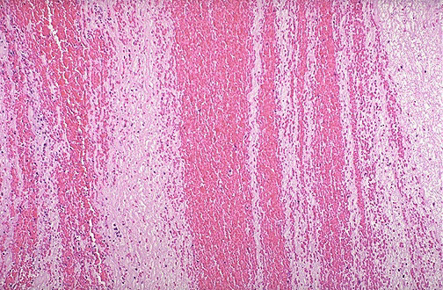
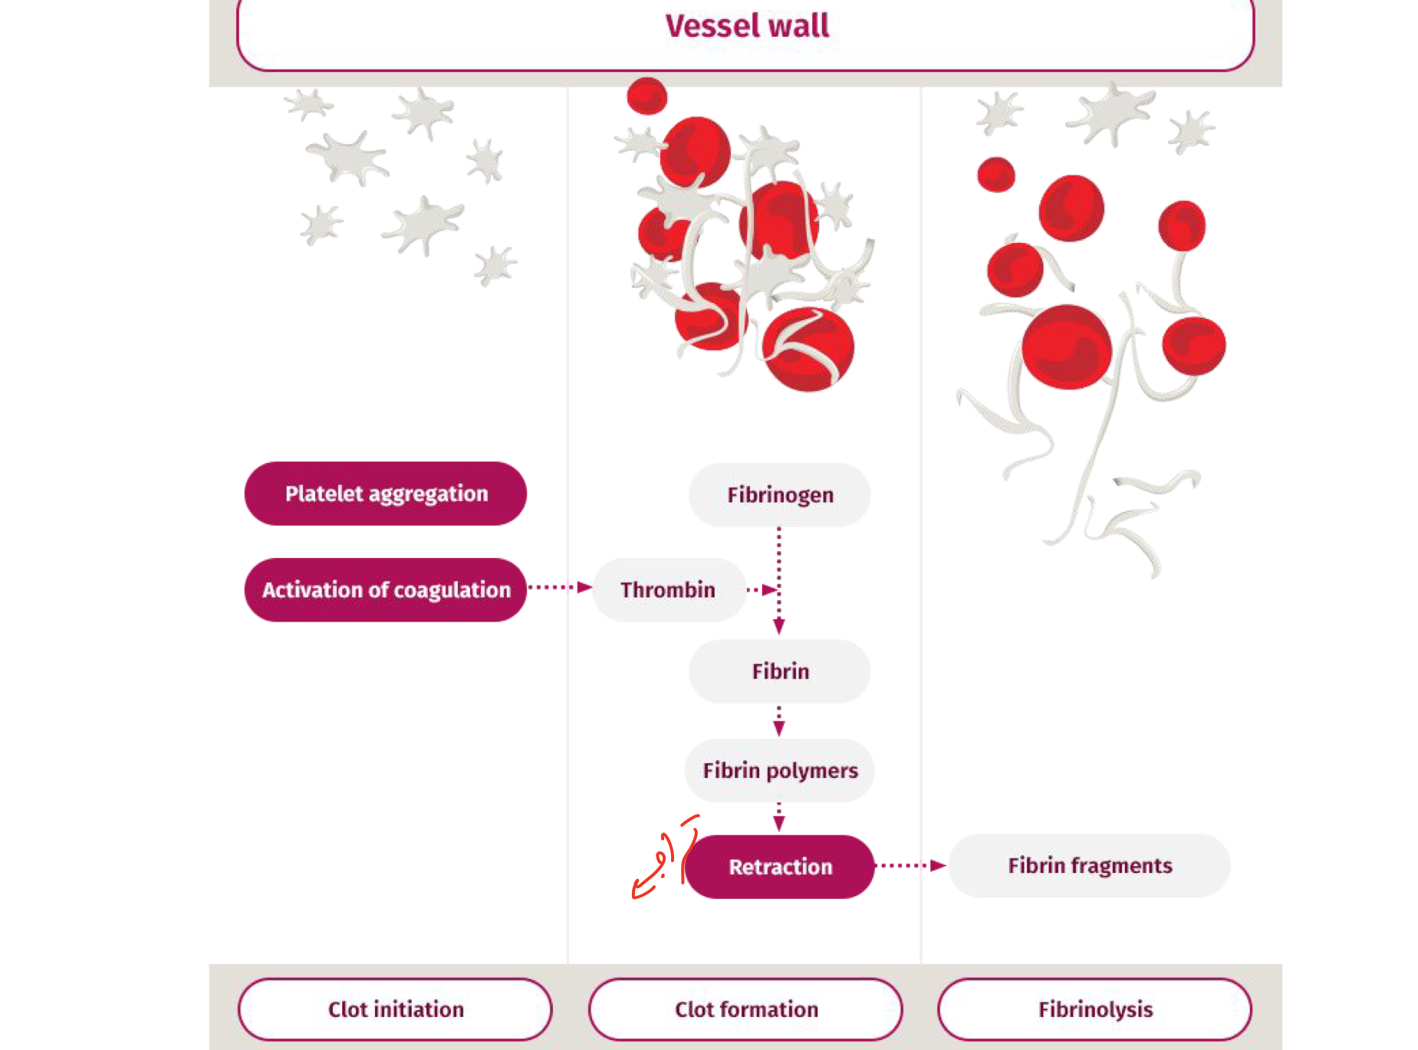
Morphology of thrombus :
Thrombi may develop anywhere in the cardiovascular system
the cardiac chambers, valve cusps, arteries, veins, or capillaries.
They vary in size and shape, depending on the site of origin.
Arterial or cardiac thrombi usually begin at a site of endothelial injury (e.g., atherosclerotic plaque) or turbulence (vessel bifurcation)
Venous thrombi characteristically occur in sites of stasis.
The propagating tail of either thrombi may not be well attached (particularly in veins) is prone to fragmentation, creating an embolus.
Platelets with fibrin
Red blood cells
Lines of Zahn
They form the lighter lines.
They are composed of platelets, fibrin, and RBCs.
They form the darker lines.

Slide 7
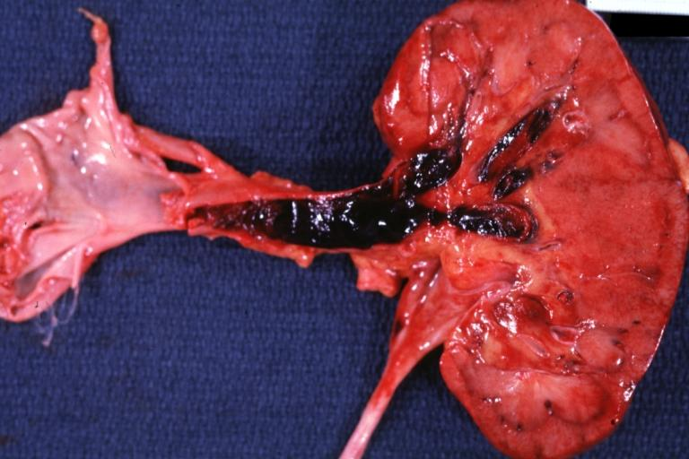
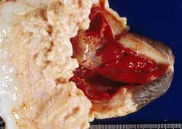
Arterial Thrombi
Venous Thrombi
Are usually occlusive
Most common sites in descending order, are coronary, then cerebral, and then femoral arteries.
It is usually superimposed on an atherosclerotic plaque and are firmly adherent to the injured arterial wall (mural).
Gray-white and friable.
Also called Phlebothrombosis, almost invariably occlusive
The thrombus often takes the shape of the vein
Because these thrombi form in a relatively static environment, they contain more enmeshed erythrocytes and are therefore known as red, or stasis thrombi.
Phlebothrombosis most commonly affects the veins of the lower extremities (legs) (90% of cases).
When thrombi are attached to the wall, we call them mural
Postmortem clots: (after death)
At autopsy, postmortem clots may be confused for venous thrombi.
Post-mortem clots are gelatinous with a dark red dependent portion where red cells have settled by gravity and a yellow chicken fat supernatant resembling melted and clotted chicken fat. They are not attached to the underlying wall.
Thrombi are firmer, almost always have a point of attachment, and on transection reveal vague strands of pale gray fibrin.
Venous thrombus
Postmortem clots
Firm
Rich admixture of RBCs and appear red
Attached to the vessel wall
Rubbery and gelatinous
Dark red in one side and yellow in the other.
Not attached to the vessel wall

Slide 8
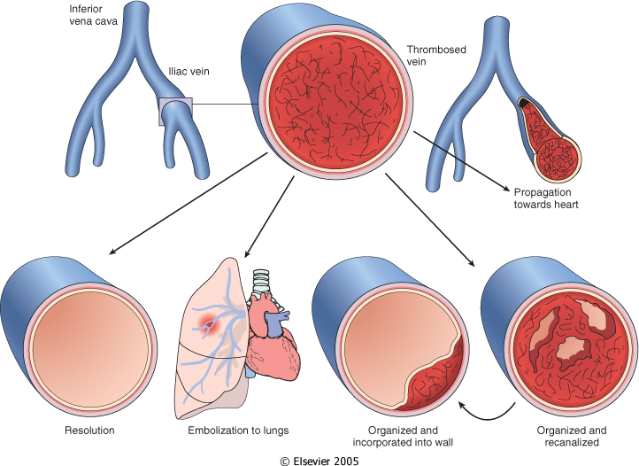
Thrombi on Heart Valves
Thrombi on Heart Valves are called vegetations.
Are infective or sterile:
1) Bacterial or fungal blood-borne infections may result in the development of large thrombotic masses on heart valves, called as vegetations (infective endocarditis).
2) Sterile vegetations can also develop on noninfected valves in patients with hypercoagulable states, so-called nonbacterial thrombotic endocarditis.
Less commonly, noninfective, verrucous (Libman-Sacks) endocarditis attributable to elevated levels of circulating immune complexes may occur in patients with systemic lupus erythematosus
Fate of Thrombus:
Deep vein of the leg
Resolution
Propagation
Embolism
Organization and recanalization
Organization and incorporation into the wall.
*Resolution, the thrombus is completely gone by fibrinolysis.
*Propagation, the thrombus propagates in the same place without going somewhere else.
*Embolism, the thrombus detaches and goes somewhere else.
*Organization, which means that the thrombus doesn't change in size. It either incorporates into the wall or forms small canalizations.

Slide 9
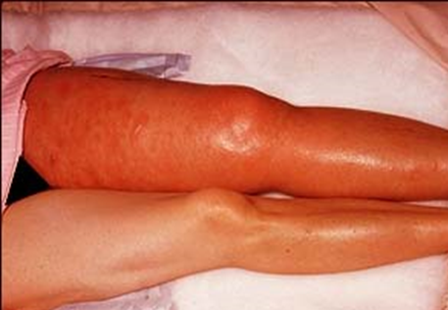
Deep vein thrombosis & Thrombophlebitis
Venous thrombosis often arises in the deep veins of the legs and then it is called deep vein thrombosis (DVT).
They occur with stasis or in hypercoagulable states.
Often associated with inflammation and then it is termed thrombophlebitis
Such thrombi more often embolize to the lungs and give rise to pulmonary infarction.
Common in deep the larger leg veins—at or above the knee (e.g., popliteal, femoral, and iliac veins)
Can cause local pain and edema.
DVTs are asymptomatic in approximately 50% of affected individuals and are recognized only in retrospect after embolization
Usually happens is stasis conditions
Common predisposing factors for DVT (are included in the hypercoagulable status table):
Bed rest and immobilization
Congestive heart failure (a cause of impaired venous return)
Trauma, surgery, and burns
Pregnancy:
the potential for amniotic fluid infusion into the circulation at the time of delivery can cause thrombogenesis
late pregnancy and the postpartum period are also associated with systemic hypercoagulability
Tumors
Advanced age

Slide 10
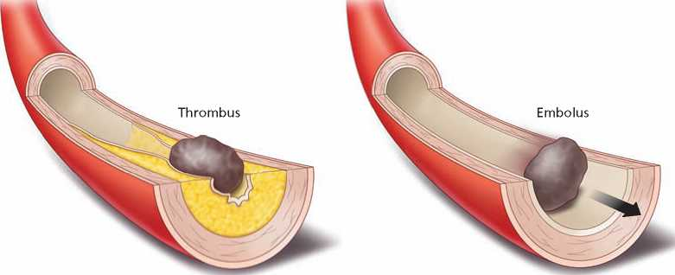
Embolism
An embolus is a detached intravascular solid, liquid, or gaseous mass that is carried by the blood to a site distant from its point of origin.
•Almost all emboli represent some part of a dislodged thrombus, hence the commonly used term thromboembolism.
•The emboli ultimately lodge in vessels too small to permit further passage, resulting in partial or complete vascular occlusion leading to ischemic necrosis of distal tissue (infarction).
•Depending on the site of origin, emboli may lodge in the pulmonary or systemic circulations.
Types of embolism
Systemic thromboembolism
Fat embolism
Air embolism
Amniotic fluid embolism
Pulmonary thromboembolism
Pulmonary thromboembolism
In more than 95% percent of the cases, venous emboli originate from deep leg vein thrombi above the knee.
Depending on size of embolus, it may occlude main pulmonary artery, or impact across the bifurcation (saddle embolus) or pass into a smaller branching arterioles of the pulmonary circulation.
An embolus may pass through an interatrial or interventricular defect to gain access to the systemic circulation but its rare (paradoxical embolism).
Most pulmonary emboli (60% to 80%) are clinically silent because they are small.
Sudden death, *right heart failure (cor pulmonale) occurs when 60% or more of the pulmonary circulation is obstructed with emboli.
Embolic obstruction of small end-arteriolar pulmonary branches may result in infarction.
*When there is an embolus in the pulmonary circulation that is obstructing 60% or more, the right ventricle is unable to pump blood to the lungs due to the occluded artery. That is why right heart failure (cor pulmonale) occurs.

Slide 11
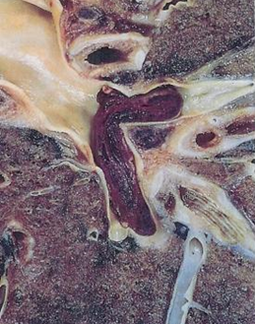
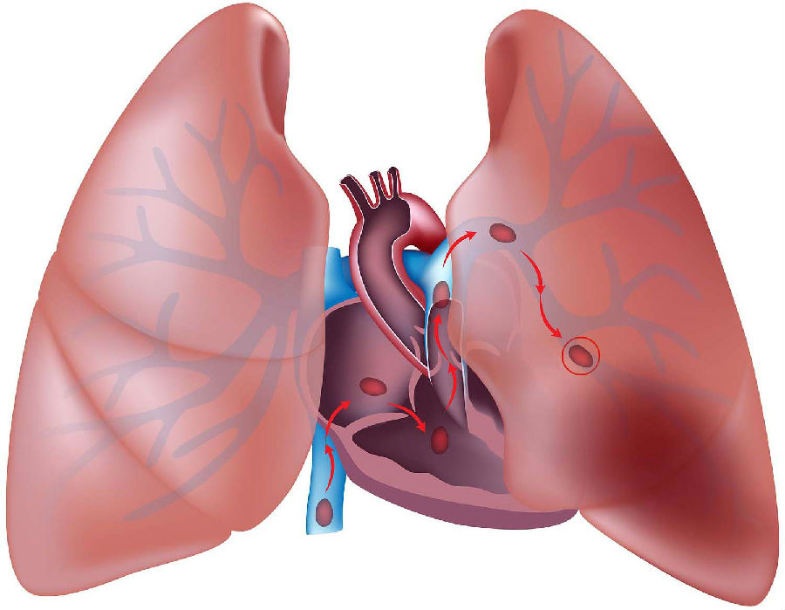
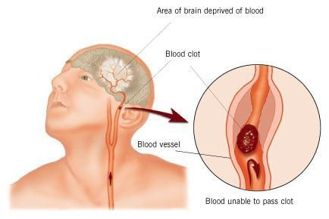
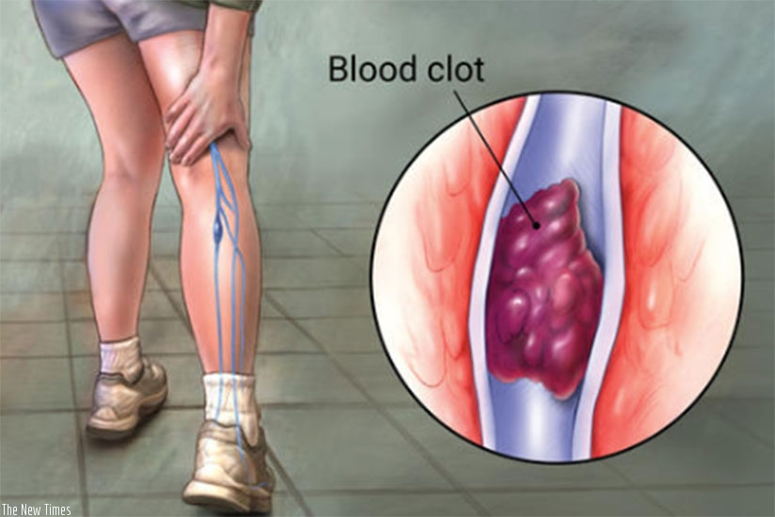
< Saddle embolus
Systemic Thromboembolism
Refers to emboli traveling within the arterial circulation.
About (80%) arise from intracardiac mural thrombi.
The major sites for arteriolar embolization are the lower extremities (75%) and the brain (10%).
Arterial emboli usually cause infarction of tissues supplied by the artery
(The consequences of systemic emboli depend on the extent of collateral vascular supply in the affected tissue, the tissue's vulnerability to ischemia, and the caliber of the vessel occluded).

Slide 12
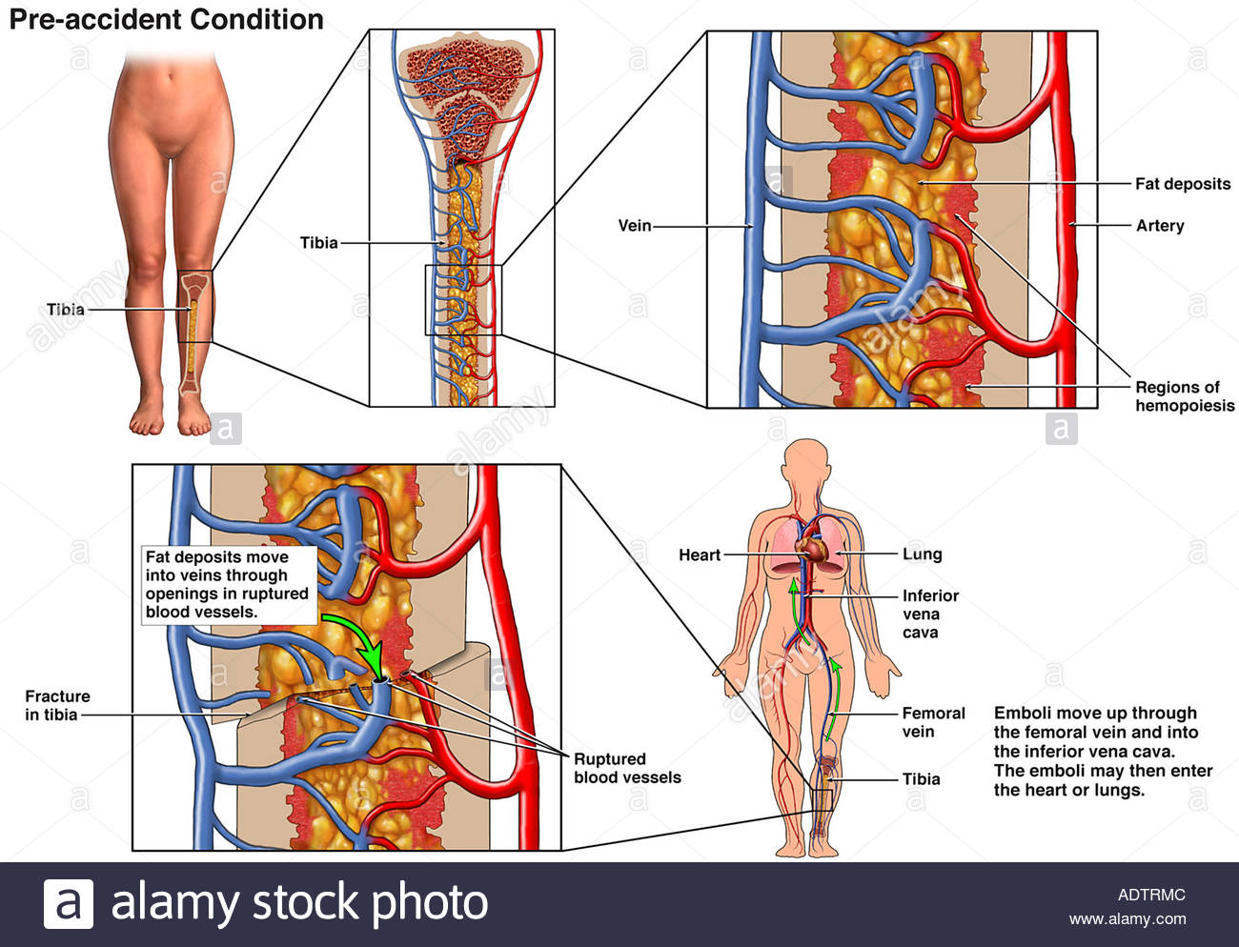
Fat embolism
Microscopic fat globules may be found in the circulation after fractures of long bones (which have fatty marrow) or, rarely, in soft tissue trauma and burns.
Fat is released by marrow or adipose tissue injury and enters the circulation through rupture of the blood vessels and act as an embolus.
Less than 10% of patients with fat embolism have any clinical findings.
Fat embolism syndrome is characterized by pulmonary insufficiency, neurologic symptoms, anemia, and thrombocytopenia.

Slide 13
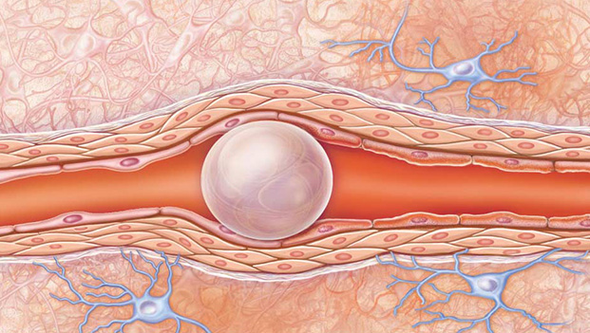
Air embolism
Gas bubbles within the circulation can obstruct vascular flow (and cause distal ischemic injury) acting as thrombotic masses. Bubbles may coalesce to form frothy masses sufficiently large to occlude major vessels.
Air may enter the circulation during obstetric procedures or as a consequence of chest wall injury, or in decompression sickness.
An excess of 100 cc is required to have a clinical effect.
Decompression sickness
Occurs when individuals are exposed to sudden changes in atmospheric pressure, Such as scuba and deep sea divers, underwater construction workers, and individuals in unpressurized aircraft in rapid ascent are all at risk.
When air is breathed at high pressure (e.g. during a deep sea dive), increased amounts of gas (particularly nitrogen) become dissolved in the blood and tissues. If the diver then ascends (depressurizes) too rapidly, the nitrogen expands in the tissues and bubbles out of solution in the blood to form gas emboli.
Symptoms: ‘Bends’ i.e. joint/muscle pain and ‘chokes’ i.e. respiratory distress.
Treatment: placing the individual in a compression chamber where the barometric pressure may be raised, thus forcing the gas bubbles back into solution followed by subsequent slow decompression.
A more chronic form of decompression sickness is called caisson disease in which, persistence of gas emboli in the skeletal system leads to multiple foci of ischemic necrosis; the more common sites are the heads of the femurs, tibia, and humeri.
‘Grecian Bend’ i.e. joint/muscle pain, and ‘chockes’ in respiratory distress

Slide 14
Amniotic fluid embolism
A grave and uncommon complication of labor and the immediate postpartum period, caused by infusion of amniotic fluid or fetal tissue into the maternal circulation via a tear in the placental membranes or rupture of uterine veins.
Characterized by sudden severe dyspnea, cyanosis, and hypotensive shock, followed by seizures and coma.
If the patient survives the initial crisis, pulmonary edema develops, along with disseminated intravascular coagulation, owing to release of thrombogenic substances from amniotic.
Microscopy
presence in the pulmonary microcirculation of squamous cells shed from fetal skin, lanugo hair, fat from vernix caseosa, and mucin derived from the fetal respiratory or gastrointestinal tract. Marked pulmonary edema and diffuse alveolar damage are also present. Systemic fibrin thrombi indicative of DIC can also be seen.

Slide 15
Summary
Embolus: is a detached intravascular solid, liquid, gaseous mass that is carried by the blood to a site distant from its point of origin.
Pulmonary thromboembolism:
-originate from deep leg vein thrombi.
-occlude main pulmonary artery or impact across the bifurcation (saddle embolus).
-sudden death , right heart failure occurs when 60% or more of the pulmonary artery obstructed with emboli.
Systemic thromboembolism:
-refers to emboli traveling within the arterial circulation.
- most (80%) arise from intracardiac mural thrombi .
- the major sites for arteriolar embolization are the lower extremities (75%) and the brain (10%).
Types of embolism
Fat embolism:
-occurs after fractures of long bones --> fat released.
Air embolism:
Air inters the circulation during:
1- obstetrics procedures (not normal delivery)
2- chest wall injury
3- decompression sickness (caisson disease) or grecian bend. Mainly deep see divers.
Amniotic fluid embolism:
-uncommon complication of labor (normal delivery) and the immediate postpartum period.
-microscopy you will see:
-fetal skin
-hair

Slide 16
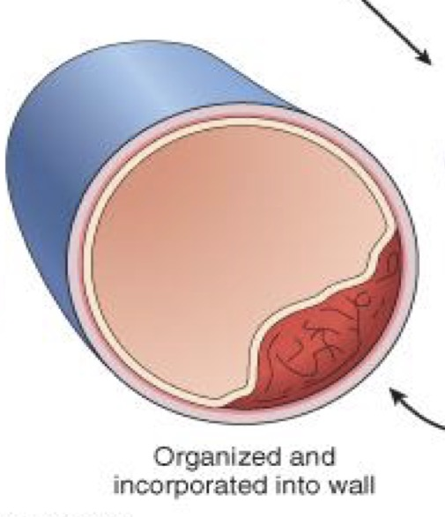
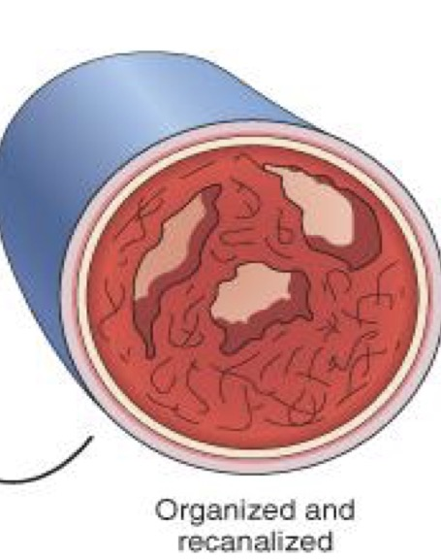
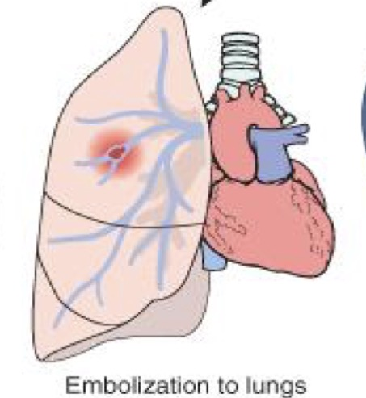
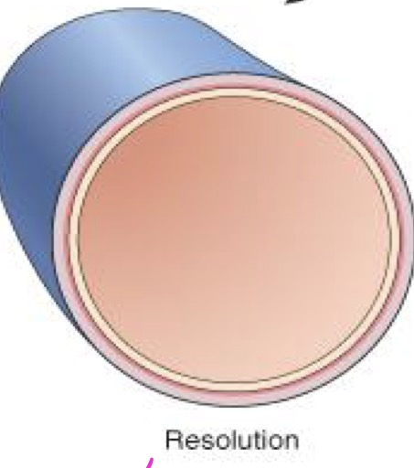
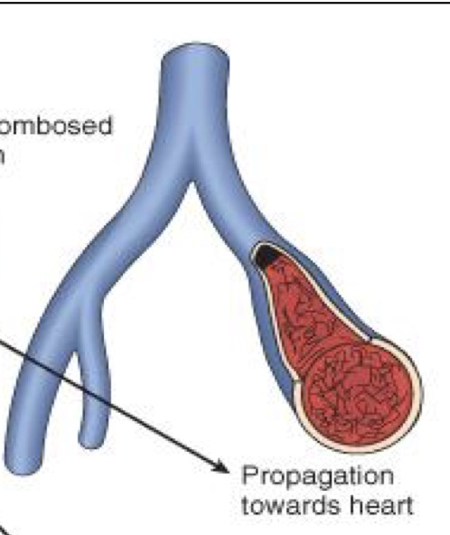
Thrombus: is a solid mass of blood constituents which develops in artery or vein.
Organization and incorporation into the wall
Organization and recanalization
Fate of thrombus
Embolism
Resolution
Propagation

Slide 17
Questions
1. Which of the following leads to thrombosis?
A. Deactivated platelets.
B. Protein C
C. Protein S
D. Coagulation cascade
2. Which of the following belongs to Virchow triad?
A. Endothelial injury
B. Protein C
C. Protein S
D. All of the above.
3. Which of the following is a fate of thrombus?
A. Resolution
B. Propagation
C. Embolism
D. All of the above
4. A detached intravascular solid, liquid, or gaseous mass that is carried by the blood to a site distant
from its point of origin. Is:
A. Embolus
B. Vessels
C. Blood
D. None of the above
5. Which of the following is not a type of embolus?
A. Air
B. Fat
C. Food
D. Pulmonary
6. During an X-ray of a 27 years old woman, fragments of hair where found in the lungs, this is most
likely:
A. Air embolus
B. Amniotic fluid embolus
C. Fat embolus
D. Pulmonary embolus
7.Which of the following is a high risk factor that causes hypercoagulability and
therefore forming thrombosis :
A. smoking
B. cardiomyopathy
C. nephrotic syndrome
D. myocardial infarction
8.deep vein thrombosis (DVT) may lead to:
A. pulmonary infarction
B. renal infraction
C. brain infraction
D. peripheral infarctions
9.Decompression sickness → high risk of:
A. An air EMBOLISM
B. An AMNIOTIC FLUID EMBOLISM
C. A FAT EMBOLISM
D. Septic embolism
1.d/2.a/3.d/4.a/5.c/6.b/7.d/8.a/9.a

Slide 18
10.What substances dissolve fibrin?
A. Plasmin
B. Plasminogen
C. Thrombin
D. Factor XII
11. What are the lighter lines in the line of zahn?
A. Fibrin And Platelet
B. White Blood Cells
C. Fat
D. RBCs
12. What are the red lines in the line of zahn?
A. Red Blood Cells
B. Lymphocytes
C. Neutrophils
D. Fibrin And Platelet
13.What do the arterial thrombi look like?
A. Red And Friable
B. Gray-White And Friable
C. Red Taking The Shape Of The Artery
D. Non of the above
10.a/11.a/12..a/13.b
---------------------------------------------------------------------------------------------------------------------------------------------
Match the following:

Slide 19
cases
1- 50-year-old man has sudden onset of severe substernal chest pain that radiates to the neck. Emergent coronary angiography shows a thrombotic occlusion of the left circumflex artery. Which of the following complications of this disease is most likely to occur within 1 hour of these events?
(A) Ventricular fibrillation
(B) Pericarditis
(C) Myocardial rupture
(D) Ventricular aneurysm
(E) Thromboembolism
2- A 60-year-old man has experienced angina on exertion for the past 6 years. A coronary angiogram performed 2 years ago showed 75% stenosis of the left anterior descending coronary artery and 50% stenosis of the right coronary artery. For the past 3 weeks, the frequency and severity of the anginal attacks have increased, and pain sometimes occurs even when he is lying in bed. Which of the following is most likely to explain these findings?
(A) Hypertrophy of ischemic myocardium with increased oxygen demands
(B) Increasing stenosis of right coronary artery
(C) Fissuring of plaque in left coronary artery with superimposed mural (partial) thrombosis
(D) Sudden complete thrombotic occlusion of right and left coronary arteries
(E) Reduction in oxygen-carrying capacity owing to pulmonary congestion
Q1) The answer is A
In the period immediately after coronary thrombosis, arrhythmias are the most important complication and can lead to sudden cardiac death. It is believed that, even before ischemic injury manifests in the heart, there is greatly increased electrical irritability.Pericarditis and rupture occur several days later.An aneurysm is a late complication of healing of a large transmural infarction; a mural thrombus may fill an aneurysm and become a source of emboli.If portions of the coronary thrombus break off and embolize, they enter smaller arterial branches in the distribution already affected by ischemia.
Q2) The answer is C
This patient has 75% stenosis of the left anterior descending branch of the coronary artery. This degree of stenosis prevents adequate perfusion of the heart when myocardial demand is increased, which occurs during exertion. The patient had angina on exertion. The patient has recently developed unstable angina, which is manifested by increased frequency and severity of the attacks and angina at rest. In most patients, unstable angina is induced by disruption of an atherosclerotic plaque followed by a mural thrombus and possibly distal embolization, vasospasm, or both. Hypertrophy of the heart is unlikely in this case because there is neither hypertension nor a valvular lesion. The remaining choices theoretically can give rise to a similar picture, but plaque disruption with mural thrombosis is the most common anatomic finding when the patient develops unstable angina. It is important to recognize this because unstable angina is a harbinger of myocardial infarction.

Slide 20
Females:
-Leader : فاطمة بالشرف
ريناد الغريبي
منيرة المسعد
شوق القحطاني
رزان الزهراني
الرحيمي بتول
فاطمة الديحان
الجوهرة الشنيفي
نورة القاضي
غادة الحيدري
مها العمري
غرام الجليدان
آلاء الصويغ
ال فهدة السليم
شيرين حمادي
رناد الفرم
نورة الحربي
ميعاد النفيعي
Males:
-Leader :منصور العبرة
خالد العقيلي
عبدالجبار اليماني
بندر الجماز
محمد المحيميد
راكان الغنيم
سليمان الزميع
طارق العلوان
أحمد الصبي
أنس السيف
تركي آل بنهار
خالد المطيري
سعد الفوزان
سعود الأحمري
سيف المشاري
عبدالعزيز العبدالكريم
عبدالله العبيدان
عبدالله السرجاني
فهد الفايز
محمد الأصقه
محمد بن معيوف

Slide 21
Kindly contact us if you have any questions/comments and suggestions:
* EMAIL: pathology437@gmail.com
* TWITTER : @pathology437
GOOD LUCK ! ☺
*references:
- Robbins Basic Pathology
- Slides
Pathology
teamwork

