Slide 1
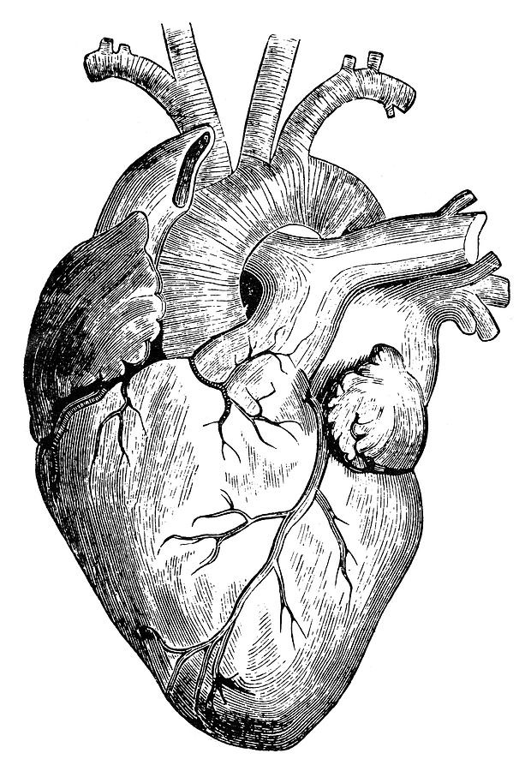
Pathology
teamwork
Lecture (6) :
Vasculitis
Editing File
Color Index :-
VERY IMPORTANT
Extra explanation
Examples
Diseases names: Underlined
Definitions
*It always seems impossible, until it’s done..

Slide 2
• Know the common causes of vasculitis with special emphasis on the clinic-pathological features and mechanism of :
Giant cell arteritis.
Polyarteritis nodosa.
Wegener's granulomatosis.
Leukocytoclastic vasculitis.
Objectives :

Slide 3
introduction
* Try to focus on the red text, all of it is important.
Vasculitis : It is the inflammation of vessel walls with many possible symptoms.
Causes:
1. It is usually immune-mediated :
Immune complex deposition
Antineutrophil cytoplasmic antibodies (ANCAs)
Anti-endothelial cell antibodies
Autoreactive T cells
2. It also can be caused by infection, physical or chemical injury.
Quick look on Vasculitis:
Vessel | Disease | Features
Large | Giant-cell arteritis | >50 years. Arteries of the head.
 | Takayasu arteritis | Female <40. “Pulseless disease”
Medium | Polyarteritis nodosa | Young adults. Widespread.
 | Kawasaki disease | <4. Coronary disease. Lymph nodes.
Small | Wegener granulomatosis | Lung, kidney, c-ANCA.
 | Churg-Strauss syndrome | Lung, Eosinophils, Asthma, p-ANCA.
 | Microscopic polyangiitis | Lung, kidney, p-ANCA.
 | Cutaneous Leukocytoclastic vasculitis | Idiopathic, infectious, drugs, chemicals, cancer and systemic disease like HNP.

Slide 4
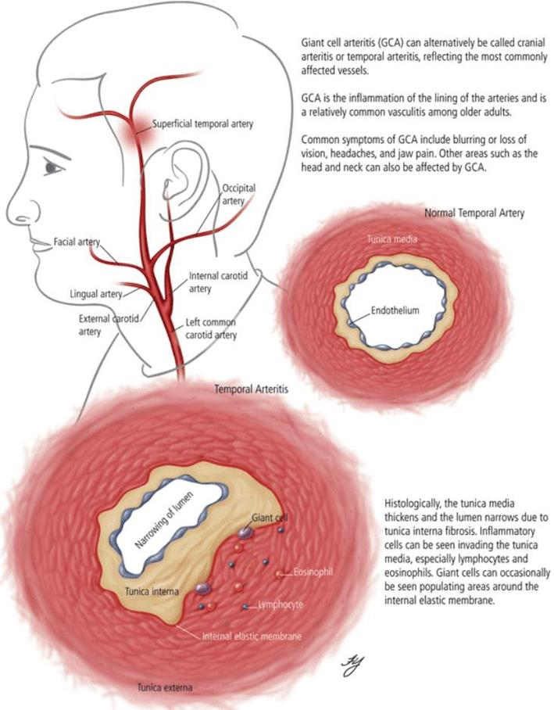
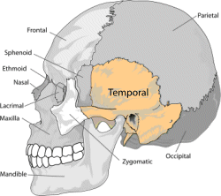
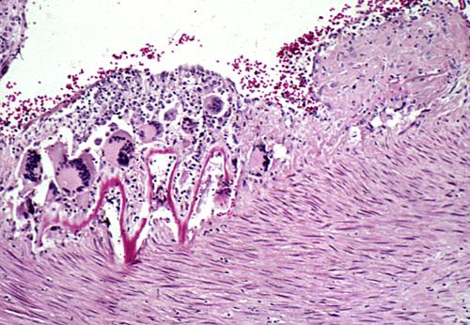
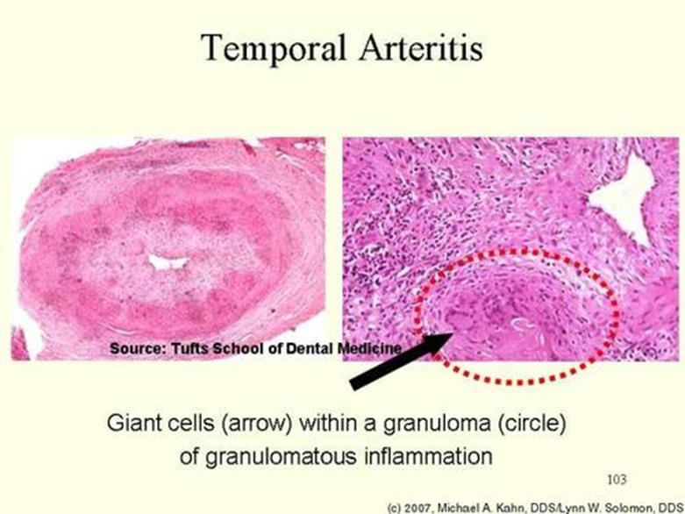
Giant cell (temporal) Arteries
Most common type of vasculitis.
Affect patients more than 50 years of age (only one occurs in elderly)
Female to male ratio is 2:1 respectively.
Chronic, granulomatous inflammation of large to small arteries, especially in the head, particularly the branches of the carotid artery (temporal artery (headache) and branches of the ophthalmic artery (blindness)).
Involvement is segmental, acute and chronic. by segmental it means it only affects sections of the arteries rather than the whole artery
Clinical Features:
Symptoms :
Fever. general symptom from inflammatory response
headache. often most intense along the course of the superficial temporal artery
Thickened and painful temporal artery. thickened From the inflammation and painful from the inflammatory mediators which cause pain
Facial pain or Jaw pain. when the facial artery is involved
Visual problems and acute vision loss. when the ophthalmic artery is involved
more specific symptoms occur when the organ supplied lacks blood supply due to the inflammation of the artery supplying the organ
The diagnosis depends on biopsy and histologic confirmation.
Treatment : corticosteroids. It weakens the Immune response that is causing the inflammation
Extra picture:-
Morphology:
Granulmatous inflammation of the blood vessel wall.
Giant cells.
Disruption and fragmentation of internal elastic lamina.
The healed stage reveals collagenous thickening of the vessel wall and the artery is transformed into a fibrous cord.
Proliferation of the intima with associated occlusion of the lumen.
Mnemonic: Giant old Head = affects Arteries in the head
Notes:
Mnemonic: Giant Old Head affects Arteries in the head

Slide 5
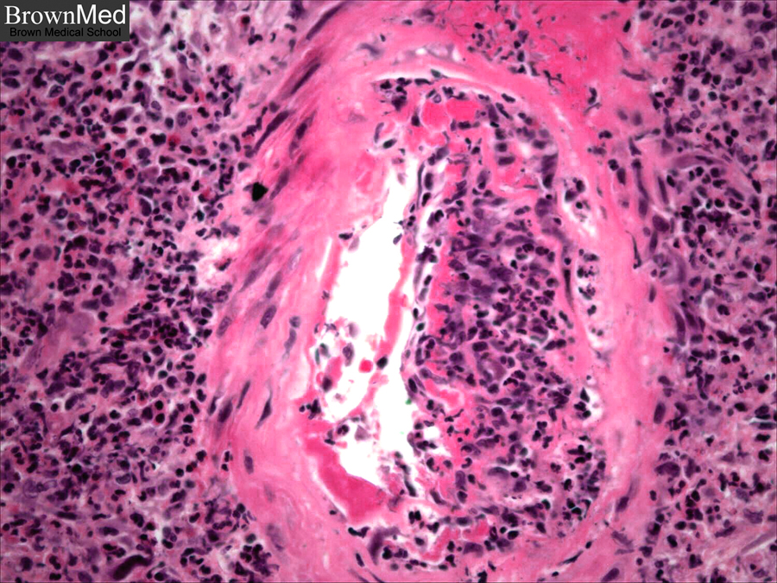
Polyarteritis Nodosa
Cutaneous only or systemic (can affect any organ).
Disease of young adults.
There is segmental necrotizing inflammation of arteries of medium to small size, in any organ (especially the kidneys and skin) except the lung. Mnemonic: Polyarteritis Nodosa = Pulmonary Are Not damaged
Polyarteritis nodosa has been associated with hepatitis B or hepatitis C.
Clinical Manifestations
Results from ischemia and infarction of affected tissues and organs.
Fever general symptom from inflammatory response
weight loss, abdominal pain and melena (bloody stool), muscular pain and neuritis. All result from the inflammation and necrosis of the arteries supplying the organ
Renal arterial involvement is often prominent and is a major cause of death.
Particularly characteristic of PAN is that all the different stages of activity (i.e. active and chronic stages) may coexist in same artery or in different vessels at the same time.
Fatal if untreated, but steroids and cyclophosphamide are curative.
Steroids are used to inhibit wbc from migrating and causing necrosis
Cyclophosphamide is used to damage the dna of Immune cells that cause the damage
Polyarteritis nodosa with segmental inflammation and fibrinoid necrosis and occlusion of the lumen of this artery. Note that part of the vessel wall at the left side is uninvolved.
Notes:
Melena is a female that has دوره this time she had BLOOD ON STOOL ☹ (Melena = Bloody Stool)

Slide 6
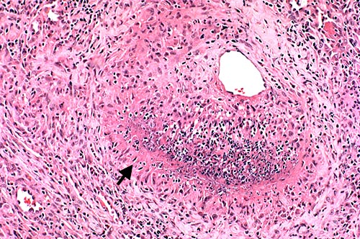
Wegener Granulomatosis (new name is granulomatosis with polyangitis)
WG is a necrotizing vasculitis characterized by the triad of:
Necrotizing granulomas of the upper and lower respiratory tract. (respiratory syptoms)
necrotizing or granulomatous vasculitis of small to medium-sized vessels.
Renal disease in the form of necrotizing, crescentic, glomerulonephritis.
Males are affected more often than females, at an average age of about 40 years
C- ANCAs (antineutrophilic cytoplasmic antibodies) is positive in serum of more than 95% of patients.
Persistent pneumonitis, chronic sinusitis, mucosal ulcerations of the nasopharynx , and evidence of renal disease. Wegener Granulomatosis involves damage to the Respiratory tract and Kidney only
Untreated: fatal - may lead to death within 2 years if not treated.
Palatal Destruction
Palatal Ulceration
Extra picture:- Crescentic
Notes:
Mnemonic: Wegener has a known AB named C-ANCA that attacks Respiratory tract and Kidney only

Slide 7
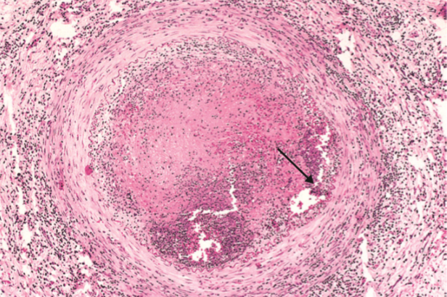
THROMBOANGIITIS OBLITERANS:
(BUERGER’S DISEASE)
Distinct disorder that results in severe vascular insufficiency and gangrene of extremities. It is characterized by areas of inflammation of medium and small sized arteries. It is associated with thrombosis and can extend to nearby veins as well as nerves.
Abstinence of cigarette smoking in early stages of disease brings relief from further attacks
Features:
Extra picture:- Buerger’s sounds like Burgers
Affects medium/small arteries
Hands and legs
Associated with heavy smokers. Before age of 35
Pain at rest due to nerve damage
Pain if affected part induced by exercise (instep claudication) claudication= العرج
Chronic ulcerations in hand and foot can progress to gangrene
Luminal thrombosis
Lymphocytic rim (acute & chronic inflammation)

Slide 8
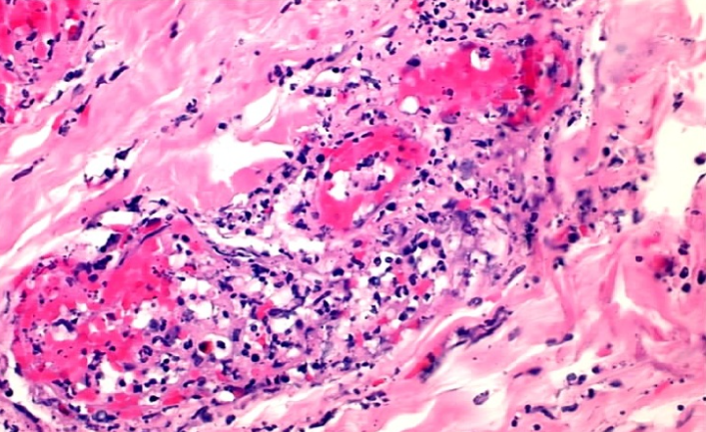
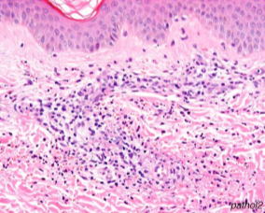
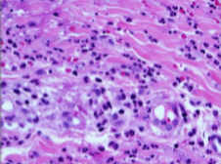
CUTANEOUS LEUKOCYTOCLASTIC
OR HYPERSENSITIVITY VASCULITIS
Necrotizing vasculitis that affects capillaries as well as small arterioles and venules. Vessels of the skin, mucous membranes, lungs, brain, heart, gastrointestinal tract, kidney and muscle can be involved.
Features:
Most common vasculitis seen in clinical practice
Inflammation of small blood vessels (usually, post capillary venules in the dermis)
Palpable purpura (purple discolored spots cause by bleeding under skin)
Can be cutaneous or systemic disease
Effects many organs, most notably the skin
Characterized by Leukocytoclasis: karyorrhexis (fragmentation) of neutrophils in and around the vessels. (leading to purpura)
Causes:
Idiopathic
Immune response towards:
Drugs: Penicillin
Infections : streptococcal
Food products/ toxic chemicals
Tumor antigens in cancer cells
Part of systemic disease:
collagen vascular diseases:
Lupus erythematosus
Rheumatoid arthritis
Henoch-Schönlein purpura
Diagnosis:
skin biopsy
Features:
Infiltration of vessel wall with neutrophils which then become fragmented resulting in leukocytoclasia or nuclear dust
Fibrinoid necrosis
Fragmented neutrophils

Slide 9
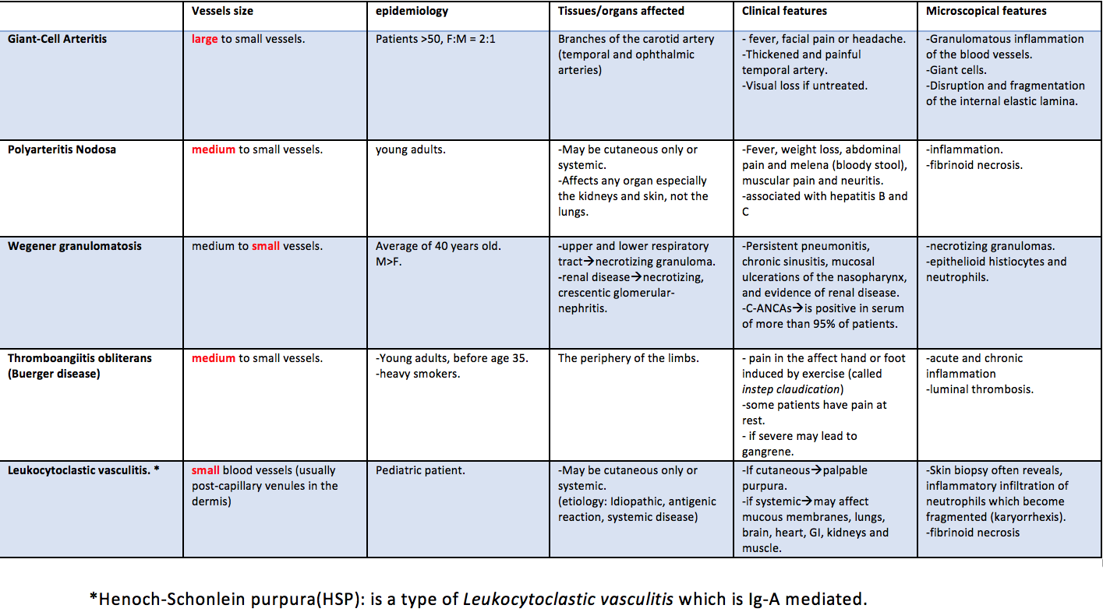
HENOCH-SCHONLEIN PURPURA (HSP)
HSP is an IgA-mediated, autoimmune systemic small vessel leukocytoclastic hypersensitivity vasculitis of childhood. It causes skin purpura, arthritis, abdominal pain, gastrointestinal bleeding, orchitis and nephritis.
The aetiology remains unknown.
Immunoglobulin A (IgA) and complement component 3 (C3) are deposited on arterioles, capillaries, and venules.
Serum levels of IgA are high in HSP.
Skin biopsy will show necrotizing leukocytoclastic vasculitis of capillaries in the dermis.
Summary
Important!

Slide 10
Cases from Dr. Alhumeidi:
Case 1:
Elderly patient with headache and visual disturbances.
Diagnosis: Giant-cell (temporal) vasculitis
Giant cell vasculitis is almost the only vasculitis that affects the elderly (old age is a hint)
Case 2:
A young adult that is a heavy smoker presents with pain in his feet while playing soccer
Diagnosis: thromboangiitis obliterans: buerger’s disease
Smoking and exercise induced pain are hints
Case 3:
A pediatric patient presents with skin lesions, abdominal pain, hematuria, and blood in stool
Diagnosis: Leukocytoclastic vasculitis
The age of the patient and these clinical manifestations like skin lesions (pupura) are hints

Slide 11
Q1) What is the most common cause of vasculitis?
Immune-mediated
Infections
Congenital defect
Drugs
Q2) Patient came to the hospital having fever and headache, what artery is most likely thickened or painful?
Carotid artery
Ophthalmic artery
Brachiocephalic artery
Temporal artery
Q3) Regarding (Q2), what can be found in the patient’s biopsy?
Disruption and fragmentation of internal elastic lamina
Segmental inflammation and fibrinoid necrosis
Crescentic inflammation of the arteries
Leukocytoclasia
Q4) A Patient came to the hospital and the doctor noticed an inflammation in a medium sized vessels. The patient has fever lost some weight, and he has a bloody stool. Which of the following organs cannot be affected?
Kidney
Heart
Lung
Liver
Q5) A 34 year old man came to the clinic with ulceration of the palate, what is the most likely diagnosis in this case?
Polyarteritis Nodosa
Wegener granulomatosis
Burger disease
Cutaneous leukocytoclastic

Slide 12
Q6) Regarding (Q5), what is the best test to confirm your diagnosis?
C-ANCA
ECR
Blood culture
X ray
Q7) Increased neutrophils infiltration and the presence of karyorrhexis of the neutrophils indicates?
Polyarteritis Nodosa
Wegener granulomatosis
Burger disease
Hypersensitivity vasculitis
Q8) In case of Thromboangiitis obliterans, which statement can be true?
Smoking is a risk factor
Pain without any activity
Gangrene
All of the above
Answers :
Q1 – A
Q2 – D
Q3 – A
Q4 – C
Q5 – B
Q6 – A
Q7 – D
Q8 – D

Slide 13
Females:
-Leader : فاطمة بالشرف
ريناد الغريبي
منيرة المسعد
شوق القحطاني
رزان الزهراني
بتول الرحيمي
فاطمة الديحان
الجوهرة الشنيفي
نورة القاضي
غادة الحيدري
مها العمري
غرام الجليدان
آلاء الصويغ
ال فهدة السليم
شيرين حمادي
رناد الفرم
نورة الحربي
ميعاد النفيعي
Males:
-Leader :منصور العبرة
خالد العقيلي
عبدالجبار اليماني
بندر الجماز
محمد المحيميد
راكان الغنيم
سليمان الزميع
طارق العلوان
أحمد الصبي
أنس السيف
تركي آل بنهار
خالد المطيري
سعد الفوزان
سعود الأحمري
سيف المشاري
عبدالعزيز العبدالكريم
عبدالله العبيدان
عبدالله السرجاني
فهد الفايز
محمد الأصقه
محمد بن معيوف

Slide 14
Kindly contact us if you have any questions/comments and suggestions:
* EMAIL: pathology437@gmail.com
* TWITTER : @pathology437
GOOD LUCK ! ☺
*references:
- Robbins Basic Pathology
- Slides
Pathology
teamwork

