Slide 1
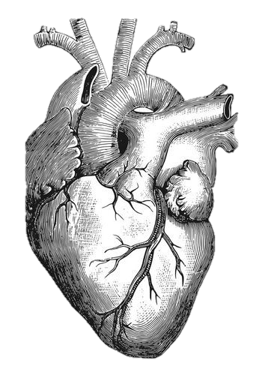
Drug Therapy of Heart Failure
Objectives:
Describe the different classes of drugs used for treatment of acute & chronic heart failure & their mechanism of action
Understand their pharmacological effects, clinical uses, adverse effects & their interactions with other drugs.
Important Notes Extra

Slide 2
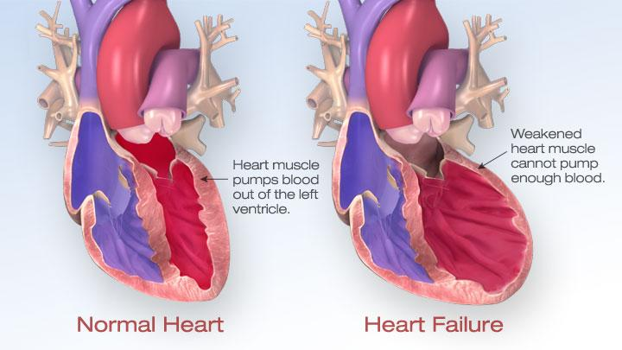
Heart Failure
What is heart failure?
Inability of the heart to maintain an adequate cardiac output to meet the metabolic demands of the body.
It could be intrinsic. ( from the heart)
Or extrinsic ( out of the heart)
Causes
Symptoms
It can be either acute or chronic
Decreased exercise tolerance (rapid fatigue)
Disorder of coronary arteries
Abnormal heart rhythm
Dyspnea (due to pulmonary congestion)
High blood pressure
Peripheral edema
Heart valve disorder
Cardiomegaly
Cardiomyopathy
Tachycardia

Slide 3
Heart Failure
Pathophysiology of CHF:
When the force of contraction is reduced it will lead to low cardiac output (low because of congestion of blood, body responds with these two reflexes-kidney is first to respond)
↓ Renal blood flow
↓ Carotid sinus firing*
kidney is the first organ to be affected by low C.O
Activate renin-angiotensin- Aldosterone system
Activate sympathetic system
↑ Sympathetic discharge
ALDOST
Remodeling of heart hypertrophy of the heart
Vasoconstriction
Salt & Water Retention
Volume expansion
↑ Force of Cardiac .cont
Venous VC
Atrial VC
↑ HR
↑ Preload = VR
*Carotid Sinus: in the internal carotid artery there is a dilated area called the carotid sinus, it works as a receptor to regulate blood pressure. Due to the low cardiac output the carotid sinus will have reduced firing which will activate the sympathetic system and increase it’s discharge leading to the following effects
↑ Preload
↑ Afterload
Preload
This becomes ↑ so we want to ↓ it
Factors affecting Cardiac output
&
Heart failure
Afterload
This becomes ↑ so we want to ↓ it
Cardiac contractility
we want to ↑ it

Slide 4
I- Drugs that decrease preload:
II- Drugs that decrease afterload:always afterload has a relation with arteries
Group | 1.Diuretics |  | 2.Aldosterone antagonists |  | 3.Venodilators
M.O.A | reduce salt and water retention decrease ventricular preload and venous pressure reduction of cardiac size Improvement of cardiac performance key word: edema |  | Antagonizes the action of aldosterone at mineralocorticoid receptors |  | dilates venous blood vessels and reduce preload
Drug | Chloro- thiazide | Furo- semide Loop diuretic on loop of henle | Spironolactone if the patient has hypokalemia Spironolactone is best choice | Eplerenone | Nitroglycerine Isosorbide dinitrate
Use | -first-line agent in heart failure therapy. -used in volume overload ( pulmonary and/ or peripheral edema ) -used in mild congestive heart failure. because it is weak diuretic. - has side effect: cause hypokalemia | -a potent diuretic. -used for immediate reduction of pulmonary congestion & severe edema associated with: -acute heart failure. -moderate & severe chronic failure. also cause hypokalemia | Nonselective antagonist of aldosterone receptor. can block other steroid receptors like: estrogens & androgens -a potassium sparing diuretic (This drug block the action of a hormone called aldosterone and this causes the kidney to pass out more fluid and keep potassium). -improves survival in advanced heart failure. | -a new selective aldosterone receptor antagonist. can block only aldosterone receptors -(does not inhibit other hormones such as estrogens & androgens). -indicated to improve survival of stable patients with congestive heart failure. | -Used I.V. for severe heart failure when the main symptom is dyspnea due to pulmonary congestion. -Dilates venous blood vessels and reduce preload. -Indicated in angina, given sublingually in emergencies
Group
Drug
M.O.A
Use
Arteriodilators
Hydralazine
reducing peripheral vascular resistance
when the main symptom is rapid fatigue due to low cardiac output

Slide 5
Drugs that decrease both preload and afterload
Group | ACE (Angiotensin Converting Enzyme) inhibitor block the formation of AngII
Uses | -Considered as first-line drugs for chronic heart failure along with diuretics -first-line drugs for hypertension therapy
Action | 1 - Decrease peripheral resistance (Afterload) 2 - Decrease Venous return (Preload) 3 - Decrease sympathetic activity 4- Inhibit cardiac and vascular remodeling associated with chronic heart failure ↓ Decrease in mortality rate
M.O.A | The drug will inhibit ACE enzyme = inhibiting formation of Angiotensin II (vasoconstrictor) and inhibiting the breakdown of bradykinin (potent vasodilator) =↓ preload & afterload= ↓ C.O.(explained further in next slide)
Drugs | Captopril | Enalapril | Ramipril
PK | -rapidly absorbed from GIT after oral administration -food reduce their bioavailability (patient should take it before eating)
 |  | -prodrugs, converted to their active metabolites in liver (they are both derived from Captopril) -have long half-life & given once daily.
ADR’S
Mnemonic: Captopril (team 435)
1- dry cough sometimes with wheezing
2- Angioneurotic edema (swelling in the nose, throat, tongue, larynx (the dangerous place here it could cause suffocation) (1-2 due to the accumulation of bradykinin with chronic use)
3- hyperkalemia (excessive potassium) especially in patients with renal insufficiency or diabetes
4- Dysgeusia (reversible loss or altered taste) (also because of bradykinin)
5- severe hypotension in hypovolemic patients (due to diuretics, salt restriction or gastrointestinal fluid loss).
6- Contraindicated during second and third trimesters of pregnancy (due to the risk of : fetal hypotension, renal failure & malformations)
7- Acute renal failure → Contraindicated in patients with renal artery stenosis because angiotensin II is important for renal perfusion.

Slide 6
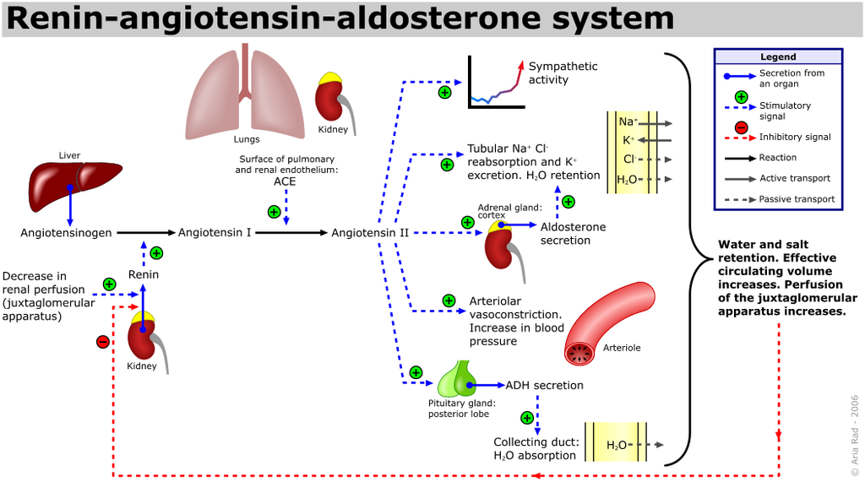
Mechanism of Action of ACE Inhibitors
In the plasma we have a protein called Angiotensinogen which is synthesized in the liver. When Renin is secreted from the kidneys, it will convert Angiotensinogen to Angiotensin I which then goes to the lungs to be converted to Angiotensin II by Angiotensin Converting Enzymes (ACE). Angiotensin II has many physiological effects such as:
severe vasoconstriction
stimulating secretion of aldosterone
stimulating secretion of vasopressin
stimulating the sympathetic system
And as a result increase the blood pressure and CO
ACE is also essential for the breakdown of Bradykinin, which when accumulated leads to vasodilatation.
So by inhibiting ACE, we will achieve the opposite of all angiotensin II normal actions in addition to vasodilatation by the accumulation of Bradykinin. This results in lower blood pressure and CO.

Slide 7
Cont. Drugs that decrease preload and afterload
IV. Drugs that increase contractility
Subclass & Drug | Angiotensin receptor blockers (ARBS): -Losartan -Valsartan -Irbesartan | Alpha- Adrenoreceptors Blockers: Prazosin | Direct acting Vasodilators: Sodium nitroprusside
Mechanism of Action | Block AT1 receptors Decrease action of angiotensin II | Blocks α-receptors in arterioles and venules Decrease both preload and afterload | Acts immediately and effects lasts for 1-5 mins. ( it doesn't affect the receptors it acts directly on blood vessels , so the action will be very fast )
Indications | - |  | Given IV for acute or severe heart failure
Drug | Cardiac glycosides (digitalis) Digoxin
MOA | Inhibit Na+/K+ ATPase enzyme (the sodium pump) (explained next slide) Increase the force of myocardial contraction (+ve inotropic effect)
Uses | Congestive heart failure Has narrow therapeutic index (therapeutic dose very close to toxic dose so we should be careful of toxicity)
ADRs | Adverse effects (Cardiac): -extrasystoles(premature contraction occurs from outside the SA node) -coupled beats (Bigeminal rhythm) (2 beats occurs together: from sa node , and other than sa node ) -ventricular tachycardia or fibrillation(because of high level of calcium) -cardiac arrest | Adverse effects (non-cardiac): -GIT: anorexia, nausea, vomiting, diarrhea. -CNS: headache, visual disturbances*, drowsiness. *( يعني ممكن المريض يشوف الدنيا كلها صفراء فأنبه المريض إذا كانت الرؤية غير واضحة هذي دلالة على toxicity ) | Factors that increase its toxicity: (contraindications) -Renal diseases -Hypokalemia: (when the digoxin block the Na-k ATPase pump it acts on potassium inside this pump , so if there is hypokalemia this will enhance the digoxin action > increase the toxicity) -Hypomagnesemia magnesium is a cofactor of tha Na-K+ pump so if it is already low it will be easier for digoxin to work faster -Hyperkalemia: (because digoxin increases the calcium level)

Slide 8
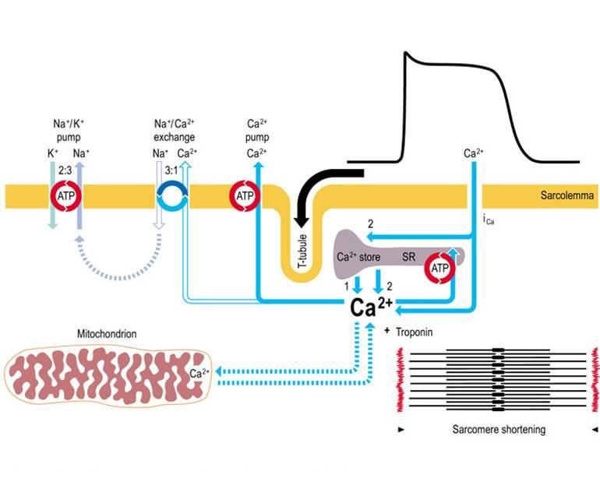
Cont.Drugs that increase contractility
Drug | β-adrenoceptor agonist (Dobutamine)
MOA | Selective β1 agonist
Uses | Treatment of acute heart failure in cardiogenic shock.
Drug | Phosphodiesterase -III* inhibitors (Milrinone) *phosphodiesterase is the enzyme that break down CAMP and CGMP so if we give inhibitors the CAMP and CGMP will increase)
MOA | Inhibits phosphodiesterase-III (cardiac & B. Vessels) (type 3 is found in cardiac and blood vessels) Increases cardiac contractility Dilatation of arteries & veins(reduction of preload & afterload)
Uses | Used only IV for management of acute heart failure Not safe or effective in the longer ( > 48 hours) Treatment of patients with (acute) heart failure ( so it is not used in chronic cases)
ADRs | Hypotension and chest pain (angina) Chemical interaction: Furosemide should not be administered in I.V. lines containing milrinone due to formation of a precipitate( ترسب )
drug | Enoximone & Vesnarinone (Phosphodiesterase -III inhibitors)
use | new drugs in clinical trials
النورمال اكشن لها تطلع الكالسيوم وتدخل الصوديوم
بسبب زيادة الصوديوم داخل، هذي ال channelتعكس شغلها تبدأ تطلع ٣ صوديوم وتدخل ١ كالسيوم
النتيجة أن الكالسيوم راح يتجمع جوا والكالسيوم معروف انه راح يزيد sarcoplasmic reticulum activity
vasoconstriction / increase cardiac contractility
digoxin will inhibit the pump so Na will build up inside
Mechanism of Action of Digoxin

Slide 9
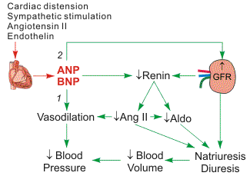
The use of β-adrenoceptor blockers
in heart failure
New drugs for heart failure
The elevated adrenergic activity in chronic heart failure patients cause structural remodeling of the heart (cardiac dilatation & hypertrophy)
What β-blockers do | Reduce the progression of chronic heart failure not used in acute heart failure.
Mechanism of action | Attenuate (reduce) cardiac remodeling . Slow heart rate, which allows the left ventricle to fill more completely. Decrease renin release. ↓ reduce mortality & morbidity of patients with HF
Generations | Second generation: cardioselective (β₁-receptors) e.g. Bisoprolol, Metoprolol | Third generation: have vasodilator actions (α-blocking effect) e.g. Carvedilol , Nebivolol.
Natriuretic Peptides:
محتقن ومتضخم
BNP* is secreted by the ventricles in response to stretch
elevated BNP is associated with advanced heart failure (compensatory mechanism in HF)
How BNP works: when heart is distended, it will secrete ANP & BNP which are vasodilator agents that go to the kidney to increase fluid excretion, decrease renin and ultimately decrease BP it is a compensatory mechanism
vasoconstrictor agent
-ANP secret from atrium
-BNP secrete from brain and ventricles
* When they discovered it for the first time they thought that the brain secrets it so they called it Brain Natriuretic Peptides, but then they noticed that it is secreted by the ventricles, so they called it the B-type Natriuretic Peptides

Slide 10
Cont. New drugs for heart failure
 | Natriuretic Peptides: | Calcium sensitisers* (للكالسيوم sensitivity تزود ال)
Drug | Nesiritide | Levosimendan
Definition | A purified preparation of human BNP, manufactured by recombinant DNA technology | -
MOA | ↑ Cyclic-GMP in vascular smooth muscle leading to : 1- Smooth muscle relaxation 2- Reduction of preload and afterload . | Calcium sensitization (improves cardiac contractility without increasing oxygen consumption) Potassium-ATP channel opening (cause vasodilation, improving blood flow to vital organs) These effects reduce the risk of worsening ADHF or death compared with dobutamine*. (it's action is only on beta 1)
Uses | Indicated (IV) for the treatment of patients with acute decompensated heart failure (ADHF) who have dyspnea at rest or with minimal activity. ADHF: sudden worsening of signs and symptoms | Management of ADHF

Slide 11
Management of Heart Failure
Congestive Heart Failure in Black patients
Acute Decompensated Heart Failure (ADHF)
Management of Chronic Heart Failure | Management of Acute Heart Failure
Reduce workload of the heart Limit patient activity Reduce weight Control hypertension Restrict sodium عشان الصوديوم يقعد في الجسم لازم يجمع معه موية بالتالي يسبب) edema ) Stop smoking | Positive airway pressure (Ventilation) Ultrafiltration Arterial vasodilation Furosemide Dobutamine Milrinone
Hydralazine/isosorbide dinitrate
fixed dose combination
FDA approved to add to standard therapy for black Americans with congestive heart failure
(due to poor response to ACE inhibitors)
( so captopril, enalapril & ramipril don’t work)
Should be considered for patients intolerant to ACE inhibitors & ARBs due to
renal dysfunction or renal stenosis
We will use this combination of drugs in patients unable to take normal drug therapy (such as black patients who are genetically resistant to ACE and patients with renal problems)
A sudden worsening of the signs & symptoms of heart failure, which typically includes:
difficulty breathing (dyspnea)
leg or feet swelling
fatigue
ADHF is a common & potentially serious cause of acute respiratory distress.

Slide 12
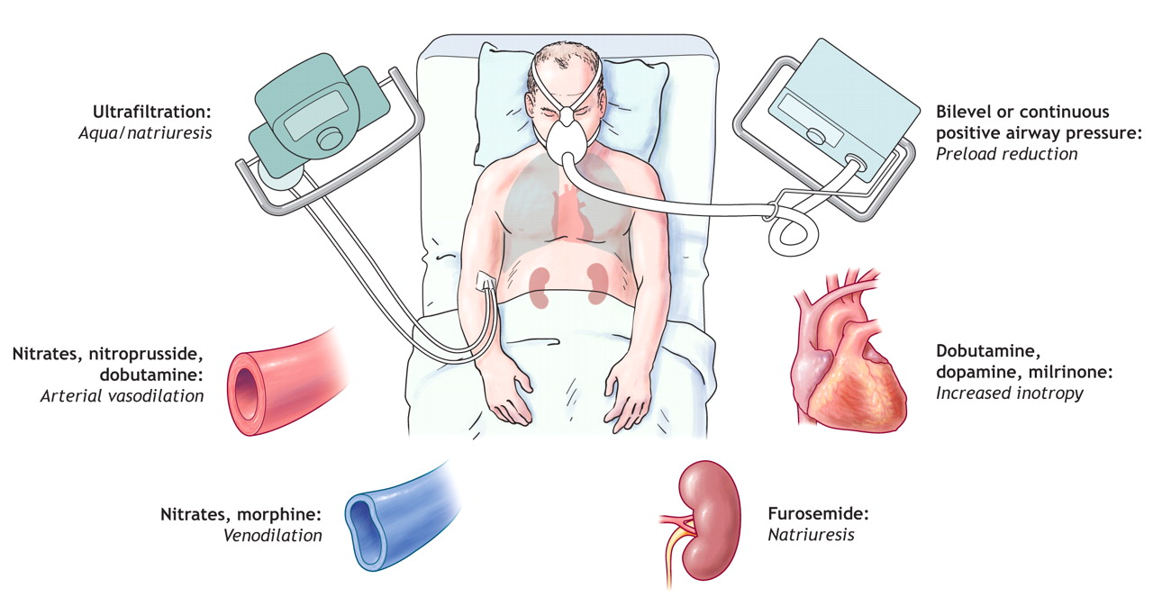
 | Heart Failure Functional Classification | Management of Chronic Heart Failure
NYHA Class | Symptoms | For Survival/Morbidity | For Symptoms
I | Cardiac disease, but no symptoms & no limitation in ordinary physical activity, e.g. no shortness of breath when walking, climbing stairs etc. | Continue ACE inhibitor/ARB if ACE inhibitor intolerant, continue aldosterone antagonist if post-MI add beta-blocker if post-MI | Reduce / stop diuretic
II | Mild symptoms (mild shortness of breath &/or angina), slight limitation during ordinary activity | ACE inhibitor as first-line treatment/ARB if ACE inhibitor intolerant add beta-blocker and aldosterone antagonist if post-MI | +/- Diuretic depending on fluid retention
III | Marked limitation in activity due to symptoms, even during less-than-ordinary activity, e.g. walking short distances (20–100 m). Comfortable only at rest | ACE inhibitor plus ARB or ARB alone if ACE intolerant beta-blocker add aldosterone antagonist | + Diuretics + Digitalis If still symptomatic
IV | Severe limitations. Experiences symptoms even while at rest. Mostly bed bound patients | Continue ACE inhibitor/ARB beta-blocker aldosterone antagonist | + Diuretics + Digitalis + consider temporary inotropic support
Management of Acute Heart Failure
diuretic

Slide 13
Questions
MCQs:
1-A 67 years man with history of Rheumatoid arthritis was referred to ER department after severe chest pain and collapsing. He was having heart attack and died at hospital after many tries of CPR. At autopsy , they found Atheroma (Fat plaque) obstructing his main coronary artery. Which drug he was on and that possibly caused atherosclerosis?
A) Tocilizumab
B) Infliximab
C) Ibuprofen
2-Primarily an arterial vasodilator that reduces peripheral vascular resistance in heart failure: A) Nitroglycerine
B) Hydralazine
C) Eplerenone
D) Isosorbide
3-furosemide should not be administered in I.V. lines containing which drug that will lead to its precipitation? A) Milrinone B) Enoximone
C) Vesnarinone
4-Digitalis-induced arrhythmias in the heart is due to: A) Increased potassium inside the cardiac cell
B) Decreased sodium inside the cardiac cell
C) Increased calcium in the cardiac cell
5- This drug can cause peripheral vasodilation by increasing cAMP levels. A) Furosemide
B) Losartan
C) Milrinone
D) Nesiritide
1-A 2-B 3-A 4-C 5-C

Slide 14
Questions
MCQs:
6-This drug can increase the synthesis of cAMP in the heart
A) Captopril
B) Digoxin
C) Dobutamine
D) Furosemide
7-A 63-year-old man complained to his physician of nausea, vomiting and visual sensation of green-yellow halos around bright objects. The man, recently diagnosed with cardiac failure
Which of the following drugs most likely caused the patient's symptoms?
A) Bisoprolol
B) Digoxin
C) Lidocaine
D) Furosemide
8-The chronic use of this diuretic can reduce mortality in patients with heart failure
A) Prazosin
B) Milrinone
C) Eplerenone
D) Spironolactone
9-This drug can increase central parasympathetic firing
A) Captopril
B) Eplerenone
C) Dobutamine
D) Digoxin
10-When teaching the patient about the signs and symptoms of cardiac glycoside toxicity, you should alert the patient to watch for:
A) Visual changes
B) Flickering lights or halos
C) Dizziness when standing up
D) Increased urine output
6-C 7-B 8-D 9-D 10-B

Slide 15
Questions
SAQ:
Mention all biologic disease modifiers classes with their mechanism of action and give one example of each.
Answer is in slide 10.
Make sure to write drugs name correctly.
These drugs are used as first-line treatment of heart failure. They work by allowing more blood to flow to the heart which decreases the workload of the heart and allows the kidneys to secrete sodium. However, some patients can develop a nagging cough angioneurotic edema. This describes which drug and why?
Angiotensin-converting-enzyme inhibitors due to bradykinin breakdown
During your morning assessment of a patient with heart failure, the patient complains of sudden vision changes that include seeing yellowish-green halos around the lights. Which medication do you suspect is causing this issue?
Digoxin
The mechanism of β-adrenoceptor blockers in heart failure:
attenuate cardiac remodeling Slows heart rate , which allow the left ventricle to fill more completely decreases renin release

Slide 16
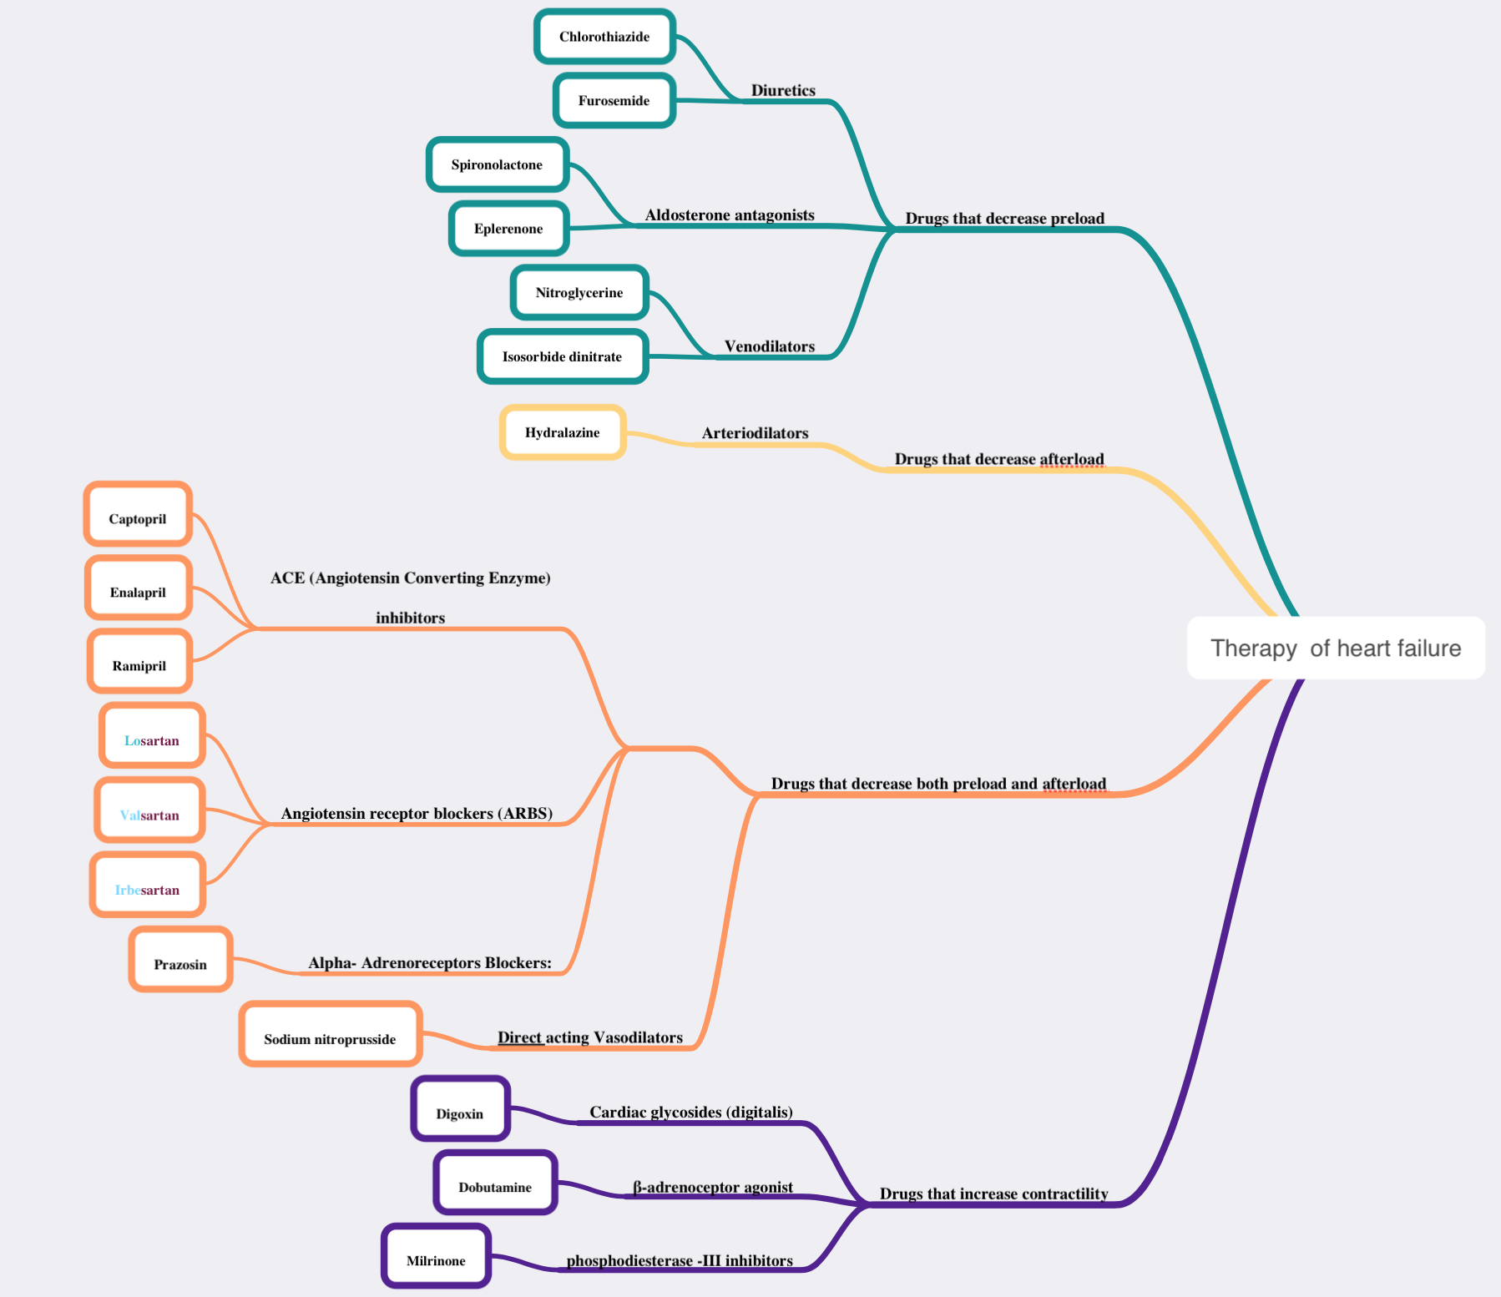

Slide 17
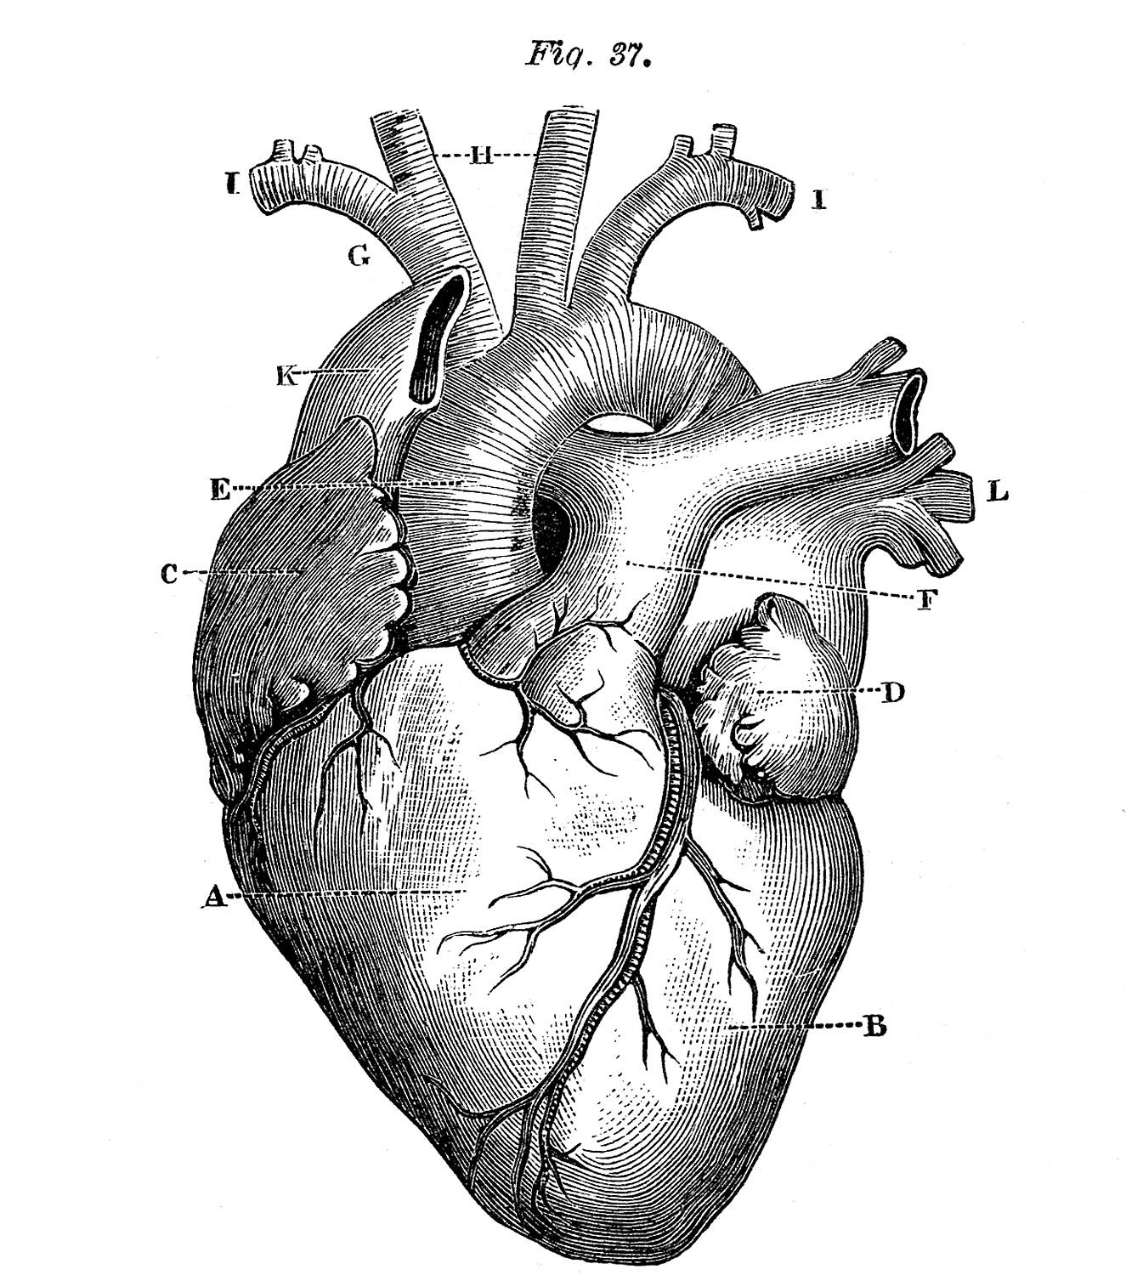
“It is not hard, you just made it to the end!”
Team Leaders:
Hadeel Awartani
Yazeed Al-Harbi
Thanks for those who worked on this lecture:
Alanoud Al-Mansour
Alanoud Al-Eissa
Aljohara Al-Shunaifi
Dana Al-Kady
Dana Al-Rasheed
Ghadah Al-Muhanna
Ghadah Al-Qarni
Hind Al-Orier
Khloud Al-Waheibi
Noura Al-Othaim
Rawan Al-Tamimi
Rinad Al-Ghoraiby
Rotana Khateeb
Sarah Al-Kathiri
Sarah Al-Sultan
Shahad Al-Tayash
References:
Doctors’ notes and slides
@Pharma4370
pharmacology437@gmail.com

