Slide 1
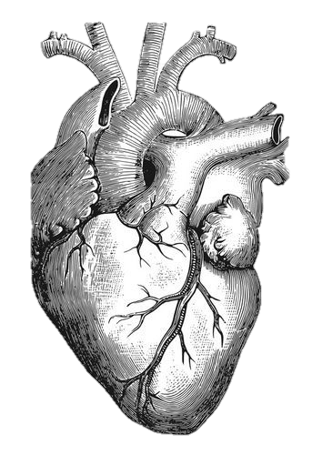
Drugs of Cardiovascular Block
Important Notes Extra

Slide 2
Drugs of Cardiovascular Block
Drug | Key Point | Contraindications
Adrenergic Blockers & 𝛂 Receptors Antagonists
Adrenergic neuron blockers
α-Methyl dopa (Formation of False Transmitters + Stimulation of presynaptic α2 receptors) | Treatment of hypertension in pregnancy | -
Reserpine | Depletion of storage sites | -
Guanethidine | Inhibition of release & enhance uptake | -
Clonidine | uses: - -Management of withdrawal symptoms -Hypertension complicated with renal disease -resistant hypertension ADRs: causes rebound hypertension | -
Apraclonidine | Used in open angle glaucoma as eye drops | -
Non-selective antagonists
Phenoxybenzamine (irreversible) | Therapeutic Use: Pheochromocytoma Cause: - Vasodilation of blood vessels - Decrease peripheral vascular resistance - Postural hypotension - Increase CO - Reflex tachycardia. - Increase in GIT motility & secretions ADRS: male sexual dysfunction&headache | Patients with decreased coronary perfusion.
Phentolamine (reversible)
Selective 𝛂1 adrenoceptor antagonists
Prazosin (short half-life) | Therapeutic Uses: - Treatment of hypertension - Urinary retention associated with benign prostatic hyperplasia - Reynaud's disease | -
Doxazosin (long half-life) |  | -
Terazosin (long half-life) |  | -

Slide 3
Drugs of Cardiovascular Block
Selective 𝛂1_{A} adrenoceptor antagonists
Drug | Key Point | Contraindications
Tamsulosin | Therapeutic Uses : - Treatment of benign prostatic hypertrophy - Help with the passage of kidney stones | -
Selective 𝛂2 adrenoceptor antagonists
Yohimbine | Used as aphrodisiac in the treatment of erectile dysfunction. | -
B Blockers
Non selective drugs ( block B1 and B2)
Propranolol | Block Na channels(Antiarrhythmic like action). -Has local anesthetic effect -NO ISA USES: -Hypertension -anxiety (Social and performance type) -Pheochromocytoma(with a blockers “never alone”) -chronic glaucoma -tremor -angina -Migraine headache prophylaxis -arrhythmia -Myocardial infarction -Thyrotoxicosis | -Bronchial Asthma,COPD -Raynaud's phenomenon & peripheral vascular disease (PVD). -Diabetics/ dyslipidemias -Variant Angina (coronary spasm) ^^ PREFERABLE TO USE BETA 1 BLOCKER in hypertensive patients with these complications
Sotalol | -
Timolol | glaucoma as eye drops
Pindolol | -

Slide 4
Drugs of Cardiovascular Block
Selective drugs( block B2)
Drug | Key Point | Contraindications
Atenolol | uses: Hypertension arrhythmia Myocardial infarction | -
Bisoprolol | USES: supraventricular & ventricular arrhythmias Hypertension Congestive heart failure Myocardial infarction
Metoprolol | USES: Hypertension Congestive heart failure Myocardial infarction
Esmolol | USES: arrhythmia( ultra short acting)
Acebutolol | -
Mixed a and B receptors blockers
Carvedilol | -NO ISA and no anesthetic effect -has Antioxidant action USES: -Congestive heart failure -Hypertensive crisis ADRs: Orthostatic hypotension, Edema | -
Labetalol | -With intrinsic sympathomimetic activity (ISA) -block Na channels(Antiarrhythmic like action) has local anesthetic effect USES: -hypertension in pregnancy -Severe hypertension in pheochromocytoma -Hypertensive crisis (e.g. during abrupt withdrawal of clonidine). ADRs: Orthostatic hypotension, sedation & dizziness | -

Slide 5
Drugs of Cardiovascular Block
Antiarrhythmic Drugs
Drug | Key Point | Contraindications
Class I drugs-Na channel blockers(Membrane stabilizing)
Class lA (slow phase 0,4 + prolong action potential + slow conduction)
Quinidine | -Use: Atrial flutter & fibrillation & ant-malaria -anticholinergic and a-adrenergic blocking effects -prolongs PR & QT interval (prolongation of QT is the cause of the following ADR) , widens QRS complex. -ORAL -ADRs: quinidine syncope due to torsades de pointes arrhythmia (at regular dose), anticholinergic ADRs “dry mouth + constipation” & hypotension. | -
procainamide | -Use: ventricular arrhythmia more than atrial arrhythmias -NO anticholinergic & a-blocking actions(so less toxic on heart) -ADRs: causes reversible lupus erythematous-like syndrome(SLE) torsades de pointes arrhythmia (at toxic dose) | -
Class lB ( slow phase 0,4 & shorten action potential )
Lidocaine | Use: Treatment of emergency ventricular arrhythmias (during surgery +following acute MI) NOT effective orally (Given I.V bolus/slow infusion) ADRs: hypotension/convulsions/Dysarthria | NOT effective in atrial arrhythmias
Mexiletine | Use: Ventricular arrhythmia & Digitalis-induced arrhythmias effective orally ADRs:hypotension/Nausea/vomiting/diplopia | -
Class lC (markedly slow phase 0 & slow phase 4 )
Flecainide | -Use:supraventricular arrhythmia/ Wolff-parkinson-white syndrome/ventricular arrhythmia -ADRs: Pro-arrhythmia/heart failure due to -ve inotropic effect / tremor / dizziness . | -

Slide 6
Drugs of Cardiovascular Block
Class II (Brenoceptors Blockers “ slow conduction”)
Drug | Key Point | Contraindications
Esmolol | Uses: given I.V. for rapid control of ventricular rate in patients with atrial flutter or fibrillation | -
Propranolol, Atenolol, Metoprolol | Used in patients who had myocardial infarction to reduce incidence of sudden death to ventricular arrhythmias | -
Class lll (Drugs that prolong action potential duration)
Amiodarone | - prolongs RP, has additional class Ia, II & IV effects - Main use: serious resistant ventricular arrhythmias, WPW -many ADRs “patients should avoid sunlight” -active metabolite: N-desethylamiodarone | -Pregnant women - Breastfeeding women - with enzymes inducers or inhibitors (CYP3A4,CYP2C8) due to drug interaction
Ibutilide (Pure class lll) | - Used for the acute conversion of atrial flutter or fibrillation to normal sinus rhythm - Causes QT interval prolongation (may cause torsades de pointes). | -
Class lV (Ca channel blockers)
Verapamil | -main site of action is A.V.N & S.A.N cause: slowing of conduction & prolongation of ERP Uses: atrial arrhythmias - WPW | NOT effective in ventricular arrhythmias.
Diltiazem
Other drugs for Arrhythmia
Adenosine | -drug of choice for acute management of paroxysmal supraventricular tachycardia -half-life = less than 10 sec ADRs: shortness of breath , chest burning & brief AV block | - asthma patients - heart block

Slide 7
Drugs of Cardiovascular Block
Drug | Key Point | Contraindications
Dronedarone (New Antiarrhythmic Drugs) | - has antiarrhythmic properties belonging to all four classes - Used for maintenance of sinus rhythm following cardioversion in patients with atrial fibrillation | - NOT be used in patients with severe (class IV) heart failure. - NOT be used in patients with permanent atrial fibrillation
Bradyarrhythmias
Atropine | Uses: sinus bradycardia after myocardial infarction & in emergency heart block with isoprenaline (with caution) | -
Drug Therapy of Heart Failure
Class I ( Drugs that decrease preload)
Diuretics (reduce salt and water retention)
Chlorothiazide | First line agent in HF therapy Used in: 1-volume overload 2- mild congestive HF | -
Furosemide | -Potent diuretic -Used for Immediate reduction of pulmonary congestion & severe edema,associated with: acute HF,moderate & severe chronic failure | -
Aldosterone antagonists
Spironolactone | -Non selective -Potassium sparing diuretic -Improve survival in advanced HF | -

Slide 8
Drugs of Cardiovascular Block
Drug | Key Point | Contraindications
Eplerenone | -Selective -Does not inhibit other hormones such as estrogen & androgen -improve survival of stable patients w/ congestive HF | -
Venodilators
-Nitroglycerin -Isosorbide dinitrate | -Used IV for severe HF when main symptom is dyspnea -Dilates venous blood vessels & reduce preload | -
ClassII Drugs that decrease afterload (Arteriodilators)
Hydralazine | -Used when main symptom is rapid fatigue due low CO -Reduce peripheral vascular resistance | حيدر الزين، بما انه زين فخدوده حمراء ويأثر على الارتريز "لونها احمر" الخدود الحمراء = ADR Lupus erythematosus like syndrome
Class III (Drugs that decrease both preload & afterload)
ACE inhibitors (first-line in HF & Hypertension)
Captopril | - rapidly absorbed from GIT after oral administration - food reduce their bioavailability ADR: - acute renal failure - hyperkalemia (especially in patients with renal insufficiency or diabetes) - severe hypotension in hypovolemic patients (due to diuretics, salt restriction or gastrointestinal fluid loss) - dry cough - angioneurotic edema - dysgeusia (reversible or altered taste) | - during the second & third trimesters of pregnancy (due to the risk of : fetal hypotension renal failure & malformations) - renal artery stenosis
Enalapril
Ramipril
رامي (Rami) كَبَت (capto) اخته اينالا (Enala) ، وبما انهم بزران ويتهاوشون فهم prodrugs لازم ينضجون ويصيرون active metabolites

Slide 9
Drugs of Cardiovascular Block
Drug | Key Point | Contraindications
Enalapril Ramipril | - prodrugs, converted to their active metabolites in liver - have long half-life & given once daily (Same ADR of previous) | (Same Contra. of previous)
Angiotensin receptor blockers (ARBs)
Losartan | M.O.A: - block AT₁ receptors - decrease action of angiotensin II | لو نجمع اول مقطع من كل درق يصير Lov al irbe انا احب العربي :)
Valsartan
Irbesartan
α-Adrenoceptor Blockers
Prazosin | - blocks α- receptors in arterioles and venules - decrease both afterload & preload | -
Direct acting vasodilators
Sodium nitroprusside | - given I.V. for acute or severe heart failure - acts immediately and effects lasts for 1-5 min. | -
Class IV (Drugs that increase contractility) (+ve inotropic effect)
β-adrenoceptor agonists
Dobutamine | - Selective β1 agonist - Uses: Treatment of acute heart failure in cardiogenic shock. | -

Slide 10
Drugs of Cardiovascular Block
Cont: Class IV (Drugs that increase contractility)
Drug | Key Point | Contraindications
Cardiac glycosides (digitalis)
Digoxin | -M.O.A: Inhibit Na+ / K+ ATPase enzyme Therapeutic uses: 1-Congestive heart failure (has narrow therapeutic index) ADR: 1-(Cardiac): digitalis-induced arrhythmias: extrasystoles - coupled beats (Bigeminal rhythm) - ventricular tachycardia or fibrillation - cardiac arrest 2-(GIT):anorexia, nausea, vomiting, diarrhea 3-(CNS):headache, visual disturbances, drowsiness. Factors that increase its toxicity: Renal diseases - Hypokalemia - Hypomagnesemia - Hypercalemia | -
phosphodiesterase -III inhibitors
Milrinone | M.O.A: - Increase cardiac Contractility - dilatation of arteries & veins (reduction of preload & afterload) Therapeutic uses: - used only IV for management of acute heart failure - not safe or effective in the longer ( > 48 hours) treatment of patients with heart failure. ADR: Hypotension and chest pain (angina) | furosemide”class I” should not be administered in I.V. lines containing milrinone due to formation of a precipitate (Due to chemical interaction )
Enoximone + Vesnarinone | new drugs in clinical trials. | -

Slide 11
Drugs of Cardiovascular Block
B adrenoceptors blockers
Drug | Key Point | Contraindications
Bisoprolol, Metoprolol | -Second generation: cardioselective (β1-receptors) -reduce the progression of chronic heart failure -attenuate cardiac remodeling | not used in acute heart failure.
Carvedilol , Nebivolol. | -Third generation: have vasodilator actions (α- blocking effect) -reduce the progression of chronic heart failure. -attenuate cardiac remodeling
New drugs
Nesiritide (Natriuretic Peptides group) | -Purified preparation of human BNP - indicated (IV) for the treatment of patients with acute decompensated heart failure (ADHF) who have dyspnea at rest or with minimal activity. | -
Levosimendan (Calcium sensitisers group) | -used in the management of ADHF -Calcium sensitization (improves cardiac contractility without increasing oxygen consumption) - potassium-ATP channel opening (cause vasodilation, improving blood flow to vital organs) | -

Slide 12
Drugs of Cardiovascular Block
Antihypertensive drugs
Drug | Key Point | Contraindications
1-Diuretics
Hydrochloro- thiazide Chlorthalidone | -mild to moderate hypertension MOA: initial diuresis lasts 4-6 weeks and then replaced by a decrease in PVR
Furosemide | Loop diuretic are useful in hypertensive patients with either renal impairment or heart failure(edema)
2-Drugs acting on the renin- angiotensin- aldosterone (RAAS) system
Angiotensin-converting enzyme inhibitors (ACEIs)
Enalapril Lisinopril Ramipril Captopril |  | -Renal artery stenosis. -Potassium-sparing diuretics. -During the second and third trimesters of pregnancy due to the risk of: fetal hypotension,anuria ,renal failure& malformations.
- The antihypertensive effect of ACE inhibitors results primarily from vasodilatation with little change in cardiac output effective when hypertension results from excess renin production.
- Hypertension in patient with chronic renal disease,ischemic heart disease,diabetes.
-ADRS Dry cough,Angioneurotic edema.First dose effect (severe hypotension).
- adrs specificto captopril Dysgeusia (reversible loss or altered taste). Proteinuria and neutropenia.

Slide 13
Drugs of Cardiovascular Block
Drug | Key Point | Contraindications
Angiotensin receptors blockers (ARBs)
Losartan | -Cause selective block of AT1 receptors. -No effect on bradykinin, no cough,no angioedema. -Produce more,complete inhibition of angiotensin as,there are other enzymes(not only ACE) that can generate angiotensin. Losartan; Has a potent active metabolite,Long half-life,taken once daily, Orally effective,Do not cross BBB. Valsartan; No active metabolites. | Same contraindicat-ions as ACEI.
Valsartan
Candesatran
Telmisartan
3- Calcium Channel Blockers
Very Nice Drugs Verapamil - Nifedipine - Diltiazem
Verapamil Nifedipine Diltiazem | -Verapamil acts more on myocardium. -Dihydropyridine group act mainly on smooth muscle, Nifedipine -Diltiazem has intermediate effect M.O.A: -peripheral vasodilatation -decrease cardiac contractility. P.K: - verapamil and nifedipine are highly bound to plasma proteins while diltiazem is less. -verapamil & diltiazem have active metabolites but nifedipine has not. Uses: -treatment of chronic hypertension. -nicardipine can be given by I.V. route in hypertensive emergency. ADRs: -nifedipine: Tachycardia -verapamil: constipation -verapamil & diltiazem: peripheral edema (ankle edema) | -

Slide 14
Drugs of Cardiovascular Block
Drug | Key Point | Contraindications
Vasodilators(IMPORTANT)
Hydralazine | MOA:Direct on SM ADRs: lupus erythematosus like syndrome Uses: hypertensive pregnant woman(2nd line)
Minoxidil | MOA:opening of K channels in SM membranes by minoxidil sulfate(ACTIVE METABOLITE) Uses: baldness ADRs: hypertrichosis | females
Diazoxide | MOA:opening of K channels Uses: treatment of hypoglycemia due insulinoma ADRs: hyperglycemia | diabetics
Sodium Nitroprusside | MOA: Arterio&venodilator Uses: severe heart failure ADRs: severe hypotension Methomoglobin during infusion cyanide toxicity /thiocyanate toxicity
4-Sympatholytic Drugs
β-adrenoceptor blockers
Propranolol (Non-selective) | -used in mild to moderate hypertension, In severe cases used in combination with other drugs. -May take two weeks for optimal therapeutic response -Evidence support the use of ß-blockers in patients with concomitant coronary artery disease -When discontinued, ß- blockers should be withdrawn gradually -M.O.A lower BP by: -Decreasing cardiac output -Inhibiting the release of renin -Central mechanism ADRs: Fatigue, Hypoglycemia, Mask the symptoms of hypoglycemia in diabetes, Increased triglycerides, Aggravate peripheral arterial disease, Erectile dysfunction | Diabetics and Asthma patients
Atenolol (Selective)
Metoprolol (Selective)
Both Drugs in hypertensive emergency

Slide 15
Drugs of Cardiovascular Block
Drug | Key Point | Contraindications
α Adrenoceptor blockers (in arterioles & venules)
Prazosin | -Reduce blood pressure by decreasing both afterload & preload Prazosin, short- acting causes first dose hypotension & postural hypotension | -
Doxazosin (Preferred Long half-life)
Centrally- acting
Clonidine | -α2-agonist, diminishes central adrenergic outflow & ↑ parasympathetic outflow -Abrupt withdrawal may lead to rebound hypertension -Does not decrease renal blood flow or glomerular filtration -Useful in the treatment of hypertension complicated by renal disease and resistant hypertension | -
α- methyldopa | -An α- 2 agonist, is converted to methyl noradrenaline centrally to diminish the adrenergic outflow from the CNS -Lead to reduced total peripheral resistance, and a decrease in blood pressure -first line treatment of hypertension in pregnancy

Slide 16
Drugs of Cardiovascular Block
Thrombolytic drugs
Drug | Key Point | Contraindications
Non fibrin-specific thrombolytic drugs
Streptokinase | -acts indirectly by forming plasminogen-streptokinase complex( THE ONLY INDIRECTLY ACTING plasminogen activator) -Given by IV infusion -It is the least expensive. -ADRs: Antigenicity/Allergic reactions//Bleeding | Not used in patients with: Recent streptococcal infections or Previous administration of drug due to antistreptococcal antibodies.
Anistreplase | -Anisoylated Plasminogen Streptokinase Activator Complex (APSAC) -prodrug, de-acylated in circulation & active -Given as a bolus I.V. (Longer duration) -More thrombolytic activity, greater selectivity. ADRS: like streptokinase but to lesser degree -more expensive than streptokinase | could be the same(?)
Urokinase | -Human enzyme synthesized by the kidney(embryonic cell) & urine -given by I.V infusion. -Used in acute massive pulmonary emboli. -no anaphylaxis. Disadvantages:-Minimal fibrin specificity/Systemic lysis /Expensive | -

Slide 17
Drugs of Cardiovascular Block
Fibrin specific agents thrombolytic drugs
Alteplase. | -They activate fibrin-bound plasminogen rather than free plasminogen in blood. -They bind to fibrin in a thrombus and convert the entrapped plasminogen to plasmin followed by activated local fibrinolysis with limited systemic fibrinolysis. -Reduced risk of bleeding -Not-antigenic (can be used in patients with recent streptococcal infections or antistreptococcal antibodies). | -use: ➢ In ST-elevation myocardial infarction (STEMI) ➢ Pulmonary embolism.
Reteplase
Tenecteplase |  | -It is only approved for use in acute myocardial infarction. - It is more fibrin-specific & longer duration than alteplase.
Fibrinolytic Inhibitors (Antiplasmins) inhibit plasminogen activation & inhibit fibrinolysis and promote clot stabilization.
-Aminocaproic Acid -Tranexamic Acid (competitive inhibition) | Uses: -Adjuvant therapy in hemophilia -Fibrinolytic therapy-induced bleeding (antidote) -Post-surgical bleeding | -
Aprotinin (plasmin antagonist)

Slide 18
Drugs of Cardiovascular Block
hyperlipidemia
Agents targeting exogenous cholesterol
Bile Acid Sequestrants (Resins) (form an insoluble complex with bile acids and salts, preventing their reabsorption from the intestines)
Colestipol | - prevents enterohepatic cycling of bile acids - obligates the liver to synthesize replacement bile acids from cholesterol -increase LDL receptors to obtain more cholesterol - decrease serum LDL-C - Excellent choice for people that cannot tolerate other types of drugs ADRs: - constipation - Decreased absorption of fat soluble vitamins (A,D, K) - The concentration of HDL-C is unchanged - Colesevelam is a better choice for patients on multiple drug regimens. (Doesn’t affect their absorption, unlike other two) | - Complete biliary obstruction - Chronic constipation - Severe hyper-triglyceridemia
Cholestyramine
Colesevelam
Cholesterol Absorption Inhibitors
Ezetimibe | - reduces C absorption and it’s flux from intestine to the liver. - reduced flux of C to VLDL particles will lower LDL-C. - reduce LDL ,TG / increases HDL slightly -Absorbed & conjugated in intestine to active glucuronide - lowering LDL will = prevention of low risk CHD (As monotherapy) - As combination therapy: -With statins:synergistic in moderate/severe increase in LDL - Or If must lowering statin dose because of side effects - Or with other lipid lowering drugs; as fibrates - ADRs are same as most antihyperlipidemic drugs | -

Slide 19
Drugs of Cardiovascular Block
Drug | Key Point | Contraindications
HMG-Co reductase inhibitors
Statins | Statins are considered as first-line drugs when lowering LDL -PLEIOTROPIC EFFECTS: cardioprotective -Pravastatin and fluvastatin are the statins of choice in patients taking other drugs metabolized by cytochrome 3A4 system. -orally at bedtime because of hepatic C synthesis except atorvastatin taken at any time because of its long half-life -Used alone or with antihyperlipidemic drugs(ezetimibe) -Combination therapy in mixed dyslipidaemias (added to fibrates or niacin) & in diabetics and patients with insulin resistance -given from the 1st day of ischemic attack & in Type IIa Hyperlipoprotinemia. ADRs: Teratogenicity Hepatotoxicity, raised concentrations of liver enzymes (serum aminotransferases) Myopathy (increased ck) discontinue lead to rhabdomyolysis | -Pregnant -Drugs that increase the risk of statin-induced myopathy include: ➢ Other antihyperlipidemics ( fibrates ) ➢ Drugs metabolized by 3A4 isoform of cytochrome P450: erythromycin, verapamil, cyclosporin, ketoconazole
Niacin (Nicotinic Acid)
Niacin | - Niacin is the most effective medication for increasing HDL -M.O.A: 1- In adipose tissue: binds to adipose nicotinic acid receptors will lead to decrease in free fatty acids resulting in TG and thus VLDL synthesis 2- In liver: diacylglycerol acyltransferase-2, akey enzyme for TG synthesis so it will decreases VLDL production (decreased TG synthesis and estrification) 3- In plasma: it increases LPL activity that increases clearance of VLDL & chylomicron. -ADRs: cutaneous flushing - GIT disturbances” Dyspepsia , nausea , vomiting & reactivation of peptic ulcer” -Uses: - type IIa, IIb hypercholesterolemia & any combined hyperlipidemia - patient with hypertriglyceridemia & low HDL-C | -Gout -Peptic ulcer -Hepatotoxicity -Diabetes mellitus -pregnancy

Slide 20
Drugs of Cardiovascular Block
Drug | Key Point | Contraindications
Fibrates
-Clofibrate -Gemfibrozil -Fenofibrate | -intracellular metabolism receptors that modulate fat -They increase genes transcription for lipoprotein lipase (LPL) leading to increased catabolism of TG in VLDL and chylomicrons. -Increased risk of myopathy when combined with statins. -Displace drugs from plasma proteins (e.g. oral anticoagulants and oral hypoglycemic drugs) -1st-line defense for Patients with low HDL and high risk of atheromatous disease (often type 2 diabetic patients) -ADRS: -Myalagia, Myositis, Rhabdomyolysis Acute renal failure Occurs > -In alcoholics, -If combined with statins -Or In impaired renal function -Gallstones (especially Clofibrate so its use is limited to patients who have cholecystectomy) | • Patients with impaired renal functions • Pregnant or nursing women • Preexisting gall bladder disease
Adjuvants in hyperlipidemia
Omega -3-FA | -M.O.A: enzymes involved in TG synthesis. beta-oxidation of FFA platelet function Prolongation of bleeding time Anti-inflammatory effects -Uses:Approved as adjunctive for treatment of very high TGs | -
β-Sitosterol | -M.O.A: Compete with dietary & biliary C absorption levels LDL levels -Uses: Given as food supplement before meal in hypercholesterolemia

Slide 21
Drugs of Cardiovascular Block
Angina
Drug | Key Point | Contraindications
Organic Nitrates
Isosorbide mononitrate or dinitrate Nitroglycerin | -M.O.A: Nitric oxide binds to guanylate cyclase in vascular smooth muscle cell to form cGMP, cGMP activates PKG to produce relaxation. -Hemodynamic effects: *Venous vasodilation (Decrease the preload) *coronary vasodilation (Increase the myocardial perfusion) *Arterial vasodilation (decrease afterload) *Shunting of flow from normal area to ischemic area by dilating collateral vessels. -Uses: *isosorbide mononitrate or dinitrate “in stable angina”: Persistent prophylaxis - Congestive Heart Failure - when there is ACE inhibitor contraindications *nitroglycerin“in stable angina”:Acute symptom relief - Situational prophylaxis - In variant angina (sublingual) - In unstable angina (IV) - Acute Heart Failure-Refractory AHF,and AMI (IV) ADRs: -Throbbing headache -Flushing in blush area -Postural hypotension, dizziness & syncope-Tachycardia & palpitation -Rarely Methemoglobinemia | -sensitivity to organic nitrates. - Glaucoma - Head trauma or cerebral haemorrhage - Uncorrected hypovolemia. - Concomitant administration of PDE₅ Inhibitors. -Sildenafil + nitrates = severe hypotension & death If Tolerance develops: give smaller doses at longer intervals (Nitrate free periods twice a day) & drugs that maintain tissue SH group e.g.Captopril.

Slide 22
Drugs of Cardiovascular Block
Calcium channel blockers (low Ca = Relaxation)
Dihydropyridines: -Nifedipine (Vascular smooth muscle) -Nicardipine -Amlodepine | Antianginal Action: - (verapamil & diltiazem) ↓ Cardiomyocyte Contraction > ↓ cardiac work (-ve ino/chronotropic) > ↓ myocardial O₂ demand - ↓ VSMC contraction > ↓ afterload > ↓ cardiac work > ↓ myocardial O₂ demand - Coronary dilatation>↑myocardial O₂ supply Uses: - Variant Angina> Attacks prevented (>60%) /sometimes variably aborted - Unstable Angina> Seldom added in refractory cases - Stable Angina> Regular prophylaxis | -
Phenylalkylamines: -Verapamil (cardiomyocytes)
Benzthiazepines: -Diltiazem (intermediate)
β Adrenergic Blockers
Atenolol, Bisoprolol , Metoprolol | -Decrease heart rate & contractility thus: 1- Increase duration of diastole >increase coronary blood flow >increase oxygen supply 2-Decrease workload > Decrease O2 consumption. -use: Stable ,unstable angina and Myocardial infarction . | -variant Contraindicated

Slide 23
Drugs of Cardiovascular Block
K+ CHANNEL blockers
Nicorandil | -has dual mechanism of action: 1.Opens potassium ATP channels (arteriolar dilator) 2. NO donor as it has a nitrate moiety (venular dilator) -As K channel opener 1. On vascular smooth muscles: opening K channels > hyperpolarization> vasodilation. 2. On cardiomyocytes: opening K channels >repolarization> decrease cardiac work. -As NO donor Increase in cGMP/PKG which leads to vasodilation -Prophylactic 2nd line therapy in stable angina -Refractory variant angina | -ADRS Flushing,headache,Hypotension, palpitation, weakness Mouth & peri-anal ulcers, nausea and vomiting.
Metabolically acting agents
Trimetazidine | shift oxidation to glucose instead of free fatty acids to reduce oxygen demand of heart no haemodynamic effect+add-on therapy | Hypersensitivity pregnancy & lactation
Ranolazine | inhibits late Na current which increase during ischemia -used in chronic angina patients w/other drugs | -in class la & lll antiarrhythmics -toxicity develop due interaction with CYT450 inhibitors
Ivabradine | treatment of chronic stable angina in patients with normal sinus rhythm who can’t take b-blockers + with b-blockers in heart failure with LVEF < 35% and HR>70 -in combination with b blockers in heart failure ADRs: luminous phenomena

Slide 24
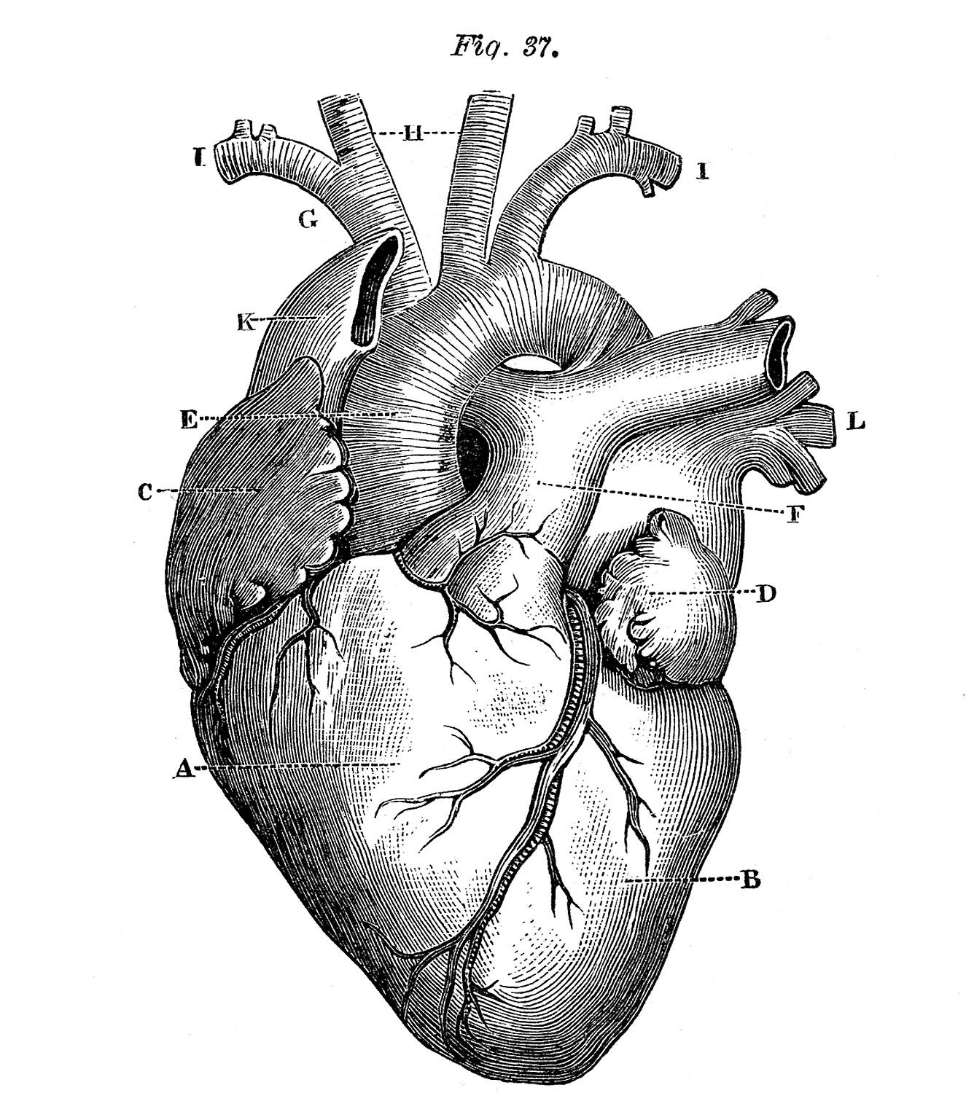
“It is not hard, you just made it to the end!”
Team Leaders:
Hadeel Awartani
Yazeed Alharbi
Thanks for those who worked on this lecture:
Dimah Al-Araifi
Nouf Al-Otaibi
Fatimah Al-Bassam
Ghaida Al-Sanad
References:
Doctors’ notes and slides
@Pharma4370
pharmacology437@gmail.com

