Slide 1
Management of Urinary Tract Infections
Prof.Hanan Habib
Pathology Department

Slide 2
Objectives
1- Recall the principal goal of management of urinary tract infection (UTI) and that antibiotics are the main treatment of UTI
2- Discuss the factors that management of UTI depends on
3- Describe the management/treatment of different conditions of UTI ( cystitis, pyelonephritis, catheter associated UTI ,etc.)

Slide 3
Goal of Management of UTI
The principal goal of management of UTI is to eradicate the offending organisms from the urinary bladder and tissues.
The main treatment of UTI is by antibiotics.

Slide 4
Management of UTI depends on:
Whether infection is complicated or uncomplicated.
Whether infection is primary or recurrent.
Type of patient (pregnant ,child , hospitalized or not, diabetic patient,…..etc)
Bacterial count.
Presence of symptoms.

Slide 5
Uncomplicated UTI
Low-risk patient (woman) for recurrent infection:
3 days antibiotic without urine test.
Cure rate 94%.
Choice of antibiotic depend on susceptibility pattern of bacteria, it includes ;
Amoxicillin ( with or without clavulanic acid)
Cephlosporins ( first or second generation)

Slide 6
Fluoroquinolone ( ciprofloxacin or norfloxacin)
(not for pregnant women or children under 18 year) ,first choice if other antibiotics are resistant.
TMP-SMX ( trade names: Bactrim, Septra ,Cotrimoxazole)
Nitrofurantoin ( for long term use)

Slide 7
Relapsing infection
Caused by treatment failure or structural abnormalities or abscesses.
Antibiotics used at the initial infection
Treatment for 7-14 days.

Slide 8
Recurrent infections
Patients with two or more symptomatic UTIs within 6 months or 3 or more over a year.
Need preventive therapy
Antibiotic taken as soon as symptoms develop.
If infection occurs less than twice a year, a clean catch urine test should be taken for culture and treated as initial attack for 3 days.

Slide 9
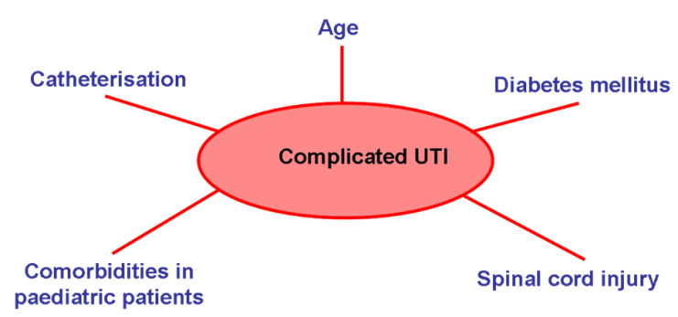

Slide 10
When to consult the doctor ?
If symptoms persist
A change in symptoms
Pregnant women
More than 4 infections per year
Impaired immune system
Previous kidney infections
Structural abnormalities of urinary tract
History of infection with antibiotic resistant bacteria.

Slide 11
Postcoital antibiotics
If recurrent UTI is related to sexual activity, and episodes recur more than 2 times within 6 months
A single preventive dose taken immediately after intercourse
Antibiotics include: TMP-SMX, Cephalexin or Ciprofloxacin

Slide 12
Prophylactic antibiotics
Optional for patients who do not respond to other measures.
Reduces recurrence by up to 95%
Low dose antibiotic taken continuously for 6 months or longer, it includes :
TMP-SMX, Nitrofurantoin, or Cephalexin
Antibiotic taken at bed time more effective.

Slide 13
Uncomplicated pyelonephritis
Patients with fever, chills and flank pain but they are healthy, non-pregnant, female, without relevant comorbidities and without structural or functional urinary tract abnormalities
Can be treated at home with oral antibiotics for 14 days with one of the followings:
Cephalosporins, Amoxicillin-Clavulanic acid, Ciprofloxacin or TMP-SMX.
First dose may be given by injection

Slide 14
Moderate to sever pyelonephritis
Patients need hospitalization
Antibiotic given by IV route for 3-5 days until symptoms relieved for 24-48 hrs.
If fever and back pain continue after 72 hrs of antibiotic, imaging tests indicated to exclude abscesses, obstruction or other abnormality.

Slide 15
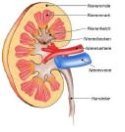
Chronic pyelonephritis
Those patients need long-term antibiotic treatment even during periods when they have no symptoms.

Slide 16
Treatment of specific populations
Pregnant women
High risk for UTI and complications
Should be screened for UTI
Antibiotics during pregnancy includes;;
Amoxicillin, Ampicillin, Cephalosporins, and Nitrofurantoin.
Pregnant women should NOT take Quinolones.

Slide 17
Pregnant women with asymptomatic bacteriuria ( evidence of infection but no symptoms) have 30% risk for acute pyelonephritis in the second or third trimester. Screening and 7-10 days antibiotic needed.
For uncomplicated UTI (any patient , not at pregnancy ) need 3-5 days antibiotic treatment.

Slide 18
Diabetic patients
Have more frequent and more sever UTIs.
Treated for 7-14 days with antibiotics even patients with uncomplicated infections.

Slide 19
Urethritis in men
Most important causes:
Neisseria gonorrheae
Chlamydia trachomatis
Treated with IM Ceftriaxone + Doxycycline or Azithromycin.
Patients should also be tested for accompanying STD.

Slide 20
Children with UTI
Usually treated with TMP-SMX or Cephalexin.
Sometimes given as IV .
Gentamicin may be recommended as resistance to Cephalexin is increasing.

Slide 21
Vesicoureteric reflux ( VUR)
Common in children with UTI
Can lead to pyelonephritis and kidney damage.
Long-term antibiotic plus surgery used to correct VUR and prevent infections.
Acute kidney infection : use Cefixime ( oral) or IV Ceftriaxone or Gentamicin a one daily dose for 2-4 days followed by oral treatment eg. amoxicillin-clavulanic acid or TMP-SMX .

Slide 22
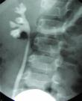

Slide 23
Management of catheter-induced UTI
Very common
Preventive measures important
Catheter should not be used unless absolutely necessary and they should be removed as soon as possible.

Slide 24
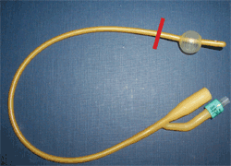
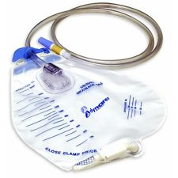
Urinary catheter

Slide 25
Intermittent use of catheters
If catheter is required for long periods ,it is best to be used intermittently.
May be replaced every 2 weeks to reduce risk of infection and irrigating bladder with antibiotics between replacements
Daily hygiene and use of closed system to prevent infection.

Slide 26
Catheter induced infections
Catheterized patients who develop UTI with symptoms or at risk for sepsis should be treated for each episode with antibiotics and catheter should be removed, if possible.
Associated organisms are constantly changing.
May be multiple species of bacteria.

Slide 27
continue-
Antibiotic use for prophylaxis is rarely recommended since high bacterial counts present and patients do not develop symptomatic UTI.
ANTIBIOTIC THERAPY HAS LITTLE BENEFIT IF THE CATHETER IS TO REMAIN IN PLACE FOR LONG PERIOD.

