Slide 1
TUMORS OF THE KIDNEY AND URINARY BLADDER
HALA KFOURY,MD

Slide 2
Objectives:
At the end of the lecture the students will be able to:
Recognize the benign tumors of the kidney.
Describe renal cell carcinoma and Wilm’s tumor.
Recognize transitional cell and squamous carcinoma of the urinary bladder.

Slide 3
Benign tumors of the kidney:
1- adenoma
2- angiomyolipoma

Slide 4
Malignant RENAL NEOPLASMS
Neoplasms of the Renal Parenchyma
Renal cell carcinoma (renal adenocarcinoma; hypernephroma)
Nephroblastoma (Wilms's tumor)
Urothelial tumors

Slide 5
RENAL NEOPLASMS
Gross pathology and histology
Histogenesis
Clinical manifestations
Diagnosis: radiographic imaging
Treatment and prognosis
Pathophysiology

Slide 6
Kidney with ischemic atrophy also bears very small subcapsular adenomas near to each pole.

Slide 7
Histology of a subcapsular papillary adenoma shows tubules arranged in a papillary fashion.

Slide 8
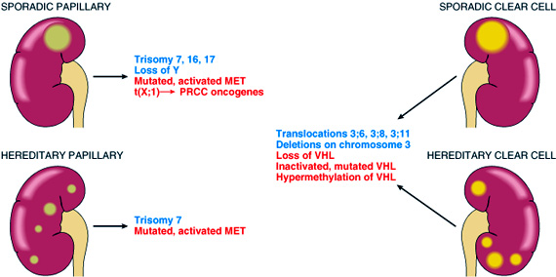
Human renal cell carcinoma

Slide 9
Renal cell carcinoma Renal cell carcinoma is the most common primary renal tumor in adults and may be occult.

Slide 10
Small clear cell renal cell carcinoma (hypernephroma, Grawitz tumor) is spreading into perirenal adipose tissue.

Slide 11
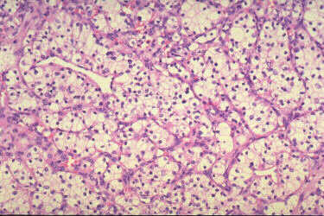
Human renal clear cell carcinoma

Slide 12
Typical lobulated, whorled, tan-colored cut surface of renal cell carcinoma.

Slide 13
Invasion of the renal vein and inferior vena cava (arrow) by renal cell carcinoma.

Slide 14
Papillary urothelial (transitional cell) carcinoma of renal pelvis. Note the exophytic, multifronded nature of the tumor.
Transitional cell carcinoma of the renal pelvis.

Slide 15
Solid, bulging, fleshy tan-white, partially necrotic tumor has replaced much of the kidney and is encompassed by a thin rim of renal tissue..
Wilms’ tumor (nephroblastoma)

Slide 16
This Wilms’ tumor appears whiter due to formalin fixation and has extended beyond the confines of the kidney

Slide 17
Histology shows hypercellular areas comprising undifferentiated blastema, loose stroma with undifferentiated glomeruloid body.
Wilms’ tumor

Slide 18
Urothelial (transitional cell) carcinoma in situ of the urinary bladder if untreated, up to 75% of cases go on to invasive cancer.

Slide 19
Histology of carcinoma in situ (surface is to the right).

Slide 20
Invasive urothelial carcinoma of the bladder is invading the muscle coat on the right side of the picture.

Slide 21
Urothelial carcinoma of bladder.

Slide 22
Advanced urothelial cancer of the bladder has spread posteriorly (arrow)to invade the uterus.

Slide 23
Poorly differentiated urothelial carcinoma.

