Slide 1
Renal functions & GFR

Slide 2
من سلك طريقا يلتمس فيه علما سهل الله له به طريقا إلى الجنة

Slide 3
Learning Objectives:
Enumerate general functions of the kidney.
Identify and describe that the nephron is the structural and function unit of the kidney.
Explain glomerular filtration membrane & filtration forces.
Describe mechanism of filtration & composition of the glomerular filtrate.
Calculate the net filtration pressure using parameters of Starling forces.

Slide 4
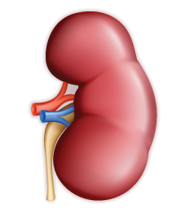
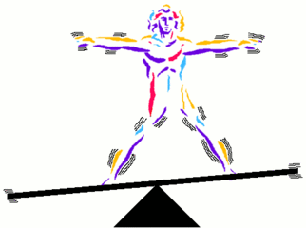
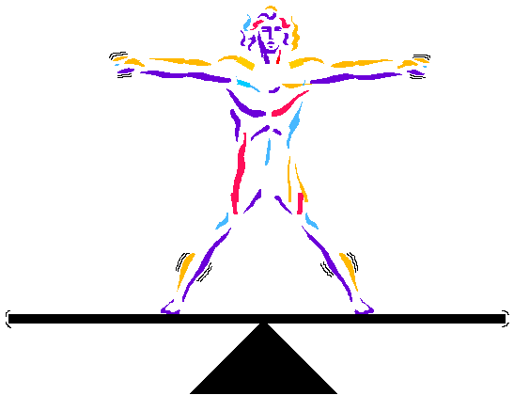
Functions of the Kidney
Synthetic function
Excretion
Regulation
Blood with metabolic waste products
Glucose (gluconeogenesis)
Erythropoietin
1,25-dihydroxy vitamin D3 (calcitriol)
Renin
Metabolic waste products:
Urea
Creatinine
Uric acid
Bilirubin
Ingested toxins:
Drugs
Pesticides
Water & electrolytes
Acid-base
Arterial BP

Slide 5
What are the functions of the kidney?
Regulation of water and electrolyte balance.
Regulation of body fluid osmolality & electrolytes.
Excretion of waste products (UREA, CREATININE, URIC ACID).
Regulation of arterial blood pressure (RAS, excretion of excess salt and water).
Regulation of acid/base balance.
Detoxification and excretion of drugs.
Synthesitic function:
1- active form of vit D (D3)= 1,25 dihydroxycholicalciferol.
2- Erythropoietin production.
3- Renin formation.
4- Synthesis of glucose from amino acids during prolonged fasting.

Slide 6
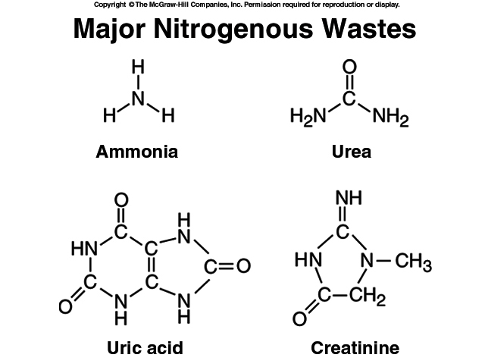
Nitrogenous Wastes
Urea
  proteins→amino acids →NH₂ removed →forms ammonia, liver converts to urea
Uric acid
Creatinine

Slide 7
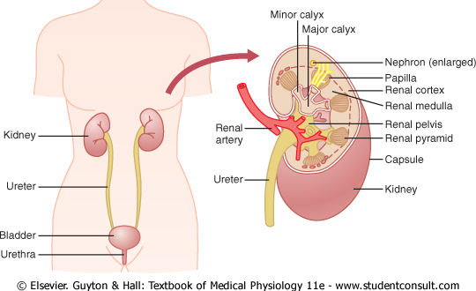
PHYSIOLOGIC ANATOMY OF KIDNEYS
Size Clenched Fist
Weight 150 grams

Slide 8
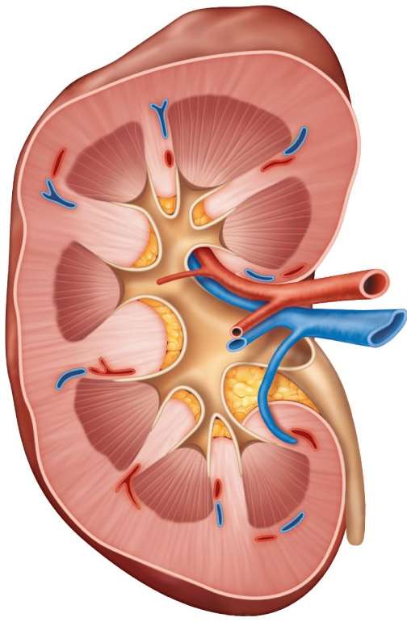
Three distinct regions
Renal cortex
Cortex granular superficial region
Medulla exhibits cone-shaped pyramids
Renal medulla
Renal
hilum
Pyramids are bundles of collecting tubules
Renal pelvis
Ureter
Renal pelvis flat, funnel-shaped tube
Renal pyramid
Renal column
Diagrammatic view of the kidney
8

Slide 9
What is the functional unit of the kidney?
The nephron is the functional and structural unit of the kidney.
Each kidney has 1 million nephrons, each nephron is capable of urine formation.

Slide 10
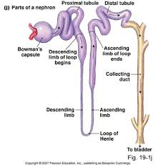
Structure of a nephron
The Glomerulus: capillary tuft: in which large amount of fluid is filtered from blood.
Bwaman’s capsule: Around the glomerulus and receives the filtrate.
Tubules: in which filtered fluid eventually is converted into urine.

Slide 11
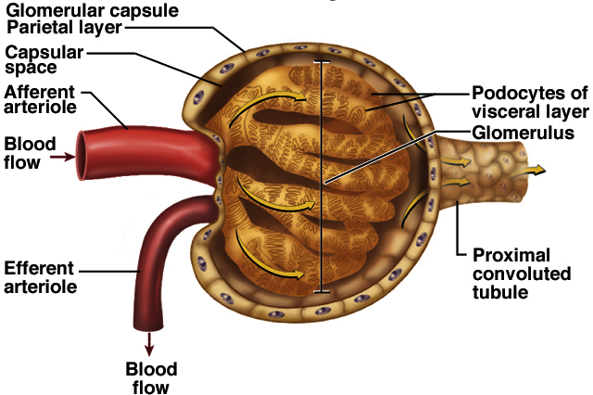
The Glomerulus
Glomerular filtrate collects in capsular space, flows into renal tubule

Slide 12
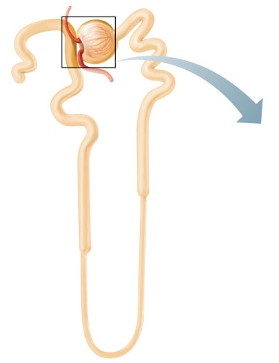
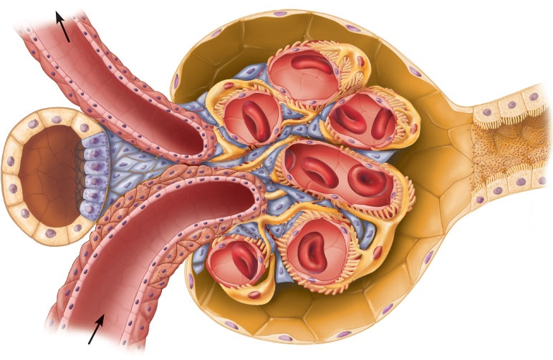
The nephron
Bowman’s capsule: Blind end of the tubule completely surrounds the glomerulus
Capsular
space
Proximal
tubule cell
Efferent
arteriole
The structural and functional units that form urine.
Glomerulus: A tuft of capillaries associated with a renal tubule
Renal corpuscle
Afferent arteriole
Renal corpuscle

Slide 13
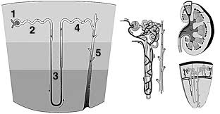
Structure of a Nephrone
1. Bowman’s capsule
2- PCT
3- Loop of Henle.
4- DCT
5- Collecting tubules & ducts.

Slide 14
Structure of a nephron, cont……
The renal tubule is divided into different sections with different structural and functional characteristics:
Proximal tubules ( in the cortex).
Loop of Henle.
Distal tubule (in the renal cortex).
Connecting tubule, cortical collecting, and the cortical collecting ducts, which run downward in the medulla and become:
Medullary collecting ducts.

Slide 15
RENAL BLOOD VESSELS
AFFERENT ARTERIOLE:
  DELIVERS BLOOD INTO THE GLOMERULI.
GLOMERULI:
  CAPILLARY NETWORK THAT PRODUCES FILTRATE THAT ENTERS THE URINARY TUBULES.
EFFERENT ARTERIOLE:
  DELIVERS BLOOD FROM GLOMERULI TO PERITUBULAR CAPILLARIES.
PERITUBULAR CAPILLARIES:
  VASA RECTA.

Slide 16
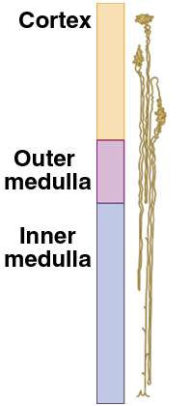
Structure of a nephron, cont…..
Types of nephrons:
1- Cortical nephrons: (85%):
Their glomeruli in the outer portion of cortex and have short loops of Henle.
. Peritubular capelaries
2-Juxtamedullary nephrons: (15%):
Have long loops extended into the medulla.
.Vasa recta
  Maintain salt gradient, helps conserve water

Slide 17
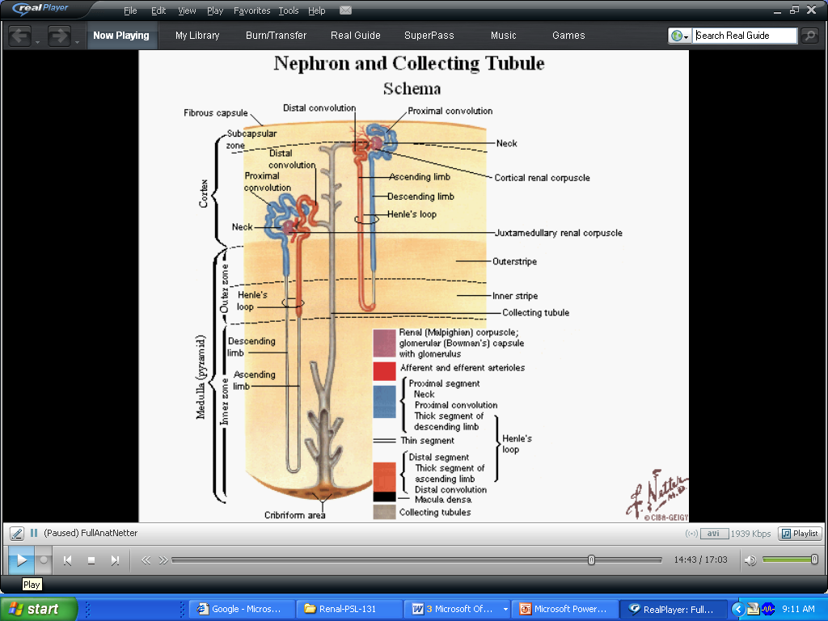
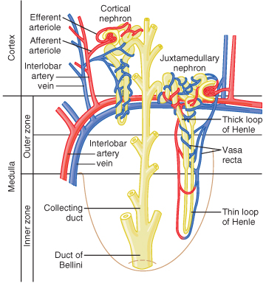
NEPHRON TYPES Cortical and Juxtamedullary Nephrons
  Originates in outer 2/3 of cortex.
1-2 % Blood
Flows
Through
Juxta Medullary
Nephrons
  Originates in inner 1/3 of cortex.

Slide 18
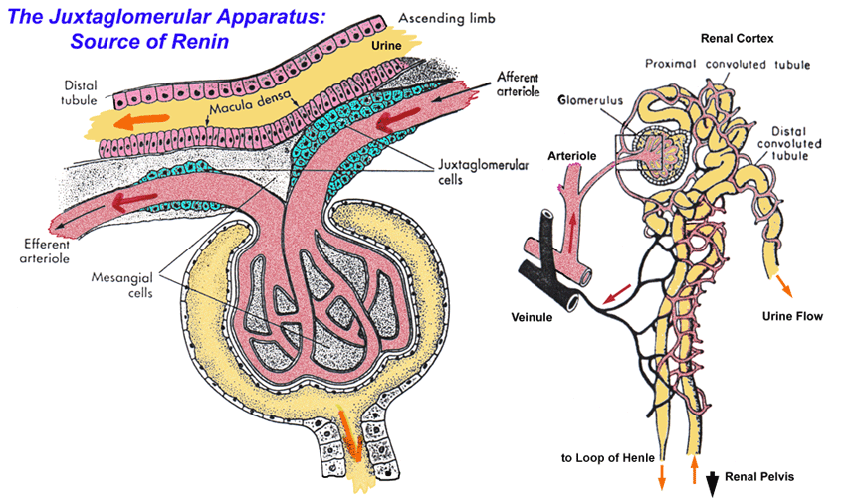
Renal blood flow:
Renal blood flow to the kidney represents 20% of cardiac output.
The blood flows to each kidney through a renal artery.
Features of renal circulation:
1- High blood flow rate (1200 ml/min).
2- Presence of two capillary beds: glomerular and peritubular.
Efferent and afferent arterioles are major sites of renal resistance.

Slide 19
Urine formation
The primary function of the kidney is to ‘clear’ unneeded substances from the blood to be excreted in urine.
Steps of urine formation (basic renal processes):
1- Glomerular filtration: Filtration of fluid from glomerular capillaries into the renal tubules.
2- Tubular reabsorption
3- Tubular secretion.
4- Excretion.
Urinary excretion rate = Filtration rate- reabsorption+secretion.

Slide 20
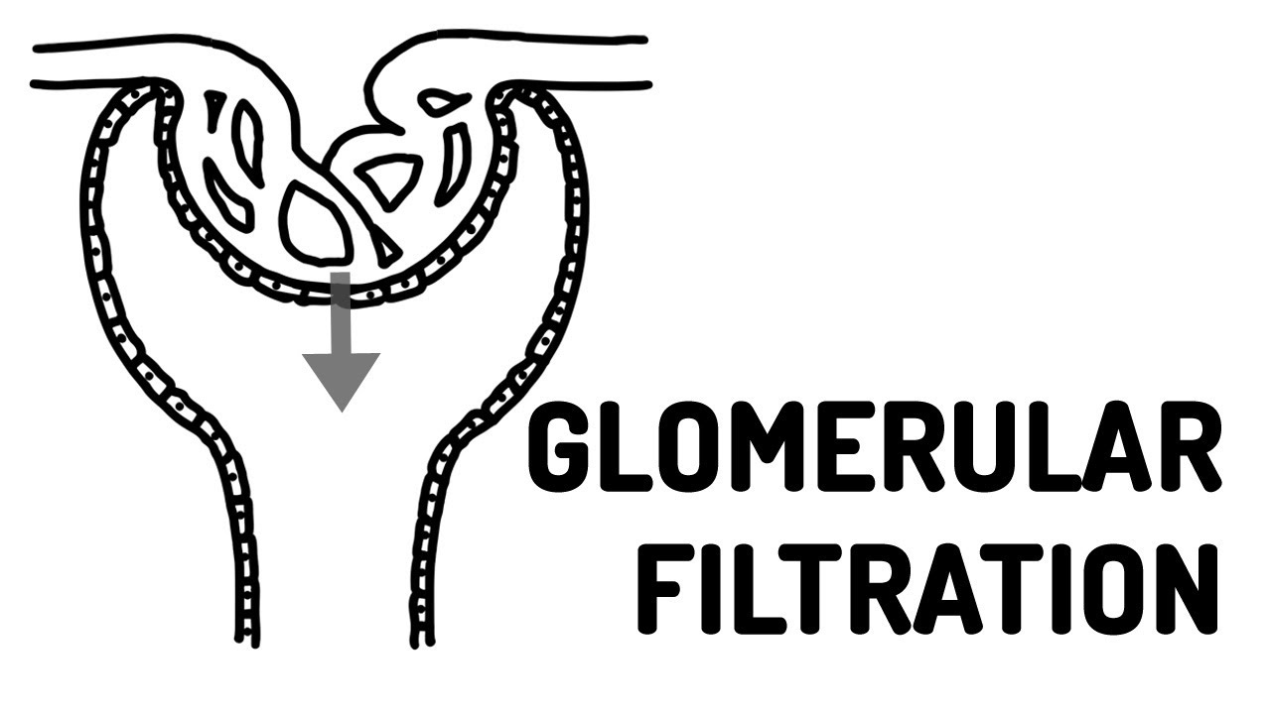
1st Step in Urine Formation

Slide 21
4 RENAL PROCESSES
1. Filtration
Filtration
Reabsorption
Secretion
Excretion
2. Reabsorption
3. Secretion
4. Excretion
Urinary Excretion Rate = Filtration Rate – Reabsorption Rate + Secretion Rate

Slide 22
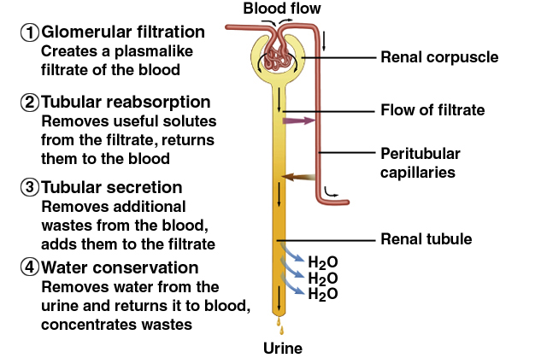
Urine Formation Preview

Slide 23
Glomerular filtration rate (GFR)
The first step in urine formation is glomerular filtration.
It is the filtration of fluid from the glomerular capillaries into the renal tubules.
It contains all substances present in plasma except proteins.
GFR is normally 125 ml/min = 20% renal plasma flow.

Slide 24
What is glomerular membrane?
What will filter? (composition of filtrate)
What determineGFR?
What are the forces responsible for passage of fluid (filtrate) through this membrane?
Regulation of GFR

Slide 25
Glomerular membrane
Blood in the glomerulus is separated from the fluid in the Bowman’s space by a filtration barrier (glomerular membrane) consisting of three layers:
1- Single layer of capillary endothelium.
2- Single epithelial lining of Bowman’s capsule (Podocytes) During filtration the fluid moves between their foot processes (psudopodia).
3- Basement membrane between endothelium and epithelium.

Slide 26
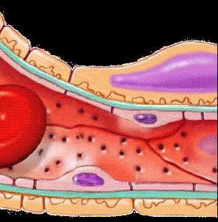
Glomerular membrane
Here we see a glomerular capillary in longitudinal section
Capillary
endothelium

Slide 27
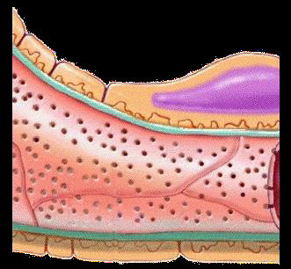
Glomerular membrane
Capillary
endothelium

Slide 28
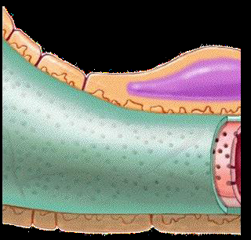
Glomerular membrane
Basement
membrane

Slide 29
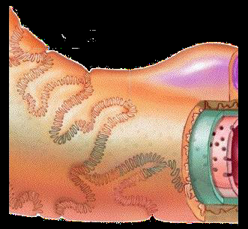
Glomerular membrane
Podocytes (cell body
with nucleus)
Filtration slits

Slide 30
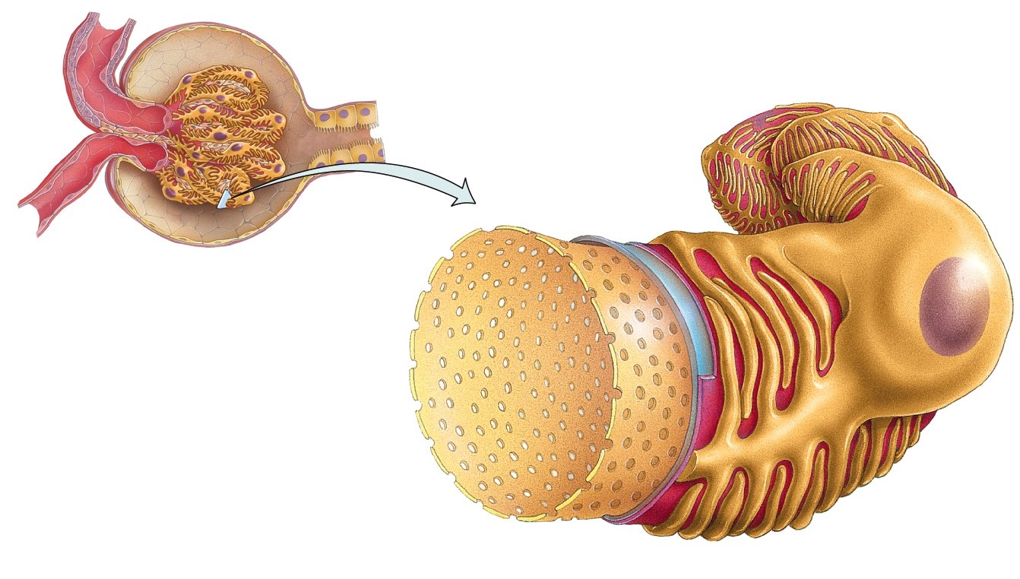
Filtration Membrane
Filter that lies between the blood and the interior of the glomerular capsule
Podocyte of visceral layer of glomerular (Bowman’s) capsule
Filtration slit
Pedicel
■ composed of 3 layers:
1
Fenestration (pore) of glomerular
endothelial cell: prevents filtration of blood cells but allows all components of blood plasma to pass through
2
Basal lamina of glomerulus:
prevents filtration of larger proteins
3
Slit membrane between pedicels:
prevents filtration of medium-sized proteins
30
Details of filtration membrane

Slide 31
FILTRATION MEMBRANE
2. Basement Membrane
Filtration
1. Endothelium
Endothelium of
Glomerular Capillaries
3. Podocyte

Slide 32
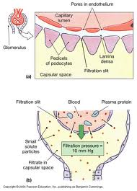
Glomerular membrane

Slide 33
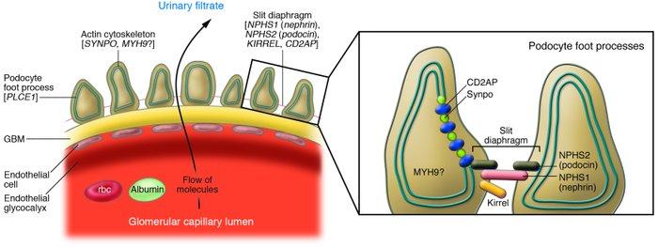
Glomerular membrane

Slide 34
Characteristics of glomerular membrane:
Allow passage of molecules up to 70,000 D
Albumin does not normally pass as they are repelled by the negative charge of the
glycoproteins material of basement membrane.
Blood cells don not normally pass through the membrane.

Slide 35
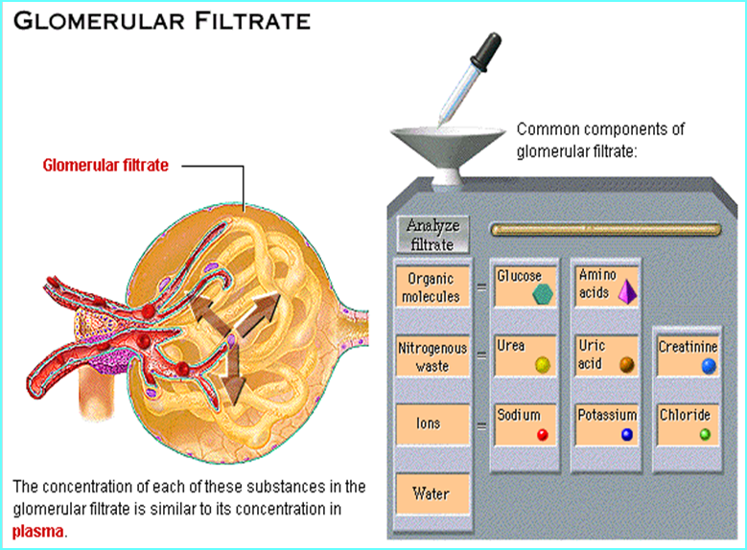

Slide 36
Glomerular Filtration Rate (GFR)
The GFR is determined by:
1- the net filtration pressure across the glomerular capillaries.
2- the glomerular capillary filtration coefficient (Kf)
GFR = Kf x Net filtration pressure.
= 12.5 X 10 = 125 ml/min

Slide 37
Glomerular Filtration Rate (GFR)
Filtrate formed per minute
Filtration coefficient (K_{f}) depends on permeability and surface area of filtration barrier
GFR = NFP x K_{f} ≈ 125 ml/min or 180 L/day
GFR = 10 X 12.5 = 125 ml/min
99% of filtrate reabsorbed, 1 to 2 L urine excreted

Slide 38
Forces controlling GFR: Starling’s forces
The net filtration pressure is the sum of:
1. glomerular hydrostatic pressure (= 60 mmHg). It promotes filtration.
2. hydrostatic pressure in Bowman’s capsule (= 18 mmHg). It opposes filtration.
3. colloid osmotic pressure of glomerular plasma proteins (= 32 mmHg). It opposes filtration.
So, net filtration pressure = 60-18-32= 10 mmHg.

Slide 39
Glomerular Filtration Rate (GFR)
What controls (determines) the GFR?
Factors related to the membrane itself
The sum of the forces acting across the membrane (starling forces)
Permeability
Filtering surface area
Net filtration pressure
(NFP)
GFR = 125 ml/min
OR 180 L/day
Capillary filtration coefficient (Kf)
GFR = Kf X NFP

Slide 40
Cont. determinants of GFR- Starling Forces
Starling Forces
Forces that control movement of fluid in/out of a capillary
Hydrostatic pressure (P)
Colloid osmotic (oncotic) pressure ()
The pressure exerted by blood (water) on the walls of the blood vessel
The osmotic pressure created by the non-diffusible plasma proteins inside the blood vessel
Moves fluid OUTSIDE
Pulls fluid INSIDE

Slide 41
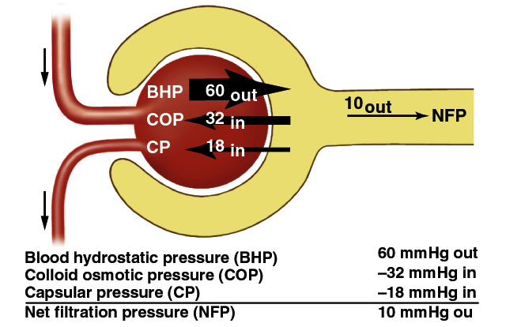
Net Filtration Pressure (NFP)

Slide 42
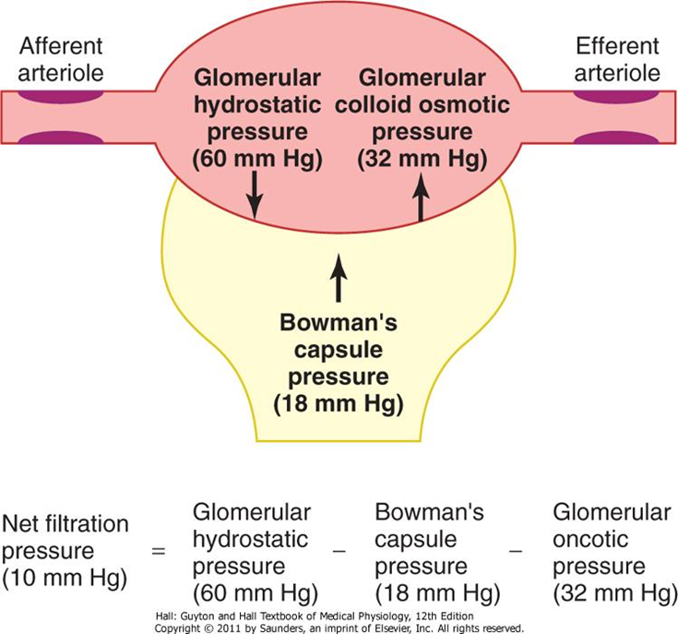
Why is the glomerular hydrostatic pressure higher than the hydrostatic pressure seen in systemic capillary beds?

Slide 43
CONTROL OF GFR
GFR = Kf x [(PG-PB)-(πG- πB)]
GFR = Kf x [(60-18)-(32- 0)]
Hydrostatic pressure inside the glomerular capillaries (glomerular hydrostatic pressure, PG), which promotes filtration
The hydrostatic pressure in bowman's capsule (PB) outside the capillaries, which opposes filtration
The colloid osmotic pressure of the glomerular capillary plasma proteins (πg), which opposes filtration
The colloid osmotic pressure of the proteins in bowman's capsule (πb), which promotes filtration

Slide 44
Regulation of GFR

Slide 45
Regulation of GFR
GFR = Kf X (PG - G - PB + B)
Any factor that affect the parameters in the equation will affect the GFR.
However, physiologic regulation of the GFR involves mechanisms that affect mainly the PG.
PG depends on:
Arterial BP
Afferent arteriolar resistance.
Efferent arteriolar resistance.
Kf
G
PB
Can get affected in disease conditions causing changes in GFR

Slide 46
How changes in Forces determining GFR affect GFR?
Increased Bowman’s capsule pressure decreases GFR. It can happen in urinary obstruction e.g. stones , tumors..
Increased glomerular capillary colloid osmotic pressure decreases GFR.
Increased glomerular capillary hydrostatic pressure increases GFR. This pressure is affected by:
ABP.
Afferent arteriolar resistance.
Efferent arteriolar resistance

Slide 47
Physiologic Regulation of GFR
Constriction of Afferent arteriole
Constriction of Efferent arteriole
↓↓ PG
Moderate
Severe
↓↓ GFR
↑↑ PG
↓↓ PG
Sympathetic stimulation
Epinephrine
Norepinephrine
Endothelin
↑↑ GFR
↓↓ GFR
Angiotensin II

Slide 48
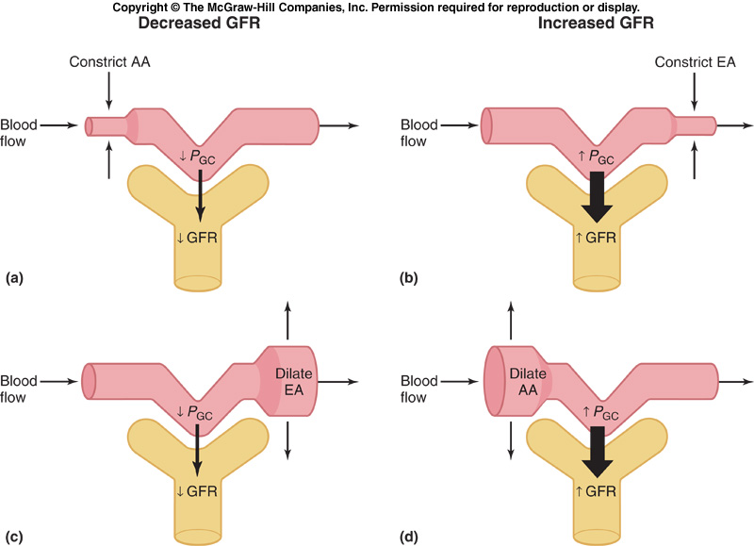
As vasodilation and vasoconstriction of the afferent and
efferent arterioles alter the blood flow through the
glomerular capillaries, there are corresponding alterations
in the glomerular filtration rate (GFR).

Slide 49
Factors affecting Renal blood flow and GFR
Sympathetic stimulation of renal arterioles decrease GFR & RBF.
Norepinephrine decreases GFR & RBF.
Angiotensin II decreases RBF. It constricts efferent arteriole more than afferent .
High protein diet increases GFR.
Hyperglycemia increases GFR & RBF.
Fever increases GFR & RBF.
Aging decreases RBF & GFR

Slide 50
JGA
Juxtaglomerular Apparatus
Mesangial cells
-contractile properties
-capillary filtration
Granular Cells
-smooth muscles
-secrete Renin
-mechanoreceptors
Efferent
arteriole
Macula densa cells
Proximal
tubule cell
Mesangial cells
Granular cells
Mesangial cells
Macula Densa
-tubular cells
-chemoreceptors (Na+, K+ and Cl-)
Afferent arteriole
50
Notes:
Juxtaglomerular apparatus is where the distal tubule lies against the afferent (sometimes efferent) arteriole
Arteriole walls have juxtaglomerular (JG) cells
- Enlarged, smooth muscle cells
- Have secretory granules containing renin
- Act as mechanoreceptors
Macula densa
- tall, closely packed distal tubule cells
- lie adjacent to JG cells
- function as chemoreceptors or osmoreceptors
- sensitive to the ionic content and water volume of the fluid in the tubule
produce molecular signals that promote renin secretion by JG cells
Mesangial cells
- have phagocytic and contractile properties
- influence capillary filtration
- provide structural support and regulate blood flow of the glomerular capillaries by their contractile activity

