Slide 1
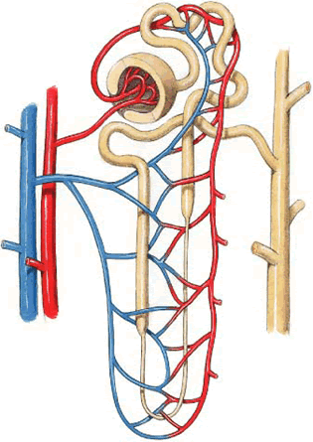
Micturition
Dr. Maha Saja
MBBS, MSc Physiology, PhD
Msaja@ksu.edu.sa
Office 89, level 2

Slide 2
Objectives
At the end of this session, students should be able to:
Identify and describe the functional anatomy of the urinary bladder.
Describe the mechanism of filling and emptying of the urinary bladder.
Cystometrogram.
Explain the neurogenic control of the micturition reflex and its disorders.

Slide 3
Introduction
What is meant by micturition?
Micturition = the process by which the bladder empties itself when it becomes filled.
Functions of the lower urinary tract (LUT) (Bladder + urethra)
Storage of urine
(without leak)
Emptying
(voiding)
Abnormalities in bladder function may lead to
Incontinence
Obstruction

Slide 4
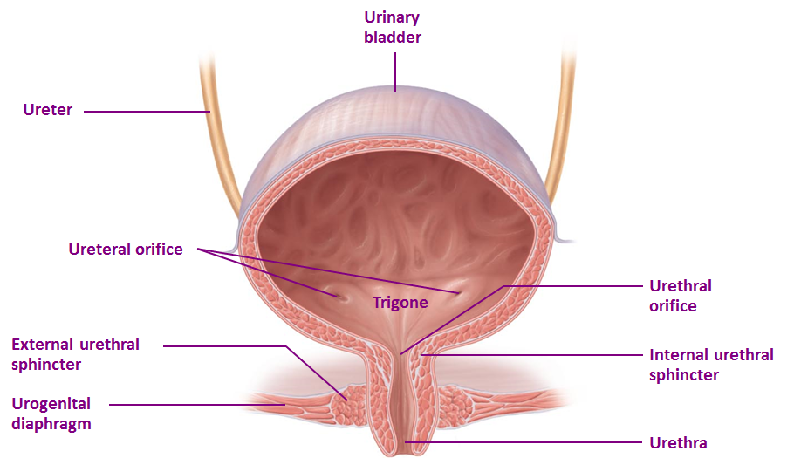
Functional Anatomy of the Bladder
Bladder has two parts: body & neck.
What is the trigone?
How many sphincters are there and how are they different?

Slide 5
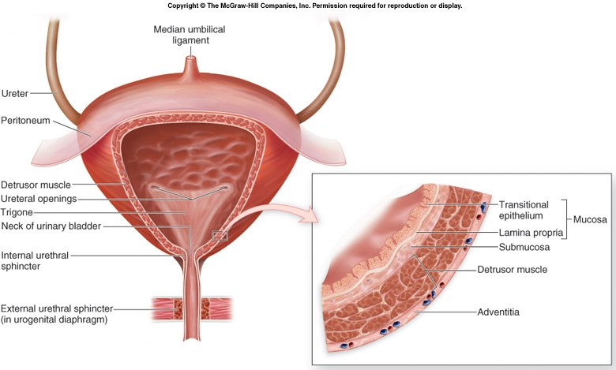
Functional Anatomy of the Bladder
Bladder wall has 4 layers;
  Mucosa → transitional epithelium → has folds “rugae”.
  Submucosa → loose connective tissue.
  Smooth muscle layer → Detrusor muscle → the main muscle of micturition.
  Serosa

Slide 6
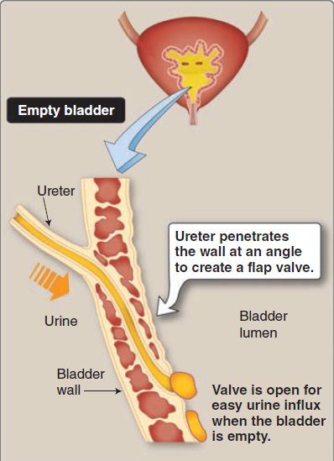
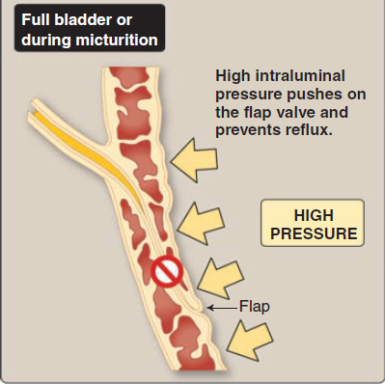
Ureterovesical Junction
(Preston R., Wilson T. Lippincott’s illustrated reviews Physiology. 2013)

Slide 7
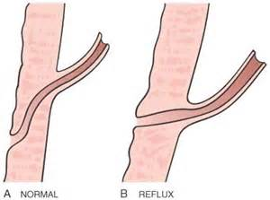
Ureterovesical Junction
What happens if the distance that the ureter courses through the bladder wall is short?

Slide 8
Urine Transport from Kidney to Bladder
Urine is transported through the ureters.
Urine is propelled through the ureter and into the bladder by the help of peristalsis.
Peristalsis is thought to be initiated by pacemaker cells in the renal pelvis.
Sympathetic stimulation → inhibits peristalsis.
Parasympathetic stimulation → enhance peristalsis.

Slide 9
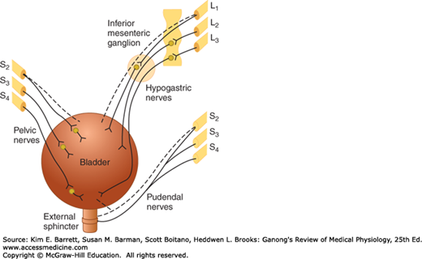
Neural Innervation of the bladder
Nerve supply of the LUT:
Somatic (S2-S4).
Autonomic
  Parasympathetic (S2-S4).
  Sympathetic (T11-L2).

Slide 10
Neural Innervation of the bladder
Neural innervation of the LUT
Autonomic nerves
Parasympathetic
(Pelvic n.)
Sympathetic
(Hypogastric n.)
Somatic nerves
Pudendal nerve
Afferent n.
Efferent n.
Afferent n.
Efferent n.
Afferent n.
Efferent n.
Enter at S2-S4
Sensory info about degree of stretch or pain in bladder
Leave at S2-S4
Motor to detrusor (contraction) and internal sphincter (relaxation)
Enter at T11-L2
Sensory info about degree of stretch or pain in bladder
Leave at T11-L2
Motor to detrusor (relaxation) and internal sphincter (contraction)
Enter at S2-S4
Sensory info from ext. sphincter
Leave at S2-S4
Motor to external sphincter (contraction)

Slide 11
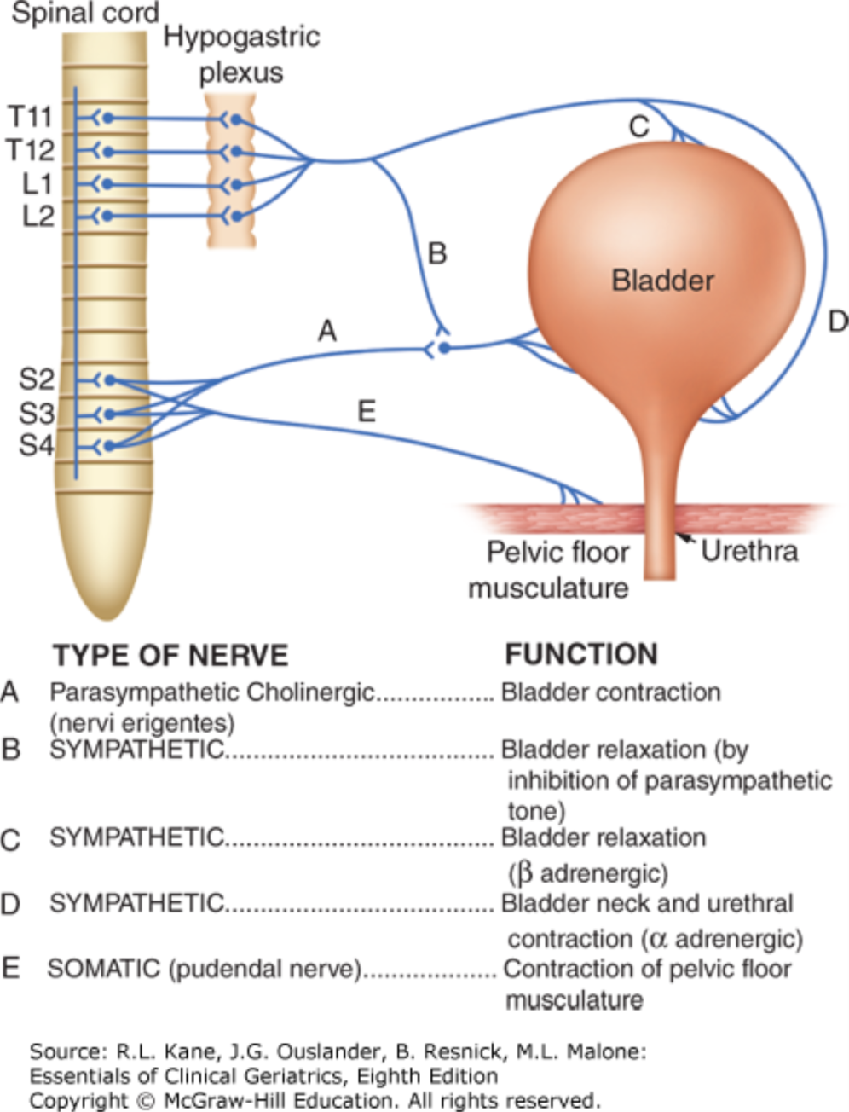
Peripheral nerves involved in micturition.
Source: Incontinence, Essentials of Clinical Geriatrics, 8e
Citation: Kane RL, Ouslander JG, Resnick B, Malone ML. Essentials of Clinical Geriatrics, 8e; 2017 Available at: https://accessmedicine.mhmedical.com/ViewLarge.aspx?figid=178119724 Accessed: April 09, 2018
Copyright © 2018 McGraw-Hill Education. All rights reserved

Slide 12
The Micturition Reflex
Emptying of the bladder when it becomes filled.
It is a nervous reflex that can be facilitated or inhibited by higher centres.
Occurs in two steps:
  Progressive filling of the bladder until a threshold is reached.
  At the threshold, a nervous reflex is initiated “micturition reflex” to empty the bladder.
If the conditions for emptying are favourable → emptying will occur.
If the conditions for emptying are unfavourable → reflex is inhibited, however, there is the conscious desire to urinate.

Slide 13
Filling of the Bladder-Bladder Tone
Bladder tone = the relationship between bladder volume and pressure (intravesical pr.).
The relationship between bladder volume and intravesical pressure can be studied using cystometry.
The volume-pressure record is called a cystometrogram.

Slide 14
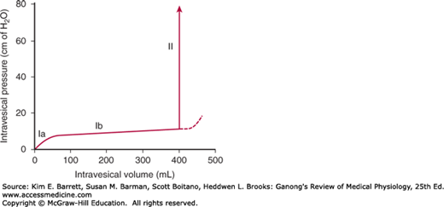
The Cystometrogram
Three phases:
Ia = an increase in IVP (0 to ≈10 cm H2O) at an initial increase in volume from 0 to ≈50ml).
Ib = filling of bladder from 50 to ≈400ml of urine causes no significant increase in IVP. Why??
II = volumes > 400ml will cause a steep increase in IVP triggering the micturition reflex.

Slide 15
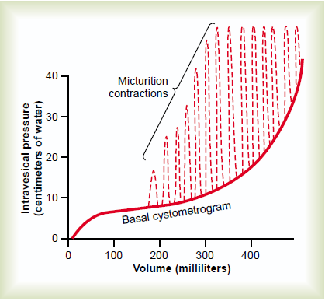
The Cystometrogram
Superimposed on the basal cytometrogram are periodic sharp increases in IVP that may last a few seconds to more than a minute.
These peaks are called “micturition waves”.. What are they caused by?

Slide 16
Bladder Sensations at Different Urine Volumes
Urine volume of ≈ 150 –300 ml ⇒ first urge to void.
From ≈ 300 –400 ml ⇒ sense of bladder fullness.
From ≈ 400 –600 ml ⇒ sense of discomfort.
From ≈ 600 –700 ml ⇒ sense of pain.
Micturition reflexes start to appear at the first stage and progressively increase in intensity as the volume increases. Micturition reflexes can be voluntarily suppressed.
At ≈ 700 ml ⇒ break point ⇒ micturition can not be suppressed.

Slide 17
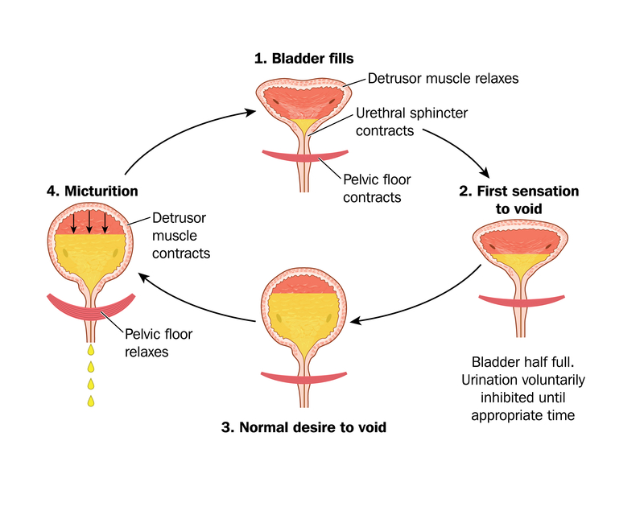

Slide 18
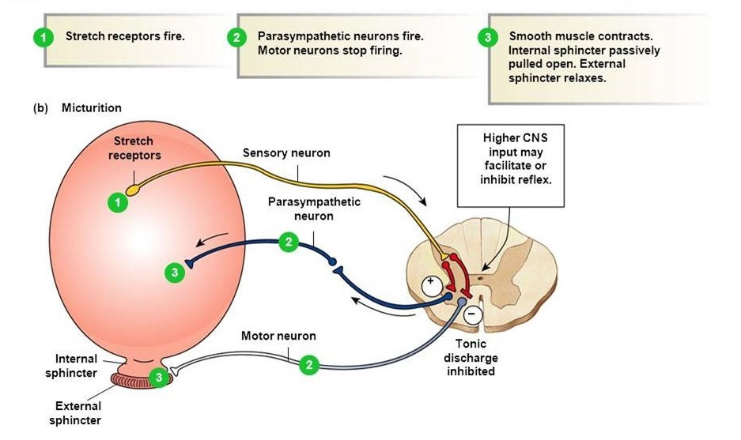
The Micturition Reflex-infants
An autonomic spinal reflex.
Involuntary-Not yet under higher CNS control.
Between 2-3 years of age-they learn to control it and becomes voluntary.

Slide 19
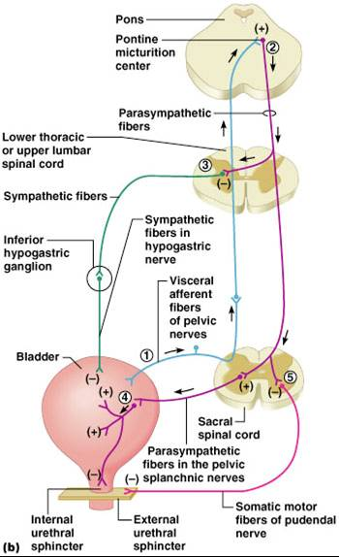
The Micturition Reflex-Adults
An autonomic spinal reflex.
Is controlled by higher CNS centres;
  Brain stem (Pons).
  Cerebral cortex.
Control is either inhibitory or facilitatory.
Voluntary.

Slide 20
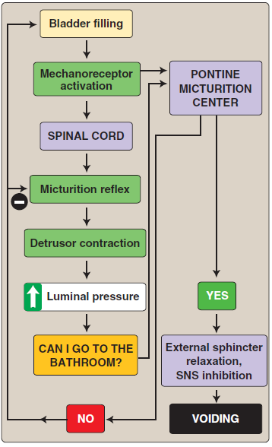
The Micturition Reflex

Slide 21
Abnormalities in Micturition
Lesions affecting the afferent sensory nerves:
Results in an atonic (flaccid) bladder.
Injury of afferent nerves → loss of perception of bladder fullness + micturition reflex cannot be initiated → bladder overstretching → thinning of the wall and ineffective contractions.
Retention of urine with overflow.
Causes e.g. tabes dorsalis (syphilis),

Slide 22
Abnormalities in Micturition
Damage to spinal cord above the sacral region:
The micturition reflex is intact, but lost higher center control.
There are several phases:
Acute phase
(Spinal shock)
Recovery from spinal shock
Loss of facilitatory impulses from CNS
↓
Micturition reflex is inhibited
↓
Bladder fills but cannot void
(overflow incontinence)
Micturition reflex recovers
↓
Not controlled by CNS
↓
Bladder fills and voids automatically
(Automatic bladder)

Slide 23
Abnormalities in Micturition
Uninhibited neurogenic bladder:
Causes frequent relatively uncontrolled micturition.
Results from lesions to spinal cord or brain stem that mainly affects the inhibitory signals to spinal cord.
This will cause a hyperactive detrusor muscle that will result in activation of micturition even at small urine volumes.
Frequent urination of small volume of urine.

Slide 24
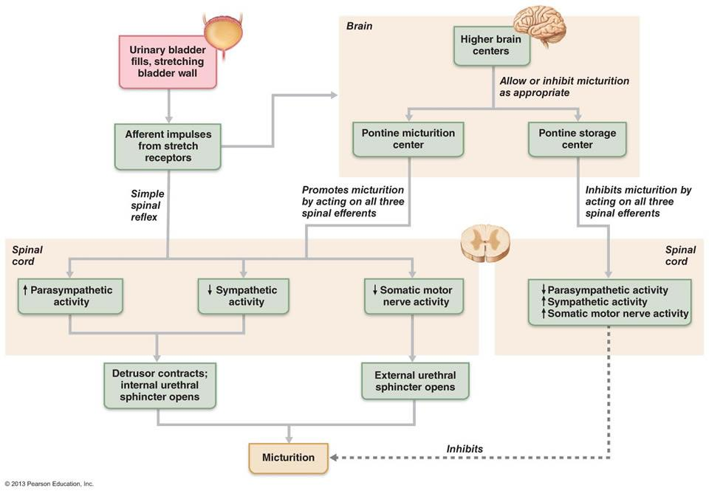
Summary

Slide 25
Thank you

