Slide 1
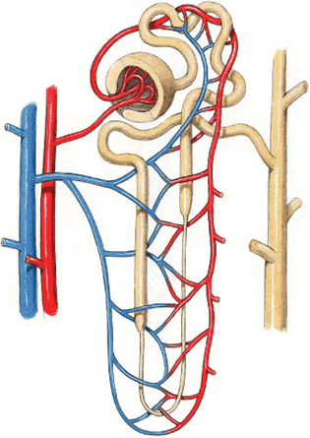
Tubular processing of filtrate
Dr. Maha Saja
MBBS, MSc Physiology, PhD
Msaja@ksu.edu.sa

Slide 2
Contents
The mechanisms of tubular transport through the different parts of the nephron.
Tubular reabsorption and tubular secretion.
Regulation of tubular processing.

Slide 3
Objectives
Define tubular reabsorption and secretion.
Identify the role of each tubular segment in glomerular filtrate modification and the types of substances being transported through each.
Describe the hormonal/physiological factors regulating tubular function at each segment.
Describe tubular reabsorption of sodium and water.
Identify and describe mechanism involved in glucose reabsorption.
Identify the tubular site and describe how amino acids and urea are reabsorbed.
Identify and describe the characteristics of the loop of Henle, distal convoluted tubule and collecting ducts for reabsorption and secretion
Describe the role of ADH in the reabsorption of water.
Identify the site and describe the influence of aldosterone on reabsorption of Na+.
List and explain the factors that control aldosterone and ADH release
Identify and describe the juxtamedullary apparatus and its role in checking the filtrate.

Slide 4
Tubular Processing of Ultrafiltrate
After glomerular filtration the ultrafiltrate gets modified as it passes through the tubules before it is finally excreted.
Tubular processing includes:
Tubular reabsorption = reabsorption of substances from the glomerular filtrate into peritubular capillary blood.
Tubular secretion = secretion of substances from peritubular capillary blood into tubular fluid
What is the importance of tubular processing?

Slide 5
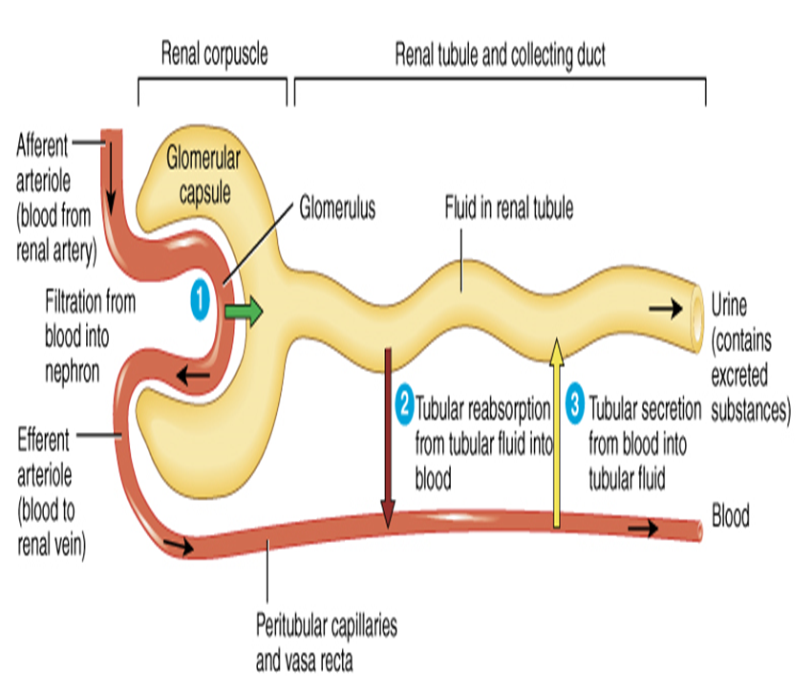
Tubular Reabsorption
Glomerular filtration and tubular reabsorption are quantitatively very large relative to the amount excreted!
Glomerular filtration is non-selective whereas tubular reabsorption is highly selective.
1.5 L/day
180L/day
178.5 L/day

Slide 6
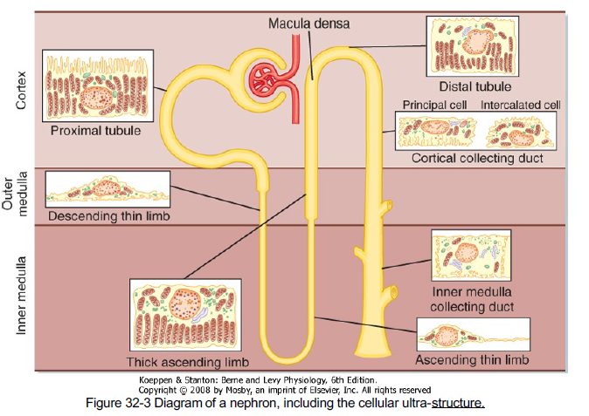
Differences in Renal Tubular Cells Reflect Their Function in Tubular Processing

Slide 7
Tubular reabsorption

Slide 8
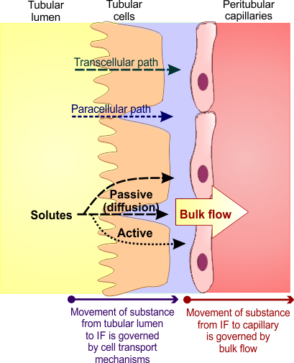
How does the nephron reabsorb substances
Reabsorption is a 2 step process:
Transport of substances from tubular lumen to IF.
Transport from IF to blood.
From tubular lumen to IF;
Transport involves active & passive mechanisms.
Occur through paracellular and/or transcellular routes.
From IF to blood:
By ultrafiltration (bulk flow).

Slide 9
Transport Mechanisms Across the Tubule
Active Transport
Passive Transport
Requires energy.
Moves substances against their electrochemical gradient.
Does not need energy.
Moves substances down their electrochemical gradient.
Primary active
Secondary active
Passive diffusion
Osmosis
Directly coupled to energy source.
e.g. Na+-K+ ATPase.
Indirectly coupled to energy source.
Carrier protein.
e.g. Glucose & a.a.
Water
Solutes like Cl-
Urea

Slide 10
Tubular reabsorption in each part of the nephron

Slide 11
Proximal Convoluted Tubule
Most of the reabsorption occurs in the PCT.. Why?
Highly metabolic cells.
Extensive brush border.
Lots of mitochondria.
Glucose
Amino acids
Water
Na
100%
65%
Bile salts
Urate
Catecholamines
Drugs
Toxins
PAH

Slide 12
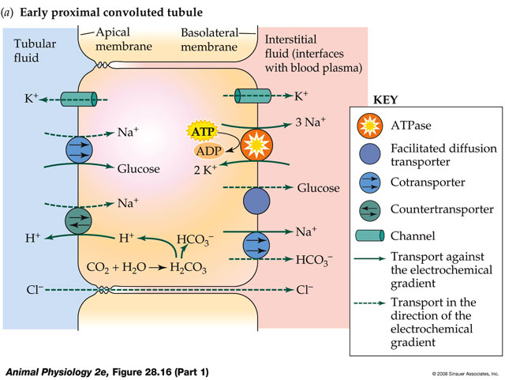
Sodium Reabsorption
Basolateral Na⁺-K⁺
ATPase pumps 3Na⁺ out and 2K⁺
into the cell
Results in low [Na⁺]i
This gradient favours Na⁺ entry across the apical membrane via transporter proteins

Slide 13
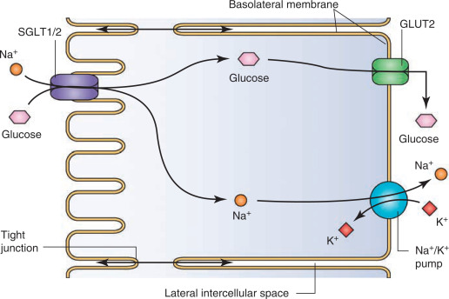
Glucose Reabsorption

Slide 14
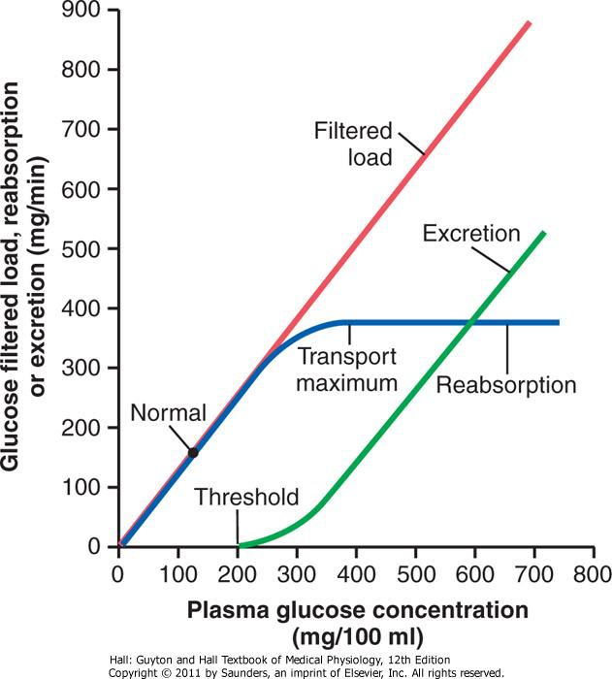
Transport Maximum for Glucose
What is meant by transport maximum?
Why does it occur?
What happens if blood glucose level increased to 400mg/dl?

Slide 15
Sodium Reabsorption
Early part of PCT
Late part of PCT
Mainly coupled to;
Glucose.
Amino acids.
Lactate.
Phosphate
Hydrogen
Mainly coupled to Cl⁻
Why??
Symporters
Antiporter

Slide 16
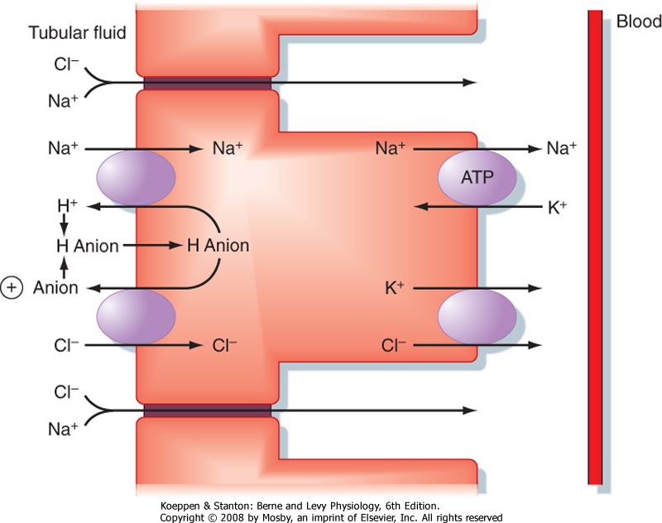
Sodium Chloride Reabsorption in the 2nd half of the PCT
e.g.
Formate
Oxalate
Sulfate

Slide 17
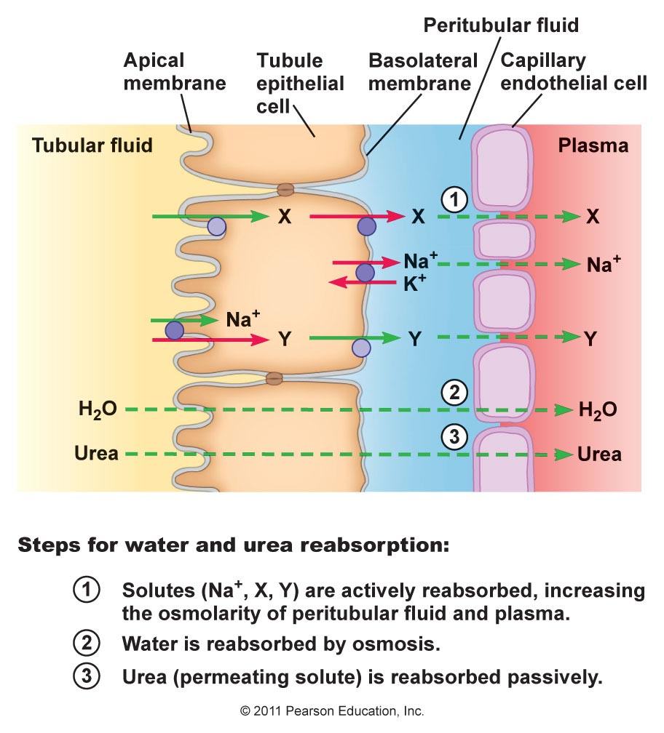
Water Reabsorption in the PCT

Slide 18
Organic Anion/Cation Secretion
Organic Anions
Organic cations
Endogenous:
Bile salts.
Oxalate.
Urate.
Vitamins (ascorbate, folate).
Exogenous:
Acetazolamide.
Furosemide.
Salicylates.
Penicillin.
Endogenous;
Creatinine.
Dopamine.
Epinephrine.
Norepinephrine.
Exogenous;
Atropine.
Morphine.
Amiloride.
Procainamide.

Slide 19
Summary of PCT Transport Mechanisms

Slide 20
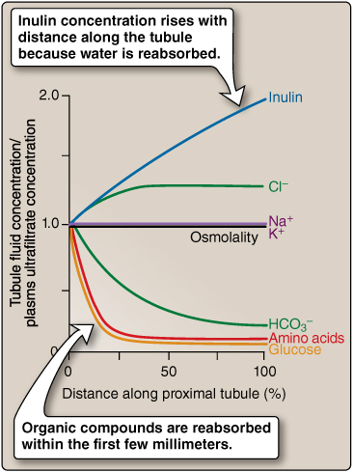
Summary of PCT Filtrate Modification

Slide 21
Loop of henle

Slide 22
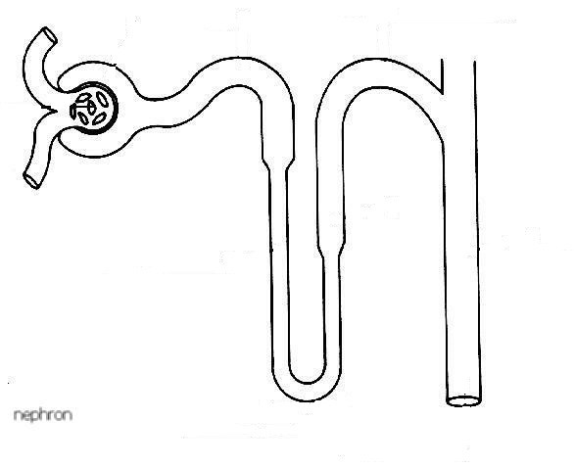
Loop of Henle
Descending limb
Ascending limb
25% of Na+, Cl-, K+ load is reabsorbed
H+
Na+
Cl-
K+
Ca++
Mg++
Active transport
1-Na+, 2-Cl-, 1-K+ co-transporter
Thick
Diffusion
20%
Thin descending
H2O
Thin
H2O
Highly permeable to water
Moderate permeability to solutes
Impermeable to water
Reabsorption of solutes in the thick segment

Slide 23
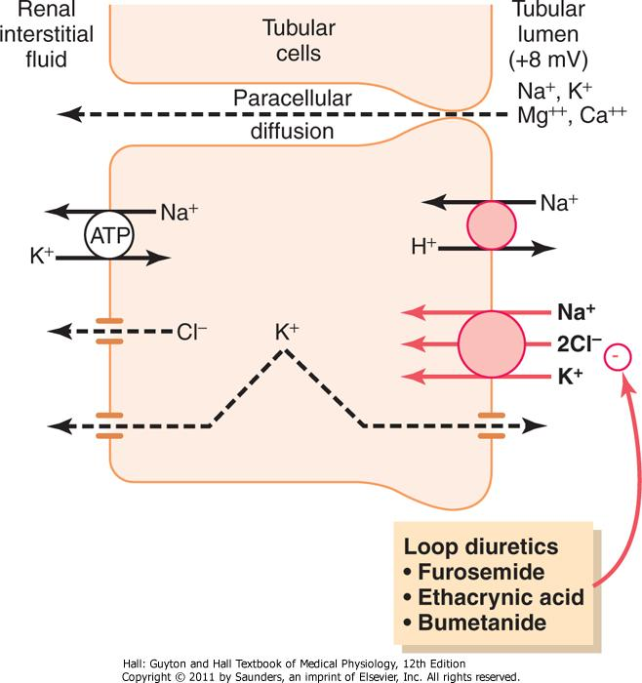
Loop of Henle
Mechanism of transport in the thick ascending loop of Henle

Slide 24
Distal Convoluted Tubule
Resembles the thick ascending loop of Henle
Known as the diluting segment
Reabsorbs 5% of NaCl
Early part
Late part
Resembles the cortical collecting tubule
Impermeable to urea
Principal cells
Intercalated cells
Type A
Reabsorb Na+ & H2O
Secrete K+
Reabsorb K+
Secrete H+
Controlled by Aldosterone
Acid-base regulation
Permeability to H2O depends on ADH

Slide 25
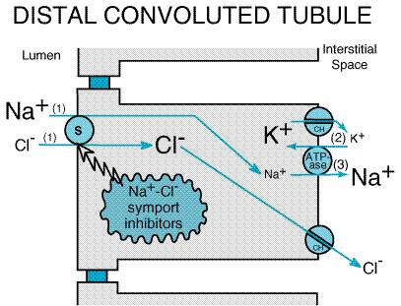
Early Distal Tubule
Thiazide diuretics

Slide 26
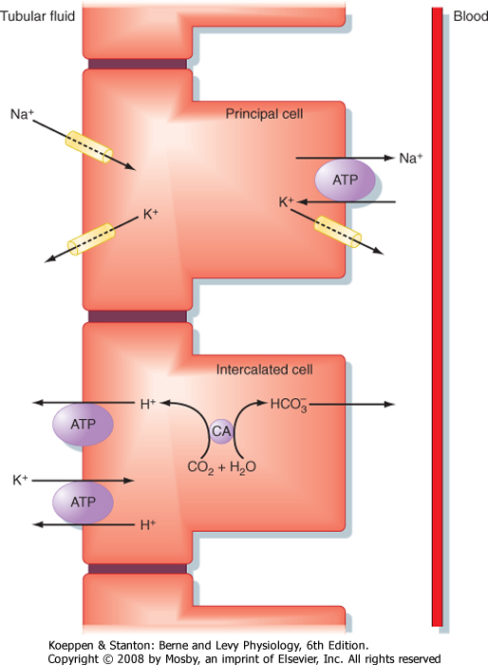
Late Distal Tubule & Collecting Tubule
Aldosterone
Aldosterone antagonists
e.g. Spironolactone
Na+ channel blockers
Potassium-sparing diuretics

Slide 27
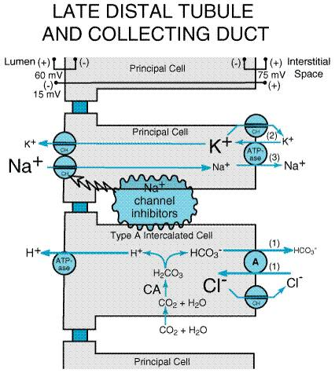

Slide 28
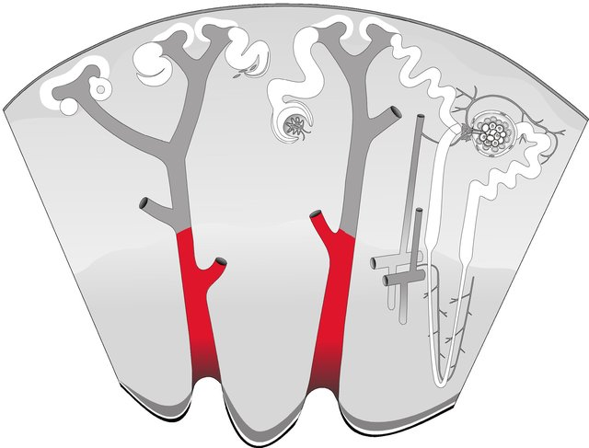
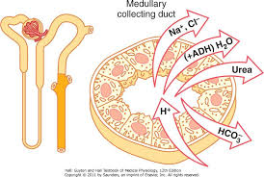
Medullary Collecting Duct

Slide 29
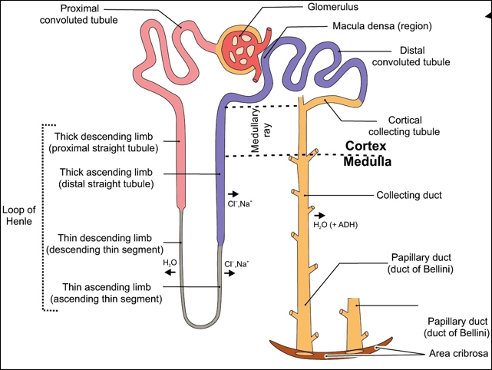
Medullary Collecting Ducts
Permeability to water is under ADH control
Permeable to urea
Secrete H+

Slide 30
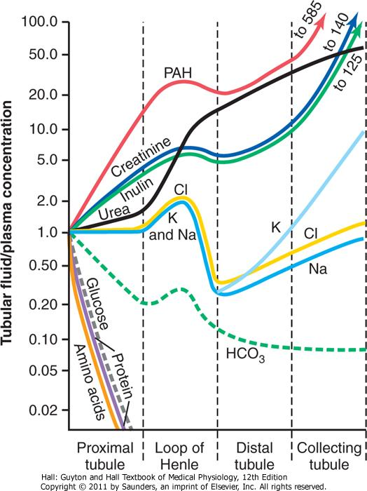
Summary of the Concentrations of the different Solutes in the Different Tubular Segments

Slide 31
Regulation of Tubular Reabsorption
Regulation of tubular reabsorption depends on:
Physical forces that govern reabsorption.
Hormonal and neural mechanisms.
Tubules can increase their reabsorption in response to increased tubular load → glomerulotubular balance.
What are the physical forces that govern tubular reabsorption?

Slide 32
Physical Forces that Govern Tubular Reabsorption
Tubular lumen
Aff- & Efferent art. resistance
Filtrate
ABP
Pc
13 mmHg
Influenced by
Pif
6 mmHg
Net reabsorptive force
10 mmHg
πc
32 mmHg
Influenced by
πif
15 mmHg
FF
Systemic plasma colloid osmotic pr
Interstitial fluid
(IF)
Tubular cells
Peritubular capillary

Slide 33
Pressure Natriuresis & Pressure Diuresis
= increasing urinary excretion of Na+ & H2O in response to increases in ABP.
Autoregulation should limit this! What happens if autoregulation is impaired?
↑↑ GFR
↑↑ ABP
↓↓ Tubular
reabsorption
↑↑ Tubular capillary pressure
↓↓ Angiotensin II

Slide 34
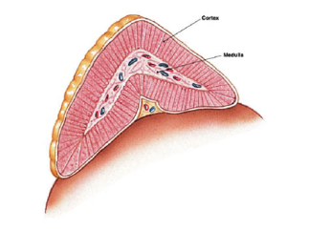
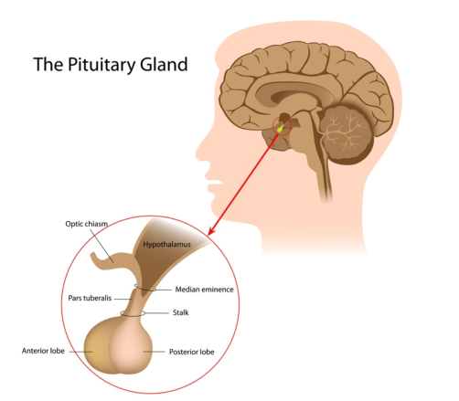
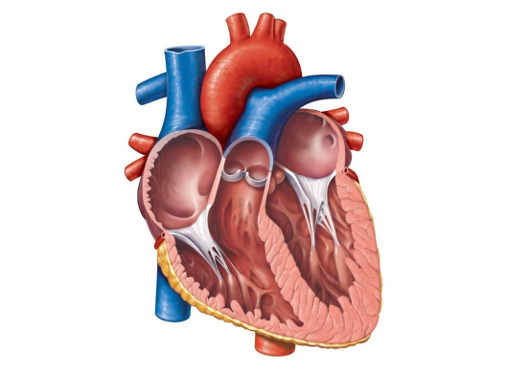
Hormonal Regulation of Tubular Reabsorption
Adrenal gland
↓↓ ABP
↓↓ Blood volume
↓↓ NaCl
Renin
Angiotensin II
Efferent constriction
Na+
Aldosterone
P cells
Na+
K+
Na+ &
H2O
ADH
ANP
H2O
↑↑ Blood volume

Slide 35
Regulation of potassium

Slide 36
Body Potassium Balance
Input:
Dietary intake = 80-120 mmol/day.
The ECF K⁺ content ≈ 70 mmol.
Output:
GI loss ≈ 5-10%
Renal excretion ≈ 90-95%.
Internal balance (within the body) is regulated by modifying the distribution of K⁺ between the ICF & ECF.
Control External balance
Between body and environment

Slide 37
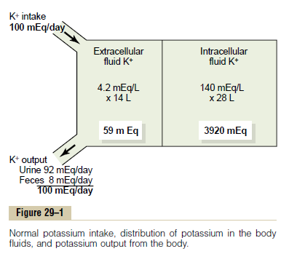
Body Potassium Balance
(Guyton & Hall. Medical Physiology)

Slide 38
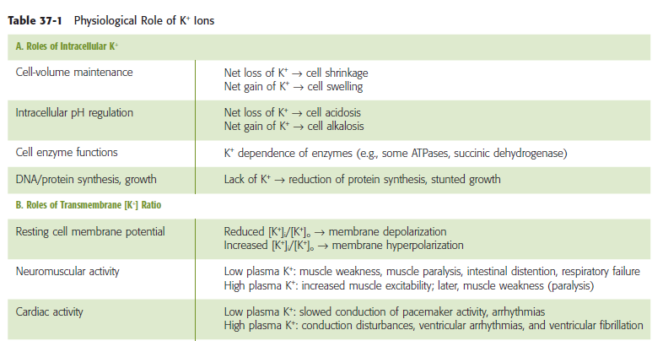
The Importance of Regulating K⁺
(Boron & Boulpaep. Medical Physiology)

Slide 39
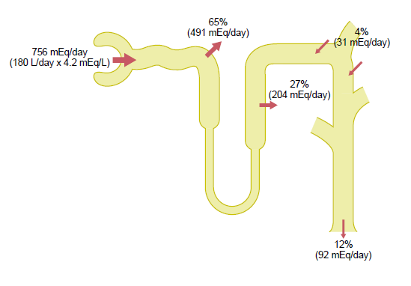
Renal Potassium Handling
≈ 90% of K⁺ is reabsorbed in the PCT & TAL.
≈ 10% enters the distal portions of the nephron.
If K⁺ intake is low only 1-3% of filtered K⁺ will be excreted.
If K⁺ intake is normal/high, 10-15% of filtered K⁺ will be excreted

Slide 40
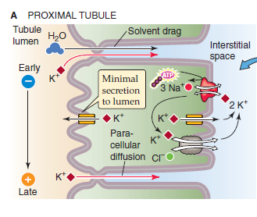
Potassium Handling by the kidney
It is the sum of filtration – reabsorption + secretion
In the PCT → K⁺ reabsorption is a passive process.. How?
Water reabsorption through the paracellular route drags K⁺ with it (solvent drag).

Slide 41
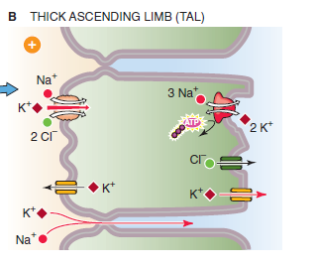
Potassium Handling by the TAL
By secondary active transport using the apical triple transporter (NKCC2).

Slide 42
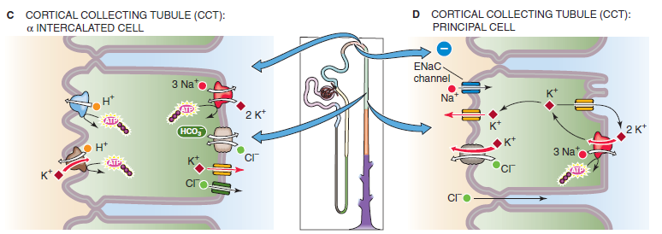
Potassium Handling by the CT
Alpha-Intercalated cells
Principal cells
Secrete H⁺ and reabsorb K⁺
Reabsorb Na⁺ and water & secrete K⁺

Slide 43
Factors affecting Potassium
Aldosterone.
Insulin
Epinephrine
ECF pH
Luminal flow (diuresis).

Slide 44
Thank you

