Slide 1
Regulation of extracellular fluid volume
Dr. Maha Saja
Physiology department,
Level 2,
Office 89,
Email: msaja@ksu.edu.sa

Slide 2
Objectives
Identify and describe the role of the sensors and effectors in the renal regulation of body fluid volume.
Describe the role of the kidney in regulation of body fluid volume.
Identify the site and describe the influence of aldosterone on reabsorption of Na⁺ in the late distal tubules.

Slide 3
Introduction
Maintaining normal ECF volume and osmolarity is crucial for the well-being of human beings.
Normal ECF volume is important for maintenance of normal ABP which ensures adequate tissue perfusion.
Normal ECF osmolarity is crucial for maintenance of normal cell volume & function.
Two separate yet interrelated control systems regulate ECF volume & osmolarity.
ECF volume is regulated through adjusting body NaCl content.
ECF osmolarity is regulated through adjusting body water content.

Slide 4
Today we will focus on ECF volume regulation
Let’s revise a few concepts!

Slide 5
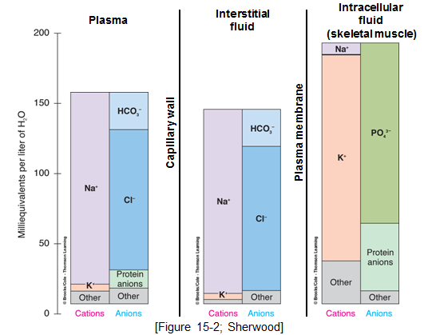
Electrolyte Composition of Body Fluids

Slide 6
ECF Volume
The most abundant cation in ECF is Na⁺
The most abundant anions in ECF are Cl⁻ and HCO3⁻
The body regulates ECF volume by monitoring and adjusting total body content of Na⁺
ECF volume is closely linked to Na⁺ balance.
To understand ECF volume regulation one must understand Na⁺ regulation.

Slide 7
Why is Na⁺ Content the Main Determinant of ECF Volume?
↑↑ [Na⁺] in ECF
↑↑ ECF osmolarity
↑↑ H2O reabsorption by kidney and stimulate thirst
Increases ECF volume
Na⁺ and its associated anions are the main osmotic constituents of ECF volume.
When Na⁺ salts move, water must follow.

Slide 8
Why is it Important to Regulate ECF Volume?
↑↑ ECF volume
↑↑ Effective circulating volume
↑↑ CO
↑↑ MAP
This will have detrimental consequences on the body

Slide 9
Sodium Balance
Input
Output
Dietary intake;
RDA = 1.5-2.3 g/day
Actual content in western diet = 7g/day
Kidney (most important).
GI loss
Sweat
Minor pathways under normal conditions
(Preston & Wilson. Lippincott’s illustrated reviews Physiology)

Slide 10
Sodium Distribution in the Body
Body sodium distribution
ECF
(65%)
ICF
(5-10%)
Bones
(25-30%)
Exchangeable
(Boron & Boulpaep. Medical Physiology)

Slide 11
Regulation of Na⁺ Excretion by the Kidney
The kidney is the main route for the body to rid itself of excess Na⁺
The signal that triggers enhanced Na⁺ excretion by the kidney is actually the ECF volume specifically the effective circulating volume.
Effective circulating volume (ECV) = a functional blood volume that reflects the extent of tissue perfusion in specific regions, as evidenced by the pressure in their blood vessels.
Usually changes in ECV parallels those of ECF volume.
(Boron & Boulpaep. Medical Physiology)

Slide 12
Regulation of ECF Volume (ECV)
↑↑ ECV
↓↓ ECV
↑↑ Na⁺ excretion by kidneys
↓↓ Na⁺ excretion by kidneys
↓↓ ECF volume
↑↑ ECF volume
(Boron & Boulpaep. Medical Physiology)

Slide 13
Regulation of ECF Volume (ECV)
Change in ECV (ECF volume)
Affects ECV sensors
Baroreceptors
This generates 4 distinct hormonal/neural pathways
RAAS
Sympathetic NS
ADH
ANP

Slide 14
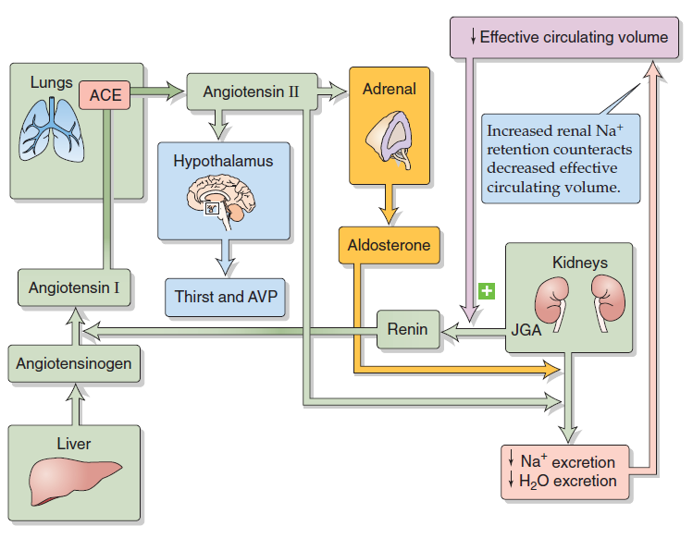
The Renin-Angiotensin-Aldosterone System (RAAS)
↓ ABP
↓ [NaCl] at macula densa
↓ renal perfusion pressure
(Boron & Boulpaep. Medical Physiology)

Slide 15
Sympathetic Nervous System (SNS)
Its role is thought to be especially important during stressful conditions, e.g. hemorrhage.
SNS effects
Direct
↑↑ Na⁺ reabsorption
↑↑ Renal vascular resistance
Indirect
Stimulate renin release

Slide 16
Atrial Natriuretic Peptide (ANP)
ANP promotes natriuresis (Na⁺ excretion).
Secreted by atrial myocytes in response to stretch.
↓↓ ECV
↓↓ ANP release
↓↓ Na⁺ excretion

Slide 17
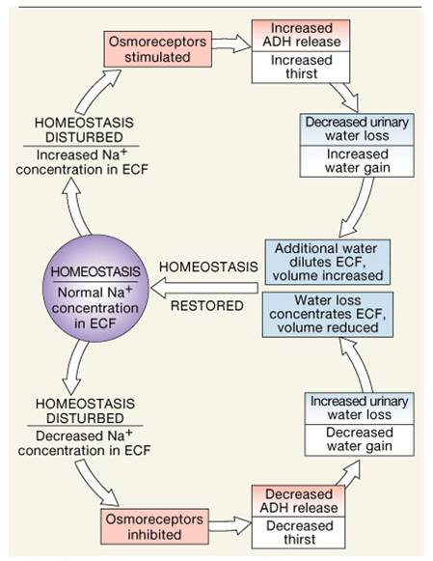
Antidiuretic Hormone (ADH)

Slide 18
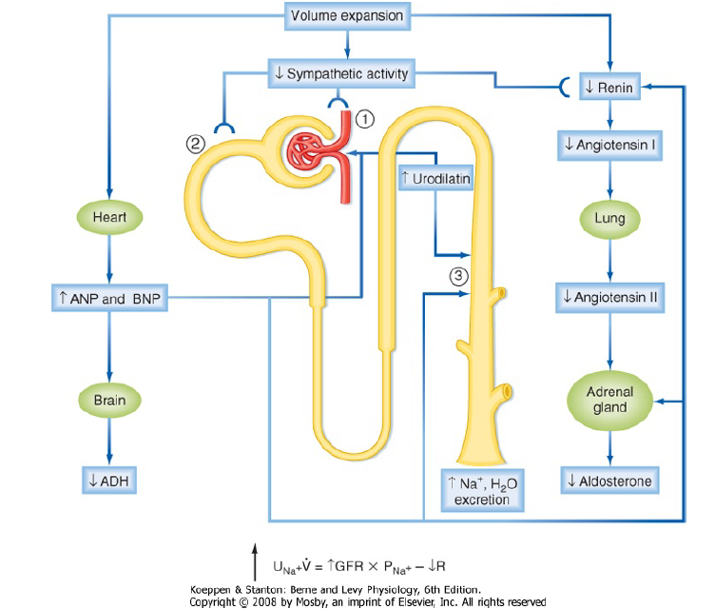
Summary

Slide 19
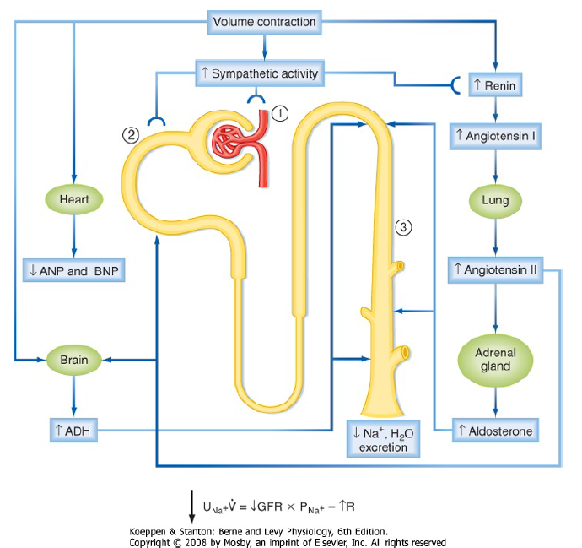
Summary

Slide 20
Final Note
Although, under physiologic conditions, the body regulates plasma volume & plasma osmolarity independently.
Severe derangements in fluid & electrolyte balance may challenge the system by presenting two conflicting changes in osmolarity and volume.
In general, the body defends volume at the expense of osmolarity.

Slide 21
Thank you

Slide 22
