Slide 1
OSPE
Artery
Vein
Muscle
Nerve
Renal Block
{وَمَنْ يَتَوَكَّلْ عَلَى اللَّهِ فَهُوَ حَسْبُهُ}

Slide 2
Psoas major muscle
Quadratus lumborum muscle
Diaphragm muscle
C
B
A

Slide 3
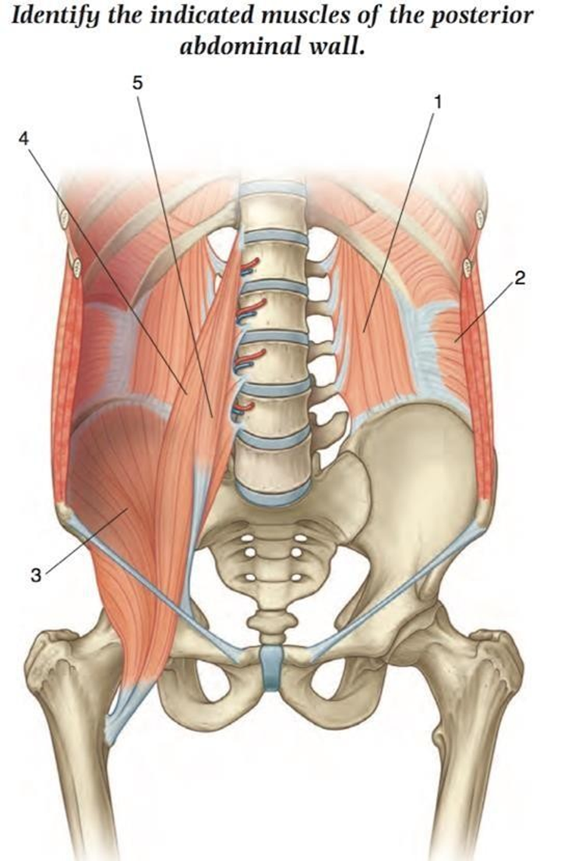
E
A
Quadratus lumborum muscle
Transverse abdominis muscle
Iliac muscle muscle
Psoas major muscle
Psoas minor muscle
D
B
C
*Note: These muscles are part of the posterior abdominal wall and are posterior relations of the kidney.

Slide 4
Psoas major muscle
Psoas minor muscle
The renal artery arises from abdominal aorta.
The level of the renal artery is L2.
The renal veins drain into inferior vena cava
The right renal vein is shorter than the left renal vein
A
B

Slide 5
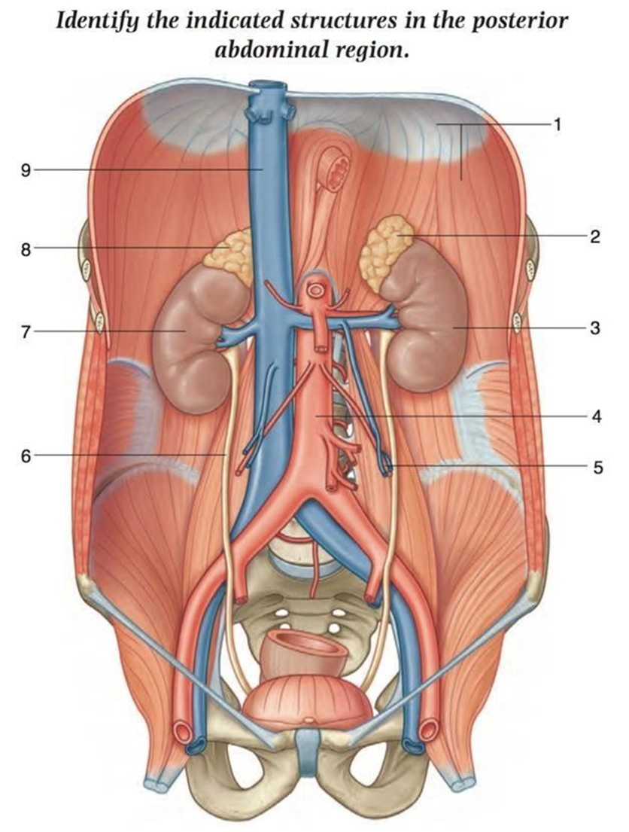
Diaphragm muscle
Left suprarenal gland
Left kidney
Abdominal Aorta
Let gonadal vessels
Right ureter
Right kidney
Right suprarenal gland
Inferior vena cava

Slide 6
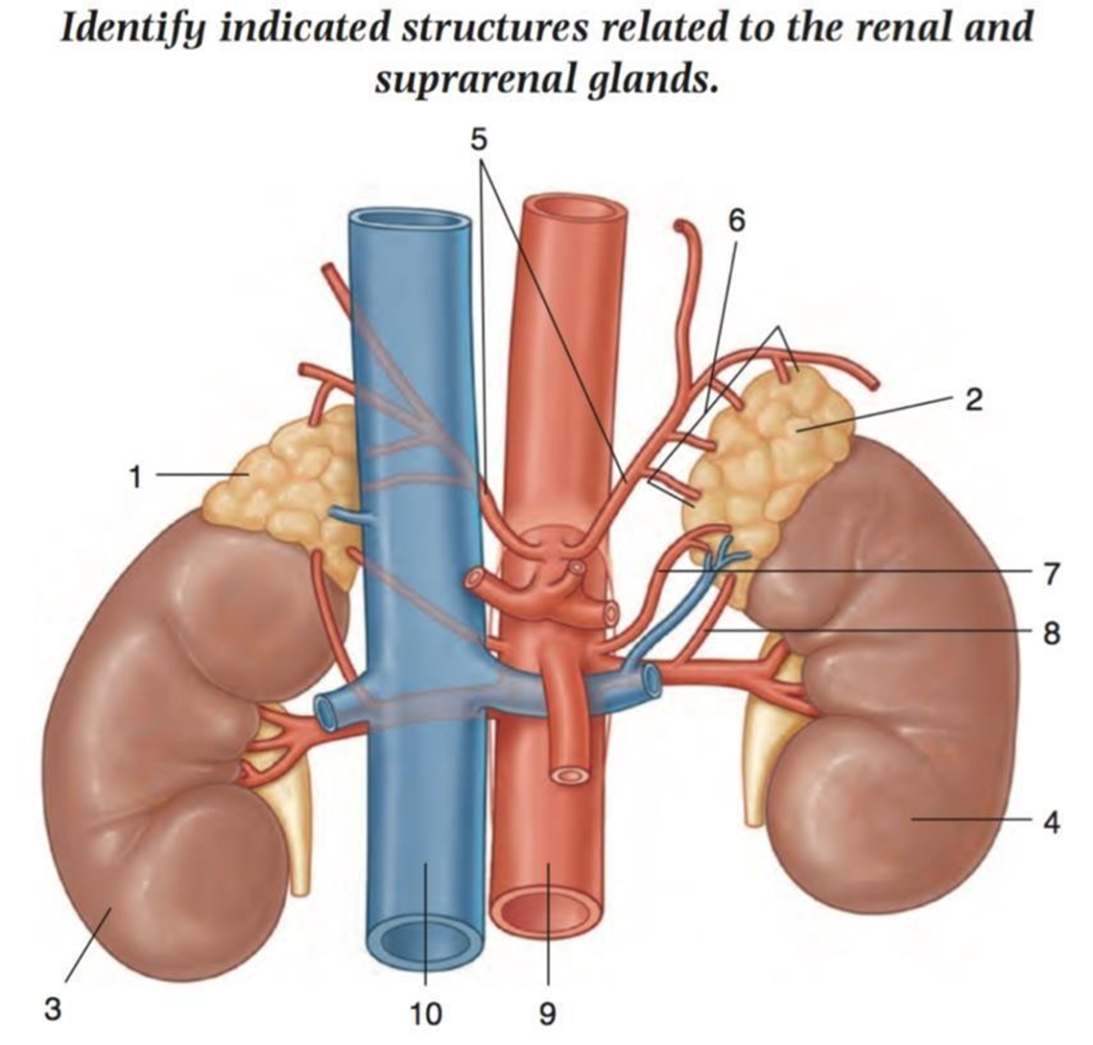
Right suprarenal gland
Left suprarenal gland
Right kidney
Left kidney
B
A
D
C

Slide 7
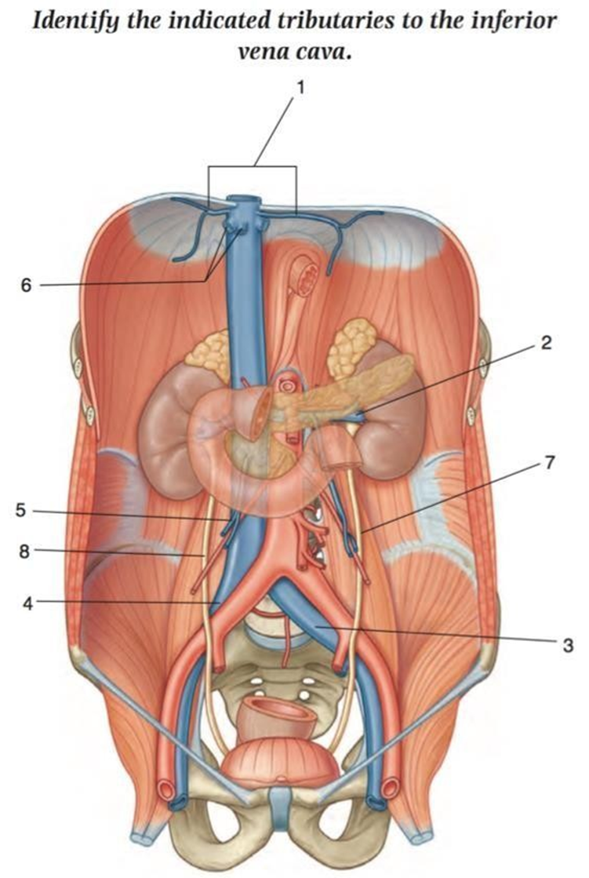
Left ureter
Right ureter
*Sites of CONSTRICTIONS in the ureter:
At ureteropelvic junction
At pelvic inlet (site of crossing of common iliac artery)
At site of entrance to bladder
A
B

Slide 8
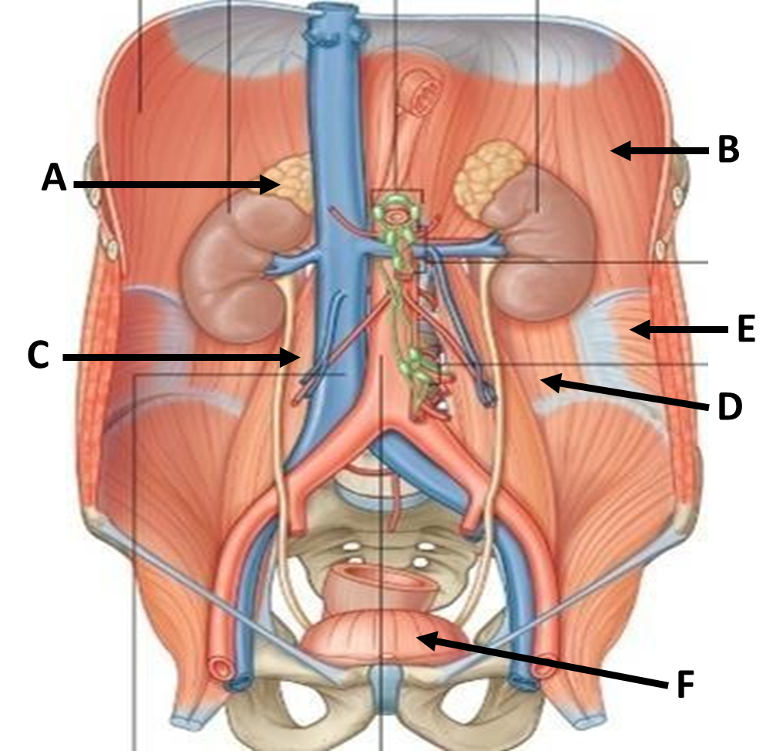
Right adrenal (or suprarenal) gland
Diaphragm muscle
Psoas major muscle
Quadratus lumborum muscle
Transverse abdominis muscle
Urinary bladder

Slide 9
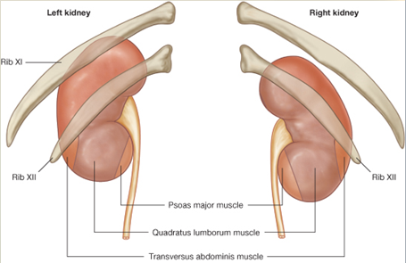
Psoas major muscle
Quadratus lumborum muscle
Transverse abdominis muscle
A
B
C

Slide 10
7
8
Psoas major muscle
Quadratus lumborum muscle
Perirenal fat
Pararenal fat
Inferior vena cava
Renal fascia
Peritoneum
Abdominal aorta
Erector spinea muscle
5
3
6
1
4
2
9

Slide 11
Renal artery
Gonadal artery
Common iliac artery
Internal iliac artery
*The urinary bladder is supplied by:
Internal iliac artery
A
B
C
D

Slide 12
Ureteric orifice
Trigone
Internal urethral orifice
Urethra
*Note: Trigone is smooth and formed by 2 ureteric orifice and 1 urethral orifice
A
A
B
B
C
D
D
C

Slide 13
Mucosal folds
Ureter
Trigone
Urethra
Ureteric orifice
Female

Slide 14
Trigone
Prostate
Prostatic urethra
Membranous urethra
Penile urethra
External urethral orifice
Fossa Navicularis
Male

Slide 15
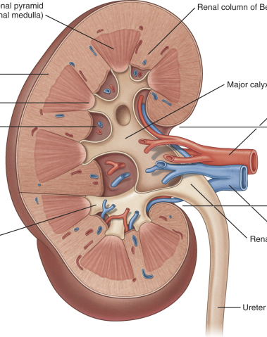
1
Renal Column
Renal Pyramid
Renal Papilla
Minor Calyx
Cortex
Renal Sinus
Renal Pelvis
Major Calyx
2
5
4
7
6
3
8

Slide 16
Renal Column
Minor Calyx
Renal artery
Renal vein
Renal Pelvis
Ureter
Minor Calyx
Renal Sinus
Renal cortex
Pyramids in renal medulla

Slide 17
Name the structures anteriorly related to the marked areas on the kidney:
Stomach
Pancreas
Descending colon
Small intestine (loop of jejunum)
Spleen
A
E
B
C
D
With Peritoneum
Without Peritoneum
*This is the left kidney because it’s closer to the aorta + longer renal vein

Slide 18
Name the structures anteriorly related to the marked areas on the kidney:
Liver
Duodenum (2nd Part)
Right colic flexure
Small intestine
A
B
C
With Peritoneum
Without Peritoneum
D
This is the right kidney because it’s closer to the inferior vena cava

Slide 19
Right suprarenal gland
Liver
Descending part of duodenum
Right colic flexure
Small intestines
Left suprarenal gland
Stomach
Spleen
Pancreas
Left colic flexure
Descending colon
Jejunum
Right Kidney
With Peritoneum
Without Peritoneum
Left Kidney

Slide 20
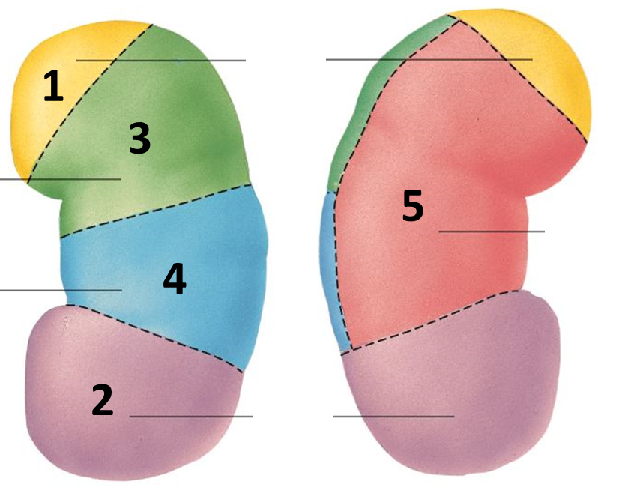
Name the structures related to the marked areas:
1. Apical segment
2. Caudal segment
3. Anterior superior segment
4. Anterior inferior segment
5. Posterior segment

Slide 21
GOOD LUCK “
(Special thank for team436)
Faisal Alsaif & Rawan Alharbi

