Slide 3
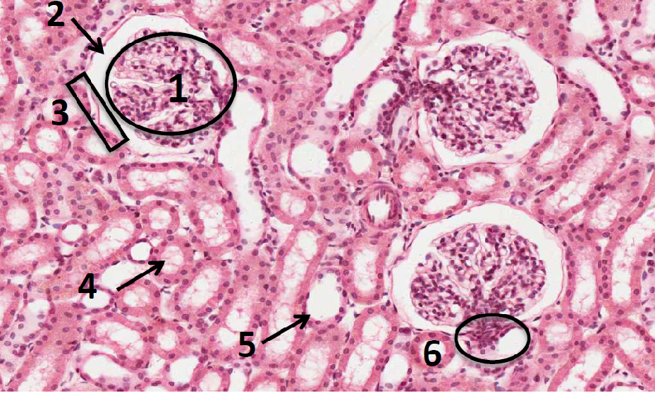
Cortex of the Kidney
Q1: Identify the structure?
Cortex of the Kidney
Q2: Identify labeling:
Glomerulus of renal corpuscle.
Urinary space (or capsular space).
Parietal layer of Bowman’s capsule.
Proximal convoluted tubules with brush border.
Distal convoluted tubules.
Juxta-glomerular apparatus.
Q3: How to differentiate between the proximal and distal convoluted tubules?
PCV: Has an ill defined lumen because it is filled with brush border (microvilli) “من جوا لونها وردي”
DCV: Has a well demarcated and clear lumen. “من جوا لونها أبيض”

Slide 4
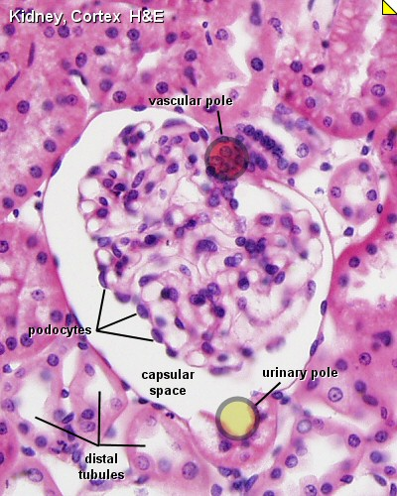
Juxtaglomerular apparatus
Q1: Identify the structure?
Juxtaglomerular apparatus
Q2: What are the components(cells) that form this structure?
Juxtaglomerular cells of afferent glomerular arteriole (they secrete renin) “afferent arteriole تكون جهة ال ”
The macula densa of distal tubule (tall columnar cells) “Distal tubuleتكون جهة ال ”
The extraglomerular mesangial cells

Slide 5
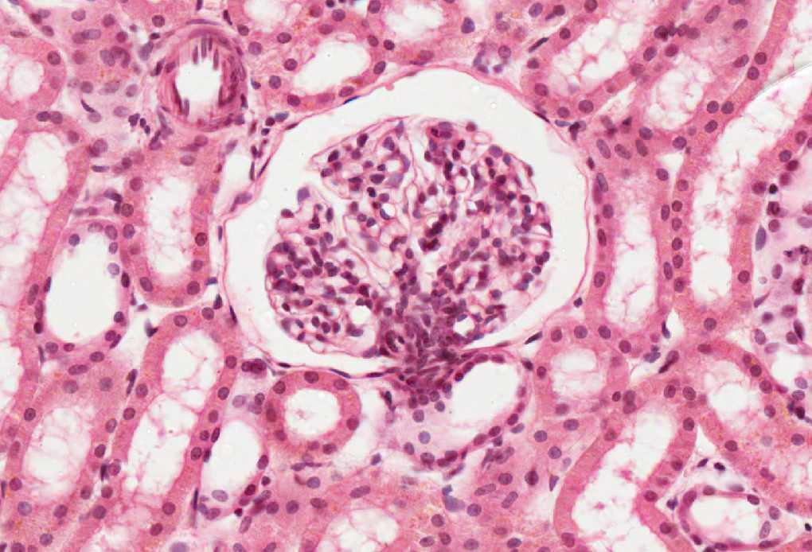
Renal Corpuscle
Q1: Identify the structure?
Renal Corpuscle
Q2: What are the components that form this structure?
Glomerulus which contains fenestrated capillaries "without diaphragm”
Bowman’s capsule: Parietal layer, urinary space, and podocytes (visceral layer)
Mesangial cells: Intra-glomerular cells
Q3: What are the cells that form this structure?
Mesangial cells
Glomerular endothelial cells
Podocytes (epithelial cells)
DCT
DCT
PCT
PCT
DCT

Slide 6
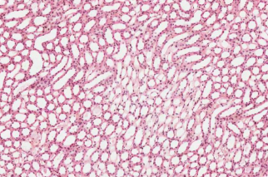
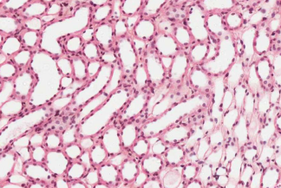
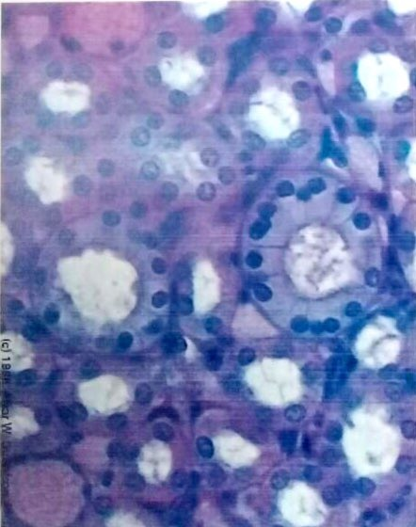
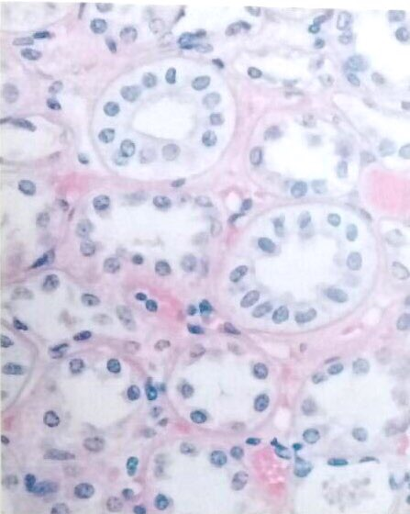
Kidney (Medulla)
Q1: Identify the structure?
Kidney (Medulla)
Q2: What is the features of the structure?
Contains tubular structures:
loop of Henle: simple squamous epithelium
collecting tubules and ducts: simple cuboidal epithelium
Papillary ducts (ducts of Bellini): Simple Columnar epithelium

Slide 7
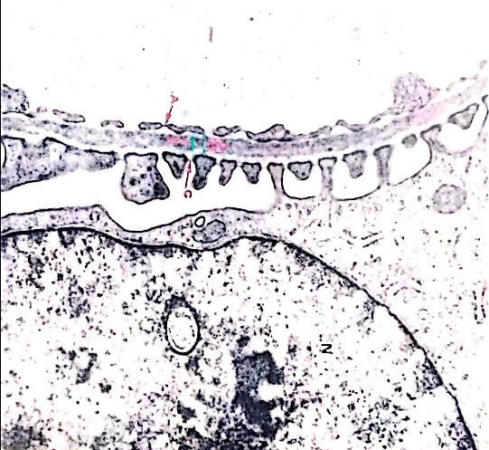
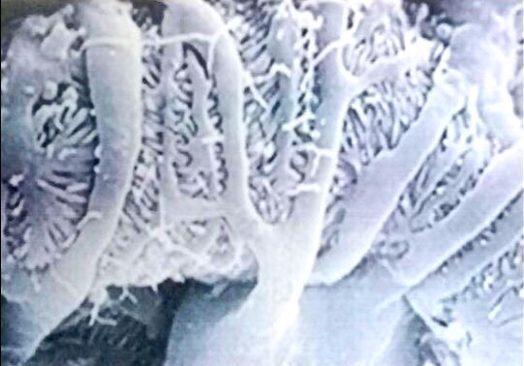
Blood renal Barrier
Q1: Identify the structure?
Blood renal Barrier (Glomerular Filtration Barrier)
Q2: What are the components that form this structure?
Endothelial wall of the glomerular capillaries.
The glomerular basal lamina (inner and outer laminae rarae and middle lamina densa).
Visceral layer of Bowman’s capsule (podocytes).

Slide 8
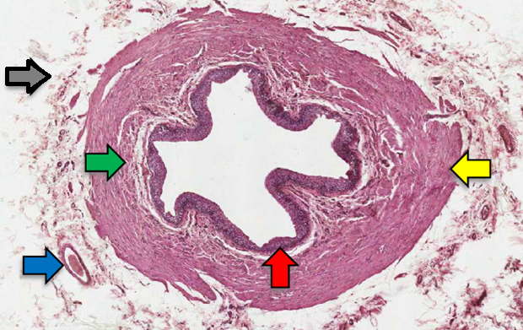
Ureter
Q1: Identify the structure?
Ureter
Q2: What is the type of epithelium in this structure?
Transitional epithelium
Q3: What is the features of the structure?
Transitional epithelium
Inner longitudinal layer
Outer circular
Blood vessels
Adventitia

Slide 9
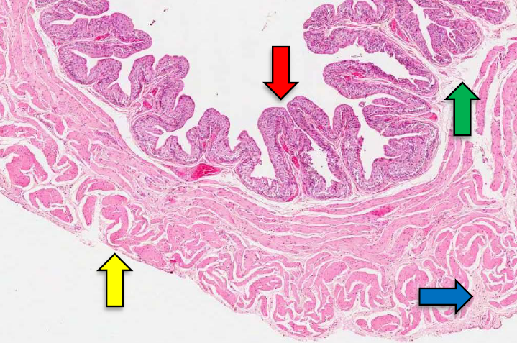
Urinary bladder
Q1: Identify the structure?
Urinary bladder
Q2: What is the type of epithelium in this structure?
Transitional epithelium
Q3: What is the features of the structure?
Transitional epithelium
Lamina propria
Connective tissue
Mesothelium
*It is a continuation of the lower third of the ureter, has the same structure except that it has serosa.

Slide 10
Layers
 | Mucosa | Muscularis | Adventitia
Ureter | Transitional Epithelium Lamina Propria | Upper 2/3: Inner Longitudinal Outer Circular Lower 1/3: Inner Longitudinal Middle Circular Outer Longitudinal | NO Serosa
Urinary bladder | Transitional Epithelium Lamina Propria | 3 layers of smooth muscle coat” Inner Longitudinal Middle Circular Outer Longitudinal | *The name of this layer is urinary bladder is “serosa or adventitia” Serosa

