Slide 1
Kidney
Lecture 1
Please check our Editing File
هذا العمل لا يغني عن المصدر الأساسي للمذاكرة
{وَمَنْ يَتَوَكَّلْ عَلَى اللَّهِ فَهُوَ حَسْبُهُ}

Slide 2
Objectives
Components of the Urinary system
Kidney:
Shape & position
Surface anatomy
External features
Hilum and its contents
Relations
Internal structure
Blood supply
Lymph drainage
Nerve supply

Slide 3
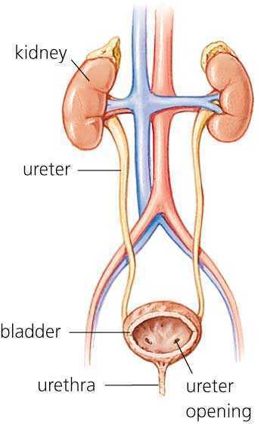
Introduction
The urinary system consists of the kidneys, ureters, urinary bladder, and urethra.
Every day, each kidney filters liters of fluid from the bloodstream.
Although the lungs and the skin also play roles in excretion, the kidneys bear the major responsibility for eliminating nitrogenous (nitrogen-containing) wastes, toxins, and drugs from the body.
Kidney (Renal) function
Excretes most of the waste products of metabolism.
Controls water & electrolyte balance of the body.
Maintain acid-base balance of the blood.
Erythropoietin hormone stimulates bone marrow for RBCs formation.
Renin enzyme regulates the blood pressure.
Converts vitamin D to its active form.

Slide 4
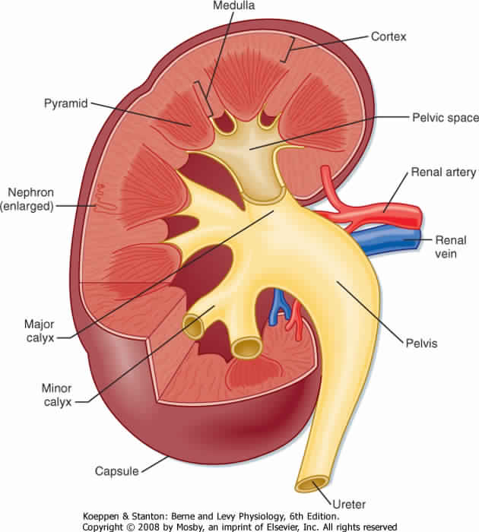
Kidney (Renal)
Kidneys are reddish brown in color.
Lie behind the peritoneum on the posterior abdominal wall on either side of the vertebral column. (T12-L3)
They are largely under cover of the costal margin.
The right kidney lies slightly lower than the left due to the large size of the right lobe of the liver.
The upper border of the right kidney is at the level of 11th intercostal space.
The upper border of the left kidney is at the level of 11th rib.
With contraction (inspiration) of the diaphragm the kidney moves downward as much as 2.5 cm.
The lateral border is convex, while the medial border is convex at both ends but its middle pat shows a vertical slit called the hilum.
The hilum extends into a large cavity called the renal sinus.
The hilum transmits the renal Vein, two branches of renal Artery, Ureter, and the third branch of renal Artery.
From the front backward (V.A.U.A.)
Renal sinus
You should know how to differentiate between right and left kidney

Slide 5
Kidney (Renal) Structure
Each kidney has an outer cortex and an inner medulla.
Medulla is composed of about 12 renal pyramids.
The base of each pyramid is directed toward the cortex & its apex (the renal papilla) is projecting medially.
The cortex extends into the medulla between adjacent pyramids as the renal column.
Extending from the bases of the renal pyramids into the cortex are striations known as medullary rays.
The renal sinus within the hilum, contains the upper expanded end of the ureter, the renal pelvis.
Renal pelvis divides into two or three major calyces, which divides into two or three minor calyces.
Renal column

Slide 6
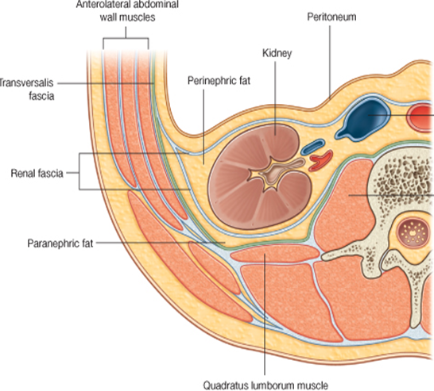
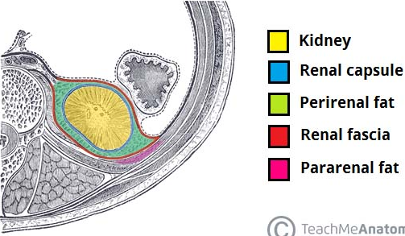
Kidney (Renal) Coverings
Fibrous capsule: It surrounds the kidney.
Perirenal (perinephric) fat: “i=inside” It covers the fibrous capsule.
Renal fascia: It encloses the kidneys and suprarenal glands.
Pararenal (paranephric) fat: It lies external to the renal fascia, and forms part of the retroperitoneal fat. On extreme diets this layer will shrink leading to “floating kidneys” causing severe pain during trotting (هرولة) .
N.B. The last 3 structures support the kidney in position.

Slide 7
Kidney (Renal) Relations
Anterior Relation
Right Kidney | Left Kidney
Right suprarenal gland Liver Second part of the duodenum (descending part) Right colic flexure* Coils of small intestine *Flexure: Junction between the descending column & Transverse column | Left suprarenal gland Stomach Spleen Pancreas Left colic flexure Descending colon Coils of jejunum
peritoneum
*The ones in bold are separated from the kidney by the peritoneum.

Slide 8
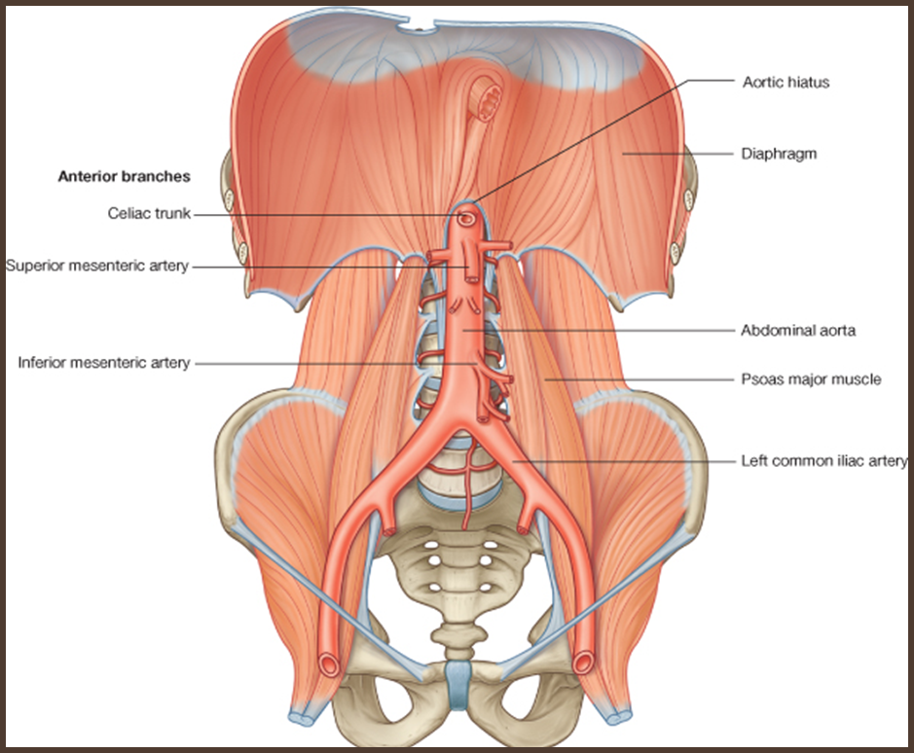
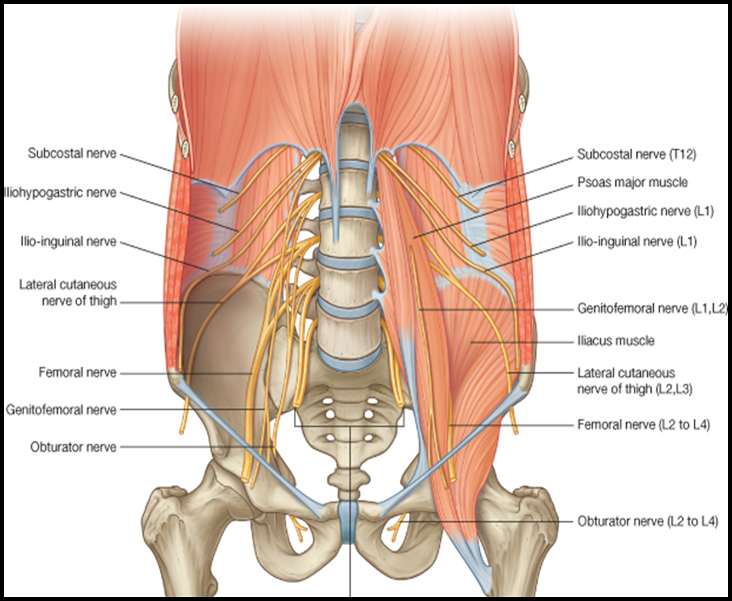
Kidney (Renal) Relations
Posterior Relation
Right Kidney | Muscles | Nerves
Last intercostal space “between 11th and 12th ribs” Twelfth rib “the left kidney reaches up to the 11th rib” Costodiaphragmatic pleural recess | Diaphragm Psoas major “most medial” Quadratus lumborum “in between” Transversus abdominis “most lateral” | Subcostal nerve (T12) Iliohypogastric (L1) nerve Ilioinguinal (L1) nerve
Quadratus lumborum

Slide 9
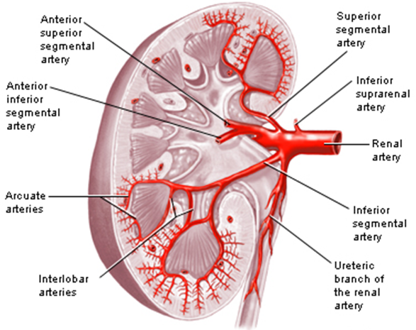
Kidney (Renal) Blood supply
arises from the aorta at the level of the second lumbar vertebra.
Renal artery
Each renal artery divides into five segmental arteries that enter the hilum of the kidney, four in front and one behind the renal pelvis.
They are distributed to different segments of the kidney.
Apical (superior) segmental artery.
Caudal (Inferior) segmental artery.
Anterior superior segmental artery.
Anterior inferior segmental artery.
Posterior segmental artery.
Segmental arteries
ONLY in boy’s slides

Slide 10
Kidney (Renal) Blood supply
Lobar artery
arises from each segmental artery, one for each renal pyramid.
Interlobar arteries
run toward the cortex on each side of the renal pyramid.
Arcuate arteries
give off several interlobular arteries.
Interlobular arteries
Each lobar artery gives off 2 or 3 interlobar arteries.
Interlobar arteries give off the arcuate arteries at the junction of the cortex & medulla.
gives off afferent glomerular arterioles.
afferent glomerular arterioles
Lobar artery
Interlobular arteries

Slide 11
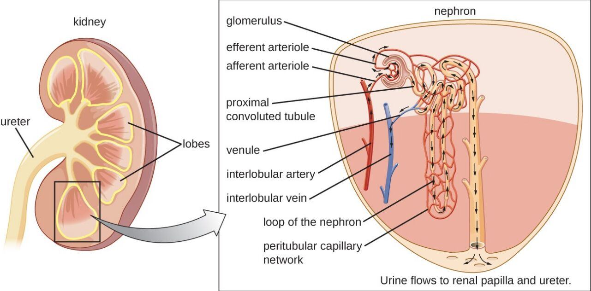
Kidney (Renal) Blood supply
Nephron, functional unit of the kidney. each nephron of the kidney contains blood vessels and a special tubule.
Each nephron is associated with two capillary beds: The glomerulus The peritubular capillary bed (network).
The glomerulus is both fed and drained by arterioles: The afferent arteriole which arises from an interlobular artery, is the "feeder vessel” The efferent arteriole receives blood that has passed through the glomerulus.
Nephron

Slide 12
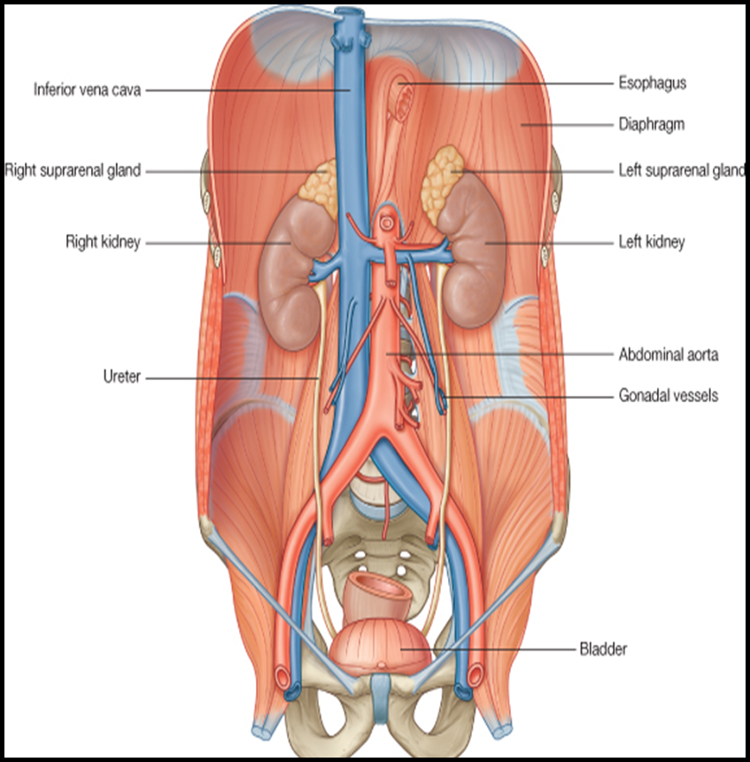
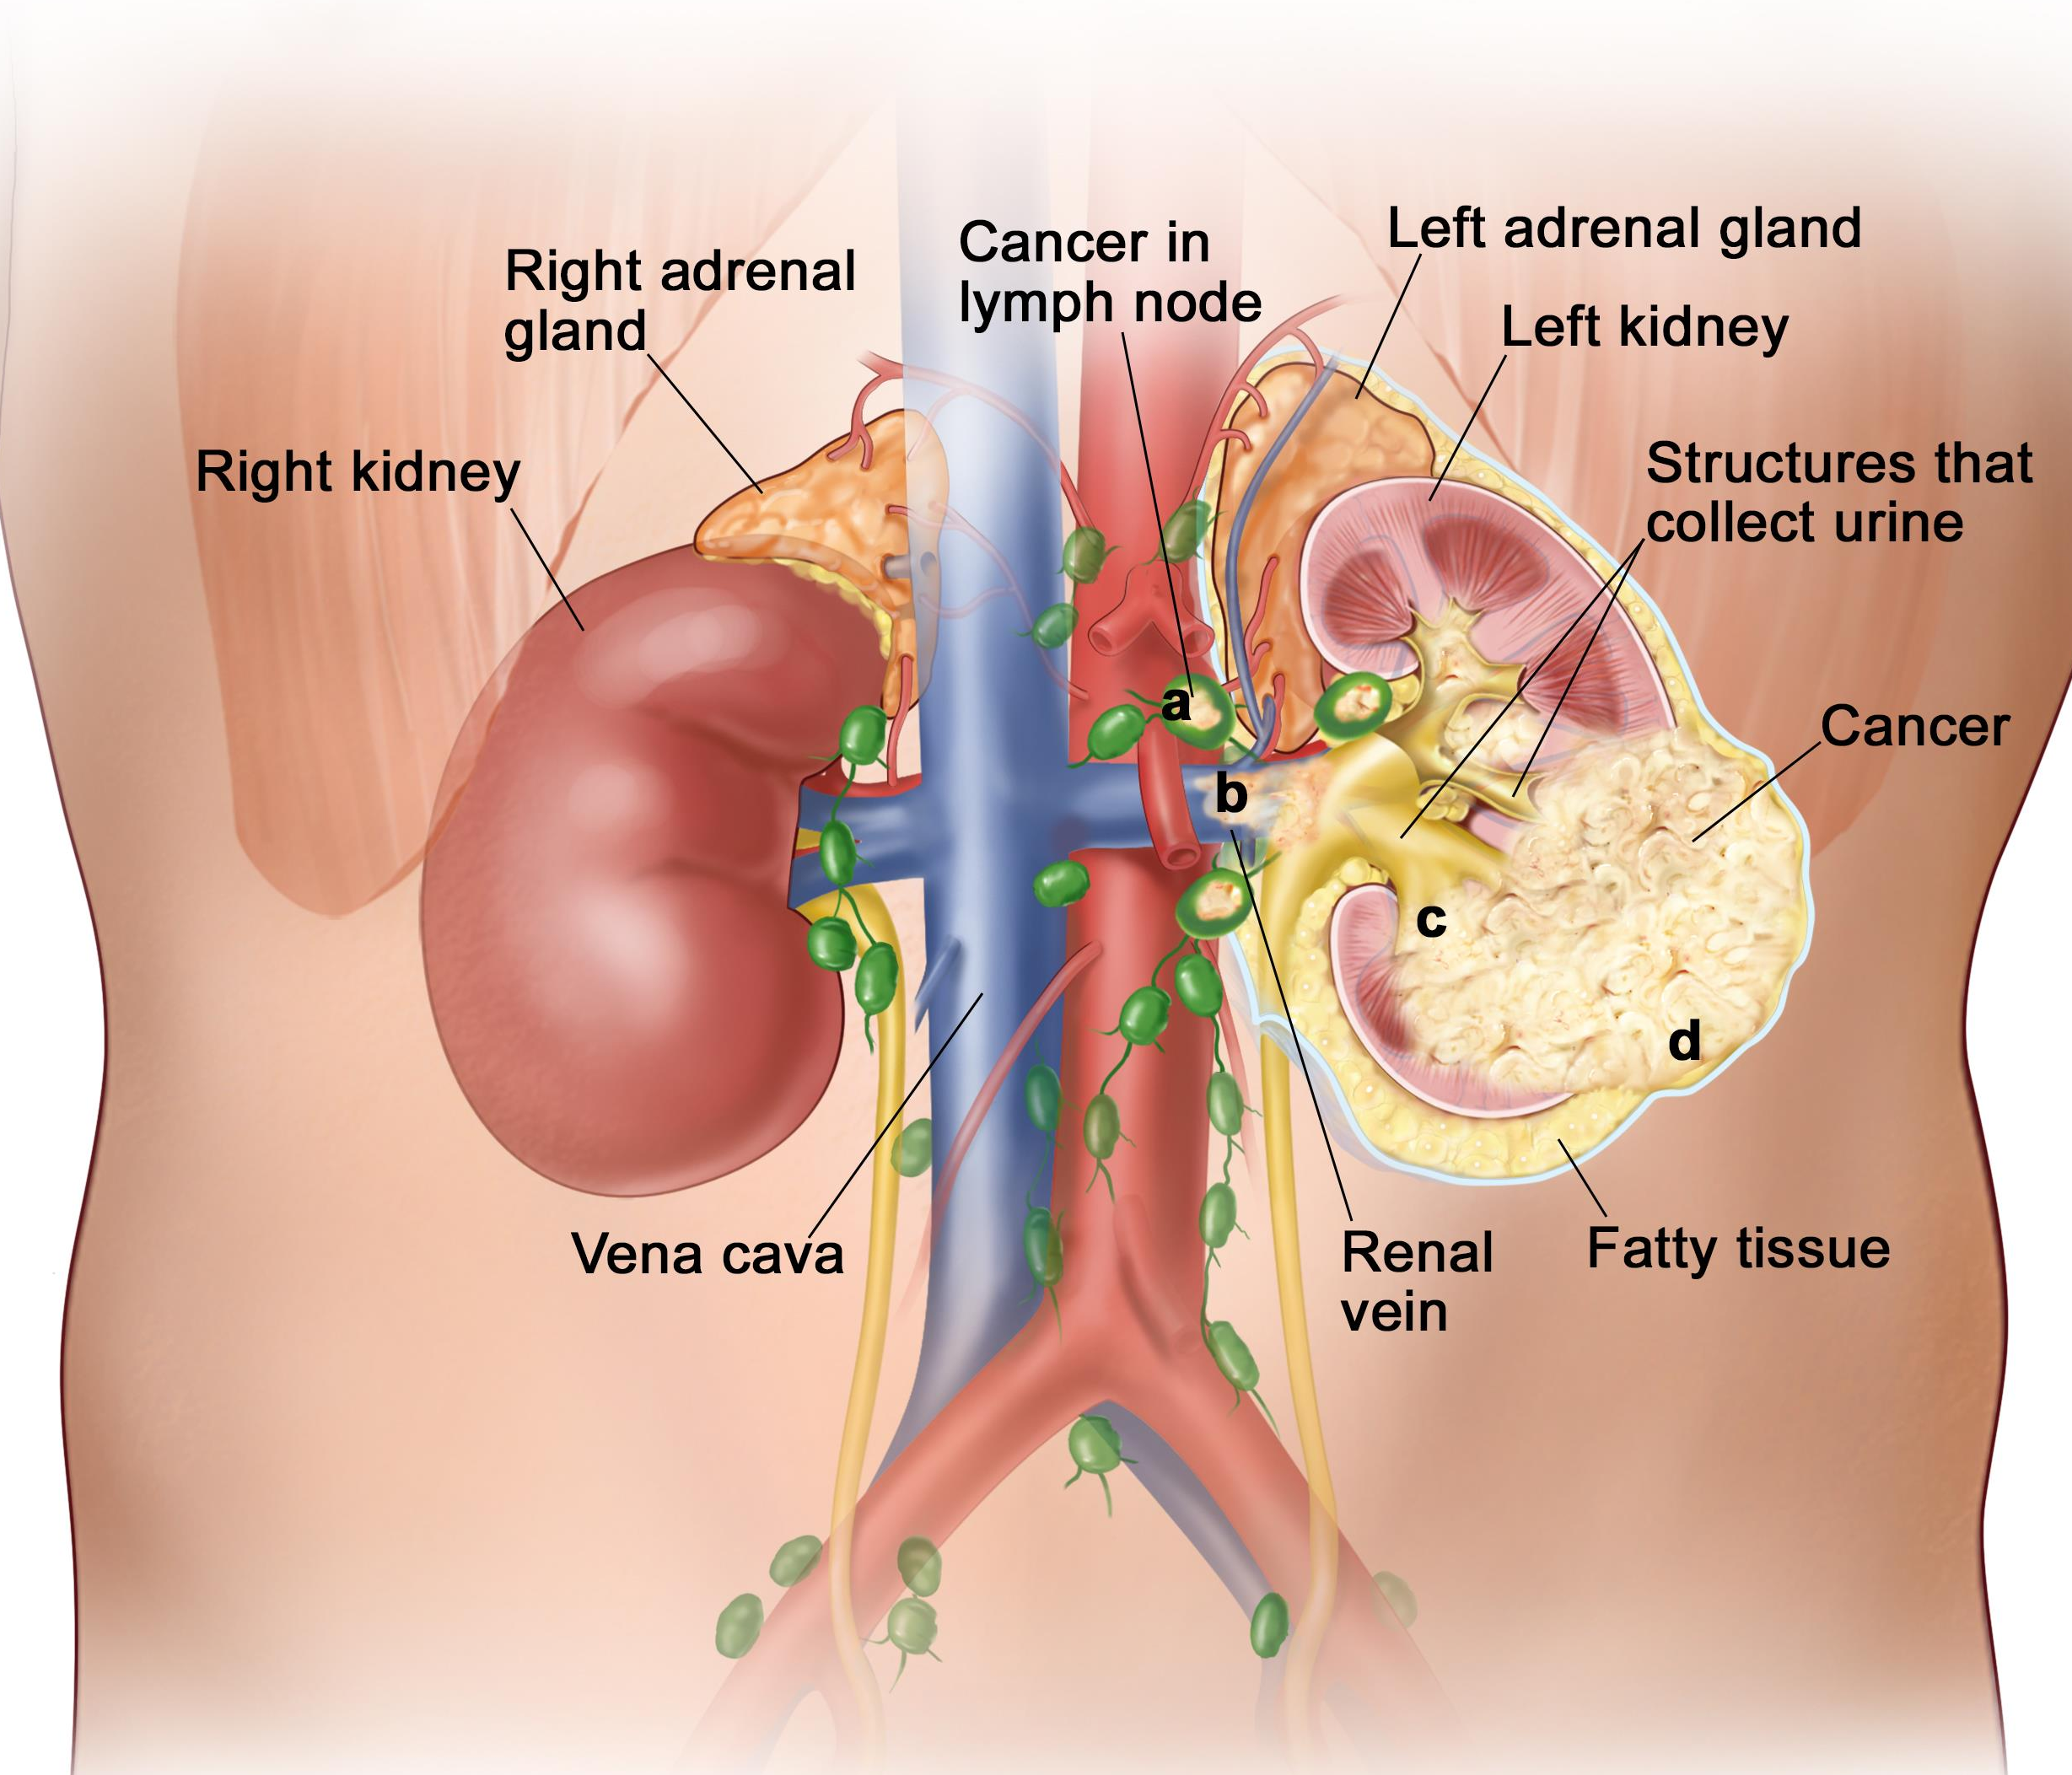
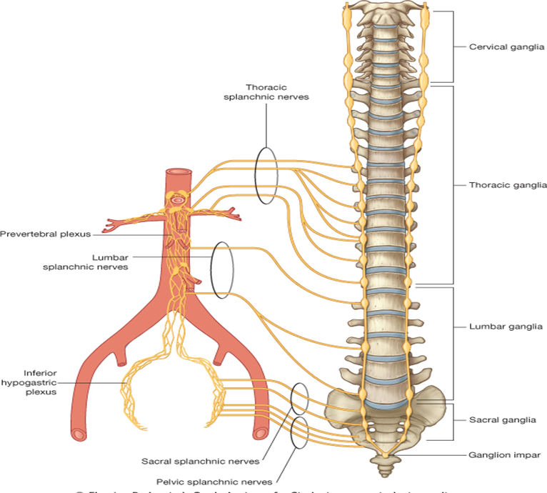
In next slide “explanation by prof. Abuel Makarem”
Venous Drainage | Lymph Drainage | Nerves Supply
Renal vein emerges from the hilum in front of the renal artery and drains into the IVC. The left renal vein is longer than the right renal vein. The left renal vein receives the left gonadal & the left suprarenal veins. | Lateral aortic lymph nodes around the origin of the renal artery. | Renal sympathetic plexus. The afferent fibers that travel through the renal plexus enter the spinal cord in the 10th, 11th, and 12th thoracic nerves.

Slide 13
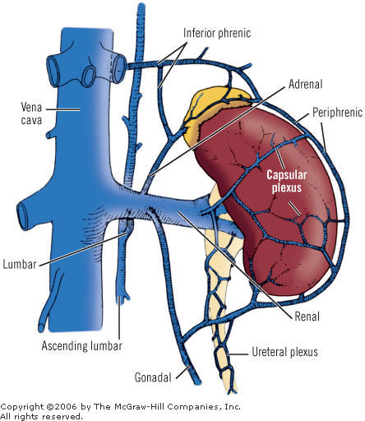
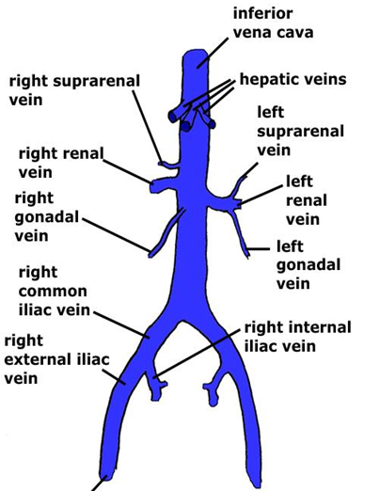
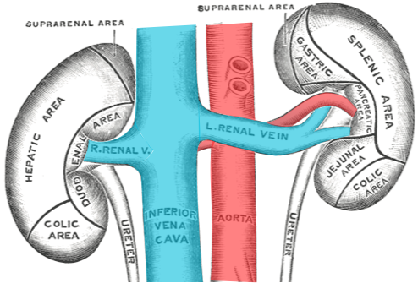
ONLY in boy’s slides
Venous drainage
The left gonadal vein enters the left renal vein from below while the left suprarenal vein, enters it from above but nearer to the midline.
The left renal vein enters the inferior vena cava a little above the right vein.
The right renal vein is behind the 2nd part of the duodenum and sometimes the lateral part of the head of the pancreas
Both renal veins drain to the inferior vena cava.
The left is three times longer than the right (7.5 cm and 2.5 cm).
So, for this reason the left kidney is the preferred side for live donor nephrectomy.
It runs from its origin in the renal hilum, posterior to the splenic vein and the body of pancreas, and then across the anterior aspect of the aorta, just below the origin of the superior mesenteric artery.
★

Slide 14
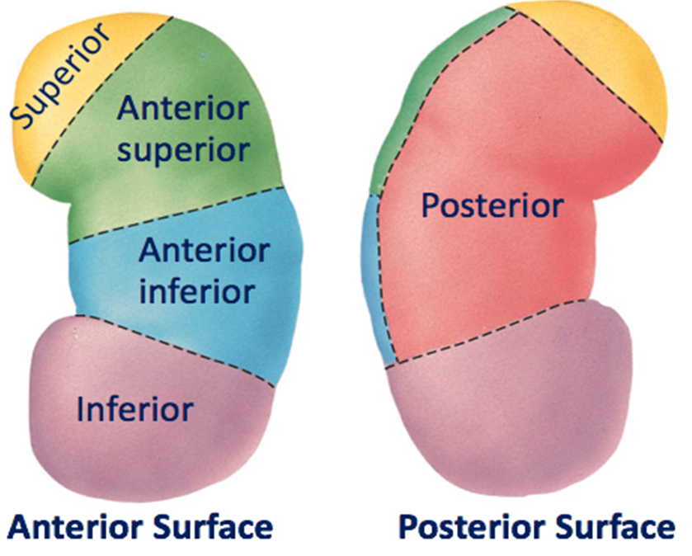
Kidney (Renal) Segments
ONLY in boy’s slides
Each kidney consists of 5 segments each has its own blood supply
Apical (superior) segment.
Anterior superior segment.
Anterior inferior segment.
Posterior segment
Caudal (Inferior) segment.

Slide 15
Summary
Easily forgotten:
Kidneys lie behind the peritoneum on the posterior abdominal wall on either side of the vertebral column.(T12-L3)
The upper border of the right kidney is at the level of 11th intercostal space.
The upper border of the left kidney is at the level of 11th rib.
The hilum transmits the renal vein, two branches of renal Artery, Ureter, and the third branch of renal Artery (from anterior to posterior)
The cortex extends into the medulla between adjacent pyramids as the renal column.
The renal sinus within the hilum, contains the upper expanded end of the ureter, the renal pelvis.
Kidney Relations (Anterior):
1- Right kidney:
Right suprarenal gland
Liver
Second part of the duodenum (Descending part)
Right colic flexure
Coils of small intestine
2- left kidney:
Left suprarenal gland
Stomach
Spleen
Pancreas
Left colic flexure
Descending colon
Coils of jejunum
Kidney Relations (Posterior):
1- Nerves:
Subcostal nerve (T12)
Iliohypogastric (L1) nerve
Ilioinguinal (L1) nerve
2-Muscles:
Diaphragm
Psoas major (most medial)
Quadratus lumborum (in between)
Transversus abdominis (most lateral)
3- Others:
Last intercostal space (between 11th and 12th ribs)
Twelfth rib “the left kidney reaches up to the 11th rib”
Costodiaphragmatic pleural recess
Renal functions:
Excretes wastes
water & electrolyte balance
Acid-base balance
Erythropoietin
Renin regulates BP
Converts Vitamin D to its active form
Renal covering:
Fibrous capsule
Perirenal (perinephric) fat “i=inside”
Renal fascia
Pararenal (paranephric) fat

Slide 16
MCQs
(1) What is the major responsibility of kidneys?
A) Eliminating wastes B) Maintain of acid base
C) Control of electrolytes D) Regulate blood pressure
(2) The right kidney lies slightly lower than the left due to the?
A) Large left lobe of liver B) Large right lobe of liver
C) Smaller right kidney D) Descent of the diaphragm (3) Which of the following structure arrangements are the cover of kidney from superficial to deep? A) Fibrous capsule, renal fascia, perirenal fat, pararenal fat B) perirenal fat, pararenal fat, renal fascia ,fibrous capsule C) Pararenal fat, renal fascia, perirenal fat ,fibrous capsule D) Fibrous capsule, perirenal fat ,renal fascia ,pararenal fat
(4) which of the following is not considered an anterior relation with right kidney?
A) Right suprarenal gland
B) Second part of the duodenum
C) Liver
D) Pancreas
(5) The renal artery arises from abdominal aorta at the level of?
A) L3 B) L2
C) L1 D) T12

Slide 17
MCQs
(6) Which one of the following is a capillary bed?
A) Peritubular B) Interlobar
C) Juxtaglomerular apparatus D) Arcuate
(7) The right renal vein is behind the 2nd part of the duodenum and sometimes the?
A) Head of the pancreas B) Ascending colon
C) Mobilized Jejunum D) Right lobe of liver
(8) the lymphatic drainage of the kidneys is? A) Intermediate aortic lymph nodes near right lobe of liver B) Right colic lymph nodes C) Renal lymph vessels D) Lateral aortic lymph nodes around the origin of the renal
(9) Which of the following are segments of the kidney?
A) Lateral segment B) Caudal segment
C) Cortical segment D) Oblique segment
(10) Kidneys are _____________ in color?
A) Brown
B) Reddish brown
C) Red
D) Black

Slide 18
MCQs
(11) Every day, each kidney filters liters of fluid from?
A) Bloodstream B) Lung
C) Skin D) All of them
(12) The right kidney lies ___________ the left kidney?
A) Upper than B) Lower than
C) Upper border of D) As the level of (13) The function of kidney? A) Excretes most of the waste products B) Controls water & electrolyte balance C) Maintain acid-base balance D) All of them
(14) With contraction of the diaphragm the kidney moves ___________?
A) Downward as much as 2 cm
B) Upward as much as 2 cm
C) Downward as much as 2.5 cm
D) Upward as much as 2.5 cm
(15) ___________ encloses the kidneys and suprarenal glands?
A) Fibrous capsule B) Perirenal fat
C) Renal fascia D) Pararenal fat

Slide 19
MCQs
(16) Medulla is composed of about?
A) 9 renal pyramids B) 10 renal pyramids
C) 11 renal pyramids D) 12 renal pyramids
(17) Renal pelvis divides into?
A) 2 or 3 major calyces B) Renal sinus
C) 2 or 3 minor calyces D) Pyramids (18) Describe the position of spleen in Anterior relation of ? A) Right kidney with peritoneum B) Right kidney without peritoneum C) Left kidney with peritoneum D) Left kidney without peritoneum
(19) Interlobular arteries gives off ___________?
A) Afferent glomerular arterioles B) Efferent glomerular arterioles
C) Loop of Henle D) Arcuate arteries
(20) The afferent fibers that travel through the renal plexus enter the spinal cord in the?
A) 9th, 10th, and 11th thoracic nerves
B) 10th, 11th, and 12th thoracic nerves
C) 11th, and 12th thoracic nerves
D) 12th thoracic nerve & 1st lumbar nerve

Slide 20
Answers
(1) A (6) A (2) B (7) A (3) C (8) D (4) D (9) B (5) B (10) B

Slide 21
Answers
(11) A (16) D (12) B (17) A (13) D (18) C (14) C (19) A (15) C (20) B

Slide 22
GOOD LUCK “
Rawan Alharbi Faisal Alsaif Abdulelah Aldossari ‏Abdulrahman Alduhayyim
Abdulaziz Aldrgam

