Slide 1
Ureters, Urinary Bladder & Urethra
Lecture 2
Please check our Editing File
هذا العمل لا يغني عن المصدر الأساسي للمذاكرة
{وَمَنْ يَتَوَكَّلْ عَلَى اللَّهِ فَهُوَ حَسْبُهُ}

Slide 2
Objectives
Describe the course of ureter & identify the site of ureteric constrictions.
Describe the important relations & identify certain areas (trigone, uvula vesicae) in the base of urinary bladder.
List the blood supply, lymphatic drainage & nerve supply of urinary bladder
Differentiate between male & female urethra regarding length, structure, course & function.

Slide 3
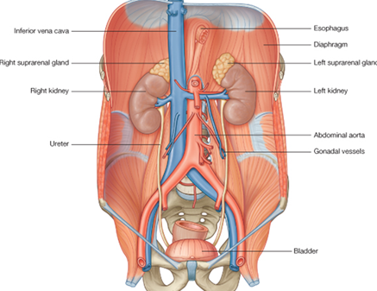
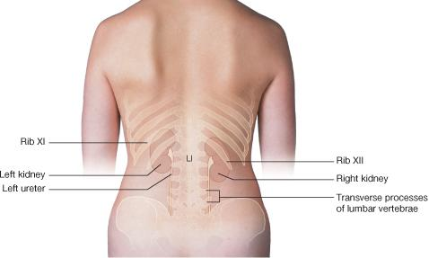
Ureter
Definition: it is a muscular tube transporting urine from kidney to urinary bladder.
Length: 25 – 30 cm
Beginning: it begins as a continuation of renal pelvis (or pelvis of ureter).
Course in abdomen:
It descends anterior to psoas major muscle (opposite the tips of lumbar transverse processes ,on the x-ray it will appear in front of them because the muscles are radiolucent ).
It crosses anterior to the end (bifurcation) of common iliac artery to enter pelvis.
Course in pelvis & termination:
It runs downward & backward to the level of ischial spine. It curves forward to open in upper lateral angles of the base of urinary bladder.
It runs obliquely for ¾ inch in wall of bladder before opening (valve-like part prevents urine from going back).
psoas major muscle

Slide 4
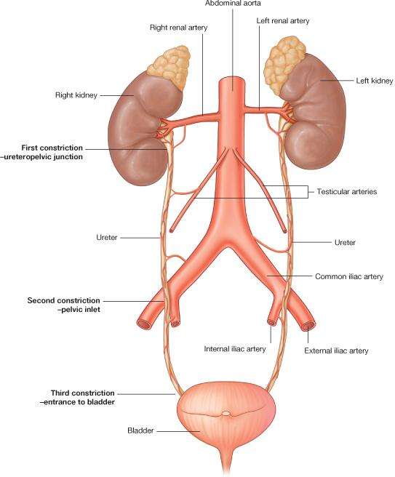
Ureter
Sites of constrictions (obstruction-stone impaction):
1st: At ureteropelvic (between renal pelvis and ureter) junction
2^{nd:} At pelvic inlet (site of crossing of common iliac artery)
3rd: At site of entrance to bladder
Arterial supply:
Renal artery
Gonadal artery
Common iliac artery
Internal iliac artery

Slide 5
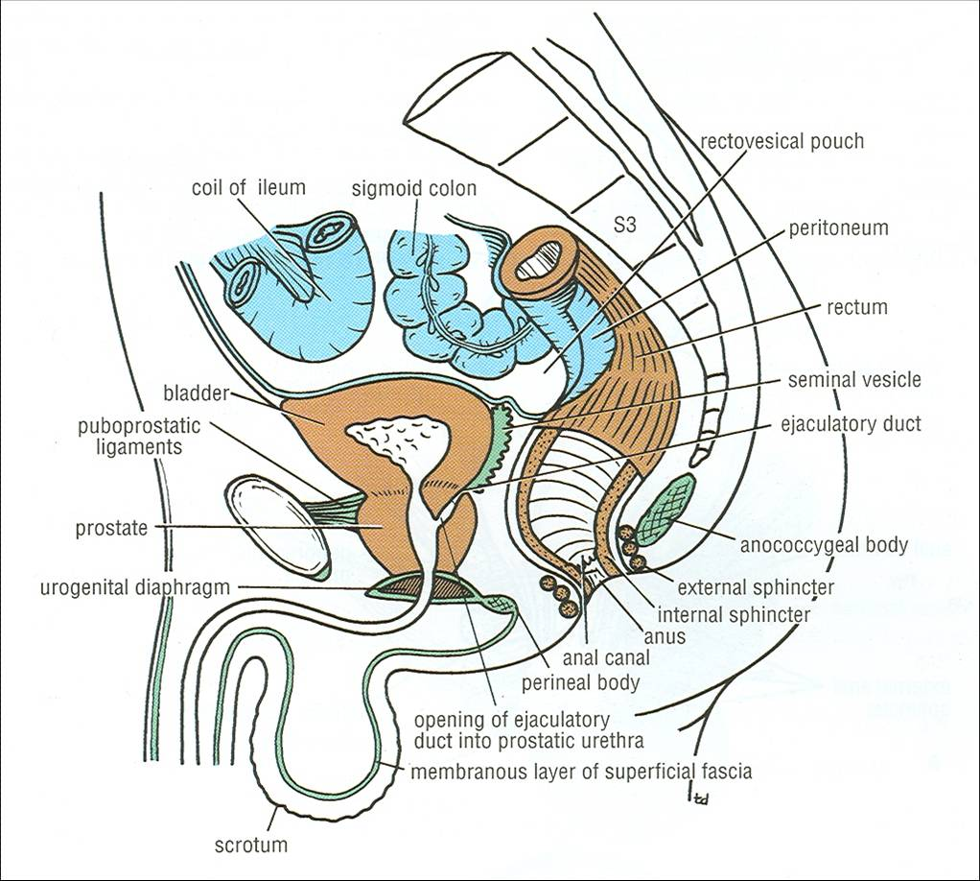
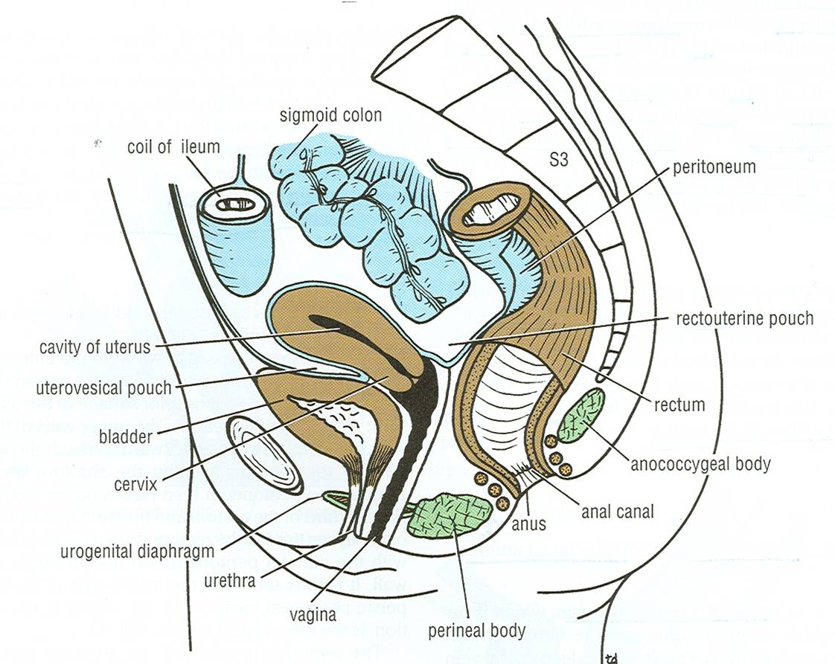
Urinary bladder
It is pelvic organ.
It has the shape of three-sided pyramid placed on one of its angle (neck).
It has apex: directed anteriorly
It has 4 surfaces:
Posterior surface (base): directed posteriorly
Superior surface
Two infero-lateral surface (right and left inferolateral)
Anterior
Posterior
Male
Apex
Is directed forward.
Is related to (lies behind) upper border of symphysis pubis.
Is connected to umbilicus by the median umbilical ligament (remnant of urachus,more explanation in embryology).
Female

Slide 6
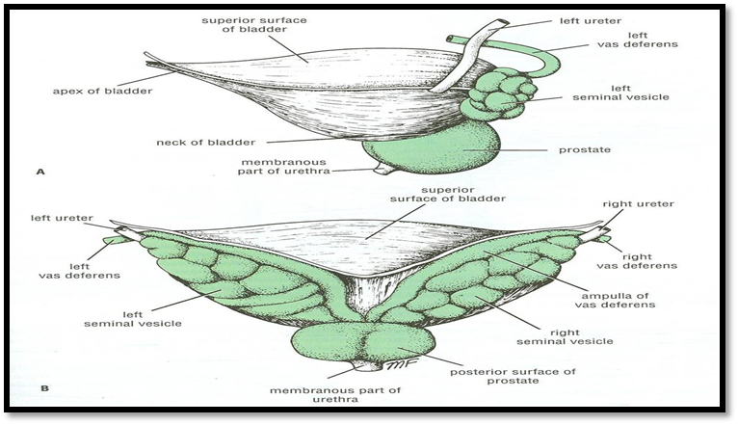
Urinary bladder
Anterior
Posterior
Posterior surface (base)
Is directed backward
In male: Is related to vas deferens & seminal vesicle of both sides
In female: Is related to vagina
Male
Lateral view
Male
Posterior view
Female

Slide 7
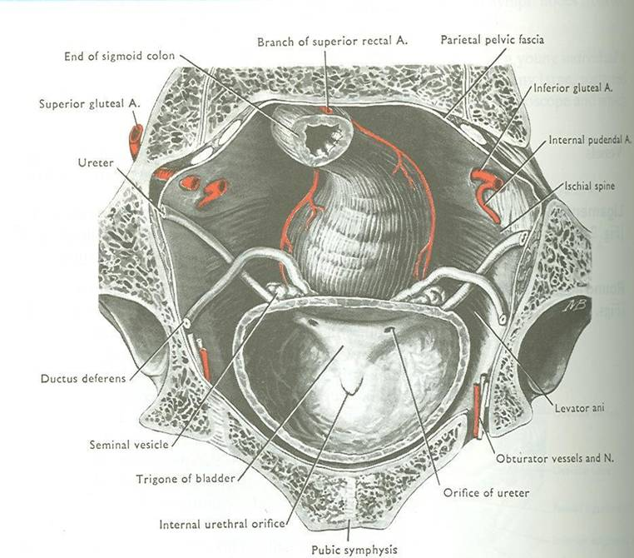
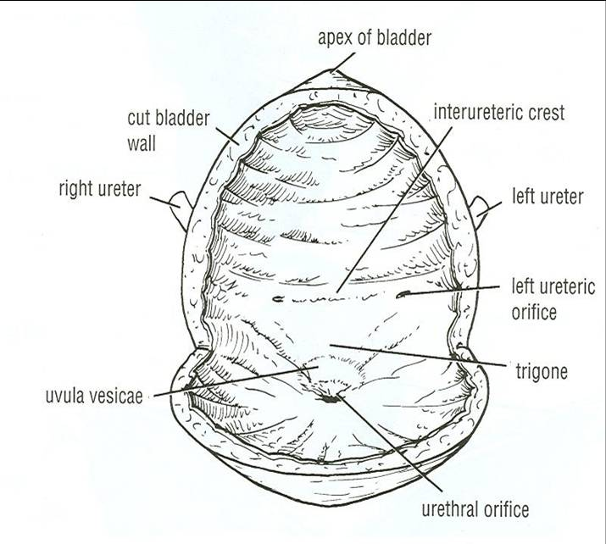
Anterior
Posterior
Urinary bladder
In male: is related to coils of ileum & sigmoid colon
In female: is related to the uterus
Male
Superior surface
Are related to retropubic fat separating them from pubic bones
Retropubic fat:
accommodates distention of bladder
Continuous with anterior abdominal wall.
Rupture of bladder escape of urine to anterior abdominal wall
Infero- lateral surface
Female
Neck
Is the lowest & most fixed part of urinary bladder.
Is continuous with urethra.
Is related to (lies behind) lower border of symphysis pubis
In male: Is related to upper surface of prostate gland (inferiorly, it rests on the base of prostate).
Mucous membrane is folded. “All urinary bladder except trigone”
Uvula vesicae: elevation behind internal urethral orifice, produced by median lobe of prostate gland
Trigone: a triangular area in base of bladder bounded by the 2 ureteric orifices & internal urethral orifice. Its mucous membrane is elastic (not folded) “only trigone”
Interior

Slide 8
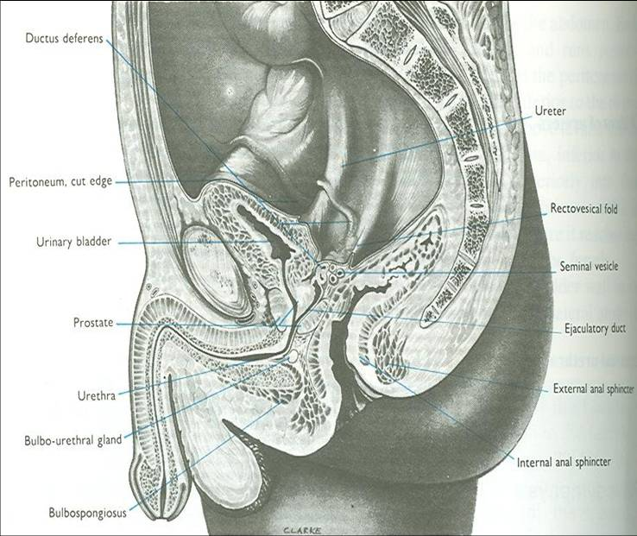
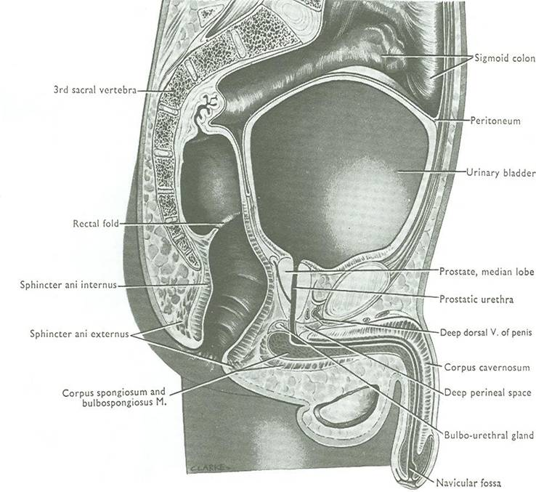
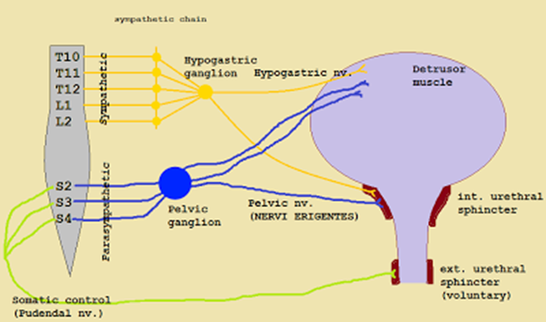
Urinary bladder
Capacity
Empty |  | Distended
Empty bladder is a pelvic organ. Accommodates from 300 – 500ml of urine. |  | Is circular in shape. Bulges into abdominal cavity.
Supply
Arteries | from internal iliac artery
Veins | into internal iliac vein
Lymph | into internal iliac lymph nodes
Nerves | Parasympathetic | through pelvic splanchnic nerves from S2, S3, & S4
 | Sympathetic | from L1 & L2 through hypogastric nerves
 | Sensory | transmitting pain due to overdistention of bladder (via general visceral afferent fibers from bladder to CNS).
*Urination involves coordination between the central, autonomic, and somatic nervous systems.

Slide 9
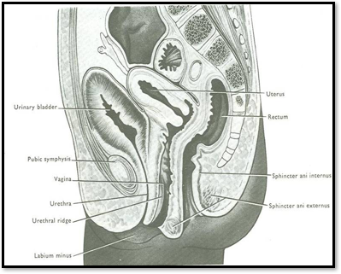
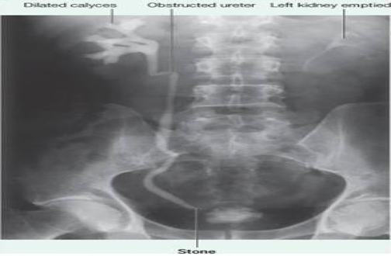
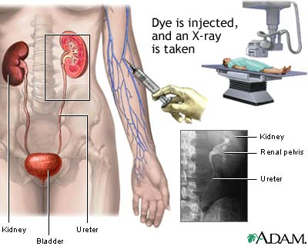
Urinary bladder
ONLY in boy’s slides
Is found in abdomen until age of 6 years
Begins to enter the enlarging pelvis from age of 6 years onward
Is found entirely in pelvis at puberty
The picture shows a median sagittal section of a newborn female child.
Position
IVU: Intravenous Urogram | IVP: Intravenous Pyelogram
IVU (Post micturition) also called IVP ,is an x-ray exam that uses an injection of contrast material to evaluate your kidneys, ureters and bladder and help diagnose (demonstrates) a bladder stone or any obstruction in the urinary system.
IVU (IVP)
Here the right side is obstructed

Slide 10
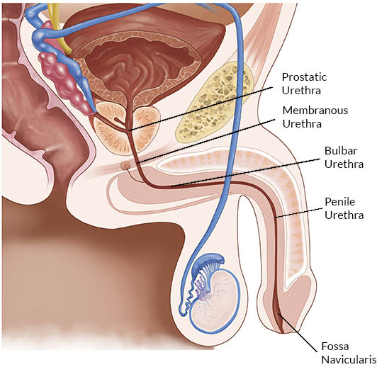
Urethra
Urethra | Characters | Picture
Male urethra (20 cm) | Prostatic urethra (length=3 cm): Widest & most dilatable Extends from neck of bladder inside prostate gland Structures openings into prostatic urethra: 1) Ejaculatory ducts: containing sperms & secretion of seminal vesicles 2) Ducts of prostate gland Membranous urethra (length=1 cm): Surrounded by external urethral sphincter Penile (spongy) urethra (length=16 cm): Extends inside penis & opens externally through external urethral orifice (narrowest part of whole urethra)
Female urethra (4 cm) | Has only urinary function. Extends from neck of urinary bladder to open externally through the external urethral orifice (anterior to the vaginal opening)

Slide 11
Summary
Ureter:
Beginning: as continuation of renal pelvis
Course: descends anterior to: psoas major & ends at (bifurcation) of common iliac artery.
Termination: opens at upper lateral angle of base of urinary bladder
Sites of constriction: at uteropelvic junction, at pelvic inlet, at site of entrance of bladder
Arterial supply: renal, gonadal, common & internal iliac arteries
Urinary bladder:
Apex: related to symphysis pubis, continuous with median umbilical ligament
Base: related to vas deferens & seminal vesicle (in male) & to vagina (in female)
Superior surface: related to coils of ileum & sigmoid colon (in male) & to uterus (in female)
Inferolateral surfaces: related to retropubic fat
Neck: continuous with urethra, related to upper surface of prostate gland (in male)
Trigone: lies in the base of bladder, bounded by ureteric orifices & internal urethral orifice, its mucous membrane is elastic
Uvula vesicae: dilatation behind internal urethral orifice, produced by the median lobe of the prostate gland
Supply: internal iliac (artery, vein, lymph nodes)
Nerves: parasympathetic (S2,3,4), sympathetic (L1,2)
Male urethra:
Function: both urinary & genital
Length: 20 cm, divided into prostatic (3 cm), membranous (1 cm) & penile ( 16 cm)
Course: Extends from neck of bladder to open externally through external urethral orifice (narrowest part of whole urethra)
Female urethra:
Function: urinary only
Length: 4 cm
Course: Extends from neck of bladder to external urethral orifice (anterior to vaginal opening)

Slide 12
MCQs
(1) _________ it begins as a continuation of renal pelvis?
A) Kidney B) Ureter
C) Urinary bladder D) Urethra
(2) runs obliquely for ________ in wall of bladder ________ opening ?
A) ¾ inch, before B) ½ inch, before
C) ¾ inch, after D) ½ inch, after (3) Sites of constrictions (obstruction-stone impaction in ureter? A) At ureteropelvic junction B) At pelvic inlet (site of crossing of common iliac artery) C) At site of entrance to bladder D) All of them
(4) Apex of urinary bladder is related to?
A) Lower border of symphysis pubis
B) Upper border of symphysis pubis
C) upper surface of prostate gland D) to vas deferens & seminal vesicle of both sides
(5) Urinary bladder has apex & ________ surfaces:
A) 2 B) 3
C) 4 D) 5

Slide 13
MCQs
(6) Which one of the following structures is related to the inferolateral surface?
A) Prostate gland B) Sigmoid colon
C) Retropubic fat D) Seminal vesicle
(7) If urinary bladder distended, the capacity?
A) Bulges into abdominal cavity B) Both A & C
C) Accommodates urine D) Non of them
(8) The neck of urinary bladder in male related to? A) Lower border of symphysis pubis
B) Upper border of symphysis pubis
C) Upper surface of prostate gland D) to vas deferens & seminal vesicle of both sides
(9) Which one of the following is the site of uvula vesicae?
A) In the superior surface of urinary bladder.
B) Behind the internal urethral orifice.
C) Between the 2 ureteric orifices.
D) In relation to the apex of urinary bladder.
(10) Which of them is sympathetic supply of urinary bladder?
A) Through pelvic splanchnic nerves from S2, S3, & S4
B) Via general visceral afferent fibers from CNS to bladder
C) Via general visceral afferent fibers from bladder to CNS D) L1 & L2 through hypogastric nerves

Slide 14
Answers
(1) B (6) C (2) A (7) A (3) D (8) C (4) B (9) B (5) C (10) D

Slide 15
GOOD LUCK “
Rawan Alharbi Faisal Alsaif

