Slide 1
Bladder and Urethra Development

Slide 2
Objectives
At the end of the lecture the student is able to:
Describe the cloaca and the formation of the urogenital sinus.
Discuss the division of the urogenital sinus into various parts and name the adult organs that are derived from each part.
Describe how the caudal parts of the mesonephric ducts are absorbed into the urogenital sinus and the significance of this embryonic event.
Discuss the position of the urachus and its significance and fate.
Describe the various anomalies concerned with the urinary bladder and urethra.

Slide 3
Extra
It’s important to know what is cloaca in order to know what are the derivative of urinary bladder and the development of urethra. The urinary bladder and the urethra come from the primitive urogenital sinus which is the anterior part of mesodermal urorectal septum.
Ventral part
The primitive urogenital sinus
Urinary bladder
+
Urethra
Cloaca
Mesodermal urorectal
Dorsal part
Rectum
The anorectal canal

Slide 4
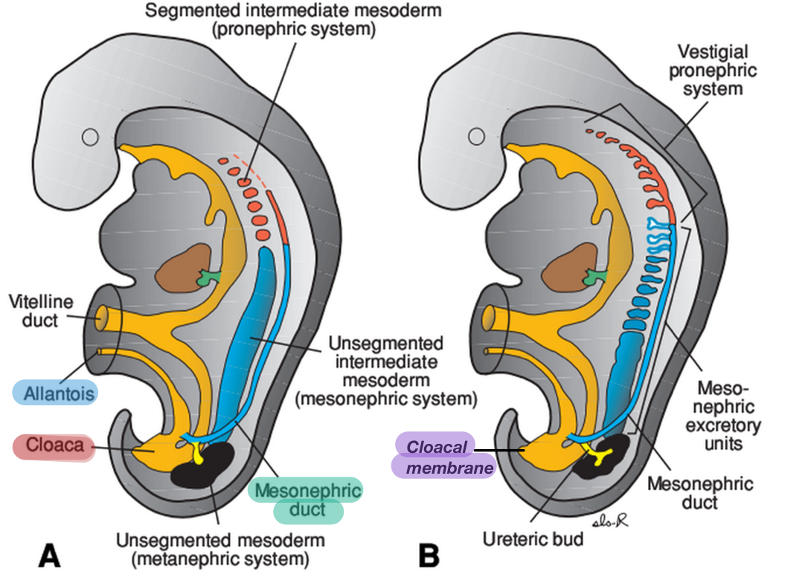
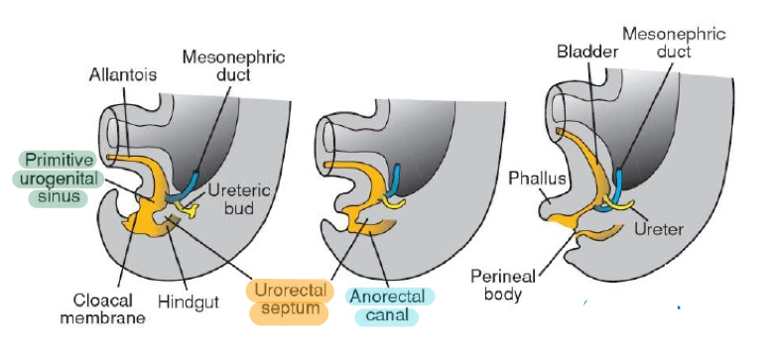
Cloaca
It is the dilated terminal part of the hind gut.
It receives the allantois and the mesonephric ducts.
Its floor is closed by the cloacal membrane.
A mesodermalurorectal septum divides the cloaca and cloacal membrane into:
Ventral part: the primitive urogenital sinus that communicates with the allantois and the mesonephric ducts. - Its floor is closed by the urogenital membrane.
Dorsal part: the anorectal canal, it’s the place which develop the rectum, that forms the rectum and upper part of anal canal.
-Its floor is closed by the anal membrane.

Slide 5
still didn't get it? (Extra, You can skip it if it was clear to you)

Slide 6
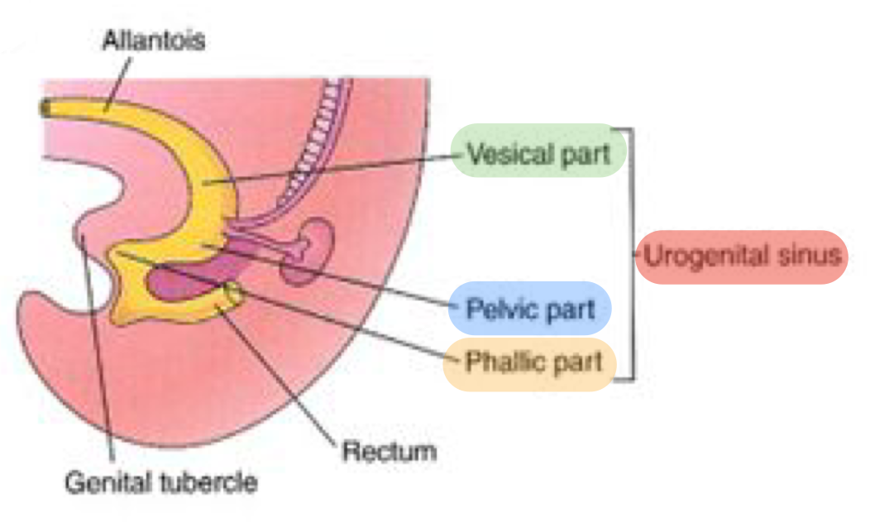
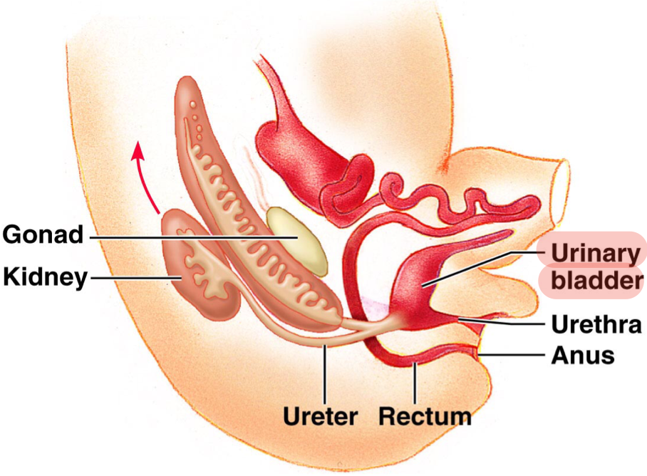
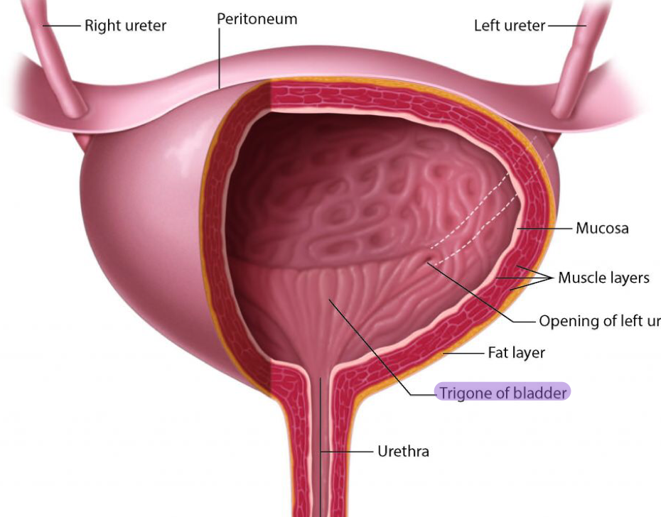
Primitive Urogenital Sinus
Urinary Bladder
Its divided into three parts:
A cranial (vesical) part : forms most of the urinary bladder and continuous with the allantois. Except the trigone because it’ll come from the mesonephric ducts.
A middle (pelvic) part : forms main part of male urethra except the distal part of penile urethra and entire female urethra.
A caudal (phallic) part, it’s a swelling above the cloaca: grows towards genital tubercle.
It develops mainly from the vesical part of the urogenital sinus.
Except: The trigone, which is in the posterior surface of the bladder, is derived from the absorbed caudal ends of the mesonephric ducts.
The epithelium of bladder is endodermal in origin.
The other layers of bladder smooth muscle are derived from the splanchinic mesoderm.

Slide 7
still didn't get it? (Extra, You can skip it if it was clear to you)

Slide 8
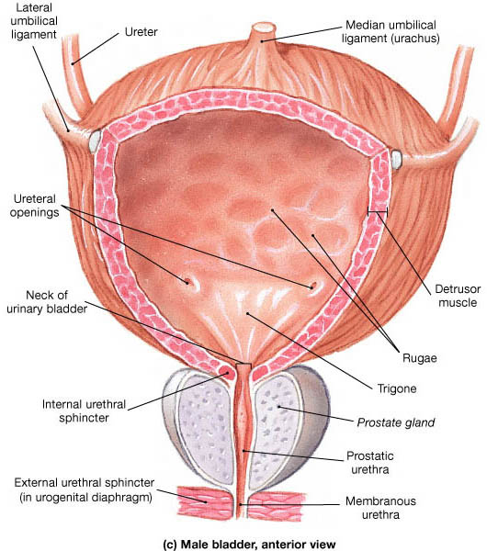
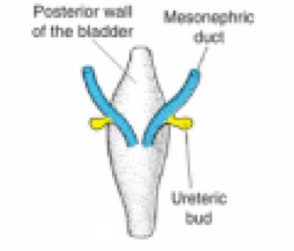
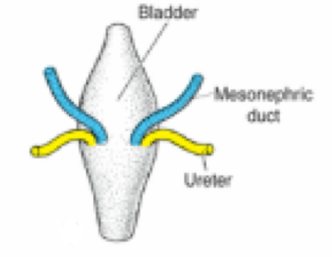
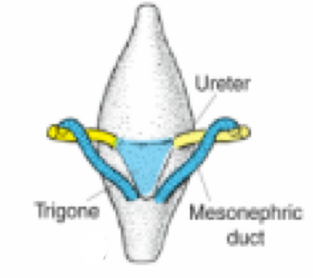
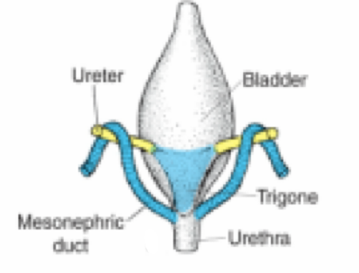
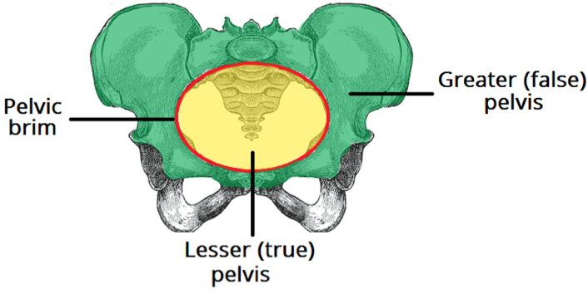
Cont..Urinary Bladder
The allantois is at first continues with the bladder, then it becomes a thick fibrous cord urachus which extends from the apex of the bladder to the umbilicus.
In infants and children at 6 years, the bladder is an abdominal organ.
it starts to enter the greater pelvis (false pelvis) at about 6 years
Becomes a pelvic (true pelvis) organ until after puberty.
At birth, it is represented by the median umbilical ligament.
After absorption of the mesonephric ducts to form the trigone, the ureters open separately in the bladder.
بعد ما يصير له تليف (fibrosis )
Extra pic

Slide 9
still didn't get it? (Extra, You can skip it if it was clear to you)

Slide 10
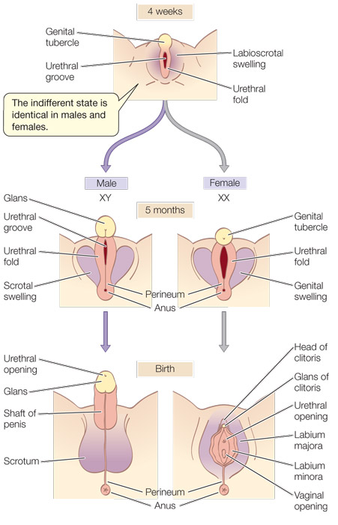
Urethra
Indifferent stage ; or undifferentiated stage which is a stage that we can’t predict the baby’s gender.
The genital tubercle (mesenchymal elevation) develops at the cranial end of the cloacal membrane.
Two urethral folds, develop on either side of the urogenital membrane.
Laterally two labioscrotal folds develop on either side of the urethral folds.
Whether it gives scrotum in male or labia majora in female
male
Female
2 urethral folds in male fuse with each other to close the penile urethra
2 urethral folds in female remain separate to form labia minora.
The genital tubercle (differentiate from female to give glans penis in male ) elongates forming the phallus, which is the precursor of the penis.
Most of the male urethra : (prostatic, membranous and spongy parts) is derived from endoderm of the pelvic middle part of urogenital sinus.
The distal part of male penile urethra in glans penis starts as ectodermal solid cord that grows towards the root of penis to meet the spongy urethra , later it canalizes.
The entire female urethra is derived from endoderm of the pelvic (middle) part of the urogenital sinus.
The external urethral orifice opens dorsal to the glans clitoris .
Genital tubercle was under effect of estrogen and gave glans clitoris
Note that the whole urethra of female and male develop from the middle part or the pelvic part except the testes. Also, the female urethra develops from the endodermal pelvic, however, the male urethra develops from the ectodermal pelvic.

Slide 11
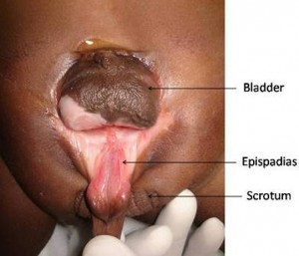
Anomalies
1- Extrophy of the bladder (Ectopia vesicae) | exposure of the posterior wall of the bladder due to a defect in the anterior abdominal wall and anterior wall of the bladder.
2- Urachal | A, Urachal cyst persistence or remnant of epithelial lining of urachus.
 | B, Urachal sinus, discharge serous fluid from the umblicus.
 | C, Urachal fistula, the entire urachus remains patent and allows urine to escape from the umbilicus and this due to a failure in fibrosis of urachus
3- Urethral | 1-Hypospadius : is the most common anomaly, with incomplete fusion of the urethral folds, and abnormal openings of the urethra occur along the ventral (inferior) aspect of the penis.
 | 2-Epispadius : is a rare abnormality, in which the urethral meatus is found on the dorsum of penis, it is most often associated with extrophy of the bladder.

Slide 12
Summary
gCloaca
receives
The dilated terminal part of the hindgut f the hind gut.
1- The allantois
2- The mesonephric ducts
Divided by the mesodermalurorectal septum into two parts:
Ventral part:
the primitive urogenital sinus
Dorsal part:
the anorectal canal
cranial (vesical) part
caudal (phallic) part
middle (pelvic) part
most of the bladder
- main part of male urethra
- entire female urethra
grows towards genital tubercle

Slide 13
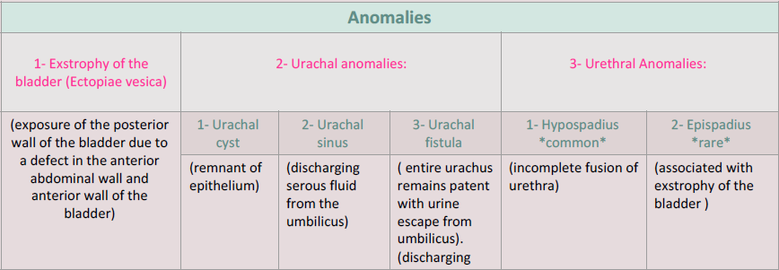
Summary

Slide 14
Team leaders:
محمد ثامر الزهراني – آلاء الصويغ
Team Members:
- مها النهدي - رشيد البلاع
- سارة البليهد - عمر سعد اليابس
- ميعاد النفيعي - علي شحادة
عهد القرين - فهد النهابي
غادة القرني
contact us on: embryology437@gmail.com
Wish all the best :)

