Slide 3
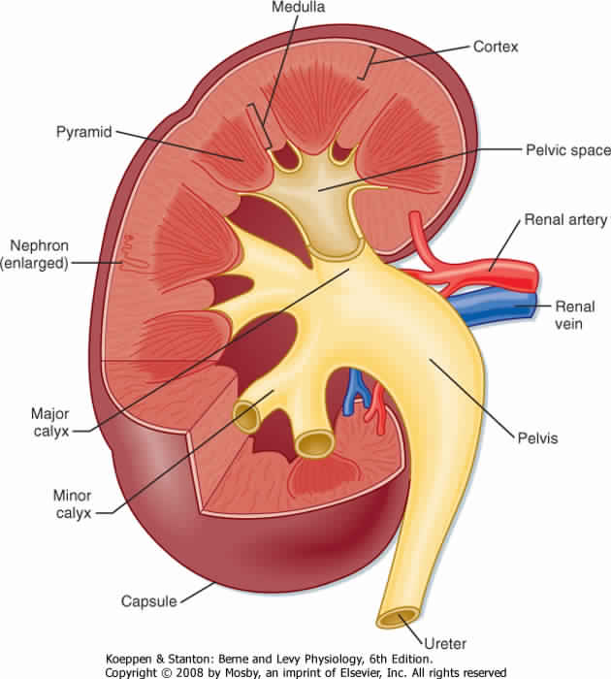
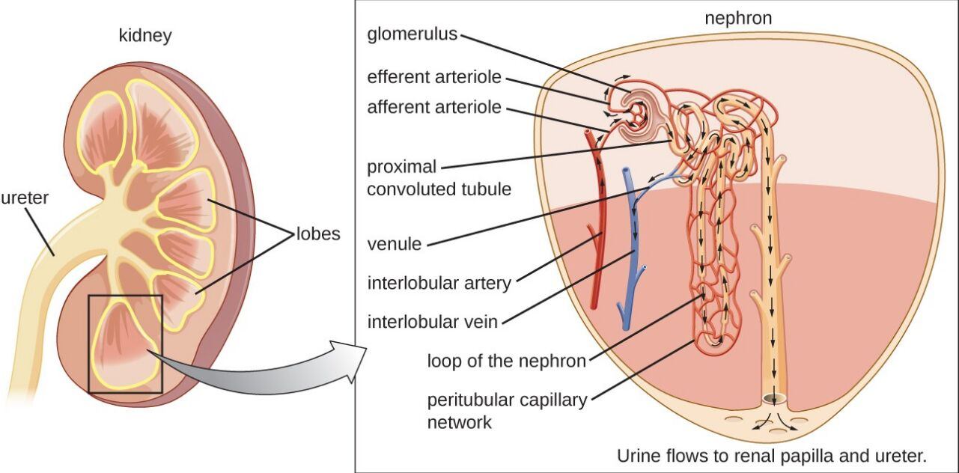
KIDNEY
Cortex: Dark brown and granular. Content of cortex (renal corpuscle, PCT, loop of Henle, DCT, part of collecting tubule)
Medulla: 6-12 pyramid-shape regions (renal pyramids) content of medulla ( collecting duct, loop of Henle, collecting tubule)
The base of pyramid is toward the cortex (cortico-medullary border)
The apex (renal papilla) toward the hilum, it is perforated by 12 openings of the ducts of Bellini (Papillary “collecting” ducts) in region called area cribrosa.
The apex is surrounded by a minor calyx.
3 or 4 minor calyces join to form 3 or 4 major calyces that form renal pelvis.
Pyramids are separated by cortical columns of Bertin (renal column)
URINIFEROUS TUBULE
It is the functional unit of the kidney.
Is formed of: 1- Nephron. 2-Collecting tubule.
The tubules are densely packed.
The tubules are separated by thin stroma and basal lamina.

Slide 4
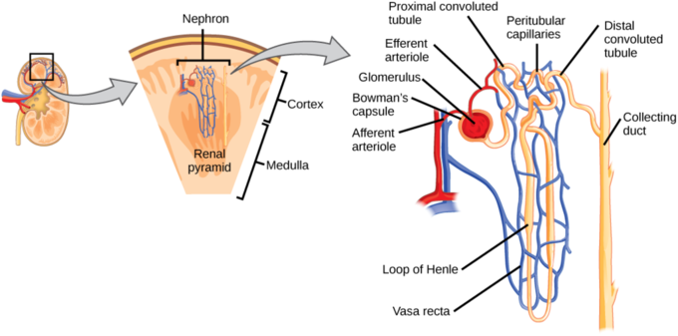
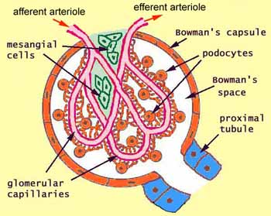
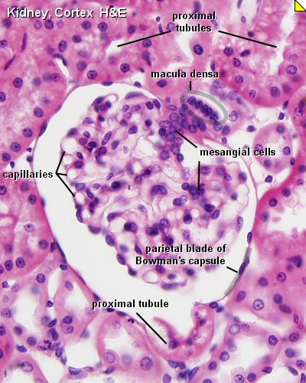
NEPHRON
There are 2 types of nephrons: a- Cortical nephrons. b- Juxtamedullary nephrons. (Juxta = near)
It is formed of : 1- Renal corpuscle. 2- Proximal tubule. 3- Thin limbs of Henle’s loop. 4- Distal tubule
Renal Corpuscle
Glomerulus; (tuft “حزمة” of fenestrated capillaries "without diaphragm”)
Bowman’s capsule; (Parietal layer, urinary space and visceral layer or podocytes) In front of bowman’s capsule known as vascular pole ,Back of bowman’s capsule known as Urinary pole.
Mesangial cells; (intra-glomerular cells).

Slide 5
GLOMERULAR FILTRATION BARRIER
Called glomerular endothelium.
Endothelial wall of the glomerular capillaries.
The glomerular basal lamina (inner and outer laminae rarae and middle lamina densa).
Visceral layer of Bowman’s capsule (podocytes) Cell come contact with glomerulus known as podocyte (podocyte = viscera layer)
Podocytes have primary (major) processes and secondary (minor) processes “pedicles”.
Between pedicles (on the surface of capillaries) there are filtration slits that have filtration slit diaphragms

Slide 6
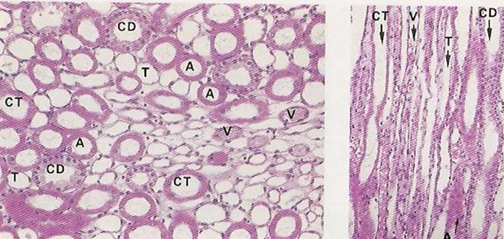
Proximal tubule:
It is composed of simple cuboidal epithelium with acidophilic cytoplasm.
The cells have striated or brush border and lateral inter-digitations.
They have well-defined basal lamina.
It's is more than tubule distal in the cortex. Most of tubular sections in cortex related to PCT PCT cells have brush border (microvilli) to help in reabsorptions
Thin limbs of Henle’s loop:
It has 3 regions: 1-Descending thin limb. 2-Crest of Henle’s loop. 3-Ascending thin limb.
It is longer in juxta-medullary nephron than in cortical nephron.
It is composed of simple squamous epithelium.
Loop of Henle’s and tubules extend to medulla
Distal tubule:
It starts at the macula densa.
macula densa (tall columnar & narrow cells)
The Distal convoluted tubule is formed of low cuboidal epithelium.
Because distal convoluted tubules are much shorter than proximal convoluted tubules, any section of renal cortex presents many more sections of proximal convoluted tubules.
Distal tubules drain into collecting tubules.
N.B. Cells in distal tubule come in contact with afferent & efferent arterioles is macula densa
N.B. More reabsorption occurs in the proximal tubules.

Slide 7
COLLECTING TUBULES
Endothelial wall of the glomerular capillaries.
Are composed of simple cuboidal epithelium.
They aren’t part of nephron.
They have 3 regions:
1-Cortical: Simple Cuboidal Epithelium.
2-Medullary: Simple Cuboidal Epithelium.
3-Papillary ducts (ducts of Bellini): Simple Columnar Epithelium.
They open in area cribrosa.
They are impermeable to water except in presence of ADH.
Collecting tubule lined with cuboidal E.P once it change to columnar E.P called collecting duct
RENAL INTERSTITIUM
It is a very flimsy, scant amount of loose connective tissue that contains: 1-Fibroblasts. 2-Macrophages. 3-Interstitial cells: They secrete medullipin I, which is converted in the liver into medullipin II, that lowers blood pressure.

Slide 8
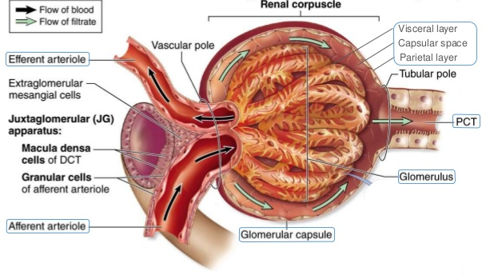
From 436 team Explanation from Dr.Raeesa
The renal corpuscle has two poles
1- vascular pole
2- urinary pole for the passage of what will give me urine later.
The vascular pole is for the blood entry and excitation of arterioles:
(Afferent + Efferent)
The blood enters the afferent arteriole and goes out when its filtered through efferent arteriole.
In the space between the two arterioles there is distal tubule, part of it is adherent to the arterioles.
So the triangle of Juxtaglomerular apparatus is formed of 3 things:
part of afferent, part of efferent, part of distal tubule and in between there is extra mesangial cells.
There are changes only in the cells of distal tubule adherent to the afferent arterioles:
The changes:
1- Columnar epithelium with oval nuclei
2- The number of cells increase
3- There is macula dense
There are changes in the arterioles in the part adherent to the distal tubule.
the changes:
1- Modification in the tunica media (smooth muscle), so instead of spindle shaped cell it will be cuboidal cell. After modification it called Juxtaglomerular cells which is responsible for renin secretion.

Slide 9
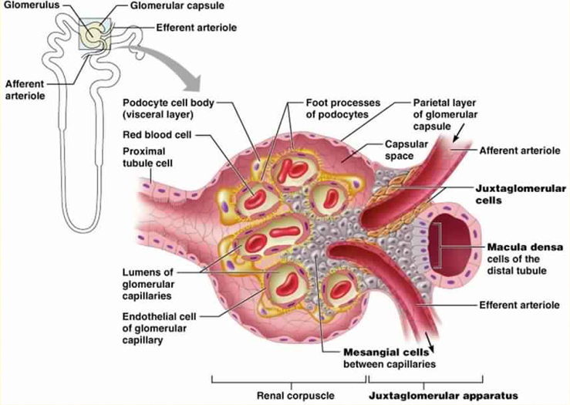
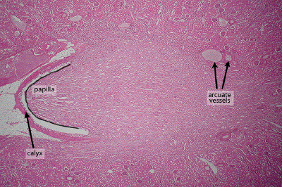
Juxtaglomerular Apparatus
When DCT come in contact with afferent & efferent arterioles some modification happened to some cell: 1) Cells in distal tubule come in contact with afferent & efferent arterioles change from cuboidal to columnar cells called macula dense 2) smooth muscle cell in wall of afferent & efferent arterioles come in contact with DCT change to cuboidal cells called juxtaglomerular cell
It has 3 components:
A-The macula densa of distal tubule: Tall cells with centrally-placed nuclei
B-Juxtaglomerular cells: of afferent glomerular arteriole (modified smooth muscle of tunica media), Nuclei are round with granular cytoplasm. They secrete renin.
C-The extraglomerular mesangial cells.
Renal Calyces
Each calyx accepts urine from the renal papilla of a renal pyramid.
They are lined with transitional epithelium, lamina propria & smooth muscle.
Minor calyces merge to form major calyces (with same lining tissue as minor calyces).
Major calyces open into renal pelvis.
Urinary track epithelium start from minor calyces until part of urethra

Slide 10
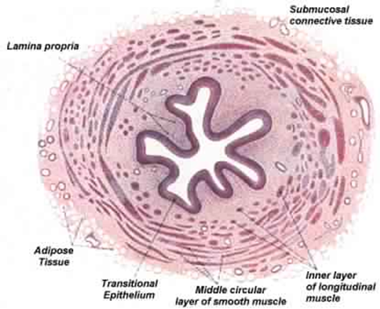
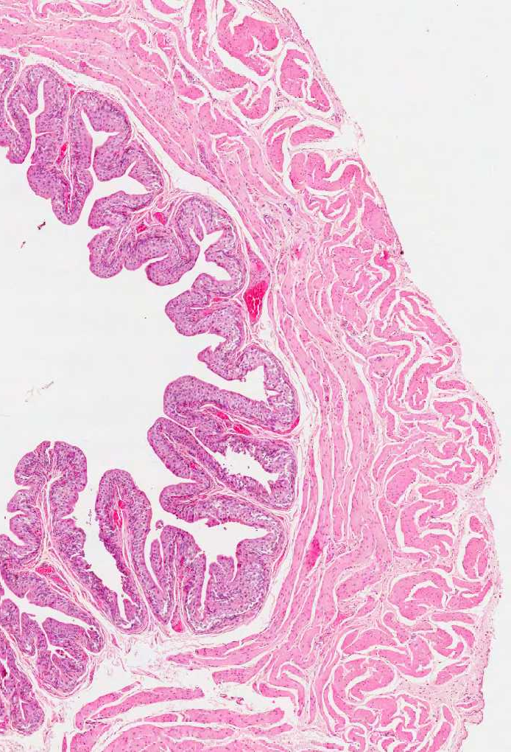
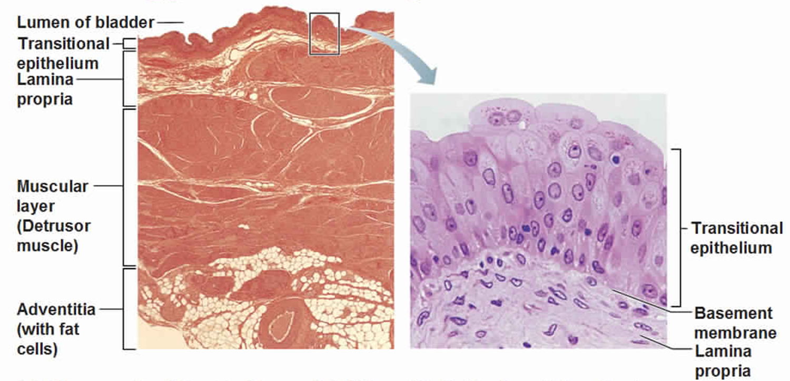
Ureter
Mucosa: Is formed of transitional epithelium and lamina propria.
Muscularis (muscular coat): Is formed of 2 layers of smooth muscle in the upper 2/3: 1) Inner longitudinal. 2) Outer circular. Is formed of 3 layers of smooth muscle in the lower 1/3: 1) Inner longitudinal. 2) Middle circular. 3) Outer longitudinal.
Adventitia: fibrous C.T. covering (Without serosa). Serosa -> adventitia + visceral layer of peritoneum (mesothelium)
Urinary bladder
It has the same structure as the lower third of ureter. (All same lower third of ureter except urinary bladder with serosa while ureter without serosa)
Superficial layer of transitional epithelium has dome-shaped cells (in empty bladder).
It has 3 layers of smooth muscle: 1) Inner longitudinal. 2) Middle circular. 3) Outer longitudinal.
Its outer covering is adventitia or serosa.
Part of urinary bladder cover with Adventitia and other part cover with Serosa

Slide 11
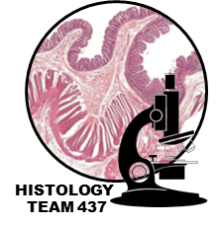
Urethra
Male urethra (divided into 3 regions) |  | Female urethra
Prostatic urethra (3 cm) | is lined with transitional epithelium | Epithelium | 1-Transitional epithelium near the bladder 2-Pseudostratified columnar epithelium 3 Stratified squamous non-keratinized epithelium
Membranous urethra (1 cm) | Its longest part is lined with Stratified columnar epithelium with patches of pseudostratified columnar epithelium | Sub-epithelial fibroelastic C.T. | that contains glands of Littre (mucus-secreting glands)
Penile (spongy) urethra (16 cm)
Penile (spongy) urethra (16 cm) |  | Smooth muscle | inner longitudinal and outer circular layers
N.B. In navicular fossa (enlarged terminal portion): Stratified squamous non-keratinized epithelium.
N.B. The lamina propria contains mucus secreting glands of Littre.
N.B. The female urethra is shorter than the male urethra

