Slide 1
Please check the editing file to see if there are any changes
Management &
Treatment for Urinary Tract Infection
Important! Doctor’s Notes
Only found in females’ slides Only found in males’ slides Extra Notes
“ I’m not telling you it’s going to be easy. I’m telling you it’s going to be worth it.”

Slide 2
Objectives
➔ Recall the principal goal of management of urinary tract infection (UTI) and that antibiotics are the main treatment of UTI
➔ Discuss the factors that management of UTI depends on
➔ Describe the management/ treatment of different conditions of UTI ( cystitis, pyelonephritis, catheter associated UTI, etc.)

Slide 3
Goal of Management of UTI
➔ The principal goal of management of UTI is to eradicate the offending organisms from the urinary bladder and tissues.
➔ The main treatment of UTI is by antibiotics.
Management of UTI depends on:
➔ Whether infection is complicated or uncomplicated.
➔ Whether infection is primary or recurrent.
➔ Type of patient (pregnant ,child , hospitalized or not, diabetic patient,…..etc)
➔ Bacterial count.
➔ Presence of symptoms.

Slide 4
Urinary Tract Infection
The treatment duration is about 7-14 d in most cases
Uncomplicated
Complicated
- Low-risk patient (woman) for recurrent infection:
- 3 days antibiotic without urine test, and the cure rate is 94%.
- The choice of antibiotic depend on susceptibility pattern of bacteria, which includes:
Diabetes mellitus
Aging
Nitrofurantoin (for long term use) prophylaxis
جﻼﻋ وﻣ ﺔﯾﺎﻗوﻛ ﻰطﻌﯾ
Spinal cord injury
لوﻠﺷﻣ
Catheterization
Amoxicillin ( with or without clavulanic acid)
Cephalosporins ( first or second generation)
Comorbidities in pediatric patients
Kids w/ structure abnormality
Fluoroquinolone (ciprofloxacin or norfloxacin):
(not for pregnant women or children under 18 year)
(first choice if other antibiotics are resistant.)
TMP-SMX ( trade names: Bactrim, Septra, Cotrimoxazole)

Slide 5
Relapsing infection | Recurrent infections
Relapse means that there’s a treatment failure (جﻼﻌﻟا دﻌﺑ نﺳﺣﺗ ﺎﻣ ﻲﻧﻌﯾ) Caused by: ➔ Treatment failure ➔ Structural abnormalities ➔ Abscesses. Antibiotics used at the initial infection treatment for 7-14 days. | Recurrent means that the patient will recover then get sick again. Patients with two or more symptomatic UTIs within 6 months or 3 or more over a year. ➔ Need preventive therapy ➔ Antibiotic taken as soon as symptoms develop. If infection occurs less than twice a year, a clean catch urine test should be taken for culture and treated as initial attack for 3 days.
When to consult the doctor?
Important!
➔ If symptoms persist
➔ A change in symptoms (like blood in urine and pain)
➔ Pregnant women (pregnant women have to always consult a doctor bc sometimes they get Asymptomatic bacteriuria → high count in urine but no symptoms. So if not treated can cause pyelonephritis)
➔ More than 4 infections per year
➔ Impaired immune system
➔ Previous kidney infections
➔ Structural abnormalities of urinary tract
➔ History of infection with antibiotic multi resistant bacteria.
The difference between Relapsing and Recurrent infections that relapsing means the patient didn’t recover completely and have the same bacteria. Recurrent means the patient recovered completely and then had reinfection.

Slide 6
Postcoital antibiotics
Prophylactic antibiotics
➔ If recurrent UTI is related to sexual activity, and episodes recur more than 2 times within 6 months
➔ A single preventive dose taken immediately after
intercourse
➔ Antibiotics include: TMP-SMX,
Cephalexin or Ciprofloxacin (for short time to avoid infection)
➔ Optional for patients who do not respond to other measures.
➔ Reduces recurrence by up to 95%
➔ Low dose antibiotic taken continuously for 6 months or longer it includes :
TMP-SMX, Nitrofurantoin, or Cephalexin
Antibiotic taken at bedtime more effective. (to protect against recurrent)

Slide 7
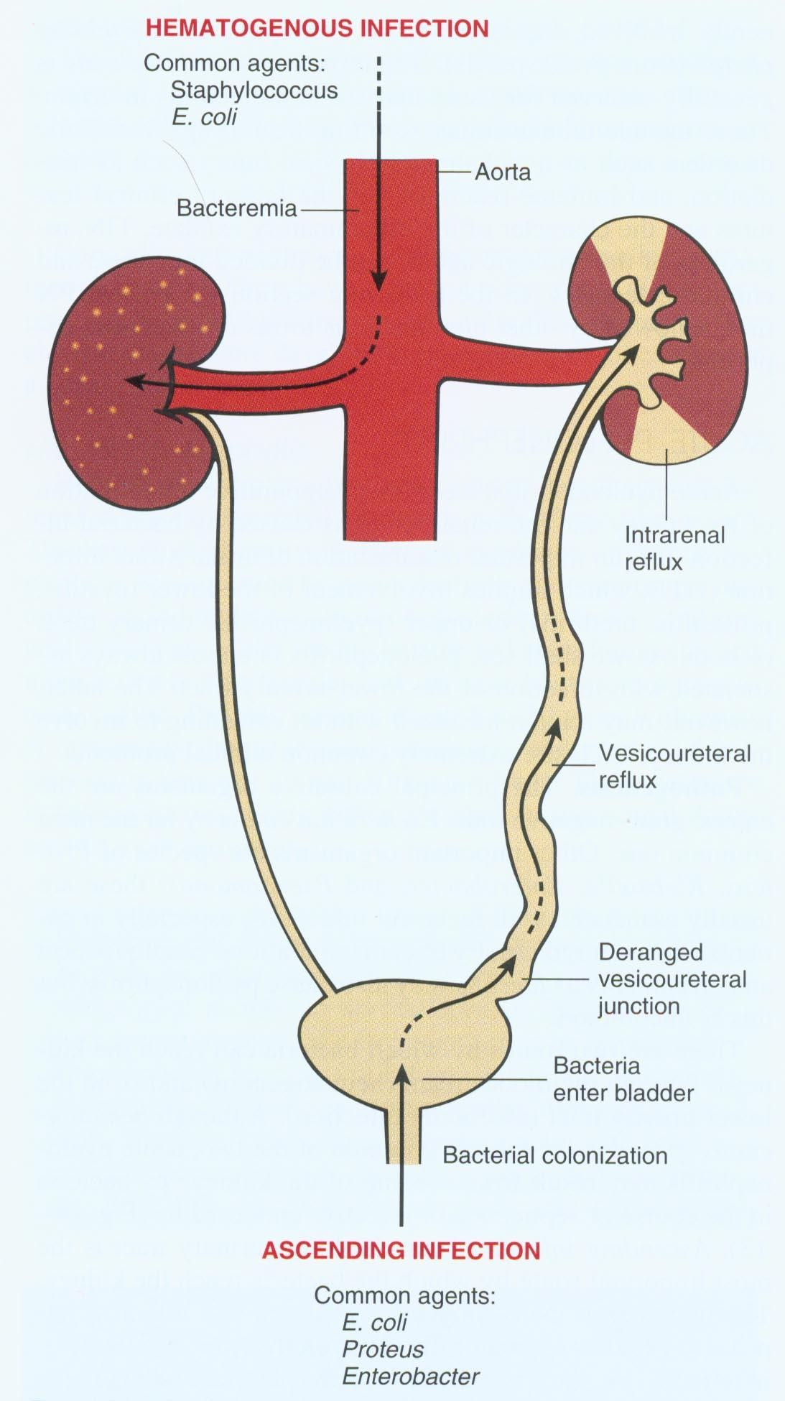
Uncomplicated pyelonephritis
Moderate to severe pyelonephritis
Chronic pyelonephritis
➔ Patients with fever, chills and flank pain but they are healthy,
non-pregnant, female, without relevant comorbidities and without structural or functional urinary tract abnormalities.
➔ Patients need hospitalization
➔ Antibiotic given by IV route for 3-5 days until symptoms relieved for 24-48 hrs.
➔ If fever and back pain continue after 72 hrs of
antibiotic, imaging tests (x-ray, ivu, ct scan) indicated to exclude abscesses, obstruction or other abnormality.
➔ Those patients need long-term antibiotic treatment even during periods when they have no symptoms.
➔ chronic pyelonephritis is a rare condition and usually due to obstruction. Unlike other infections, chronic pyelonephritis doesn’t develop from acute phase it just
➔ Can be treated at home with oral antibiotics for 14 days with one of the followings:
Cephalosporins
Amoxicillin-Clavulanic acid
Ciprofloxacin
TMP-SMX.
starts as chronic.
Fibrosis
- First dose may be given by injection.
Dilated ureter

Slide 8
Treatment of specific populations
Pregnant women
Uncomplicated UTI
Diabetic patients
➔ High risk for UTI and complications
➔ Should be screened for UTI
➔ Antibiotics during pregnancy includes: Amoxicillin, Ampicillin, Cephalosporins, and Nitrofurantoin.
➔ Pregnant women should NOT take Quinolones or
Tetracycline.
➔ For uncomplicated UTI (any patient, not at pregnancy) need 3-5 days antibiotic treatment.
➔ Similar to pregnant women
➔ Have more frequent and more severe UTIs.
➔ Treated for 7-14 days with antibiotics even patients with uncomplicated infections
➔ Pregnant women with asymptomatic bacteriuria (evidence of infection but no symptoms) have 30% risk for acute pyelonephritis in the second or third trimester. Screening and 7-10 days antibiotic needed.

Slide 9
Very Important!!!
Remember when children have UTI always try to know the cause especially in young boy.
Urethritis in Men
Urethritis in Children
Prof. hanan said you should know the name of the drugs.
Vesicoureteric Reflux (VUR)
➔ Sexually transmitted disease
➔ Most important causes:
Neisseria gonorrheae
Chlamydia trachomatis
➔ Treated with IM Ceftriaxone (work on Neisseria) + Doxycycline or Azithromycin (work on Chlamydia).
➔ Patients should also be tested for accompanying STD.
➔ Once a kid has recurrent UTI a congenital abnormality might occur.
➔ Usually treated with TMP-SMX or Cephalexin.
➔ Sometimes given as IV .
➔ Gentamicin may be recommended as resistance to Cephalexin is increasing.
➔ Common in children with UTI
➔ (if not treated) can lead to pyelonephritis and kidney damage.
➔ Long-term (for months) antibiotic plus surgery used to correct VUR and prevent infections.
➔ Acute kidney infection (like fever, high bacteria count and pain): use Cefixime (oral) or IV Ceftriaxone or Gentamicin a one daily dose for 2-4 days followed by oral treatment eg. amoxicillin-clavulanic acid or TMP-SMX .
➔ Start with IV then continue w/ oral meditation for 14 days

Slide 10
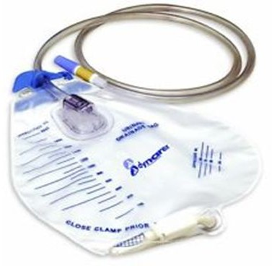
Management of catheter-induced UTI
➔ The catheter is a foreign body so it will cause infection
➔ Very common
➔ Preventive measures important.
➔ Catheter should not be used unless absolutely necessary and they should be removed as soon as possible.
Intermittent use of catheters:
➔ If catheter is required for long periods ,it is best to be used intermittently. (فﻗوﻧ نﯾدﻌﺑ هرﺗﻔﻟ ﮫﻣدﺧﺗﺳﻧ ﻲﻧﻌﯾ)
➔ May be replaced every 2 weeks to reduce risk of infection and irrigating bladder* with antibiotics between replacements.
irrigating of the bladder means that they enter sterile water and sterile antibiotic to wash and flush the bladder then introduce to the new catheter.
➔ Daily hygiene and use of closed system to prevent infection.

Slide 11
Catheter induced infections
➔ Its normal for patients who are on catheters to have a urine full of bacteria so it doesn’t mean that they have UTI.
➔ Catheterized patients who develop UTI with symptoms or at risk for sepsis (fever and chill) should be treated for each episode with antibiotics and catheter should be removed, if possible.
➔ Associated organisms are constantly changing.
➔ May be multiple species of bacteria.
➔ We will only treat patients with symptoms.
➔ Antibiotic use for prophylaxis is rarely recommended since high bacterial counts present and patients do not develop symptomatic UTI.
➔ Antibiotic therapy has little benefit if the catheter is to remain in place for long period.
نﯾﻋوﺑﺳا لﻛ رﺗﺛﺎﻛﻟا رﯾﻐﻧ مزﻻ اذﻛ نﺎﺷﻋ.

Slide 12
Dr’s Notes
vesicoureteric reflux: *very important*
whenever a child gets UTI than you must look for a cause. Most of them usually have vesicoureteric reflux.
why is it important? Because it may lead to acute pyelonephritis and if not treated may lead to recurrent infections leading finally to kidney damage. you give them antibiotics until they get their surgery, antibiotics include oral Cefixime or IV ceftriaxone or Gentamycin followed by oral treatment “amoxicillin-clavulanic acid or TMP-SMX”
Case 1: 30 year old w/ frequency and painful urination. Urine analysis showed + leukocyte esterase and nitrate. Microscopy revealed presence of WBCs & bacteria.
Diagnosis? Uncomplicated acute cystitis
Duration of treatment? Since it’s uncomplicated, the treatment should from 3-5 days.
Management? amoxicillin or TMP-SMX or Cephalosporin first or second generation or ciprofloxacin What if she was diabetic? it would be complicated thus she have to be treated for 7-14 days.
Case 2: 30 year old asymptomatic pregnant woman. Culture was positive for 100,000 CFU/ml E coli Sensitive to all tested abx.
Management? antibiotic: Amoxicillin or a narrow spectrum antibiotic since she’s pregnant and we don’t to harm the fetus. other antibiotics include Ampicillin, or Cephalosporins first or second generation ( first: cephalexin, second: cefuroxime axetil).
Doctor asked: if we have the same case but instead of pregnant we have diabetic, what would be the treatment? Since she’s asymptomatic and non-pregnant then you don’t treat.”
Another question the doctor asked: which of the following is an indication to treat an asymptomatic patient? Pregnant”
Case 3: 30 year old with frequency and painful urination. Fever, flank pain and tenderness on exam of the area. Urine analysis showed + leukocyte esterase and nitrate. Microscopy revealed presence of WBCs and bacteria.
Diagnosis? Acute pyelonephritis
Management? In this case the patient is not that sick so you would favour oral treatment with Ciprofloxacin which is a good choice . Why? Because it has high bioavailability; however, overuse of it may cause resistance
If the patient was highly sick you would go with IV 2-4 days with ceftriaxone or gentamycin then you would step down to oral.

Slide 13
Dr’s Notes
Case 4: a 4 year old male child with pyelonephritis.
- Management? you can use third generation cephalosporins (if the patient was old we can start w/ ciprofloxacin) ”cefixime” or first generation “cephalexin” or you can start with Gentamicin or IV Ceftriaxone then step down to oral treatment (amoxicillin- clavulanic acid or TMP-SMX) .
(Found to have VUR) this might be mentioned directly in the case or it might be mentioned later in one of the questions
- Management? Why? you should start with long-term prophylactic antibiotic until they get their surgery. Why? Because meanwhile they are prone to infections which may lead to kidney damage.
We must know the conditions of when to consult the doctor.
Low-risk patient (females) can be treated with antibiotic for three days without urine culture. Amoxicillin works well for E.coli.
You should watch out age and pregnancy when using Fluoroquinolones. when of the bad aspects about using prophylactic is that resistance may develop. Staph saprophyticus is one of the common agents that cause Post coital UTI. in the case of lower UTIs you can use narrow spectrum antibiotic? Why narrow spectrum? Because lower UTIs are not potentially harmful. Chronic pyelonephritis happens mostly whenever there’s a structural or functional abnormality (ex: vesicoureteral reflux) in these patient you should start with an antibiotic until they get a sugary.
In pregnant woman you go with a narrow spectrum because the type of antibiotic might harm the infant. Pregnant females are at risk for pyelonephritis

Slide 14
Summary
Uncomplicated Complicated
Relapsing infection
Recurrent infections
Uncomplicated pyelonephritis
Moderate - sever pyelonephritis
Chronic pyelonephritis
Low-risk patient (woman) for recurrent infection
1-Aging 2-DM
2-Spinal cord injury
4-Catheterization 5-Comorbidities in children.
1-treatment failure
2-structural
3-abnormalities 4-abscesses.
two or more symptomatic UTIs within 6 months or 3 or more over a year.
fever, chills and flank pain but healthy, female non-pregnant, without comorbidities and without structural or functional UT abnormalities
Patients need hospitalization
need long-term antibiotic treatment even during periods when they have no symptoms.
Amoxicillin (with or without clavulanic acid) Cephlosporins(1or 2g) Fluoroquinolone TMP-SMX
Nitrofurantoin ( for long term use)
Antibiotics used at the initial infection
Need preventive therapy
If infection occurs less than 2 a year, a clean catch urine test should be taken for culture and treated as initial attack for 3d.
at home with oral antibiotics: Cephalosporins, Amoxicillin-Clavulanic acid, Ciprofloxacin or TMP-SMX.
First dose may be given by injection
-Antibiotic given by IV route
-If fever and back pain continue after 72 hrs of antibiotic, imaging tests to exclude abscesses, obstruction or other abnormality.
Antibiotic
-
-
Time
3 days antibiotic without urine test.
-
Treatment for 7-14 days
Antibiotic taken as soon as symptoms develop
14 days
for 3-5 days
-

Slide 15
 | Pregnant women | Diabetic patients | Urethritis in men | Children with UTI | VUR | Acute kidney infection
 | -High risk for UTI and should be screened. -Pregnant women with asymptomatic bacteriuria have risk for acute pyelonephritis, Screening and 7-10 days antibiotic needed. | Have more frequent and more sever UTIs. | causes: 1-Neisseria gonorrheae 2-Chlamydia trachomatis Patients should be tested for other STD. |  | Common in children with UTI Can lead to pyelonephritis and kidney damage. | Cefixime ( oral) or IV Ceftriaxone or Gentamicin a one daily dose for 2-4 days followed by oral treatment eg. amoxicillin-clav ulanic acid or TMP-SMX
Treatment | Amoxicillin, Ampicillin, Cephalosporins, and Nitrofurantoin. NEVER Quinolones Fluoroquinolone ( ciprofloxacin or norfloxacin) | Treated for 7-14 days with antibiotics even patients with uncomplicated infections | Treated with IM Ceftriaxone + Doxycycline or Azithromycin. | TMP-SMX Cephalexin. Gentamicin (if resistant for Cephalexin) | Long-term antibiotic + surgery
If catheter is required for long periods ,it is best to be used intermittently, and irrigate bladder with antibiotics.
Catheterized patients who develop UTI with symptoms or at risk for sepsis should be treated with antibiotics and catheter should be removed, if possible.
Antibiotic use for prophylaxis is rarely recommended since high bacterial counts present and patients do not develop symptomatic UTI.

Slide 16
Summary for antibiotic:
 | Amoxicillin | Cephalosporins | Fluoroquinolone |  | TMP-SMX | Nitrofurantoi n | Cephalexin | Gentamicin
 | - | - | ciprofloxacin | norfloxacin | - | - | - | -
Use in | 1-Uncomplicated | 1-Uncomplicated | 1-Uncomplicated | Uncomplicated | 1-Uncomplicated | 1-Uncomplicated | 1-Postcoital | 1-Children with
 | UTI | UTI | UTI | UTI | UTI | UTI | antibiotics | UTI
 | 2-Uncomplicated | 2-Uncomplicated | 2-Postcoital | first choice if | 2-Postcoital | 2-Prophylactic | 2-Prophylactic | 2-VUR
 | pyelonephritis - | pyelonephritis | antibiotics | other antibiotics | antibiotics(UTI is | antibiotics | antibiotics
 | VUR (with | 3-Safe with | 3-Uncomplicated | are resistant. | related to sexual | 3-Safe with | 3-Children with
 | Clavulanic acid) | pregnancy | pyelonephritis |  | activity) | pregnancy | UTI
 | 3-Safe with |  |  |  | 3-Prophylactic
 | pregnancy |  |  |  | antibiotics
 |  |  |  |  | 4-Uncomplicated
 |  |  |  |  | pyelonephritis
 |  |  |  |  | 5-Children with
 |  |  |  |  | UTI
 |  |  |  |  | 6-VUR

Slide 17
3- A young married man was diagnosed with urethritis. To complete your tests what do you have to do next?
MCQs
Thanks team 435-436
1-50 year old diabetic male came with frequent urination and a dysuria, his doctor diagnosed him with urethritis.
Which of the following can be is the best choice for him? A-Azithromycine for 7 days.
B-Doxycycline for 7 days.
C-Azithromycine for 7­-14 days. D-Doxycycline for 7-­14 days.
2-A 10 years child presented with UTI, was prescribed Cephalexin, second urine analysis after a full course of Cephalexin shows same bacteria. What should you prescribe as alternative antibiotic?
A-norfloxacin
B-Ciprofloxacin C-Nitrofurantoin D-Gentamicin
A)CT scan.
B)Test him for STD.. C)Look for abscesses. D)Nothing should be done.
4-A 26 year old female presented to the clinic with a recurrent dysuria after sexual activity, which of the following procedures can benefit her best?
A- A single dose of gentamicin before intercourse. B- A single dose of TMP­-SMX before intercourse. C-A single dose of gentamicin after intercourse.
D-A single dose of TMP­-SMX after intercourse.
5- A female patient was complaining of flank pain, chills and her temperature was high, she was diagnosed with pyelonephritis. She has no further problems. What is the best treatment plan for this case?
A-Gentamicin orally for 7 days.
B-Ciprofloxacin orally for 14 days. C-Cefixime orally for 14 days.
D-Ceftriaxone orally for 7 days
5-B
4-D
3-B
2-D
1-D

Slide 18
SAQ
the choice of antibiotic depend on?
susceptibility pattern of bacteria
A pregnant woman’s urine analysis show bacteriuria, her general appearance is
normal. She complain of nothing, and she denies having nausea or vomiting.
→ What should you be concerned of ?
acute pyelonephritis
→ For how long will you put her on antibiotic?
7-10 days
→ which antibiotic we can not give to this patient?
Quinolones, Fluoroquinolone ( ciprofloxacin or norfloxacin)
3- A male patient presented with Urethritis, what would you prescribe him?
IM Ceftriaxone + Doxycycline or Azithromycin.

Slide 19
Team Leaders
Alanoud Almansour & Omar Alsuhaibani
Team Members
Please contact us if you have any suggestion, correction, or question: Microbiology.med437@gmail.com
Special thanks to: Reem AlQahtani
Alanoud Alessa Dana Alrasheed Hadeel Awartani Khulood Alwehaibi Nada Alobaid Norah Alkadi
Nouf Alotaibi Noura Alothaim Reema Aldihan Reema AlEnezy Sara Alsultan Shouq Alqahtani
Adel Alsuhaibani Hussien Alami Khaled Aldosari
Mohammed Aldwaghri Sulaiman Alzomia

