Slide 1
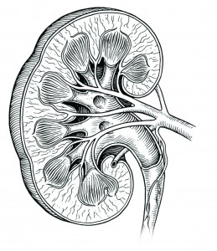
Diuretics
Define and classify diuretics
Identify the site of action of each class of diuretics in the nephron
Describe the mechanisms of action of diuretics
Detail on the pharmacodynamic actions and pharmacokinetic aspects of diuretics
List ADRS, therapeutic uses, contraindications and drug- drug interactions of diuretics
Important Notes Extra Boy’s Slides only

Slide 2
Diuretics
Definitions:
Diuretics: Drugs that increase urine volume.
Diuresis: The process of excretion of water in the urine.
Can we use water as a diuretic? Yes
Indications of diuretics:
Edema of any origin
Congestive heart failure
Hypertension (mild)
Elimination of toxins
All Diuretics have naturetic effect.
Natriuresis: is the process of excretion of sodium in the urine
Mechanism of action of diuretics:
Most diuretics act by interfering with normal sodium reabsorption by the renal tubules resulting into sodium and water excretion.
Site of action for diuretics:
Target molecules for diuretics are carriers or transporters in luminal membrane of renal tubule cells required for tubular reabsorption of sodium from filtrate back into blood.
Classification:
Carbonic anhydrase inhibitors
Loop diuretics
Thiazide diuretics
K+ sparing diuretics
*Osmotic diuretics
*Osmotic diuretic has no target, it gives the action by it's physical character
physical character :
sugar or salt يسحب موية لانه اما

Slide 3
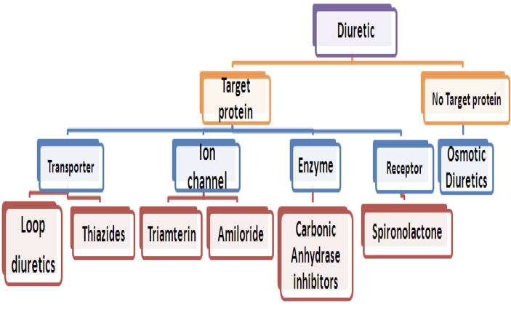
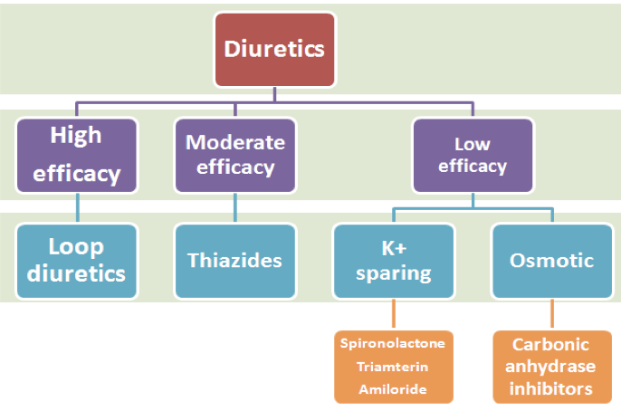
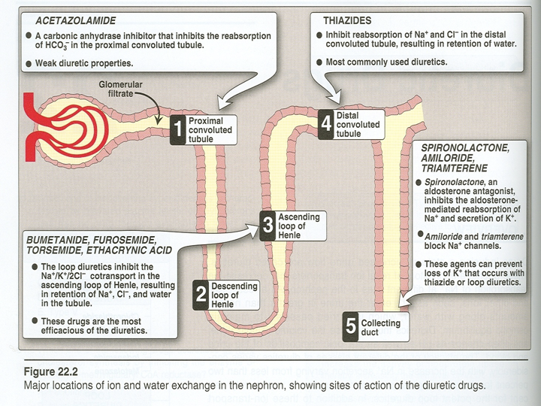
Classification of Diuretics
Site of action of diuretics
dr hanan mentioned it is important to know which diuretic works on what
Helpful Videos!

Slide 4
Site of action of diuretics
Normal sodium reabsorption
Segment | Function | Filtered Na + reabsorbed | Transporter | Diuretics
Proximal convoluted tubules | Reabsorption of: - 66% Na, K, Mg, Ca - 100% glucose and amino acids - 85% NaHCO3 | 85 % Na, HCO3 65 % As NaHCO3 | Na/H transporter *Carbonic anhydrase enzyme | Carbonic anhydrase inhibitors work on: Na/H transporter Carbonic anhydrase enzyme
Proximal straight tubules | Secretion and reabsorption of organic acids and bases |  | Acid and base transporter
Thick ascending loop | Active reabsorption 25% Na, K, Cl Secondary Ca, Mg reabsorption | 20-30% Active reabsorption Na, K, Cl Ca and Mag | Na/K/2Cl* cotransporter *Sodium potassium dichloride | Loop diuretics work on: Na/k/2Cl co- transporter
Distal convoluted tubule | Active tubular reabsorption of 5% Na, Cl, Ca | 5-10% Active reabsorption Na, Cl | Na/Cl Cotransporter | Thiazide diuretics work on: Na/Cl co- transporter
Collecting tubules | Na reabsorption K & H secretion | 5% Na reabsorption K & H secretion | Na channels K and H transporter Aldosterone Antidiuretic hormone | K-sparing diuretics work on: Na+ channels and aldosterone
site for the reabsorption of large amount of sodium, but sodium get reabsorbed in the form of sodium bicarbonate
*Enzyme required for the reabsorption of bicarbonate
>Once bicarbonate get reabsorbed , as a sequence Na will get reabsorbed

Slide 5
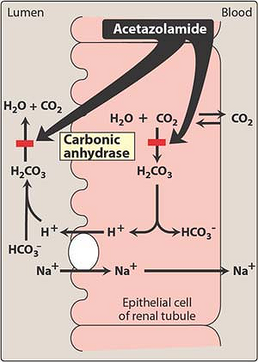
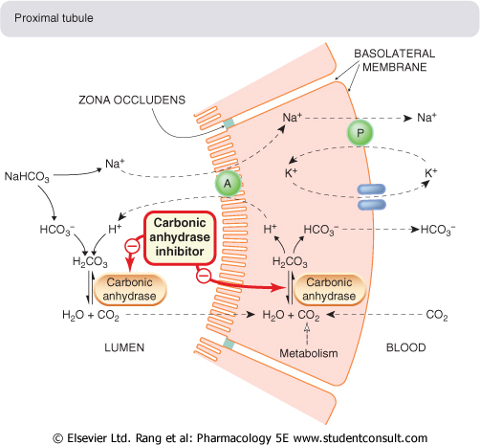
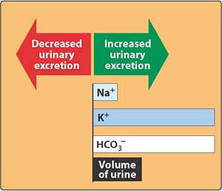
Carbonic Anhydrase Inhibitors
 | Dorzolamide |  | Acetozolamide
 | Inhibits carbonic anhydrase (CA) enzyme in proximal convoluted tubules thus interferes with NaHCO3 re-absorption and causes diuresis.
 | Carbonic anhydrase is required for reversible reaction in which CO2 +H2O H2CO3 H⁺ + HCO3⁻
 | given orally once a day. Onset of action is rapid (30 min). Duration of action (9-12 h) long duration of action. Excreted by active secretion in proximal convoluted tubules. Produces alkaline urine
 | ↑ Mild increase in urine volume ↑ urinary excretion of sodium, potassium , bicarbonate (alkaline urine). Metabolic acidosis. ↑ Urinary phosphate excretion. *Promotes K+ excretion by ↑the load of Na+ delivered to the distal tubules.
 | Why do CA inhibitors have weak diuretic properties? Diuretic properties decreases after several days as the blood bicarbonate falls. it’s dependent on the bicarbonate so when it is limited it’s effect will decrease
it’ll work there
M.O.A
Lumen
Blood
Luminal membrane
Basolateral membrane
Proximal tubules
Pharmacokinetics
because of the loss of bicarbonate in the urine due to inhibiting the enzyme responsible for reabsorbing it, we will produce an alkaline urine but = metabolic acidosis
Pharmacological actions
العادة الدايروتيكس هذي تزيد الصوديوم اكسكريشن لو تشتغل على الجزء الأول من
راح يلاقي الالدوستيرون اللي بيسوي DCT النفرون ، بعدين الصوديوم وهو ماشي يوصل عند
reabsorption of Na and excretion of K
>> Hypokalemia
*
NOTE

Slide 6
Carbonic Anhydrase Inhibitors CONT
 | 1..Open angle glaucoma carbonic anhydrase inhibitors decrease aqueous humour formation and ↓ IOP by reducing aqueous humor formation in ciliary body of eye.(tolerance doesn’t develop to this effect so we can use it continuously) 2.As prophylactic therapy, in acute mountain sickness ↓ CSF of brain given nightly 5 days before the ascent ↓ weakness, breathlessness , dizziness, nausea, cerebral & pulmonary oedema. who will need this drug? mountain climbers IOP: Intraocular pressure; CSF: Cerebrospinal fluid 3.Formation of CSF: (↓ of carbonic anhydrase in the choroid plexus→↓formation of CSF. Useful in treating benign intracranial hypertension). 4.*Urinary alkalinization to enhance renal excretion of acidic substances (uric acid, methotrexate cancer drug and cysteine in cystinuria). 5.Hyperphosphatemia 6.Adjunct for treatment of epilepsy: Glial cells contain carbonic anhydrase. Nerves are highly responsive to rise in pH 7.4→ 7.8 causes convulsions. ↓ neuronal carbonic anhydrase →↓ pH in the vicinity of neurons→↓ convulsions. 7.Metabolic alkalosis Useful for correcting a metabolic alkalosis, especially an alkalosis caused by diuretic-induced increases in H⁺ excretion & metabolic alkalosis of heart failure.
 | -Hypokalemia (potassium loss). -Metabolic acidosis. -Renal stone formation (calcium phosphate stones). -Hypersensitivity reaction. Contraindication : In patient with liver cirrhosis (alkaline urine ↓ excretion of NH4 → hyperammonemia and hepatic encephalopathy)
Dorzolamide
-Is a carbonic anhydrase inhibitor present in eye aqueous humor and in kidney -Used topically for treatment of open-angle glaucoma only use of dorzolamide. -no diuretic or systemic side effects (Why?) cause it’s used locally as eye drops
Therapeutic uses
المجموعة الوحيدة اللي تعمل*
loss of sodium as a sodium bicarbonate
alkaline range وتخليه في ال pH بالتالي تغير في
this will enhance metabolic acidosis
-Drowsiness
-Disturbance of vision
-Tingling sensation of the face and extremities
-Numbness
ADRs
because this group of drugs is a derivative of sulfa medications
orally لايمتص

Slide 7
Osmotic Diuretics
اسمها د.منان تجنن مثل السكر
Osmotic diuretics= Mannitol (sugar)
Thanks Team 436 for the mnemonic!
Mannitol
Pharmacokinetics | -Poorly absorbed - Given I.V, not absorbed from the GIT, ↑water excretion with relatively less effect on Na+ *If given orally --> osmotic diarrhea. -Little/not metabolized. -Excreted by glomerular filtration, without being reabsorbed or secreted ,within 30-60 minutes. -t½0.25-1.7h, prolonged in renal failure to 36h
Pharmacological Actions | -Acts in proximal tubules and descending loop of Henle by osmotic effect. -Mannitol increases urine output by osmosis, drawing water out of cells and into the bloodstream -Expand the extracellular fluid volume, decrease blood viscosity, and inhibit renin release,↑renal blood flow. by -IV administration of any solute filtered by glomeruli may produce osmotic diuresis when the amount delivered to tubules exceeds their absorptive capacity -The dissolved compound exert an osmotic pressure →↓water & Na+ reabsorption - increase Water excretion with relatively less effect on Na+ (water diuresis)
Therapeutic Uses | -Acute renal failure due to shock or trauma (maintain urine flow – preserve kidney function)To maintain urine volume & prevent anuria resulting from large pigmentation load to the kidney e.g. haemolysis, rhabdomyolysis - In acute drug poisoning: to eliminate drugs that are reabsorbed from renal tubules e.g. salicylates, barbiturates. just to increase urine volume - To decrease intraocular & intracranial pressure before ophthalmic or brain procedures (cerebral edema) -To prevent acute renal necrosis after severe injury , haemorrhage, hypovolemia (because the absorption will be only in proximal tubules and the distal tubule and loop of henle will be dry)→↓ GFR, absorption of water & salts is complete , distal part dries up→ irreversible damage. - we can use it with kidney stones.
ADRS | Headache, nausea, vomiting→ hyponatremia Extracellular volume expansion, complicates heart failure and pulmonary edema. Excessive use > dehydration & hypernatremia (adequate water replacement is required). Contraindication: Chronic heart failure, Anuric patients or patients not responding to a test dose of mannitol
منان ما تأخذ وتعطي مع أي أحد
Mannitol not secreted or reabsorbed
Receptor طبعا هذا الدواء مايشتغل على أيGITلما آخذه مايصير له امتصاص ويضل قاعد في
كل اللي يسويه انه يشد معاه موية
>Withdrawal water from the surrounding cells > osmotic diarrhea
د.منان تعرف تجذب البنات بشرحها
(cell the of out water drag)
وتخلي المحاضرة زي المويه سهله
(only drag the water)

Slide 8
Loop Diuretics
Potency, t½ | Bumetanide “Most potent” | Torsemide “Longest duration” | Furosemide | Ethacrynic Acid (non-sulphanamid derivative)
 | Potency 40, t½ 0.8 h | Potency 3, t½ 3.5 h | Potency 1, t½ 1.5 h | Potency 0.7, t½ 1 h
Efficacy | High natriuresis as 25-30% Na+ is reabsorbed. The most potent diuretic , termed “high ceiling diuretic”= starts strong then decreases
Mechanism | Inhibit Na+ / K+ / 2 Cl- co-transporter in the luminal membrane of the thick ascending loop of Henle (TAL). Inhibit Ca++ and Mg ++ reabsorption.
Pharmaco- kinetics | Given orally or I. V. Have fast onset of action (suitable for emergency). Have short duration of action. Excreted by active tubular secretion of weak acids into urine (avidly bound to plasma proteins). Interfere with uric acid secretion (hyperuricemia).
Pharmacological Effects | ↑ Urinary excretion of Na+ and K+. ↑ Urinary excretion Ca++ and Mg ++. ↑ Urine volume. ↑ Renal blood flow. Induce expression of COX, PGE↓ salt transport in TAL. ↓Renal vascular resistance & ↑ renal blood flow→ PGs. Furosemide and ethacrynic acid reduce pulmonary congestion and left ventricular filling pressures in heart failure → ↑venous capacitance.
Uses | Drugs of choice for emergency situations as: Edema associated with congestive heart failure, nephrotic syndrome. (Increase Na Excretion to 25% of Filtered Load). Acute Pulmonary Edema (Increase Venous Capacitance). Acute Hyperkalemia (Increase K+ Excretion). Acute Hypercalcemia (Increase Ca Excretion). Oliguric ARF (Increase Urine Volume). Toxicity of Br, F & I (Anion Overdose).
Drug-drug Interactions | *NSAIDS →↓Diuretic response. Digitalis → Arrhythmias. Aminoglycosides → ↑Ototoxicity of loop diuretic. Loop diuretic → ↑Nephrotoxicity of aminoglycosides.
↑Prostaglandin > vasodilation > ↑ renal blood flow
*because NSAIDS ↓prostaglandin production

Slide 9
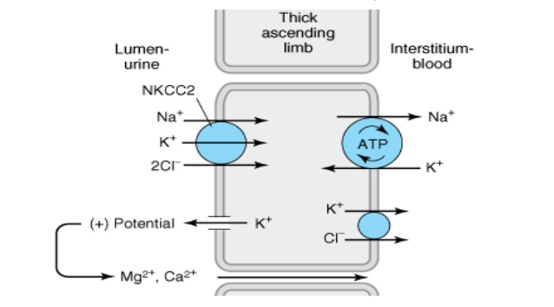
ADRs | Hypovolemia (profound ECFV depletion). Hyponatraemia (↓ blood Na+). Hypokalemia (↓ blood K+). Dietary K supplementation or K-sparing diuretics should be used to avoid hypokalemia. Hypomagnesaemia (↓ blood Mg2+). Hypocalcaemia (↓ blood Ca2+). Metabolic alkalosis. Postural hypotension. Hyperuricemia (increase blood uric acid and gouty attack). Hyperglycemia. Ototoxicity (risk increased if combined with aminoglycosides so reduce dose and follow up patient). Allergic reactions. another sulfa derivative
Contra- indications | Severe Na and volume depletion. Hypersensitivity to sulfonamides. Anuria unresponsive to a trial dose of loop diuretic.
Ascending Loop of Henle
Is impermeable to water.
In thick ascending loop of Henle (TAL) is responsible for active reabsorption of Na, K and Cl (25-30% Na+ is reabsorbed) via transport system in luminal membrane called Na+/ K+ / 2Cl- co-transporter.
Ca and Mg are reabsorbed and enter the interstitial fluid via paracellular pathway.

Slide 10
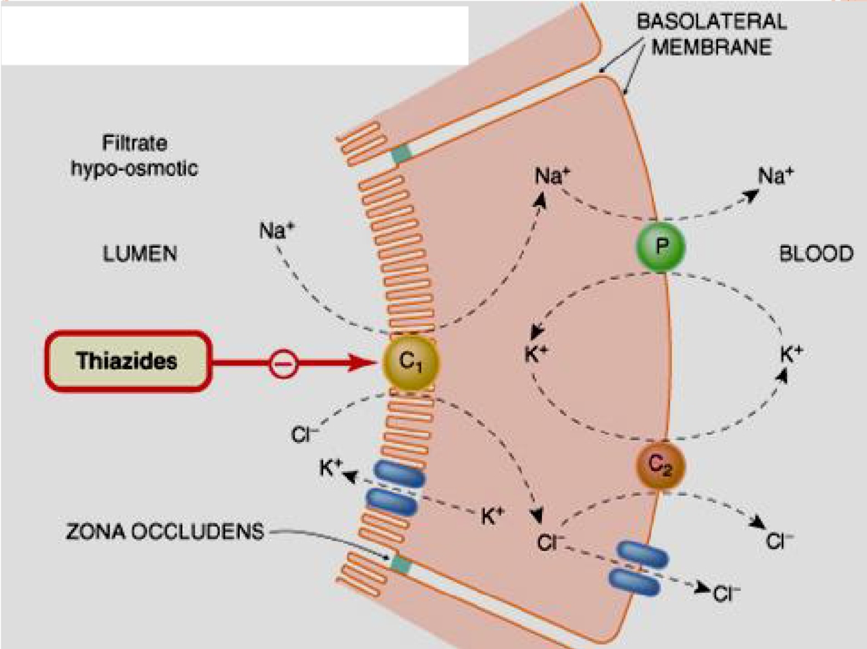
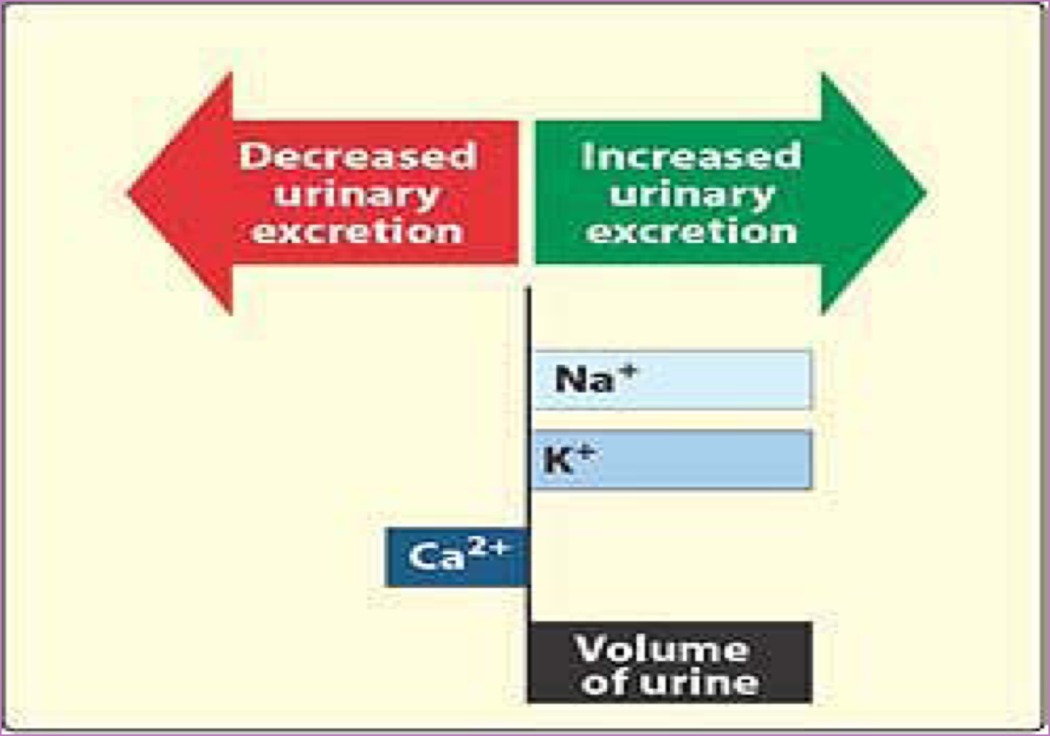
Thiazide diuretics
M.O.A | Acts via inhibition of Na/Cl co-transporter on the luminal membrane of distal convoluted tubules. Weak inhibitors of carbonic anhydrase, but this does not contribute to their action
Efficacy | Moderate natriuresis (5-10% of filtered load of sodium is reabsorbed).
P.K | Thiazides are lipid soluble Given orally, slow of onset Efficiently absorbed from the GIT Long duration of action (40 h) Are secreted by active tubular secretory system of the kidney Eliminated by glomerular filtration & tubular secretion , some is reabsorbed May interfere with uric acid secretion and cause hyperuricemia
 | urinary NaCl excretion urinary K excretion (Hypokalemia) urinary magnesium excretion Calcium re-absorption (hypercalcemia). urinary calcium excretion
Pharmacological effects
Can be an adjuvant in osteoporosis , because it enhances the reabsorption of calcium.

Slide 11
Thiazide diuretics
 | May give rise to hypokalemic alkalosis Causes vasodilatation, diazoxide, non diuretic thiazide is a potent vasodilator ↓ of urine volume in case of diabetes insipidus
Uses | Treatment of essential hypertension (cheap-well tolerated). Treatment of mild heart failure (to reduce extracellular volume). Treatment for Mild Edema Treatment for Osteoporosis Calcium nephrolithiasis due to hypercalciuria (to increase calcium reabsorption and decrease renal calcium stones) Nephrogenic diabetes insipidus (decrease blood volume + GFR)
ADRs | Fluid and electrolyte imbalance Hyponatremia Hypovolemia (volume depletion) Hypokalemia Metabolic alkalosis.
Drug-drug interaction | •Uricosurics , Sulphonylurea Thiazides Diminish effect •Digitalis , Diazoxide Thiazides Increase effect. (Toxicity) •NSAIDs Reduce thiazide efficacy
Cont-
Pharmacological Effects
Hyperuricaemia (gout)
Hypercalcemia
Hyperglycaemia
Hyperlipidemia

Slide 12
Mechanism of antidiuretic effect of thiazide in Diabetes Insipidus
Thiazide
↓Distal tubular Na+ reabsorption
↑ Urinary Excretion
↓Extracellular Volume
↓Urine Volume
↓Distal Delivery of Na+ & Water
↑ Proximal Na+ & water reabsorption
Thank you Team 435!

Slide 13
Potassium Sparing Diuretics
All potassium sparing diuretics work on the connecting ducts , and the collecting tubules..
Potassium Sparing Diuretics
recall: steroids are of two types Mineralocorticoids ( aldosterone is naturally occuring) , and glucocorticoids that are concerned with metabolism.
Steroids
Non-Steroids
Competitive Aldosterone Antagonists:
also called K-Sparing Diuretics or
Mineralocorticoid receptor antagonists
Spironolactone
Eplerenone
Na+ Channels Inhibitors:
Amiloride
Triamterene
عشان نفهم محاضرة اليوم لازم نعرف وظيفة الالدوستيرون لأن كثير من الأدوية تتمحور حوله. ما وظيفة الالدوستيرون؟ reabsorption of Sodium , and excretion of potassium.
Drug | Spironolactone
M.O.A | act at the collecting duct by competitive inhibition of cytoplasmic aldosterone receptors →↑ Excretion of Na+,Cl- & ↓Excretion of K+,H+
P.K. | Well absorbed from the GIT ,t½=1.6h Highly protein-bound Undergoes enterohepatic recycling Delayed onset of action (nuclear receptor), maximum diuretic action 4 days. Converted in gut & liver to active metabolite, t½=16h]
Pharmacodynamics | ↑urinary Na⁺ excretion ↓urinary K⁺ excretion Hyperkalemia ↓ H⁺ excretion (acidosis) has antiandrogenic action
spare= يحفظ
resulting in hyperkalemia.

Slide 14
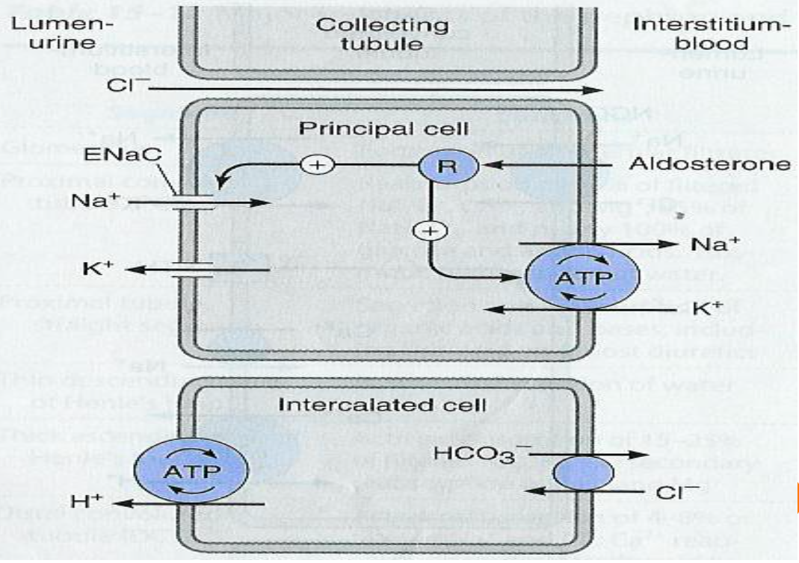
Collecting Tubules
aldosterone receptor that stimulates reabsorption of sodium in exchange for potassium. spironolactone will block aldosterone effect on this receptor. sodium will be excreted in addition to water in the urine , potassium will be retained leading to hyperkalemia.
potassium excretion is linked to hydrogen , once potassium is retained hydrogen will also be retained which may lead to metabolic acidosis.

Slide 15
Competitive Aldosterone Antagonists:
Uses | Treatment of hypertension usually used combined with thiazide or loop diuretics to: -Enhance natriuresis caused by other diuretics - Correct for hypokalemia Treatment of primary hyperaldosteronism (Conn's syndrome) Treatment of secondary hyperaldosteronism in diseases as CHF, Edema of hepatic cirrhosis, Nephrotic syndrome Treatment of hirsutism, acne due to the antiandrogenic effects
ADRs | Hyperkalaemia. Metabolic acidosis. Gynecomastia ( enlargement of the breast in men) Impotence Menstrual irregularities GIT upset and peptic ulcer
Contraindications | Hyperkalaemia: chronic renal failure K+ supplement use β-blockers ACE inhibitors. Liver disease (dose adjustment is needed).
Drug-Drug Interactions | Patients using: ACE inhibitors B-Blockers K supplements K-sparing diuretics Aliskiren Because it will lead to ↑Hyperkalemia induced by K-Sparing diuretics
hirsutism: excess production of hair.
who may have hyperkalemia?
Salicylates decrease secretion of canrenone and decrease efficacy of spironolactone
Digitalis Spironolactone alters it’s clearance
Explanation by Dr. Hanan : how does K sparing diuretics enhance the natriuresis of loop and thiazide diuretics? when I give a diuretic that works on the proximal part of the tubules, sodium will be retained in the filtrate. as the filtrate passes to the distal and collecting parts , and if aldosterone IS NOT BLOCKED , aldosterone will cause reabsorption of some of that sodium. giving an aldosterone antagonists with other diuretics prevents the reabsorption of sodium from any part of the tubules. الصوديم يوصل ويلاقي السكه مقفوله :)

Slide 16
Na+ Channels Inhibitors:
Triamterene
Potency 0.1,
t½ 4.2 h,
Amiloride
Potency 1,
t½ 21h,
Mechanism of action | Inhibition of Na influx through directly blockade of the epithelial sodium channel epithelial sodium channel (ENaC) on the lumen side of the kidney collecting tubule
Uses | Used in Combination with Loop & Thiazide Diuretics Treatment for lithium-Induced Diabetes Insipidus. (lithium structurally similar to sodium)
Adverse effects | Triamterene | Amiloride
 | Hyperkalemia Renal stones | Hyperkalemia
Contra- indications | The risk of developing hyperkalemia is increased in patients who are also on ACE inhibitors, angiotensin II receptor antagonists, other potassium- sparing diuretics, or any potassium-containing supplements.
both cause metabolic acidosis
K+ sparing diuretics make the K+ stay (not go down in the urine) STAy Spironolactone Triamterene Amiloride.
Thank You Team 435!!

Slide 17
Therapeutic applications of diuretics
Hypertension | • Thiazide diuretics: used alone or in combination with beta blockers at low doses (fewer side effects) • Loop diuretics are used in the presence of renal failure. because loop diuretics secrete prostaglandins that cause vasodilation and increase the blood flow to the kidney helping in kidney failure.
Edema states | • Mild edema with normal renal function > Thiazide diuretics • Impaired renal function >Loop diuretics
Congestive heart Failure | • Mild cases: thiazides may be used with well preserved renal function • Severe cases: loop diuretics are much preferred, especially when GFR is lowered. E.g. In life-threatening acute pulmonary edema, furosemide is given I.V
Renal failure | • Thiazides are used till GFR ≥ 40-50 ml/min • Loop diuretics are used below given values, with increasing the dose as GFR goes down.
Nephrogenic diabetes insipidus | • In nephrogenic DI, Large volume (>10 L/day) of dilute urine thiazide > diuretics are used to reduce urine volume.
Hepatic cirrhosis with ascites | • Spironolactone is the drug of choice.

Slide 18
Summary
 | CA Inhibitors |  | Osmotic Diuretic | Loop Diuretics | Thiazide Diuretics | K-sparing Diuretic
 | Dorzol- amide | Aceto- zolamide | Mannitol | Furosemide | Hydrochloro- thiazide | Spironolactone
 | Inhibition of NaHCO3 reabsorption in PCT |  | Osmotic effect in PCT | Na/K/2Cl transporter in TAL the most effective | Na and Cl cotransporter in DCT | competitive antagonist of aldosterone in CCT
 | -Urinary Na HCO3, K. -Urinary alkalosis. -Metabolic acidosis. |  | -Urine excretion. -Little Na. | Urinary Na, K, Ca, Mg | -Urinary Na, K, Mg -BUT↓ urinary Ca (hypercalcemia). -Metabolic alkalosis. | ↑ Urinary Na ↓ K, H secretion Metabolic acidosis
 | -Glaucoma,epilepsy. -Mountain sickness. -Alkalosis. -Phosphatemia. |  | -Cerebral edema. -glaucoma. -Acute renal failure. -drug toxicities. | -Acute pulmonary edema (Drug of choice). -Heart failure. -Hyperkalemia. -Hypercalcemia. | -Commonly used -Hypertension -mild heart failure. -nephrolithiasis - diabetes insipidus. | Hepatic cirrhosis (Drug of choice)
 | -Metabolic acidosis. -Urinary alkalosis. -Hypokalemia. |  | -Extracellular water expansion. -Dehydration. -Hypernatremia. | -Hypokalemia. -hyponatremia. -hypomagnesemia. -hypovolemia. -alkalosis. -precipitate gout -hyperglycemia |  | -Gynaecomastia. -Hyperkalaemia. -Metabolic acidosis. -GIT upset -peptic ulcer
 |  |  |  | -hypocalcemia. | -Hyperlipidemia. -hypercalcemia.
Diuretics
MOA
Effect
Uses
Side Effects

Slide 19
Questions
MCQs:
6-which of the following diuretics has antiandrogenic action?
A-Chlorothiazide
B-Furosemide
C-Spironolactone
1-Which one of the following diuretics is used in the treatment of glaucoma?
A-Mannitol
B-Dorzolamide
C-Eplerenone
7-Your 60 year old male hypertensive patient who had an MI a year ago is now showing signs of CHF. You therefore add spironolactone to his drug regimen. What side effect should you warn him about?
A-ototoxicity
B-hypokalemia
C-gynecomastia
2-Which one of the following statement about diuretics is false?
A-All potassium sparing diuretic may be taken orally
B-osmotic diuretic can cause an expansion of the extracellular fluid
C-spironolactone and amiloride produce potassium loss by the same mechanism
8-Which of the following is NOT a therapeutic use of acetazolamide?
A-Acute mountain sickness
B-Potassium sparing
C-Urinary alkalinization
3-what is the target for thiazides ?
A-proximal convoluted tubules
B-Ascending loop of henle
C-distal convoluted tubules
4-which class of diuretics work by acting on the proximal tubules?
A-Carbonic anhydrase inhibitors B-Loop diuretics C-K-sparing diuretics
9-Which drug functions at the proximal convoluted tubule?
A-Mannitol
B-Furosemide
C-Spironolactone
5-which of the following diuretics is an epithelial sodium channel blockers?
A-Mannitol
B-Acetazolamide
C-Amiloride
10-The net effect of what type of drug is to pull water out of the body in excess of electrolytes?
A-Thiazide diuretics
B-Osmotic diuretics
C-Loop diuretics
8-B 9-A 10- B
4-A 5-C 6-C 7-C
1-B 2-C 3-C

Slide 20
Questions
11) A hypertensive patient was prescribed diuretics along with beta blockers. She later developed renal failure and was prescribed a different class of diuretic. Which of the following was she prescribed?
Furosemide then Metolazone
Furosemide then Ethacrynic acid
Hydrochlorothiazide then Furosemide
Hydrochlorothiazide then Metolazone
13) A CHF patient undergoing an ophthalmic procedure was given a drug. She later developed pulmonary edema and died. What was she given?
Bumetanide
Dorzolamide
Acetohexamide
Mannitol
12) Which of the following is a Potassium sparing diuretics can be used to treat hyperaldosteronism?
Spironolactone
Amiloride
Triamterene
Indapamide
14) A patient was admitted to the ER with acute pulmonary edema. Which of the following is the drug of choice?
Hydrochlorothiazide
Furosemide
Spironolactone
Chlorthalidone
11- C
12- A
13- D
SAQ:
62 year old African-American man who has had poorly controlled hypertension for the past 10 years, and now presents with signs of ankle edema, a low GFR and a serum creatinine of 2.5 mg/dL.
1-The most effective drug for producing a diuresis and fall in blood pressure
Since his GFR is low, a loop diuretic is the drug of choice.
2-what is the mechanism of action of loop diuretics?
• inhibit Na+ / K+ / 2 Cl co-transporter in the luminal membrane of the thick ascending loop of Henle (TAL).
• inhibit Ca++ and Mg ++ re-absorption.
3-what are the adverse effects of loop diuretics? (mention three)
Metabolic alkalosis,Hypovolemia and Hypokalemia.

Slide 21
“You just finished your last Pharmacology lecture of first year!!!”
Team Leaders:
Hadeel Awartani
Yazeed Alharbi
Thanks for those who worked on this lecture:
Dana Al-Rasheed
Ghadah Al-Muhanna
Aljohara Al-Shunaifi
Ghadah Al-Haidari
Rotana Khateeb
Rinad Al-Ghoraiby
Sarah Al-Sultan
Lujain Al-Zaid
Alanoud Al-Mufarrej
Rawan Al-Tamimi
Majd Al-Barrak
Ghaida Al-Sanad
Sarah Al-Kathiri
Ghadah Al-Qarni
Alanoud Al-Mansour
Alanoud Al-Eissa
Dana Al-Kady
Khloud Al-Waheibi
Munira Al-Hadleg
Nouf Al-Otaibi
Noura Al-Othaim
Rahaf Al-Thunayan
Shahad Al-Tayash
Dimah Al-Araifi
Fatimah Al-Bassam
Hind Al-Orair
References:
Doctors’ notes and slides
@Pharma4370
pharmacology437@gmail.com

