Slide 1
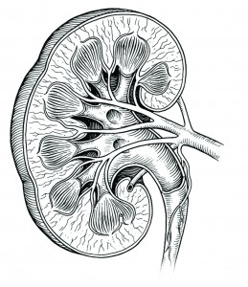
Drugs of Renal Block
Important Notes Extra

Slide 2
Renal Excretion
Renal excretion of drugs occurs through
Glomerular filtration
Active tubular secretion
Passive or active tubular reabsorption
1-Glomerular filtration
Glomerular filtration occurs to :
➢ Low MW drugs. ➢ Only free drugs. ➢ Polar or ionized. e.g aminoglycosides
➢ Drugs with low volume of distribution.
2-Active tubular secretion
General characteristics of active tubular secretion include;
1-carrier mediated.
2- saturable.
3-Requires energy.
4-transports drugs against concentration gradients. 5-Non-specific.
Types of Transporters
Transporters for organic acids
Transporters for organic bases
Aspirin
Penicillin
Sulfonamides
Probenecid
Morphine
Catecholamines
Atropine
Quinine.

Slide 3
Renal Excretion
Competition Between Drugs For Same Transporter
Beneficial Competition between Drugs
Harmful Competition between Drugs
Probenecid and Penicillin G
Probenecid and Nitrofurantoin
Passive or Active Tubular reabsorption
Only lipid soluble drugs are passively reabsorbed
Ionized drugs are poorly reabsorbed
Endogenous substances such as glucose, uric acid, electrolytes, amino acids, and vitamins are actively reabsorbed. Probenecid will inhibit the reabsorption of uric acid so is uricosuric drug.
Occurs in DCT and collecting ducts.
Factors Affecting Renal Excretion of Drugs
Blood flow to the kidney
Physiochemical properties of drugs
Molecular weight
Lipid solubility
Degree of ionization
Volume of distribution
Binding character
Biological factor e.g. age
Disease states
Urine pH
Molecular weight
Lipid solubility
Degree of ionization
Volume of distribution
Binding character

Slide 4
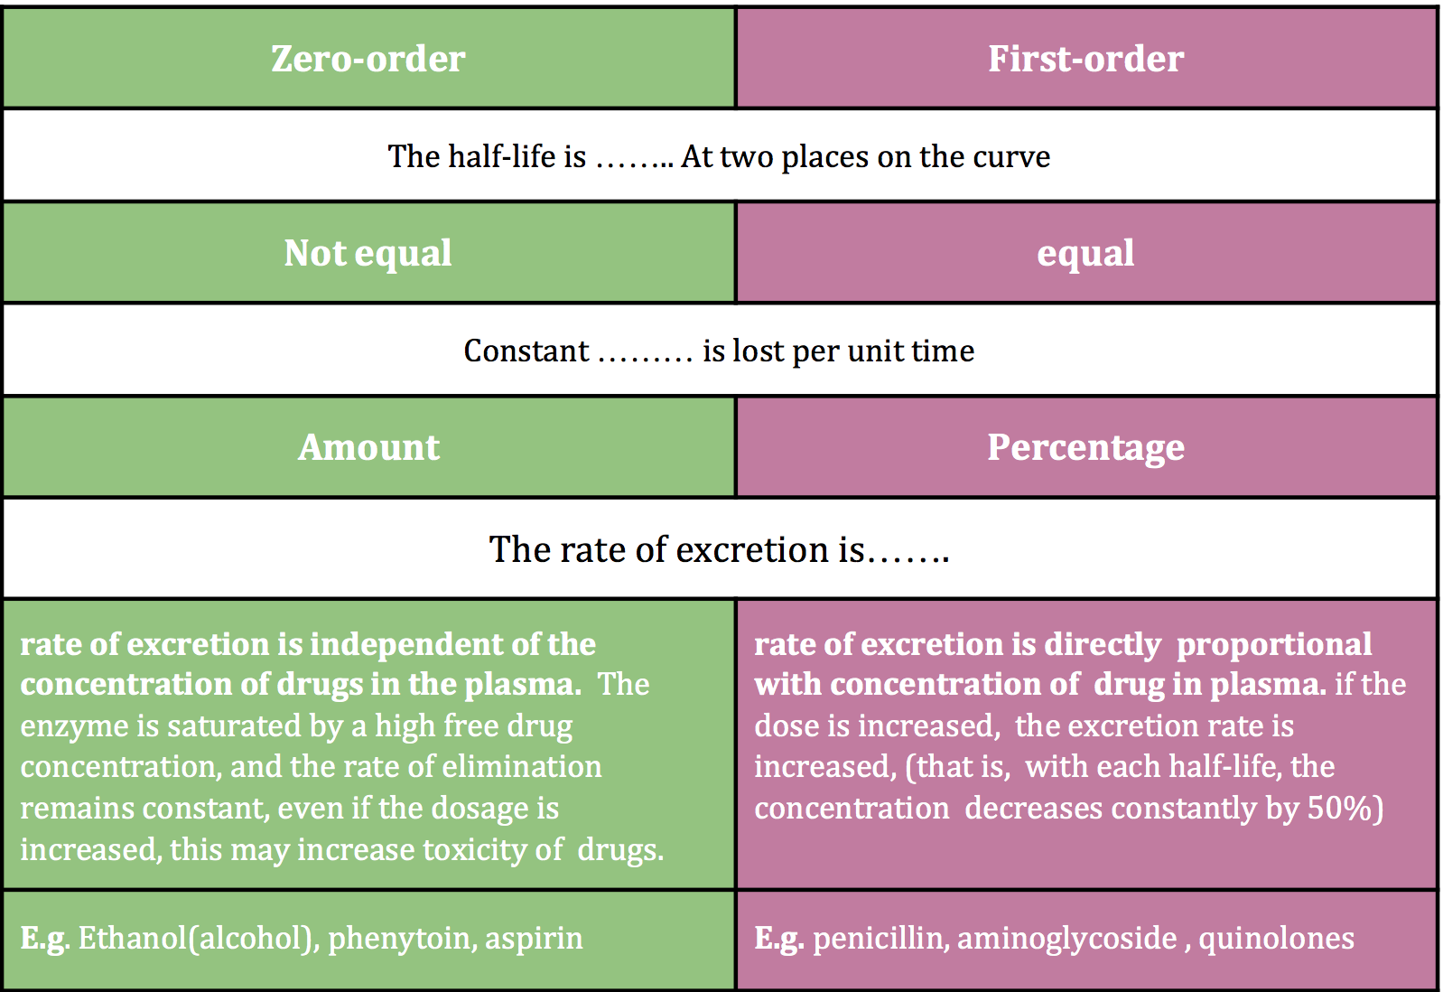
Renal Excretion
Urine is normally slightly acidic and favors excretion of basic drugs.
Urine acidification by ammonium chloride (NH4Cl) increases excretion of basic drugs.
Urine alkalization by by sodium bicarbonate NaHCO3 increases excretion of acidic drugs.
NSAIDS e.g aspirin and ibuprofen inhibits the production of PGs and therefore reduces renal perfusion and GFR.
Urinary pH trapping (Ion trapping)
Orders of Elimination:
What do we do in the case of renal impairement ?
Drugs that are primarily excreted by the kidney need dose adjustment when creatinine clearance is below 60 ml/min. Minor dose adjustment if CrCl = 30-60 mL/min. Major dose adjustment if CrCl < 15mL/min. Monitor blood levels of drugs (therapeutic drug monitoring).

Slide 5
Drugs of Renal Block
Treatment of UTIs
Drug | Key Points |  | Contraindications
Co-trimoxazole | Bactericidal. M.O.A: Sulfamethoxazole inhibits the incorporation of PABA into dihydrofolic acid precursors, and trimethoprim prevents reduction of dihydrofolate to tetrahydrofolate. ratio of TMP to SMX in vivo is 1:20 (formulated 5(SMX):1(TMP)* ADRS: 1. Hypersensitivity. 2. G6PD deficiency. |  | -Renal or hepatic failure. -Pregnancy -Nursing mother -Infants < 6 weeks -Blood disorders
Nitrofurantoins | Effective against E.coli & Staph. Saprophyticus. Urine turns to dark orange-brown (harmless). M.O.A: Sensitive bacteria reduce the drug to an active agent that inhibits various enzymes and damages DNA. Uses: It’s usefulness is limited to lower UTI’s & cannot be used for upper UT or systemic infections. Dose: 50-100mg, orally, 6h/7 days. Long acting: 100mg twice daily. ADRS: 1.GI disturbance(take with food to avoid Diarrhea) 2. Hemolytic anemia (G6PD Deficiency). 3. Headache and nystagmus |  | -Patients with G6PD deficiency. -Neonates -Pregnancy
Doxycycline | M.O.A: Inhibit protein synthesis by binding reversibly to 30s subunit Against gm+ve & gm-ve bacteria. given 100 mg orally twice daily Uses: 1. Treatment of UTIs due to Mycoplasma & Chlamydia. 2. Prostatitis. ADRS: 1. Thrombophlebitis - I.V. 2. Brown discolouration of teeth in children. 3. Deformity/growth inhibition of bones in children. |  | -Pregnancy -Breast feeding -Children below 10 years
3. Displace bilirubin (kernicterus)
4. Bleeding and hemolytic anemia

Slide 6
Drugs of Renal Block
Treatment of UTIs
Drug | Key Points |  | Contraindications
Cephalosporins 3rd gen e.g ceftriaxone, Ceftazidime. | Bactericidal. M.O.A: Inhibit bacterial cell wall synthesis. Uses: severe/complicated UTIs & acute prostatitis. ceftriaxone t1/2=4-7 hours, others very short 30-90 mins. ADRS: 1. Hypersensitivity reactions. 2. Thrombophlebitis. |  | Renal or hepatic failure.
Fluoroquinolones (Ciprofloxacin, Moxifloxacin and Gatifloxacin) | M.O.A: Block bacterial DNA synthesis by inhibiting DNA Gyrase enzyme. Uses: 1. UTIs caused by multidrug resistance organism as pseudomonas. 2. Prostatitis (acute/chronic). gram -ve bacter ADRS: 1. Arthropathy. 2. Phototoxicity. |  | -Not recommended for patients younger than 18 years -Pregnancy -Breastfeeding women
Gentamicin | Given I.M or I.V . poorly absorbed orally (highly charged). Active against gm-ve aerobic organisms. More active in alkaline medium. M.O.A: Inhibit protein synthesis by binding to 30S ribosomal subunits . Similar to tetracyclines. Uses: Severe infections caused by gram negative organism (pseudomonas or enterobacter). ADRS: Ototoxicity.

Slide 7
Drugs of Renal Block
Diuretics
Drug | Key Point | Contra- indications
Carbonic anhydrase inhibitors (in PCT, interferes with NaHCO3 re-absorption and causes diuresis)
Dorzolamide | Used topically for treatment of open- angle glaucoma. No systemic ADRS or diuresis.
Acetazolamide | - po, rapid onset, long duration of action - Excreted by active secretion in PCT - Produces alkaline urine and cause metabolic acidosis - Mild ↑ in urine volume - ↑excretion of sodium, bicarbonate, potassium, phosphate. Therapeutic uses: - As prophylactic therapy, in acute mountain sickness ↓ CSF of brain - Formation of CSF (Useful in treating benign intracranial hypertension) - Urinary alkalinization to enhance renal excretion of acidic substances - Hyperphosphatemia - Adjunct for treatment of epilepsy - Metabolic alkalosis ADRs: - Hypokalemia, Metabolic acidosis, Renal stone formation, Hypersensitivity reaction, CNS effects, tingling, numbness | patient with liver cirrhosis
Osmotic Diuretics (In PCT + descending loop)
Mannitol | - Poorly absorbed by GI, given I.V, if given PO will cause osmotic diarrhea, Not metabolized - Excreted by glomerular filtration without being re-absorbed or secreted within 30-60 min - ↑urine output by osmosis Therapeutic uses: - Acute renal failure due to shock or trauma - acute drug poisoning - maintain urine volume & prevent anuria resulting from large pigmentation load to the kidney | Chronic heart failure

Slide 8
Drugs of Renal Block
Drug | Key Point | Contraindications
Cont. Osmotic Diuretics
Mannitol | - To↓intracranial & intraocular pressure before ophthalmic or brain procedures (cerebral edema). ADRs: - Headache, nausea, vomiting - Extracellular volume expansion - Excessive use will cause dehydration & hypernatraemia
Loop diuretics
Furosemide Torsemide Bumetanide Ethacrynic acid | M.O.A: Inhibit Na/K/2Cl co-transporter in the luminal membrane of the thick ascending loop of Henle &inhibit reabsorption of Ca&Mg -increase urinary excretion of Na/k/2cl and paracellularly Ca and Mg. -High natriuresis -Oral or IV -Emergency use -Excretion of active tubular secretion of weak acids into urine -USES: Edema associated w/ CHF & nephrotic syndrome- Acute hypercalcemia & acute hyperkalemia, Br, F, I toxicity ADRS: ototoxicity/metabolic alkalosis/allergic reactions | Drug-drug interactions: 1- NSAIDs: reduce diuretic response 2-digitalis: arrhythmia 3-aminoglycosides: increase ototoxicity
Thiazide diuretics
Chlorothiazide Hydrochlorothiazide Chlorthalidone Metolazone Indapamide | -M.O.A: acts via inhibition of Na/Cl co-transporter on the luminal membrane of distal convoluted tubules. -P.K: moderate efficacy natriuresis & given orally. -Uses: essential hypertension, mild heart failure & edema,osteoporosis, Calcium nephrolithiasis, Nephrogenic diabetes insipidus. -ADRs: Fluid and electrolyte imbalance,Hyponatremia, Hypovolemia (volume depletion) Hypokalemia, Metabolic alkalosis, Hyperuricaemia (gout), Hypercalcemia, Hyperglycaemia & Hyperlipidemia. | Drug- drug interactions: 1- Uricosurics diminish Thiazide effect. 2-Thiazide increase Digitalis effect. 3- NSAIDs Reduce Thiazide efficacy

Slide 9
Drugs of Renal Block
Drug | Key Point | Contraindications
Potassium Sparing Diuretics
Aldosterone Antagonists
Spironolactone Eplerenone | -act at the collecting duct by competitive inhibition of cytoplasmic aldosterone receptors - ↑urinary Na+ excretion -↓urinary K+ excretion (Hyperkalemia ) -↓ H+ excretion (acidosis) -has antiandrogenic action. Uses : -Treatment of hypertension combined with thiazide or loop diuretics to: -Enhance natriuresis caused by other diuretics - Correct for hypokalemia -Treatment of primary hyperaldosteronism (Conn's syndrome) -Treatment of secondary hyperaldosteronism in diseases as CHF, Edema of hepatic cirrhosis(drug of choice), Nephrotic syndrome. -Treatment of hirsutism, acne due to the antiandrogenic effects. ADRS: Hyperkalaemia,Metabolic acidosis,Gynecomastia ,Impotence,Menstrual irregularities,GIT upset and peptic ulcer. | -Hyperkalaemia: ➔ chronic renal failure ➔ K+ supplement use* ➔ β-blockers* ➔ ACE inhibitors*. -Liver disease (dose adjustment is needed) Digitalis-Spironolactone alters it’s clearance Salicylates-decrease efficacy and secretion. *Drug-Drug Interaction Because it will lead to ↑Hyperkalemia induced by K-Sparing diuretics
Na+ Channels Inhibitors
Amiloride Triamterene | -Inhibition of Na influx through directly blockade of the epithelial sodium channel epithelial sodium channel (ENaC) on the lumen side of the kidney collecting tubule. Uses: -Used in Combination with Loop & Thiazide Diuretics -Treatment for lithium-Induced Diabetes Insipidus. ADRS: -Hyperkalemia -Renal stones(Triamterene) | in patients who are also on -ACE inhibitors, -angiotensin II receptor antagonists -other potassium sparing diuretics -potassium-containing supplements.

Slide 10
“It is not hard, you just made it to the end!”
Team Leaders:
Yazeed Alharbi
& Hadeel Awartani
Thanks for those who worked on this lecture:
Adel Alsuhaibani
Abdullah Almoaither
Faisal Alhawtan
Nouf Al Otaibi
Dimah Al Araifi
Ghaida Al Sanad
Fatimah Al Bassam
References:
Doctors’ notes and slides
@Pharma4370
pharmacology437@gmail.com

