Slide 1
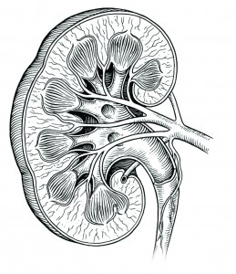
Renal/Q-bank

Slide 2
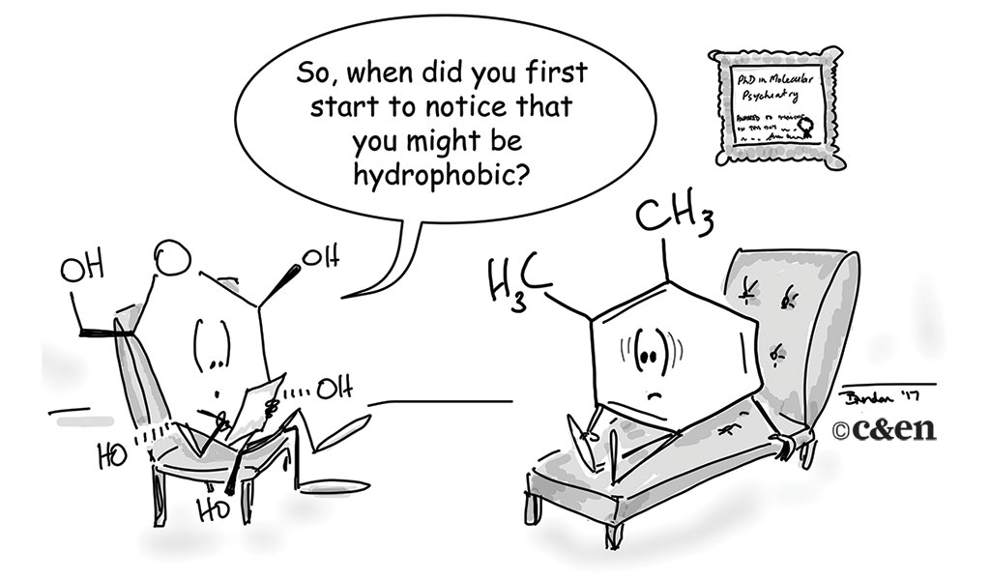
Direct questions
Choose the most likely answer
“Poisons and medicine are often the same substance given with different intents.” – Peter Mere Latham

Slide 3
(1)- the glomerular filtration is high for drugs that are(__)
ionized
low in molecular weight (MW)
unbound to protein
ALL
(2)-which of the following drugs does have a
high pH (base)?
morphine
atropine
quinine
ALL (-ine suffix)
(3)-if you a administered penicillin with probenecid;
the penicillin ½t will be (__)
increased
decreased
same
Steady

Slide 4
(4)- which of the following can be administered in order to increase the excretion for acidic drugs ?
NaHCO3
NH4CL
sodium bicarbonate
A&C are the same
(5)-which of the following will lead to increase the excretion For morphine ?
NaHCO3
NH4CL
ammonium chloride
B&C are the same
(6)- which of the following is antibiotic is good for UTI because it gets excreted by the kidney ?
aminoglycosides
macrolides
penicillin
A&C

Slide 5
(7)- a patient who was using an anti-epileptic drug
(100mg tablet every day) and renal clearance becomes Low, what dose/interval adjustment should be done ?
he should decrease the dose.
he should increase the dose interval
he should decrease the dose and increase the interval
A or B
(8)- which of the following factors is directly related to drug excretion ?
lipid solubility
volume of distribution
renal blood flow
protein binding
(9)- a drug that has a constant rate of excretion independent of the plasma concentrations ?
aminoglycosides
penicillin
quinolones
zero order elimination drugs

Slide 6
(10)-long term NSAIDs usage can lead to renal failure Why?
because they their end product is toxic to the kidney
because they cause non-enzymatic glycosylation
because they increase PG which are inflammatory mediators
because they decrease PGI2 and PGE2 which will decease renal perfusion
(11)-the sulfamethoxazole-trimethoprim SMX-TMP
dosage ratio is?
SMX/TMP =1/5
SMX/TMP=5/1
SMX/TMP=1/0.5
A&B
(12)-which of the following acts on dihydrofolate reductase?
sulfamethoxazole
trimethoprim
dihydropyridine
A&B

Slide 7
(13)-which of the following is concentrated in the prostate ?
TMP
SMX
A&B
Non of these
(14)-which of the following inhibit DNA gyrase ?
fluoroquinolones
aminoglycosides
tetracycline
ceftriaxone
(15)-which of the following inhibit protein synthesis by acting on 30s subunit ?
aminoglycosides
tetracycline
A&B
Non of these

Slide 8
(16)-which one of the following is metabolized by acetylation ?
sulfamethoxazole
aminoglycosides
nitrofurantoin
trimethoprim
(17)-which of the following is poorly absorbed orally ,acts in gram negative bacteria ?
gentamicin
doxycycline
ciprofloxacin
B&C
(18)-which of the following should not be taken with milk or Mg ,Fe because they decrease absorption?
doxycycline
penicillin
nitrofurantoin
trimethoprim

Slide 9
(19)-which one of the following is not a main indications for diuretics in general ?
edema
congestive heart failure
hypertension
glaucoma
(20)-which one of the following is used as used to decrease the intraocular pressure before surgery?
mannitol
K sparing diuretics
thiazide
furosemide
(21)-which one of the following is used to prevent acute renal necrosis after severe injury ?
mannitol
acetazolamide
thiazide
dorzolamide

Slide 10
(22)-which one of the following is a indicated for
Mountain sickness prophylaxis ?
mannitol
acetazolamide
thiazide
furosemide
(23)-which one of the following can’t be used with gentamicin ?
mannitol
acetazolamide
thiazide
furosemide
(24)-which one of the following is used in diabetes insipidus ?
penicillin
mannitol
thiazide
NaHCO3

Slide 11
(25)-which one of the following is used in case of sulfonamide allergy ?
ethacrynic acid
furosemide
bumetanide
torsemide
(26)-which one of the following is suitable for emergency pulmonary edema?
furosemide
chlorothiazide
mannitol
A&C
(27)-which one of the following gets converted to canrenone by the liver ?
spironolactone
amiloride
triamterene
ALL

Slide 12
(28)-which one of the following is a K sparing diuretic ?
amiloride
furosemide
bumetanide
torsemide
(29)-furosemide can be used in CHF . Due to ?
K+ sparing effect
the carbonic anhydrase like action
Prostaglandin effect
B&C
(30)-which one of the following explains the drug-drug
Interaction between NSAIDS and furosemide?
furosemide will be displaced from it’s plasma protein
the NSAIDS will decrease the bioavailability for furosemide
the NSAIDS will potentiate the effect of furosemide
the NSAIDS will decrease furosemide response

Slide 13
(31)-which one of the following is a competitive aldosterone antagonist ?
spironolactone
aldosterone
eplerenone
A&C
(32)- which one of the following is an indirect diuretic?
spironolactone
aldosterone
mannitol
thiazide
(33)-which one of the following is used in lithium induced diabetes insipidus ?
spironolactone
aldosterone
eplerenone
amiloride

Slide 14
(34)- which one of the following increase the excretion of chloride and decrease the excretion of NH4 ?
spironolactone
furosemide
thiazides
acetazolamide
(35)-which of the following has the slowest onset of action ?
spironolactone
furosemide
thiazides
acetazolamide
(36)-which of the following has the fastest onset of action ?
spironolactone
furosemide
thiazides
acetazolamide

Slide 15
(37)-a 30 years old man who's having a liver failure, is presented to the clinician with generalized edema , his blood potassium level is(3mEq/L) low which one of the following doesn’t undergo a hepatic metabolism and thus can be used in this case ?
furosemide
amiloride
triamterene
eplerenone
(38)-a 44 years old man was brought to the emergency
department with malignant hypertension.
Which one of the following is the best drug that can be given to restore the blood pressure?
furosemide
amiloride
triamterene
mannitol

Slide 16
(39)-a 60 years old man with osteoporosis is presented to the clinician with edema and mild hypertension which one of the following is the best to be administered ?
furosemide
amiloride
thiazide
eplerenone
(40)-a 20 years old man with epilepsy is presented to the clinic with mild edema, his doctor administered him a drug for epilepsy and which one of the following diuretics ?
carbonic anhydrase antagonist
K+ sparing diuretic
mannitol
thiazide

Slide 17
(41)-a 30 years old man is presented to the clinic with oliguria; his blood electrolytes are within the normal range; the blood culture showed that it’s a bacterial infection .
The doctor prescribed him furosemide and one of the following antibiotics, what is it ?
gentamicin
aminoglycosides
thiazide
cephalosporin
(42)-a 30 years old man is presented to the clinic with essential hypertension, after further investigations we found that he has Liddle syndrome which one of the following drugs is the best to be prescribed ?
triamterene
furosemide
3rd generation cephalosporin
ciprofloxacin

Slide 18
(43)- which one of the following drugs acts on a membranous Na+ ionic channel ?
Amiloride
Furosemide
Mannitol
acetazolamide
(44)- which one of the following acts on a Na+ transporter?
Amiloride
thiazide
captopril
Acetazolamide
(45)-which one of the following has a fixed amount of excretion regardless of the plasma conc.?
Alcohol
Aspirin
Phenytoin
ALL

Slide 19
(46)- 35 years old female presented to the clinic with edema she said that she is using her edema treatment in time ,but he took a painkiller
And the drug for edema has become less effective .What edema treatment she is using?
furosemide
Mannitol
Acetazolamide
None of these
(47)-a patient presented to the clinic with Deeping and gynecomastia after using a diuretic, what is it?
triamterene
furosemide
3rd generation cephalosporin
spironolactone
(48)-which one if the following should describe the cause of these side effects (in the previous question)
Hyperlipidemia caused by carbonic anhydrase block
Interference with K+ excretion which will increase hair growth
The interference with androgen
ALL

Slide 20
(49)-a 33 years old female presented to the clinic with severe volume overload further investigations showed that she’s having conns disease which one of the following is the best to be used?
amiloride
Spironolactone
Eplerenone
thiazide
(50)-a 65 years old man presented to the clinic with
Severe edema he mentioned that
he had done adrenalectomy 2 years ago
Which one of the following should be used?
triamterene
Amiloride
Mannitol
furosemide

Slide 21
(51)-a 30 years old female presented to the clinic with skin rash after taken a loop diuretics, due to a hypersensitivity reaction, which one of the following should be used in this case?
ethacrynic acid
Furosemide
Bumetanide
torsemide
(52)-a 30 years female presented to the clinic with severe edema, he was administered with furosemide and it didn’t show any effect
Which of the following should be done
increase the dose
Use k sparing diuretic
Use thiazide
Use ethacrynic acid

Slide 22
answers
D
D
A
D
D
D
D
C
D
D
B
B
A
14.A
15.C
16.A
17.A
18.A
19.D
17.A
18.A
19.D
A
D
A
A
B
D
A
D
C
B
D
A
C
20.A
21.A
22.B
23.D
24.C
25.A
26.A
27.A
28.A
29.C
30.D
31.D
32.C
33.D
34.D
35.A
36.B
37.B
38.A
39.C
40.A

Slide 23
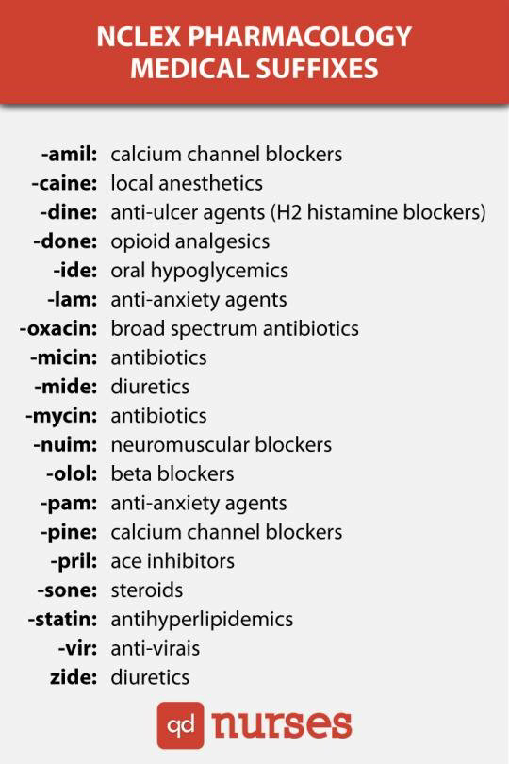
Side effects
Choose the most accurate answer

Slide 24
(1)-which of the following antibiotics can cause megaloblastic anemia by lowering body folate ?
fluoroquinolones
aminoglycosides
tetracycline
TMP-SMX
(2)-which of the following can cause hemolytic anemia and thus contraindicated in G6PD deficiency?
penicillin
tetracycline
nitrofurantoin
cephalosporins
(3)-which of the following can cause damage to the growing cartilage and phototoxicity ?
nitrofurantoin
tetracycline
fluoroquinolones
B&C

Slide 25
(4)-which of the following can lead to hearing loss ?
fluoroquinolones
aminoglycosides
tetracycline
TMP-SMX
(5)-which of the following can to lead to brown teeth discoloration ?
gentamicin
doxycycline
ciprofloxacin
amoxicillin
(6)-which of the following is not contraindicated in pregnancy?
cefixime
doxycycline
ciprofloxacin
aminoglycosides

Slide 26
(7)-which one of the following can cause vision disturbance and tingling sensation ?
acetazolamide
furosemide
bumetanide
torsemide
(8)-which one of the following may lead to thrombophlebitis?
ciprofloxacin
nitrofurantoin
cephalosporins
A&B
(9)-which one of the following damage the growing cartilage?
fluoroquinolones
nitrofurantoin
cephalosporins
gentamicin

Slide 27
(10)-which one of the following can lead to ECF expansion ?
ethacrynic acid
furosemide
mannitol
torsemide
(11)-which of the following can lead to gynecomastia?
ethacrynic acid
spironolactone
amiloride
eplerenone
(12)-which one of the following can precipitate gout and can cause hyperlipidemia ?
thiazide
triamterene
mannitol
ALL

Slide 28
(13)-which one of the following is the most potent
And can lead to fainting ?
osmotic diuretics
acetazolamide
aminoglycosides
bumetanide
(14)-which one of the following can increase LDL ?
mannitol
acetazolamide
thiazide
ALL
(15)-which one of the following can lead to hypercalcemia ?
mannitol
acetazolamide
thiazide
furosemide

Slide 29
(16)- which one of the following can have a neuromuscular blocking effect and can cause muscle weakness ?
gentamicin
carbapenem
erythromycin
tetracycline
(17)-which one of the following should be avoided in case of CHF?
mannitol
furosemide
torsemide
ALL
(18)-which one of the following blood electrolytes can explain being tired after taking thiazide ?
increase glucose level in the blood
increase Ca level in the blood
Decrease K level in the blood
ALL

Slide 30
(19)-which one of the following can’t precipitate gout ?
amiloride
acetazolamide
thiazide
furosemide
(20)-which one of the following causes alkalosis , urinary acidosis and hypokalemia ?
mannitol
acetazolamide
spironolactone
furosemide
(21)-which one of the following causes metabolic acidosis .urinary alkalosis and hyperkalemia ?
mannitol
acetazolamide
spironolactone
furosemide

Slide 31
answers
D
C
D
B
B
A
A
C
A
C
B
A
D
C
C
A
A
C
B
D
C

Slide 32
Lippincott's BANK question
(might come in real exam)
1-27-year-old woman presents to the emergency
department complaining of right flank pain and
hematuria. She has passed calcium oxalate stones in the past and likely has another stone. After treating her for the stone, which of the following diuretics could be started to prevent future calcium oxalate stones?
Acetazolamide
(B) Furosemide
(C) Hydrochlorothiazide
(D) Mannitol
E) Spironolactone

Slide 33
2-A 54-year-old woman with severe essential hypertension refractory to treatment switched to a new antihypertensive drug 1 month ago. Her blood pressure is currently well controlled. She now comes complaining of excessive hair growth. Which antihypertensive drug is she taking?
(A) Hydrochlorothiazide
(B) Isosorbide dinitrate
(C) Minoxidil
(D) Nifedipine
(E) Nitroglycerin
3-A 63-year-old man presents to the emergency department with worsening heart failure following a myocardial infarction 2 weeks previously. The patient complains of shortness of breath. Physical exam reveals 12 pitting edema in his ankles. Past medical history is significant for an allergic reaction following exposure to trimethoprim– sulfamethoxazole. The physician wants to prescribe furosemide as part of this patient’s regimen. Which drug should she prescribe him?
Acetazolamide
(B) Ethacrynic acid
(C) Hydrochlorothiazide
(D) Mannitol
(E) The best drug to use in this case is furosemide

Slide 34
4-A 62-year-old man with congestive heart failure has been taking a loop diuretic to reduce peripheral edema. His labs today reveal low potassium. Which of the following diuretics would be better to use in this patient?
acetazolamide
Ethacrynic acid
Hydrochlorothiazide
Methazolamide
Triamterene
5-A 47-year-old woman with Type-2 diabetes presents to the nephrology clinic for follow-up. She has been doing well other than an increase in her blood sugars lately. She was started on a new medication recently, but she cannot remember the name. All she knows was it affected her kidneys. What is the most likely medication that she started taking?
(A) Acetazolamide
(B) Furosemide
(C) Hydrochlorothiazide
(D) Mannitol
(E) Spironolactone

Slide 35
6- A 64-year-old man with left heart failure is managed with digoxin and a thiazide diuretic. His primary care physician orders a laboratory panel. Which of the following electrolytes is most likely to be abnormal in this patient?
(A) Calcium
(B) Glucose
(C) Magnesium
(D) Potassium
(E) Sodium
7- 52-year-old woman presents to the primary care clinic with progressive weakness and muscle aches for the past month. She can still do her daily tasks but can notice a difference in her strength. When she lies down at night, her legs always ache. Her electrolytes are significant for a K1 of 2.9 mEq/L. She was recently started on a diuretic for peripheral edema. She is pleased that she has not had peripheral edema since starting the diuretic. What is the most appropriate diuretic to treat this patient?
(A) Acetazolamide
(B) Furosemide
(C) Hydrochlorothiazide
(D) Mannitol
(E) Spironolactone

Slide 36
Answers and Explanations
1- The answer is B: Furosemide. Calcium oxalate stones are caused by an increase of calcium, oxalate, or both in the urine. Stone formation can be avoided by preventing high amounts of calcium from being excreted in the urine. Loop diuretics such as furosemide
increase renal excretion of calcium, thereby raising the urinary calcium level and predisposing to stone formation. (A) Amiloride inhibits the sodium– potassium exchanger in the distal tubule. It does not raise urinary calcium nearly as much as furosemide and is not associated with an increase in stone formation. (C) Hydrochlorothiazide, by an unknown mechanism, causes calcium retention. It would be a useful drug for this patient because it decreases urinary
excretion of calcium. (D) Mannitol is an osmotic
diuretic because it is filtered at the glomerulus but minimally reabsorbed. It does not alter calcium handling by the kidney. (E) Spironolactone is an antagonist of aldosterone. Normally, aldosterone causes resorption of sodium from the distal tubules. It does not alter calcium handling by the kidney.

Slide 37
Answers and Explanations
2- The answer is C: Reduction of dietary salt to 10 g/d. Lifestyle modifications to improve blood pressure include the following: weight—maintain normal body weight (BMI 18.5 to 24.9); DASH diet—rich in fruits, vegetables, grains, low-fat dairy products; and low in fat, cholesterol, and sodium; salt—reduce dietary sodium to no more than 2.4 g/d of sodium or 6 g/d of NaCl; exercise—regular aerobic activity such as walking (30 min/d on most days); and alcohol—limit to no more than two drinks per day for men and one drink per day for women. (A) This is a useful modification that may improve blood pressure. (B) This is a useful modification that may improve blood pressure. (D) This is a useful modification that may improve blood pressure. (E) This is a useful modification that may improve blood pressure

Slide 38
Answers and Explanations
3- The answer is B: Ethacrynic acid. Diuresis is an important aspect of the treatment of heart failure. Putting a patient with heart failure on a diuretic will help keep excess fluid from accumulating in the lungs and other body tissues. One potential problem with diuretics is that most contain a sulfonamide group, which is the antigen responsible for reactions in patients with a sulfa allergy. Of the diuretics listed, only mannitol and ethacrynic acid do not contain a sulfonamide group. Mannitol should not be used because it is contraindicated in patients with heart failure. Ethacrynic acid is a loop diuretic but is structurally not related to other members of that group. It would be the best
option in this patient. (A) Acetazolamide contains a sulfonamide group. No sulfonamide should be used in this patient because of his history of a previous
allergic reaction. Further exposure could result in anaphylaxis and death. (C) Hydrochlorothiazide contains a sulfonamide group. (D) Mannitol is an osmotic
diuretic. It is contraindicated in patients with heart failure because it initially increases circulatory volume and would likely make his swelling and heart failure worse. (E) Furosemide contains a sulfonamide group

Slide 39
Answers and Explanations
4- The answer is E: Triamterene. Potassium-sparing diuretics such as triamterene or amiloride are commonly used in combination with more potent potassium-wasting diuretics (e.g., loop diuretics) or simply in cases of low serum potassium. Potassium is lost in the urine when high amounts of sodium pass through the distal convoluted tubule (as is the case with potassium-wasting diuretics) because of a
sodium-potassium exchange pump on the distal tubule cells. Triamterene and amiloride inhibit this pump, leaving sodium in the urine and potassium in the blood. (A) Acetazolamide is a carbonic anhydrase inhibitor and works in the proximal tubule. It causes mild potassium loss in the urine. (B) Loop diuretics such as ethacrynic acid work by inhibiting the Na1/ K1/2Cl2 transporter on the ascending limb of the loop of Henle. Loop diuretics are potassium-wasting diuretics. (C) Hydrochlorothiazide inhibits the sodium chloride symporter in the distal tube. It causes calcium retention by an unknown mechanism but does not cause potassium retention. (D) Methazolamide is a carbonic anhydrase inhibitor and works in the proximal tubule. It causes mild potassium loss in the urine

Slide 40
Answers and Explanations
5-The answer is C: Hydrochlorothiazide. A side effect of hydrochlorothiazide is hyperglycemia. The exact mechanism of the cause of hyperglycemia is unknown; however, it is believed to be through decreased insulin secretion. (A) Acetazolamide can lead to hyperchloremic metabolic acidosis but not commonly hyperglycemia. (B) Furosemide may lead to ototoxicity or hypokalemia but not commonly hyperglycemia. (D) Mannitol may lead to pulmonary edema but not commonly hyperglycemia. (E) Spironolactone may lead to gynecomastia or hyperkalemia but not commonly hyperglycemia.

Slide 41
Answers and Explanations
6- The answer is D: Potassium. Digoxin can cause electrolyte abnormalities. Hypokalemia can precipitate serious arrhythmia. Reduction of serum potassium levels is most frequently observed in patients receiving thiazide or loop diuretics, which can usually be prevented by use of a potassium-sparing diuretic or supplementation with potassium chloride. Hypercalcemia and hypomagnesemia also predispose to digoxin toxicity. (A) Calcium abnormalities are less common than potassium abnormalities. (B) Glucose abnormalities are unlikely unless the patient has diabetes. (C) Magnesium abnormalities are less common than potassium abnormalities. (E) Sodium abnormalities are unlikely in this patient

Slide 42
Answers and Explanations
7-The answer is E: Spironolactone. Spironolactone is a potassium-sparing diuretic that can be used for diuresis. Spironolactone competitively inhibits aldosterone receptors in the collecting tubules. It decreases the secretion of potassium in the urine. (A) Acetazolamide causes the excretion of potassium leading to hypokalemia. (B) Furosemide causes the excretion of potassium leading to hypokalemia. (C) Hydrochlorothiazide causes the excretion of potassium leading to hypokalemia. (D) Mannitol causes the excretion of potassium leading to hypokalemia

Slide 43
USMLE
A 50-year-old man presents with a blood pressure of 160/100. He is to be started on hydrochlorothiazide. Which of the following is a common adverse effect of hydrochlorothiazide?
A.atrioventricular (AV) blockade
B.constipation
C.drug-induced lupus erythematosus
D.potassium wasting
E.Tachycardia
Because thiazides decrease the reabsorption of sodium in the distal convoluted tubule, aldosterone secretion is increased and a compensatory response is evoked that releases potassium in response to increased sodium reabsorption in the cortical collecting tubule, therefore, potassium- wasting results. Other adverse effects
of thiazides include increased blood glucose, uric acid, and lipids. None of the other choices (AB, E) are adverse effects of thiazide administration.
Correct Answer: D

Slide 44
Which of the following drugs causes hyperchloremic metabolic acidosis and may cause hyperammonemia in a patient with cirrhosis ?
A.acetazolamide
B.amiloride
C.furosemide
D.hydrochlorothiazide
E.spironolactone
Explanation/Reference: Explanation: Acetazolamide acts in the proximal tubule to block carbonic anhydrase, greatly increasing bicarbonate excretion and alkalinizing the urine while causing metabolic acidosis. In cirrhosis, ammonia is excreted in larger amounts because urea production in the liver is limited. If an acid urine (necessary for converting ammonia to ammonium ion) cannot be produced, the ammonia is promptly reabsorbed, causing hyperammonemia and hepatic encephalopathy. None of the other drugs (choices BE) causes hyperammonemia in cirrhotic patients.
Correct Answer: A Section: Pharmacology Explanation

Slide 45
A 73-year-old woman complains of difficulty sleeping, exercise fatigue, and shortness of breath. Examination reveals mental confusion, swollen ankles, pulmonary rales, and dyspnea while supine. Immediate treatment of the patient may be needed if signs and symptoms, especially those of pulmonary congestion, worsen rapidly. Which of the following would be most beneficial in treating acute, severe pulmonary edema?
A. amiloride
B. furosemide
C. Hydrochlorothiazide
D. losartan
E. Metoprolol
Explanation/Reference: Explanation: Rapid worsening of pulmonary congestion is suggestive of life-threatening acute cardiac decompensation (acute heart failure). Furosemide, a loop diuretic, is one of the most effective agents available because it has powerful diuretic action and also reduces pulmonary vascular pressures. Amiloride (choice A) is a much less efficacious diuretic with primary action in the collecting tubule of the nephron and little or no effect on pulmonary vessels. Hydrochlorothiazide (choice C) is a diuretic of intermediate efficacy that acts in the distal convoluted tubule. Losartan (choice D) is an angiotensin receptor blocker and is not effective in acute reduction of congestive symptoms. Metoprolol (choice E) is a beta adrenoreceptor blocker that is valuable in the long-term, chronic therapy of HF, but not effective (and usually contraindicated) in acute decompensation.
Correct Answer: B Section: Pharmacology Explanation

Slide 46
A 35-year-old woman with hypertension is planning to become pregnant. Which of the following is contraindicated in pregnancy?
A. clonidine
B. hydralazine
C. hydrochlorothiazide
D. losartan
E. methyldopa
Explanation/Reference: Explanation: Losartan causes renal damage in the fetus, and renal impairment in renovascular disease. It is contraindicated in pregnancy. Clonidine (choice A) causes some sedation and rebound hypertension when stopped suddenly, but is not contraindicated in pregnancy. Hydralazine (choice B) causes a reversible type of lupus erythematosus. Hydrochlorothiazide (choice C) may cause hypokalemia, dilutional hyponatremia, elevated lipids, hyperuricemia, and glucose intolerance. Methyldopa (choice E) causes sedation and formation of red blood cell antibodies, but has been shown to be safe in pregnancy
Correct Answer: D Section: Pharmacology Explanation

Slide 47
A 24-year-old woman presents with hypertension and hypokalemic metabolic alkalosis. Although these symptoms are normally indicative of hyperaldosteronism, this patient's aldosterone levels are undetectable, and no other mineralocorticoid activity is found. A diagnosis of Liddle syndrome is made on the basis of the signs and symptoms and a family history. Liddle syndrome is caused by a genetic defect leading to excessive expression of the apical sodium channel in the principal cells of the cortical- collecting tubule and excess sodium transport in this part of the nephron. Which of the following agents is the best choice for treatment of the hypertension and hypokalemic metabolic alkalosis in this patient?
A.amiloride
B.fludrocortisones
C.hydrochlorothiazide
D.lisinopril
E.spironolactone
Answer in next slide

Slide 48
Correct answer: A
Explanation: Treatment of Liddle syndrome consists of direct inhibition of the abnormally expressed sodium channel by either amiloride (choice A) or triamterene, both of which are classified as potassium-sparing diuretics. Triamterene is less useful than amiloride because of its low potency and low solubility, which may lead to the formation of stones. Fludrocortisone (choice B) is a synthetic mineralocorticoid used for replacement therapy in hypoaldosteronism. Although aldosterone levels are reduced in this patient, administration of a mineralocorticoid will exacerbate rather than relieve the hypertension and hypokalemic metabolic alkalosis. Hydrochlorothiazide (choice C), a thiazide diuretic, will exacerbate the problem because inhibition of the N /C symporter in the distal convoluted tubule results in
delivery of more sodium to the cortical collecting duct, where the hyperactivity of the sodium channel and resulting potassium extrusion along with increased proton exchange from type A intercalated cells results in greater hypokalemia and alkalosis. Lisinopril (choice D) is an ACE inhibitor used in the treatment of essential hypertension. Spironolactone (choice E) is a selective antagonist at the aldosterone receptor. It is used as a potassium-sparing diuretic. In the case of Liddle disease, spironolactone has no utility; aldosterone does not play a causative role and its levels are already depressed.

Slide 49
A 78-year-old man has ankle edema, tachycardia, and shortness of breath on mild exercise. His blood pressure is 155/98. He has been diagnosed with hypertension and mild heart failure. Which of the following regimens is most appropriate for starting therapy?
A. captopril plus dobutamine
B. captopril plus hydralazine
C. enalapril plus hydrochlorothiazide
D. furosemide plus spironolactone
E. Losartan plus hydralazine
Section: Pharmacology Explanation
Explanation/Reference: Explanation: The combination of an ACE inhibitor and a diuretic is rational for this patient with hypertension and mild heart failure as both drugs are effective for both conditions. Furthermore, ACE inhibitors have been shown to slow or stop the progression of heart failure and thiazide diuretics have been shown to be among the cheapest and most effective agents for hypertension. If this combination is not sufficiently active to control the heart failure, a loop diuretic might be substituted for the thiazide. Dobutamine (choice A) is a parenteral drug for acute failure. Hydralazine (choices B, E) is a vasodilator that causes tachycardia and usually requires concurrent administration of a beta blocker. Use of two diuretics choice D) is probably unnecessary in this early stage of failure and is not the most effective therapy for hypertension.
Correct Answer: C

Slide 50
Potassium supplementation is often necessary for patients taking large doses of which of the following drugs?
A.amiloride
B.captopril
C.hydrochlorothiazide
D.losartan
E.Spironolactone
Explanation/Reference: Explanation: Hydrochlorothiazide causes potassium wasting and may lead to hypokalemia requiring dietary potassium supplementation. Potassium wasting is characteristic of diuretics that present more sodium to the collecting tubule, where sodium is conserved in exchange for potassium under the control of aldosterone. Therefore, diuretics that act in the proximal convoluted tubule (carbonic anhydrase inhibitors), ascending limb of the loop of Henle (loop diuretics), and distal convoluted tubule (thiazides) cause potassium wasting and may lead to dangerous hypokalemia. Angiotensin antagonists (because they interfere with aldosterone secretion) and aldosterone inhibitors have the opposite effect. Amiloride (choice A) and spironolactone (choice E) are aldosterone antagonists; captopril (choice B) and losartan (choice D) are angiotensin antagonists. The latter agents cause potassium retention and may cause hyperkalemia, not hypokalemia.
Correct Answer: C Section: Pharmacology Explanation

Slide 51
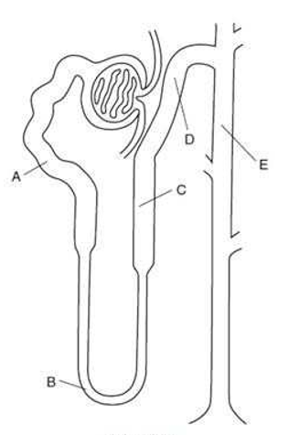
QUESTION 834 A 68-year-old postmenopausal female with a history of osteoporosis and essential hypertension is placed on the thiazide diuretic chlorothiazide, which has a beneficial action toward both conditions. Which letter in below figure depicts the tubular location of epithelial cells containing a / cotransport
protein inhibited by thiazide diuretics?
A.A
B.B
C.C
D.D
E.E
Explanation
Explanation/Reference: Explanation: The epithelial cells of the early portion of the distal tubule contain a / cotransporter that is
inhibited by thiazide diuretics which promote a diuresis and a natriuresis, and which secondarily, promote increased renal reabsorption of filtered calcium. Choices A and B denote the proximal and thin loop of Henle segments, respectively; which do not have the properties of the early distal tubular segment. Likewise, choices C and E denote the thick ascending loop of Henle and the collecting duct, which also do not have the same properties as the early distal tubular segment.
Correct Answer: D

Slide 52
At a blood alcohol level of 200 mg/dL (0.2%), which of the following correctly describes the systemic elimination process for ethanol?
A.constant clearance via liver, kidney, and lungs
B.first-order elimination via pulmonary exhalation
C.first-order elimination via renal excretion
D.second-order elimination via biliary secretion
E.zero-order elimination via hepatic metabolism
Answer in next slide .

Slide 53
Correct Answer: E
Explanation/Reference: Explanation: At a blood alcohol level of 200 mg/dL, most individuals are grossly inebriated; a level of 80100 mg/dL (0.080.1%) is considered the legal threshold for intoxication in most states. Ethanol is metabolized by alcohol dehydrogenase (and to a lesser extent by the microsomal ethanol oxidizing system) to acetaldehyde, primarily in the liver. At most ethanol concentrations, the metabolizing system is saturated. As a result, zero.order kinetics are observed. A typical adult shows a constant elimination rate manifested as a decline in blood level of 1622 mg/dL/h. As blood alcohol levels drop below about 100 mg/dL, elimination has characteristics intermediate between zero and first order. Only at concentrations below 1 mg/dL is the elimination truly first order. Constant clearance (choice A) requires firstorder elimination. Pulmonary excretion (choice B) of ethanol accounts for only a minor component of elimination. Breath analyzers are used to estimate the blood alcohol level in drivers suspected of driving under the influence of alcohol. Renal excretion (choice C) also accounts for only a minor component of systemic elimination of alcohol. Because of the small size of the ethanol molecule, most of the alcohol undergoing filtration at the glomerulus is reabsorbed. Biliary secretion (choice D) is not significant in ethanol elimination. At a concentration of 200 mg/dL, blood alcohol is eliminated at zero-order kinetics via hepatic alcoholic dehydrogenase

Slide 54
The following are pharmacokinetic data for the drug propranolol in a 70-kg person: clearance, 50 L/h; volume of distribution, 270 L; effective plasma concentration, 20 ng/mL; oral availability (percentage), 25%. What is the oral maintenance dosing rate for propranolol in a 70-kg person?
A.10 g/h
B.200 g/h
C.1 mg/h
D.4 mg/h
E.54 mg/h
Explanation/Reference: Explanation: The maintenance dosing rate (D/T) is calculated using the formula D/T = target × CL/F, where D is the dose administered, T is the time interval between doses, the target is the desired steady-state plasma concentration (for which the effective plasma concentration is used), CL is the systemic clearance, and F is the fractional absorption. After multiplying the clearance (50 L/h) times the effective plasma concentration (0.02 mg/L), the resulting product of 1 mg/h must be divided by the fractional absorption of 0.25, giving a dosing rate of 4 mg/h. Note that the units for clearance and target concentration must be consistent with respect to volume. The extensive first-pass metabolism of propranolol means that to achieve the same systemic concentration, an oral dose four times larger than the IV dose must be administered.
Correct Answer: D

Slide 55
“It is not hard, you just made it to the end!”
Team Leaders:
Yazeed Alharbi & Hadeel Awartani
Thanks for those who worked on this lecture:
Khaled Al-oqeely
References:
slides.
SMLE.
Lippincott’s bank
@Pharma4370
pharmacology437@gmail.com

