Slide 1
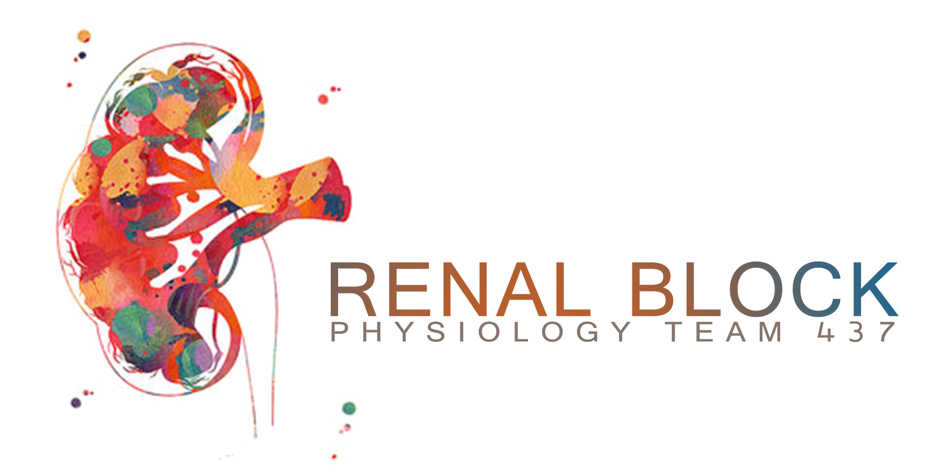
Glomerular Filtration
Lecture 1+2
Objectives:
Editing file
Index:
Important
Extra information
Doctor’s notes
Only in female slides
Only in male slides
by the end of this lecture you will be able to:
Enumerate general functions of the kidney.
Identify and describe that the nephron is the structural and function unit of the kidney.
Describe that the mechanism of urine formation include three basic processes; glomerular filtration, tubular reabsorption and tubular secretion.
Explain glomerular filtration membrane & filtration forces.
Describe mechanism of filtration & composition of the glomerular filtrate.
Calculate the net filtration pressure using parameters of Starling forces.
Define GFR and quote normal value.
Identify and describe the factors controlling GFR in terms of starling forces, permeability with respect to size, shape and electrical charges and ultra-filtration coefficient.
Describe Intrinsic and extrinsic mechanism that regulate GFR.
Describe autoregulation of GFR & tubuloglomerular feedback mechanism.
Physiology 437 teamwork

Slide 2
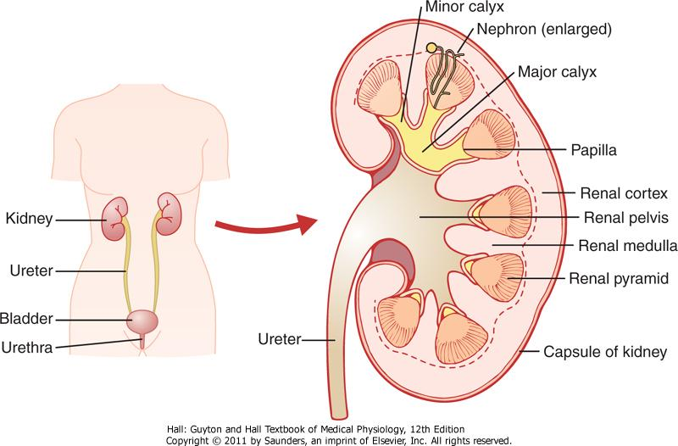
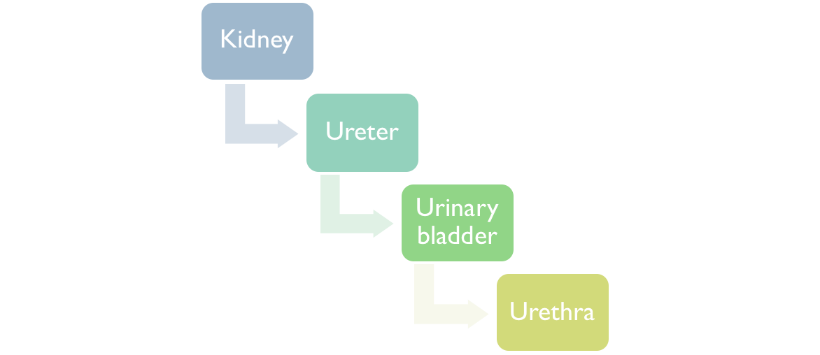
Urinary System:
Physiologic Anatomy of KIDNEYS:
Size Clenched Fist
Weight 150 grams
perform the functions of the urinary system.
Transport urine from the kidneys to the bladder
temporary storage of urine.
conveys urine out of the body.
Video of kidney-nephron overview, Duration 8:38 mins

Slide 3
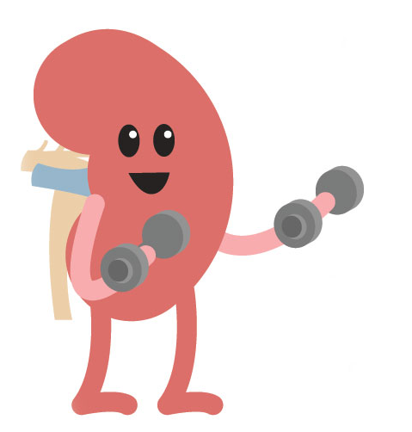
Kidney Functions:
1-Filtration
2-Regulation of blood pressure
3-Regulation
4-Excretion
5-Synthetic Function
1-Filtration
ONLY in male slides
200 liters of blood daily, allowing toxins, metabolic wastes, and excess ions to leave the body in urine.
2-Regulation of blood pressure
By controlling the rate at which water is excreted in the urine -> regulate plasma volume -> total blood volume -> blood pressure.
By release of renin -> vasoactive agents.
3-Regulation
1-water and electrolyte balance: Maintain the proper balance between water and salts, and acids and bases.
By ↑ or ↓ the excretion of specific ions in the urine, the kidneys regulate the concentration of the following ions in the plasma:
Na⁺, K⁺, Ca²⁺, Mg²⁺, Cl⁻, HCO₃⁻, H⁺ and phosphates.
2-RBC production by bone marrow by controlling erythropoietin hormone levels.
4-Excretion
Excretion of bioactive substances (hormones and many foreign substances, such as: metabolic waste products: Urea, Creatinine, Uric acid, Bilirubin, drugs and Pesticides that affect body function.
5-Synthetic Function
active form of vit D (D3)= 1,25 dihydroxycholecalciferol.
Erythropoietin production.
Renin formation.
Synthesis of glucose from amino acids and glycerol during prolonged fasting

Slide 4
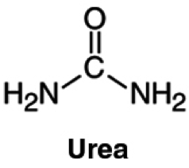
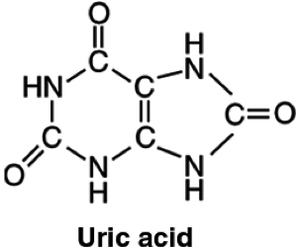
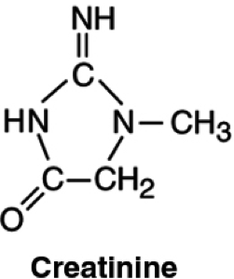
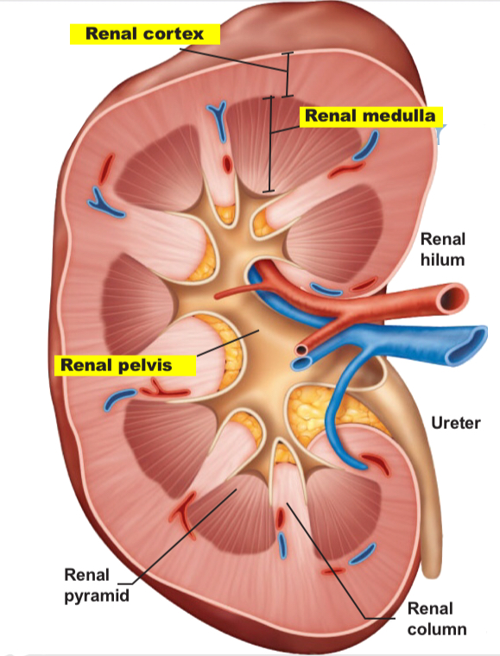
Nitrogenous Wastes:
The Kidney Consists of Three Distinct Regions:
ONLY in female slides
Urea : protein > amino acids > NH₂ removed > forms ammonia, liver converts to urea
Uric acid
Creatinine
Cortex: granular superficial region Medulla: exhibits cone-shaped pyramids
Pyramids are bundles of collecting tubules
Renal pelvis: flat, funnel-shaped tube
What is the Functional Unit of the Kidney?
The nephron is the functional and structural unit of the kidney.
Each kidney has 1 million nephrons, each nephron is capable of urine formation.

Slide 5
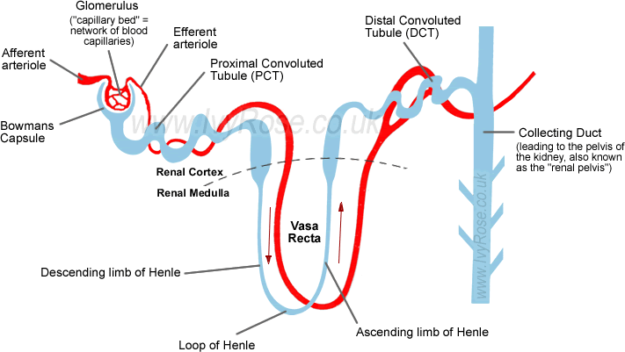
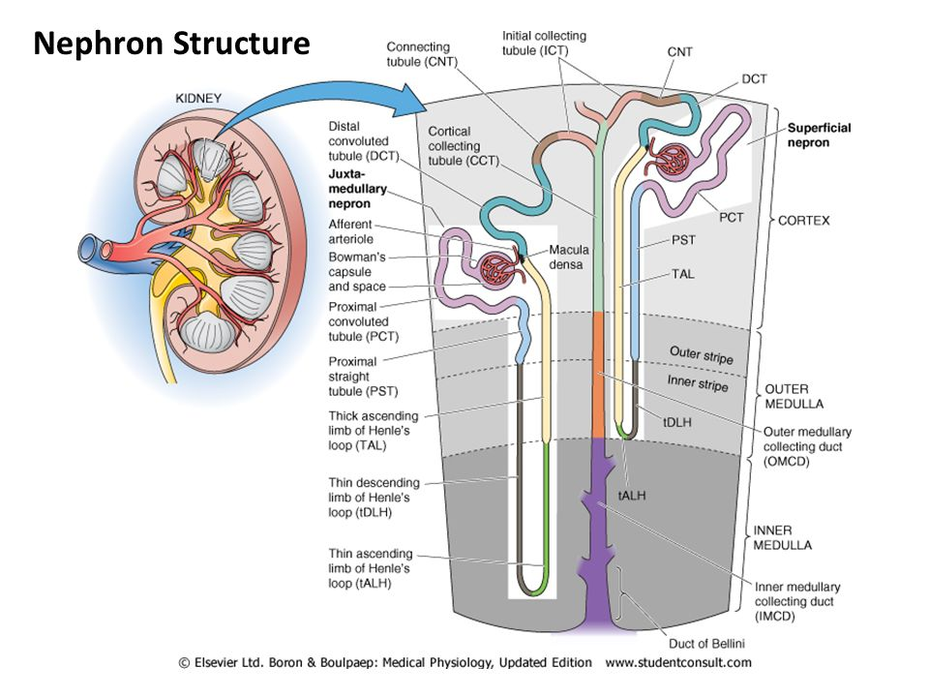
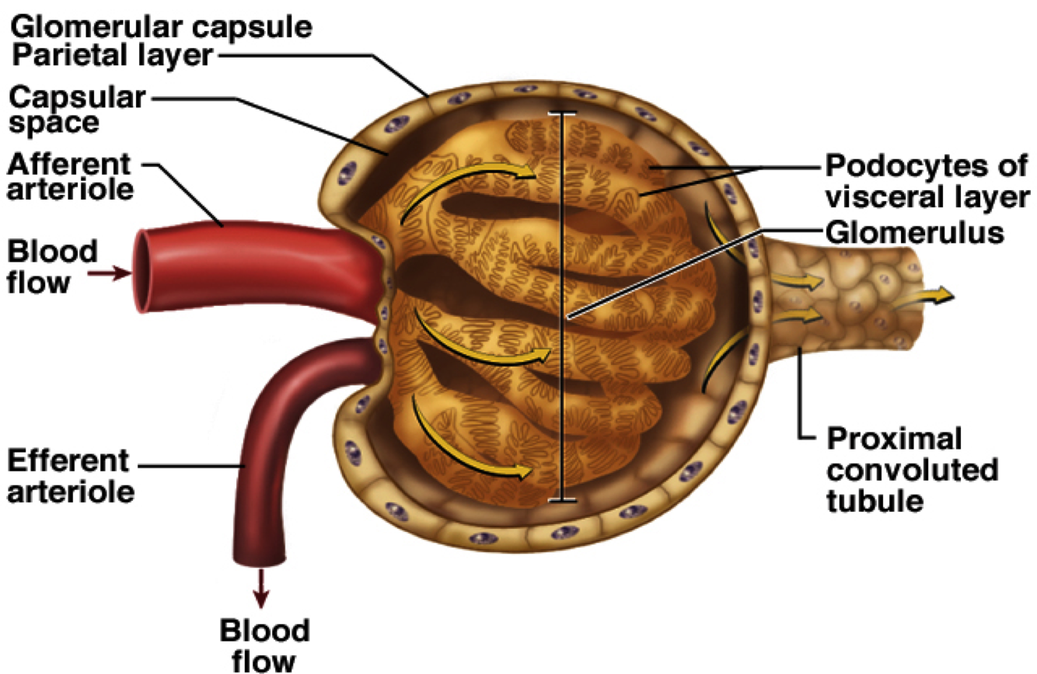
Nephron: The Functional Unit of The Kidney
Nephron
Renal Corpuscle
Renal Tubules
Loop of Henle
Glomerulus
Bowman’s Capsule
Proximal
Convoluted Tubules
Distal
Convoluted Tubules
Connecting Tubules
Peripheral cells
Intercalated cells
Structure of Nephron:
The Glomerulus: capillary tuft: in which large amount of fluid is filtered from blood.
Bowman's capsule: Blind end of the tubule completely surrounds glomerulus and receives the filtrate.
Tubules: in which filtered fluid eventually is converted into urine.
ONLY in female slides
The Glomerulus
Glomerular filtrate collects in capsular space, flows into renal tubule.
Glomerulus: A tuft of capillaries associated with a renal tubule.

Slide 6
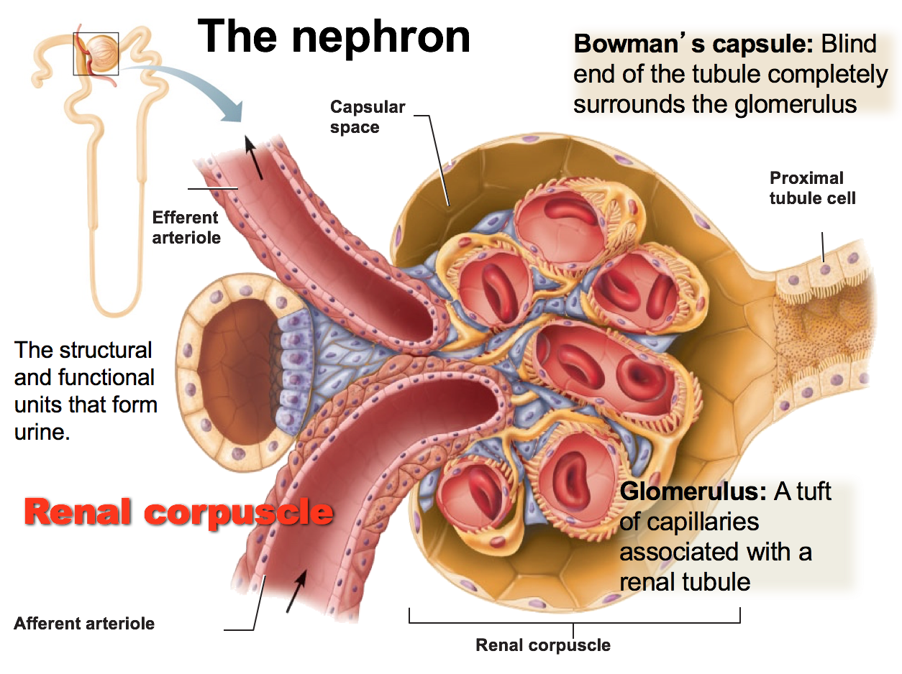
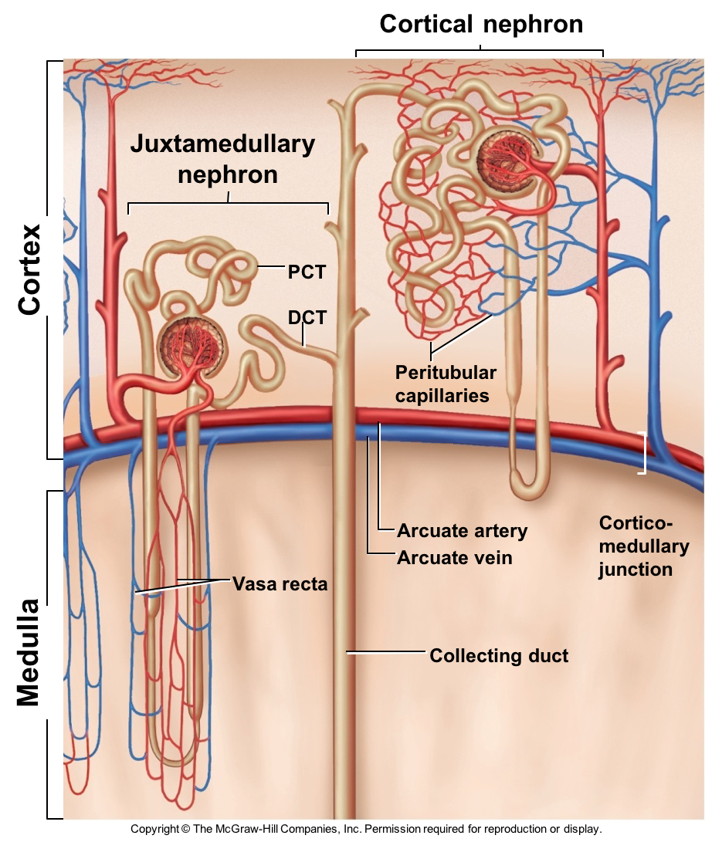
ONLY in female slides
The Nephron consist of :
Bowman’s capsule
PCT
Loop of Henle.
DCT
Collecting tubules and ducts
The renal tubule is divided into different sections with different structural and functional characteristics:
Proximal tubules (in the cortex).
Loop of Henle.
Distal tubule (in the renal cortex).
Connecting tubule, cortical collecting, and the cortical collecting ducts, which run downward in the medulla and become: Medullary collecting ducts.
Types of Nephrons:
Cortical Nephrons |  | Juxtamedullary Nephrons: (15%) 1-2% of Blood Flows Through Them
Their glomeruli in the outer portion of cortex |  | Located at the Cortex-medulla junction They’re located in the cortex within the border of the medulla. Only loop of Henle extend to the medulla.
--- |  | Maintain salt gradient, helps conserve water
Have short loops of Henle |  | Have long loops extended into the medulla with extensive thin segments. are involved in the production of concentrated urine.
Continues from efferent as Peritubular capillaries |  | Continues from efferent as Vasa recta
Juxtamedullary nephrons are counter current in structure like this: Allowing more water reabsorption.
Juxtamedullary nephrons work during prolonged fasting.

Slide 7
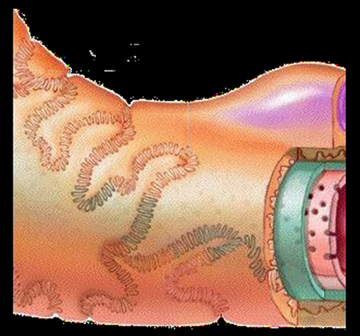
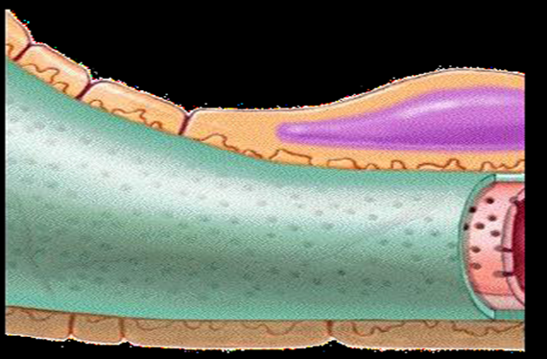
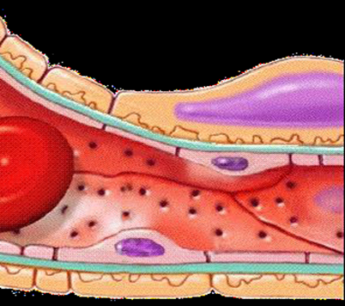
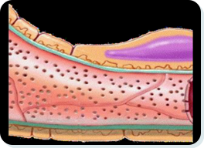
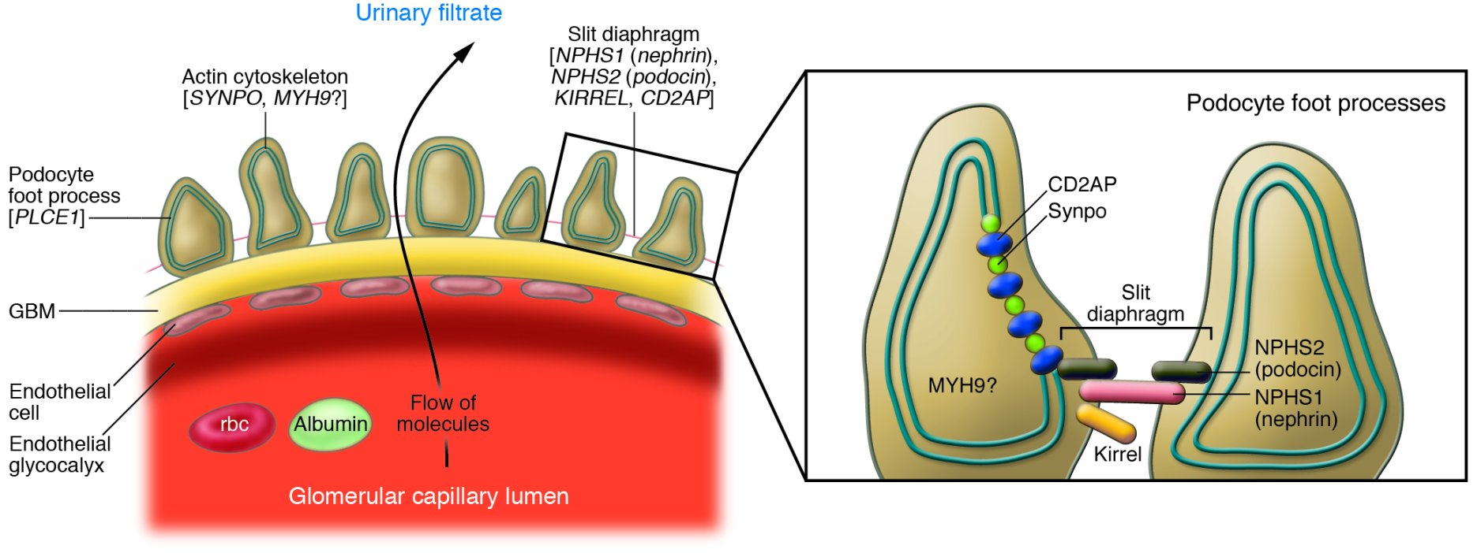
Glomerular Membrane
Allow passage of molecules up to 70,000 D.
Albumin does not normally pass as they are repelled by the negative charge of the glycoproteins material of basement membrane.
Blood cells do not normally pass through the membrane.
Filter that lies between the blood and the interior of glomerular capsule.
ONLY in female slides
Blood in the glomerulus is separated from the fluid in the Bowman’s space by a filtration barrier (glomerular membrane) consisting of three layers:
1- Single epithelial lining of Bowman’s capsule (Podocytes) During filtration the fluid moves between their foot processes (pseudopodia).
2- Basement membrane between endothelium and epithelium.
3- Single layer of capillary endothelium.
Podocytes
(cell body with nucleus)
Basement Membrane
Capillary Endothelium
3
2
1
Characteristics of Glomerular Membrane:
Video of overview of histology of glomerular and GFR, Duration 7 mins

Slide 8
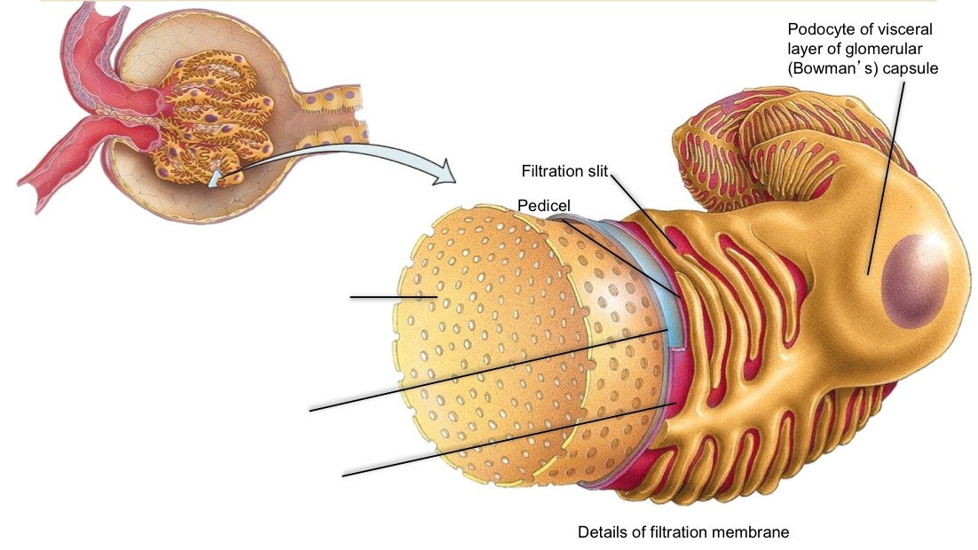
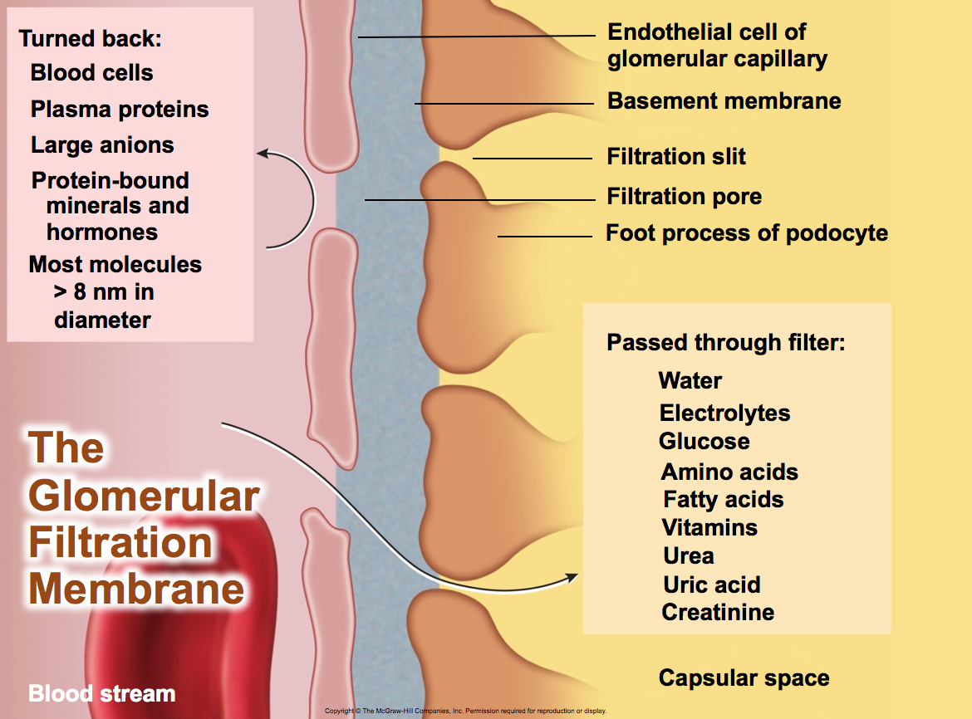
Composed of 3 layers:
Fenestration (pore) of glomerular endothelial cell: prevents filtration of blood cells but allows all components of blood plasma to pass through.
Basal lamina of glomerulus: prevents filtration of larger proteins.
Slit membrane between pedicels: prevents filtration of medium-sized proteins.
1
2
3

Slide 9
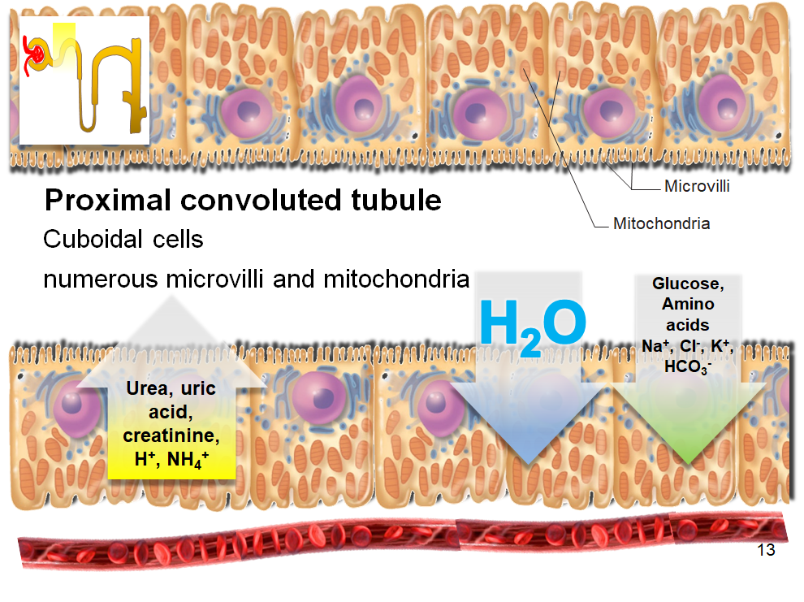
ONLY in male slides

Slide 10
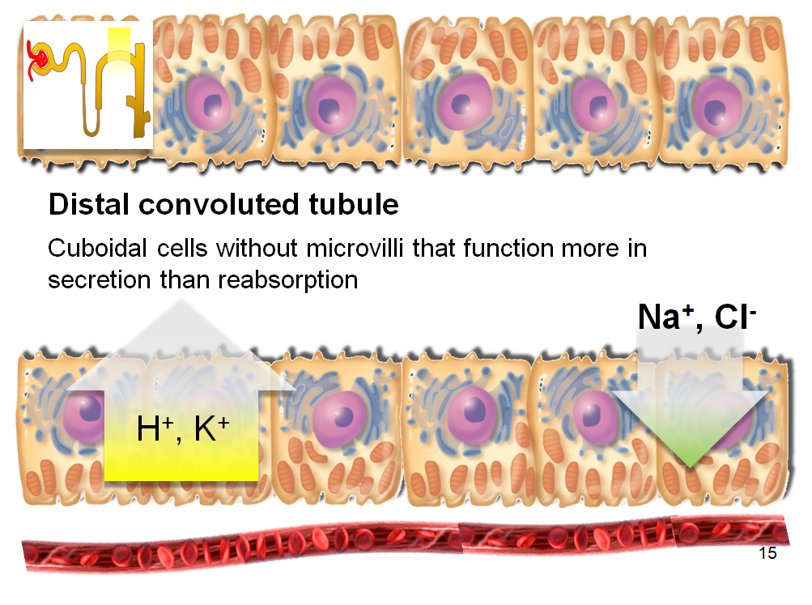
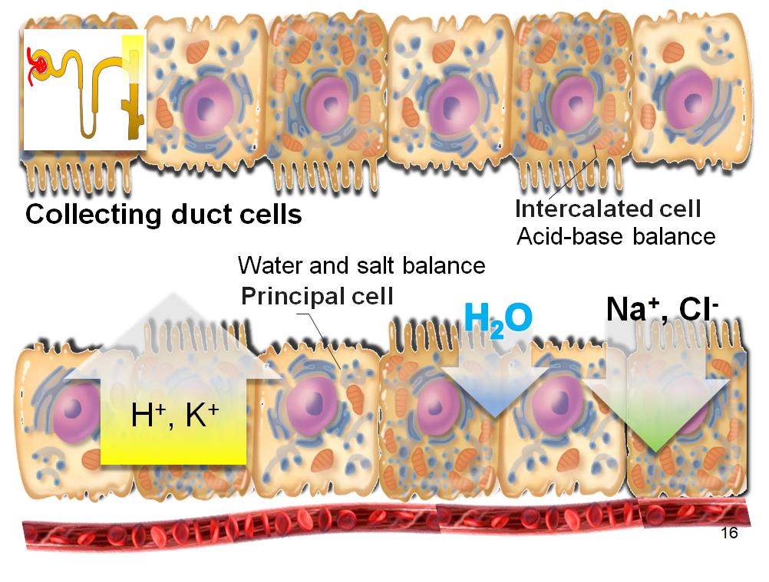
ONLY in male slides

Slide 11
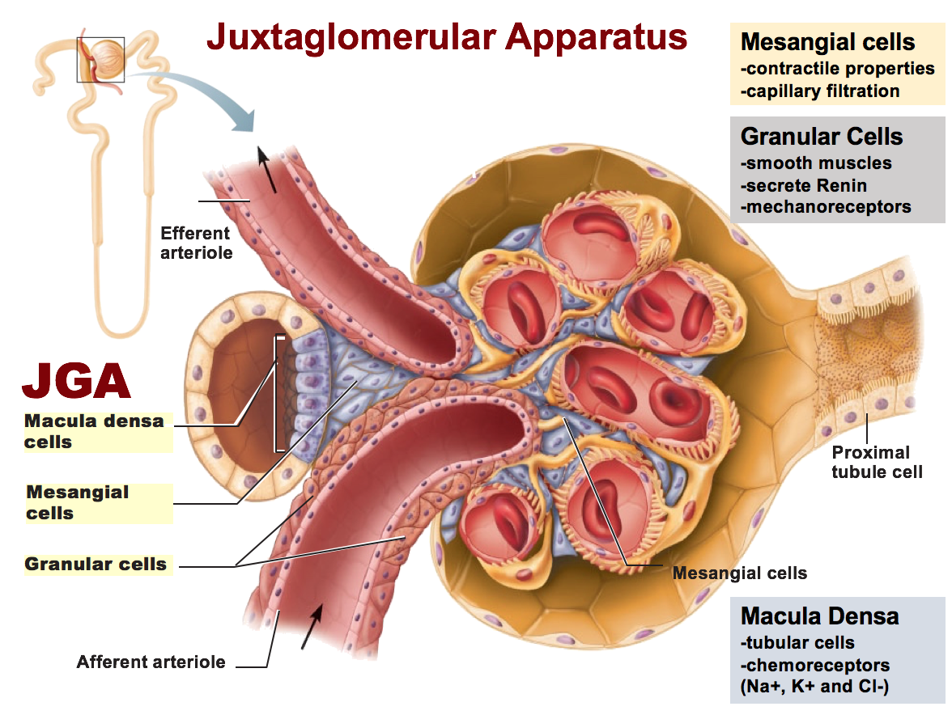
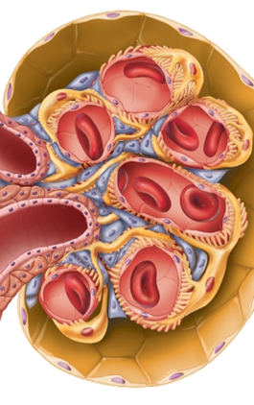
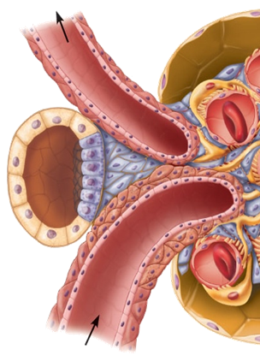
Macula Densa:
Juxtaglomerular Apparatus (JGA)
Juxtaglomerular apparatus
JQ cells
Macula densa
Mesangial cells
Mesangial Cells:
ONLY in male slides
Irregularly shaped cells in the central part of the glomerular tuft.
Phagocytic function -> prevent the accumulation of macromolecules in the basement membrane which have escaped from the capillaries.
Hold the delicate glomerular structure in position.
Contraction -> modifies the surface area of the glomerular capillaries available for filtration.
Tall, closely packed distal tubule cells
Lie adjacent to JG cells
Function as chemoreceptors or osmoreceptors
The cells of the macula densa are sensitive to the ionic content and water volume of the fluid in the tubule.
produce molecular signals that promote renin secretion by the juxtaglomerular cells
Juxtaglomerular apparatus:
Is where distal tubule lies against the afferent (sometimes efferent) arteriole.
Arteriole walls have juxtaglomerular (JG) cells, which:
Enlarged, smooth muscle cells.
Have secretory granules containing renin.
Act as mechanoreceptors
Extra Information

Slide 12
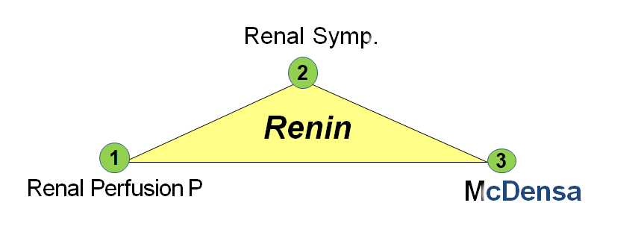
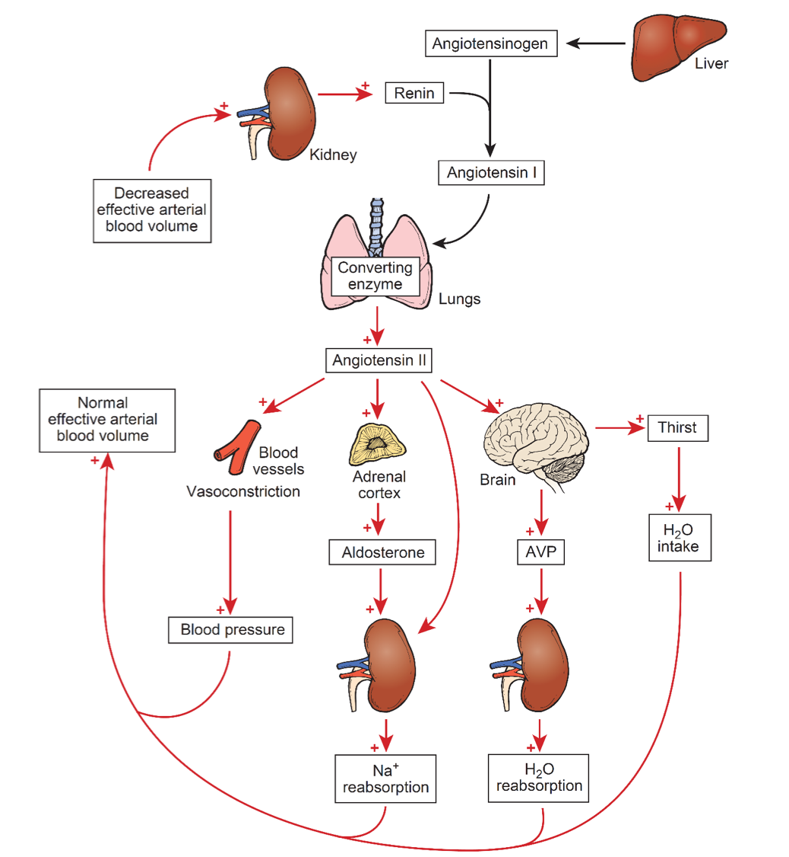
Innervation of the Kidney
RAAS “Renin Angiotensin Aldosterone System”
Only sympathetic nerves supply renal blood vessels
Regulate blood flow, filtration, water reabsorption, renin secretion.
↑ sympathetic = constriction, ↓ blood flow
There is no parasympathetic innervation
A hormone system that regulates BP and water balance.
Day-to-day control of Na⁺ excretion.
Three Main Stimuli for Renin Release

Slide 13
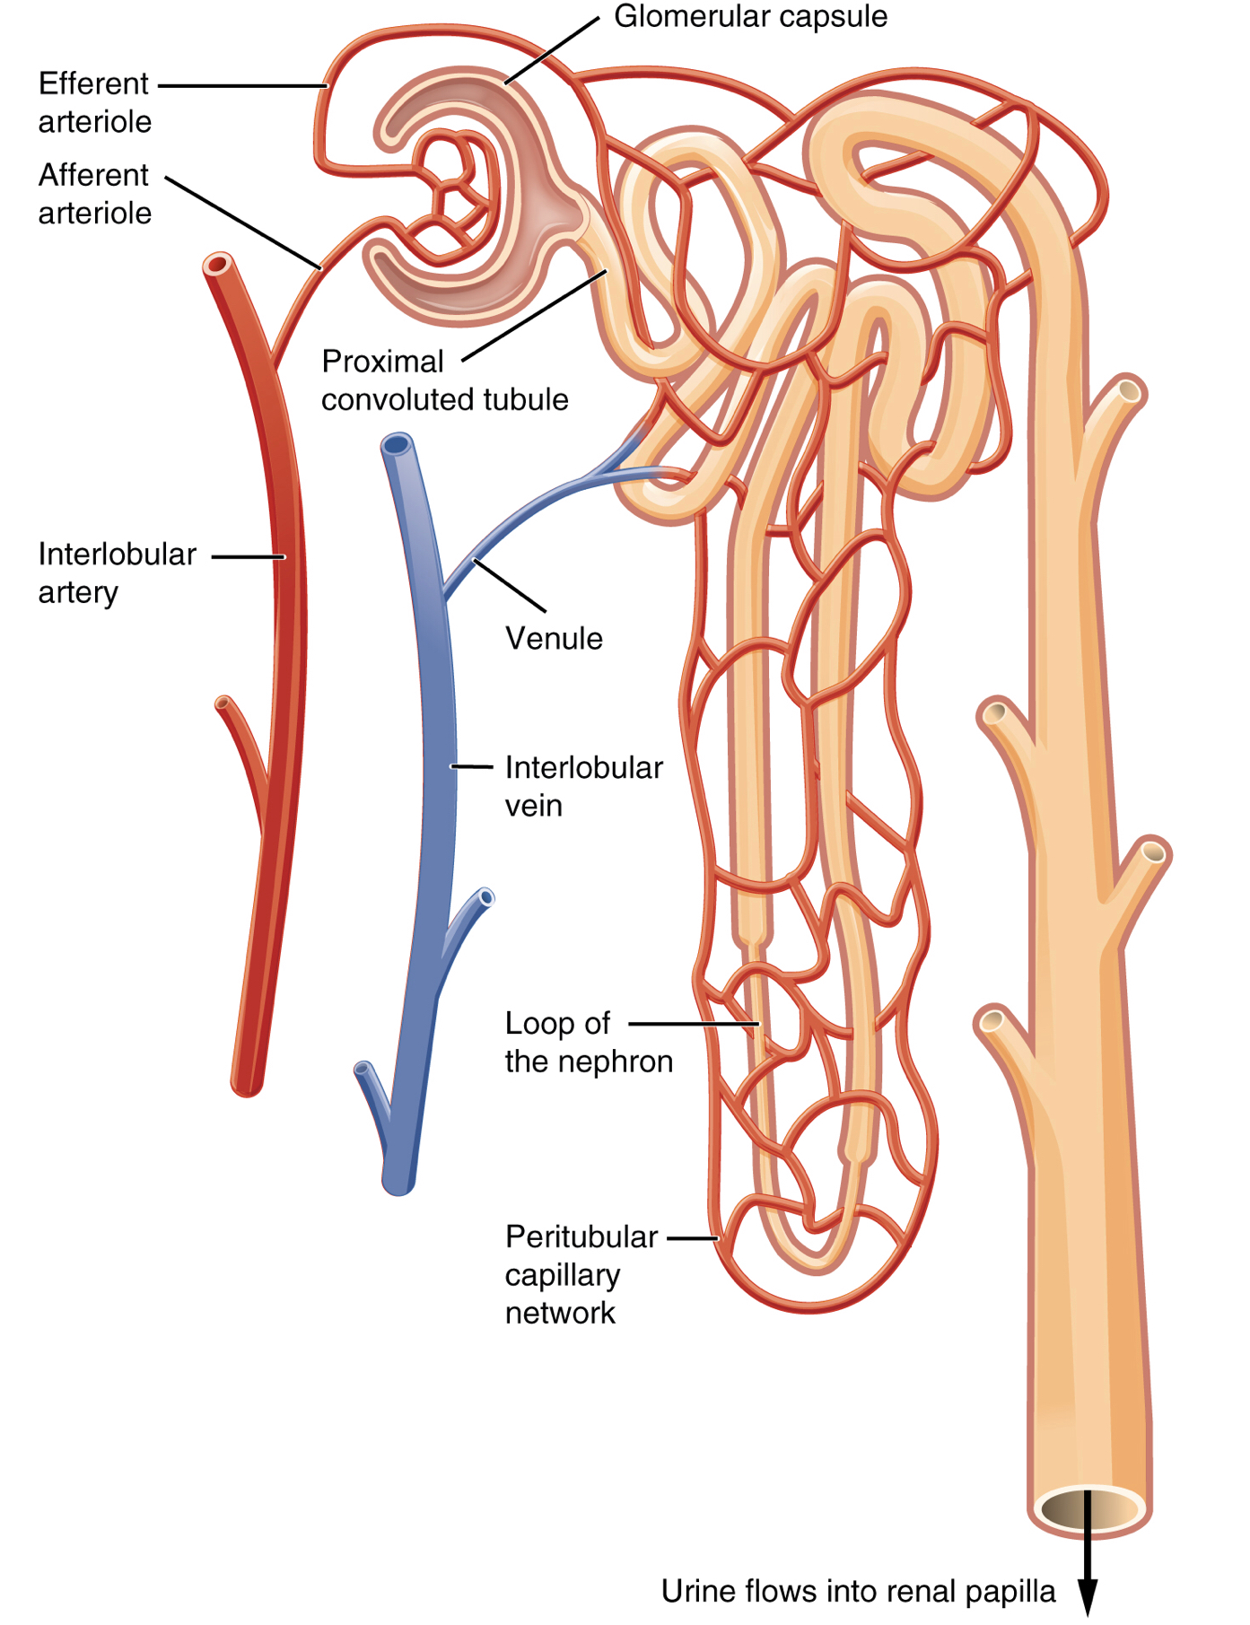
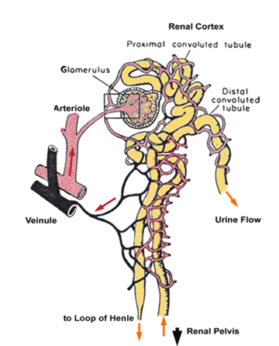
RENAL BLOOD VESSELS
ONLY in female slides
Afferent Arteriole:
Delivers blood into the glomeruli.
Glomeruli:
Capillary network that produces filtrate that enters the urinary tubules.
Efferent Arteriole:
Delivers blood from glomeruli to peritubular capillaries.
Peritubular Capillaries:
Vasa Recta.
Renal blood flow:
¨Renal blood flow to the kidney represents 20% of cardiac output.
¨The blood flows to each kidney through a renal artery.
¨Features of renal circulation:
1- High blood flow rate (1200 ml/min).
2- Presence of two capillary beds: glomerular and peritubular.
Efferent and afferent arterioles are major sites of renal resistance.
EXTRA
Urine formation
The primary function of the kidney is to ‘clear’ unneeded substances from the blood to be excreted in urine.
-Steps of urine formation (basic renal processes):
1- Glomerular filtration: Filtration of fluid from glomerular capillaries into the renal tubules.
2- Tubular reabsorption
3- Tubular secretion.
4- Excretion.
Urinary excretion rate = Filtration rate- reabsorption+secretion.

Slide 14
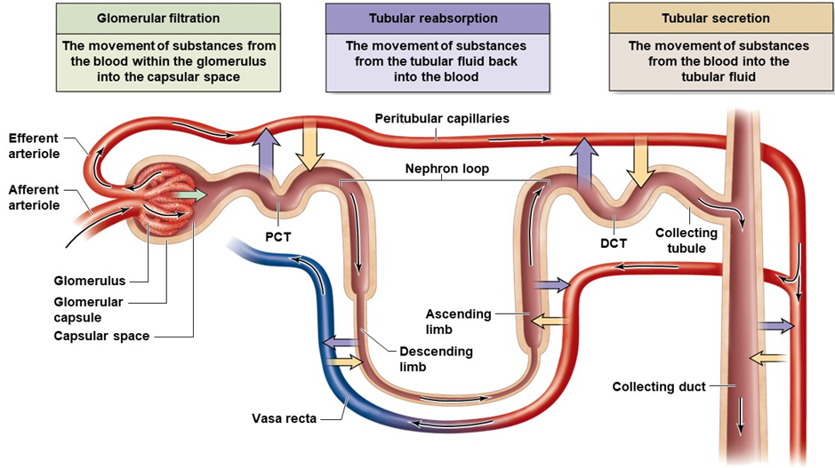
Capillary Beds of the Nephron:
ONLY in male slides
-Every nephron has (Glomerulus & Peritubular capillaries).
-Each glomerulus fed by afferent arteriole & drained by efferent arteriole.
-Blood pressure in the glomerulus is high because:
1- Arterioles are high-resistance vessels.
2- Afferent arterioles have larger diameters than efferent arterioles*.
-Fluids and solutes are forced out of the blood throughout the entire length of the glomerulus.
Capillary Beds & Resistance:
Peritubular beds are low-pressure, porous capillaries adapted for absorption that:
1- Arise from efferent arterioles
2- adhere to adjacent renal tubules
3- Empty into the renal venous system
-Resistance in afferent arterioles:
Protects glomeruli from fluctuations in systemic blood pressure.
-Resistance in efferent arterioles:
1- Reinforces high glomerular pressure.
2- Reduces hydrostatic pressure in peritubular capillaries.
*That’s why the pressure between them is high
Filtrate: Movement of substance from glomerulus to capsular space and then to Proximal tubules.
Mechanisms of Urine Formation:

Slide 15
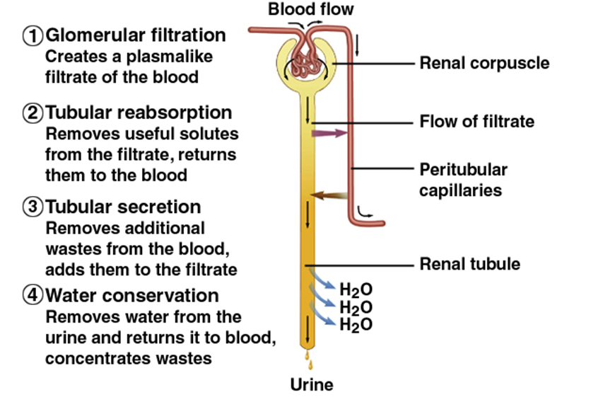
Glomerular filtration rate (GFR)
The first step in urine formation is glomerular filtration.
It is the filtration of fluid from the glomerular capillaries into the renal tubules.
It contains all substances present in plasma except proteins.
GFR is normally 125 ml/min = 20% renal plasma flow.
ONLY in female slides
The GFR is determined by:
1- the Net Filtration Pressure (NFP) across the glomerular capillaries.
2- the Glomerular Capillary Filtration Coefficient (K_{f}).
GFR = K_{f} x Net filtration pressure.
= 12.5 X 10 = 125 ml/min or 180 L/day
The volume of filtrate produced by both kidneys per min.
Filtration coefficient (K_{f}) depends on permeability and surface area of filtration barrier (Mesangial cells).
99% of filtrate reabsorbed, 1 to 2 L urine excreted.
GFR is directly proportional to the NFP:
An increase in NFP → ↑GFR.
A decrease in NFP → GFR.
Changes in GFR normally result from changes in glomerular blood pressure.

Slide 16
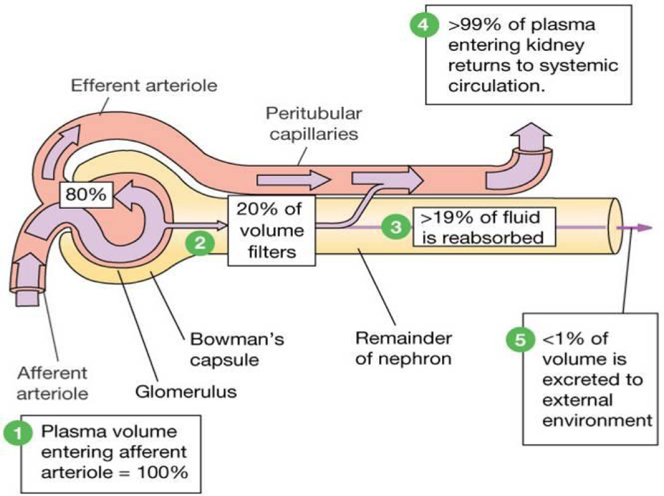
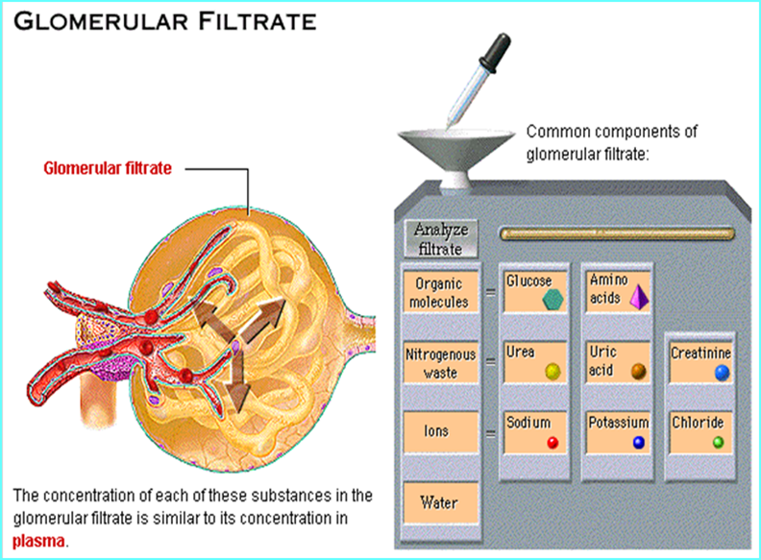
Cont.
ONLY in female slides
GFR = 125 ml/min
180 L /day
1% excreted
Factors governing filtration rate at the capillary bed are:
1-Total surface area available for filtration.
2-Filtration membrane permeability.
3-Net filtration Pressure.
ONLY in male slides
level depends on age, sex and body size

Slide 17
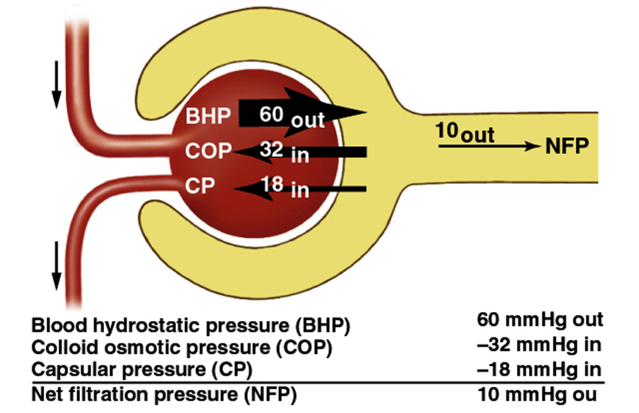
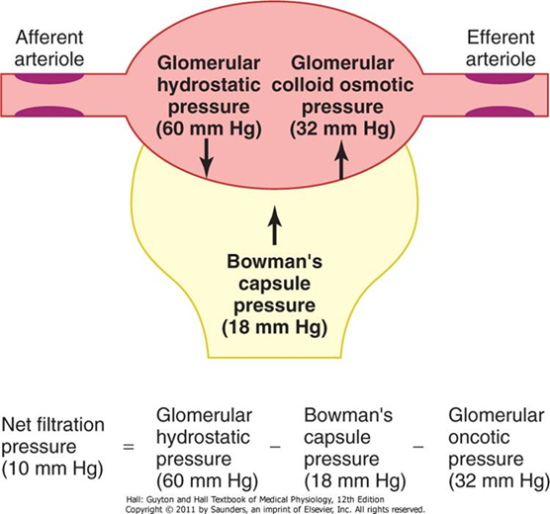
Net Filtration Pressure (NFP):
•The pressure responsible for filtrate formation
•NFP equals the glomerular hydrostatic pressure (HP_{g}) minus the oncotic pressure of glomerular blood (OP_{g}) combined with the capsular hydrostatic pressure (HP_{c})

Slide 18
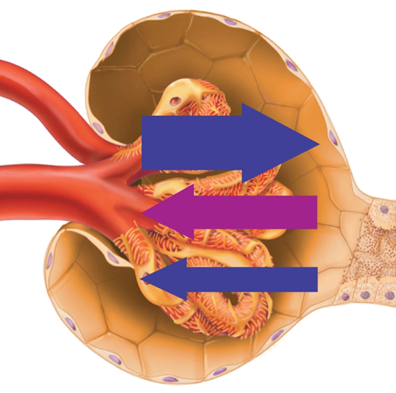
Filtration
Hydrostatic Pressure
glomerular hydrostatic pressure (GHP) push fluid out of vessels
capsular hydrostatic pressure (CsHP) push fluid back into vessels
net hydrostatic pressure (NHP):
NHP = GHP - CsHP
35 = 50 - 15 mmHg
Colloid Pressure
blood colloid osmotic pressure (BCOP)
proteins in blood (hyperosmotic):
draw water back into blood ~ 25 mm Hg
Filtration Pressure (FP):
NFP = NHP - BCOP
10 = 35 - 25 mmHg
importance of blood pressure:
20% drop in blood pressure.
50 mmHg to 40mm Hg
Filtration would stop
Determinants of GFR;
Glomerular capsule
Filtration coefficient (K_{f})
Net Filtration Pressure (NFP)
The cumulative pressure responsible for filtrate formation.
= OUTWARD pressures – INWARD pressures
= (PGC + πBS) – (PBS + πGC)
= (50) – (15 + 25) = 10 mm Hg
Afferent arterioles
PGC = 50 mmHg
Efferent arterioles
πGC = 25 mmHg
NFP = 10
mmHg
PBS = 15 mmHg
Changes in GFR result from changes in glomerular blood pressure.

Slide 19
Control of GFR:
GFR = Kf x [(PG-PB)-(pG- pB)]
GFR = Kf x [(60-18)-(32- 0)]
Hydrostatic pressure inside the glomerular capillaries (glomerular hydrostatic pressure, PG), which promotes filtration
The hydrostatic pressure in bowman's capsule (PB) outside the capillaries, which opposes filtration
The colloid osmotic pressure of the glomerular capillary plasma proteins (πg), which opposes filtration
The colloid osmotic pressure of the proteins in bowman's capsule (πb), which promotes filtration.
Mentioned in male slides
with different numbers
Regulation of GFR:
GFR = Kf X (PG - πG - PB + πB)
-Any factor that affect the parameters in the equation will affect the GFR. However, physiologic regulation of the GFR involves mechanisms that affect mainly the PG
PG depends on:
Arterial BP
Afferent arteriolar resistance
Efferent arteriolar resistance
P= hydrostatic
π= osmotic
Kf
πG
PB
Can get affected in disease conditions causing changes in GFR

Slide 20
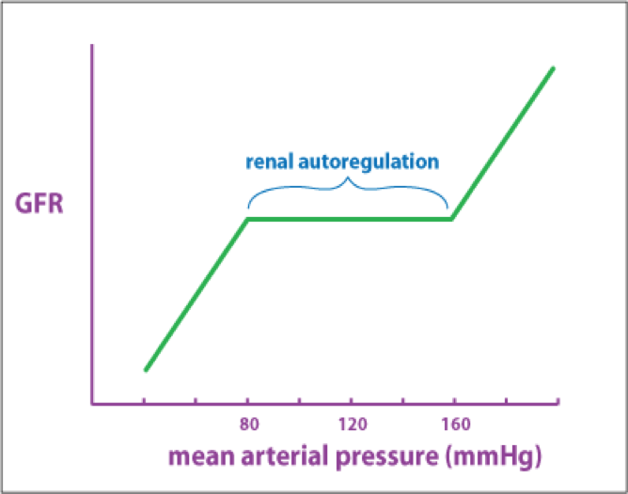
Effect of Arterial blood pressure on GFR:
↑↑ABP → ↑↑GFR.
However, the body maintains constant GFR over an ABP range of 75-160 mmHg.
Why? And how?
Why is it important to have the GFR regulated?
Glomerular Filtration Rate:
If the GFR is too high:
If the GFR is too low:
-Fluid flows through tubules too rapidly to be absorbed, so needed substances cannot be reabsorbed quickly enough and are lost in the urine.
-Urine output rises.
-Fluid flows sluggishly through tubules.
-Tubules reabsorb wastes that should be eliminated (everything is reabsorbed).
-Azotemia develops (high levels of nitrogen-containing substances in the blood).
Creates threat of dehydration and electrolyte depletion
GFR controlled by adjusting glomerular blood pressure through the following mechanisms:
Autoregulation.
Sympathetic control.
Hormonal mechanism: renin and angiotensin.

Slide 21
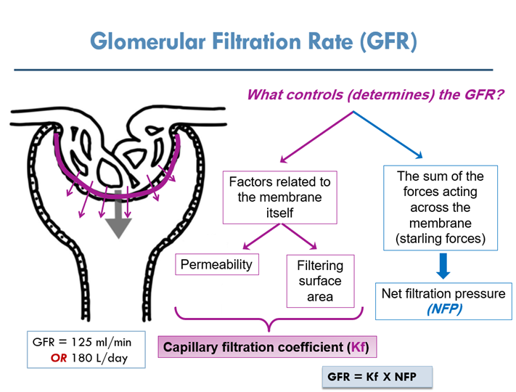
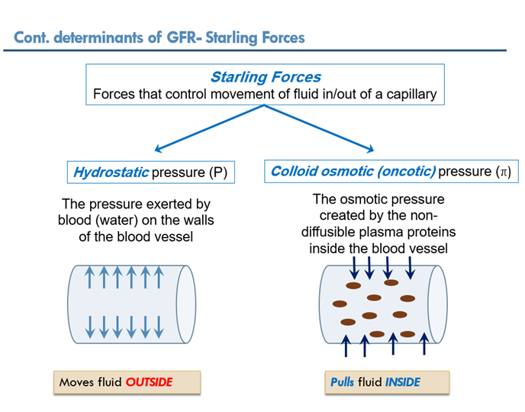
The net filtration pressure is the sum of:
1. glomerular hydrostatic pressure (= 60 mmHg). It promotes filtration.
2. hydrostatic pressure in Bowman’s capsule (= 18 mmHg). It opposes filtration.
3. colloid osmotic pressure of glomerular plasma proteins (= 32 mmHg). It opposes filtration.
So, net filtration pressure = 60-18-32= 10 mmHg.
Forces controlling GFR: Starling’s forces
Mentioned in male slides
with different numbers

Slide 22
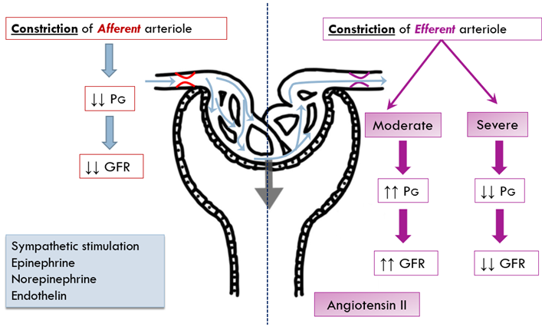
How changes in Forces determining GFR affect GFR?
ONLY in female slides
•Increased Bowman’s capsule pressure decreases GFR. It can happen in urinary obstruction e.g. stones , tumors..
•Increased glomerular capillary colloid osmotic pressure decreases GFR.
Increased glomerular capillary hydrostatic pressure increases GFR. This pressure is affected by:
1-ABP
2-Afferent arteriolar resistance
3-Efferent arteriolar resistance
Physiologic Regulation of GFR:

Slide 23
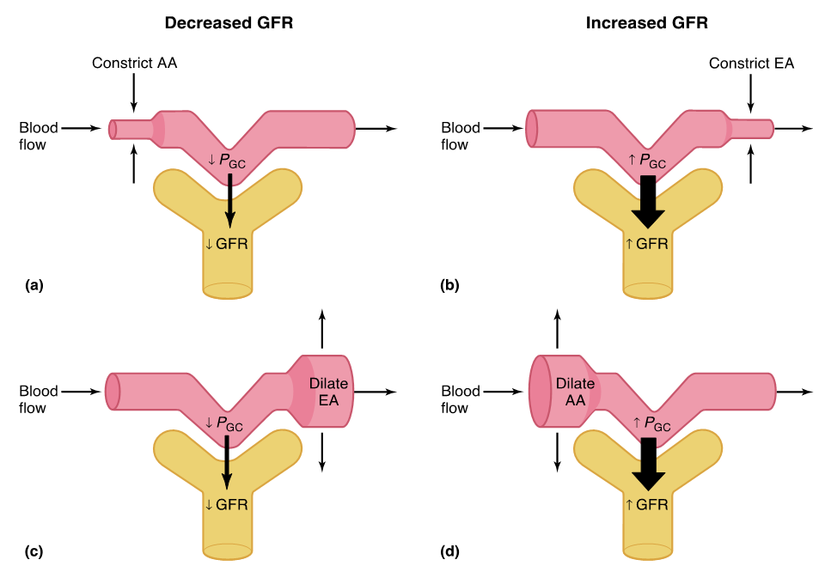
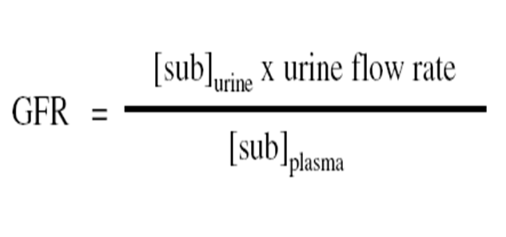
Constriction/dilation of afferent/efferent arterioles & GFR:
As vasodilation and vasoconstriction of the afferent and
efferent arterioles alter the blood flow through the
glomerular capillaries, there are corresponding alterations
in the glomerular filtration rate (GFR).
ONLY in female slides
↓ RPF
↓ RPF
FF=GFR/RPF ↓
FF=GFR/RPF ↑
Important
↑ RPF
↑ RPF
FF=GFR/RPF ↓
FF=GFR/RPF ↔︎
Factors affecting Renal blood flow and GFR
Sympathetic stimulation of renal arterioles decrease GFR & RBF.
Norepinephrine decreases GFR & RBF.
Angiotensin II decreases RBF. It constricts efferent arteriole more than afferent .
High protein diet increases GFR.
Hyperglycemia increases GFR & RBF.
Fever increases GFR & RBF.
Aging decreases RBF & GFR
Glomerular Filtration Rate Formula:

Slide 24
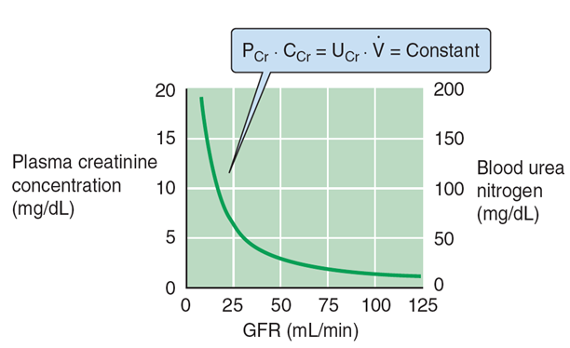
Substances Used to Measure GFR:
ONLY in male slides
Important
freely filtered
not reabsorbed
not secreted
not synthesized by kidney
not degraded by kidney
does not alter renal function
Creatinine - endogenous released by skeletal muscle
Not as accurate as inulin as a small quantity is secreted into the proximal tubule -> Amount excreted > amount filtered
Regulation of GFR & RBF:
Intrinsic controls (renal autoregulation): Act locally - maintain GFR, BP 80-180 mmHg.
Extrinsic controls (Sympathetic)
1-Neuroendocrine mechanisms - maintain BP.
2-Can negatively affect kidney function
3-Take precedence over intrinsic controls if systemic BP < 80 or > 180 mmHg
Hormonal mechanism

Slide 25
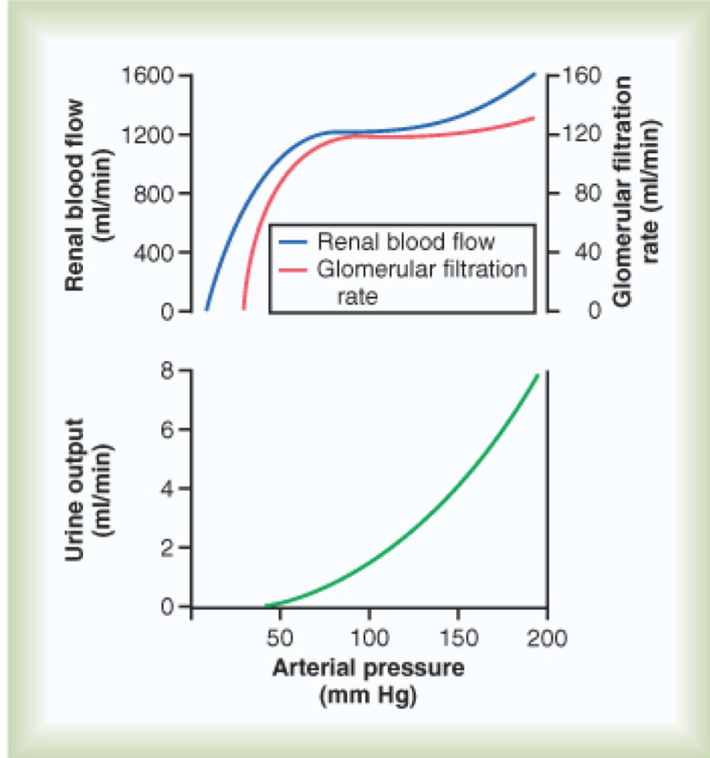
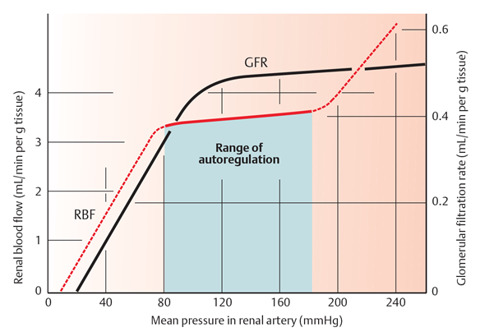
1- Autoregulation of GFR:
GFR remains constant over a large range of values of BP
75-160 mmHg (80-180 mmHg)
Intrinsic Autoregulation:
How autoregulation takes place?
Refer to feedback mechanisms intrinsic to the kidney that keep the renal blood flow and GFR relatively constant despite fluctuations in ABP.
These mechanisms operate over an ABP ranging between 75-160 mmHg.
Achieved by 2 major mechanisms:
Tubulo-glomerular feedback mechanism.
Myogenic auto-regulation.
RBF remains ~ constant as BP changes between 80 and 180 mmHg.
Autoregulation, is achieved by changes in resistance, mainly through the afferent arterioles.
< 80 mmHg (75 mmHg), filtration decreases, and ceases altogether when MAP = 50 mmHg
- Autoregulation is independent of nerves or hormones
- occurs in denervated and in isolated perfused kidneys.

Slide 26
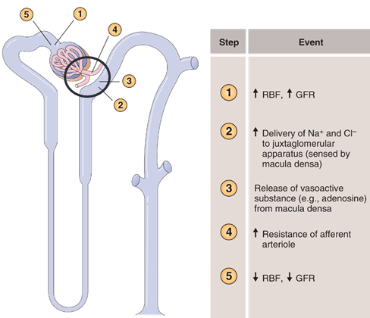
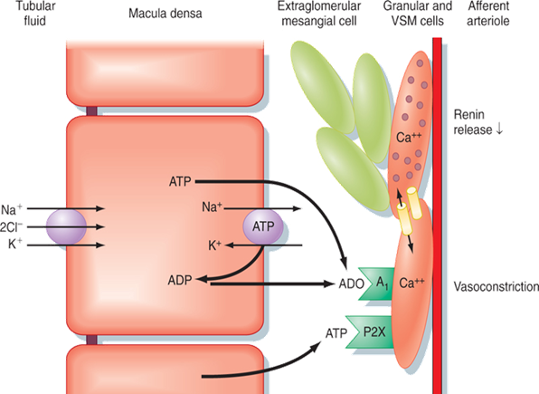
A- Tubuloglomerular Feedback:
mechanism:
↓ABP → ↓delivery of NaCl to the macula densa cells, which are capable of sensing this change , this will cause two effects:
decrease in resistance of the afferent arterioles (i.e. vasodilatation) → ↑glomerular hydrostatic pressure to normal levels.
increase in renin release from JG cells → Ang II → constrict efferent arteriole → ↑glomerular hydrostatic pressure & GFR to normal.
Here the ABP is increased so the opposite happens.
McDensa TGF
Decrease
Renin release
Mediators:
Adenosine and Renin
Increase FLOW
[NaCl] dependent mech.
Afferent arterioles
B- Myogenic Mechanism:
It is the intrinsic capability of blood vessels to constrict when blood pressure is increased. The constriction prevents excess increase in renal blood flow and GFR when blood pressure rises.
When blood pressure decreases the myogenic mechanism reduces vascular resistance and the vessel dilates.

Slide 27
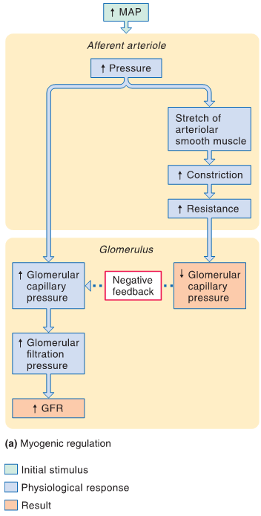
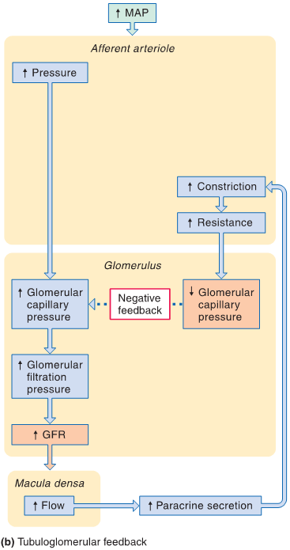
ONLY in male slides
(Tubulo-glomerular Feedback)
ONLY in female slides

Slide 28
Example of autoregulation
2-Extrinsic controls: Sympathetic Control of GFR
When the sympathetic system is :
at rest:
-Renal blood vessels are maximally dilated
-Autoregulation mechanisms prevail
Under stress:
-Norepinephrine is released by the sympathetic nervous system
-Epinephrine is released by the adrenal medulla
-Afferent arterioles constrict and filtration is inhibited
-Note: during fight or flight blood is shunted away from kidneys
The sympathetic nervous system also stimulates the renin-angiotensin mechanism. This induces vasoconstriction of efferent arteriole.

Slide 29
Summary of neurohumoral control of GFR and RBF:
Stimulates vasoconstriction of afferent arterioles:
- Preserves blood volume to
muscles and heart.
Cardiovascular shock:
- Decrease glomerular capillary
hydrostatic pressure.
- Decrease urine output.
ONLY in male slides
Important

Slide 30
-How does a high protein diet affect, if any, GFR?
3-Hormonal Control of GFR:
-Possible role of macula densa feedback in increasing GFR after a high protein meal.
ONLY in male slides

Slide 31
Quiz
1- The juxtaglomerular apparatus is a part of :
A. The efferent arteriole
B. The distal convoluted tubule
C. The Afferent arteriole
D. Both C and B
4- Autoregulation can only response when systemic pressure is:
A. Between 100 - 200 mmHg
B. Between 80- 180 mmHg
C. Between 120-60 mmHg
D. None of the above
2- When the sympathetic nervous system is stimulated:
A. Renin angiotensin mechanisms dilate Afferent arterioles
B. Renal blood flow is elevated
C. Norepinephrine is released from adrenal medulla
D. Afferent arterioles are constricted to decrease GFR
5-If an increase in ABP, which one of these mechanism will occur?
A. a decrease in resistance of the afferent arterioles
B. Secrete angiotensin II
C. decrease in renin release
D. constrict efferent arteriole
3- Increased glomerular filtration leads to:
A. Fluid flows through tubules too rapidly to be absorbed
B. Fluid flows through tubules slowly to be absorbed
C. None of the above
D. Both A and B
6- When a patient is treated with an aldosterone antagonist, there is likely to be a fall in:
A. Urine volume
B. Plasma potassium concentration
C. Blood viscosity
D. Blood volume
1- D 2- D 3- A 4- B 5- C 6-D

Slide 32
Thank you for checking our work
Male Team:
Female Team:
فهد الفايز
خالد المطلق
نواف الهلال
هشام الشايع
خالد العقيلي
عبدالله الزيد
حسين علامي
سلطان الفهيد
خالد المطيري
فهد النهابي
عمر اليابس
أنس السويداء
أنس السيف
خالد شويل
ريان الموسى
سعد الهداب
سلطان الناصر
سعود العطوي
سيف المشاري
عبدالجبار اليماني
عبدالرحمن آل دحيم
هشام الموسى
مها النهدي
ريناد الغريبي
عائشة الصباغ
ميعاد النفيعي
آلاء الصويّغ
رناد المقرن
رهف الشنيبر
روان مشعل
ريم القرني
نورة بنت حسن
Team Leaders:
عبدالمجيد الوردي ~ ساره البليهد
@physio437
physiologyteam437@gmail.com

