Slide 1
Radiology
Renal Block
Team 437
Radiology of the renal system
Colour Code
Important Doctor’s notes Extra explanation

Slide 2
Objectives:
Modality used for assessment of the urinary system
X-ray
US
CT
MRI
Nuclear
Normal anatomy
Common pathologies
Kidney
Ureter
Bladder
Urethra

Slide 3
Modalities used

Slide 4
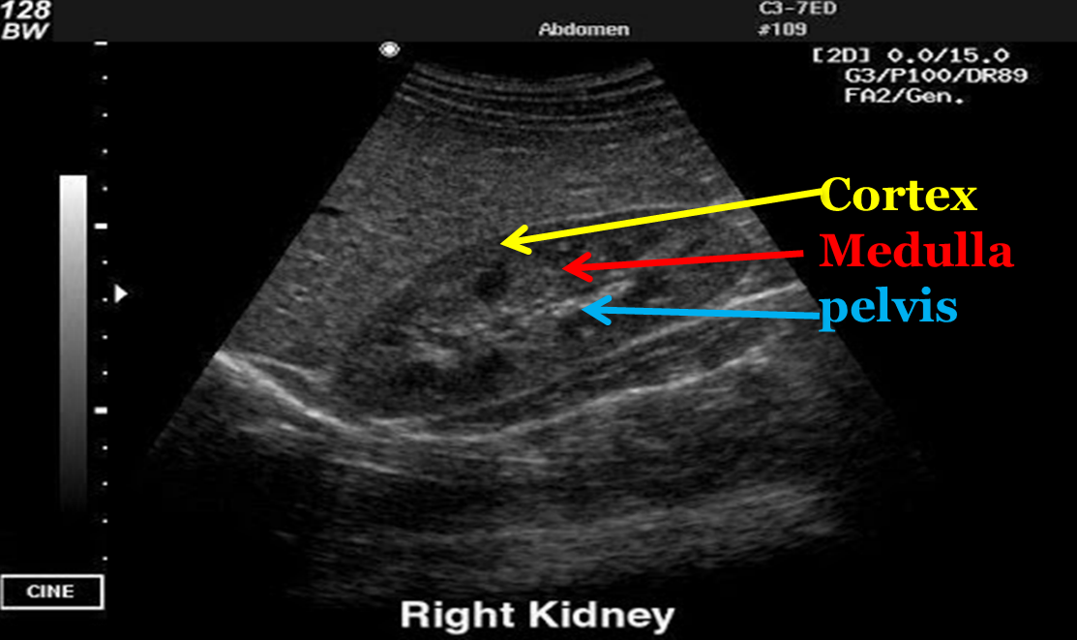
Ultrasound
Pros (Advantages)
Portable
Inexpensive
No ionizing radiation
Cons (Disadvantages)
Time consuming
Operator dependent(depends on the skill of the operator).
Image Key:
White = stones and calcification.
Grey = soft tissue.
Black = fluid.
-Ultrasound: Sound waves that reflect off dense surfaces, giving us a hyper–echoic view of the surface.
-Objects with less density appear in gray such as sub tissue
-Fluids such as water and urine will not reflect the sound wave
-The renal pelvis appears white because it is filled with fat

Slide 5
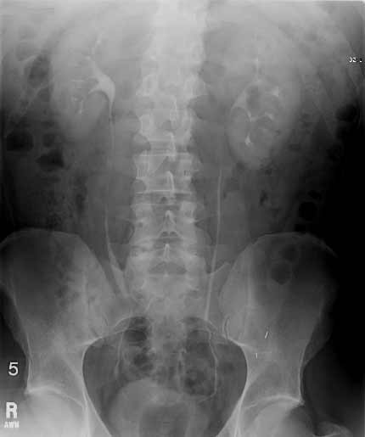
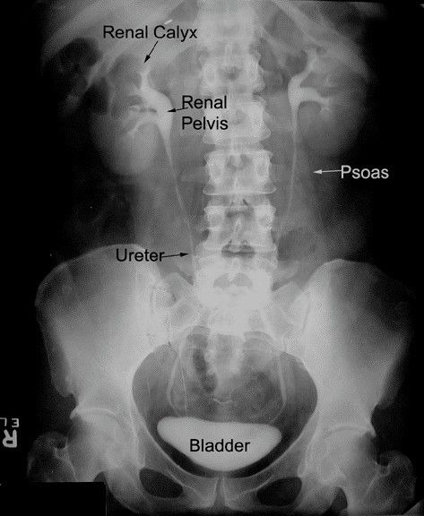
X-RAY
Not commonly used on the renal system.
Pros (Advantages)
Inexpensive
Quick
Cons (Disadvantages)
Ionizing radiation
Not definitive
Image Key:
White = bone and calcification.
Grey = soft tissue.
Black = air.
IVP -Intravenous pyelogram commonly used on the renal system -patient is given contrast which appears bright after entering the renal system -you can tell if there is any stone or obstruction in the ureter -contrast is given Intravenously, and it ends up being excreted by the kidneys
IVP

Slide 6
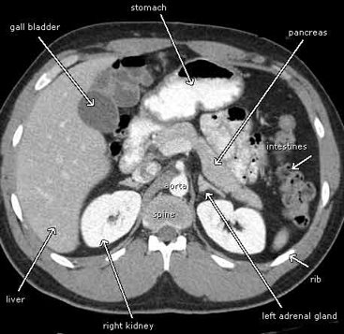
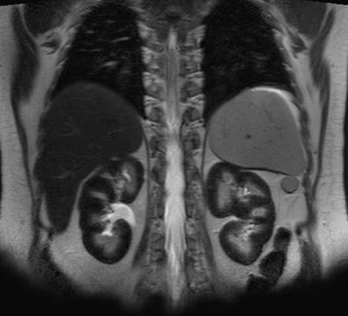
CT
MRI
Multi leveled X ray, which gives a more definitive and clearer images.
Stands for (Magnetic Resonance Imaging)
Pros (Advantages)
Quick
A lot of information(can view .(small structures in the kidney
Pros (Advantages)
No ionizing radiation(uses magnetic fields).
A lot of information(can be used in pregnancy).
Cons (Disadvantages)
Ionizing radiation
Expensive
Cons (Disadvantages)
Time consuming
Expensive
Image key: same as X ray
White = bones and calcification.
Grey = soft tissue.
Black = air.
Image key:
White = high intensity. Grey to black = low intensity.

Slide 7
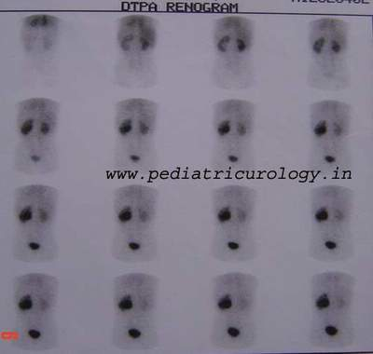
Nuclear scans
Pros (Advantages)
assess the function
Cons (Disadvantages)
Time consuming
radioactive materials
-The patient is given radioactive materials which give off gamma rays, these rays can be detected by special cameras.
-This picture shows that the right kidney filtered the radioactive material while the left one did not.

Slide 8
Summary
-Ultrasound and MRI are the only ones with no ionizing radiation -Nuclear scan is the only one that can asses the function(not only the anatomic structure)

Slide 9
Urinary System Anatomy

Slide 10
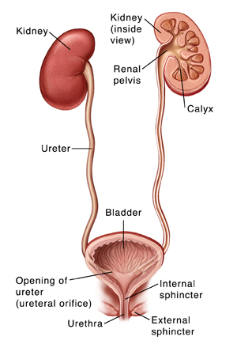

Slide 12
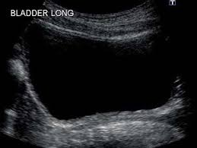
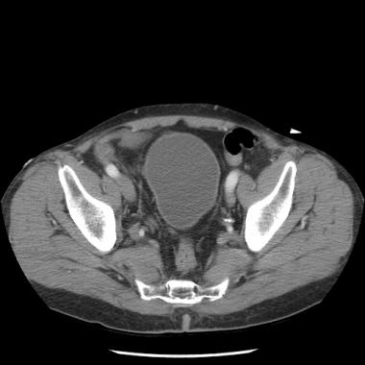
Urinary bladder
-Black in Ultrasound(because it’s fluid) -We use it to asses the amount of urine in bladder
-Smooth muscle of the bladder -Tumors will cause irregularities

Slide 13
Common Kidney Pathologies

Slide 14
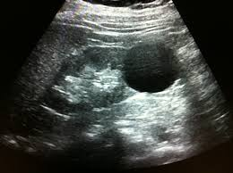
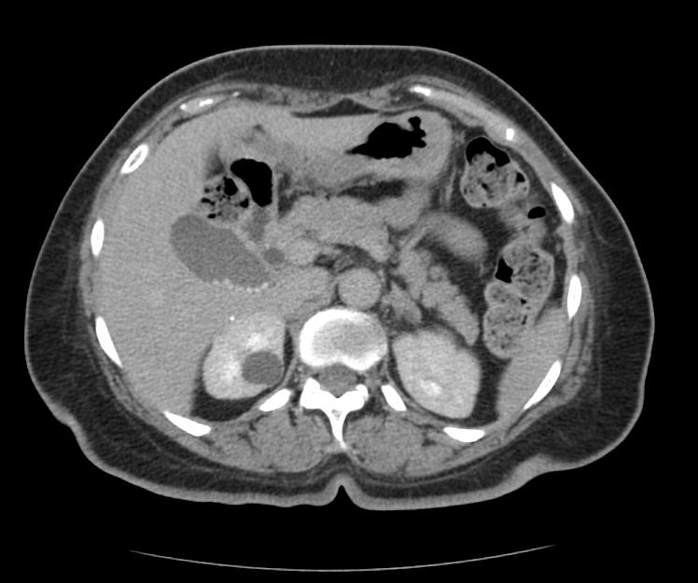
Cysts
Cysts: are sac-like structures that may be filled with gas, liquid, or solid materials.
It is benign, common and predominantly incidental.
Anechoic circular mass , clear borders.
Hypo-dense clear border mass in right kidney.
-Here it’s cyst not tumor, why? Because it has well demarcated fluid inside

Slide 15
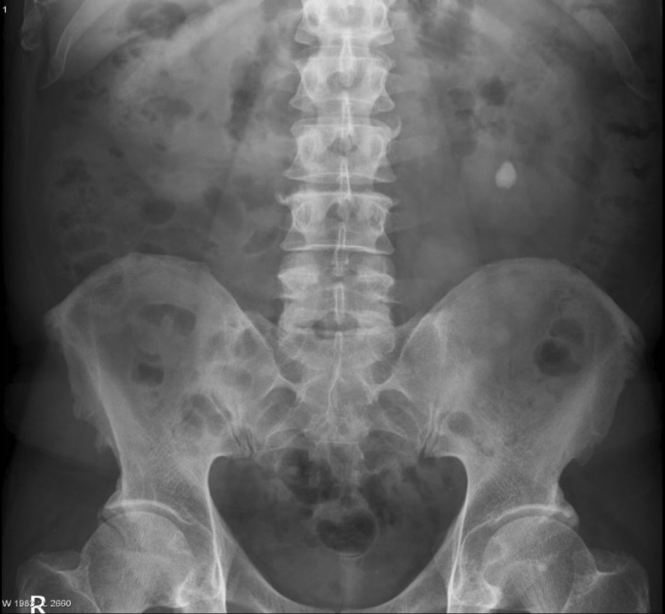
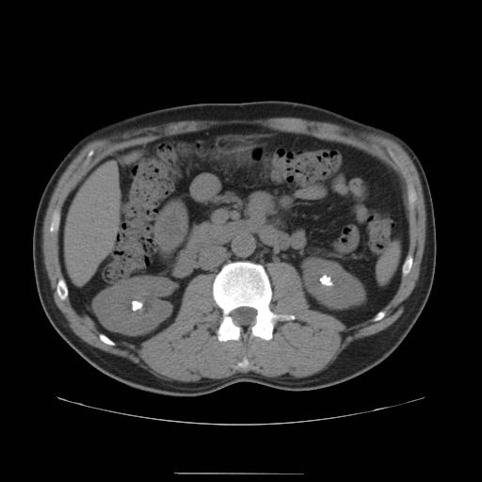
Stones
Radio-opaque (calcium , struvite)
(can be seen in X-RAY)
Radio-lucent (uric acid , cysteine)
(can’t be seen in X-RAY)
Struvite: (magnesium ammonium phosphate)
The best modality for the diagnosis of renal stones is non-contrast CT
-Contrast CT will mask the stones because the whole area will become bright -In the other hand non-contrast CT will only make the stones appear bright as you can see in the picture.

Slide 16
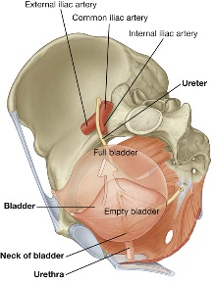
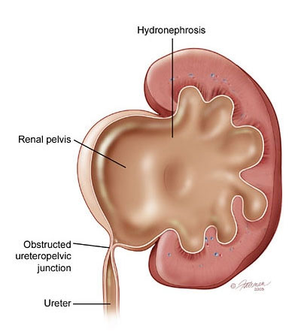
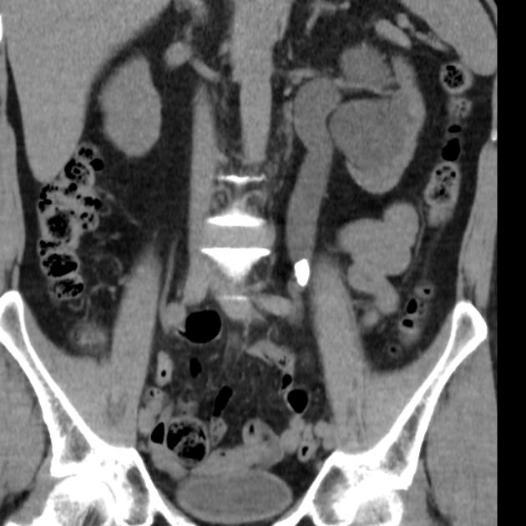
Stones
Uretropelvic junction.
Pelvic brim junction: intersection of iliac arteries and ureter
-Here we have a stone in the Uretropelvic junction
-Here we have a stone in the Pelvic brim junction

Slide 17
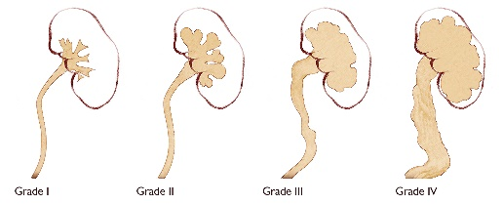
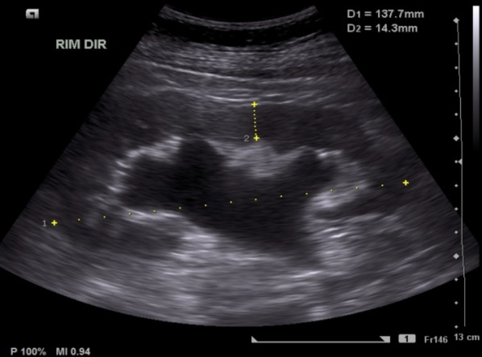
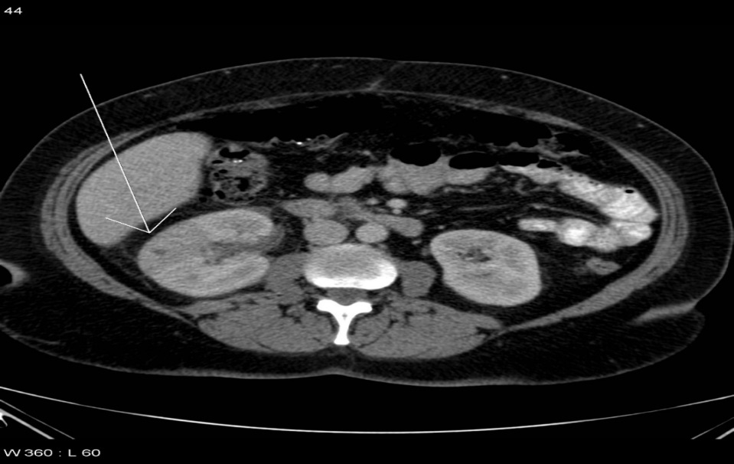
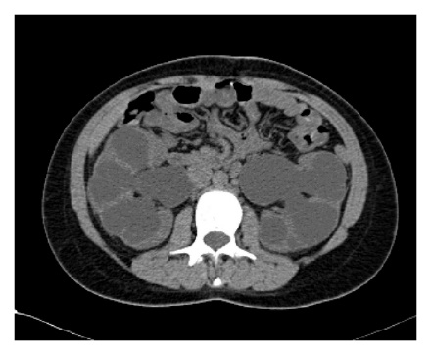
Hydronephrosis
Pyelonephritis
It is the infection of the kidney.
Acute pyelonephritis results from bacterial invasion of the renal parenchyma. Bacteria usually reach the kidney by ascending from the lower urinary tract.
CT scan for a patient with pyelonephritis, we do it only if the patient doesn't respond to the treatment or he had a recurrent pyelonephritis.
-A block in the drainage of the renal system which causes the urine to accumulate in the renal pelvis. -When there is a complete obstruction to the ureter by a stone , the kidney eventually fills with urine and become swollen along the ureter
-You can notice how the kidney pelvis is dilated or extended if you compare it to the normal ultrasound

Slide 18
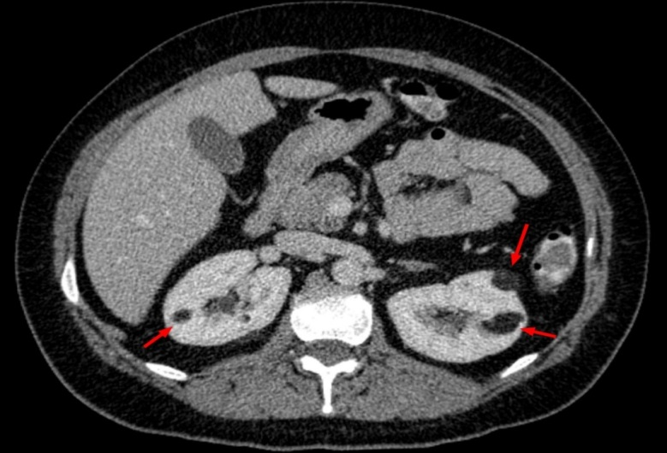
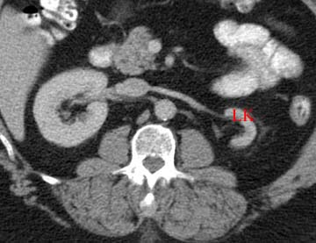
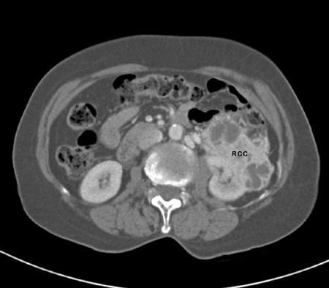
End-stage renal disease (ESRD)
Tumors
1-Benign
most common type is angiomyolipoma.
-ESRD causes Kidney atrophy -In the picture below we can see atrophy in the left kidney -The right kidney is trying to compensate, that’s why it’s hypertrophied
2-Malignant
most common type is
renal cell carcinoma.

Slide 19
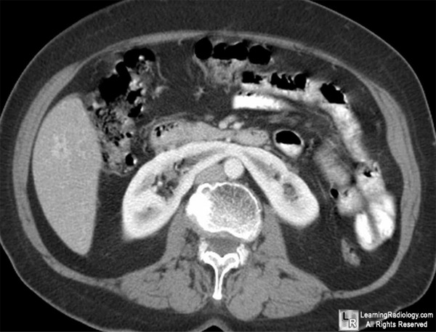
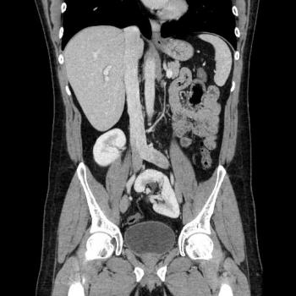
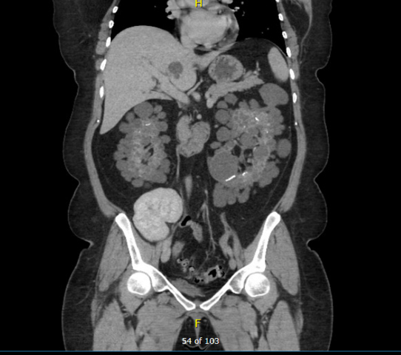
Congenital kidney diseases
Horseshoe Kidney
Ectopic Kidney
Polycystic Kidney Disease

Slide 20
Common Ureter and Urinary bladder Pathologies

Slide 21
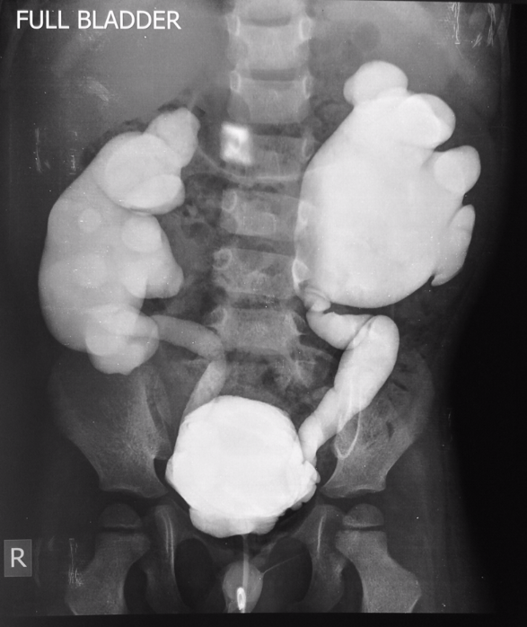
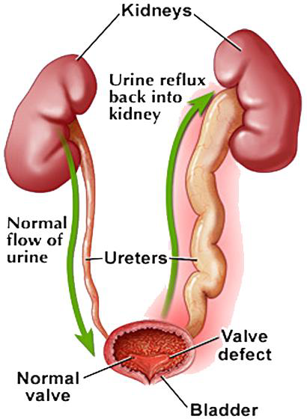
Ureter pathology
vesicoureteral reflux disease
-This disease characterized by backflow of the urine
-How do we diagnose it ?
By giving the patient contrast , after that we will see it go from the ureter back to kidney

Slide 22
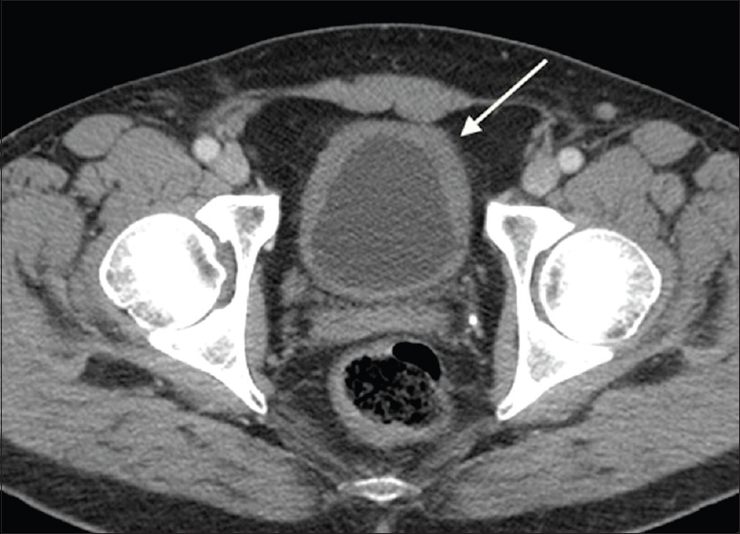
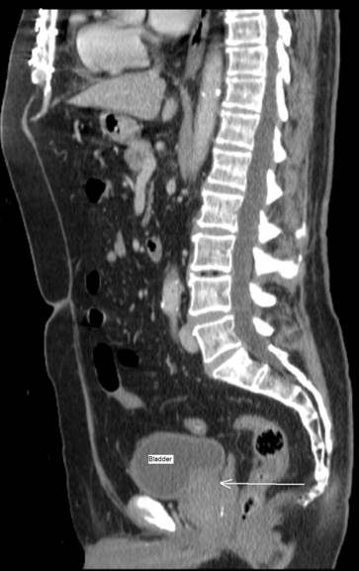
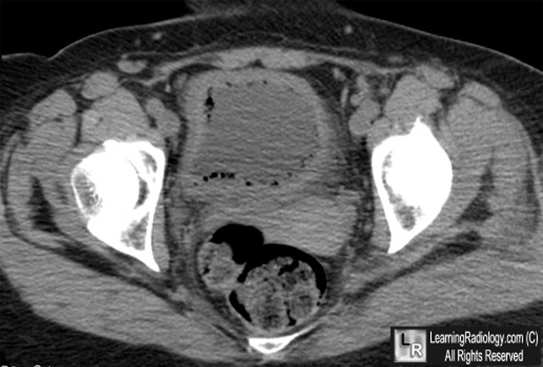
Cystitis
Urinary bladder pathologies
Benign Prostate Hypertrophy
Image 1: an inflamed urinary bladder (thick surrounding walls).
Image 2: This bladder has gas bubbles that could be due to inflammation or infection from ‘gas producing’ bacteria.
Bladder
Prostate
-Hypertrophied prostate causing the bladder to be compressed

Slide 23
Quiz
1)What modality is cheap and with no Ionized radiation? A- Ultrasound B- X-ray C- CT-scan D- MRI 2)What modality is used to assess the function? A- Nuclear scan B- X-ray C- MRI D- CT scan 3)What modality is used with a lot of information and no Ionized radiation? A- X-ray B- Ultrasound C- MRI D- CT scan 4)What type of stones we can see under X-ray? A- Radio-opaque B- Radio-lucent 5)What is the best modality used to diagnose renal stones? A- Contrast CT B- Non-Contrast CT 6)What is the most common type of benign and malignant kidney tumors? A- Transitional cell carcinoma/Renal cell carcinoma B- Angiomyolipoma/Renal cell carcinoma
1-A 2-A 3-C 4-A 5-B 6-B

Slide 24
THANK YOU
For checking our work.
Contact us on:
Radiology437@gmail.com
@Radiology437
Team Leaders:
Rawan Alharbi
Faisal Alqusaiyer
Team members:
Mohammad alasqah Abdulrahaman Altalasi Abdullah Almeaither
Abdullah alsergani Abdullah Alomar Mohannad alamri
Afnan almustafa
Revised by:
Homoud al zaid
Adel alzahrani

