Slide 1
DNA Extraction and Purification

Slide 2
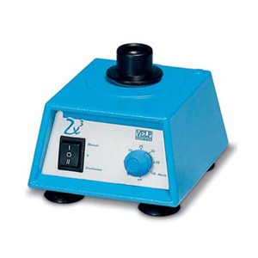
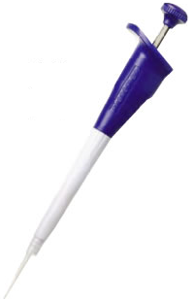
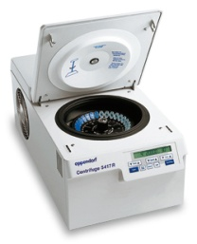
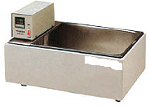
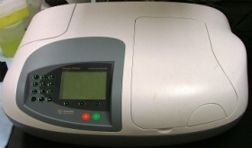
Lab Equipment
Vortex
Automatic pipettes
Microcentrifuge
Water bath
UV-spectrophotometer

Slide 3
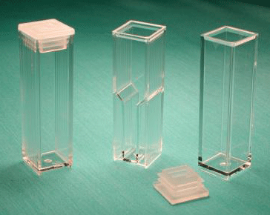
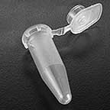
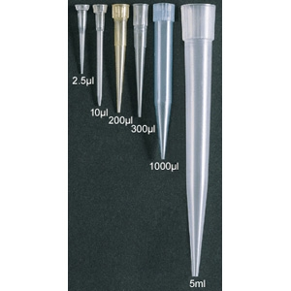
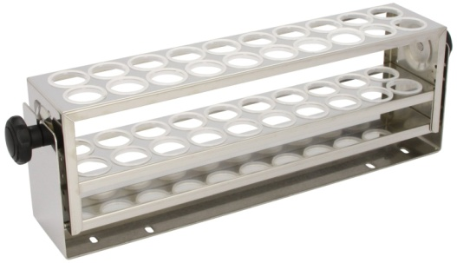
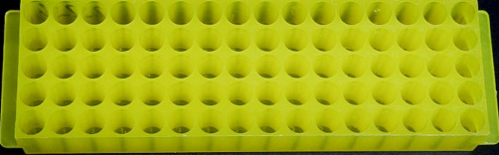
Continued …
Eppendorf tube
Cuvettes
Rack- test tube
Tips
Rack- eppendorf tube

Slide 4
DNA Extraction
Principle:
Lysis of nucleated cells.
Removal of contaminants: Any substance other than DNA, e.g., proteins.
Measurements: UV absorbance at 260nm and 280nm
Purity of DNA solution: 260/280 ratio
DNA concentration: Absorbance at 260nm

Slide 5
Continued …
Steps:
Lysis of nucleated cells using lysis buffer.
Binding of DNA to the membrane of spin column.
Wash: using wash buffer.
Elution of pure DNA.

Slide 6
Spin Protocol of DNA Purification from Blood

Slide 7
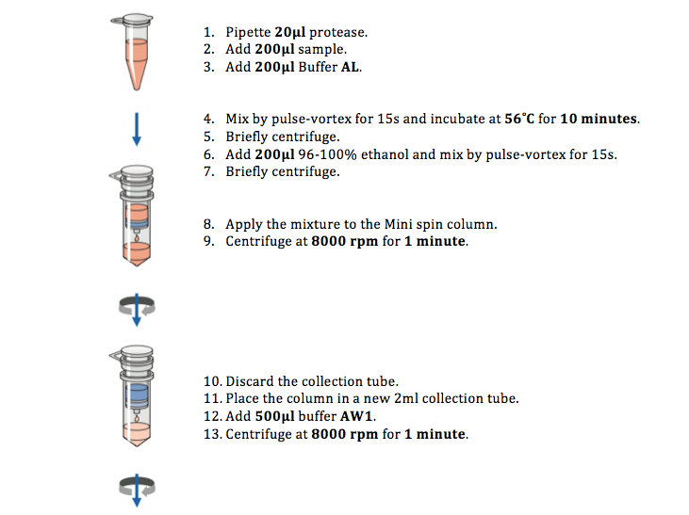
Video
https://www.youtube.com/watch?v=gmNw6CWtN5k

Slide 9
Quantification of the purified DNA

Slide 10
Measurements
Measure the Absorbance at 260nm and at 280nm.
Assess the DNA purity: 260/280 ratio
(Accepted ratio: 1.7 - 1.9)
Calculate DNA Conc.: Provided A260 = 1.0, DNA is 50 μg/ml, unknown DNA Conc. can be calculated by cross multiplication
A260 = 1.0 DNA conc. = 50 μg/ml
A260 = 0.5 DNA conc. ?
Note: In case of diluting the eluted sample, multiplies the final concentration by the dilution factor. This can be adjusted by the spectrophotometer.
Done by
the spectrophotometer

Slide 11
DNA Yield
DNA Yield = DNA Volume x final DNA Conc.
Example:
If you have
Volume of DNA solution: 200μl (0.2 ml)
Final DNA Conc.: 30 μg/ml
Then, the yield (μg) = 0.2 ml x 30 μg/ml
= 6.0 μg

Slide 12
Molecular Techniques and Applications

Slide 13
Note:
Almost all molecular biology techniques can be utilized for diagnosis and research

Slide 14
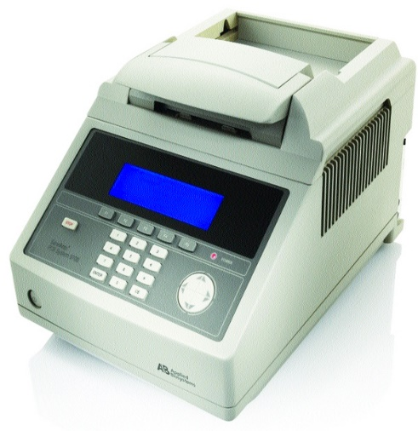
a. Amplification techniques: e.g. Polymerase Chain Reaction (PCR)

Slide 15
Continued …
Applications of PCR:
Comparison of a normal gene with a mutant form of the gene.
Detection of low-abundance nucleic acid sequences.
Forensic analysis of DNA samples.
Prenatal diagnosis.

Slide 16
Other examples of molecular techniques:
Restriction Fragment length polymorphism (RFLP).
https://www.ncbi.nlm.nih.gov/probe/docs/techrflp/
Southern blotting.
http://www.onlinebiologynotes.com/southern-blotting-principle-procedure-application/

