Slide 1
Antibody-mediated Immunity
Immunology Unit
Department of Pathology
College of Medicine
KSU

Slide 2
Reference
Kuby Immunology 7th Edition 2013
Chapter 13 Pages 416-423
Chapter 3 Pages 80-90

Slide 3
Objectives
1. To describe B-cells as the mediators of humoral immunity, (antibody-mediated immunity)
2. To describe activation of B-cells which involve:
-Antigen recognition
-T-dependent & T-independent antigens
- Requirement for T-helper cells
3. To explain clonal selection, clonal expansion &
generation of plasma cells & memory cells
4. To describe primary & secondary immune responses
5. To describe the structure & function of Immunoglobulins

Slide 4
Humoral immunity is so named because it involves substances found in the:
humours or body fluids
The Humoral Immune Response is the aspect of immunity that is mediated by secreted antibodies

Slide 5
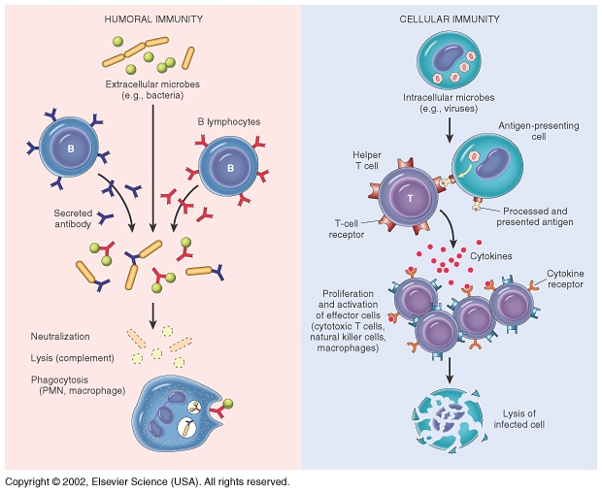
Nature of antigen determine type of response either
EXTRACELLULAR or INTERACELLUALR

Slide 6
Activation of B cells by antigens
Two types of antigens:
1. T-dependant :
- Antibody production by B-cells require T- helper cells
- Antigen presenting cell recognize antigen & present it to T-helper cells
- T-helper cells stimulate B-cells specific for that antigen to become plasma cells
- T-dependant antigens are mainly proteins on viruses, bacteria & other foreign materials.

Slide 7
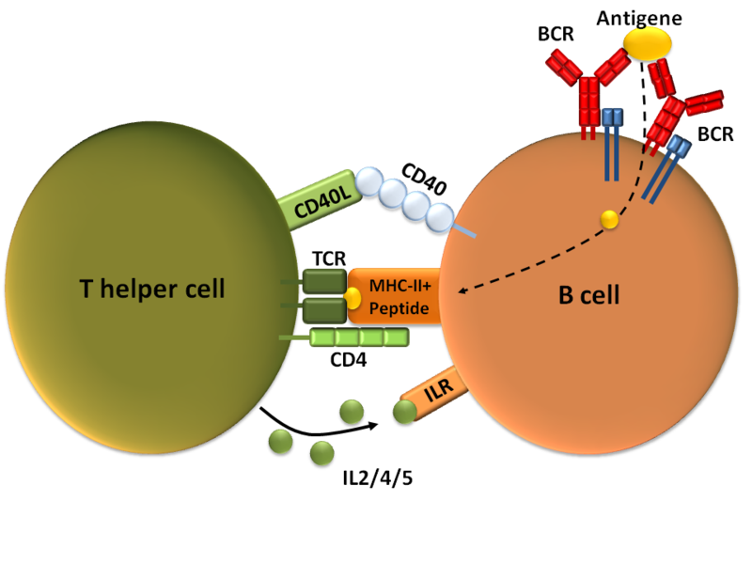
(Th2)

Slide 8
Clonal selection and clonal proliferation

Slide 9
2. T- independent antigens
  B-cells do not require T-helper cells to produce antibody.
  2. Antigens are mainly polysaccharides or
lipopolysaccharides with repeating subunits (bacterial capsules).
3. Immune responses induce the production of IgM of low affinity for the antigen and no immunologic memory

Slide 10
Antibodies
Antibodies are immunoglobulins with specific functions
Antibodies bind to specific sites on antigen surfaces (epitopes) and perform protective functions by different mechanisms
There is a SPECIFIC antibody for any one given type of an antigen, part of antibody interacting with the epitope on antigen is the paratope

Slide 11
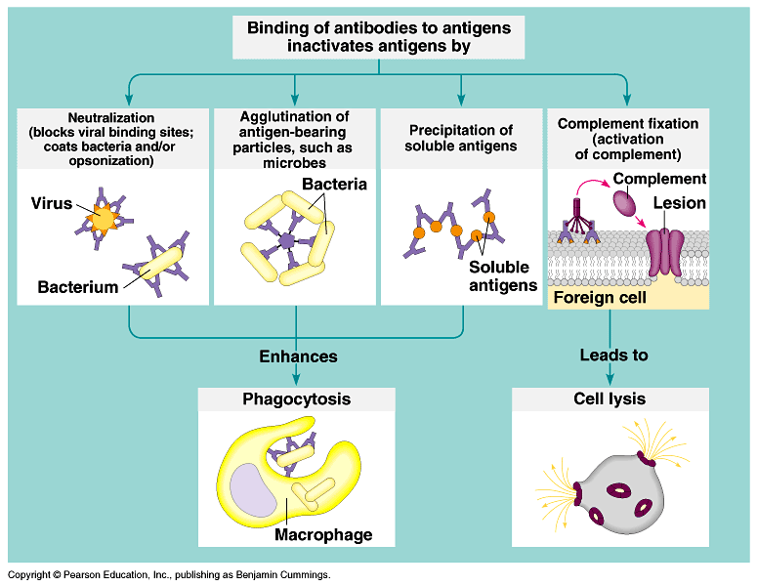
Protective functions of antibodies

Slide 12
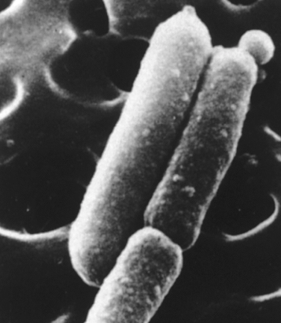
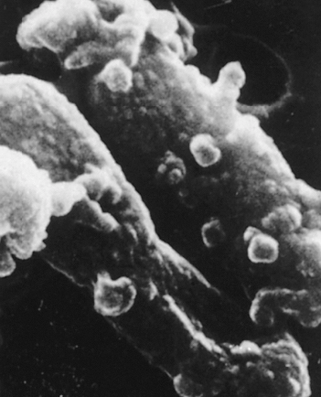
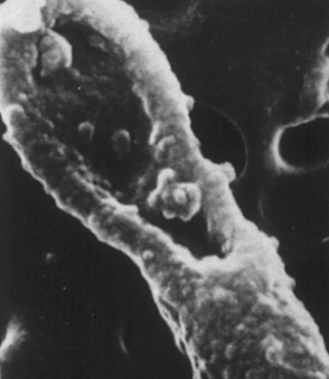
Electron micrographs of the effect of antibodies and complement upon bacteria
Antibody + complement-mediated
damage to E. coli
Healthy E. coli

Slide 13
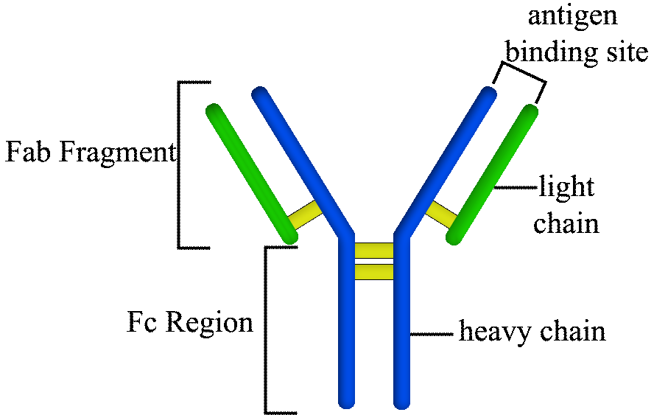
Antibody structure and functions
Made up of four polypeptides chains
Two longer and larger (heavy chains ) and the other two shorter and smaller (light chains)
Have the shape of a letter “Y”

Slide 14
Variable region has the potential to bind with particular classes of antigens
    Once a raw antibody is stimulated to fit to a specific antigen, it can then react with ONLY that antigen
    This is known as SINGLE SPECIFICITY
Can fit as precisely as a lock-and-key to an antigen

Slide 15
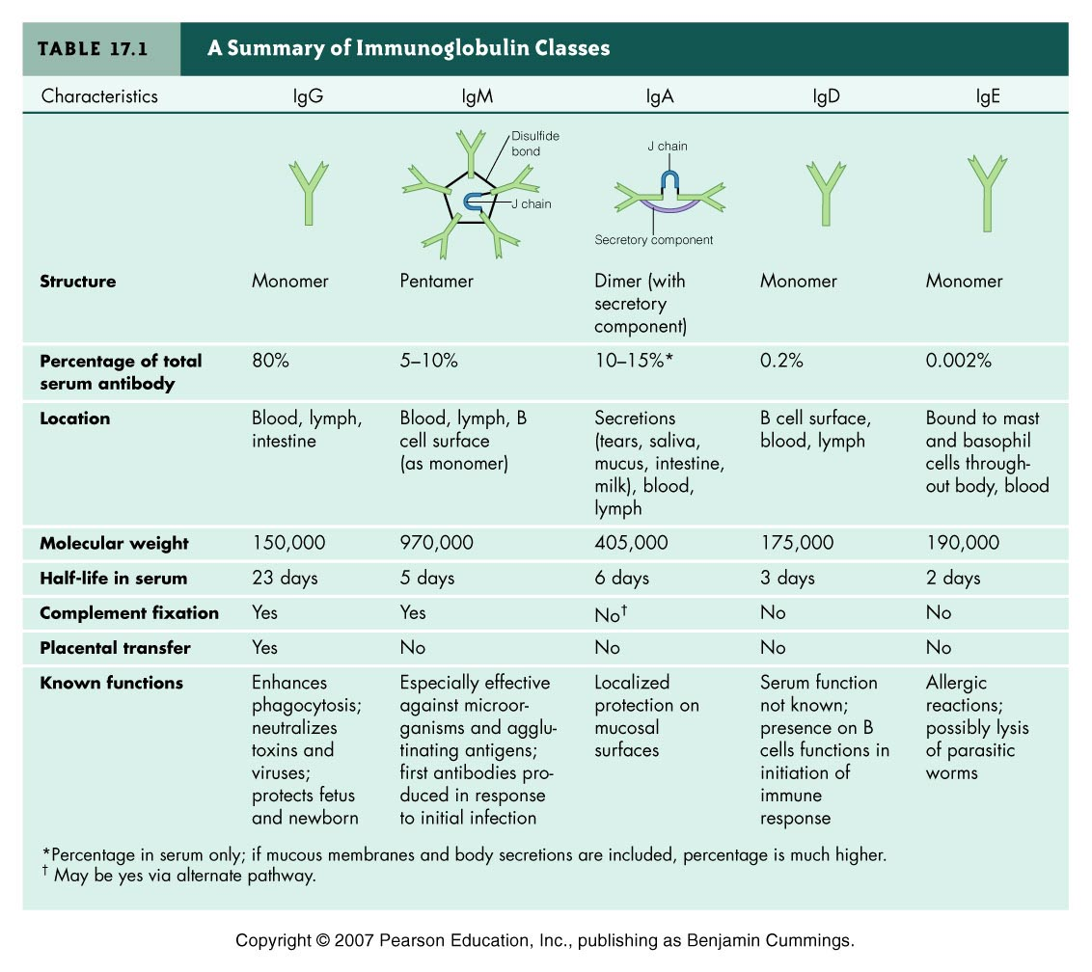

Slide 16
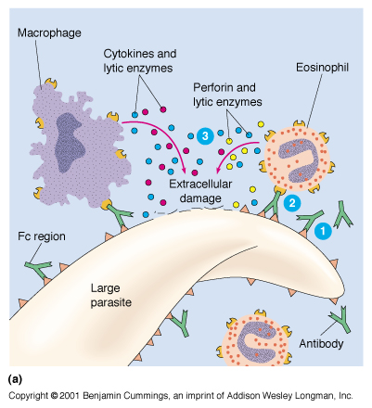
Functions of Antibodies
Antibody dependent cell-mediated cytotoxicity
  Antibodies coat infecting cell (large parasite usually) - FC facing outwards
  NK (lysing ability), Macrophage, neutrophils, and eosinophils have receptors for FC region of antibody
  Secretion of lytic enzymes to destroy parasite

Slide 17
Opsonisation and phagocytosis
Antibodies coat infecting cells and facilitate their phocytosis by cells possessing Fc Receptors
Complement activation
classical pathway , after binding to antigen
IgM+++, IgG1 > IgG3 > IgG2
Transplacentar transfer
IgG

Slide 18
Primary & Secondary immune responses
Initial encounter with antigen produce primary immune response
Subsequent challenge with same antigen produce secondary immune response

Slide 19
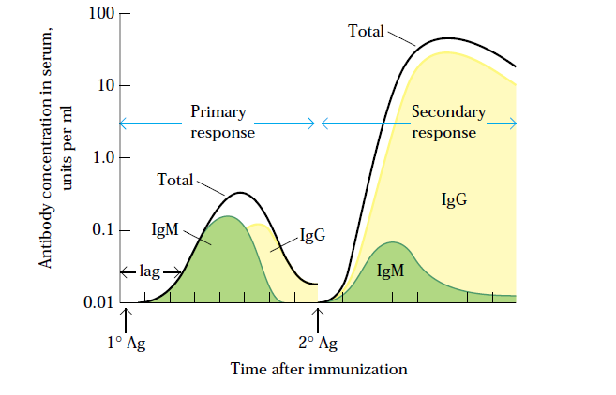
Concentration & type of antibody in primary & secondary immune responses

Slide 20
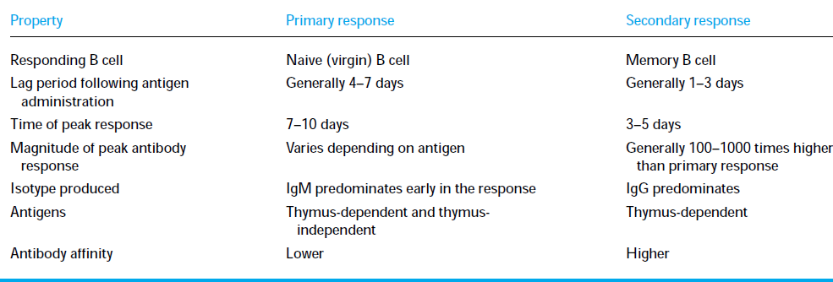
Comparison between primary & secondary responses

Slide 21
Take Home Message
B cells can be activated by antigen to produce antibodies either with the assistance of helper T cells or directly by the antigen itself
Antibodies are made up of two heavy and two light amino acid chains and have a shape of letter “Y”
Different types of antibodies are located at various sites to provide protection by agglutination, precipitation, complement fixation etc.
Secondary humoral immune response is swift and a stronger immune response mediated by IgG class of antibodies because of the memory cells.

