Slide 1
Bacterial Structure , Function & Genetics
Prof. Hanan Habib
College of Medicine , Department of Pathology ,
KSU

Slide 2
Objectives
Define the cellular organization of bacteria and recall the differences between Eukaryotes and Prokaryotes.
Recall major structures of bacteria and its function.
Describe the structure of cell wall of bacteria including the differences between Gram positive and Gram negative bacteria and main functions.

Slide 3
Objectives, cont.,
Describe the external and internal structures of bacteria and their functions.
Describe bacterial spores and its application in the practice of medicine.
Recall basic information about bacterial genetics and replication of bacteria .

Slide 4
Objectives, cont.
Describe plasmids , its origin , types and its importance in clinical practice.
Recall genetics variations, including ; mutation and mechanisms of gene transfer and its implication on bacterial resistance to antimicrobial agents.

Slide 5
Definition
Bacteria : Is a heterogenous group of unicellular organisms , about 1-8 μm in diameter
Bacteria is a Prokaryote (has a primative nucleus):
- one chromosome
- no nuclear membrane
- no mitochondria
- no sterols
Bacteria contain Plasmids: an extra piece of DNA.

Slide 6
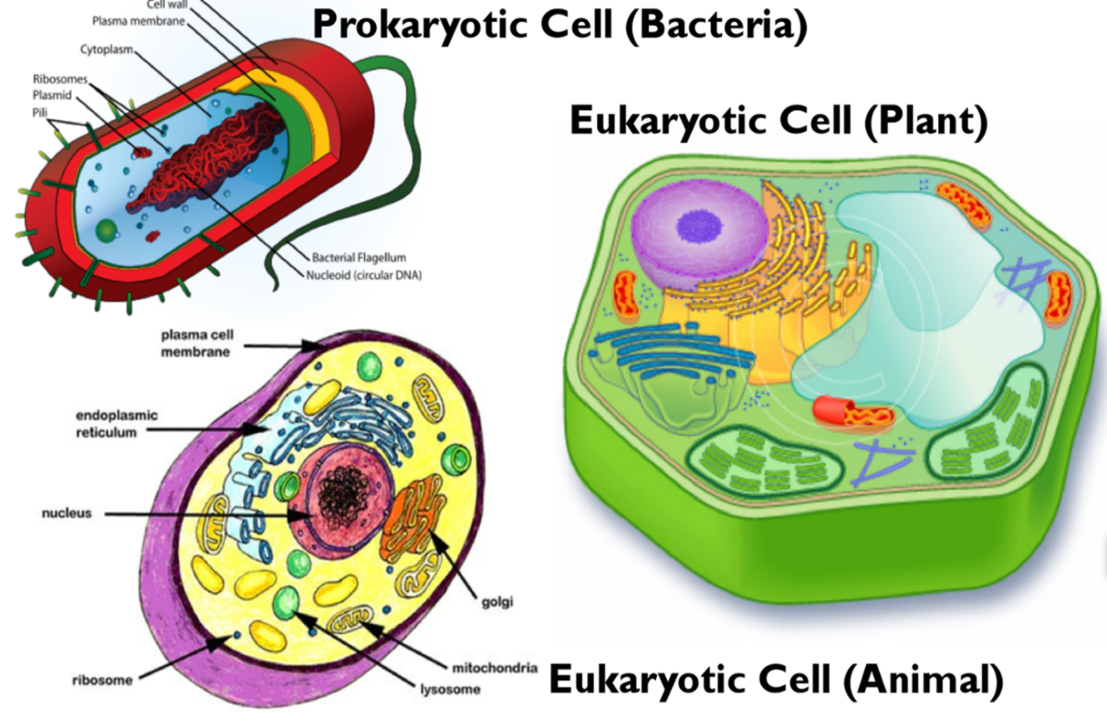

Slide 7
Shapes & Types of Bacteria
Spherical / Oval…………Cocci
Rods………………………Bacilli
Very short Bacilli…………Coccobacilli
Tapered end ……………Fusiform
Club-shaped / Curved……Vibrio
Helical / Spiral… …………Spirochaetes

Slide 8
Arrangements of Bacteria
Arrangements among Cocci :
Pairs………….Diplococci
Chains………Streptococci
Clusters…….Staphylococci
In four……….Tetrad
Palisades…..Corynebacterium

Slide 9
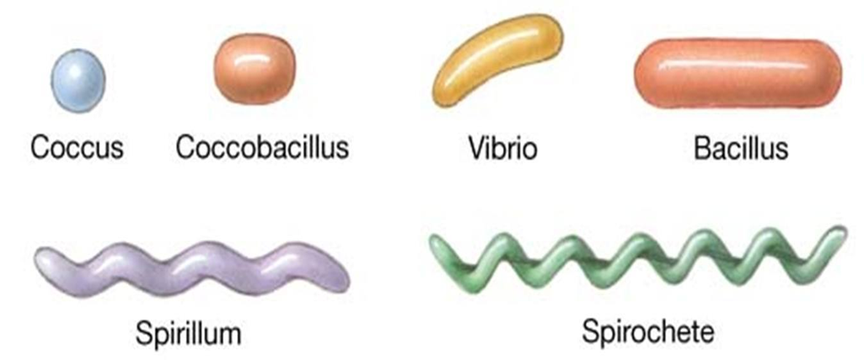

Slide 10
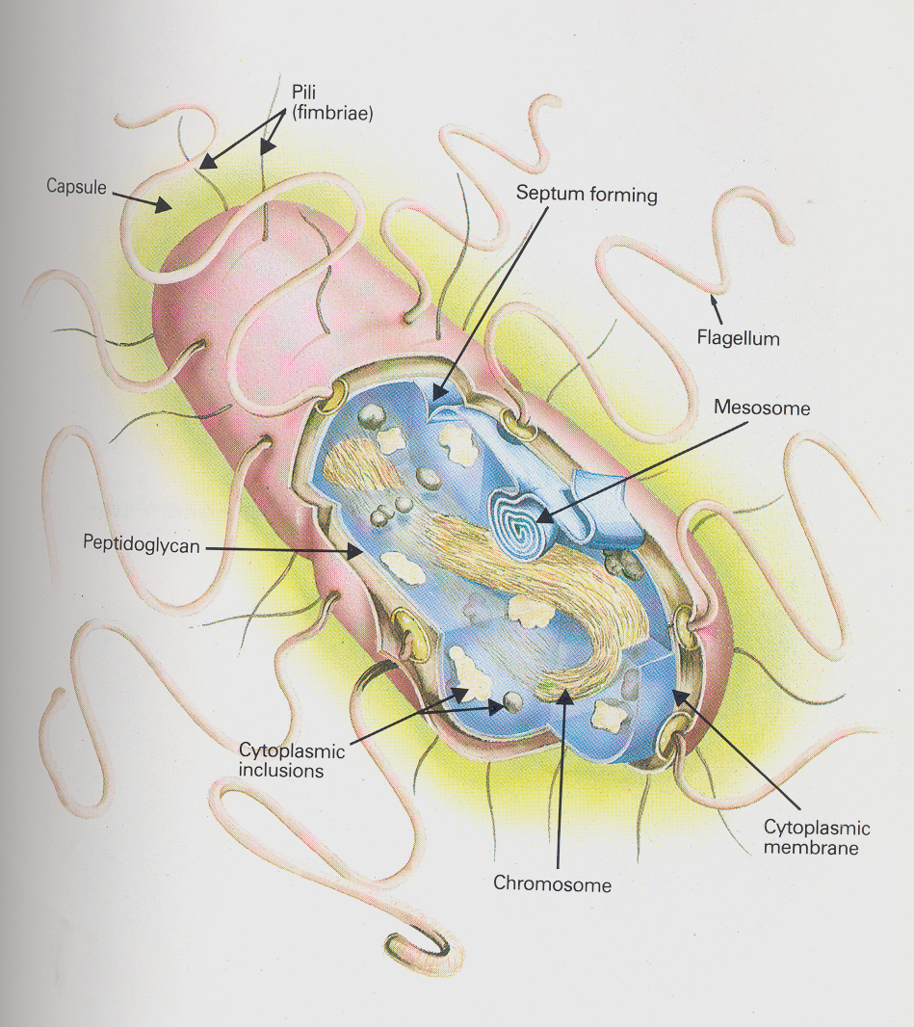
Structure of Bacteria

Slide 11
Cell Wall of Bacteria
Bacteria are cells with rigid cell wall surround cytoplasmic membrane and internal structures.
Functions of cell wall:
Rigidity
Shapes bacteria
Protection
Porous / permeable to low molecular weight molecules
Cell division
Antigenic determinants

Slide 12
Cell Wall of Bacteria
Two groups of bacteria depending on reaction to GRAM STAIN:
GRAM POSITIVE BACTERIA: stain blue/purple by Gram stain
GRAM NEGATIVE BACTERIA: stain red by Gram stain
Note : Mycoplasma is naturally have no cell wall.
Chemical structure of bacterial cell wall:
Peptidoglycan :
Rigid part , mucopeptide composed of alternating strands of N- acetyl muramic acid and N- acetyle glucosamine linked with peptide sub units.

Slide 13
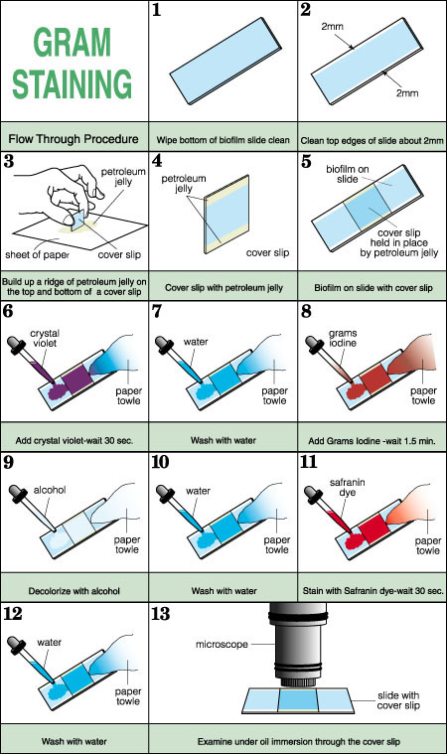
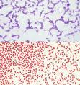

Slide 14
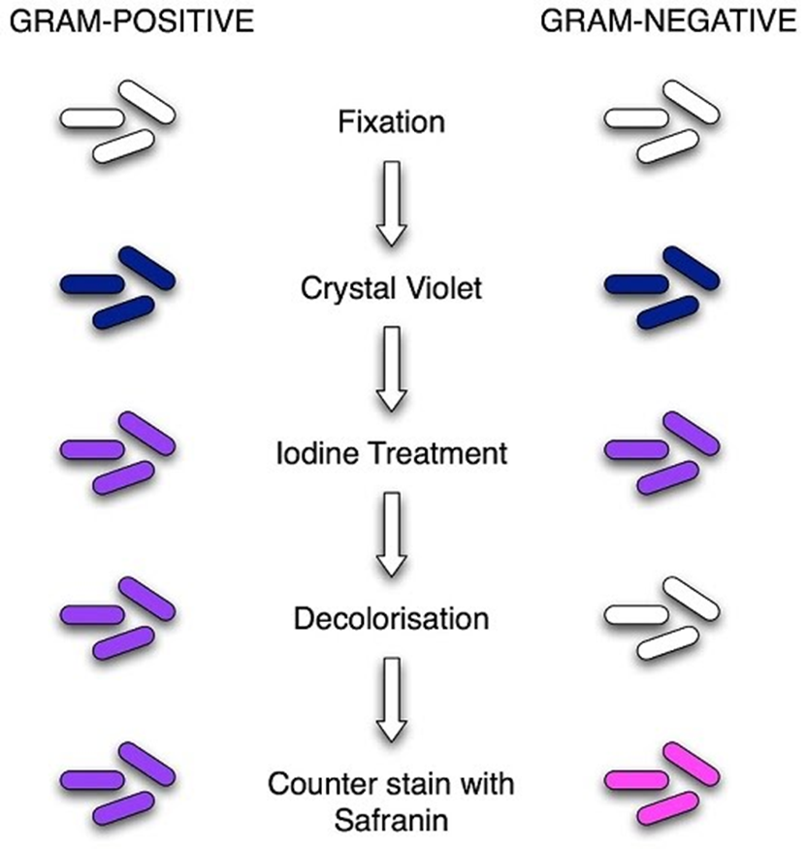

Slide 15
Cell Wall of Gram Positive Bacteria
Peptidoglycan thicker than Gram negative bacteria.
Closely associated with cytoplasmic membrane.
Teichoic acid : anchors cell wall to cell membrane , epithelial cell adhesion.
Antigens : - polysaccharides (Lancefield)
- protein (Griffith)

Slide 16
Cell Wall of Gram Negative Bacteria
Thin Peptidoglycan
Outer membrane that contains :
- specific proteins (porins) important in the transport of hydrophilic molecules
- lipopolysaccharide (ENDOTOXIN)

Slide 17
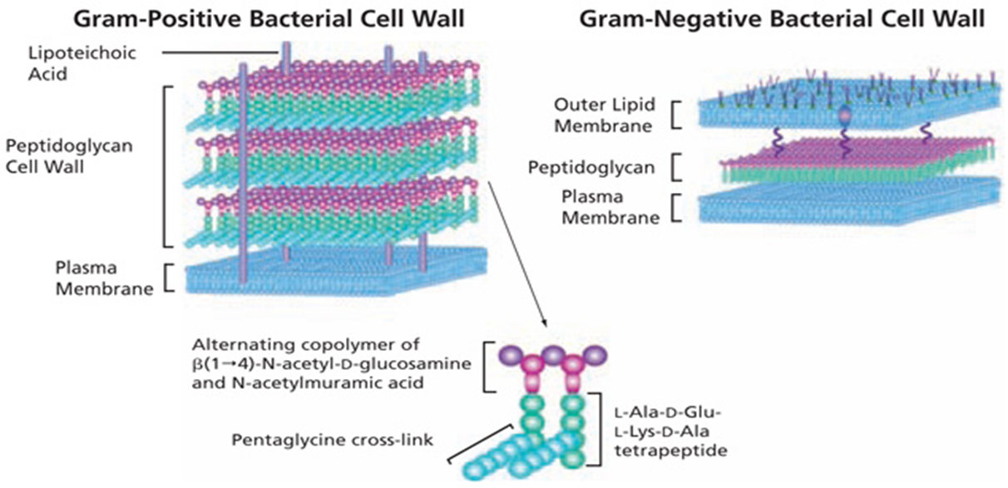
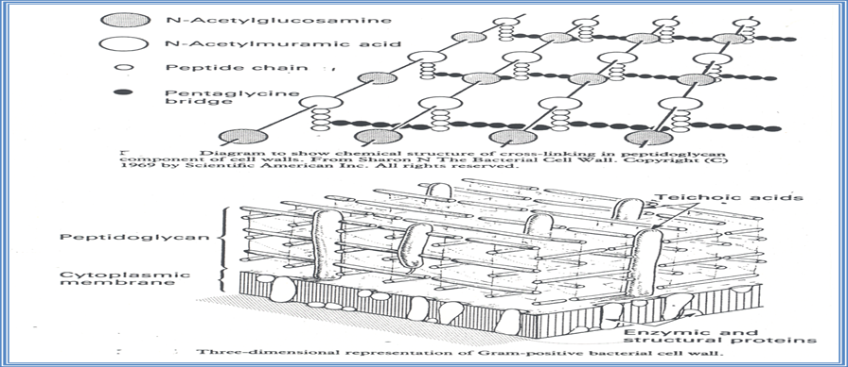

Slide 18
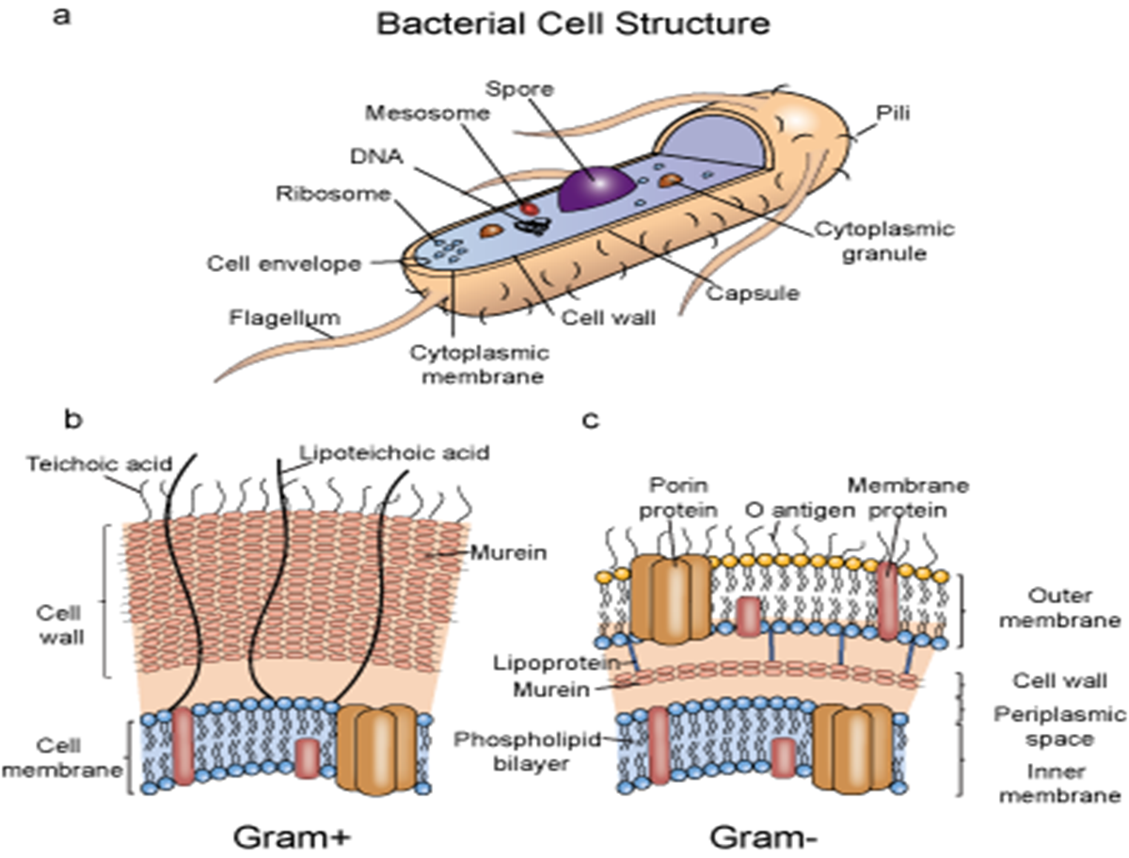

Slide 19
External Structures of Bacteria
External protrude from the cell into the environment:
Flagella
Pili
Capsule

Slide 20
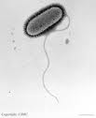
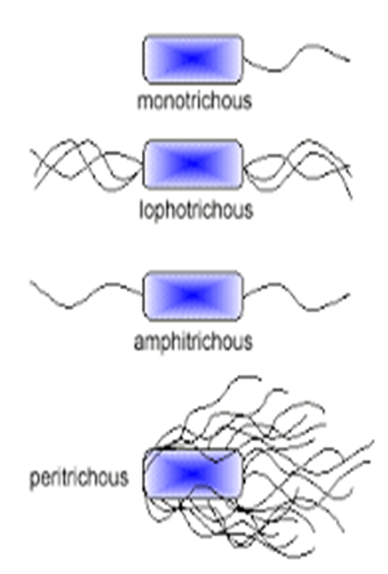
Flagella
Helical filaments
Composed of protein FLAGELLIN.
Found in Gram positive & Gram negative bacteria.
Function : motility& chemotaxis
Distribution:
- Peritrichous
- Monotrichous
- Lophotrichous

Slide 21
Pili
Fine short filaments extruding from cytoplasmic membrane.
Found on the surface of many Gram negative & Gram positive bacteria.
Composed of protein Pilin.
Two types:
1- Common pili (fimbriae): covers the surface— responsible for: adhesion & colonization
2- Sex pili : in some bacteria only, responsible for conjugation.

Slide 22
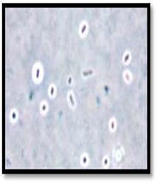
Capsules and Slime layer
These are the structures surrounding the outside of cell envelop.
Usually consist of polysaccharide, however ;in some bacteria consist of polypeptide(protein).
They are not essential for cell viability, some strains within species produce capsule while others do not .
Functions, include :
Attachment
Protection from phagocytic engulfment
Resistant to dryness
Reservoir for certain nutrient

Slide 23
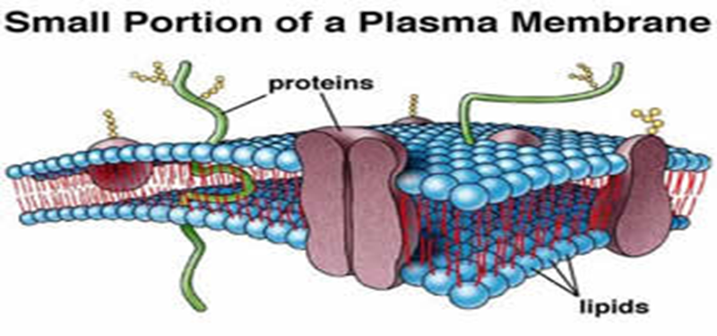
Cytoplasmic Membrane (plasma membrane)
Double layered structure composed of phospholipid & protein
Act as semi- permeable membrane (passive diffusion)
Site of numerous enzymes involved in active transport of nutrients and various metabolic processes

Slide 24
Internal structures of bacteria
Mesosomes :convolutes invaginations of cytoplasmic membrane .
Function:
Involved in DNA segregation during cell division and respiratory activity
Contain receptors involved in chemotaxis
Permeability barrier (active transport of solutes).

Slide 25
Core of Bacteria
Core composed of : Cytoplasmic inclusions
Nucleoid ( nuclear body)
Ribosomes
Cytoplasmic inclusions:
Are nutritional storage granules , examples:
- Volutin
- Lipid
- Starch / or Glycogen

Slide 26
Nucleoid ( Nuclear Body)
Circular single stranded chromosome (bacteria genome or DNA)
No nuclear membrane
DNA undergoes semi-conservative replication , bidirectional from a fixed point
.

Slide 27
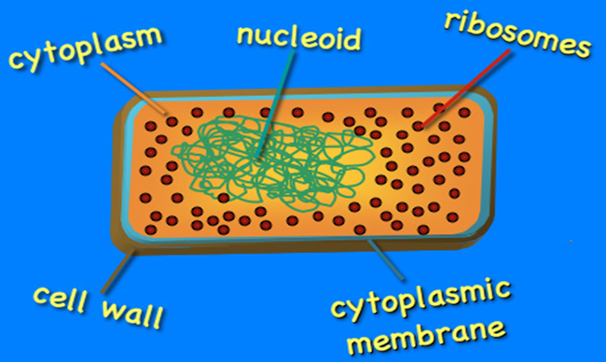
Ribosomes of Bacteria
Distributed throughout the cytoplasm
Site of protein synthesis
Composed of RNA and protein

Slide 28
Bacterial Chromosomes
Haploid, circular molecule of double stranded- DNA attached to cell membrane.
Genetic code in Purine and Pyrimidine bases of nucleotides that makes DNA strand.
3 bases comprise one code, each triplet codon codes for one amino acid.
Replication is semiconservative ,takes place by binary fission .

Slide 29
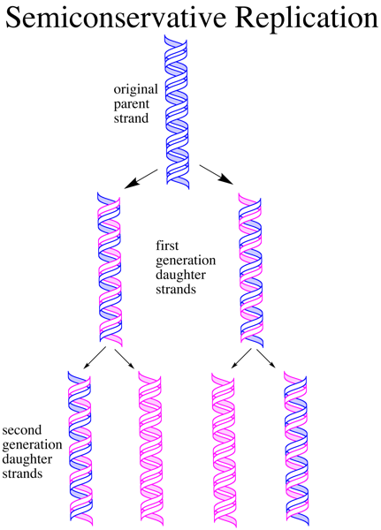
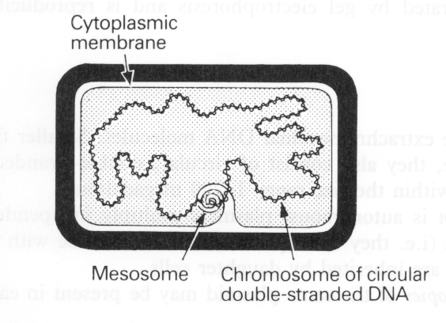

Slide 30
Spores of Bacteria
Small ,dense, metabolically inactive , non- reproductive structures produced by Bacillus & Clostridium
Enables the bacteria to survive adverse environmental conditions.
Contain high concentration of Calcium dipicolonate.
Resistant to heat, dissecation & disinfectants
Often remain associated with the cell wall

Slide 31
Spores of Bacteria-cont.
Spores are described as :
1- Terminal spores
2- Sub-terminal spores
3- Central spores
Spores germinate when growth conditions become favorable to produce vegetative cells.
Application in medical practice :spore preparations used for checking the efficacy of Autoclaves, eg. Bacillus subtilis & Bacillus sterothermophilus.

Slide 32
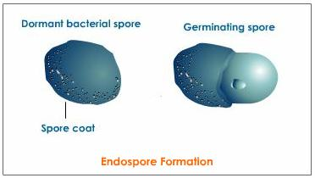
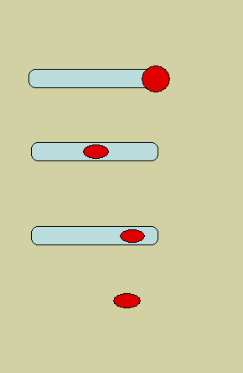
Spores of Bacteria

Slide 33
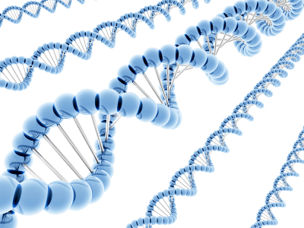
BACTERIAL GENETICS

Slide 34
Bacterial Genetics: definitions
Genetics is the study of inheritance and variation.
Genetic information encoded in DNA.
Function of genetic material:
1- Replication of the genome
2- Expression of DNA to mRNA then to protein.

Slide 35
Definitions-cont.
Genotype: the complete set of genetic determinants of an organism.
Phenotype: expression of specific genetic material .
Wild type: reference (parent) strain
Mutant: progeny with mutation.
2 types of DNA in bacteria
Chromosomal
Extra-chromosomal (Plasmid).

Slide 36
Plasmids
Extra chromosomal DNA composed of double stranded-DNA.
Found in most species of bacteria.
Origin?
Govern their own replication
Application :Genetic exchange, amplify genes
Transfer by conjugation

Slide 37
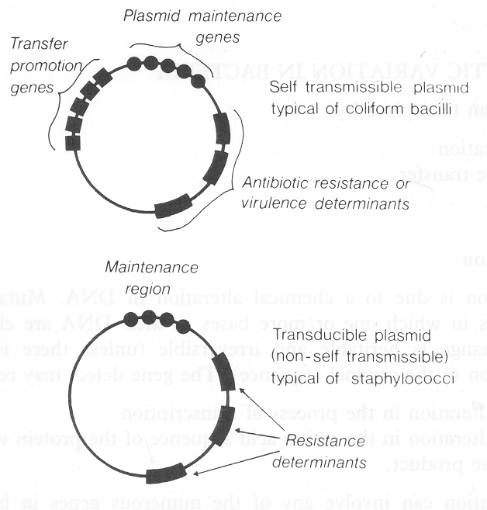
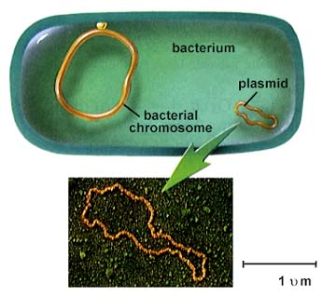
Plasmids

Slide 38
Types of Plasmids
1- R-plasmids: genes code for antibiotic resistance particularly Gram negative bacteria.
2-Col-plasmids: in Enterobacteria, codes for extracellular toxins.
3- F-plasmids: (fertility) factor, transfer of chromosome during mating .

Slide 39
Genetic variation in bacteria takes place by:
1- Mutations
2-Gene transfer

Slide 40
Mutation
Inheritable changes in the structure of genes (DNA).
Chemical changes in one or more bases of DNA.
Mutation /gene defect leads to alteration in:
Transcription,
Amino acid sequences,
Function eg. Bacteria resistant to antibiotic.

Slide 41
Classification of Mutation
Depends on biological sequencing:
1- Resistance mutation: affects structure of cell protein. Main application in medical practice.
Bacteria become resistant to antibiotics.
2- Auxotrophic mutation: affects biosynthetic enzyme resulting in a nutritional requirement of mutant cell.
3- Lethal mutation: leads to death of bacteria.

Slide 42
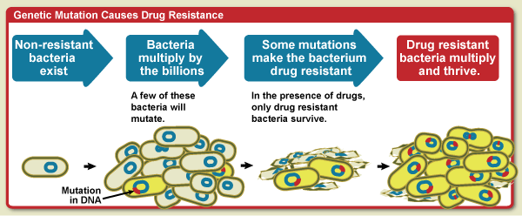
Mutation Causes Antimicrobial Resistance

Slide 43
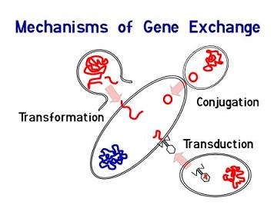
Gene Transfer Among Bacteria
Three mechanisms:
1- Transformation
2- Transduction
3- Conjugation.

Slide 44
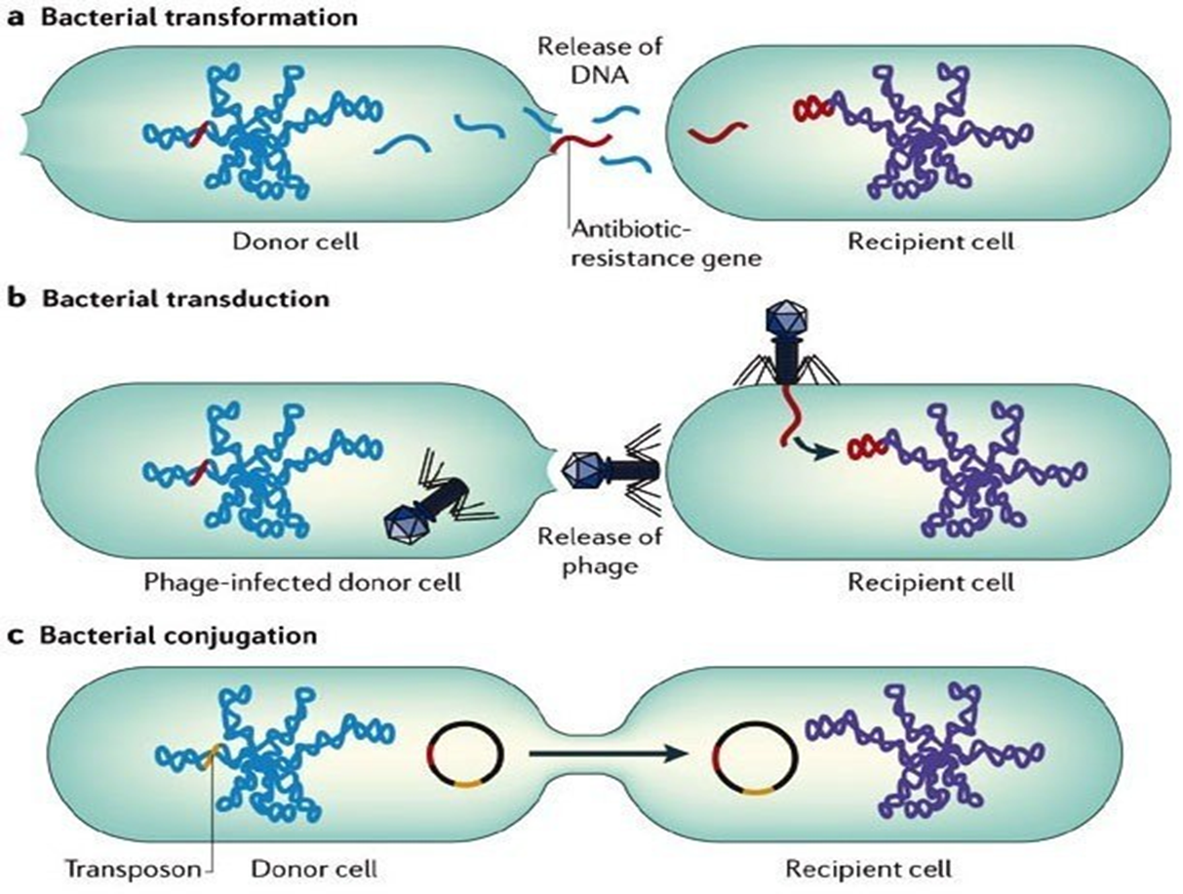

Slide 45
Transformation
A fragment of exogenous naked bacterial DNA are taken up and absorbed into recipient cells.
Common in Haemophilus influenzae & Streptococcus pneumoniae.
Bacteria become resistant to Ampicillin.

Slide 46
Transduction
Phage mediated transfer of genetic information from donor to recipient cells.
Examples:
Beta – Lactamase production in Staphylococcus aureus : Bacteria becomes resistant to penicillin.
Toxin production by Corynebacterium diphtheriae.

Slide 47
Conjugation
Major way bacteria acquire additional genes.
Plasmid mediated( F factor)
Cell contact required and genes reside on plasmid resident within donor cells transfer to recipient cell (mating).
Conjugation is the common way of transfer of genes resistance to antibiotics among bacteria in hospitals.

Slide 48
Genetic Recombination
After gene transfer, there are three possible fates:
1-Exogenous DNA degraded by nuclease.
2-Stabilized by circulization and become plasmid.
3- Form a partially hybrid chromosome with segment derived from each source.

Slide 49
Reference Book
Sherris Medical Microbiology, an Introduction to Infectious Diseases.
Latest edition, Kenneth Ryan and George Ray. Publisher : McGraw Hill .

