Slide 1
Pathogenesis of viral infection
Allie Sherlock cover
( Foundation Block , Microbiology : 2018)
Dr.Malak M. El-Hazmi
Associate professor
Consultant Virologist
College of Medicine &
King Saud University Medical City

Slide 2
OBJECTIVES
definition and levels of viral pathogenesis.
cellular level.
host level.
The immune response to viral infection.
The stages of viral infection.
The types of viral infections at host level.

Slide 3
Pathogenesis of viral infection
Viral disease at the cellular level
Cytopathogenesis
Viral disease at the host level
Mechanism of the disease

Slide 4
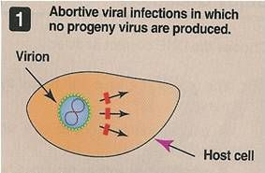
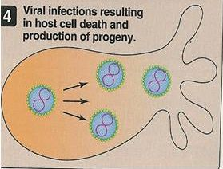
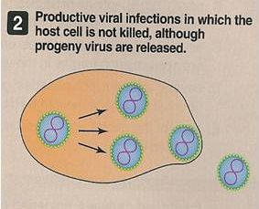
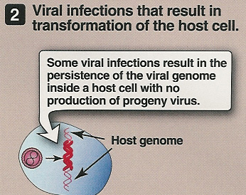
Cytopathogenesis:
The types of viral infections at cellular level
The effects on cells/ Type of Infection
Virus Production
Abortive Vs not produced
Productive
Cytolytic Vs Produced
Non-cytolytic Vs Produced
Non-productive Vs not Produced
Latent Viral NA present
Transformation Viral NA present

Slide 5
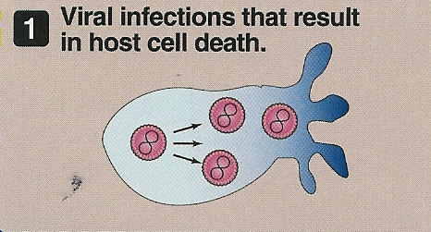
The types of viral infections at cellular level
A) Abortive Infections:
Viruses don’t complete
the replication cycle
Due to mutation,
defective interfering particles
& the action of IFNs
B) Productive Infections:
Cytolytic Infections
Viruses replicate
& produce progeny
Cell death & Cytopathic effects [CPE]
Inhibition of cellular protein & NA synthesis
A
B

Slide 6
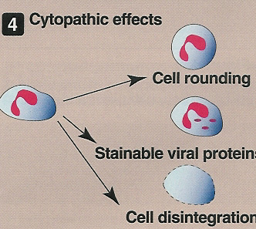
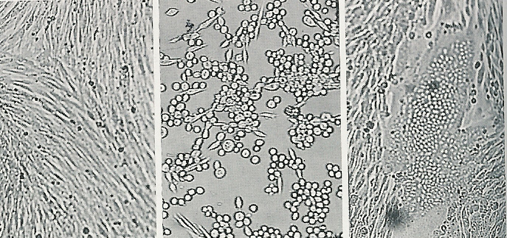
Cytopathic Effects
CPE can take several forms:
Cell lysis
Cell rounding
Syncytium formation
Inclusion bodies formation
Uninfected cc
Cell rounding
Syncytium

Slide 7
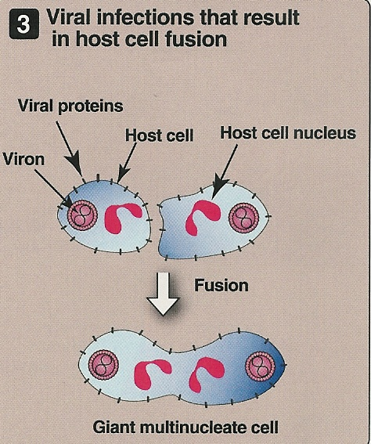
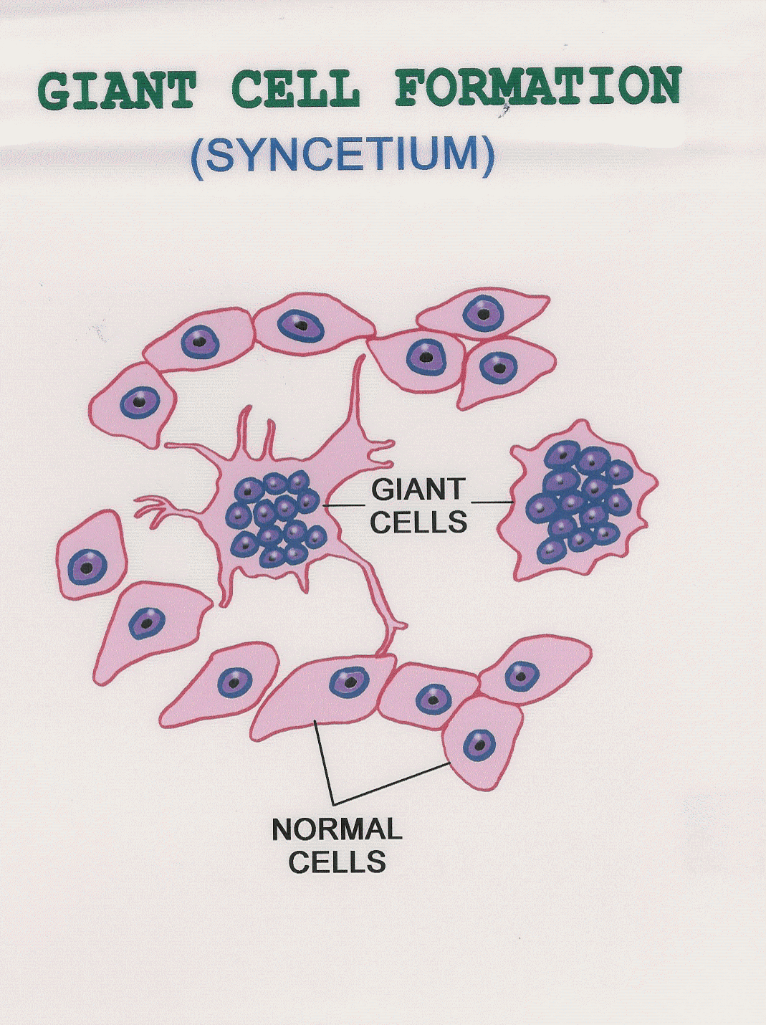
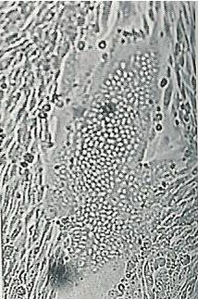
Syncytium formation
Syncytium

Slide 8
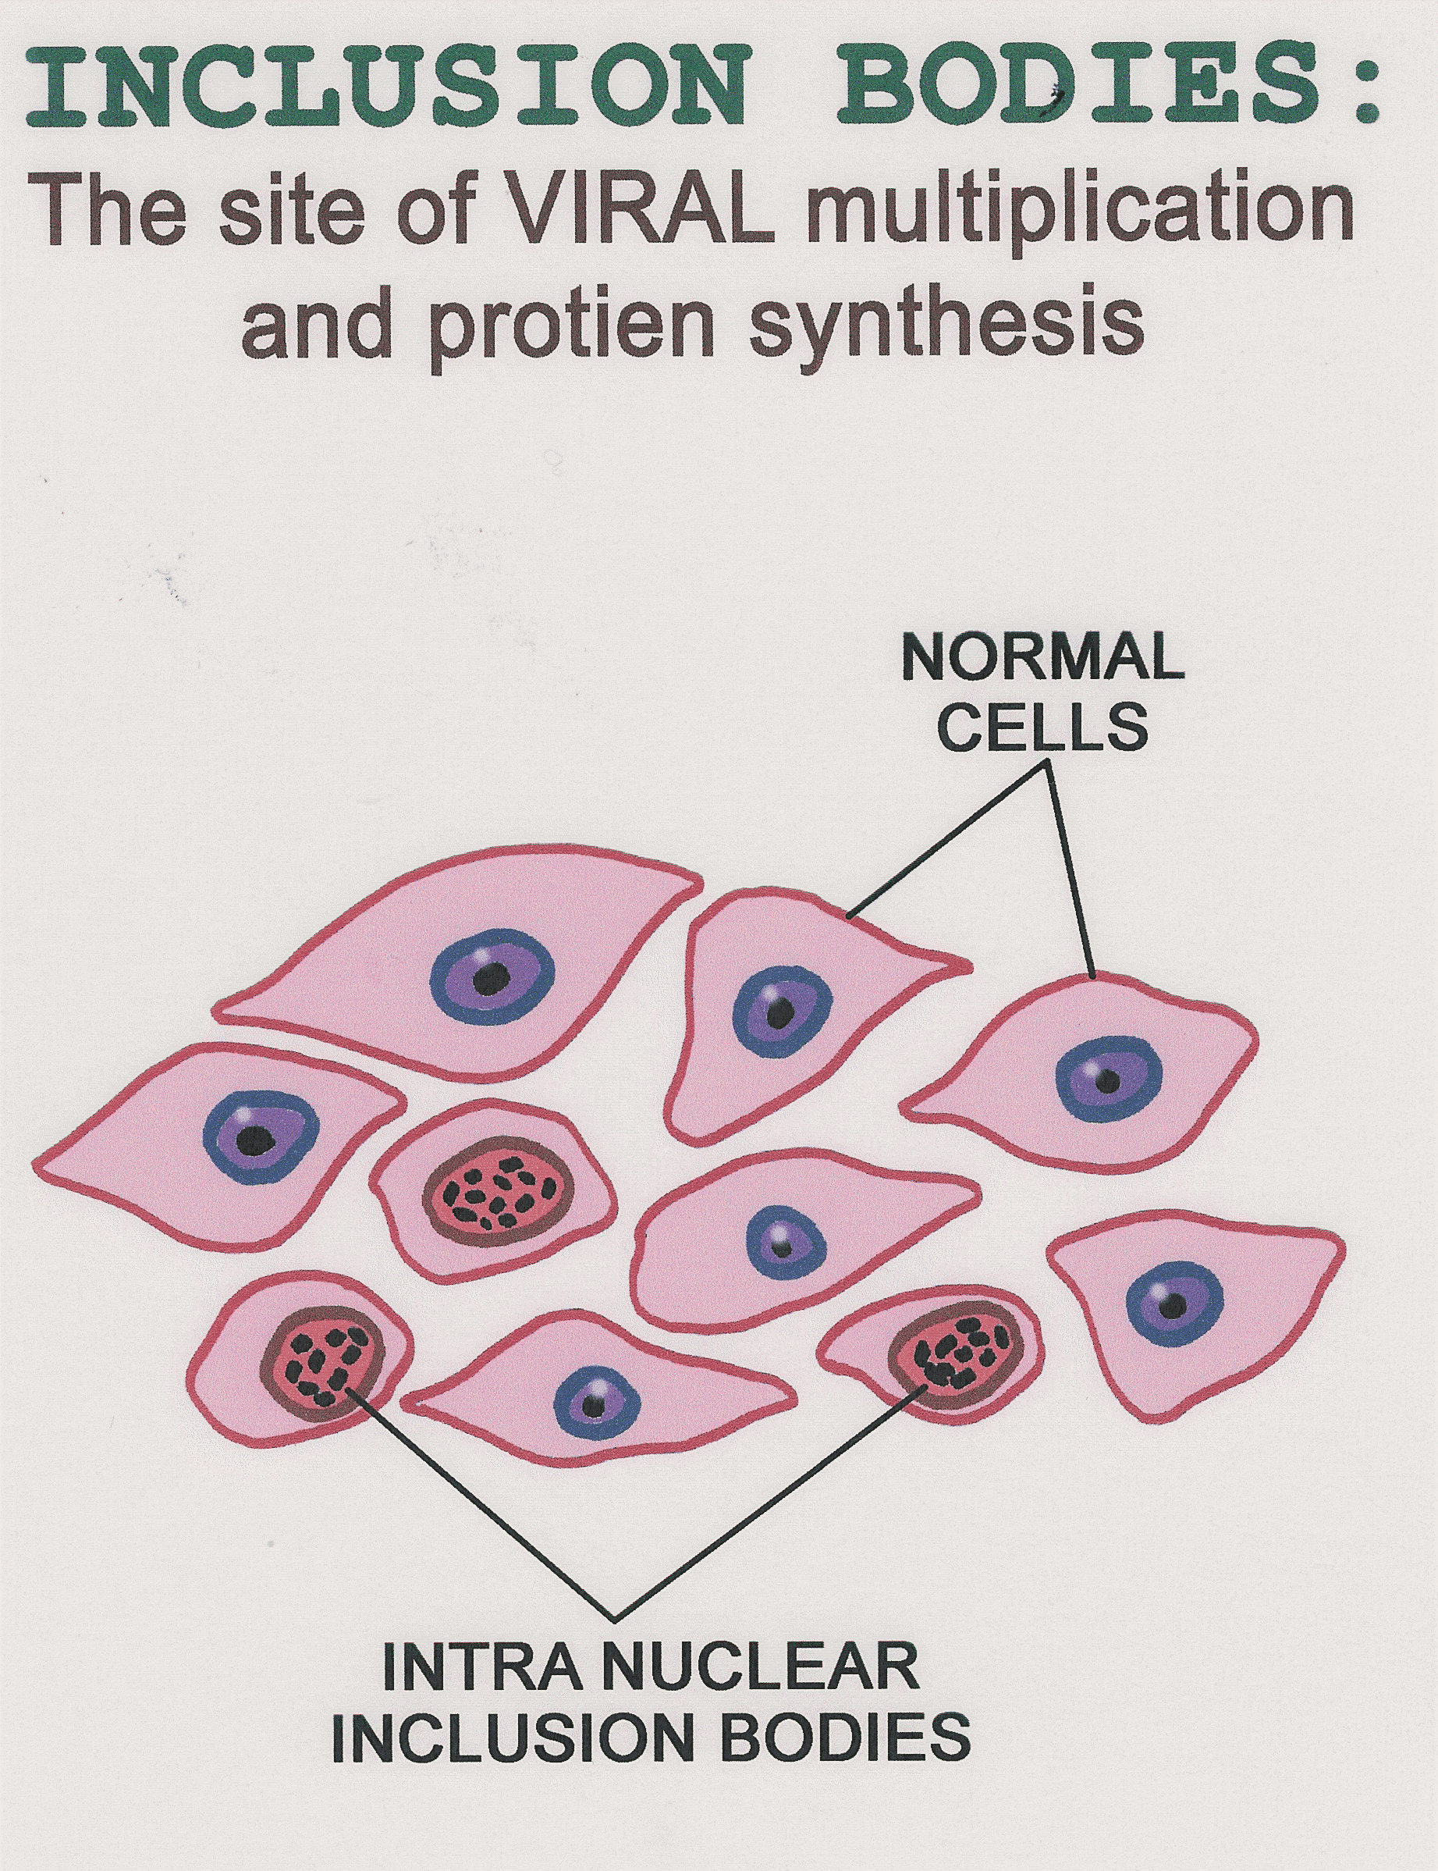
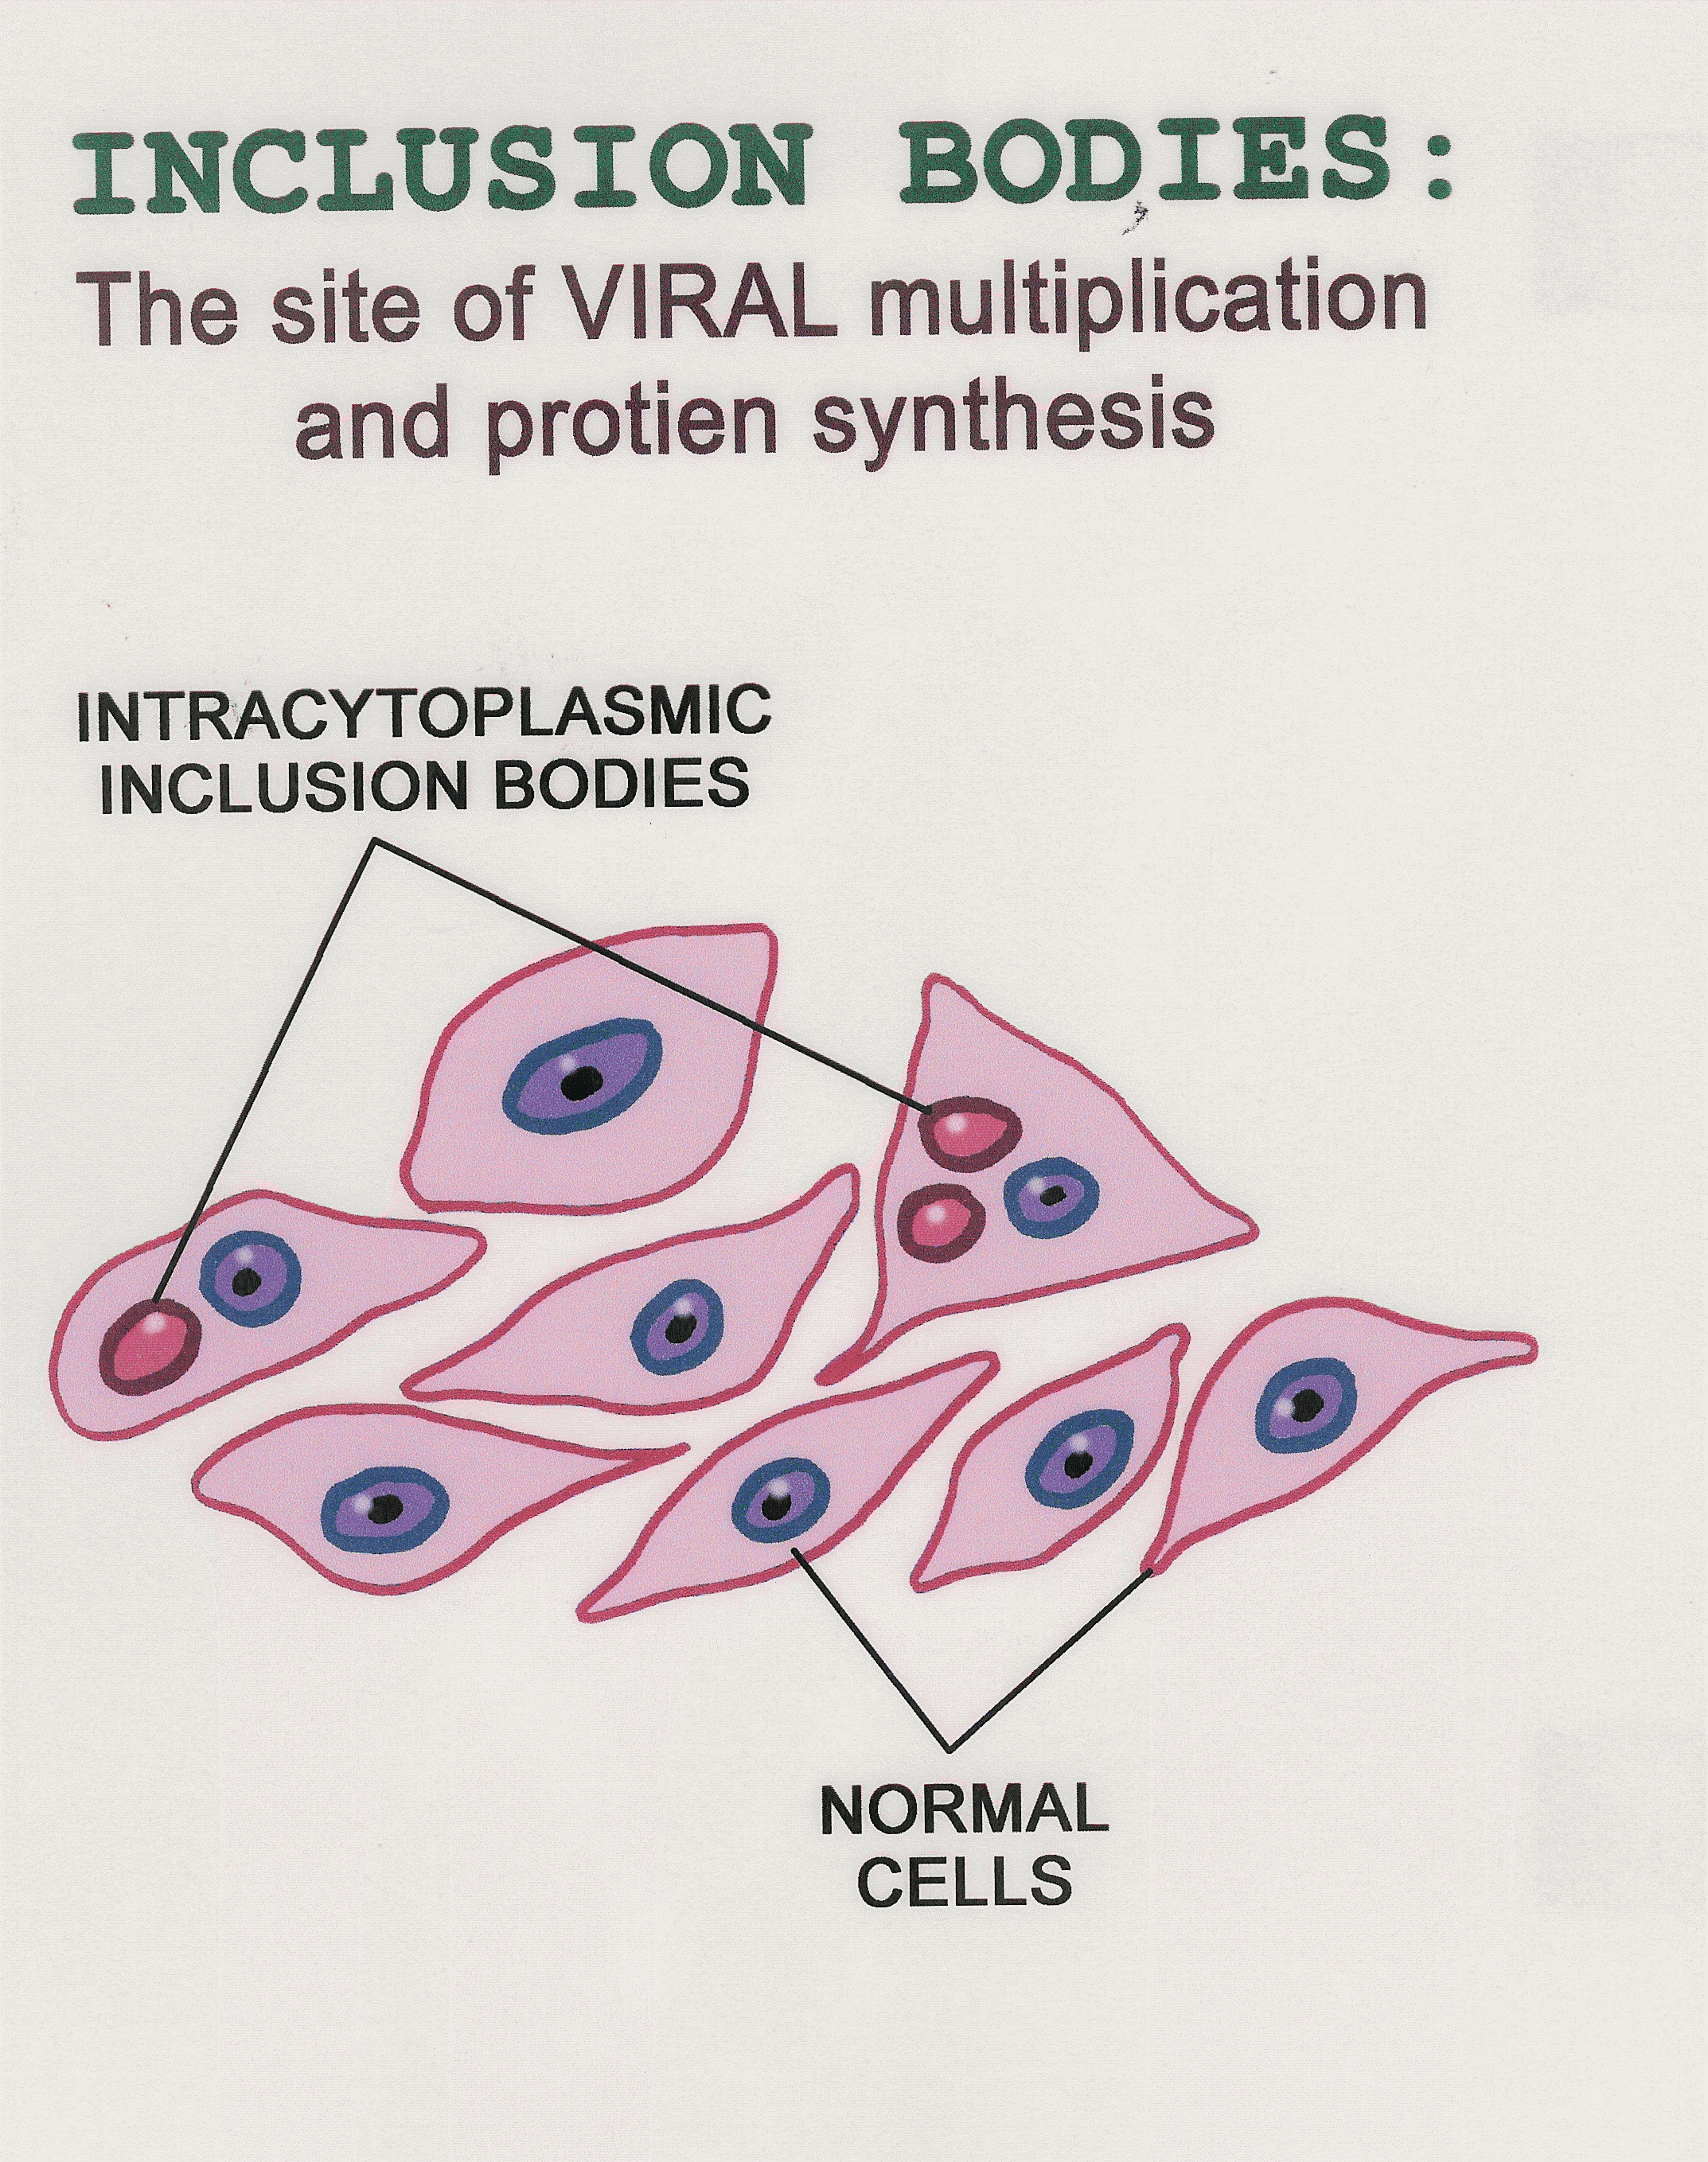
Inclusion bodies formation
Site:
Intranuclear [Herpes V.]
Intracytoplasmic [Rabies V.]
Take several forms:
Small/large
Single/multiple
Round/irregular

Slide 9
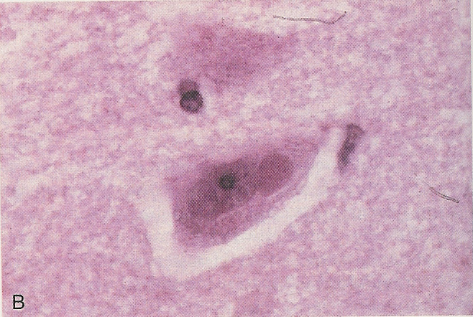
Inclusion bodies formation
Negri bodies caused by Rabies virus
Owl’s eye inclusions caused by CMV

Slide 10
The types of viral infections at cellular level
B) Productive Infections:
1. Cytolytic Infections
2. Non-cytolytic infections :
Viruses replicate & produce progeny
Vs released by cell budding & little or no CPE

Slide 11
The types of viral infections at cellular level
C) Non-productive Infections:
Vs infect cells that restrict or lack the machinery for transcribing viral genes.
Viral genome is found either integrated into cell DNA or as a circular episome or both.
1) Latent Infection:
Persistent inf b/c
there is limited expression of viral genes
Ex: HSV
2) Transformation:

Slide 12
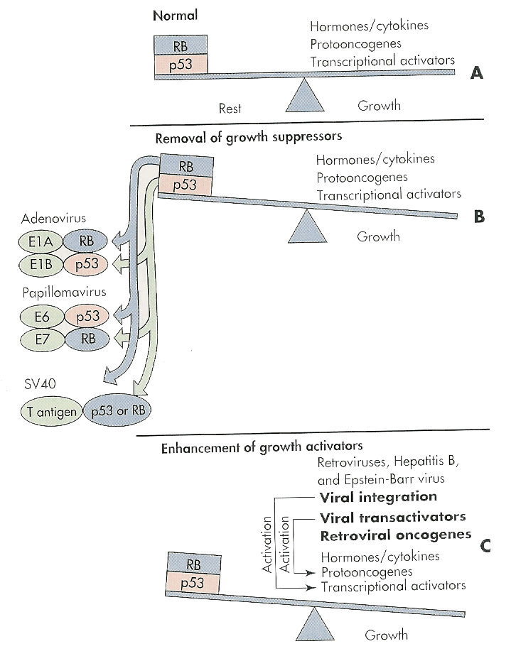
Transformation:
Ex ; EBV, HPV and HTLV
Cause tumor in animals & H
and can transform cell culture
--
Vs can stimulate uncontrolled cell growth causing Tf by
alternating the balance between growth activators &
growth suppressors gene products

Slide 13
Cytopathogenesis:
The types of viral infections at cellular level
The effects on cells/ Type of Infection
Virus Production
Abortive Vs not produced
Productive
Cytolytic Vs Produced
Non-cytolytic Vs Produced
Non-productive Vs not Produced
Latent Viral NA present
Transformation Viral NA present

Slide 14
Pathogenesis at Host Level
Transmission of the virus & its entry into the host.
Replication of the virus
Vs remain localized or spread to other organs
Viral shedding
The immune response as
Host defense
Immunopathogenesis

Slide 15
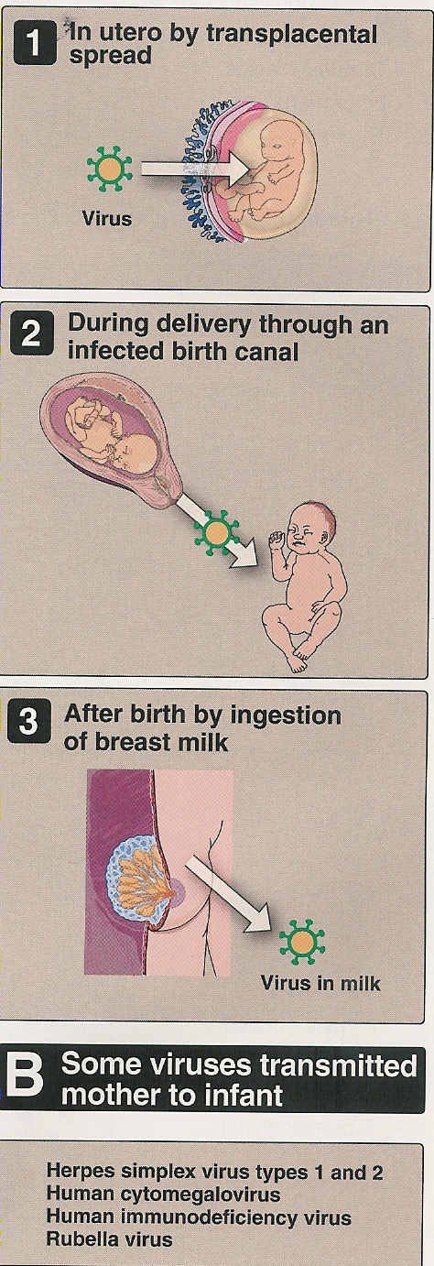
Transmission
Person to person
Horizontal transmission
Skin contact , Blood
Respiratory route
Fecal - oral route
Genital contact
Vertical transmission
Animal to person
Reservoir Human (Rabies v. )
Reservoir vector Human (YFV)

Slide 16
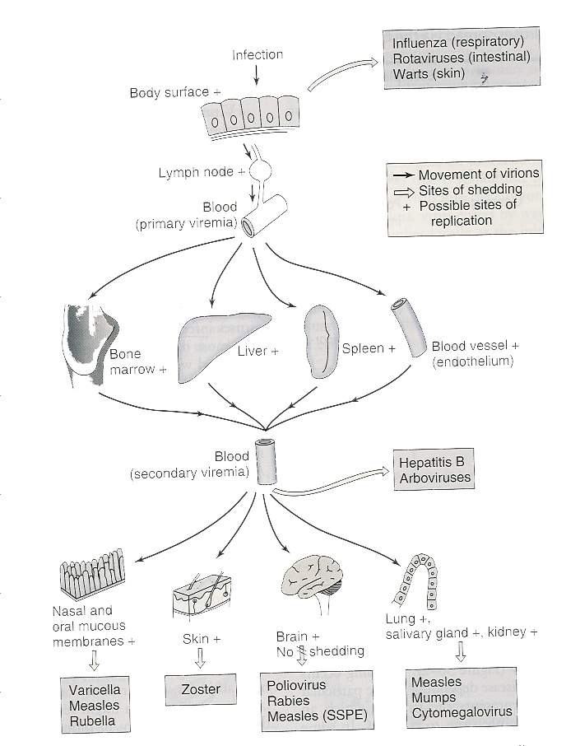
Mechanisms of spread of virus through the body
Virus
shedding

Slide 17
Important features of Acute Viral Diseases
 | Local Infections | Systemic Infections
Ex. of specific Disease | Rhinovirus | Measles
Site of Pathology | Portal of entry | Distant site
IP | Relatively short | Relatively long
Viremia | Absent | Present
Duration of Immunity | Variable- may be short | Usually life long
Role of Secretory AB [IgA] in resistance | Usually important | Usually not important

Slide 18
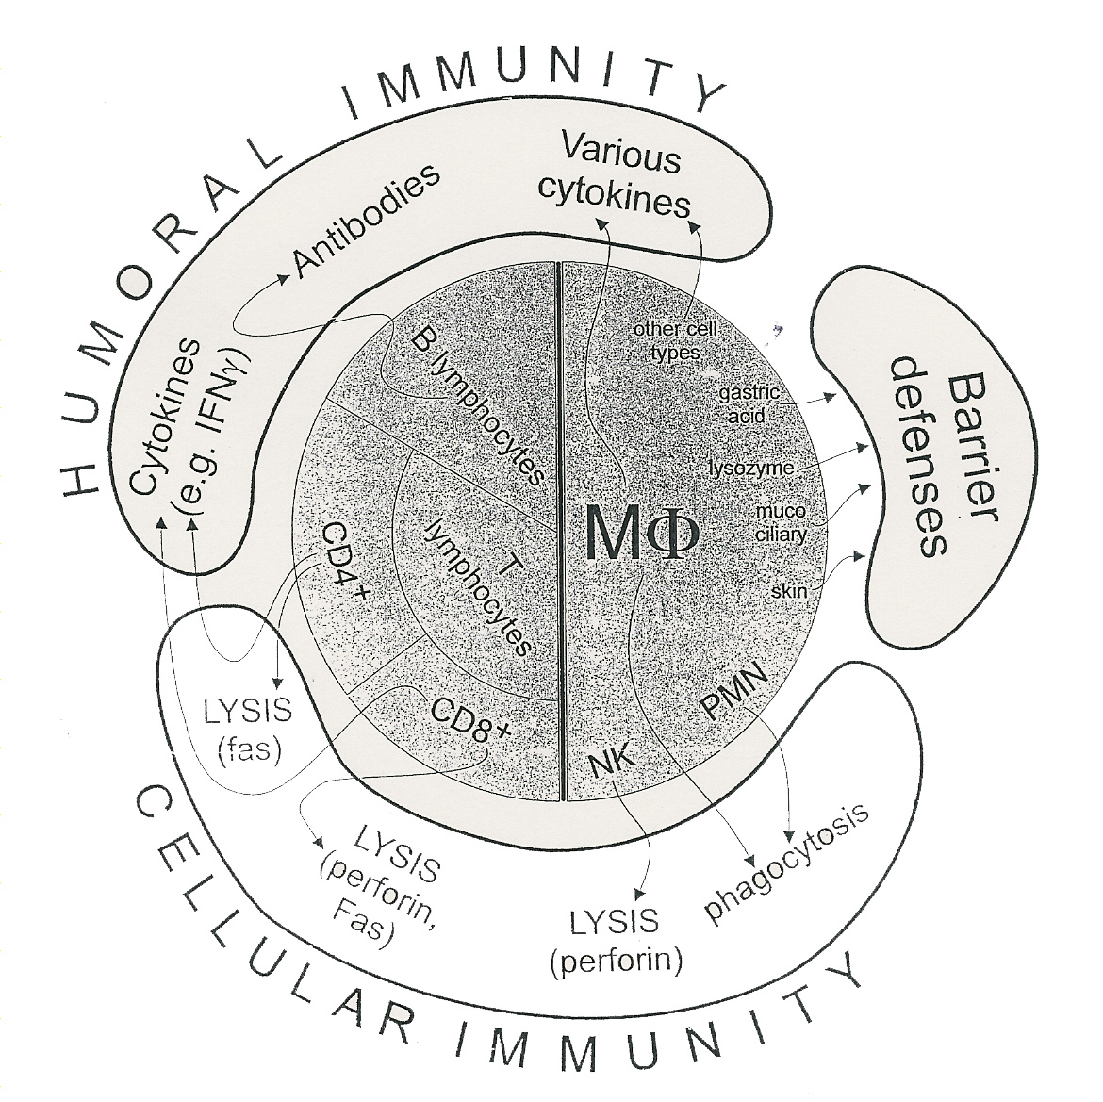
The immune response to virus

Slide 19
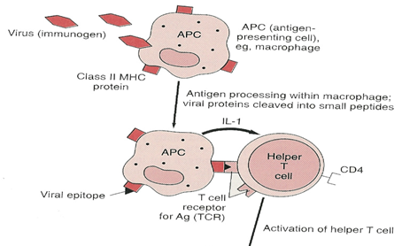
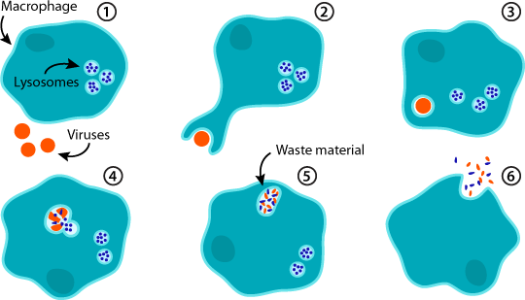
The immune response to virus
Natural killer (NK) cells :
Lysis of VICs
Macrophages:
APC, Cytokines production ,Phagocytosis

Slide 20
The immune response to virus
Natural killer (NK) cells :
Lysis of VICs
Macrophages:
APC, Phagocytosis , Cytokines production
Cytokines:
Interferons
(IFN)
α , β IFN inhibit viral translation
γ IFN stimulate phagocytosis and killing by macrophage & NK cells

Slide 21
The immune response to virus

Slide 22
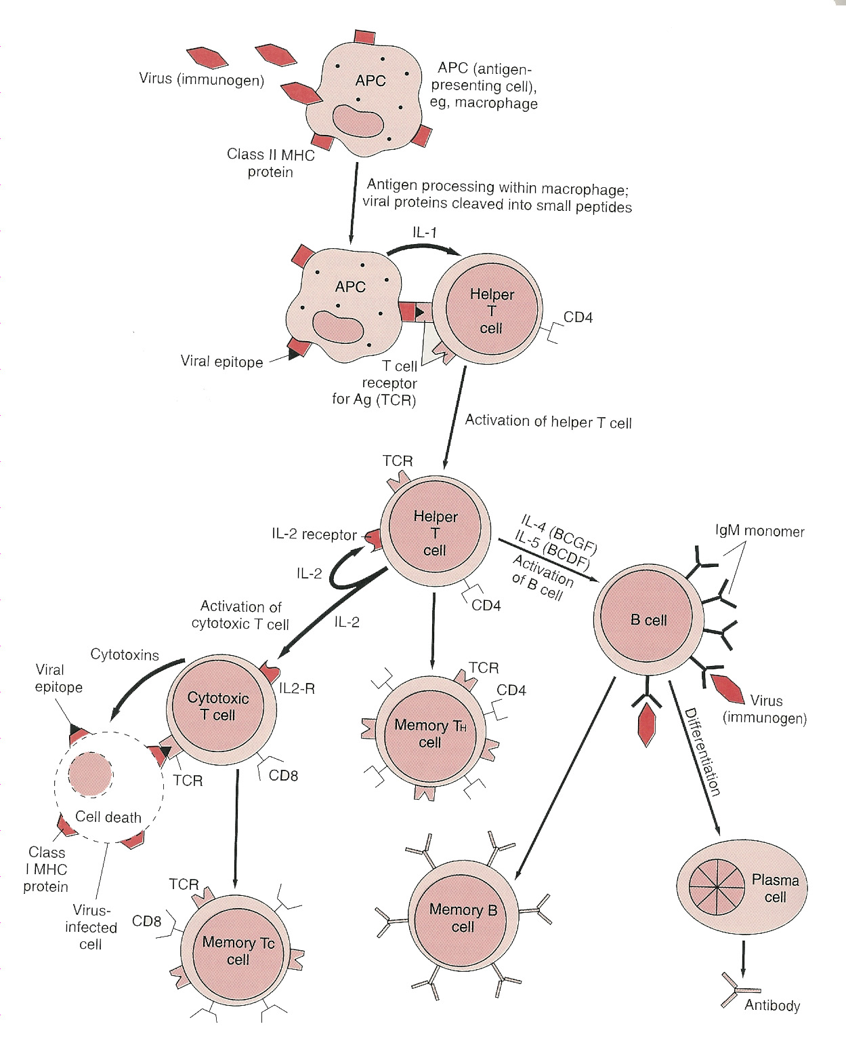

Slide 23
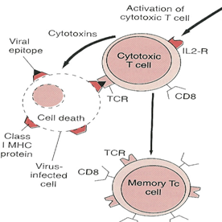
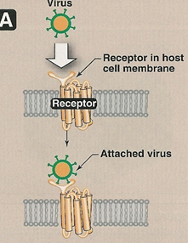
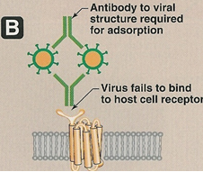
The immune response to virus
CMI:
Effective against intracellular viruses
Lysis of virally infected cells
by CTCs [CD8]
Humoral Immunity:
Effective on extracellular viruses
[viremia]
- Neutralization

Slide 24
The stages of a typical viral infection:
The incubation period
Prodromal period
The specific-illness period:
The signs & symptoms of viral diseases are the result of
Cell killing by:
A) Inhibition of cellular macromolecular synthesis
B) Immunologic attack ( Immunopathogenesis)
Cytotoxic T cells e.g. Hepatitis (HAV, HBV,HCV)
The recovery period

Slide 25
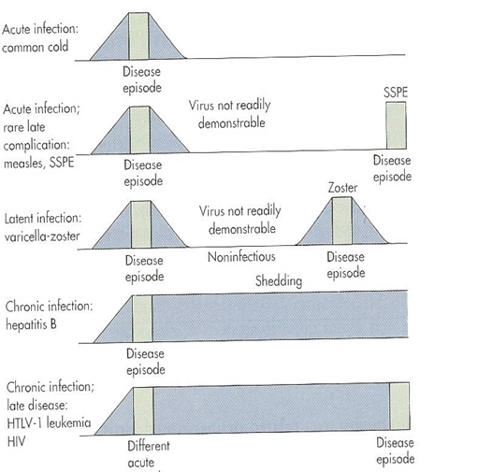
Types of viral infections at host level:
Asymptomatic infection
Acute infection
Persistant infection
Late complication
of acute infection
Latent infection
Chronic infection

Slide 26
RSV = Respiratory syncytial virus
HAV = Hepatitis A virus
HBV = Hepatitis B virus.
HCV = Hepatitis C virus
HIV = Human immunodeficiency virus
HPV = Human papillomavirus
HSV = Herpes simplex virus
HTLV = The human T-lymphotropic (leukemia) virus
YFV = Yellow Fever Virus
VZV = Varicella zoster virus

Slide 28
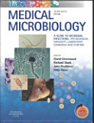
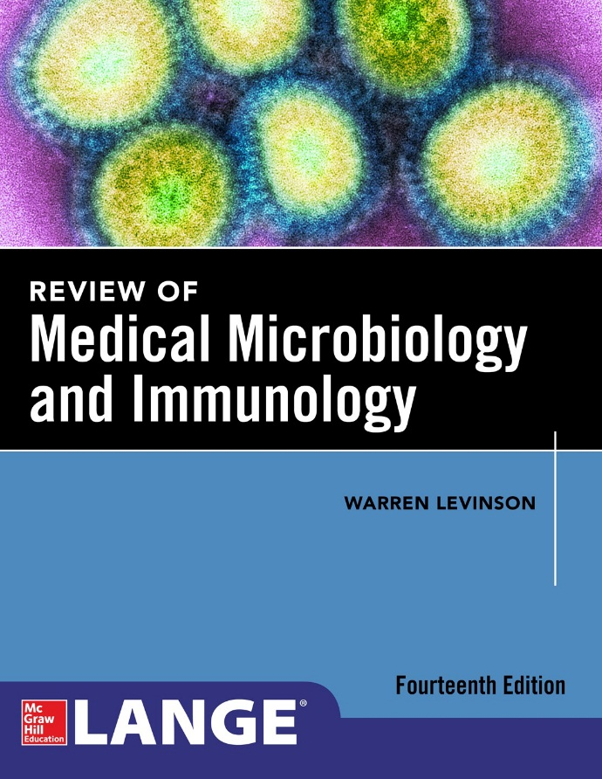
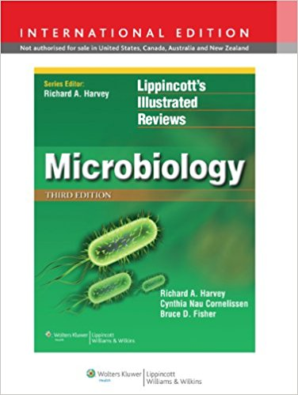
Reference books

Slide 29
Thank you

