Slide 1
PROF. HANAN HABIB DEPARTMENT OF PATHOLOGY COLLEGE OF MEDICINE, KSU
Normal Flora

Slide 2
Objectives
Define the terms: Normal Flora, Resident flora, Transient flora and carrier state
Know the origin of normal flora.
Know the effects and importance of normal flora eg.:
Source of opportunistic infection.
Immunostimulation.
Nutrition: Vitamins production.
Production of Carcinogens.
Protection against external invaders.

Slide 3
Objectives, cont,.
Know areas of the body with normal flora (gastrointestinal tract, urogenital tract, and skin) , most common types of organisms and its relation to pathogenicity.
Know the sites of the body with no normal flora eg. sterile body sites and the importance of this fact in relation to interpretation of culture results.

Slide 4
Introduction
Normal flora are population of microorganisms that are frequently found in the skin , mucous membrane and other particular sites in normal healthy individual.
Some are found in association with humans and animals. The Majority are bacteria.
Symbolic relationship (symbiosis ): close association with the host.
Subject to constant changes.
Altered by antimicrobial agents.

Slide 5
Types of Normal Flora
Commensals: Microorganisms that have natural relationship with the host. Found in low number and has no benefit or harm . Mainly associated with the GIT.
Residents : Consist of relatively fixed types of microorganisms . Regularly found in a given area at invariable period. If disturbed promptly re-establish itself .

Slide 6
Types of Normal Flora-cont.
Transients : Consist of nonpathogenic or potential pathogenic microorganisms that inhabit the skin or mucous membrane for hours or days. The transient organisms living in the external environment are attracted to moist and warm body sites.
Excluded by host defense or competition from resident flora.

Slide 7
Transient flora- cont.,
Exist temporarily for the following reasons:
They are washed by hand wash or bathing
Competition by resident flora
Killed by substances produced by resident flora
May not survive in acidic or alkaline PH of the body site
May be flushed away by bodily secretions like tears, sweat, oil urine,feces,..etc.

Slide 8
Carrier state: Potentially pathogenic bacteria that are carried by the individual without causing disease. However, it is the source of infection to other susceptible (non-immune ) individual.
Examples: Neisseria meningitides and Streptococcus pneumoniae in the throat of healthy individual .

Slide 9
Origin of Normal Flora
Newborn is sterile in uterus.
After birth , newborn is exposed to flora of mother’s genital tract, skin, respiratory tract flora of individuals handling him and the organisms in the environment.

Slide 10
Beneficial Effects of Normal Flora
1- Immunostimulation (antibody production)
2- Exclusionary effect (vacuum effect ) and protection from external invaders.
3- Antagonize other bacteria through the production of substances (toxin) that inhibit or kill non-indigenous bacteria.
4-Production of essential nutrients (Vitamin K & B) by some normal intestinal flora eg. Eschericia coli ( E.coli).
Notes:
‹#›

Slide 11
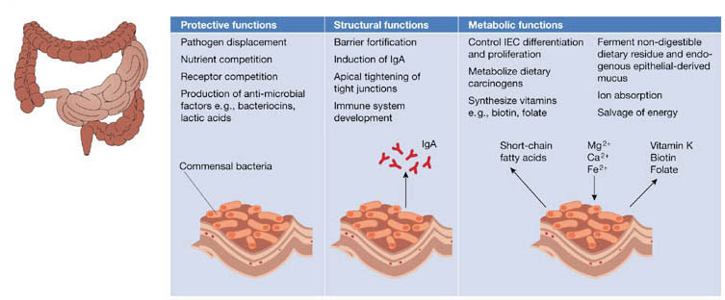

Slide 12
Facts About Normal Flora
May be a source of opportunistic infections in patients with impaired defense mechanisms. eg. Staphylococcus epidermidis and E.coli.
Some may cross react with normal tissue components ,eg. antibodies to various ABO group arise because of cross reaction between intestinal flora and the antigens of A & B blood substances.

Slide 13
Facts About Normal Flora-cont.,
Production of Carcinogens:
Some normal flora may modify through their enzymes chemicals in our diets into carcinogens. eg. artificial sweeteners may be enzymatically modified into bladder carcinogens.
Affected by : antibiotics, tissue damage, mechanical procedures and diet change.

Slide 14
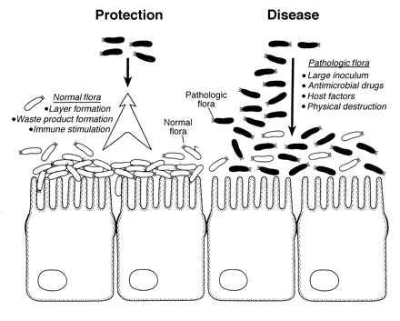
Normal Flora vs Pathogenic Flora

Slide 16
Distribution of Normal Flora
Normal flora found on external body sites
Internal organs are sterile at health (except the Gastrointestinal tract) .
Sterility of internal organs maintained by :
- Local defense mechanisms
- Chemical substances in serum & tissues eg. Complement and antibodies.
-Phagocytic activity of Polymorphnuclear Monocytes.

Slide 17
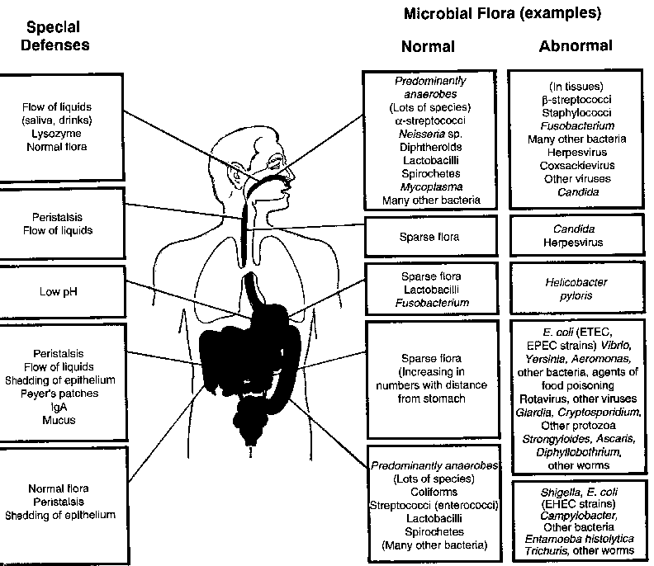

Slide 18
Body Sites With Normal Flora
All external body sites contain normal flora:
Gastro intestinal tract (GIT): mouth & large colon
Urogenital tract: vagina & distal one third of the urethra.
Skin ( including external ear & conjunctiva)

Slide 19
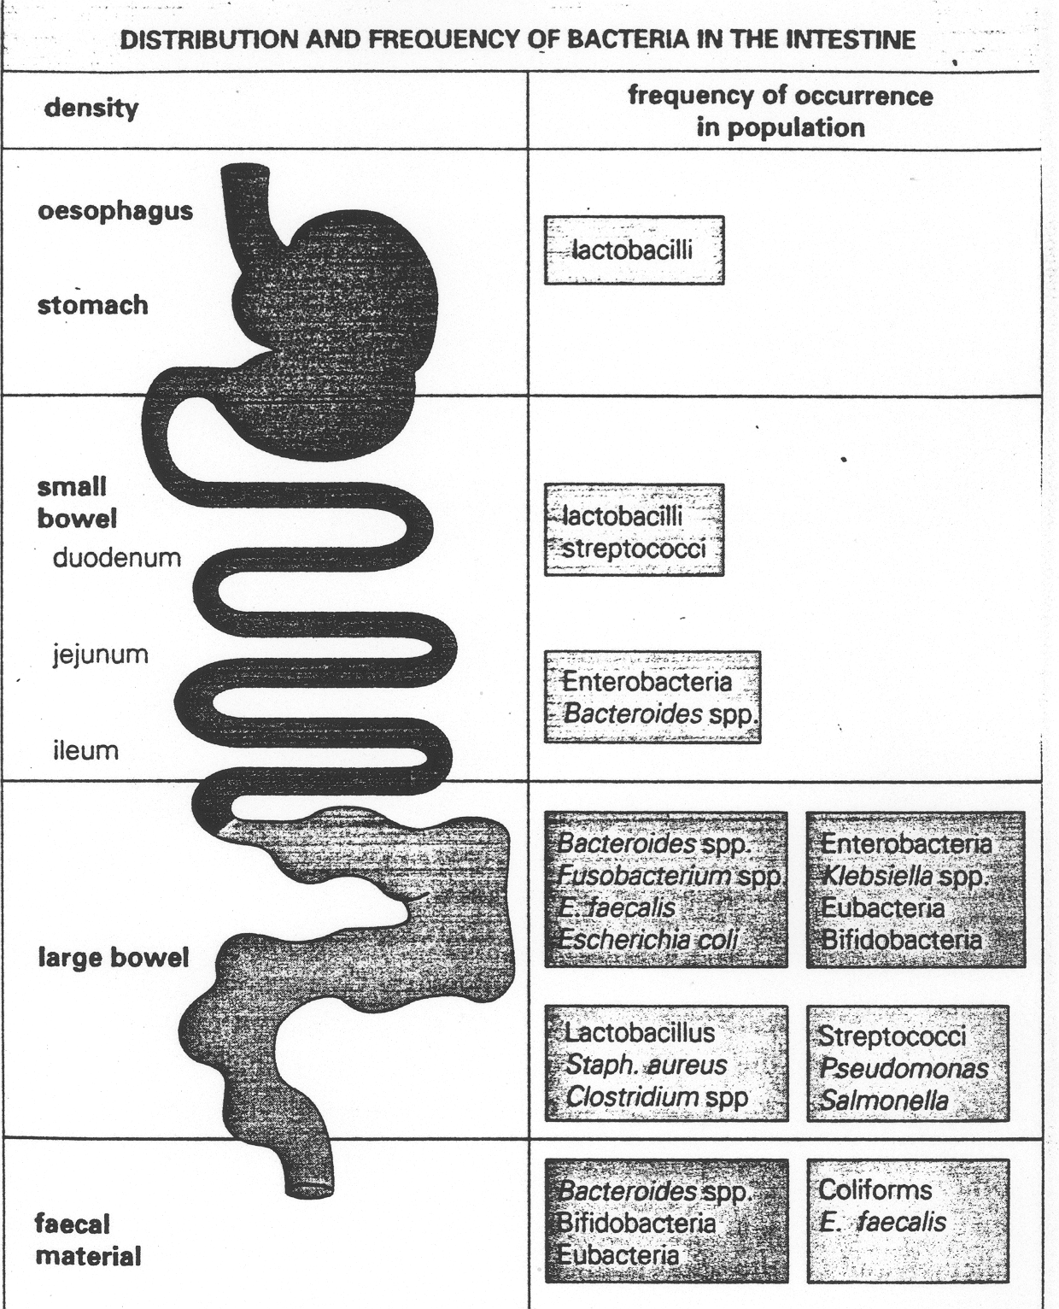

Slide 20
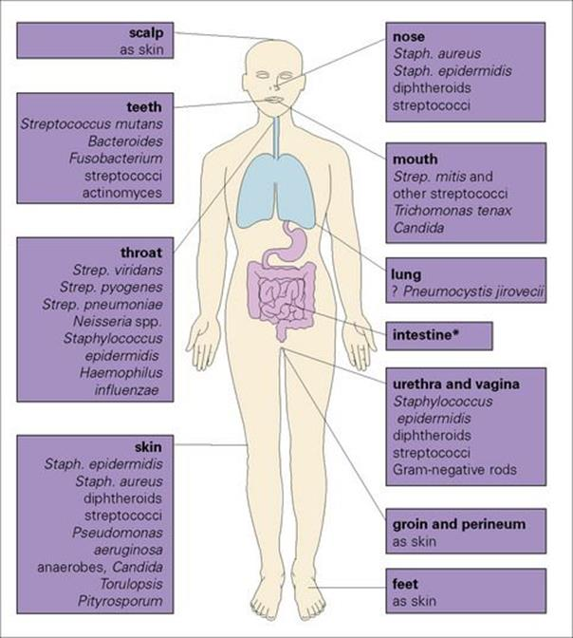

Slide 21
Normal Flora Of The Respiratory Tract
Upper respiratory tract colonized by normal flora as in mouth & nasopharynx
Lower respiratory tract is sterile
Nose Flora : - Staphylococcus epidermidis
- Staphylococcus aureus
-Corynebacterium species

Slide 22
Normal Flora Of The Oropharynx
Viridans streptococci
Commensal neisseriae
Corynebacteria
Bacteroides
Fusobacteria , Veillonella, Actinomyces, Spirochaetes.
Heamophilus inflenzea & Pneumcoccus are potential pathogens.
Less common potential pathogens : Streptococcus pyogenes and Niesseria meningitidis

Slide 23
Normal Flora Of The GIT
Saliva contains 10⁸ bacteria/ml
Gingival margin debris & dental Plaque continually colonized by bacteria.
Oesophagus has normal flora similar to pharyngeal flora.
Empty stomach sterile due to gastric acid.
Duodenum, jejunum& upper ielium have scanty flora
Large intestine heavily colonized by bacteria.

Slide 24
Feces (Stool)
1/3 of feces weight is bacteria , mainly dead.
Living bacteria about 10¹⁰/gm
99% anaerobes
Anaerobic environment maintained by aerobic bacteria utilizing free O2.
Bacteroides fragilis group is the dominant anaerobes, Bifidobacteria , Lactobacilli…etc.
Less common aerobics: E.coli ,Proteus,….etc.

Slide 25
Normal Flora Of The Genital Tract
Female genital tract heavily colonized , why ?
10⁸/ml flora in normal vaginal secretion.
In both sexes Mycobacterium smegmatis in secretions which contaminate urine and leads to confusion /misdiagnosis.
Male & Female distal urethra:
- S.epidermidis
-Corynebacteria
-Mycoplasma species

Slide 26
Normal Flora Of The Female Genital Tract
Vulva : S. epidermidis , Corynebacteria, E.coli and other coliforms & Enterococcus faecalis.
Vagina :
-Lactobacillus (Doderlein’s bacilli)
- Bacteroides melaninogenicus
-Enterococcus faecalis
- Corynebacteria
-Mycoplasma
- Yeasts.

Slide 27
Normal Flora Of The Skin
Skin has rich resident bacterial flora(10⁴/cm²).
Exist as microcolonies.
Anaerobic organisms predominate in areas with sebaceous glands.
Moist skin often colonized by coliforms (Gram negative bacteria).

Slide 29
Main Skin Flora:
Staphylococcus epidermidis
Propionibacterium acnes
Anaerobic cocci
Corynebacteria
Staphylococcus aureus (potential pathogen)
Coliforms

Slide 30
Normal Flora Of The External Auditory Meatus
External ear has the following normal flora:
S. epidermidis
Corynebacteria
Acid fast bacilli (AFB)( occasionally in wax).
Middle and inner ear are sterile.

Slide 31
Normal Flora Of The Conjunctival Sac
Conjunctiva has normal flora eg.
Corynebacterium xerosis
Staphylococcus epidrmidis
Internal eye is sterile.

Slide 32
Reference Book
Sherris medical microbiology ,an introduction to infectious diseases.
Kenneth Ryan/George Ray. Latest edition . Publisher : McGrew Hill.

