Slide 1
Classification of Tumors
Dr. Maria A. Arafah
Assistant Professor – Department of Pathology
http://fac.ksu.edu.sa/mariaarafah/courses

Slide 2
Objectives
Definitions: neoplasm, tumor, oncology.
Classification of tumors into benign and malignant.
Nomenclature of tumors.
Characteristics of benign and malignant tumors.
Definitions: teratoma, hamartoma, choristoma.

Slide 3
Definitions
Neoplasia: literally means “new growth.”
A neoplasm often is referred to as a tumor, and the study of tumors is called oncology (from oncos, “tumor,” and logos, “study of”).
Notes:
Neoplastic cells are said to be transformed because they continue to replicate, apparently oblivious to the regulatory influences that control normal cell growth.

Slide 4
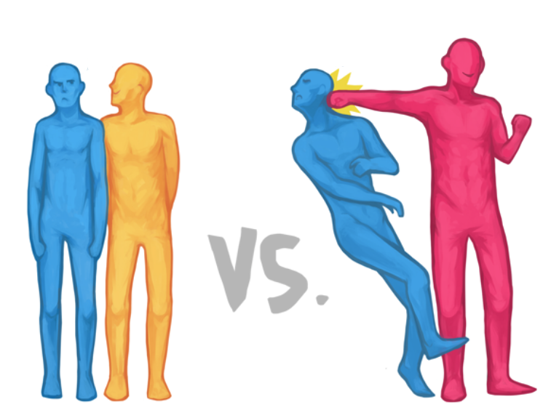
Classification of Tumors
The division of neoplasms into benign and malignant categories is based on their potential clinical behavior.

Slide 5
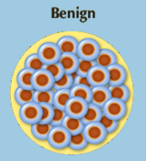
Classification of Tumors
Benign: the microscopic and gross characteristics of the lesion are considered to be relatively innocent.
Tumors remain localized.
Tumors are amenable to local surgical removal.
Patients generally survive.

Slide 6
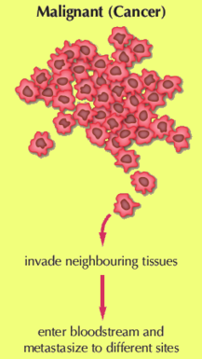
Classification of Tumors
Malignant: lesions can invade and destroy adjacent structures and spread to distant sites (metastasize) to cause death.

Slide 7
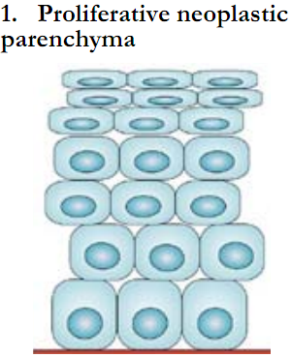
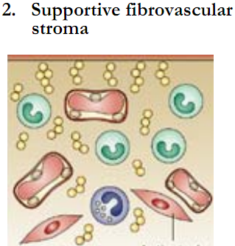
Classification of Tumors
All tumors, benign and malignant, have two basic components:
The parenchyma, made up of transformed or neoplastic cells.
The supporting, host-derived, non-neoplastic stroma, made up of connective tissue, blood vessels, and host-derived inflammatory cells.

Slide 8
Classification of Tumors
The nomenclature of tumors and their biologic behavior are based primarily on the parenchymal component.
However, the growth and evolution of tumors is critically dependent on their stroma as an adequate stromal blood supply is a requisite for the tumor cells to live and divide.

Slide 9
Nomenclature of Tumors - Benign
Benign tumors are designated by attaching the suffix -oma to the cell type from which the tumor arises.
The nomenclature of mesenchymal tumors usually apply this rule e.g.
Fibroma: a benign tumor arising in fibrous tissue.
Chondroma: a benign tumor arising in cartilaginous tissue.
Osteoma: a benign tumor arising in bone tissue.

Slide 10
Nomenclature of Tumors - Benign
The nomenclature of benign epithelial tumors is more complex: cell of origin, microscopic pattern or macroscopic appearance.
Adenoma is generally applied to benign epithelial neoplasms producing gland patterns and to neoplasms derived from glands but not necessarily exhibiting glandular patterns.

Slide 11
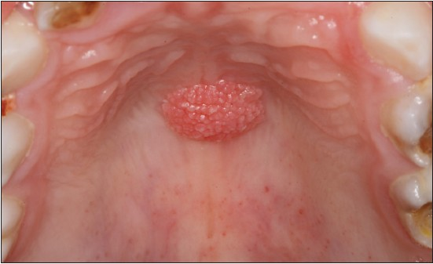
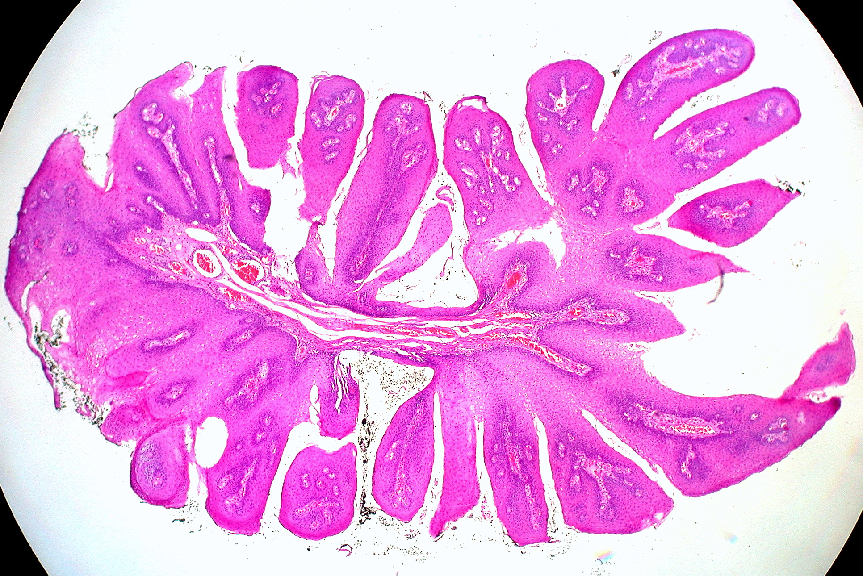
Nomenclature of Tumors - Benign
Benign epithelial neoplasms producing microscopically or macroscopically visible finger-like or warty projections from epithelial surfaces are referred to as papillomas.

Slide 12
Nomenclature of Tumors - Benign
Benign epithelial neoplasms forming large cystic masses, as in the ovary, are referred to as cystadenomas.
Some of the latter produce papillary patterns that protrude into cystic spaces and are called papillary cystadenomas.

Slide 13
Nomenclature of Tumors - Benign
Cystadenoma – Macroscopically
Cystadenoma – Microscopically

Slide 14
Nomenclature of Tumors - Benign
Papillary cystadenoma – Macroscopically
Papillary cystadenoma – Microscopically

Slide 15
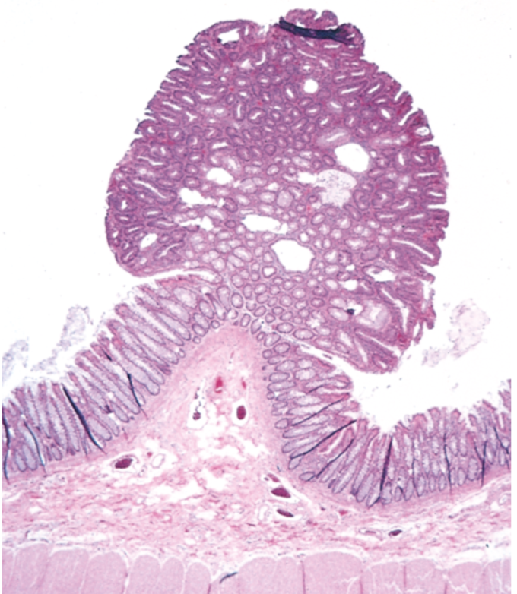
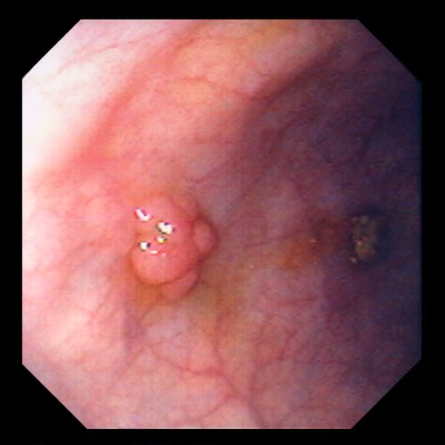
Nomenclature of Tumors - Benign
A polyp is a mass that projects above a mucosal surface, as in the gut, to form a macroscopically visible structure.

Slide 16
Nomenclature of Tumors - Malignant
Malignant neoplasms arising in mesenchymal tissues are called sarcomas.
Fibrosarcoma: a malignant tumor arising in fibrous tissue.
Chondrosarcoma: a malignant tumor arising in cartilaginous tissue.
Osteosarcoma: a malignant tumor arising in bone tissue.

Slide 17
Nomenclature of Tumors - Malignant
Malignant neoplasms arising from epithelial cells are called carcinomas.
Carcinomas include:
Carcinomas that arise from glandular epithelial cells (with or without forming glands): adenocarcinomas
Carcinomas that arise from squamous cells (some producing keratin): squamous cell carcinomas.
Carcinomas that show little or no differentiation: poorly differentiated or undifferentiated carcinoma.

Slide 18
Nomenclature of Tumors - Malignant
Squamous cell carcinoma
Adenocarcinoma

Slide 19
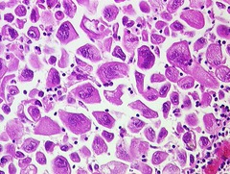
Nomenclature of Tumors
Not infrequently, however, a cancer is composed of undifferentiated cells of unknown tissue origin, and must be designated merely as an undifferentiated malignant tumor.

Slide 20
Nomenclature of Tumors
The transformed cells in a neoplasm, whether benign or malignant, often resemble each other, as though all had been derived from a single progenitor, consistent with the monoclonal origin of tumors.
In some unusual instances, however, divergent differentiation of a single neoplastic clone along two lineages occurs, creating the so-called mixed tumors.

Slide 21
Nomenclature of Tumors
The best example is the mixed tumor of the salivary gland. These tumors have obvious epithelial components dispersed throughout a fibromyxoid stroma, sometimes harboring islands of cartilage or bone.
All of these diverse elements are thought to derive from a single clone capable of giving rise to epithelial cells or myoepithelial cells, or both, and the preferred designation for these neoplasms is pleomorphic adenoma.

Slide 22
Pleomorphic Adenoma
Macroscopically
Microscopically

Slide 23
Nomenclature of Tumors
Some glaring inconsistencies may be noted. For example, the terms lymphoma, mesothelioma, melanoma, and seminoma are used for malignant neoplasms.

Slide 24
Teratoma
Teratoma is a special type of mixed tumor that contains recognizable mature or immature cells or tissues representative of more than one germ cell layer and sometimes all three.
Teratoma originates from totipotential cells such as those normally present in the ovary and testis and sometimes abnormally present in sequestered midline embryonic rests. Such cells have the capacity to differentiate into any cell type found in the adult body.

Slide 25
Teratoma
When all the components within the teratoma are well differentiated, it is a benign (mature) teratoma.
However, when they are less differentiated, it is an immature, potentially or overtly, malignant teratoma.

Slide 26
Teratoma
Macroscopically
Microscopically

Slide 27
Hamartoma
Hamartoma is a mass of disorganized benign-looking tissue indigenous to the particular site.
For example, pulmonary chondroid hamartoma, which contains islands of disorganized, but histologically normal cartilage, bronchi, and vessels.
Hamartomas have traditionally been considered developmental malformations, but some genetic studies have shown the presence of acquired translocations, suggesting a neoplastic origin.

Slide 28
Choristoma
Choristoma is a congenital anomaly consisting of a heterotopic rest of cells.
For example, a small nodule of well-developed and normally organized pancreatic tissue may be found in the submucosa of the stomach, duodenum, or small intestine.
Choristoma has usual trivial significance.

Slide 29
Summary
Although the terminology of neoplasms is regrettably not simple, a firm grasp of the nomenclature is important because it is the language by which the nature and significance of tumors are categorized.

Slide 30
Summary

Slide 31
Summary

Slide 32
Summary

Slide 33
Reference
Kumar V, Abbas AK, Aster JC. Robbins Basic Pathology. 10th ed. Elsevier; 2018. Philadelphia, PA.

Slide 34
End of lecture
Thank You

