Slide 1
Grading, staging and clinical manifestations of tumors
Dr. Maria A. Arafah
Assistant Professor – Department of Pathology
http://fac.ksu.edu.sa/mariaarafah/courses

Slide 2
Objectives
To define the host defenses against cancer
To define tumor grade & clinical stage.
To define cachexia & its causes.
To define a paraneoplastic syndrome & know examples of tumors associated with endocrinopathies, osseous, vascular and hematologic changes.
To be familiar with the general principles, value, procedures, and applications of biopsies, exfoliative & aspiration cytology and frozen sections.
To list examples of tests used to diagnose cancer: immunohistochemistry & flow cytometry.
To discuss the use of molecular diagnostic testing in the setting of cancer diagnosis & prognosis.

Slide 3
Host Defense Against Tumors
Tumor antigens:
Tumor-specific antigens, which are present only on tumor cells and not on any normal cells.
Tumor-associated antigens, which are present on tumor cells and also on some normal cells.

Slide 4
Host Defense Against Tumors
Classes of tumor antigens:
Products of mutated oncogenes and tumor suppressor genes
P53 tumor suppressor gene, RAS oncogene
Products of amplified genes
HER2-NEU
Tumor antigens produced by oncogenic viruses
HPV, EBV

Slide 5
Host Defense Against Tumors
Classes of tumor antigens:
Oncofetal antigens: expressed during embryogenesis but not in normal adult tissues.
CEA, AFP in colon and liver carcinomas, respectively.
Cell type–specific differentiation antigens: Tumors express molecules that normally are present on the cells of origin. These antigens are called differentiation antigens, because they are specific for particular lineages or differentiation stages of various cell types.
PSA in prostatic carcinoma

Slide 6
Host Defense Against Tumors
Antitumor effector mechanisms
Cytotoxic T lymphocytes
Natural killer cells
Macrophages
Humoral mechanisms:
Complement system
Antibodies

Slide 7
Clinical Aspects of Neoplasia
Both malignant & benign tumors may cause problems because of:
Location and impingement on adjacent structures
Bleeding, secondary fractures or infections
Symptoms that result from rupture, obstruction or infarction
Functional activity such as hormone synthesis or the development of paraneoplastic syndromes
Cachexia or wasting.

Slide 8
Clinical Aspects of Neoplasia
Location and impingement on adjacent structures:
Location is crucial in both benign and malignant tumors.
A small (1-cm) pituitary adenoma can compress and destroy the surrounding normal gland, giving rise to hypopituitarism.
A 0.5-cm leiomyoma in the wall of the renal artery may encroach on the blood supply, leading to renal ischemia and hypertension.

Slide 9
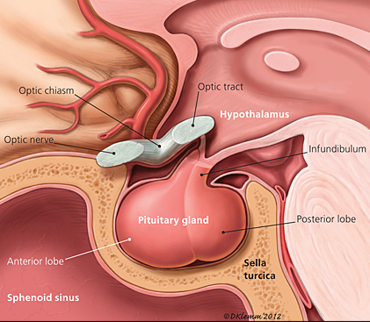
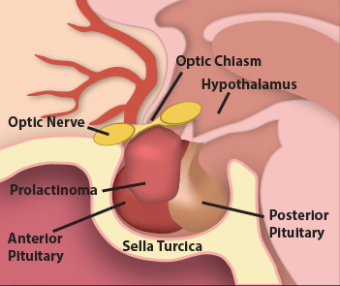
Clinical Aspects of Neoplasia
Pituitary Gland
Pituitary Adenoma

Slide 10
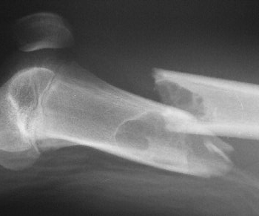
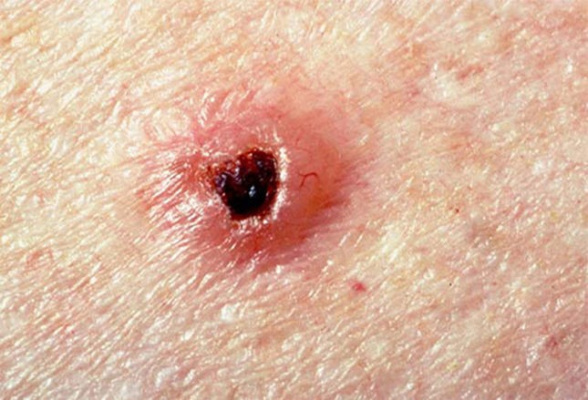
Clinical Aspects of Neoplasia
Bleeding, secondary fractures and infections:
A tumor may ulcerate through a surface or adjacent structures causing consequent bleeding or secondary infection or fracture.

Slide 11
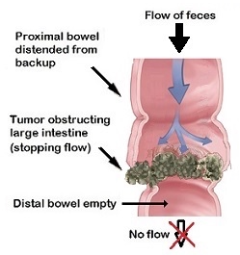
Clinical Aspects of Neoplasia
Symptoms that result from rupture, obstruction or infarction:

Slide 12
Clinical Aspects of Neoplasia
Functional activity such as hormone synthesis or the development of paraneoplastic syndromes:
Hormone production is seen with benign and malignant neoplasms arising in endocrine glands.
Adenomas and carcinomas arising in the beta cells of the pancreatic islets of Langerhans can produce hyperinsulinism, sometimes fatal.
Some adenomas and carcinomas of the adrenal cortex elaborate corticosteroids that affect the patient (e.g., aldosterone, which induces sodium retention, hypertension, and hypokalemia).
Such hormonal activity is more likely with a well-differentiated benign tumor than with a corresponding carcinoma.

Slide 13
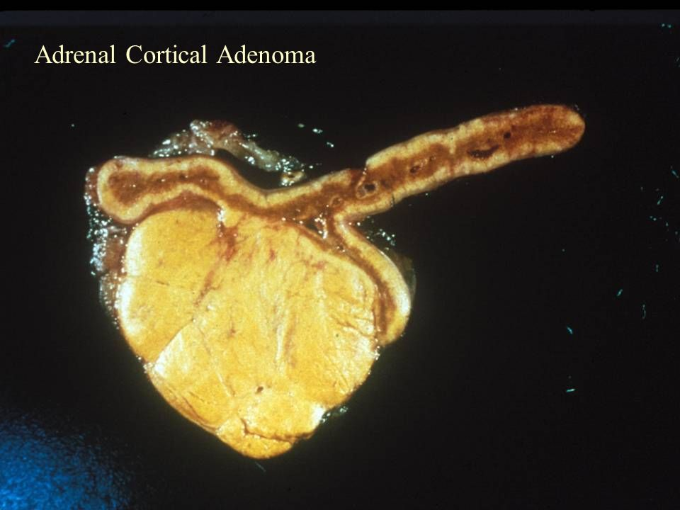
Clinical Aspects of Neoplasia
Functional activity such as hormone synthesis:

Slide 14
Clinical Aspects of Neoplasia
Paraneoplastic syndromes:
They are symptoms that occur in cancer patients & cannot be explained.
They are diverse and are associated with many different tumors.
They appear in 10% to 15% of patients.
They may represent the earliest manifestation of an occult neoplasm.
They may represent significant clinical problems & may be lethal.
They may mimic metastatic disease.

Slide 15
Clinical Aspects of Neoplasia
Paraneoplastic syndromes:
The most common paraneoplastic syndrome are:
Hypercalcemia
Cushing syndrome
Nonbacterial thrombotic endocarditis
The most often neoplasms associated with these syndromes:
Lung and breast cancers and hematologic malignancies

Slide 16
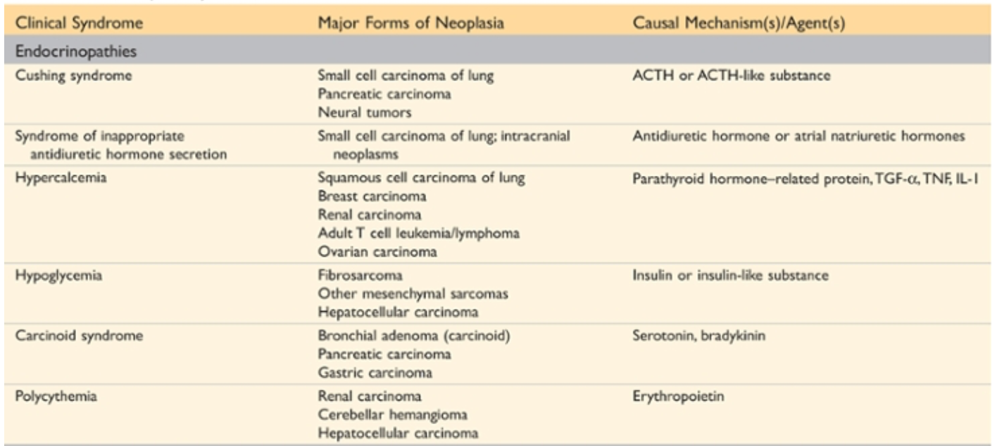
Paraneoplastic Syndromes

Slide 17
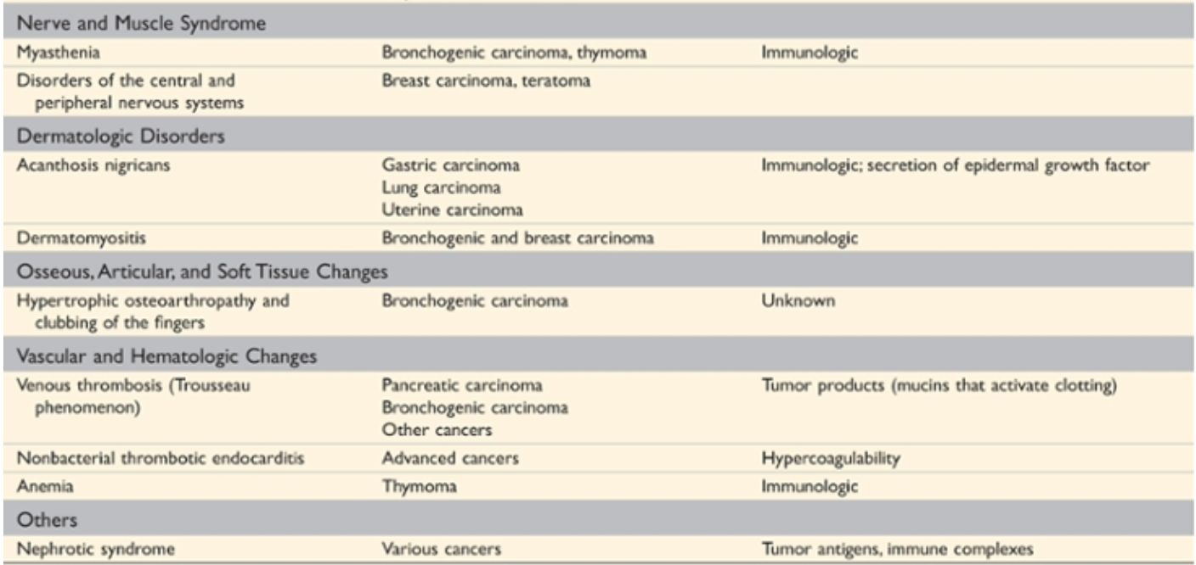
Paraneoplastic Syndromes

Slide 18
Clinical Aspects of Neoplasia
Cancer cachexia:
It is usually accompanied by weakness, anorexia and anemia.
The severity of cachexia is generally correlated with the size and extend of spread of the cancer.
The origin of cancer cachexia is multifactorial:
Anorexia (reduced calorie intake): TNF suppresses appetite.
Increased basal metabolic rate & calorie expenditure.
General metabolic disturbance

Slide 19
Grading and Staging of Cancer
Grading:
It is based on the cytologic differentiation of tumor cells and the number of mitoses within the tumor.
Malignant tumors are classified as:
Grade I → well differentiated
Grade II → moderately differentiated
Grade III → poorly differentiated
Grade IV → anaplastic (undifferentiated)

Slide 20
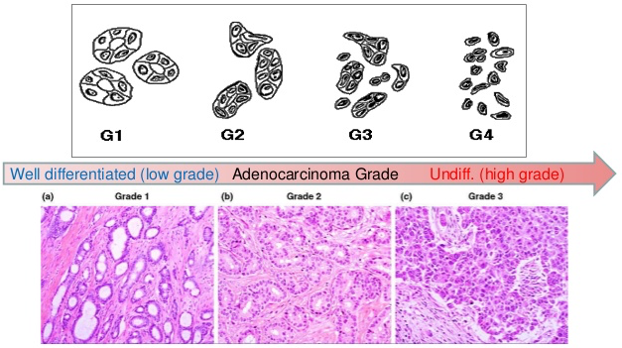
Grading

Slide 21
Grading and Staging of Cancer
Staging:
Staging is based on the size of the primary lesion, its extent of spread to regional lymph nodes, and the presence or absence of metastases.
Two methods of staging are currently in use: the TNM system (T, primary tumor; N, regional lymph node involvement; M, metastases) and the AJC (American Joint Committee) system.

Slide 22
Grading and Staging of Cancer
Staging:
TNM staging system:
T0, Tis, T1, T2, T3, and T4 describe the increasing size of the primary lesion
N0, N1, N2, and N3 indicate progressively advancing node involvement
M0 and M1 reflect the absence and presence, respectively, of distant metastases.

Slide 23
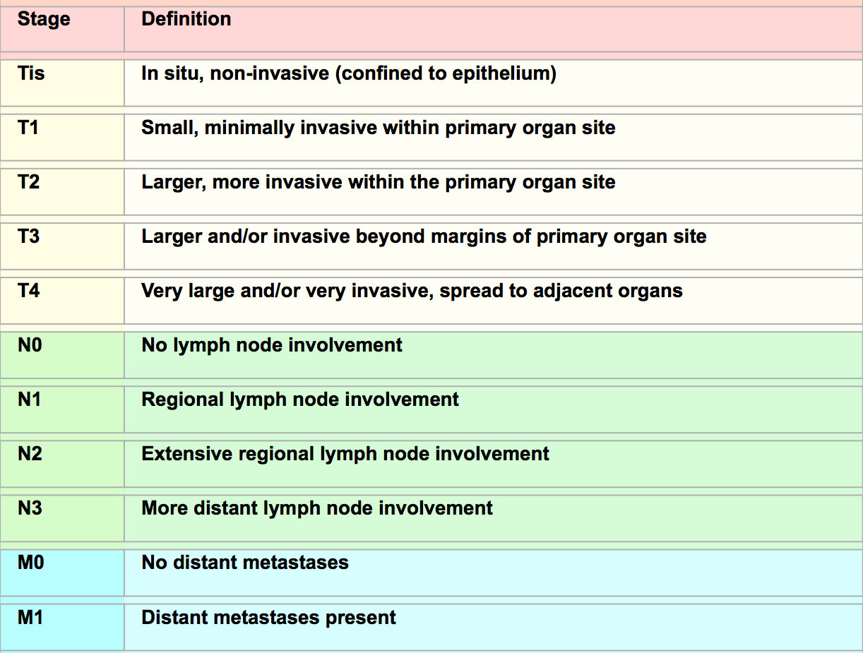
Staging

Slide 24
Laboratory Diagnosis of Cancer
Laboratory diagnosis of cancer can be achieved by:
Morphologic methods
Biochemical assays
Molecular tests

Slide 25
Laboratory Diagnosis of Cancer
Morphologic methods include microscopic tissue or cellular diagnosis:
It is the gold standard for cancer diagnosis.
Several sampling approaches are available:
Biopsy, excision & frozen section
Fine-needle aspiration
Cytologic smears
Immunohistochemical stains
Flow cytometry

Slide 26
Laboratory Diagnosis of Cancer
Sampling approaches:
Biopsies
Surgical excisions
Frozen section: a method in which a sample is quick-frozen and sectioned, permits histologic evaluation within minutes.

Slide 27
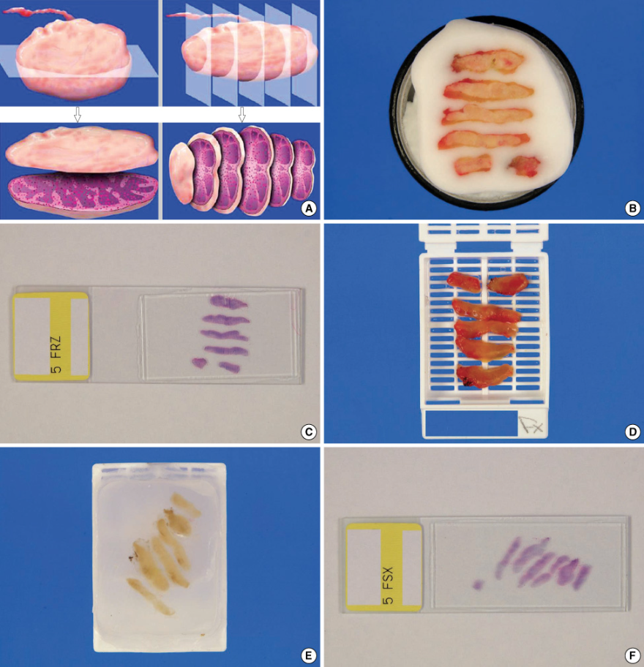
Frozen Section & Histological Sections

Slide 28
Laboratory Diagnosis of Cancer
Fine needle aspiration: it involves aspiration of cells from a mass, followed by cytologic examination of the smear.
Cytologic (Papanicolaou) smears provide another method for the detection of cancer. Neoplastic cells are less cohesive than others and are therefore shed into fluids or secretions.

Slide 29
Laboratory Diagnosis of Cancer
FNA
Pap Smear

Slide 30
Laboratory Diagnosis of Cancer
Immunocytochemistry offers a powerful adjunct to routine histologic examination.
Flow cytometry is used routinely in the classification of leukemias and lymphomas.

Slide 31
Laboratory Diagnosis of Cancer
Biochemical assays:
They are useful for measuring the levels of tumor associated enzymes, hormones, and tumor markers in serum.
They are useful in screening, determining the effectiveness of therapy & detecting tumor recurrences.
Elevated levels may not be diagnostic of cancer e.g. PSA.
Only few tumor markers are proven to be clinically useful e.g. CEA & AFP.

Slide 32
Laboratory Diagnosis of Cancer
Molecular tests:
Polymerase chain reaction (PCR)
PCR is useful for the detection of BCR-ABL transcripts in chronic myeloid leukemia.
Fluorescent in situ hybridization (FISH)
FISH is useful for detecting chromosomal translocations characteristic of many tumors.
Both PCR and FISH can show amplification of oncogenes e.g. HER2-NEU & N-MYC.

Slide 33
Laboratory Diagnosis of Cancer
Molecular tests:
DNA microarray analysis:
It evaluates the expression of thousands of genes.
Different tissues have different patterns of gene expression.
It is a powerful tool for subcategorizing diseases e.g. lymphomas.
It confirms the morphologic diagnoses.
It is useful in illustrating genes involved in certain disease & help plan possible therapies.

Slide 34
Reference
Kumar V, Abbas AK, Aster JC. Robbins Basic Pathology. 10th ed. Elsevier; 2018. Philadelphia, PA.

Slide 35
End of lecture
Thank You

