Slide 1
Foundation block: pathology
INFLAMMATION AND REPAIR
Lecture 3
Dr. Maha Arafah
Associate Professor
Department of Pathology
King Saud University
Email: marafah@hotmail.com
Oct, 2018

Slide 2
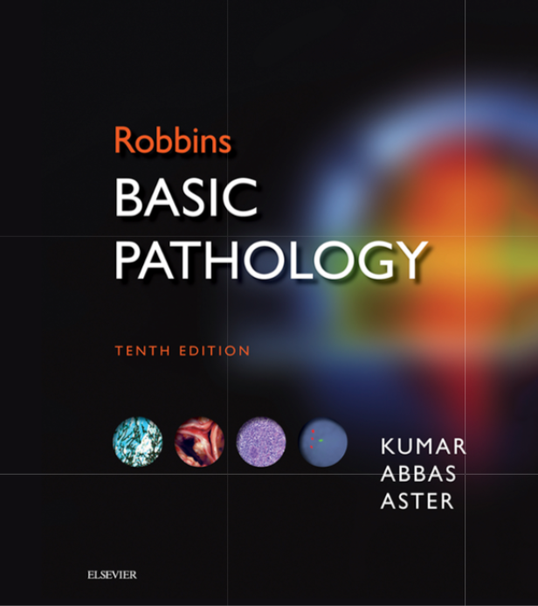
1. Outcomes of acute inflammation 2. Different patterns of inflammation 3. Chronic inflammation
Robbins Basic Pathology 10th edition
Page: 78 to 86

Slide 3
Objectives
List and describe the outcome of acute inflammation.
Recognize the different patterns of inflammation.
Define chronic inflammation with emphasis on causes, nature of the inflammatory response, and tissue changes.
Compare and contrast the clinical settings in which different types of inflammatory cells (eosinophils, macrophages, and lymphocytes) accumulate in tissues.

Slide 4
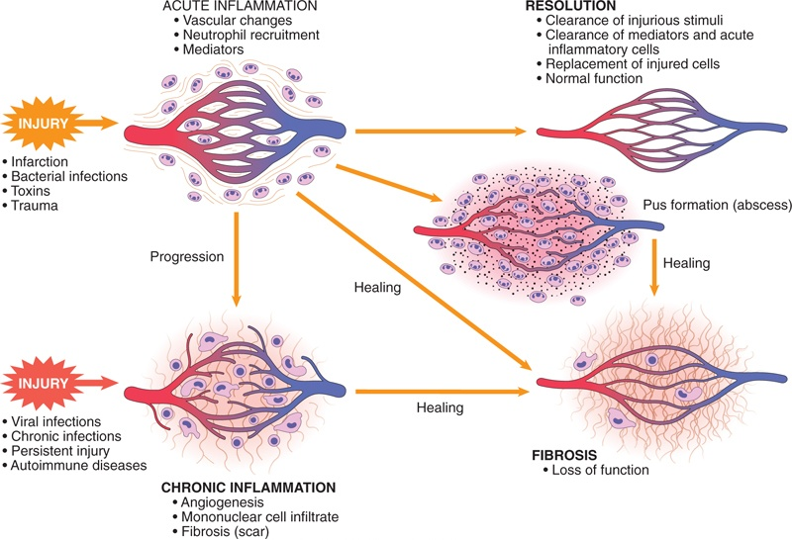
List and describe the outcome of acute inflammation.

Slide 5
Outcomes of Acute Inflammation
List and describe the outcome of acute inflammation.
Acute inflammation may have one of the four outcomes:
Complete resolution
Healing by connective tissue replacement (fibrosis)
Progression of the tissue response to chronic inflammation
Abscess formation

Slide 6
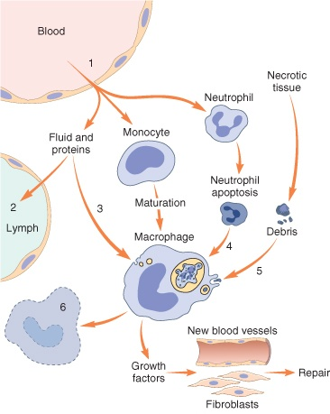
List and describe the outcome of acute inflammation.
Events in the resolution of inflammation
This involves neutralization, decay, or enzymatic degradation of the various chemical mediators; normalization of vascular permeability; and cessation of leukocyte emigration and apoptosis
The necrotic debris, edema fluid, and inflammatory cells are cleared by phagocytes and lymphatic drainage
Lymph node become enlarged and inflamed

Slide 7
Objectives
List and describe the outcome of acute inflammation.
Recognize the different patterns of inflammation.
Define chronic inflammation with emphasis on causes, nature of the inflammatory response, and tissue changes.
Compare and contrast the clinical settings in which different types of inflammatory cells (eosinophils, macrophages, and lymphocytes) accumulate in tissues.

Slide 8
Morphologic Patterns of Acute Inflammation
2. Recognize the different patterns of inflammation.
Several types of inflammation vary in their morphology and clinical correlates. Why?
The severity of the reaction
specific cause
the particular tissue
site involved

Slide 9
Morphologic Patterns of Acute Inflammation
2. Recognize the different patterns of inflammation.
SEROUS INFLAMMATION
FIBRINOUS INFLAMMATION
SUPPURATIVE OR PURULENT INFLAMMATION
ULCERS

Slide 10
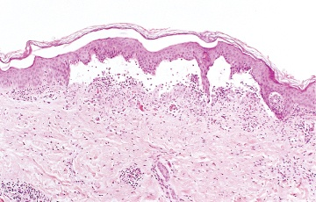
2. Recognize the different patterns of inflammation.
SEROUS INFLAMMATION:
marked by the outpouring of a thin fluid

Slide 11
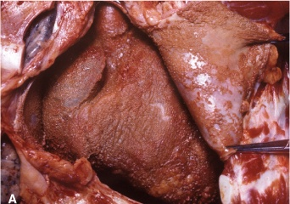
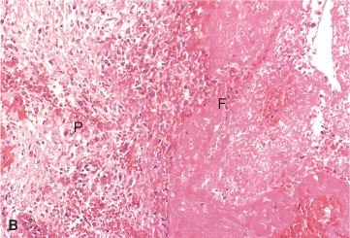
FIBRINOUS INFLAMMATION
2. Recognize the different patterns of inflammation.
A fibrinous exudate is characteristic of inflammation in the lining of body cavities, such as the meninges, pericardium and pleura (larger molecules such as fibrinogen pass the vascular barrier)
Fibrinous exudates may be removed by fibrinolysis,
if not: it may stimulate the ingrowth of granulation tissue (organization)

Slide 12
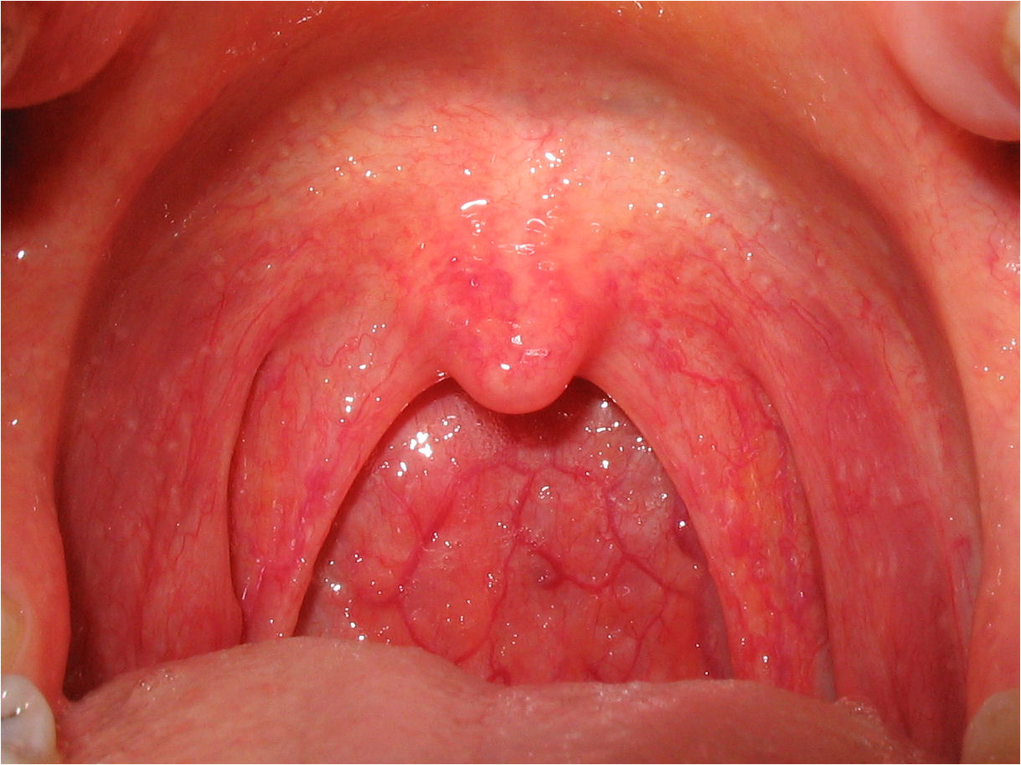
Catarrhal inflammation
2. Recognize the different patterns of inflammation.
Inflammation affects mucosa-lined surfaces with the outpouring of watery mucus

Slide 13
SUPPURATIVE OR PURULENT INFLAMMATION
2. Recognize the different patterns of inflammation.
characterized by the production of large amounts of pus or purulent exudate consisting of neutrophils, necrotic cells, and edema fluid caused by pyogenic (pus-producing) bacteria

Slide 14
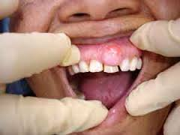
Suppurative abscess
2. Recognize the different patterns of inflammation.
An abscess is a cavity lined by granulation tissue and containing neutrophils, necrotic cells, bacteria and fibrinous material
An enclosed collection of pus consists of a mixture of neutrophils and necrotic debris

Slide 15
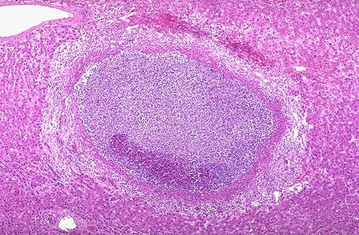
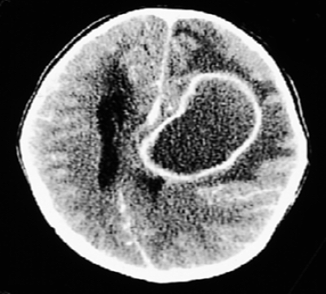
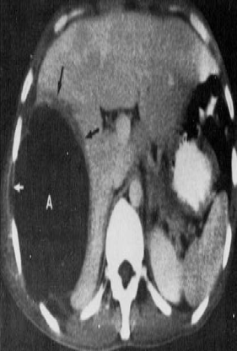
Morphologic Patterns of Acute Inflammation SUPPURATIVE OR PURULENT INFLAMMATION
2. Recognize the different patterns of inflammation.
Abscesses : A localized collections of purulent inflammatory tissue caused by suppuration buried in a tissue, an organ, or a confined space

Slide 16
2. Recognize the different patterns of inflammation.
ULCERS
An ulcer is a local defect of the surface of an organ or tissue that is produced by the sloughing (shedding) of inflammatory necrotic tissue
Epithelial Defect
Necrotic base
Fibrinopurulent exudates
Granulation tissue
Fibrosis

Slide 17
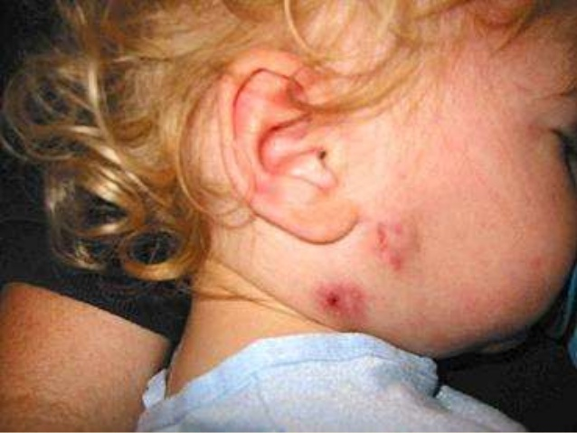
Sinus
2. Recognize the different patterns of inflammation.
A tract between the abscess and a surface.

Slide 18
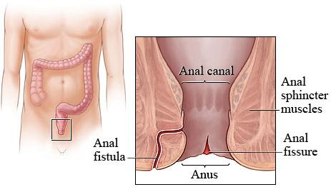
Fistula
2. Recognize the different patterns of inflammation.
A tract between two surfaces.

Slide 19
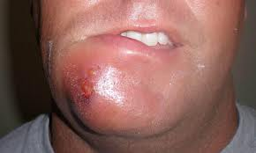
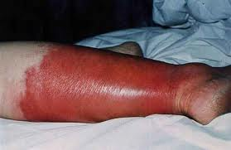
Cellulitis
2. Recognize the different patterns of inflammation.
denotes a spreading of acute inflammation through interstitial tissues.

Slide 20
Objectives
List and describe the outcome of acute inflammation.
Recognize the different patterns of inflammation.
Define chronic inflammation with emphasis on causes, nature of the inflammatory response, and tissue changes.
Compare and contrast the clinical settings in which different types of inflammatory cells (eosinophils, macrophages, and lymphocytes) accumulate in tissues.

Slide 21
CHRONIC INFLAMMATION
3. Define chronic inflammation, its causes, effects and patterns
It is slow evolving (weeks to months) resulting into fibrosis
The essential changes are:
Absence of polymorphs (natural life span of 1–3 days); replaced by macrophages, lymphocytes and often plasma cells
Continuous tissue injury and necrosis
Proliferation of vascular endothelium by ‘budding’ – formation of new capillaries (angiogenesis)
Proliferation of fibroblasts with collagen production leading to Fibrosis.

Slide 22
Chronic inflammation may arise in the following settings:
3. Define chronic inflammation, its causes, effects and patterns
Persistent infections by microbes that are difficult to eradicate.
e.g.
Mycobacterium tuberculosis
Treponema pallidum (the causative organism of syphilis)
certain viruses and fungi
Persistent infections elicit a T lymphocyte-mediated immune response called delayed-type hypersensitivity.

Slide 23
3. Define chronic inflammation, its causes, effects and patterns
2. Immune-mediated inflammatory diseases (hypersensitivity diseases- Autoimmune diseases)
e.g.
Rheumatoid arthritis
Inflammatory bowel disease
Psoriasis
or
Immune responses against common environmental substances that cause allergic diseases, such as bronchial asthma.

Slide 24
3. Define chronic inflammation, its causes, effects and patterns
3. Prolonged exposure to potentially toxic agents.
Examples are nondegradable exogenous materials such as inhaled particulate silica, which can induce a chronic inflammatory response in the lungs (silicosis)
Endogenous agents such as cholesterol crystals, which may contribute to atherosclerosis
Other examples:
neurodegenerative disorders such as Alzheimer disease
metabolic syndrome and the associated type 2 diabetes,
some forms of cancer in which inflammatory reactions promote tumor development

Slide 25
3. Define chronic inflammation, its causes, effects and patterns
Chronic inflammation is characterized by a 3 different set of reactions:
Infiltration with mononuclear cells, including:
Macrophages
Lymphocytes
Plasma cells
Tissue destruction, largely induced by the products of the inflammatory cells
Repair, involving new vessel proliferation (angiogenesis) and fibrosis
Acute inflammation is distinguished by vascular changes, edema, and a predominantly neutrophilic infiltrate

Slide 26
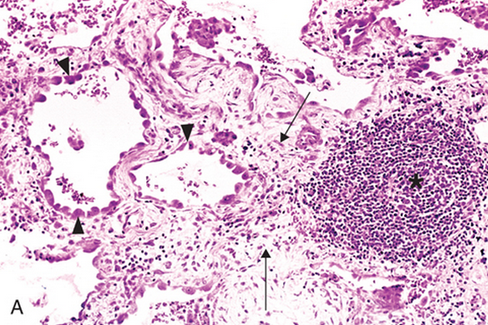
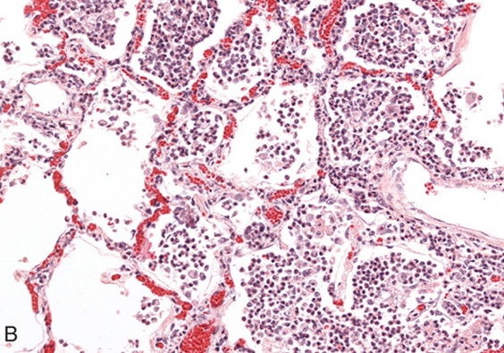
3. Define chronic inflammation, its causes, effects and patterns
Lung chronic inflammation
Lung acute inflammation

Slide 27
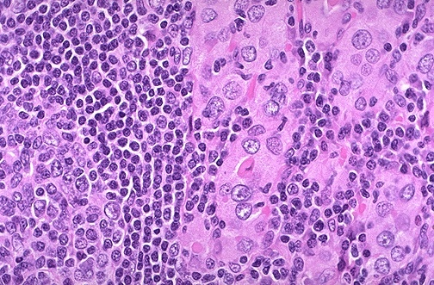
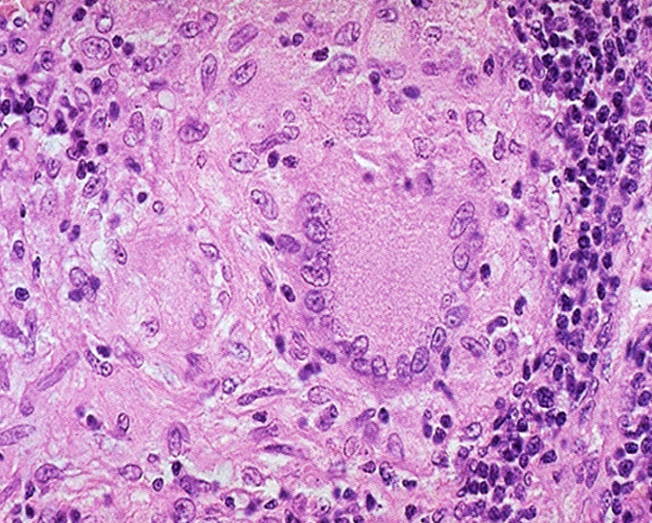
Chronic inflammation patterns
3. Define chronic inflammation, its causes, effects and patterns
Chronic non specific inflammation
Chronic granulomatous inflammation
Features of chronic inflammation e.g.:
Foreign material, e.g. silicates, including asbestos.
Auto-immune diseases, e.g. auto-immune thyroiditis
Chronic inflammation in which modified macrophages (epithelioid cells) accumulate in small clusters surrounded by lymphocytes. The small clusters are called: (GRANULOMAS)
Example: TUBERCULOSIS

Slide 28
Objectives
List and describe the outcome of acute inflammation.
Recognize the different patterns of inflammation.
Define chronic inflammation with emphasis on causes, nature of the inflammatory response, and tissue changes.
Compare and contrast the clinical settings in which different types of inflammatory cells (eosinophils, macrophages, and lymphocytes) accumulate in tissues.

Slide 29
Cells in Chronic inflammation
1. Define chronic inflammation, its causes, effects and patterns
4. Different types of inflammatory cells accumulate in tissues
Complex interactions between several cell populations and their secreted mediators.
Mediated by the interaction of monocyte/macrophages with T and B lymphocyte, plasma cells and others

Slide 30
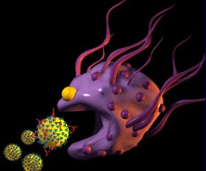
Macrophages
1. Define chronic inflammation, its causes, effects and patterns
4. Different types of inflammatory cells accumulate in tissues
In tissue:
the liver (Kupffer cells)
spleen and lymph nodes (sinus histiocytes)
central nervous system (microglial cells)
and lungs (alveolar macrophages)
In blood: monocytes
Under the influence of adhesion molecules and chemokines, they migrate to a site of injury within 24 to 48 hours after the onset of acute inflammation
(macrophages)
Monocytes are likely to be seen in an inflammatory response to salmonella typhi infection

Slide 31
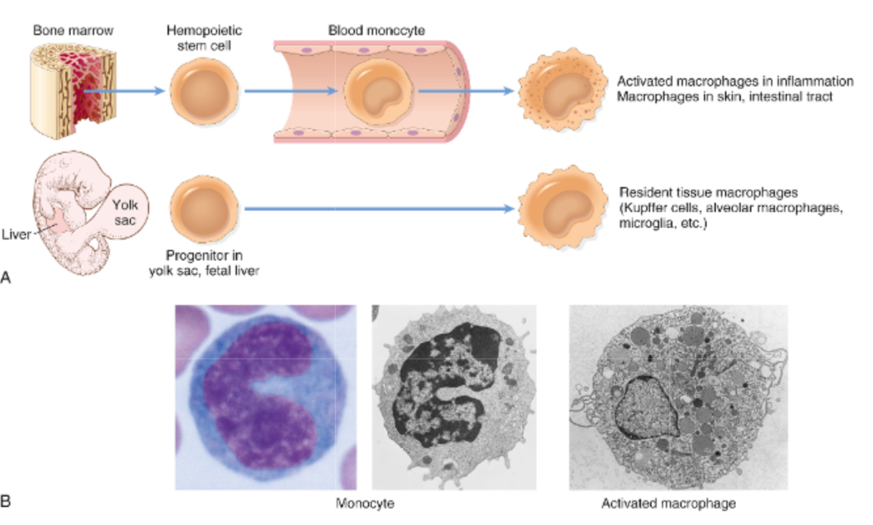
4. Different types of inflammatory cells accumulate in tissues
mononuclear phagocyte system
monocytes begin to emigrate into extravascular tissues quite early in acute inflammation and within 48 hours they may constitute the predominant cell type

Slide 32
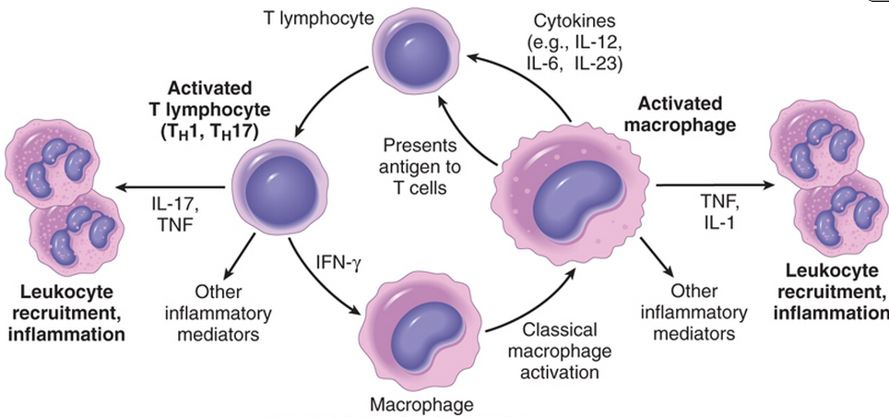
MONONUCLEAR CELL INFILTRATION Macrophages
1. Define chronic inflammation, its causes, effects and patterns
4. Different types of inflammatory cells accumulate in tissues
Macrophages may be activated by a variety of stimuli, including:
cytokines (e.g., IFN-γ) secreted by sensitized T lymphocytes and by NK cells
bacterial endotoxins

Slide 33
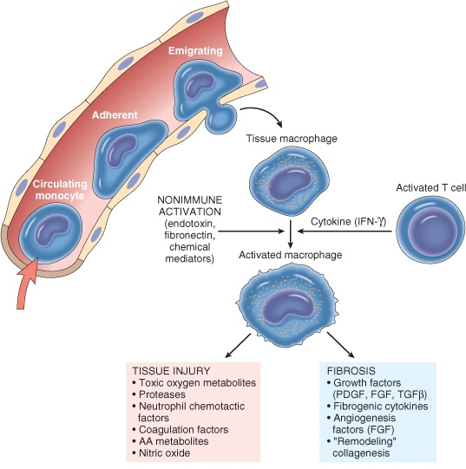
1. Define chronic inflammation, its causes, effects and patterns
4. Different types of inflammatory cells accumulate in tissues
The roles of activated macrophages in chronic inflammation
to eliminate injurious agents such as microbes
to initiate the process of repair
secrete mediators of inflammation, such as cytokines (TNF, IL-1, chemokines, and eicosanoids).
display antigens to T lymphocytes and respond to signals from T cells, thus setting up a feedback loop
It is responsible for much of the tissue injury in chronic inflammation

Slide 34
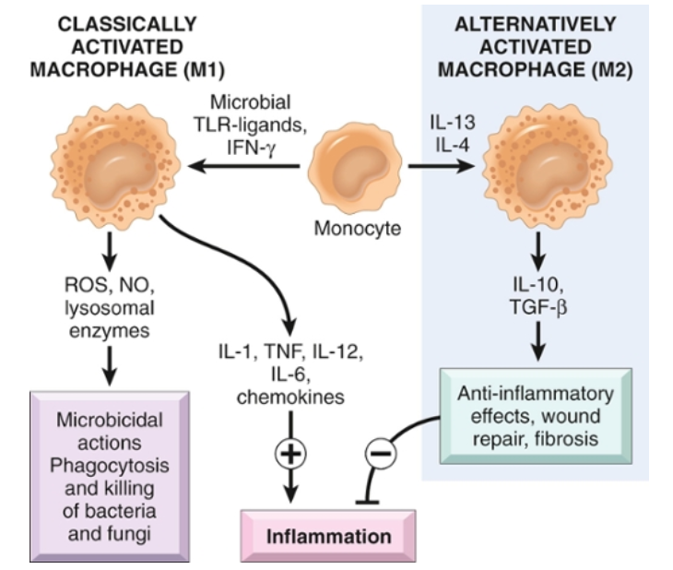

Slide 35
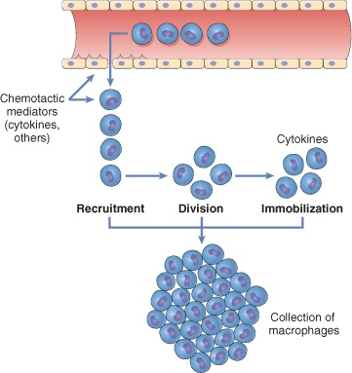
Macrophages/Monocytes
1. Define chronic inflammation, its causes, effects and patterns
4. Different types of inflammatory cells accumulate in tissues
In chronic inflammation, macrophage accumulation persists, this is mediated by different mechanisms:
Recruitment of monocytes from the circulation
Local proliferation of macrophages
Immobilization of macrophages
Collection of activated macrophages :
GRANULOMA

Slide 36
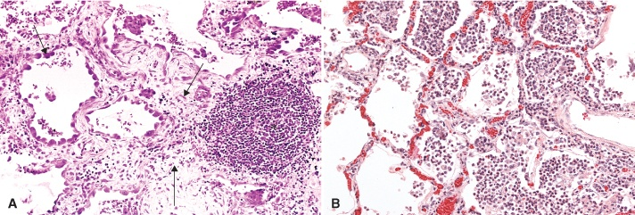
CELLS IN CHRONIC INFLAMMATION
1. Define chronic inflammation, its causes, effects and patterns
4. Different types of inflammatory cells accumulate in tissues
Lymphocytes
Both T & B Lymphocytes migrates into inflammation site
most commonly seen in tissue affected by chronic inflammation
Role: mediators of adaptive immunity, which provides defense against infectious pathogens

Slide 37
Lymphocytes
4. Different types of inflammatory cells accumulate in tissues
1. Define chronic inflammation, its causes, effects and patterns
T lymphocytes are activated to secrete cytokines:
CD4+ T lymphocytes promote inflammation and influence the nature of the inflammatory reaction

Slide 38
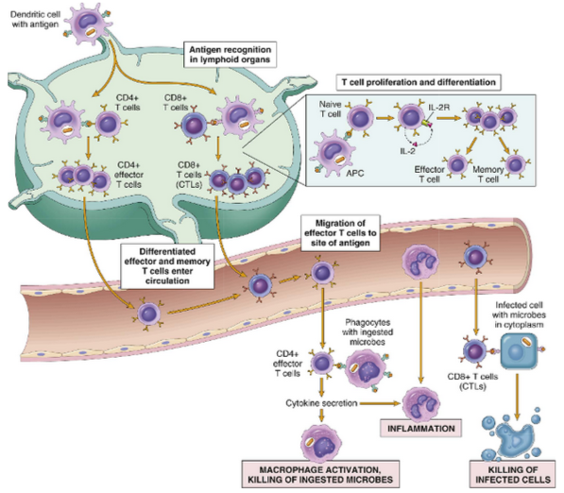
1. Define chronic inflammation, its causes, effects and patterns
4. Different types of inflammatory cells accumulate in tissues
Cell-mediated immunity

Slide 39
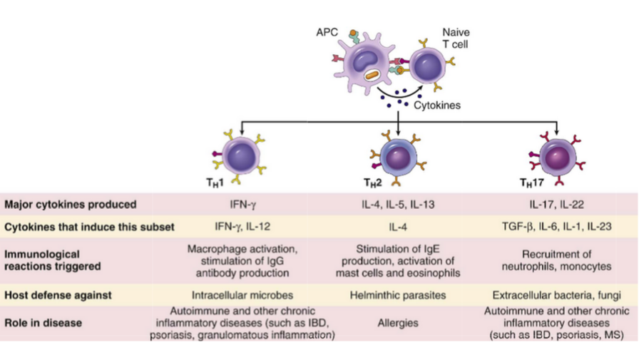
4. Different types of inflammatory cells accumulate in tissues
Subsets of helper T (TH) cells
In response to stimuli (mainly cytokines) present at the time of antigen recognition, naive CD4+ T cells may differentiate into populations of effector cells that produce distinct sets of cytokines and perform different functions.
IBD, inflammatory bowel disease
MS, multiple sclerosis

Slide 40
CD4+ helper T cells
4. Different types of inflammatory cells accumulate in tissues
There are three subsets of CD4+ helper T cells :
T_{H}1 cells produce the cytokine IFN-γ,
Function: activates macrophages in the classical pathway.
T_{H}2 cells secrete IL-4, IL-5, and IL-13
Function: recruit and activate eosinophils and are responsible for macrophage activation.
T_{H}17 cells secrete IL-17 and other cytokines
Function: induce the secretion of chemokines responsible for recruiting neutrophils and monocytes into the reaction.

Slide 41
1. Define chronic inflammation, its causes, effects and patterns
4. Different types of inflammatory cells accumulate in tissues
B lymphocytes
B lymphocytes may develop into plasma cells, which secrete antibodies (Humoral immunity)
Naive B lymphocytes recognize antigens, and under the influence of TH cells and other stimuli, the B cells are activated to proliferate and to differentiate into antibody-secreting plasma cells.

Slide 42
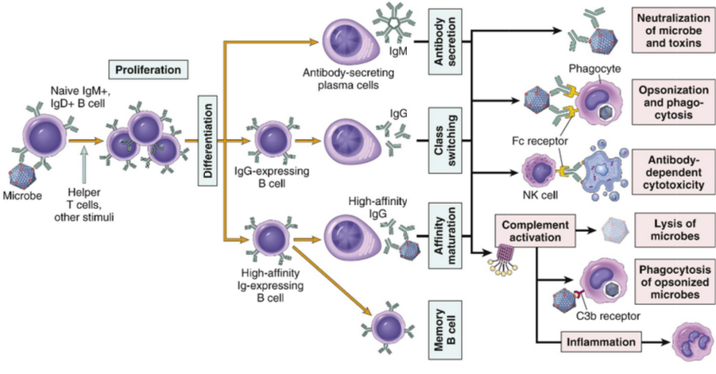
4. Different types of inflammatory cells accumulate in tissues
Humoral immunity

Slide 43
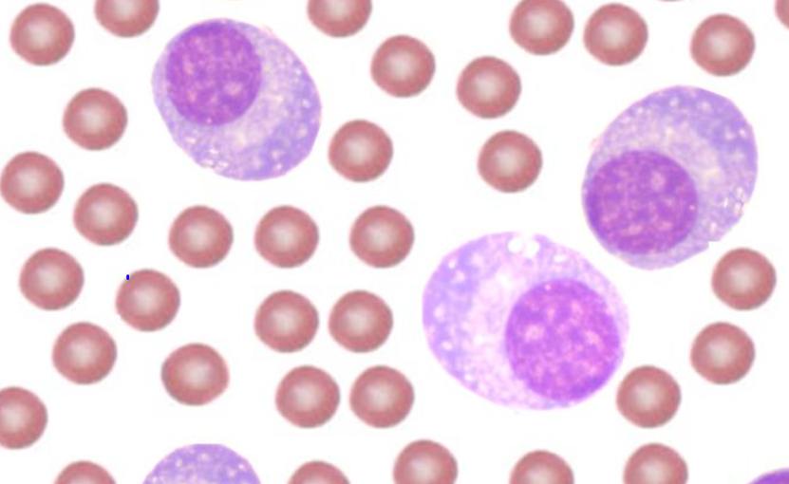
OTHER CELLS IN CHRONIC INFLAMMATION
4. Different types of inflammatory cells accumulate in tissues
Plasma cells
Lymphoid cell (Mature B cells)
Common cell in chronic inflammation
Primary source of antibodies
Antibodies are important in inflammation e.g. neutralize antigen and clearance of foreign antigen

Slide 44
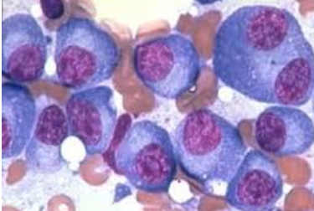
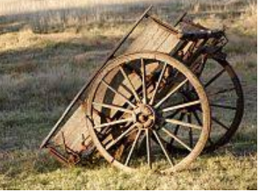
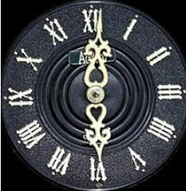
Plasma cells
Morphology of plasma cells:
Cells has an eccentric nucleus shows a cartwheel or clock face pattern of nuclear chromatin with a perinuclear halo

Slide 45
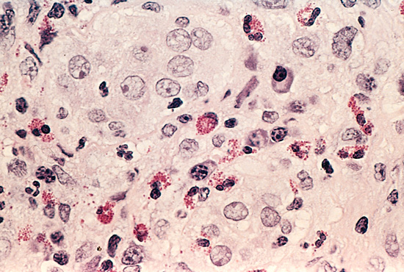
4. Different types of inflammatory cells accumulate in tissues
Eosinophils
are abundant in immune reactions mediated by IgE in allergic reaction and in parasitic infections
respond to chemotactic agents derived largely from mast cells
Granules contain major basic protein: toxic to parasites and lead to lysis of mammalian epithelial cells

Slide 46
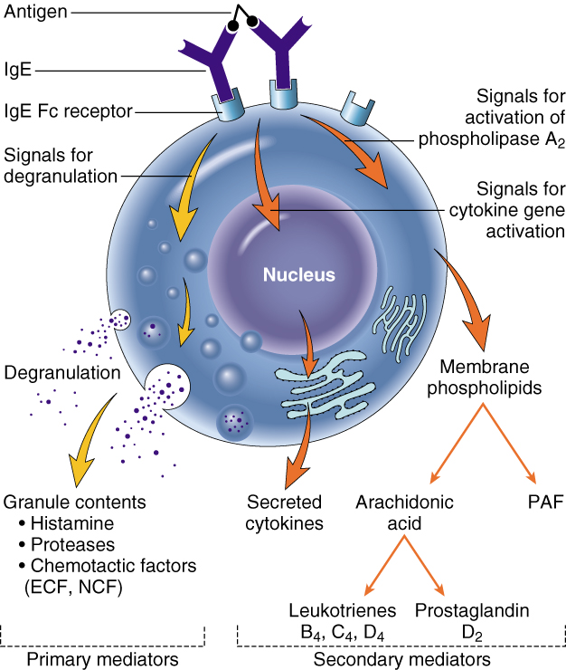
4. Different types of inflammatory cells accumulate in tissues
Mast cells
are widely distributed in connective tissues
express on their surface the receptor that binds the Fc portion of IgE antibody
the cells degranulate and release mediators, such as histamine and products of AA oxidation

Slide 47
Describe the outcome of acute inflammation.
Recognize the different patterns of inflammation.
Define chronic inflammation with emphasis on causes, nature of the inflammatory response, and tissue changes.
Compare and contrast the clinical settings in which different types of inflammatory cells (eosinophils, macrophages, and lymphocytes) accumulate in tissues.

