Slide 1
Granulomatous infection Practical
2018

Slide 2
Granulomatous/Tuberculous Lymphadenitis
Figure A. Enlargement of the upper deep cervical lymph glands caused by tuberculosis.

Slide 3
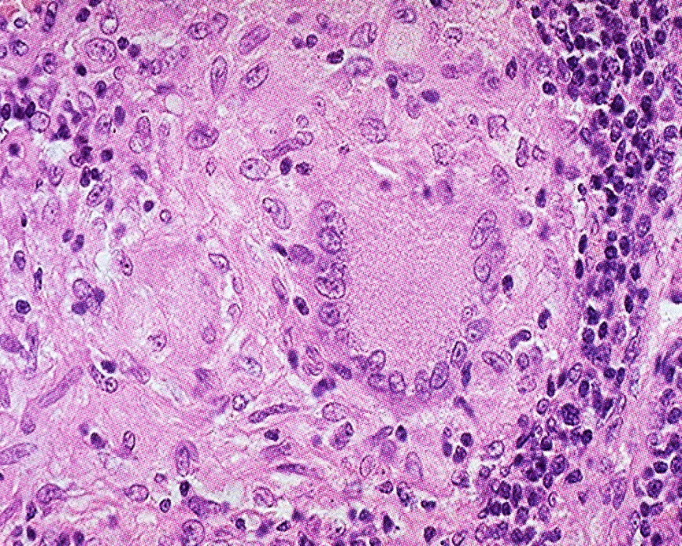
Granulomatous/Tuberculous Lymphadenitis
Non-caseating giant cell granuloma.
Notes:
Principal lesion seen in this picture is Non-caseating giant cell granuloma.

Slide 4
Granulomatous/Tuberculous Lymphadenitis
A granulomatous inflammatory response to tuberculosis includes mainly epithelioid cells, lymphocytes and fibroblasts.
The granuloma shows that the epithelioid -histiocytes are elongated with long, pale nuclei and pink cytoplasm.
The macrophages join together and form multinucleated cells called giant cells.
The typical giant cell for infectious granulomas is called a Langhans giant cell and has the nuclei lined up along one edge of the cell in a horse-shoe pattern

Slide 5
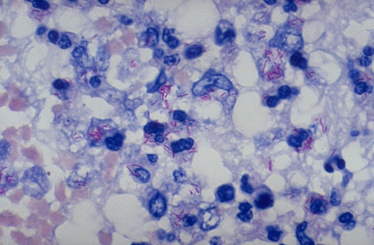
Ziehl-Neelsen stain to highlight/identify AFB
Notes:
Stain used in such cases in order to identify the causative organism: Ziehl-Neelsen stain.

Slide 6
Leishmaniasis

Slide 7
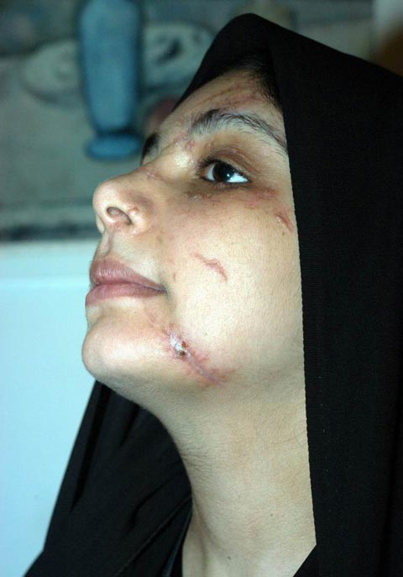
Mucocutaneous Leishmaniasis
Cutaneous Leishamaniasis presenting as a non-healing ulcerated and crusted lesion over the mandible in a 22-year-old Saudi female patient. Note the presence of a scarred area adjacent to the crusted lesion.
Mucocutaneous Leishmaniasis affecting both upper and lower lips of this patient.
Note the presence of ulcerated lesions.

Slide 8
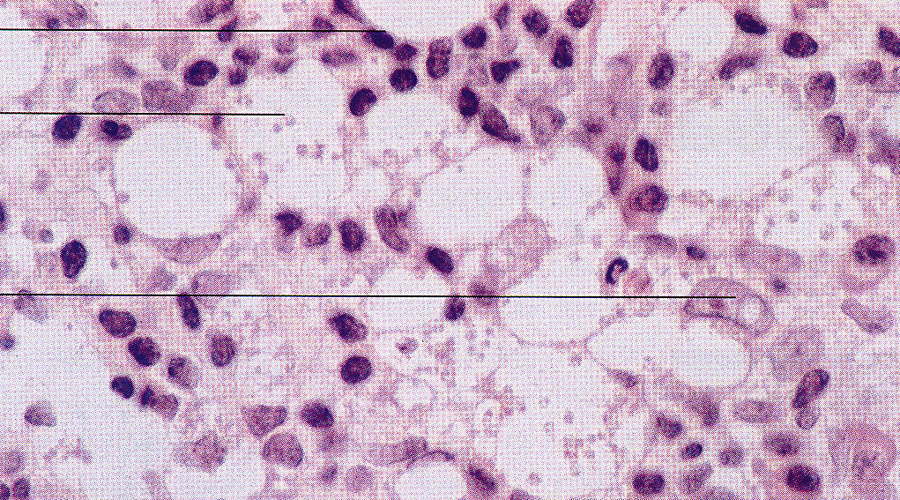
Mucocutaneous Leishmaniasis
Lymphocyte
Leishman Donovan bodies
Macrophage
Figure C. Histopathological features of Cutaneous Leishmaniasis (high mag.).
Note the presence of numerous Leishman-Donovan bodies within the foamy macrophages.

Slide 9
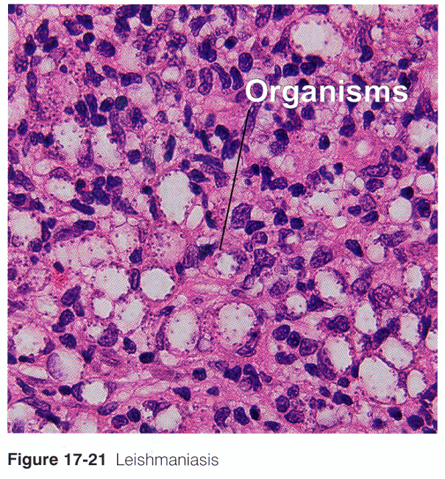
Mucocutaneous Leishmaniasis
Figure D. Leishmaniasis.
Numerous macrophages containing Leishman-Donovan bodies. Note the presence of many lymphocytes.

Slide 10
Actinomycosis

Slide 11
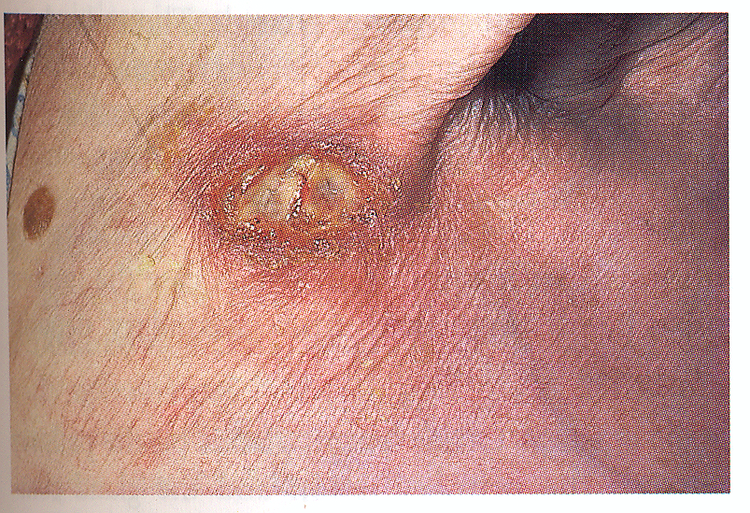
Cervical Actinomycosis
Figure A. An infected sinus in the axilla of a patient with actinomycosis.
He had similar lesions on the lateral side of his neck. Note the presence of silver yellowish granules near the opening of the sinus and adjacent ulcerated area.

Slide 12
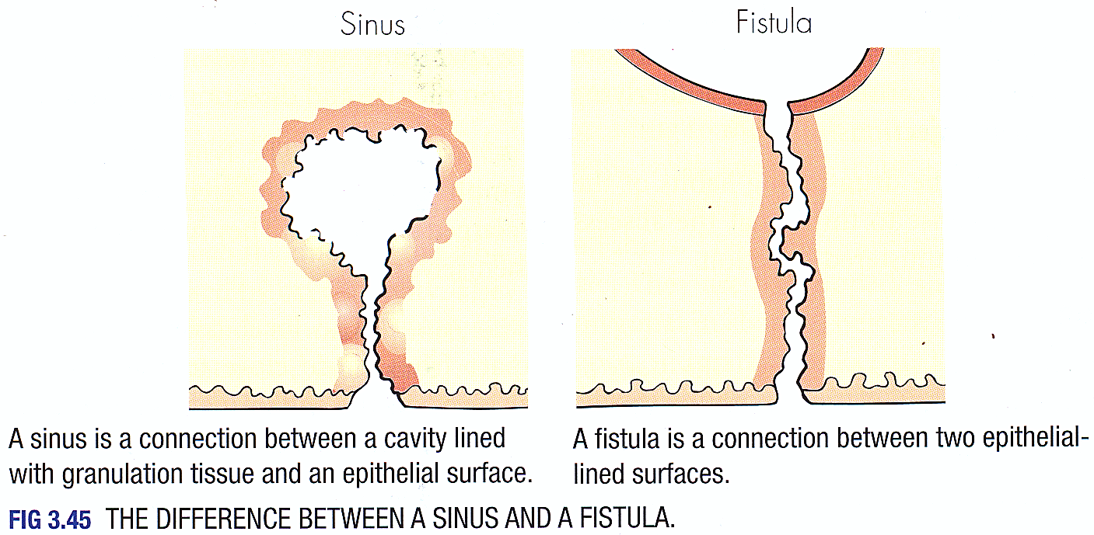
Cervical Actinomycosis

Slide 13
Cervical Actinomycosis
Figure C. Actinomycosis organism stained with gram stain.
Note the filamentous structures at the periphery of the actinomycosis organisms.

