Slide 1





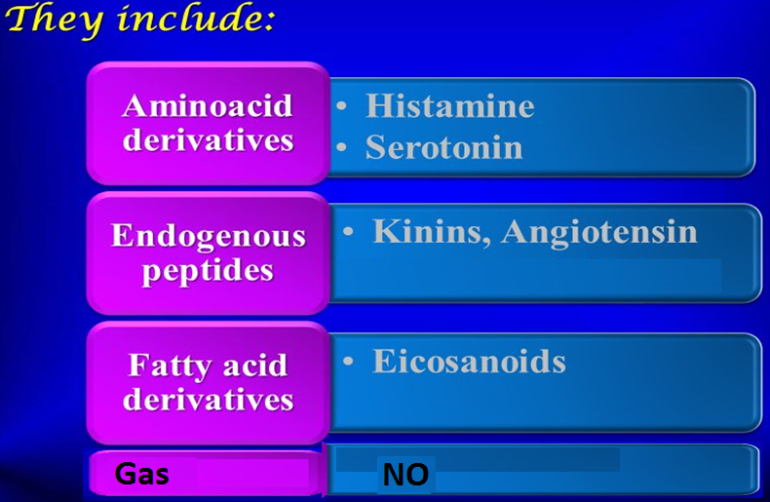
Autacoids
WINTER
Self remedy
They have autocrine or paracrine effects
Template
Produced locally, act locally & metabolized locally
Paracrine
Have different biological actions including modulation of the activity of smooth muscles, glands, nerves, platelets & other tissues.
Autocrine

Slide 2
Autacoids
WINTER
ILOS
Template
To describe the synthesis, receptors & functions of histamine, 5-HT, eicosanoids, nitric oxide, angiotensin, & kinins
To study the agents which enhance or block their effects.

Slide 3
1- Histamine

Slide 4
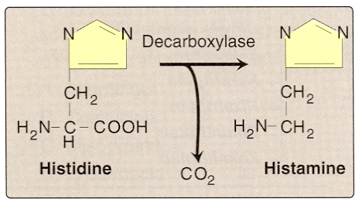
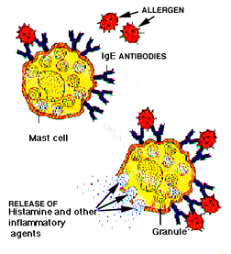
Histamine
Synthesis:- from L- histidine
Stored in mast cells, basophils, lung, intestinal mucosa
Release:- during allergic reaction, inflammatory reaction

Slide 5
Histamine receptors
Receptor Type | Major Tissue Locations | Major Biologic Effects
H₁ | Smooth muscle, Endothelial cells, Brain | Acute allergic responses
H₂ | Gastric parietal cells, Cardiac muscle, Mast cells, Brain | Secretion of gastric acid & increase in *COP
H₃ | Central nervous system | Neurotransmission
H₄ | Mast cells, Eosinophils, T-cells | Regulating immune responses
* COP: cardiac output

Slide 6
Actions
Histamine stimulates gastric acid secretion, through H2- receptors
Stimulation of H1-receptors contract smooth muscles, bronchioles, uterus
Increases bowel peristalsis

Slide 7
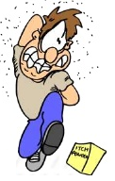
Actions of histamine
Slow IV or SC injection causes flushing of skin, raise temperature, edema, increase blood flow to the periphery, increase heart rate & COP (through increasing Ca²⁺ influx)
Rapid IV bolus injection induces a fall in blood pressure, an increase in CSF pressure, headache, due to dilation of blood vessels
Intradermal injection causes itching.

Slide 8
Histamine receptor blockers
WINTER
Physiological antagonist: epinephrine
Template
Histamine h1 receptor antagonists :
First generation
Diphenhydramine, Promethazine
Second generation
Cetirizine, Fexofenadine.

Slide 9

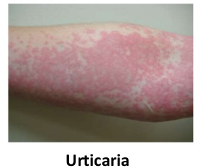

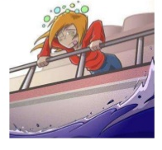
Histamine H1 receptor blockers
First generation
Has a sedating effect
Clinical uses:
Allergic rhinitis
Urticaria
Insomnia
Motion sickness

Slide 10
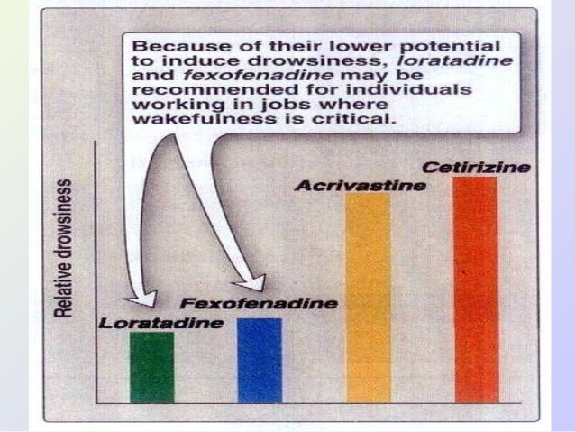
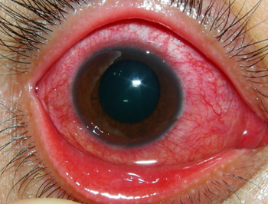
Histamine H1 receptor blockers
Second generation
Non-sedating effect
Clinical uses
Allergic conditions such as:-
Allergic rhinitis
Conjunctivitis
Urticaria.

Slide 11
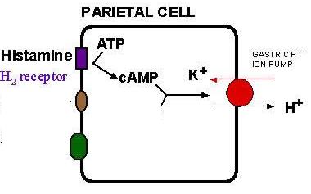
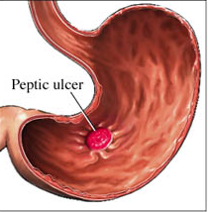
H2- receptor blockers
Histamine plays an important role in the formation & secretion of HCl by the activity of H2 receptors
Blockers of H2 receptors inhibit gastric acid secretion
e.g. Cimetidine
Used for treatment of:
Gastritis
Peptic ulcers

Slide 12

H3- receptor blockers
e.g. Betahistine
It produces dilatation of blood vessels in inner ear
Used in treatment of :
Vertigo of Ménière’s disease & other balance disturbances of vestibular origin
Side effects:
May produce headache & insomnia.

Slide 13
2- Eicosanoids

Slide 14
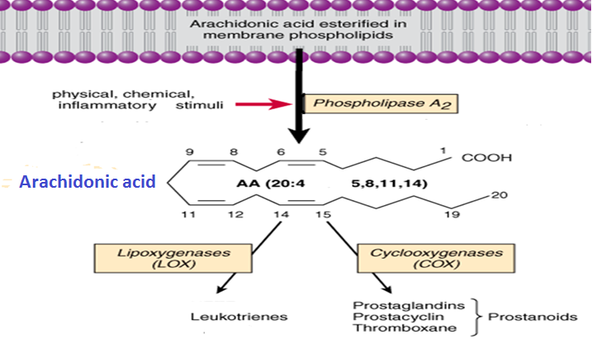
eicosanoids
WINTER
NSAIDS
synthesis
Glucocorticoids
Zileuton
Template

Slide 15
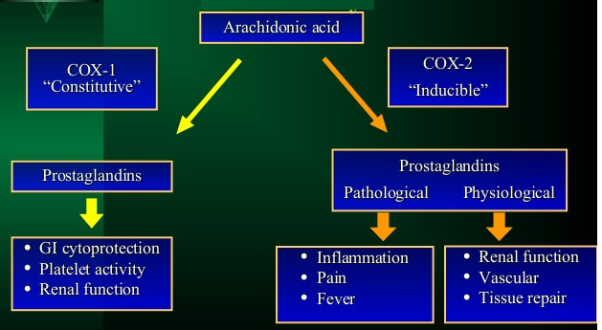
Cox Isozymes

Slide 16
Actions of prostaglandins
They are pro-inflammatory
Cause vasodilatation of vascular smooth muscle
Inhibition of platelets aggregation (high PG conc) / increase platelet aggregation (low PG conc)
Sensitize neurons to cause pain
Induce labor.

Slide 17
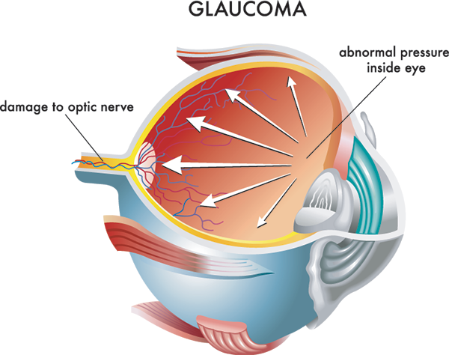
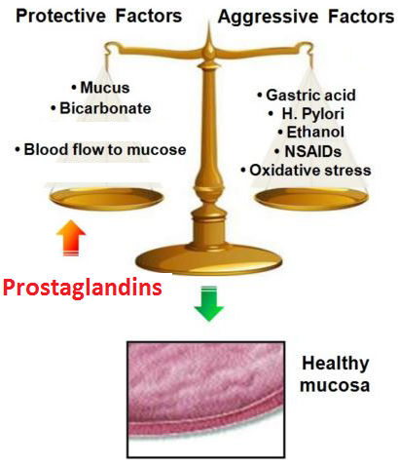
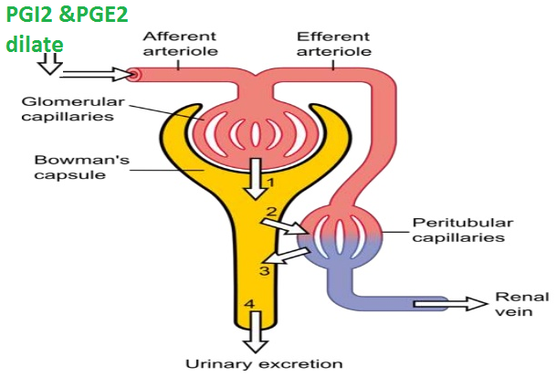
Actions of prostaglandins
Decrease intraocular pressure
Acts on thermoregulatory center of
hypothalamus to ↑ body temperature
Acts on kidney to increase glomerular filtration
Acts on parietal cells of stomach to protect gastric mucosa.

Slide 18
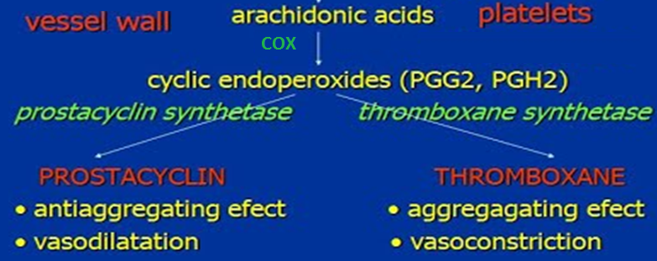
Prostacyclin versus thromboxane

Slide 19
Clinical uses of PGs analogs
WINTER
Carboprost (PGF): Induce abortion in first trimester
Template
Latanoprost (PGF): Glaucoma
Misoprostol (PGE1): Peptic ulcer
Alprostadil (PGE1): Erectile dysfunction
Zileuton (lipoxygenase inhibitor): Asthma
Zafirlukast (leukotriene receptor blocker): Bronchial asthma.

Slide 20
3- Nitric oxide

Slide 21
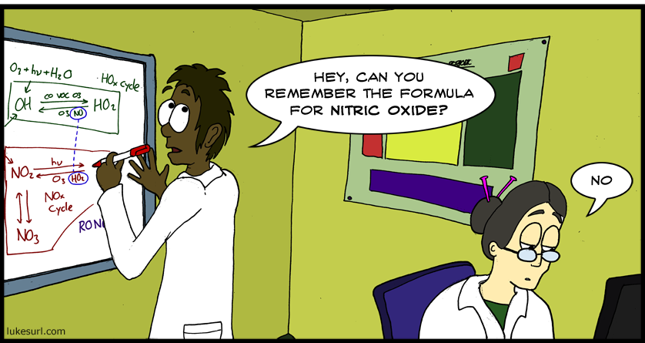
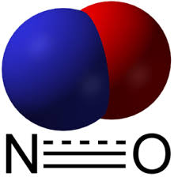
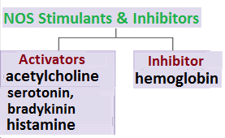
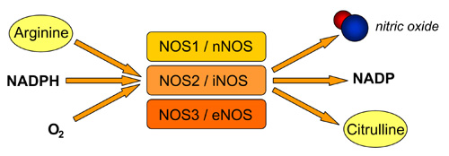
Nitric oxide
Biosynthesis
Synthesized from L- arganine by nitric oxide synthase (NOS)
NO release is stimulated by:
acetylcholine, 5-HT bradykinin & histamine
There are 3 isoforms of the enzyme NOS.

Slide 22
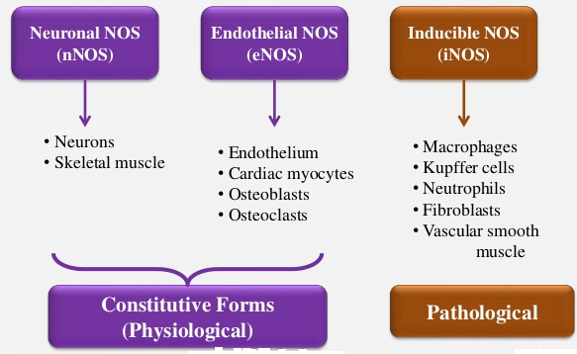
Isoforms of nos

Slide 23
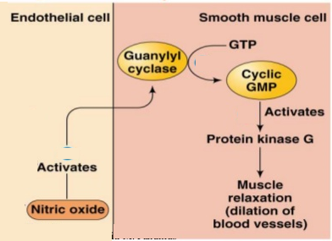
NO Mechanism of Action
Combining with haem in guanylate cyclase, activating the enzyme, increasing cGMP & thereby lowering [Ca²⁺]_{i}
Ca²⁺

Slide 24
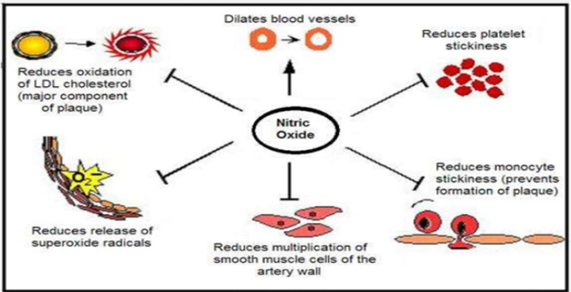
Actions of NO
Inhibition of platelet & monocyte adhesion & aggregation
Inhibition of smooth muscle proliferation
Protection against atherogenesis
Synaptic effects in the peripheral & CNS
Host defense & cytotoxic effects on pathogens
Cytoprotection

Slide 25
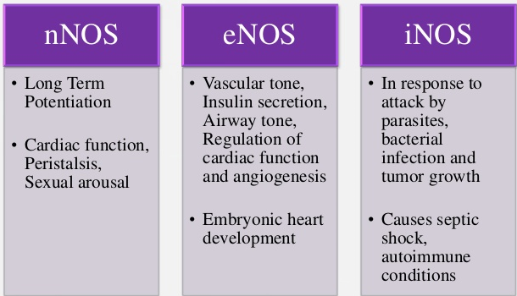
Actions of nos
WINTER
Template
Notes:
nNOS in nerve terminals, in neurons of most organs
NO is considered as a co-transmitter mediator especially for the para-sympathetic postganglionic neurons. Muscarinic agonist release NO from the EC
NO itself can be used therapeutically. Inhalation of NO results in reduced pulmonary artery pressure & improved perfusion of ventilated areas of the lung. Inhaled NO is used for pulmonary hypertension, acute hypoxemia, & CPR, & there is evidence of short-term improvements in pulmonary function. Inhaled NO is stored as a compressed gas mixture with nitrogen, which does not readily react with NO, & further diluted to the desired concentration upon administration. NO can react with O2 to form nitrogen dioxide, a pulmonary irritant that can cause deterioration of lung function.

Slide 26
No in therapeutics
Endothelial NO production is reduced in patients with diabetes, hypertension & atherosclerosis
Overproduction of NO occurs in neurodegenerative diseases (e.g. Parkinsonism) & in septic shock
NO donors have well established therapeutic uses e.g. in hypertension & angina pectoris
NO is used in critical care to treat pulmonary hypertension in neonates
NO is used in patients with right ventricular failure secondary to pulmonary embolism
Sildenafil potentiates the action of NO on corpora cavernosa smooth muscle.
It is used to treat erectile dysfunction.

Slide 27
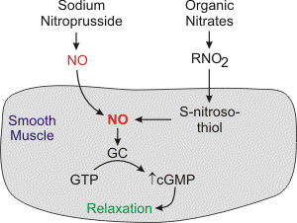
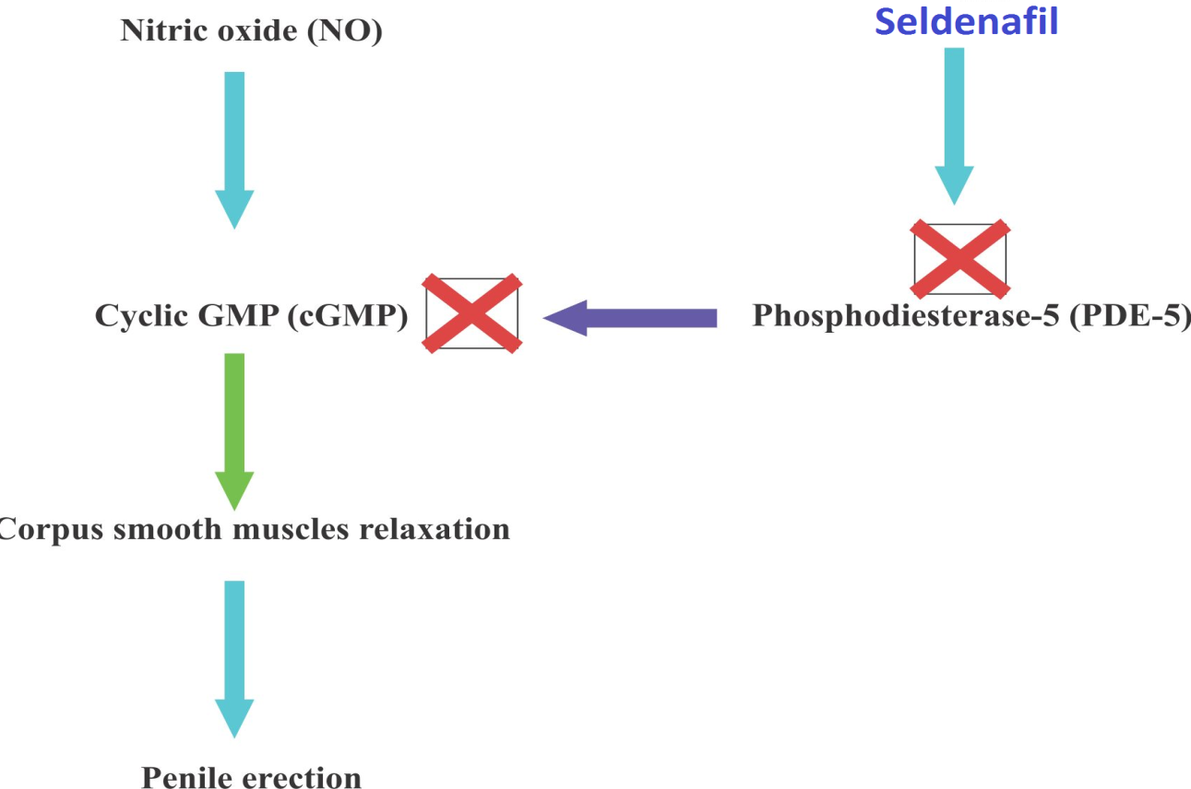

Slide 28
4- Angiotensin
Notes:
Part II

Slide 29
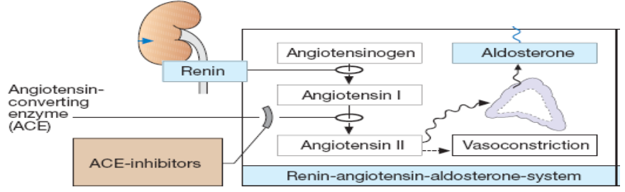
angiotensin
Biosynthesis
Renin released from the kidney converts angiotensinogen to Ag I
ACE converts Ag I to Ag II

Slide 30
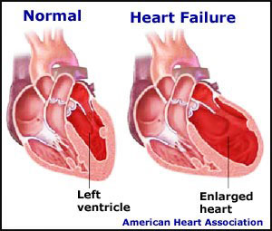
Actions of angiotensin II
Promotes vasoconstriction directly or indirectly by releasing NA & AD
Increases force of contraction of the heart by promoting Ca²⁺ influx
Increases aldosterone release → sodium & water retention
Causes hypertrophy of vascular & cardiac cells & increases synthesis & deposition of collagen by cardiac fibroblasts (remodeling).

Slide 31
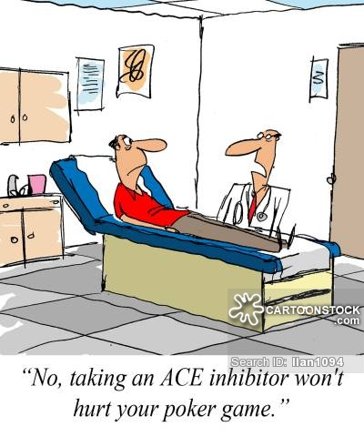
Angiotensin inhibitors
ACE inhibitors: e.g. Captopril
Angiotensin receptor blockers (ARBs): e.g. Losartan.

Slide 32
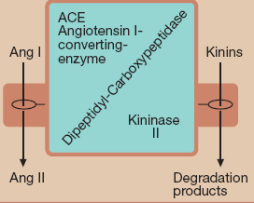
ACE inhibitors
WINTER
Cause a fall in blood pressure in hypertensive patients especially those with high rennin levels
Template
Clinical uses:
Hypertension
Cardiac failure
Following myocardial infarction.

Slide 33
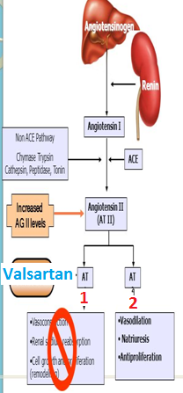
Angiotensin receptor blockers
Angiotensin receptors AT₁ & AT₂
AT₁ receptors predominate in vascular smooth muscle, mediate most of the known actions of Ang, coupled to G proteins & DAG
Similar uses to ACEI

Slide 34
5- Kinins

Slide 35
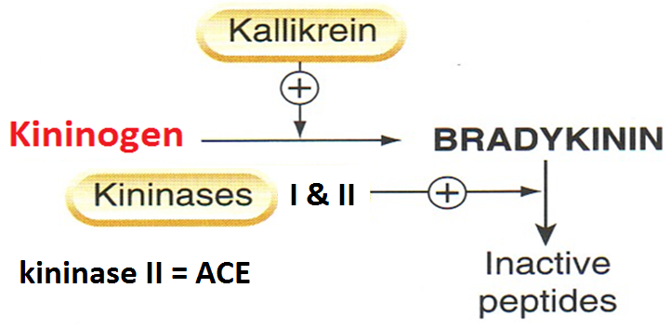
kinins
Are Bradykinin & kallidin
Bradykinin is formed by proteolytic cleavage of circulating proteins (kininogens)

Slide 36
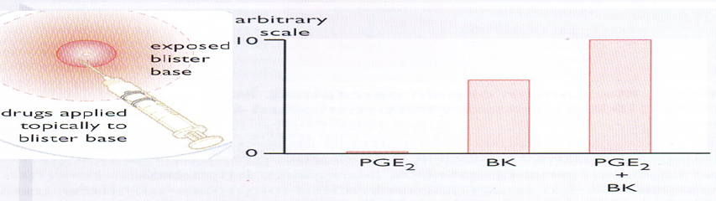
Actions of bradykinin
Causes pain, this effect is potentiated by PG. Has a role in inflammation
  Potent vasodilator, reduces blood pressure
If injected locally it dilates arterioles [→generation of PGI, release of NO] & increases permeability of post capillary venules
Constricts most smooth muscles, intestine, uterus bronchiole, contraction is slow & last long
Stimulation of epithelial ion transport & fluid secretion in airways & GIT.

Slide 37
Receptors & clinical uses
  Receptors B1 & B2 (both are G protein-coupled receptors)
  B1 inducible under condition of inflammation
  B1 receptor has low affinity to bradykinin
  plays a significant role in inflammation & hyperalgesia
  B2 constitutive
  High affinity to bradykinin & mediates the majority of its effects.

Slide 38
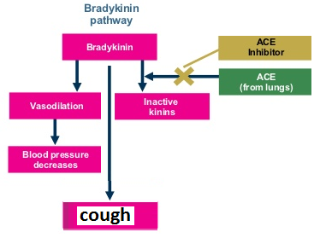
Therapeutic uses
WINTER
Template
  No current therapeutic use of bradykinin
  Increased bradykinin is implicated in the therapeutic efficacy & cough produced by ACEIs.

Slide 39
6- Serotonin

Slide 40
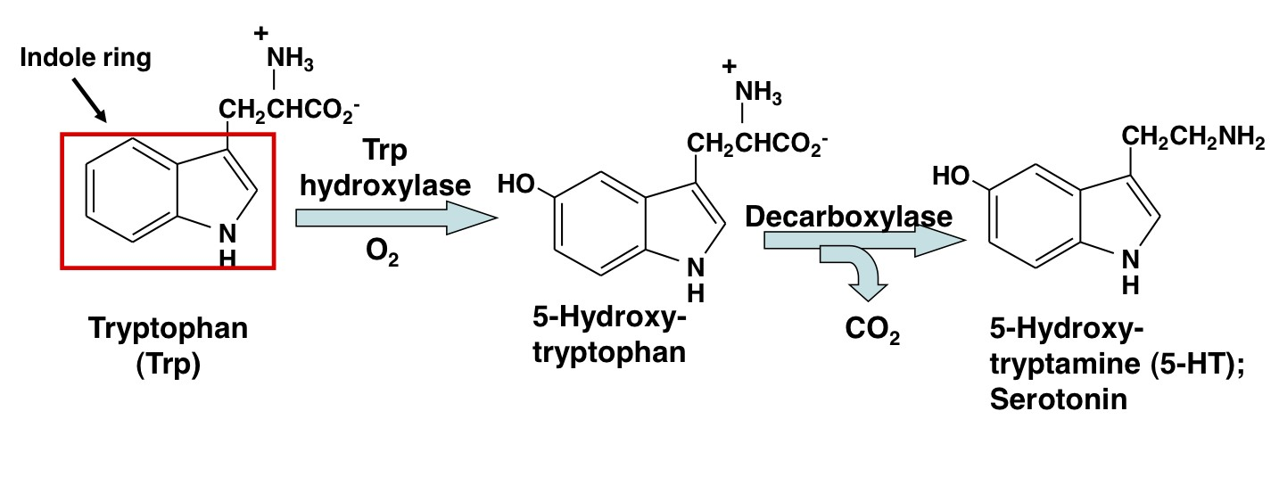
Serotonin [5ht]
Serotonin is synthesized from the amino acid L-tryptophan

Slide 41
Serotonin [5-ht]
distribution
1] Intestinal wall: in chromaffin cells, in neuronal cells in the myenteric plexus
2] Blood, in platelets, released when aggregated, in sites of tissue damage
3] CNS: a neurotransmitter, in midbrain

Slide 42
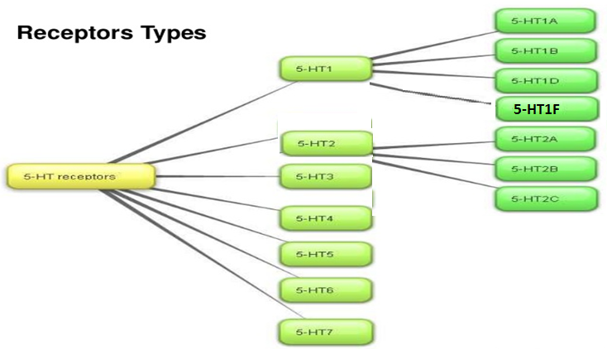
5-ht
receptors

Slide 43
Actions of 5-ht
GIT: 5-HT increases motility
Contracts uterus, bronchiole, other smooth muscles
Blood vessels:-
Contracts large vessels by a direct action & relaxes other vessels by releasing NO
Increases capillary pressure & permeability.

Slide 44
5-ht actions
WINTER
Platelets:- causes aggregation, aggregated platelets release 5-HT
Template
Neuronal terminals: 5-HT stimulates nociceptive neuron endings → pain
CNS;-stimulates some neurons & inhibits others, inhibits release of other neurotransmitters.

Slide 45

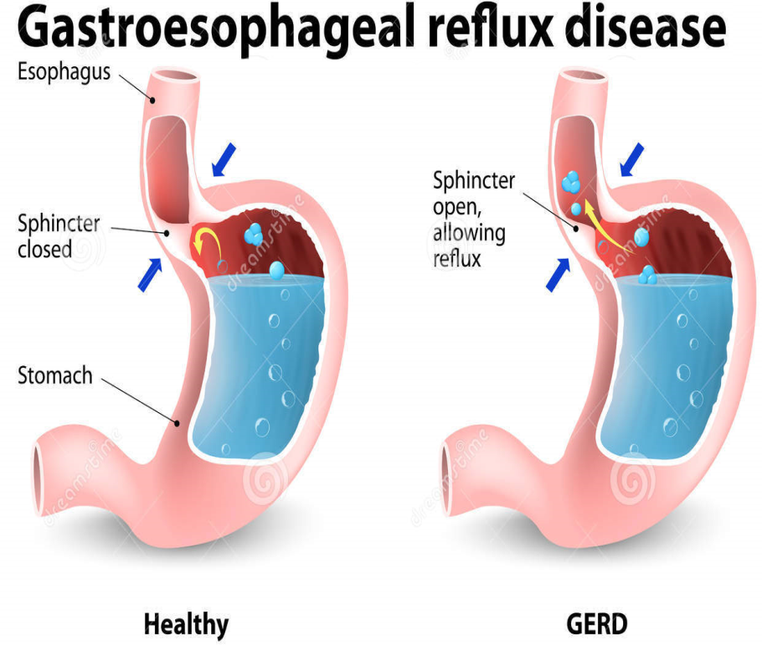
5-ht receptor agonists
Buspirone:- 5-HT1A agonist, effective anxiolytic
Cisapride:-
5-HT4 -receptor agonist, used in gastroesophageal reflux & motility disorders.

Slide 46
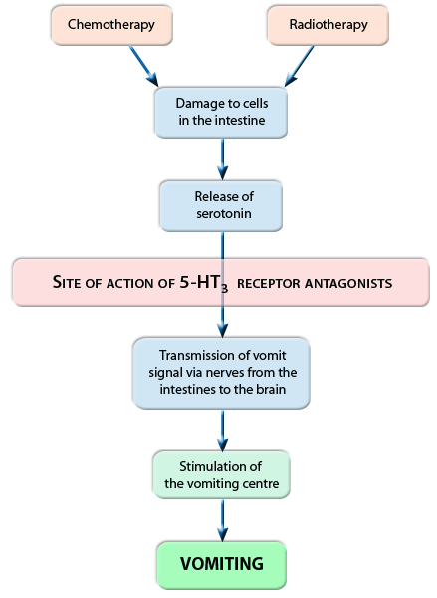

5-ht receptor antagonists
Selective 5-HT3 antagonist, Ondansetron, antiemetic action, for cancer chemotherapy

Slide 47
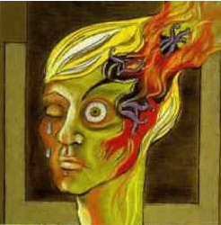
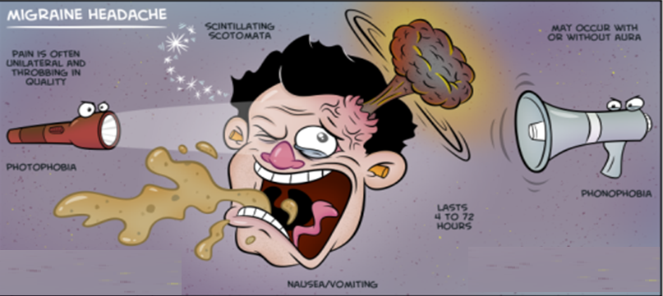
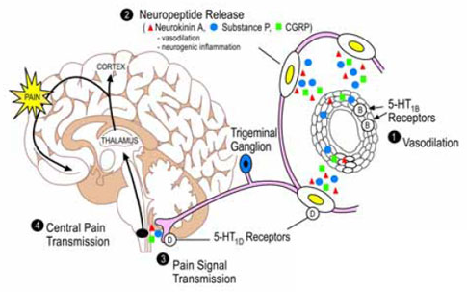
Clinical conditions in which 5-ht is implicated
1-migraine
Activation of trigeminal system leads to vasodilator peptides release promoting an inflammatory reaction
This increases flow of sensory traffic through the brain stem, the thalamus & the cortex.

Slide 48
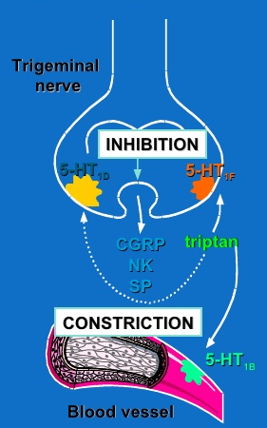
sumatriptan
5-HT 1B, 1D & 1F-receptor agonists, effective in acute migraine attack
It binds to 5HT1B, in cranial blood vessels causing vasoconstriction & 1D & 1F in presynaptic trigeminal nerve causing inhibition of pro- inflammatory neuropeptide release.

Slide 49
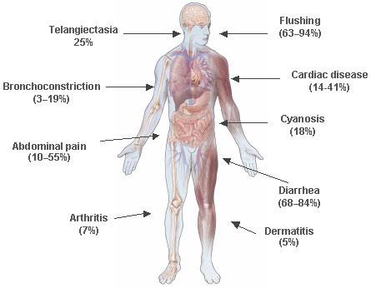
2- Carcinoid syndrome
A malignant tumor of intestinal chromaffin cells
The tumor releases 5-HT, SP, PGs, kinins & histamine causing flushing, diarrhea, bronchoconstriction & hypotension
Serotonin antagonists (cyproheptadine, 5HT2 antagonist) could be administered to control diarrhea, flushing & malabsorption.

