Slide 1
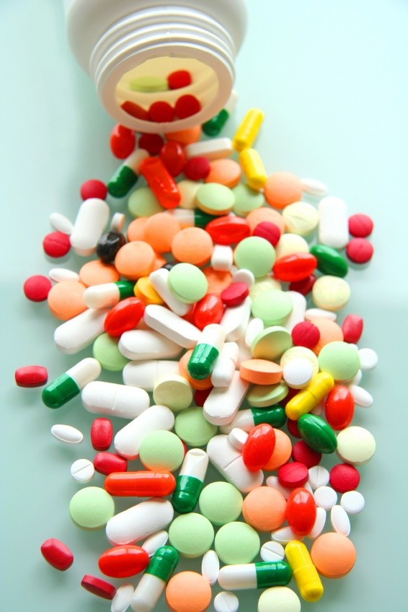
Tolerance and
Adverse drug reactions
Prof. Yieldez Bassiouni

Slide 2
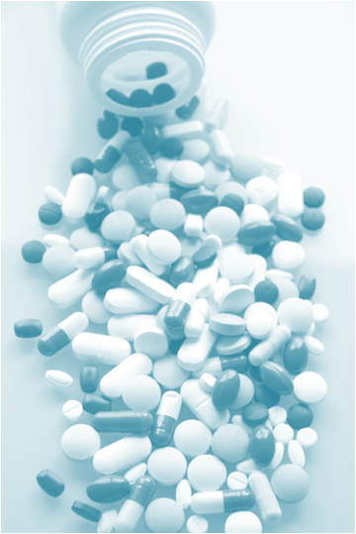
Variation in drug responsiveness
Decrease in drug effects
Development of side effects
Between different individuals
Within the same individual

Slide 3
Phenomenon of variation in drug response, where by there is a diminution of the response to the drug when given continuously or repeatedly
Tolerance and Desensitization

Slide 4
Adverse drug reactions [ADR]
Harmful or seriously unpleasant effects occurring at doses intended for therapeutic effects.

Slide 5
ilos
By the end of this lecture you will be able to :
Distinguish difference between tolerance and desensitization (tachyphylaxis) and reasons for their development
Recognize patterns of adverse drug reactions (ADRs)

Slide 6
Tolerance and Desensitization

Slide 7
Diminution of a response
Rapid, in the course of few minutes
Gradual in the course of few days to weeks
Tachyphylaxis / Desensitization
Tolerance
These should be distinguished from
Loss of effectiveness of antimicrobial agent
Resistance

Slide 8
Tolerance
Tolerance may be defined by either of the following:
a. a need for markedly increased amounts of the substance to achieve intoxication or desired effect
b. markedly diminished effect with continued use of the same amount of the substance

Slide 9
Reasons for development of tolerance
Pre-receptor events
Events at receptors
Post receptor events
↓ drug availability at the relevant receptors due to pharmaco- kinetic variables
Nullification of drug response by a physiological adaptive homeostatic response
Drug becomes:
> metabolized or excreted
< absorbed
altered distribution to tissues
Antihypertensive effects of ACEIs become nullified by activation of renin angiotensin system (RAS) by NSAIDs
e.g. Barbiturates (enzyme inducers) metabolism of Contraceptive pills =  it availability
Loss of therapeutic efficacy
Refractoriness

Slide 10
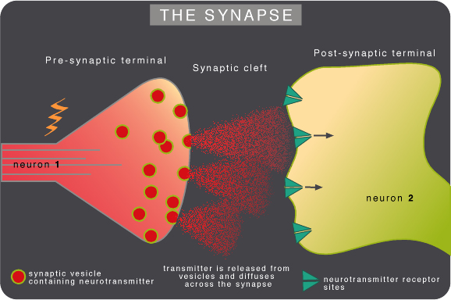
Notes:
A membrane action potential arriving at the terminal opens axonal Ca channels; Ca inflow releases neurotransmitter molecules from many vesicles by fusing the vesicle membranes to the nerve terminal membrane. Membrane fusion generates an opening through which the molecules are expelled into the synaptic cleft via exocytosis

Slide 11
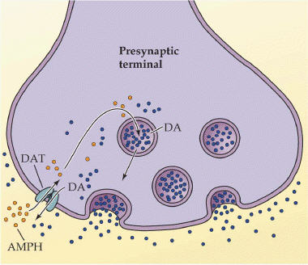
REASONS FOR DEVELOPMENT OF TOLERANCE
Pre- receptor events
Events at receptors
Post-receptors events
Binding alteration
Down regulation
Exhaustion of mediators
Depletion of mediator stores by amphetamine
Phosphorylation of R by ß-adrenoceptors → ↓ activation of AC to related ionic channel [functional defect]
↓ number of receptors.
Isoprenaline activation to β receptors →↑ R recycling by endocytosis [structural defect]
DOWN REGULATION
BINDING ALTERATION
Notes:
Isoprenaline is a non-selective beta-adrenergic agonist
G protein-coupled receptor kinases (GRKs) : regulate the activity of GPCRs by phosphorylating their intracellular
Arrestin is a protein that prevent the re-association of the G proteins with their receptors, thereby preventing reactivation of the signaling pathway.

Slide 13
Adverse drug reactions [ADR]
Harmful or seriously unpleasant effects occurring at doses intended for therapeutic effects.

Slide 14
Types of ADR
Type A
Type C
Type E
Augmented
Continuous
End-of-Use
Predictable
Occurs during chronic drug administration
Occurs upon sudden stoppage of chronic drug use due to existing adaptive changes present
Occurs consequent but in excess of drug primary pharmacological effect.
Of quantitative nature
Type B
Type D
Bizarre
Delayed
Unpedictable
Occurs after long period of time even after drug stoppage
Occurs different [heterogenous / idiosyncratic ] to known drug pharmacological effect usually due to patient’s genetic defect or immunological response.
Of qualitative nature

Slide 15
TYPES OF ADR
Type C
Continuous
End-of-Use
Type E
e.g. Patients can develop
1. Osteoporosis secondary to chronic corticosteroid intake
2. Dependence
a. Psychological [Craving] as by cannabis
b. Psychological [Craving] + Physical withdrawal manifestations (syndrome) = Addiction as by morphine
e.g. Patients on stoppage of - Clonidine develop rebound hypertension
Morphine develop withdrawal syndrome
Type D
Delayed
Long after patients can show:
Teratogenicity after retinoids
Carcinogenicity after tobacco smoking
Notes:
Clonidine belongs to a class of drugs (central alpha agonists) that act in the brain to lower blood pressure.

Slide 16
Comparison between type A & B -ADRs
 | Type A Augmentation | Type B Idiosyncratic
Pharmacological predictability | Yes | No
Nature | Quantitative [ extension of pharmacology effect ] | Qualitative [ immune or genetic base]
Dose- dependent | Yes (dose response relationship present) | No (dose response relationship absent)
Onset of symptoms | Usually Rapid | Usually delayed
Mortality | Low | High
Treatment | Dose adjustment or Substitute by > selective + Antagonize unwanted effect of 1st drug | Stop drug + Symptomatic treatment
Example | Bradycardia β- ADR Blockers Hemorrhage Warfarin | Apnea succinylcholine Thrombocytopenia Quinine

Slide 17
Examples of TYPE A & B -ADR
Drug Type A Type B
Chlorpromazine Sedation Cholestatic jaundice
Naproxen GIT haemorrhage Agranulocytosis
Phenytoin Ataxia Hepatitis, lymphadenopathy
Thiazides Hypokalaemia Thrombocytopenia
Quinine Tinnitus Thrombocytopenia
Warfarin Bleeding Breast necrosis
Genetics Variation / defect
Immunological Predisposition
Notes:
Quinine=anti-malarial drug can occasionally cause damage to the ear when given in high or prolonged doses
Thrombocytopenia: antibody-mediated platelet destruction caused by exposure to a drug

Slide 18
TYPE B
Immunological Predisposition
The drug or its bi-product [protein macromolecules or haptens] react as antigens and provoke immune response that results in damage to the tissue Hypersensitivity Reaction
1st exposure to a drug
Sensitization
Repeated exposures
HYPERSENSITIVITY REACTION

Slide 19
Classification of hypersensitivity reactions
Type I – Immediate ( atopic, or anaphylactic)
Type II – Cytotoxic
Type III – Immune complex
Type IV – Cell-mediated or delayed

Slide 20
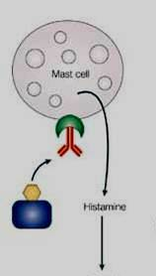
Type I hypersensitivity: Anaphylactic
Type I hypersensitivity is an allergic reaction provoked by re-exposure to a specific antigen
Fast response which occurs in minutes, rather than multiple hours or days. The reaction usually takes 15 - 30 minutes from the time of exposure to the antigen.
The reaction is mediated by IgE antibodies and produced by the immediate release of histamine, serotonin, leukotrienes from tissue mast cells or blood basophils
IgE

Slide 21
The reaction may be either local or systemic. Symptoms vary from mild irritation to sudden death from anaphylactic shock.
Some examples:
Allergic asthma
Allergic conjunctivitis
Allergic rhinitis "hay fever"
Urticaria (hives)
Anaphylaxis
- may be caused by Penicillin, Streptomycin

Slide 22
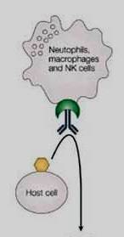
Type II hypersensitivity : Cytotoxic
Antibody-dependent
The antigens may be endogenous or exogenous chemicals (haptens) which can attach to cell membranes
The antibodies (IgM or IgG) produced by the immune response bind to antigens on the patient's own cell surfaces that is perceived by the immune system as foreign, leading to cellular destruction.
The reaction takes hours to a day
Examples: Drug-induced haemolytic anemia , thrombocytopenia
by Penicillin, Quinidine
IgG
Notes:
leading to cellular destruction via the membrane attack complexes (MAC)

Slide 23
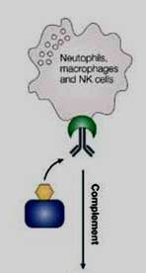
Type III hypersensitivity : Immune complex
Soluble immune complexes (aggregations of antigens and IgG and IgM antibodies) form in the blood, are not completely removed by macrophages and are deposited in various tissues (typically the skin, kidney and joints)
The reaction takes hours to days to develop
Example: Serum sickness (fever, arthritis,
enlarged lymph nodes, urticaria)
by Sulphonamides, Penicillin, Streptomycin
IgG

Slide 24
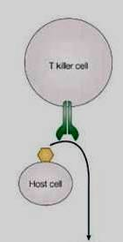
Type IV Hypersensitivity: Cell-mediated
also known as delayed type hypersensitivity as the reaction takes two to three days to develop.
Unlike the other types, it is not antibody- mediated but rather is a type of cell-mediated response.
Cytotoxic T cells cause direct damage
whereas helper T cells secrete cytokines
that attracts inflammatory cell infiltrate
Example : Contact dermatitis by local anesthetics
creams, anti -histamine creams, topical antibiotics

Slide 25
GOOD LUCK

