Slide 1

Autonomic Nervous System
The Autonomic Nervous System
Associated Prof. Fawzia Al-Rouq Department of Physiology College of Medicine
King Saud University

Slide 2

THE NERVOUS SYSTEM
INTRODUCTION
The Central Nervous System (CNS): Includes the brain and spinal cord.
The Peripheral Nervous System (PNS): Formed by neurons & their process present in all the regions of the body.
It consists of cranial nerves arises from the brain & spinal nerves arising from the spinal cord.
The peripheral NS is divided into
Somatic Nervous system
Autonomic nervous system

Slide 3
Functional Anatomy & Physiology of Autonomic NS

Slide 4
OBJECTIVES

Slide 5
▶ Anatomy and physiology of Autonomic Nervous System
▶ At the end of this lectutre the student should be able to:-
▶ -appreciate the anatomy of sympathetic& parasympathetic nervous system.
▶ -explain physiological functions of Sympathetic &parasympathetic nerves in head&neck,chest,abdomen and pelvis

Slide 6
FUNCTIONAL ANATOMY OF THE AUTONOMIC NERVOUS SYSTEM

Slide 7
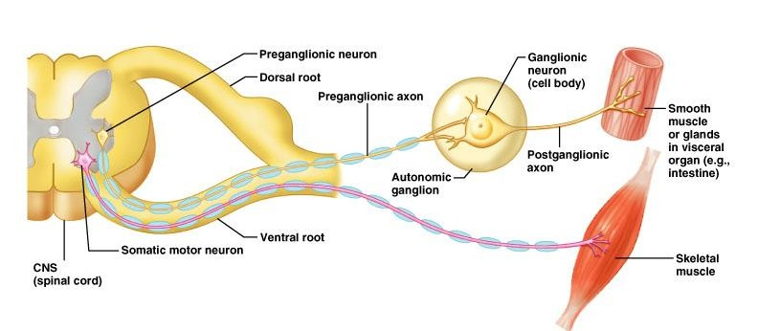
Basic anatomical difference between the motor pathways of the voluntary somatic nervous system (to skeletal muscles) and those of the autonomic nervous system

Slide 8
Basic anatomical difference between the motor pathways of the voluntary somatic nervous system⁸ (to skeletal muscles) and those of the autonomic nervous system
▶ Somatic division:
▶ Cell bodies of motor neurons reside in CNS (brain or spinal cord)
▶ Their axons (sheathed in spinal nerves) extend all
the way to their skeletal muscles
▶ Autonomic system: chains of two motor neurons
▶ 1st = preganglionic neuron (in brain or cord)
▶ 2nd = gangionic neuron (cell body in ganglion outside CNS)

Slide 9
▶ ANS is the subdivision of the peripheral nervous system that regulates body activities that are generally not under conscious control
9
▶ Visceral motor innervates non-skeletal
(non-somatic) muscles
▶ Composed of a special group of neurons serving:
▶ Cardiac muscle (the heart)
▶ Smooth muscle (walls of viscera and blood vessels)
▶ Internal organs
▶ Skin

Slide 10
Higher control of the autonomic Nervous System
▶ Sympathetic NS is regulated by neurons in the Posterior part of the hypothalamus.
▶ Parasympathetic NS is regulated by neurons in the Anterior part of the hypothalamus.

Slide 11
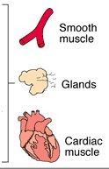
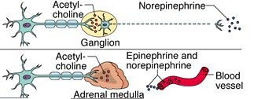
Sympathetic
Innervation of Visceral Targets
Short, lightly myelinated preganglionic neurons
Long, unmyelinated postganglionic neurons
▶ Ganglia close to spinal cord
Spina l

Slide 12

Parasympathetic
Innervation of Visceral Targets
▶ Ganglia close to or on target organs
Preganglionic neurons - long
Post ganglionic neurons - short

Slide 13

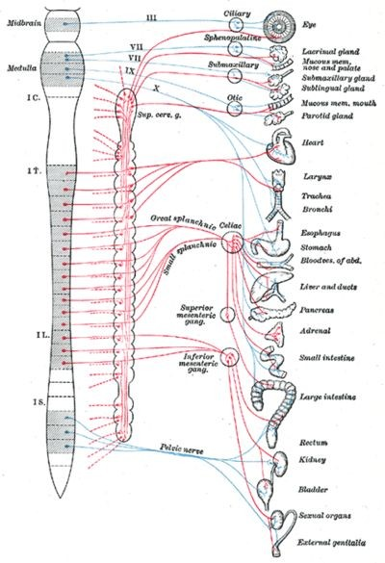
SYMPATHETIC & PARASYMPATHETIC NERVOUS SYSTEM ORIGIN
Blue= Para symp;
Red symp

Slide 14
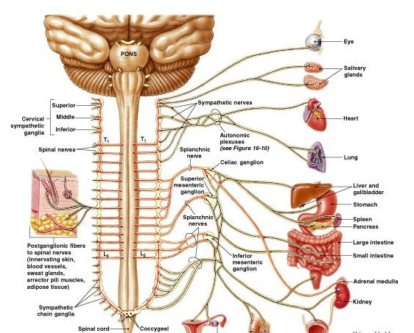
Sympathetic - Origin
▶ Thoracolumbar lateral horns of the spinal segments T1-L2.
▶ Nerve fibers originate between T1 & L2

Slide 15
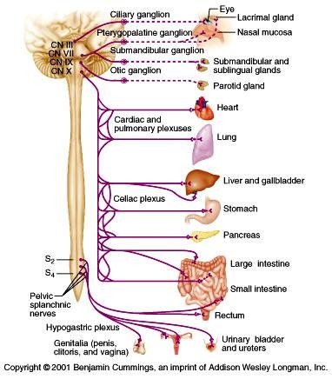
Parasympathetic - Origin
Craniosacral Cell bodies of the motor nuclei of the cranial nerves III, VII, IX and X in the brain stem
Second, third and fourth [S2-S4] sacral segments of the spinal cord
▶ Nerve fibers emerge from brain &
▶ sacrum cranio-sacral outflow

Slide 16

THE AUTONOMIC
NERVOUS SYSTEM
SubdivisioNerves
n Employed
Location of Ganglia
Chemical Messenger
General Function
Sympathe Thoracolumb Alongside
Norepinephr Fight or ine flight
tic ar
vertebral column
Parasymp Craniosacral athetic
On or near
an effector e organ
Acetylcholin Conservation
of body energy

Slide 17
PHYSIOLOGICAL FUNCTIONS OF THE AUTONOMIC NERVOUS SYSTEM

Slide 18
The Autonomic Nervous System
Structure Sympathetic Stimulation Parasympathetic Stimulation
Iris (eye
Pupil dilation Pupil constriction
muscle)
Salivary
Saliva production reduced
Saliva production increased
Glands
^{Oral/Nas} Mucus production
al
Mucus production increased
reduced
Mucosa
Heart rate and force increased
Heart
Heart rate and force decreased
Lung
Bronchial muscle relaxed Bronchial muscle contracted

Slide 19
The Autonomic Nervous System
Sympathetic Stimulation Parasympathetic Stimulation
Structure
Gastric juice secreted; motility increased
Stomach
Peristalsis reduced
Small Intes Motility reduced
Digestion increased
Large Intes Motility reduced
Secretions and motility increased
Increased conversion of glycogen to glucose
Decreased urine secretion
Norepinephrine and epinephrine secreted
Wall relaxed Sphincter closed
Liver
Kidney
Increased urine secretion
Adrenal
medulla
Wall contracted Sphincter relaxed
Bladder

Slide 20
MECHANISM OF ACTIONS
The neurotransmitters & receptors of Autonomic NS

Slide 21
OBJECTIVES
▶ describe neurotransmitters that can release at pre and post ganglionic of Autonomic NS.
▶ Describe Autonomic NS
receptors.

Slide 22
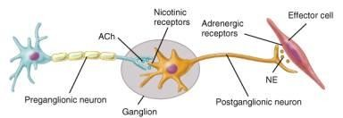
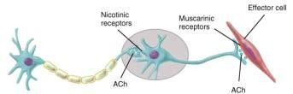
ANS Neurotransmitters: Classified as either cholinergic or adrenergic neurons based upon the neurotransmitter released

Slide 23
Sympathetic
▶ Pr^{N}eganglionic ^{e}neurons - ^{urotransmitters}
▶ Preganglionic neurones
▶ Are Cholinergic = ( release acetylcholine )
▶ Postganglionic neurons:
▶ release norepinepherine at target organs . All sympathetic postganglionic release
noradrenalin except sweetglands & bl vessels to
skeletal muscles
▶ ie. Adrenergic

Slide 24
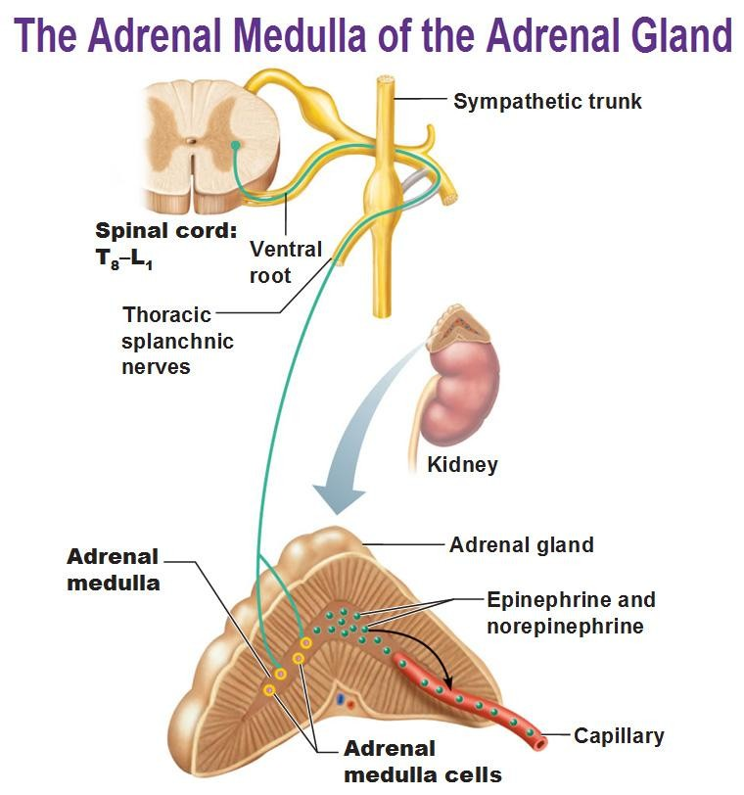

Slide 25


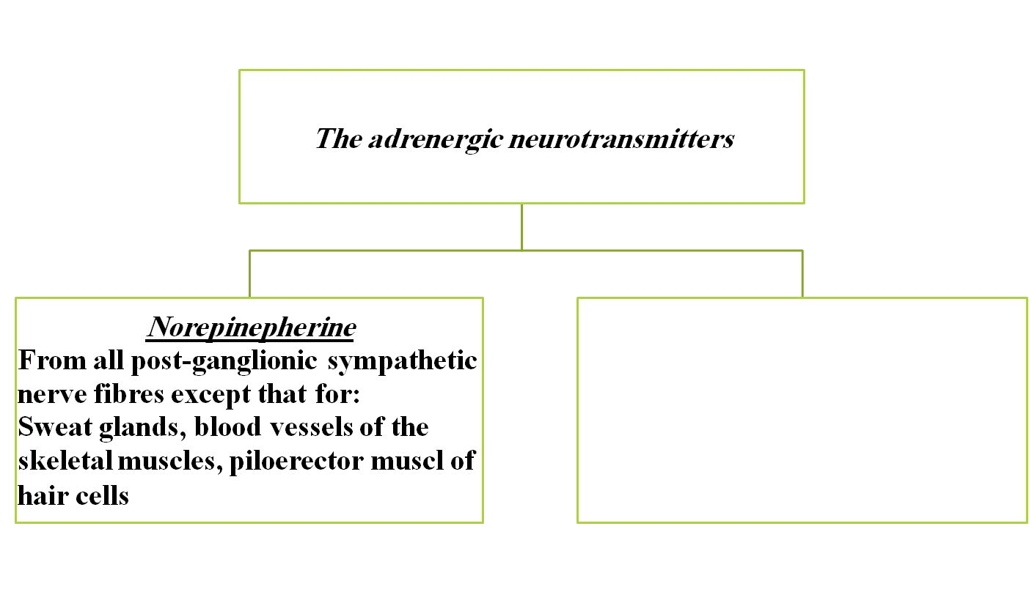




Response to adrenergic stimulation
Epinephrine
From adrenal medulla which acts as modified sympathetic ganglia

Slide 26
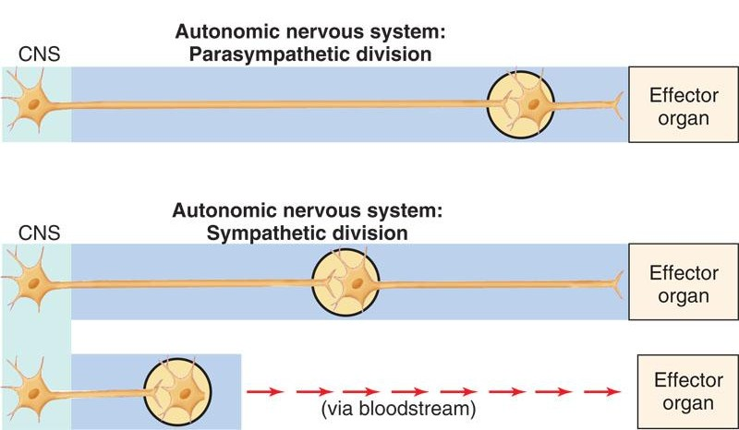
Autonomic nervous system: neurotransmitters
 | preganglionic | postganglionic
parasympathetic | acetyl choline | acetyl choline
sympathetic | acetyl choline | norepinephrine*
adrenal medulla: preganglionic - acetyl choline postganglionic (chromaffin cell) - 80% epi, 20% norepi

Slide 27
Parasympathetic Neurotransmitters
Pre & Postganglionic neurons release acetylcholine = Cholinergic

Slide 28
Chemical or neural transmitter
▶ All preganglionic fibers release
acetylcholin (Ach).
▶ All parasympathetic postganglionic
release Ach.
▶ All sympathetic postganglionic release noradrenalin except sweat glands & bl vessels to skeletal muscles

Slide 29
RECEPTORS
All preganglionic autonomic nicotonic
receptores are
The Sympathetic NS Acts on tow types of postganglionic adrenergic receptors : α and β.
The Parasympathetic NS Acts on postganglionic muscrinic receptors

Slide 30
Sympathetic Adrenergic Receptors

Slide 31
Parasympathetic muscarinic receptors

Slide 32
The Sympathetic NS Acts on tow types of receptors
: α and β.
What do the receptors do?
Activation of α receptors leads to smooth muscle contraction Activation of β receptors leads to smooth muscle relaxation
2
Activation of β receptors leads to smooth muscle
1
contraction (especially in heart)

Slide 33












