Slide 1
BLOOD PHYSIOLOGY
Lecture 2
Dr Nervana Mostafa

Slide 2
Objectives
At the end of this lecture you should be
able to:
Describe essential elements needed for RBC formation.
Describe the process of Vit B12 absorption and its malabsorption.
Recognize haemaglobin structure and its
functions.
Discuss iron metabolism (absorption,
storage and transport)
2

Slide 3
Objectives – cont.
Describe the fate of old RBC.
Describe anemia and its causes.
Recognize causes of polycythemia.
3

Slide 4
Topics:
Essential elements for RBC formation
Proteins
Vitamins: B12, Folic acid, Vit C …)
Iron Metabolism.
Anemia
Polycythemia
Structure & functions of Hb

Slide 5
Essential elements for RBCs formation
and Maturation
Certain elements are essential for RBC formation and maturation:
Amino acids: formation of globin in haemoglobin
sever protein deficiency → anaemia
Iron: formation of haemoglobin
Deficiency → anaemia
5

Slide 6
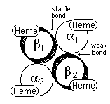
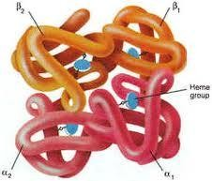

Slide 7
Essential elements for RBCs formation and
Maturation
cont.
Vitamins:
Vit B12 and Folic acid
Synthesis of nucleoprotein Deficiency → anemia
Other :Vit B6, Riboflavin, nicotinic acid,
biotin, Vit C, Vit E
○
○
4. Essential elements
Copper, Cobalt, zinc, manganese

5. Hormones
Androgens, Thyroid, cortisol & growth hormones Deficiencies of any one results in anaemia



Slide 8
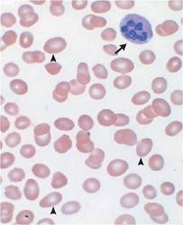
Vitamin B12 & Folic acid
Important for DNA synthesis and final maturation of RBC.
Dietary source: meat, milk, liver, fat, green vegetables.
Deficiency leads to:
Failure of nuclear maturation & division
Abnormally large & oval shape RBC
Short life span
reduced RBC count & Hb
Macrocytic (megaloblastic) anemia

Slide 9
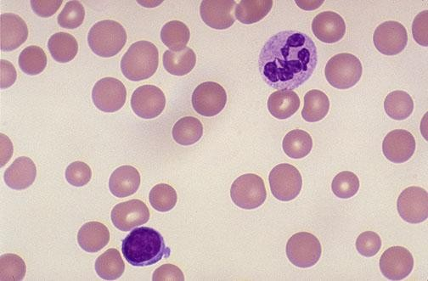
Macrocytic anemia
Note the hypersegmented neurotrophil and also that the RBC are almost as large as the lymphocyte.
Finally, note that there are fewer RBCs.

Slide 10
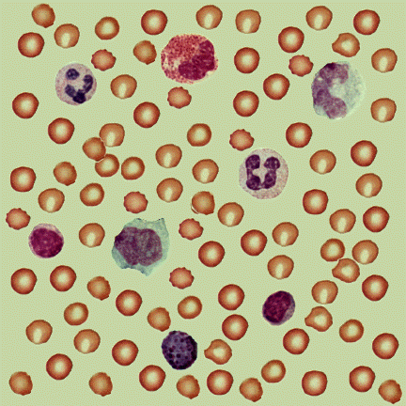
Blood Film

Slide 11
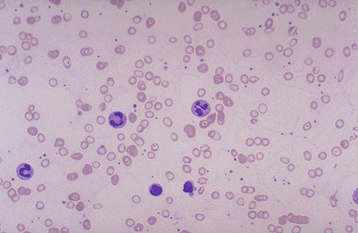
Microcytic hypochromic anemia
The RBC's are smaller than normal and have an
increased zone of central pallor.
- This is indicative of a microcytic (smaller size of each RBC) and hypochromic (less hemoglobin in each RBC) anemia.
There is also increased anisocytosis (variation in size)
and poikilocytosis (variation in shape).

Slide 12
ANAEMIAS
Definiation
Decrease number of RBC
Decrease Hb
○
Symptoms: Tired, Fatigue, short of
breath, heart failure.

Slide 13
Causes of anaemia
1.Blood Loss
–acute
–Chronic
accident (RBC return to normal 3-6w)
microcytic hypochromic anaema (ulcer, worms)
2.Decrease RBC production
Nutritional causes:
•Iron
microcytic hypochromic anaemia.
•Vit B12 & Folic acid megaloblastic anaemia .
➢Bone marrow failure: destruction by cancer, radiation, drugs Aplastic anaemia.
3.Haemolytic excessive destruction
Abnormal cells or Hb
•Spherocytosis
•sickle cells
Incompatible blood transfusion.
Erythroblastosis fetalis .

Slide 14
Polycythemia
Increased number of RBC
Types:
Primary (Polycythemia Rubra Vera - PRV):
uncontrolled RBC production.
Secondary to hypoxia: high altitude (physiological), chronic respiratory or cardiac disease

Slide 15
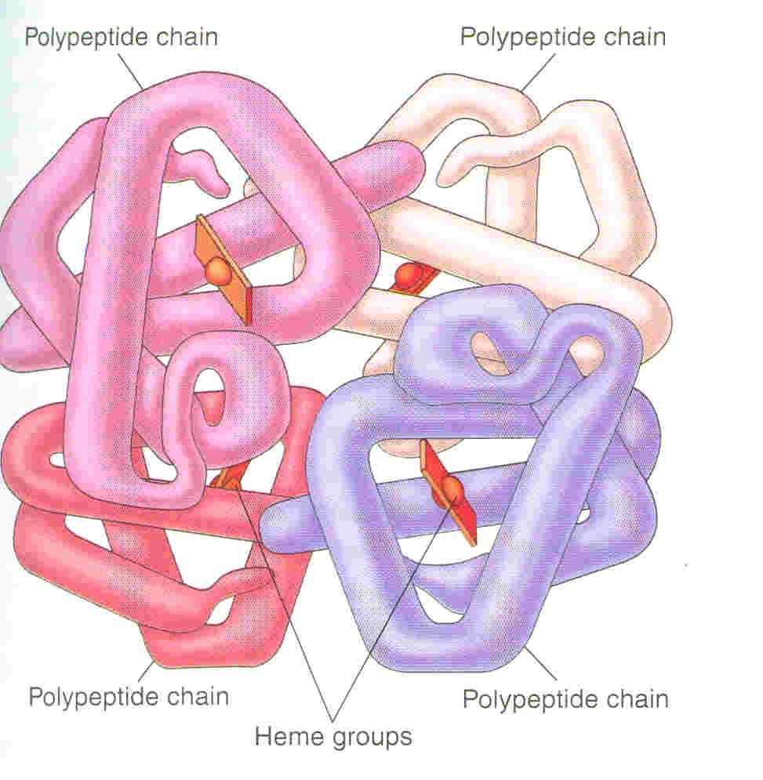
HAEMOGLOBIN
Hb molecules consist 4 chains each formed of heme & polypeptide chain (globin)
Heme consist of protoporphyrin iron (F²⁺)
ring +

Slide 16
Types of normal Hb.:
-Hb A (2 α & 2 beta chains) (adult Hb) (98%).
- Hb A2 (2 α & 2 delta chains) (2%)
-Hb F (2 α & 2 γ chains) (Hb of intrauterine life).
-Abnormality in the polypeptide chain - abnormal Hb (hemoglobinopathies) e.g thalassemias, sickle cell (HbS).

Slide 17
Functions of Hemoglobin
Carriage of O2
Hb reversibly bind O₂ to form oxyhemoglobin, affect by pH, temperatre,
_{H}+
Carriage of CO2
Hb bind CO₂ = carboxyhemaglobin
Buffer
25

Slide 18
Malabsorption of Vit. B12
Pernicious Anemia
VB12 absorption needs intrinsic factor secreted by parietal cells of stomach.
VB12 + intrinsic factor is absorbed in the
terminal Ileum.
Deficiency arise from (Causes of deficiencies):
Inadequate intake
Poor absorption due to Intestinal
disease

Slide 19
Iron metabolism (Fe)
Iron is needed for the synthesis of haemoglobin, myoglobin cytochrome oxsidase, peroxidase & catalase
Total Iron in the body = 4-5g
65% ….. Haemoglobin
5% …….. other hems
1% ……. bound to transferrin (betaglobulin) in blood
15-30% …… stored iron in the form of ferritin in the liver, spleen and bone marrow.

Slide 20
Iron absorption
Iron in food mostly in oxidized form
(Ferric, F⁺³)
Better absorbed in reduced form
(Ferrous, F⁺² )
Iron in stomach is reduced by gastric acid, Vitamin C.
Rate of iron absorption depend on the
amount of iron stored

Slide 21
Transport and storage of iron
Iron is transport in plasma in the form of Transferrin (apotransferrin + iron).
Iron is stored in two forms:
Ferritin (apoferritin + iron)
Haemosiderin (insoluble complex molecule, in liver, spleen, bone marrow)
Daily loss of iron is 0.6 mg in male & 1.3mg/day in females.

Slide 22
Destruction of RBC
RBC life span in circulation = 120 days.
Metabolic active cells.
Old cell has a fragile cell membrane, cell will rupture as it passes in narrow capillaries (and spleen).
Released Hb is taken up by macrophages in liver, spleen & bone marrow:
Hb is broken into its component:
Polypeptide—amino acids (protein pool = storage)
Iron ---- ferrtin
Haem (Porphyrin)>>—bilirubin>>—secreted by the liver into bile. [excess destruction of RBC Jaundice]

Slide 23
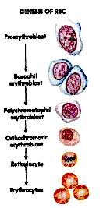
Stages of differentiation of RBC

Slide 24
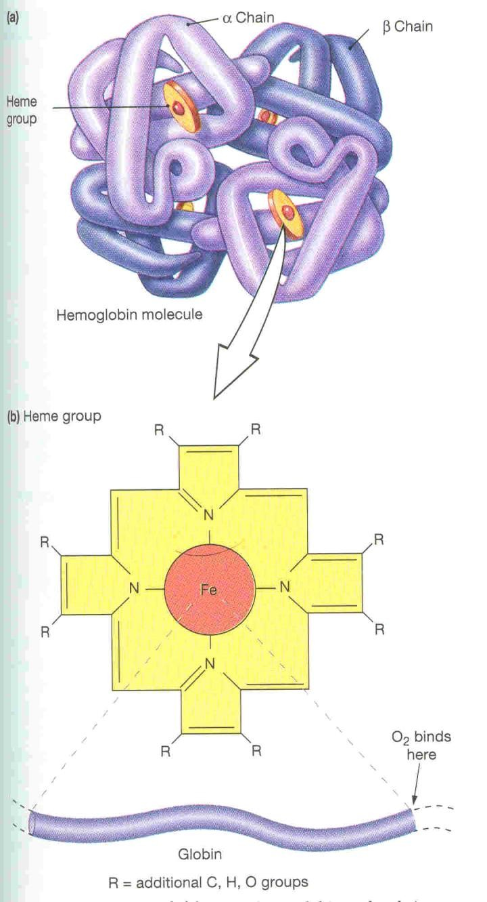
23

