Slide 1
BLOOD PHYSIOLOGY
White Blood Cells
(WBC)
Dr Nervana Mostafa

Slide 2
Lecture content
.1 Eosinophils and Basophilophils formation,
maturation and function.
Monocytes and macrophage formation, maturation and function. Reticuloendothelial system component and function.
Lymphocytes formation, maturation and
Function.
Leucocytosis, leucopenia and leukemia
.2
.3
.4
.5

Slide 3
White Blood Cells
EOSINOPHILLS &
BASOPHILS

Slide 4
Formation and Maturation of Eosinophils
Formed in Bone Marrow:
Stem cells → Myeloblast→ Promyelocytes →
Eosinophil myelocytes →
Eosinophil metamyelocytes →
polymorphnuclear eosinophil (Mature Eosinophil released to blood)

Slide 5
Eosinophil Function
•
•
Phagocytosis
High eosinophil count:
Parasitic (hook worm, ascaris, bilharzia) Allergic (asthma, rhinitis, drug reaction)
–
–
•
Eosinophil attach themselves to parasites _{and}
releases substances (hydrolytic anzymes,
superoxide) to kill it.

Slide 6
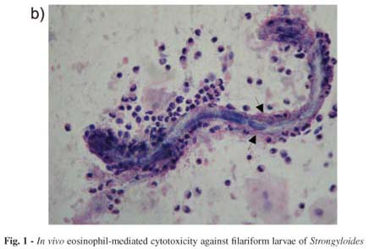
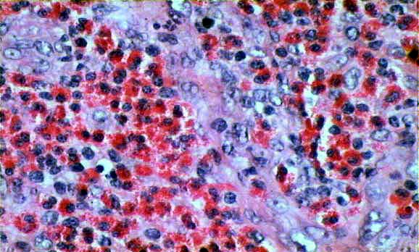

Slide 7
Formation and Maturation of Basophils
Formed in Bone Marrow
Stem cells → Myeloblast→ Promyelocytes →
Basophil myelocytes →
Polymorphnuclear Basophil (Mature Basophils
released to blood)
.1
.2
.3

Slide 8
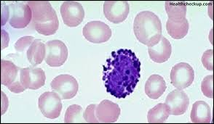

Slide 9
Basophils
Similar to mast. cells secret:
Heparin to prevent clotting,
Histamine , bradykinin & serotinin contribute
to inflammation response
The release of those substances cause local and vascular reactions characteristic of allergic manifestation.
Mast cell: cell filled with basophil granules, found in connective tissue & releasing histamine & other substances during inflammatory & allergic reactions.

Slide 10
White Blood Cells
MONOCYTES & MACROPHAGES

Slide 11
Monocytes and Macrophages
Formed in Bone Marrow
Stem cell → monoblast → promonocyte → mature monocytes released into blood.
Stay for 10-20 hours in circulation.
Then leave blood to tissues transforming into larger cells macrophage.
.4 Macrophage life span is long upto few months.
.1
.2
.3

Slide 12
Function of Monocytes and Macrophages
Macrophages are a powerful phagocytic cells; first line of defense.
– Ingest up to 100 bacteria,
–
–
Ingest larger particles as: old RBC
Get rid of waste (scanvenger)
Functions: anti-inflamatory
Directly: phygocytosis of bacteria, dead cells.
Indirectly cooperating with lymphocytes by recognizing foreign body (take in foreign body process it and present it to lymphocytes)

Slide 13
Direct anti Inflammatory

Slide 15
Indirect anti-inflammatory
Dr Sitelbanat 2011

Slide 16
Reticuloendothelial ^{system}
Consist of:
Monocytes.
Macrophage.
Endothelial cells (bone marrow,
spleen, lymph node)
•
Located in all tissues especially:
Skin (histocytes), liver (kupffer), spleen, bone marrow, lymph nodes, lung

Slide 17
Functions of Reticuloendothelial system
Phagocytosis: Bacterial, dead cells,
foreign particles
Immune function: processing antigen & antibodies production (indirect)
Breakdown of Hb
Storage of iron

Slide 18
White Blood Cells
LYMPHOCYTES

Slide 19
Lymphocytes Formation & Maturation
.1 Formed in bone marrow, thymus, lymphoid tissues.
Stem cell (thymus, lymphoid tissue & bone marrow) → lymphoblast → intermediate pyronophilic blast cell → lymphocytes
.3 Life Span Of Lymphocytes ranges from weeks to months according to the type.
.2

Slide 20
LYMPHOCYTES
Types:
.1 Thymus dependent (T-lymphocytes)
.2 Thymus independent (B-lymphocytes)
independent

Slide 21
T-Lymphocytes
(Thymus dependent)
•
Formed in bone marrow or lymphoid tissue migrate to thymus for maturation.
Life spans 100-300 days.
Circulate between blood, tissues, lymph.
Types of T-lymphocytes
•
•
•
–
–
–
T-helper
T-cytotoxic Natural killer
Functions
–
Cellular immunity (graft rejection - delayed hypersensitivity.)
– Role in antibody secretion.

Slide 22
- These are the main types of T-lymphocytes, the remainder few are mainly regulatory.

Slide 23
B- Lymphocytes
(thymus-independents)
•
•
First discovered in Bird Bursa Formed in: Bone marrow, germinal
layer of lymph node, red pulp of spleen
Life span 2-7 days
•
Stimulated by antigen
•
It transforms into large plasma cell (produce
antibody)
Function: Humoral immunity.

Slide 24
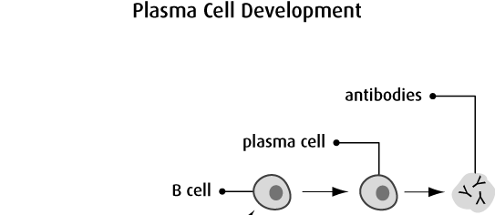

Slide 26
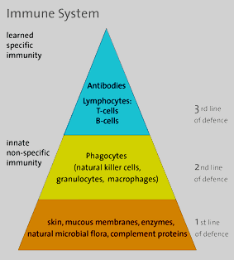
Immune System

Slide 27
Major organs
Primary Lymphoid Organs
Secondary (or peripheral) Lymph organs
Bone marrow
Thymus
tonsils
adenoids
spleen
Lymph nodes
Lymphatic vessels
appendix
peyer's patches

Slide 28
Types of Immunity
Immune system
Innate (non-specific; natural) immunity
Adaptive (specific; acquired) immunity
Second line of defense
Is present at birth
Persists throughout life
Can be mobilized rapidly and act quickly
Attacks all antigens fairly equally
Third line of defense.
Antigen specificity. It is activated by thousands of diverse antigens.
Responds with the proliferation of cells and the generation of antibodies.
Responds slowly, being fully activated about 4 days after the immunologic threat.
Exhibits immunologic memory, so that repeated exposure to the same infectious agent results in improved resistance against it.

Slide 29
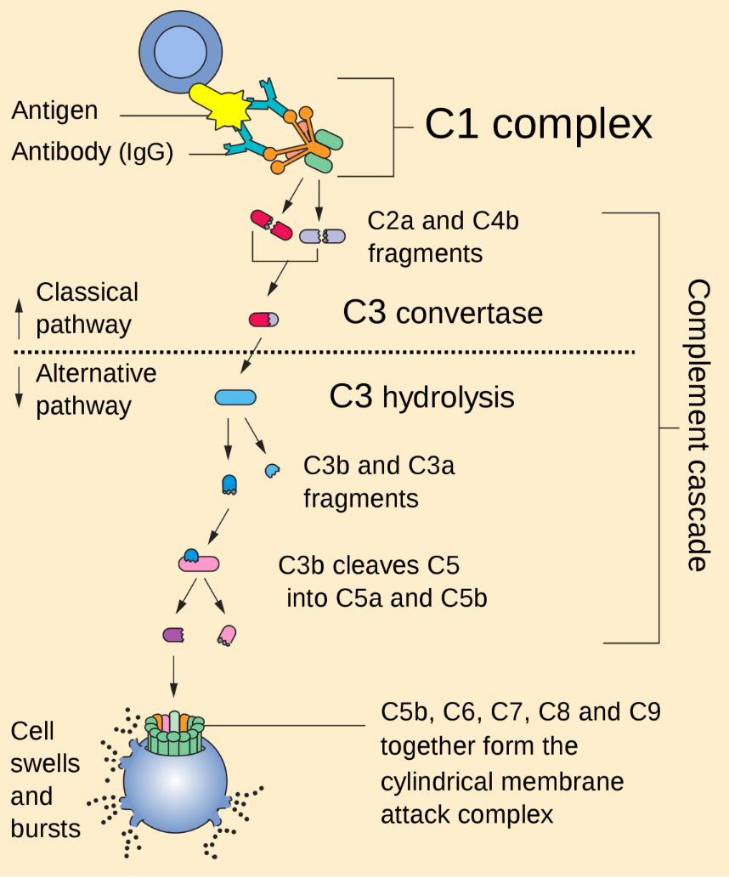
The Complement System is Part of the 1st Line of Defense
complement system:
1- The first part of the immune system that meets invaders such as bacteria
2-it is a group of proteins.
3- These proteins flow freely in the blood and can quickly reach the site of an invasion where they can react directly with antigens ( molecules that the body recognizes as foreign substances).
functions of complement proteins (When activated ):
Trigger inflammation.
Attract eater cells such as macrophages to the area.
Coat intruders so that eater cells are more likely to devour (swallow and eat) them (a process called as opsonization).
Kill intruders.

Slide 30
Leucocytosis
Increased number of WBC
Physiological
Diurnal ↓ morning ↑ evening
After physical exercise
Stress or Adrenaline injection
Pathological:
Bacterial infection (tonsillitis,
Appendicitis)
Worm infection.
Allergric reactions.

Slide 31
Leucopenia
2- typhoid fever.
4- B12 & folic acid↓
Deficiency of the white blood cells:
Causes:
1- malnutrition.
3- drugs.
5- radiation

Slide 32
Leukaemia
•
Cancer of white cells due to chromosomal abnormality caused by chemicals, radiation, and viruses.
WBC more than 50x10³
Types of leukaemia
– Myeloblast leukaemia → myeloid cells
– Lymphoblast leukaemia →
lymphocytic cells Acute or chronic onset
•
•
•
•
Accompanied with anaemia, bleeding

Slide 33
Objectives
At the end of this lecture student
should be able to:
Describe Esinophils formation and functions
Describe Basophils formation and
functions
Describe Monocytes and macrophage formation and functions.
Describe Reticuloendothelial componants
and functions
.3
.4
33

Slide 34
Objectives
At the end of this lecture student should be
able to:
Describe lymphocytes formation and
maturation.
Describe the functions of the different
types of lymphocytes.
Recognise leucocytosis and leucopenia.
Recognize type of leukaemia
34

