Slide 1
INTRODUCTION TO EMBRYOLOGY
Dr. Sanaa Al Sharawi, Dr. Essam Salama

Slide 2
Objectives
After this lecture you should be able to :
Define Embryology.
Define the developmental periods.
Define the significance of embryology.
Define the different embryological terminology.
Define the nomenclature used to describe body parts, positions, and relationships.
Describe in brief the important events in embryology.

Slide 3
Definition of Embryology
This term generally refers to prenatal development of embryos and fetuses.
“Human embryology’’ is the science concerned with the origin and development of a human being from a zygote to birth of an infant.
Development does not stop at birth. Important changes, in addition to growth, occur after birth (postnatal changes) e.g., development of teeth and female breasts.

Slide 4
Significance of embryology
Importance of Embryology :
The study of prenatal stages of development, especially those occurring during the embryonic period helps us understand the normal body structure and the cause of congenital anomalies.
So, It concerned with various genetic and /or environmental factors that disturb normal development and produce birth defects.

Slide 5
Developmental periods :
Developmental periods are divided into:
1- Prenatal development.
The main developmental changes occurring before birth, including the embryonic and fetal periods.
The embryonic period : starts from the fertilization to the end of 8th week.
The fetal period : begins from the 9th week until birth.

Slide 6
Con.
2- postnatal development.
The changes occurring after birth, like teeth and breast.
Prenatal development is more rapid than postnatal development and results in more striking changes.

Slide 7
Critical Periods of Human Development
This is the stage of development of an embryo that is susceptible to an agent, such as a drug or virus, which can lead to congenital abnormalities.
Development of the embryo is most easily disrupted when the tissues and organs are forming during the embryonic period.

Slide 8
Common terms :
Oocyte; the immature ovum, female germ cell.
Ovum; the mature female germ cell.
Sperm; the mature male germ cell.
Zygote; the fertilized ovum.
Cell division; one cell divides into two cells; there are two types of cell division:
A- Mitotic; the cell produces 2 cells each contains 44 autosomes and 2 sex chromosomes
B- Meiotic; (reduction) it occurs in the primitive germ cells in the testes or the ovaries, it produces 2 cells each contains 22 autosomes and one sex chromosomes.

Slide 9
Descriptive Terms:
Directions:
Cranial; the top of the embryo or the head.
Cephalic; superior or the head.
Caudal; inferior or the tail end.
Dorsal; back of the embryo.
Ventral; anterior or the belly side.
Medial; near to the midline.
Lateral; flank side.

Slide 10
Descriptive Terms:
Plans of sections:
Longitudinal; median or sagittal.
Coronal; frontal.
Transverse; horizontal

Slide 11
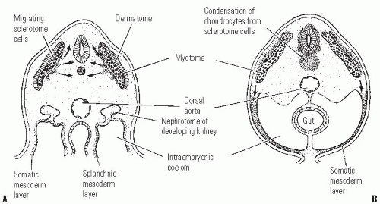
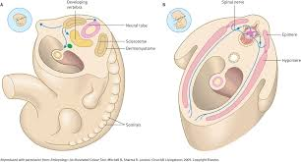
Transverse; horizontal
Longitudinal

Slide 12
Major events during embryonic period
Gametogenesis : occurs at 1st week.
Fertilization : 1st week
Implantation : begins one week after fertilization
Development of the Central Nervous System : 3rd week
Embryonic Folding : 4th week

Slide 13
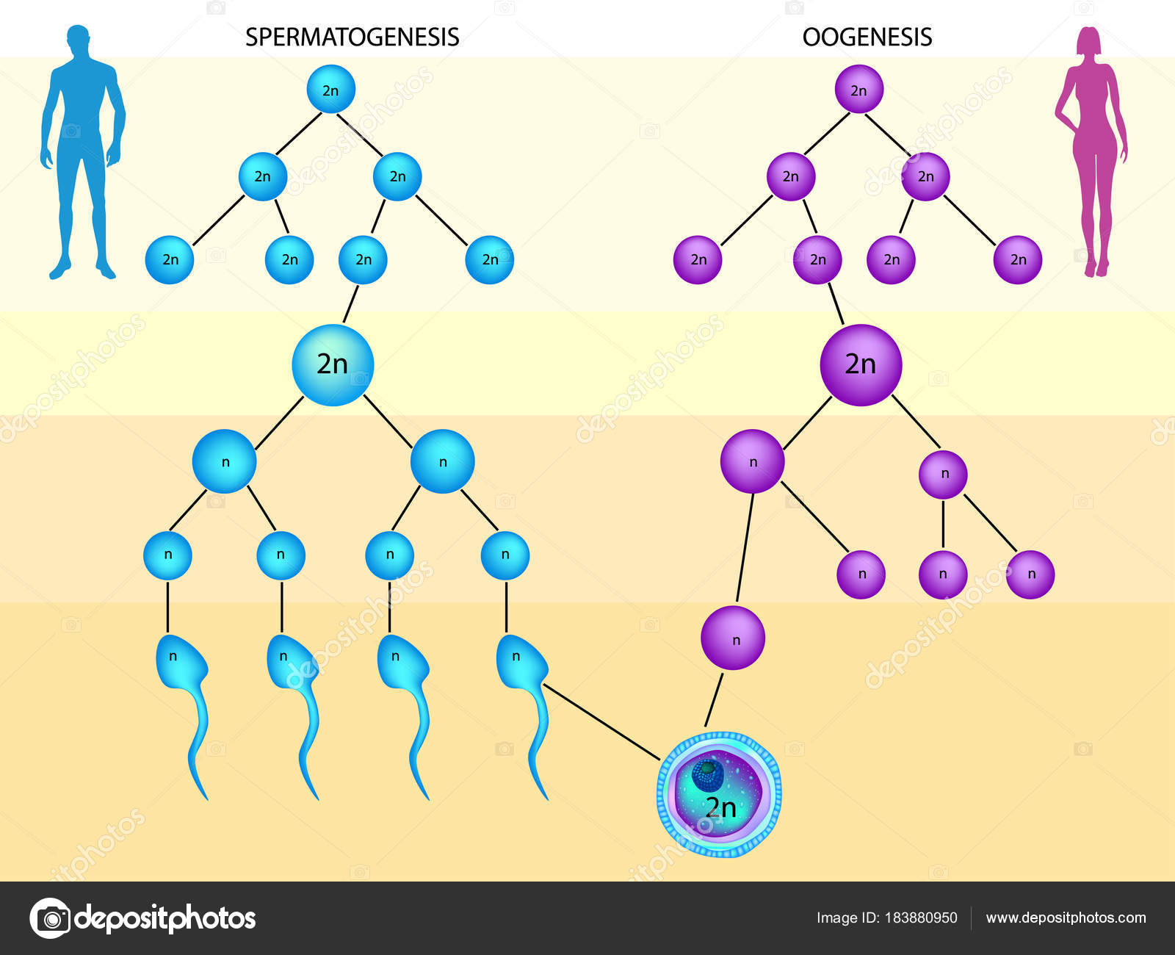
Gametogenesis
It is the production of mature gametes (sperm and ova) by gonads (testes in males and ovaries in females).
It is divided into:
1- Spermatogenesis.
2- Oogenesis.

Slide 14
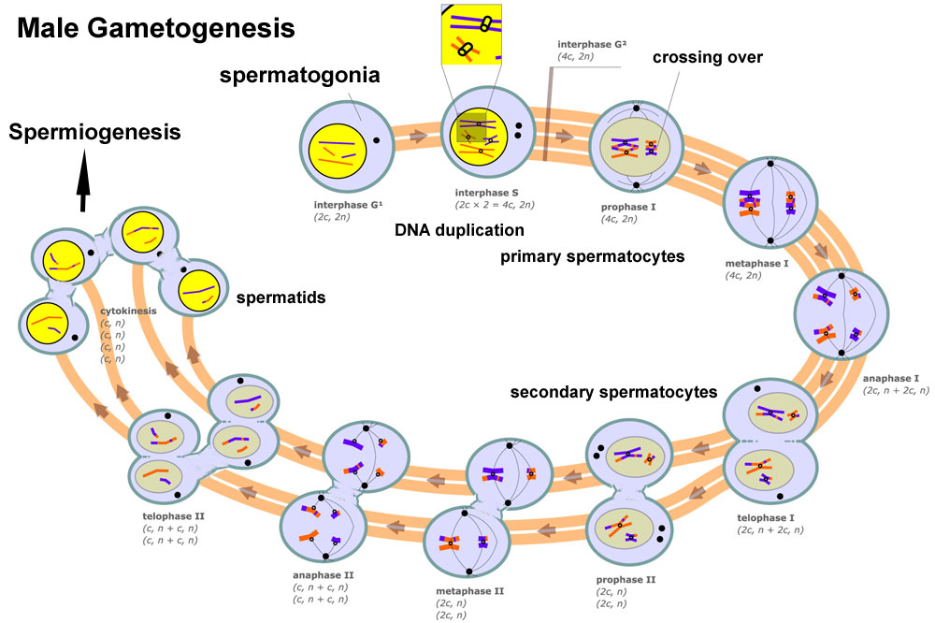
Spermatogenesis
It is the process of formation of mature sperms, takes place in the seminiferous tubules, occurs continuously from puberty till old ages.

Slide 15
Results of spermatogenesis;
1- Reduction of chromosomal number from the diploid to the haploid number.
2- Change the germ cell to the motile sperm.
3- Increase the number of the sperms.

Slide 16
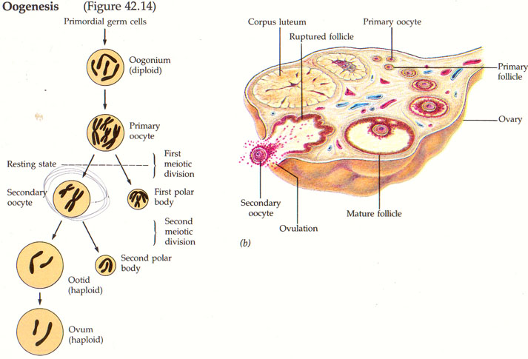
Oogenesis
It is the process of formation of mature ovum, occurs in the cortex of the ovary, starts during fetal life, continues after puberty, and fertilization, till menopause.
It ends by haploid number of chromosomes.

Slide 17
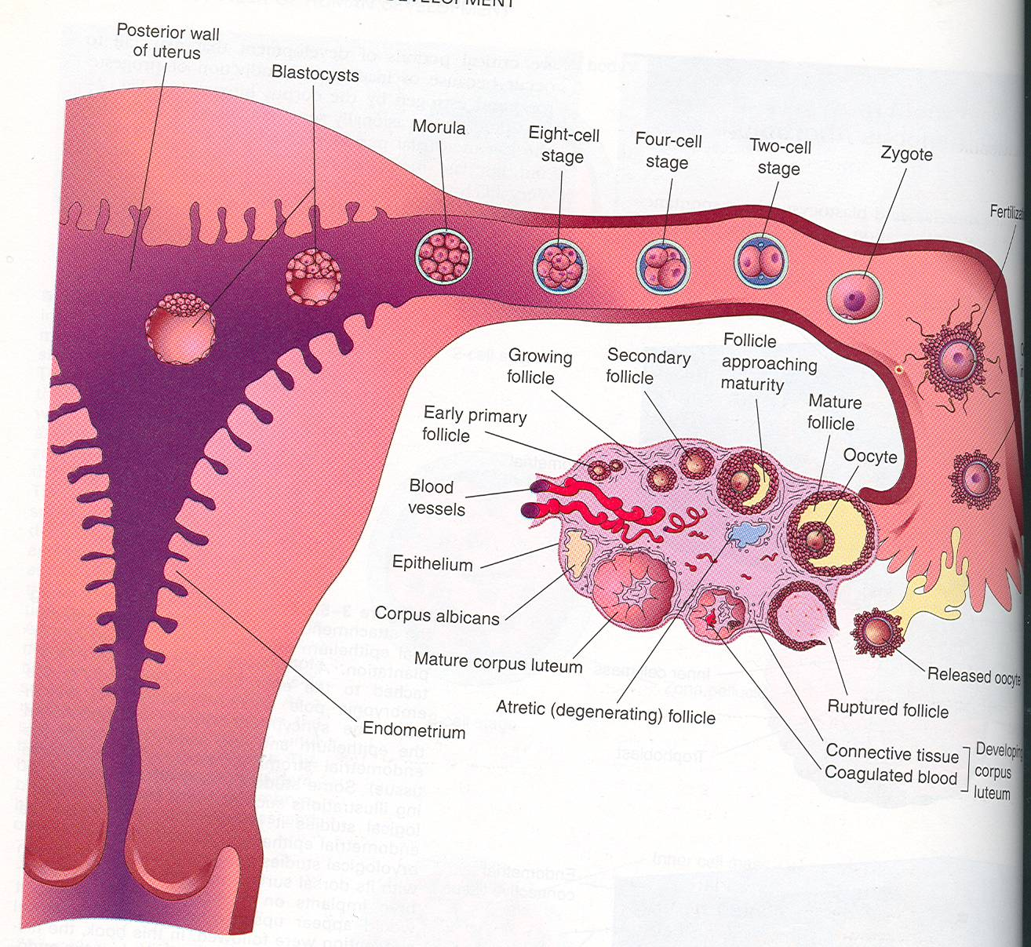
Fertilization
Definition:
It is the process during which a male gamete (sperm) unites with a female gamete (oocyte) to form a single cell (ZYGOTE).

Slide 18
Implantation
The process of embedding of the blastocyct in the endometrium of the uterus,
It begins one week after fertilization.
It is completed by the 12th day after fertilization.
Normal site of implantation;
In the upper part of the posterior surface of the uterus near the funds,
Abnormal site of implantation (ectopic pregnancy);
Most of ectopic pregnancies occurs in the uterine tube.

Slide 19
Bilaminar disc
It is The differentiation of the cells into Two layers :
(A) Epiblast
High columnar cells adjacent to the amniotic cavity.
(B) Hypoblast
Small cuboidal cells adjacent to
Yolk sac.

Slide 20
Trilaminar disc
Now the embryonic disc is formed of 3 layers :
Embryonic Ectoderm
Intraembryonic Mesoderm.
Embryonic Endoderm.
Cells in these layers will give rise to all tissues and organs of the embryo.

Slide 21
Thank you

