Slide 1
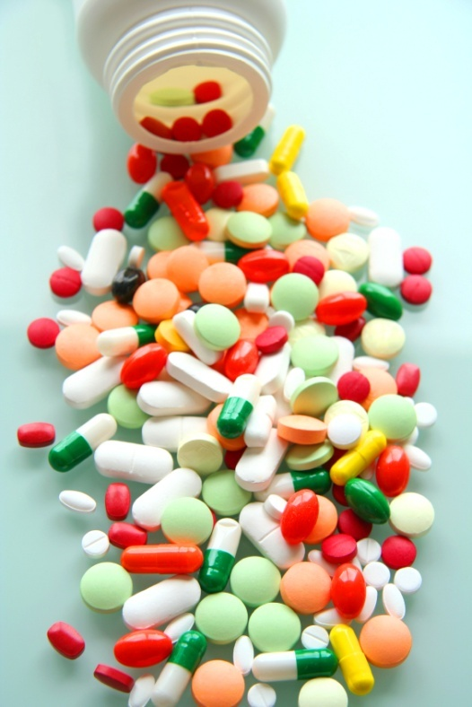
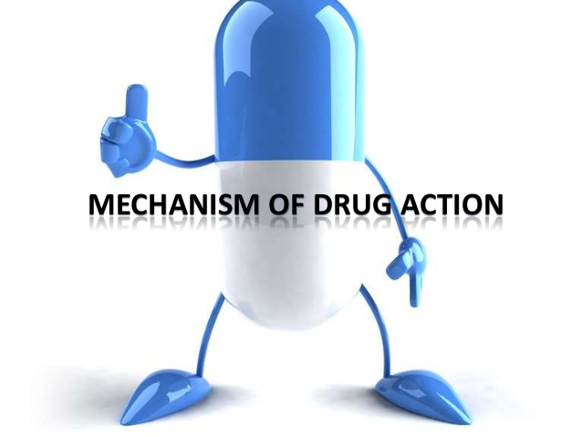
PHARMACdYNAMICS IV
TOLERANCE / DESENSITIZATION
&ADVERSE DRUG REACTIONS

Slide 2
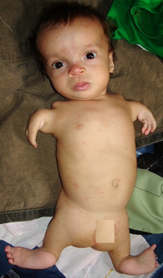
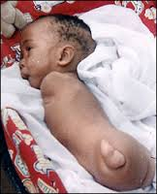
Phocomelia
Thalidomide crisis
Thalidomide was marketed in 1958 in West Germany as a hypnotic & as for morning sickness during pregnancy
Iatrogenic disease
In 1961 a report of out break of phocomelia in the neoborn babies(40000-100000 cases)

Slide 3
Ilos
Distinguish difference between tolerance and desensitization (tachyphylaxis) and reasons for their development
Recognize patterns of adverse drug reactions (ADR)

Slide 4
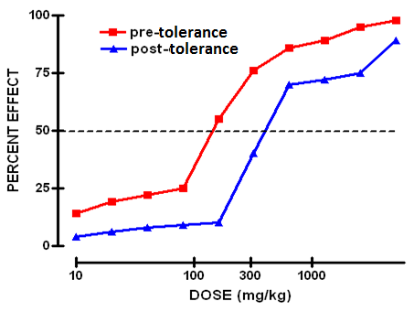
TOLERANCE and DESENSITIZATION
Phenomenon of variation in drug response, whereby there is a gradual diminution of the response to the drug when given continuously or repeatedly

Slide 5
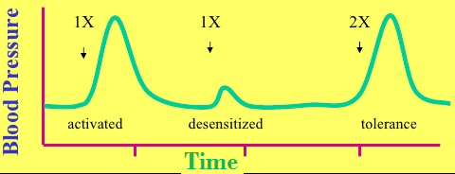
DIMINUTION OF A RESPONSE
Rapid, in the course of few minutes
Gradual in the course of few days to weeks
TACHYPHYLAXIS / DESENSITIZATION
TOLERANCE
These SHOULD BE DISTINGUISHED FROM
Loss of effectiveness of antimicrobial agent
Resistance

Slide 6
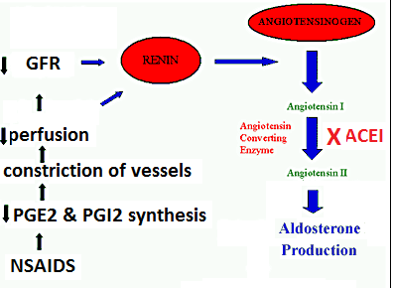
REASONS FOR DEVELOPMENT OF TOLERANCE
PRE RECEPTOR EVENTS
EVENTS AT RECEPTORS
POST RECEPTOR EVENTS
↓ Drug availability at the relevant receptors due to pharmaco- kinetic variables
Nullification of drug response by a physiological adaptative homeostatic response
Drug becomes:
> metabolized or excreted
< absorbed
altered distribution to tissues
Antihypertensive effects of ACEIs become nullified by activation of renin angiotensin system by NSAIDs
eg. Barbiturates  metabolism of Contraceptive pills =  it availability
LOSS OF THERAPEUTIC EFFICACY
Refractoriness

Slide 7
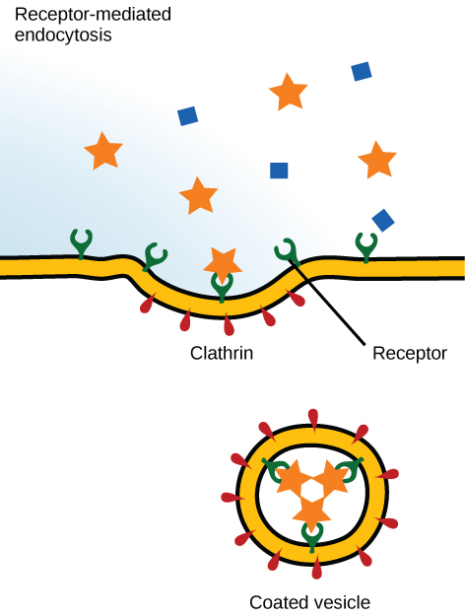
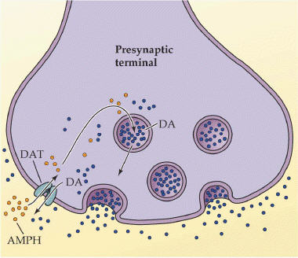
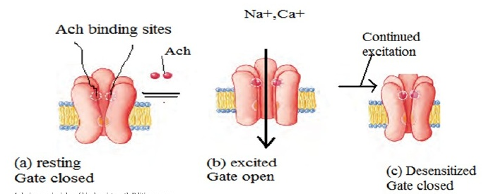
REASONS FOR DEVELOPMENT OF TOLERANCE
PRE RECEPTOR EVENTS
EVENTS AT RECEPTORS
POST RECEPTOR EVENTS
BINDING ALTERATION
DOWN REGULATION
EXHUSTION
OF MEDIATORS
Depletion of mediator stores by amphetamine
1-Phosphorylation of receptors i.e. Tight binding of ß-adrenoceptors agonists → ↓ activation of AC
2-Desenzitiation of Ach- receptors
[Functional defect]
↓ Number of receptors.
Isoprenaline activation to β receptors →↑ receptor recycling by endocytosis [Structural defect]

Slide 8
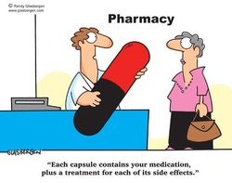
ADVERSE DRUG REACTIONS [ADRs]
Harmful or seriously unpleasant effects occurring at doses intended for therapeutic effects.

Slide 9
Types of adrs

Slide 10
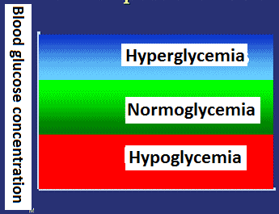
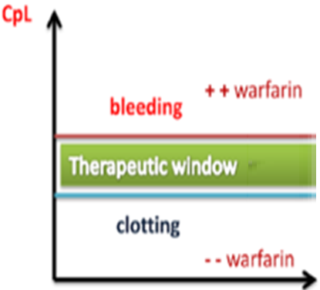
Type a
Augmented
80% of ADRs
Is it dose dependent?
Is the ADR quantitatively or qualitativel different from the primary effect?
Is it predictable?
Is the incidence high or low?
How mortal is it ?
A consequence of the primary effect of the drug
How is it treated?
e.g. Hypoglycemia from hypoglycemic drugs
Bleeding from warfarin

Slide 11
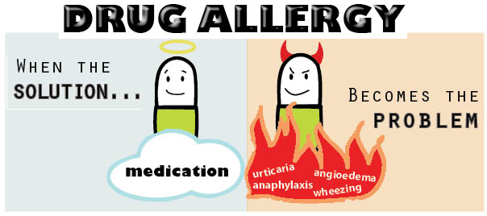
Type b
bizarre
Occurs different to known drug pharmacological effect[idiosyncrotic ]
Is it predictable?
Idiosyncratic reactions are drug reactions that occur rarely and unpredictably amongst the population
Is the ADR quantitatively or qualitativel different from the primary effect?
Is the incidence high or low?
How mortal is it ?
Is it dose dependent?
How is it treated?
Usually due to [1]immunological response or [2]patient’s genetic defect
Penicillin Anaphylactic shock
QuinineThrombocytopenia

Slide 12
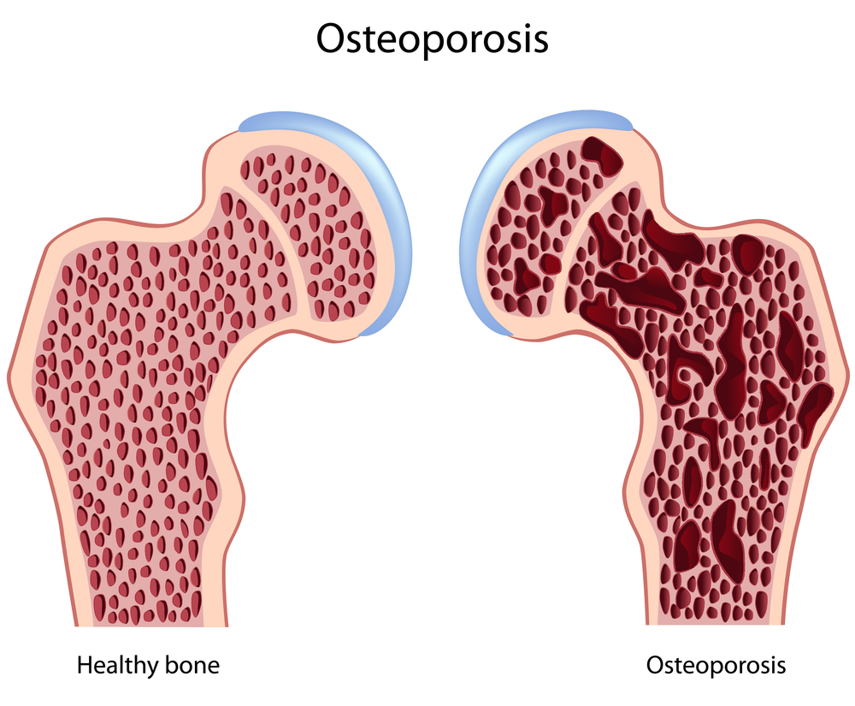
Type c
COntinued
Occurs during chronic drug administration
Osteoporosis  chronic
corticosteroid intake

Slide 13
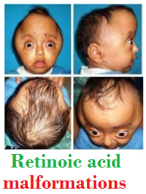
Type d
delayed
Occurs after long period of time even after drug stoppage (delayed in onset)
Refers to carcinogenic and teratogenic effects
Teratogenicity→Retinoids
Carcinogenicity→ Tobacoo smoking

Slide 14
Type e
End of use
Occurs after sudden stoppage of chronic drug use due to existing adaptive changes
Withdrawal syndrome  Morphine
↑ Body ache, insomnia, diarrhea, goose flesh, lacrimation
Withdrawal of diazepam  anxiety, insomnia

Slide 15
TYPE B
[1] If due to immunological response
1st exposure to a drug
Repeated exposures
Sensitization
HYPERSENSITIVITY REACTION
TYPE I
Anaphylaxsis
TYPE II
Cytotoxic
TYPE III
Immune complex
TYPE IV
Cell mediated
Release of mediators from mast cells or blood basophils
Antibody-directed cell-mediated lysis
Deposition of soluble antigen–antibody- complement complexes in small blood vessels
Interaction release cytokines that attracts inflammatory cell infiltrate
Urticaria rhinitis, bronchial asthma
by Penicillin,
Haemolytic anaemia thrombocytopenia by Quinidine
Serum sickness (fever arthritis enlarged lymph nodes, urticaria)
by Sulphonamides,
Streptomycin
Contact dermatitis by local anaesthetics creams

Slide 16
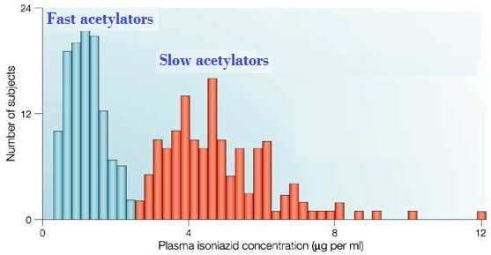
TYPE B
[2] If due to genetic defect
When isoniazid is given in identical doses /kg, two distinct groups can be identified, a group with low blood level acetylate the drug more rapidly ‘fast acetylators’ & ‘a group with high blood level acetylate the drug slowly “slow acetylators’
Relapse of infection & hepatitis occur in fast acetylators
Isoniazid causes peripheral neuropathy in slow acetylators

